Slide 1

Telemetry Driver Interface Design
Data Display Architecture
Michigan State University Solar Racing Team | Team #13

Slide 2

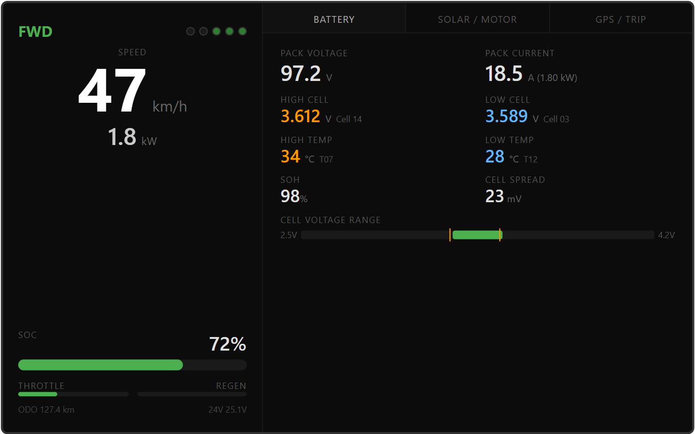
LEFT PANEL — DRIVER HUD
Permanent ~380px panel
Speed — 72px center-dominant
Power (kW) directly below speed
Drive mode top-left: FWD (green), REV (orange), PARK (gray)
5 status dots top-right: Fault (red), Warn (yellow), DCDC / Batt / MC (green)
SOC — % number + horizontal bar
Throttle & Regen bars side by side at bottom (green throttle L→R, blue regen R→L)
Odometer + 24V (dcdc voltage) tiny readouts at bottom
CAN Sources
BPS_PowerLimit: PackV, PackI, SOC
Vega_VehicleStatus: Speed, Odo, DriveMode
Vega_DriverInputs: ThrottleOut, RegenOut
BPS_SafetyState: status dots, mode
Not shown requests:
Make the 5 status dots bigger. Maybe position them under the power?
Increase the font size of the power.
The DCDC / Batt / MC are checked based on voltage feedback. It would be nice to have extra dots for (contactor statuses) [0]=HV+ [1]=HV- [2]=MC [4]=WC_Relay [6]=DCDC_Relay from the Relays_B0 signal on BPS_SafetyState msg
As well as an automatic toggle that shows if PrechargeActive is on or HV_Ready is on BPS_SafetyState
MSU Solar Racing Team | Team #13

Slide 3
RIGHT PANEL — BATTERY TAB
Three touch tabs: Battery
Pack voltage & current with computed power (V × I)
High/low cell voltages with cell IDs — crew can radio “cell 14 is running hot”
High/low temperatures with thermistor IDs
SOH (State of Health) and cell spread in mV
Cell range bar — visual 2.5V–4.2V scale showing all cell positions
Orange tick marks show high/low cell boundaries — spreading ticks = imbalance visible at a glance
CAN Sources
BPS_PowerLimit: PackV, PackI, SOC, SOH
BPS_CellData: HighCell, LowCell, CellIDs, Spread
BPS_TempData: HighTemp, LowTemp, ThermistorIDs
Not shown requests: - Add a Cell Balancing Active under Cell Voltage Range that turns (green) based on Bit #3 (0x08) in the Failsafe Statuses message. That message has the name R_BMS_Fault on the vehicle can bus. See Orion BMS 2 Utility Manual
Also add:
R_BMS_Energy | PackAh
R_BMS_Energy | TotalCap
R_BMS_Energy | DOD
R_BMS_AdaptEnergy | AdaptSOC
R_BMS_AdaptEnergy | AdaptAh
R_BMS_AdaptEnergy | AdaptCap
MSU Solar Racing Team | Team #13

Slide 4
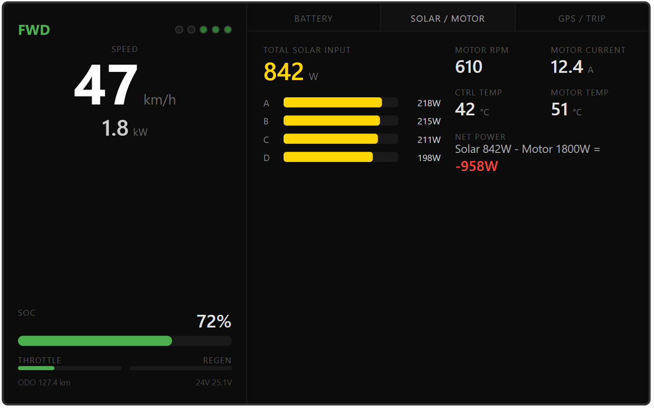
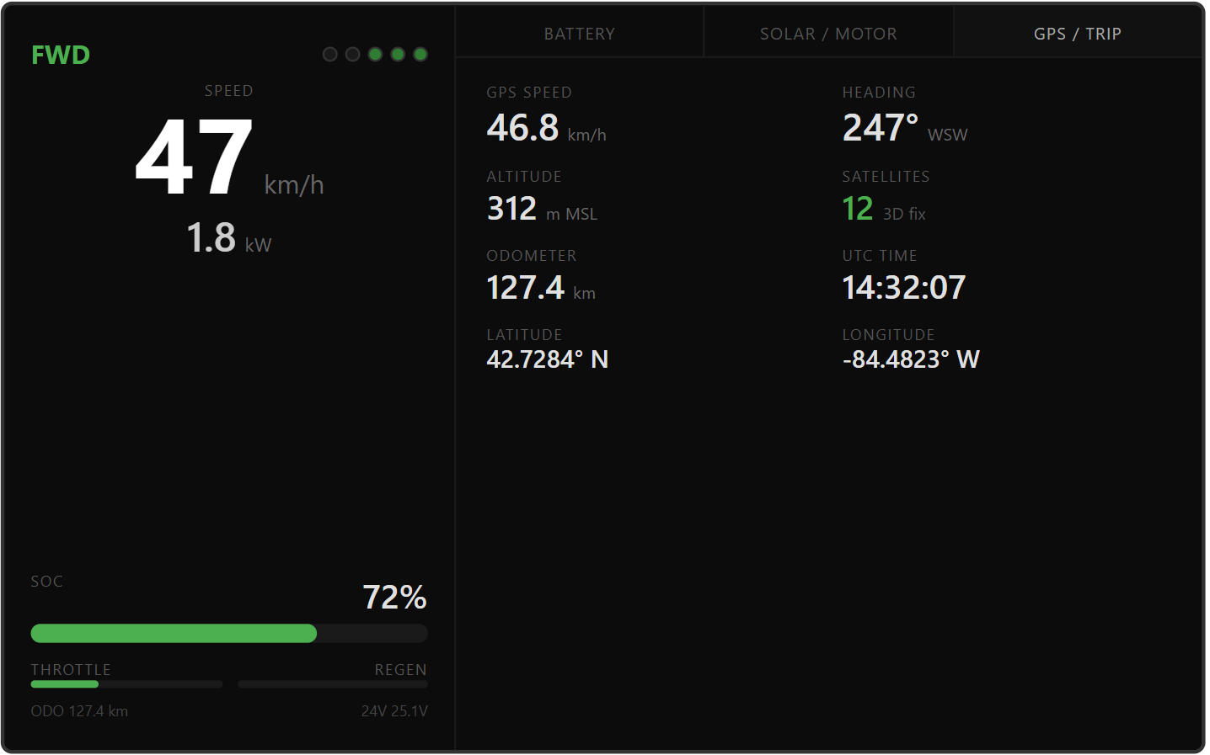
RIGHT PANEL — SOLAR/MOTOR & GPS
Solar / Motor Tab
Total solar power displayed in gold at top
4 MPPT bars (A/B/C/D) with individual wattages — short bar = shaded panel or faulted MPPT
Right half: Motor RPM, motor current, controller temp, motor temp
Net power calc (Solar − Motor): red if negative, green if positive — most useful number for strategy team
GPS / Trip Tab
GPS ground speed — cross-reference with motor-derived speed on left panel
Heading with cardinal direction, altitude MSL (matters for hilly ASC segments)
Satellite count with fix type, odometer, UTC time
Raw lat/lon for race timing checkpoints
MSU Solar Racing Team | Team #13

Slide 5
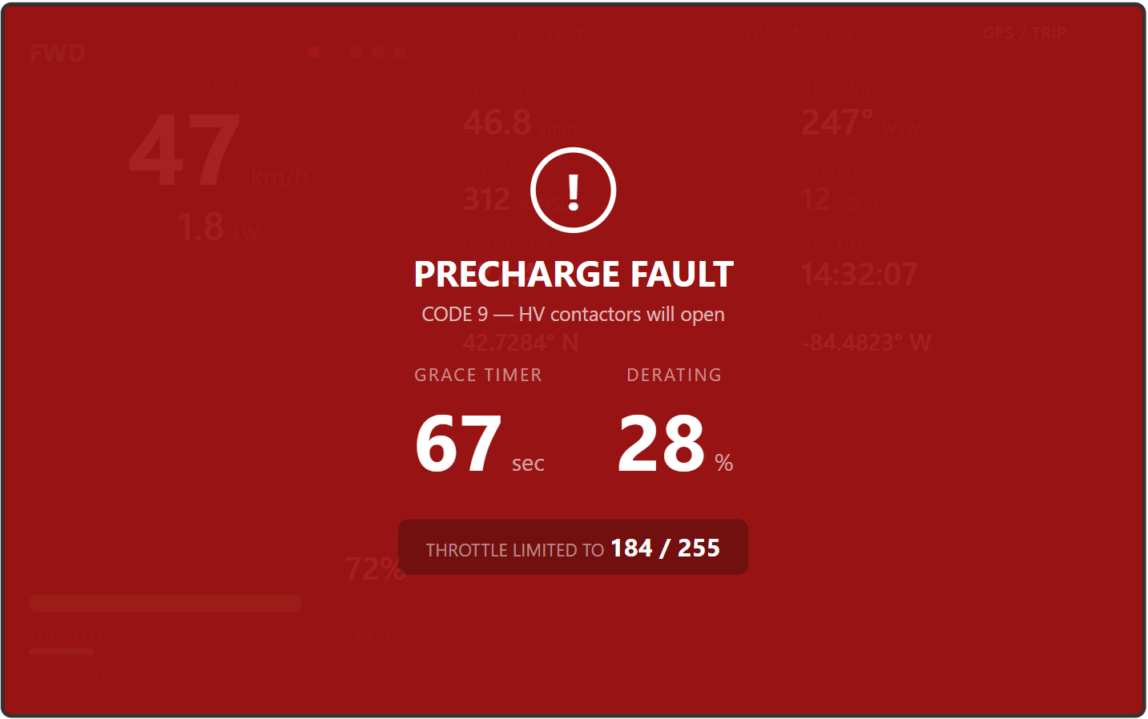
FAULT OVERLAY & WARNING STATE
Fault Overlay
Triggered when BPS_SafetyState.FaultCode != 0 — covers ONLY THE RIGHT PORTION of display (not both panels) (wt’s shown cover both but I changed my mind)
Red background, white text — maximum contrast for immediate visibility
Shows: fault name (mapped from 14 codes), fault code #, subtitle (e.g., “HV contactors will open”)
Grace timer countdown in large numerals, derate %, throttle limit raw (e.g., “184 / 255”)
Grace timer and derate with throttle limited are only shown when the vehicle is in LIMP mode from VegaState on Vega_SafetyState msg as well as SafetyState on BPS_SafetyState
Non-dismissable — only clears when BPS clears the fault code
Warning State — non-overlay
When CockpitWarningYellow is set (no hard fault)
Thick amber strip at bottom of left panel: “DERATING ACTIVE — SOFT LIMIT”
Yellow status dot lights up; driver can still see everything and use all tabs
MSU Solar Racing Team | Team #13

