Slide 1


Slide 2


Slide 3
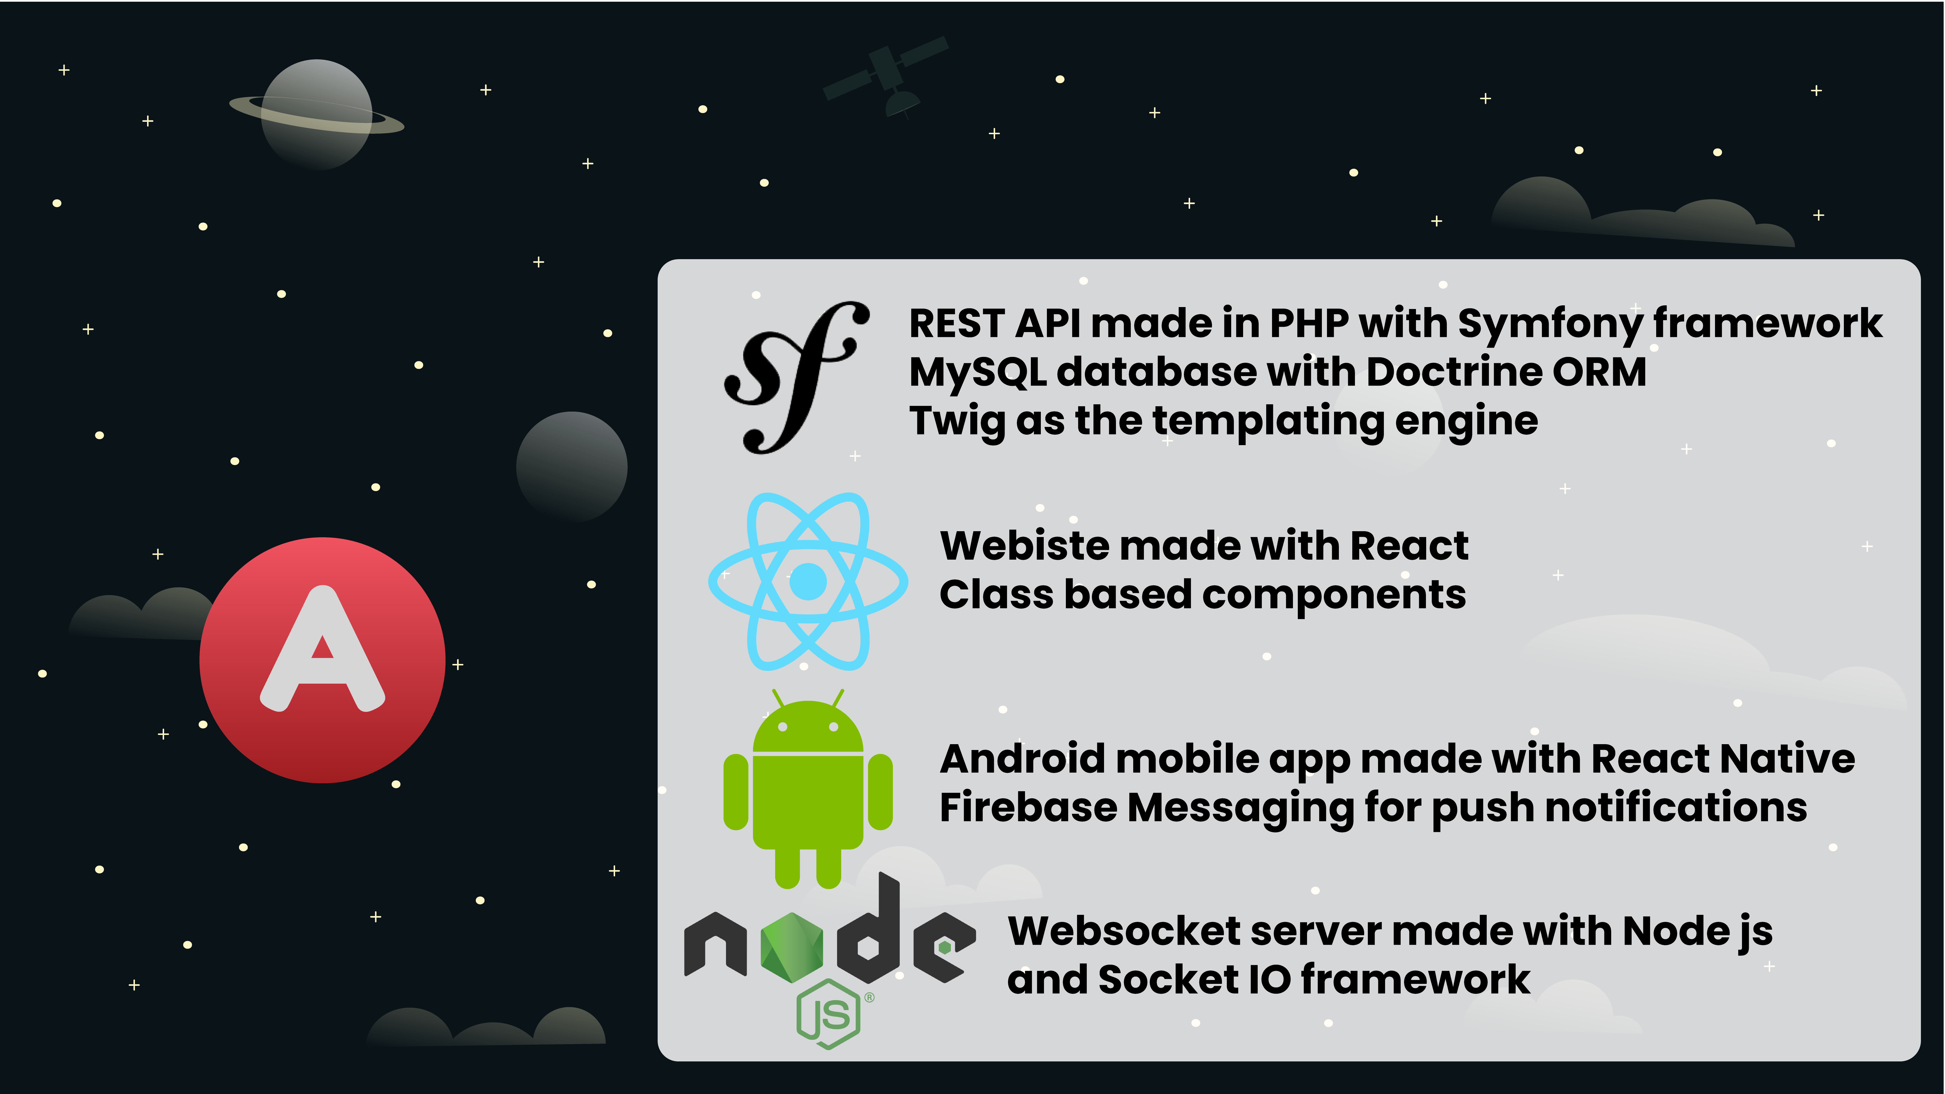
TECHNOLOGIES

Slide 4

API Features
Fully stateless with REST best practices
JWT authentication
Communicating with MySQL via Doctrine
Mail Service with Swift Mailer
Commands for Cron job
Postman for testing HTTP Requests
Unit Tests

Slide 5

Website Features
React app with class components
Design with Material Design Bootstrap and Adobe Illustrator
Routing with React Router
Posting text with pictures on timeline
Liking, commenting and sharing posts
Follower system like Instagram
Viewing own profile and other profiles

Slide 6
Mobile App Features
React Native with class components
Design with React Native Paper
React Navigation 5
Every feature like on website
Real time chat system

Slide 7
Hosting Features
cPanel shared hosting
Every website runs on Apache 2.0
Every website has SSL encryption
PHP version 7.4
MySQL version 5.7.31
Node.js version 10.22
Cron jobs

Slide 8
Versioning System
GitHub
Over 80 commits
Around 100k lines of code
60% JavaScript
33% PHP
9% other

Slide 9



