Slide 1
Application Executing
Notes:
SHOW APPLICATION LOGGED OUT
When the user is logged out, the calendar has a grey overlay to convey that the user is not able to use it until they are logged in. At this point, the user has the option to toggle the theme (TOGGLE THEME) and log in. (PAUSE, TOGGLE THEME BACK)
CLICK LOG IN
If the user does not have an account, then they can register an account (CLICK REGISTER). When they fill in the form, if all the information is provided and the username is not already in use then the account will be created and the user will be logged in
LOG IN
After the user has logged in, they will be able to see any reminders that they have already created. If a reminder has a description that is too long to fit, the user can hover over the description and the whole description will appear
The user can also create new reminders (CLICK NEW). If they fill in all the required information the reminder will be saved to the server and displayed in their calendar
If the user wants to edit a reminder this can easily be done by clicking on the reminder (DEMONSTRATE) and editing the information. This will then be updated both on the server and in the calendar.
When the user has completed the task they can complete the reminder by ticking the checkbox, making the reminder disappear from the calendar and it will be removed from the server (DEMONSTRATE).
The calendar can also be navigated to different weeks by using the buttons in the nav bar (DEMONSTRATE) and the user can easily return to the this week afterwards.

Slide 3
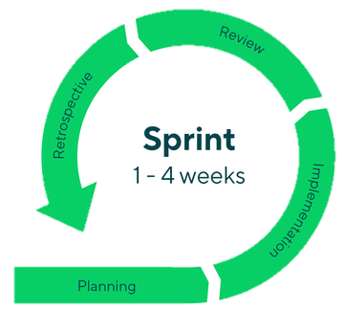
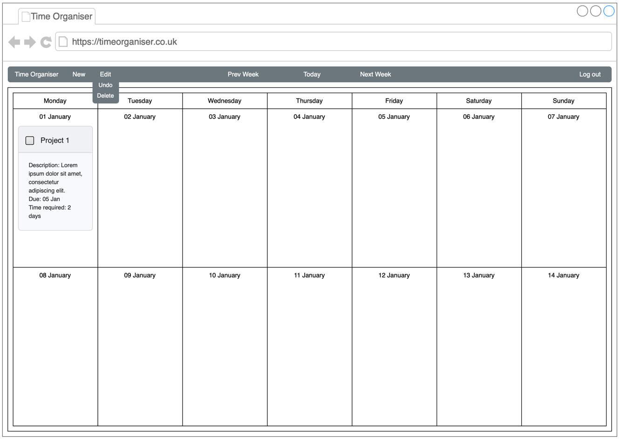
Sprints
Sprint 1:
Introduction
Project Vision
Research Background
Create Wireframes
Sprint 2:
UML Diagrams
Program template:
Nav bar
Calendar table
Log in dialogue
Register dialogue
Notes:
In the first sprint, I started by writing an introduction to the project and creating the project vision. I then conducted research on the background of how reminders and calendars have been used in the past, and this dates back thousands of years, emphasizing how important a reminder calendar system can be to people. To finish off this sprint I created some wireframes which laid out how the application should look.
In the second sprint I created UML diagrams to understand how data structures should be organized so that all the required data was stored logically, and the data is only accessed through getter and setter functions so that it is easy to control how the data is changed. I also began to program the application. I started with the nav bar, the table that contains the calendar and reminders, the log in dialogue and the register dialogue.

Slide 4

Sprints
Sprint 3:
JavaScript function for putting dates in calendar
Highlight current date
Function for navigating calendar
Sprint 4:
Create NodeJS server
Server-side log in function
Client-side log in function
Server-side register function
Notes:
In my third sprint I started to create JavaScript functions to allow the application to function. The first function I created sorted out putting dates into the calendar table and making sure that the dates lined up with the corrected day of the week. The current date is also highlighted to make it easier for the user to know which day it is. I also implemented functions to allow the user to navigate through the calendar.
The fourth sprint consisted of creating a NodeJS server to allow data to be stored centrally to allow access from anywhere. A log in and register function were also created to allow the client to communicate with the server to either verify log in credentials or create an account. A client side JavaScript function was also created to allow the user to log in.

Slide 5
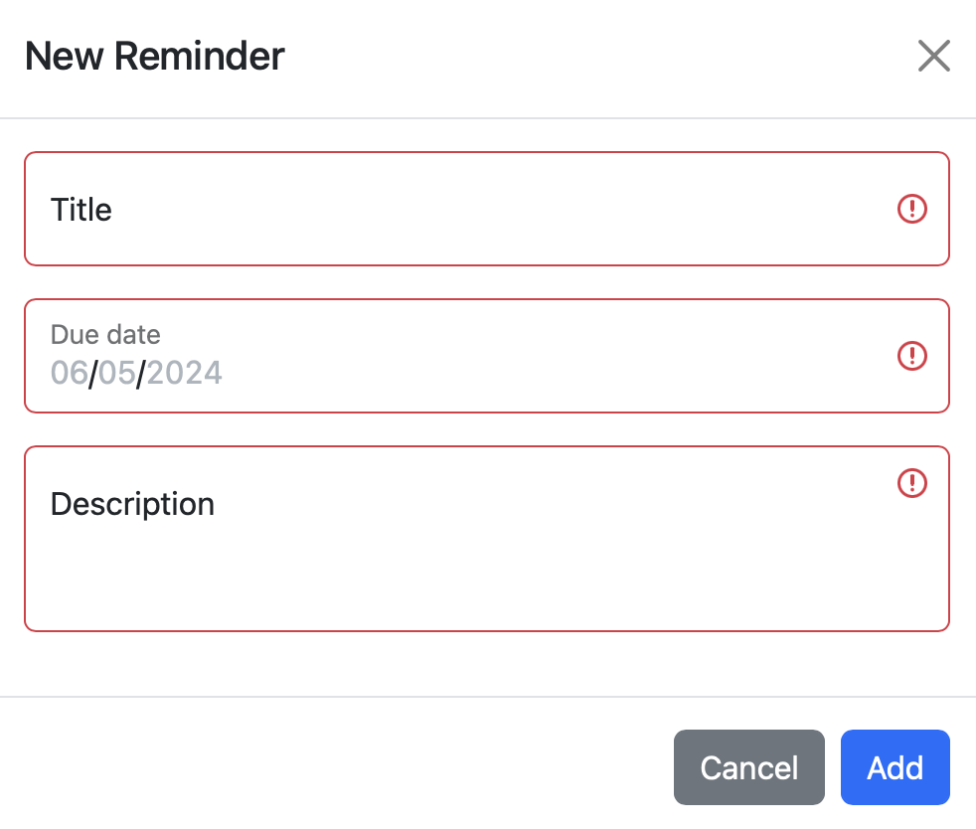
Sprints
Sprint 5:
Client-side register function
Server-side new reminder function
Make sure all previous sprints are complete
Sprint 6:
Client-side create reminder function
HTML create reminder dialogue
Bug fixing
Notes:
In my fifth sprint, the client side function was created to allow users to register for an account, along with a server side function for creating new reminders. I also used this sprint to make sure that all previous sprints were complete, catching up on any delays.
The sixth sprint implemented the JavaScript function to allow the user to create the reminders, as well as a dialogue for the user to fill in data for that reminder. This sprint was also used to fix any bugs that had been found.

Slide 6
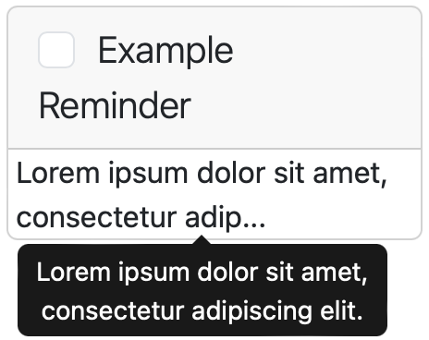
Sprints
Sprint 7:
Server-side function to send reminders
Server-side function for completing reminders
Reminder template in calendar
Sprint 8:
Client-side function to receive reminders
Client-side function for displaying reminders
Dialogue for editing reminders
Sprint 9:
Server-side function for editing reminders
Bug fixing and delayed tasks
Notes:
The seventh sprint involved creating server-side functions for both sending reminders from the server to the client and completing reminders. A template for how the reminder would be displayed was also created.
In Sprint 8, client-side functions were created for receiving reminders from the server, and sorting them into an array. A function was also created to sort displaying the relevant reminders on the screen as well as a dialogue box to allow users to edit reminders that already exist.
In the final sprint, the server-side function for editing reminders was created, as well as completing any delayed tasks and fixing any bugs that had been found.

Slide 7
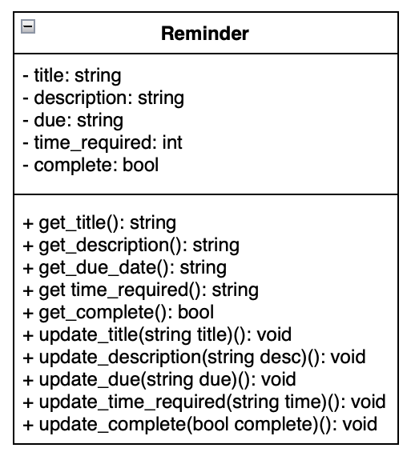
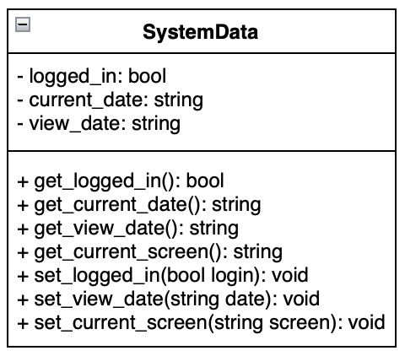
UML Diagrams
This diagram demonstrates how the system will store relevant data for the application to run.
This UML diagram demonstrates how reminders will be stored and handled client-side.
Notes:
These are a couple of UML diagrams that were created to demonstrate how data should be stored, and the functions associated with that data. The Reminder diagram contains data to hold the contents of the reminders, and the relevant getter and setter functions to access the data. These functions are used to prevent the data from being edited anywhere in the program which makes it easier to monitor and error check the data before it gets overwritten.
The system data UML diagram shows how the data will be stored that is required for the application to run successfully. After having created the application, this data structure also stores the users data, such as name and username.

Slide 8
Issues and Challenges Faced
Learning how to setup and use a NodeJS server
Lining up the dates in the calendar when navigating through
Time management making sure other module deadlines were met while still completing sprints
Notes:
The first challenge I came across was how to centrally store user data. After researching how to solve this issue, I found that creating a NodeJS server would solve this issue. I then had to research and learn how to use and create this type of server, and how best to communicate between the client and server.
Another issue I came across was creating the functions for navigating through the calendar. I wasn’t expecting this to be as challenging as it turned out to be as when navigating backwards and forwards, the dates would not stay lined up with the correct day of the week. This challenge led to this sprint being extended to make sure that these functions operated correctly.
A third challenge I faced was managing my time when other modules deadlines were approaching, to make sure that my other coursework was completed whilst still trying to complete the sprints on time. This did lead to some delays in sprints being completed.

Slide 9
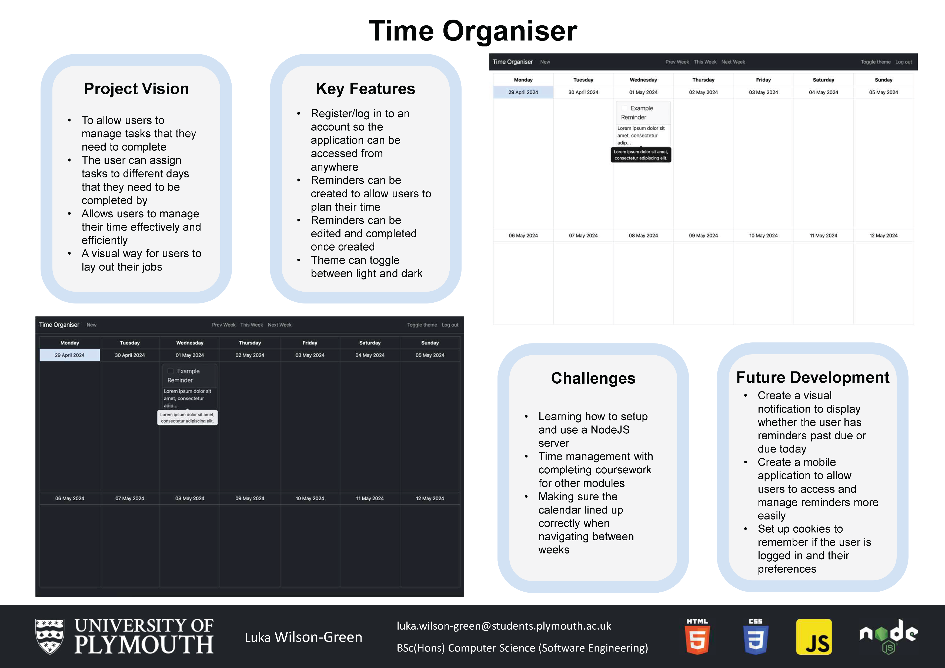
Notes:
This poster was created to outline what the project is, allowing people to see what the project vision is as well as the key features of the application. It also gives people the opportunity to see what is likely to happen to the application in the future by reading the future development section.

