Slide 1
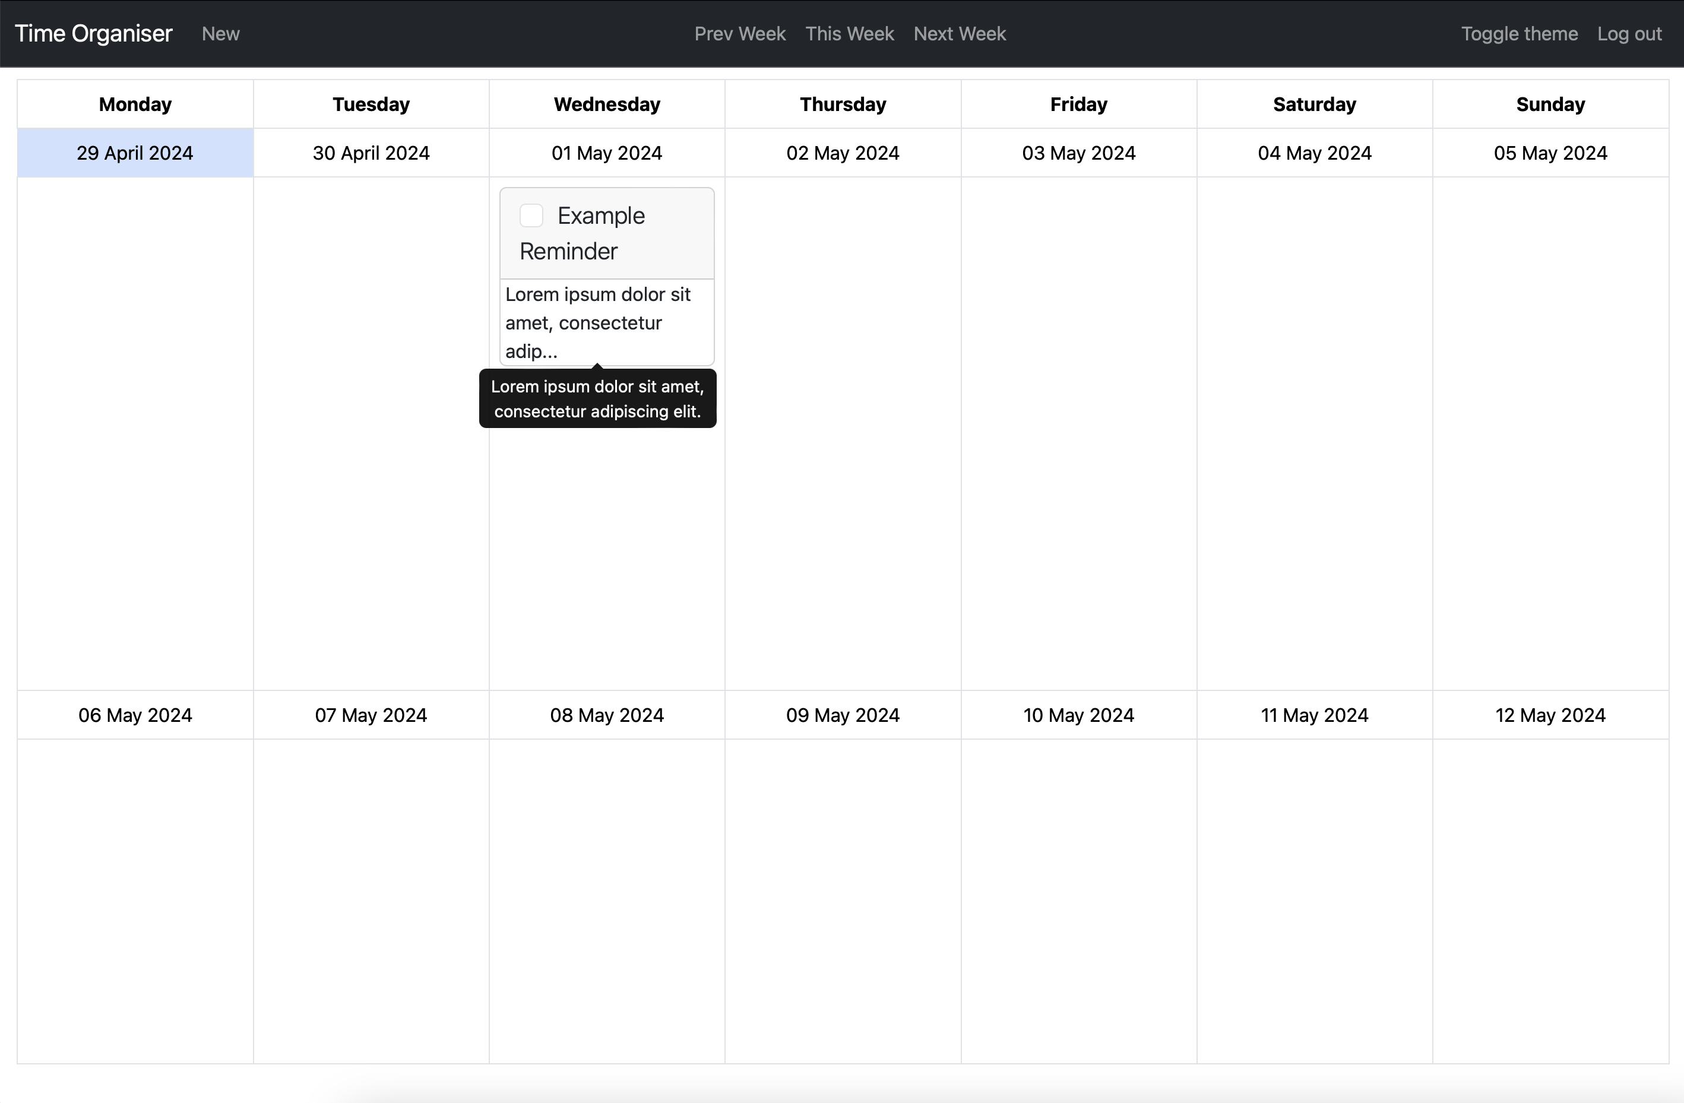
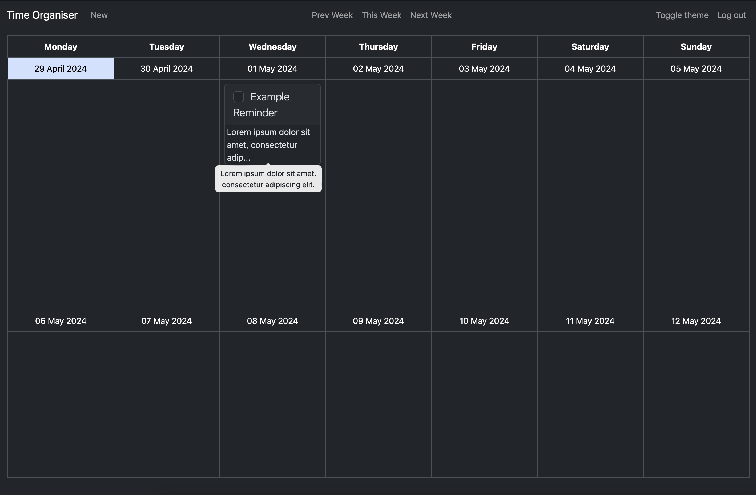





Time Organiser
Project Vision
Key Features
Register/log in to an account so the application can be accessed from anywhere
Reminders can be created to allow users to plan their time
Reminders can be edited and completed once created
Theme can toggle between light and dark
To allow users to manage tasks that they need to complete
The user can assign tasks to different days that they need to be completed by
Allows users to manage their time effectively and efficiently
A visual way for users to lay out their jobs
Challenges
Future Development
Create a visual notification to display whether the user has reminders past due or due today
Create a mobile application to allow users to access and manage reminders more easily
Set up cookies to remember if the user is logged in and their preferences
Learning how to setup and use a NodeJS server
Time management with completing coursework for other modules
Making sure the calendar lined up correctly when navigating between weeks
Luka Wilson-Green
luka.wilson-green@students.plymouth.ac.uk
BSc(Hons) Computer Science (Software Engineering)

