Slide 1
Application Executing
Notes:
SHOW APPLICATION LOGGED OUT
When the user is logged out, the calendar has a grey overlay to convey that the user is not able to use it until they are logged in. At this point, the user has the option to toggle the theme (TOGGLE THEME) and log in. (PAUSE, TOGGLE THEME BACK)
CLICK LOG IN
If the user does not have an account, then they can register an account (CLICK REGISTER). When they fill in the form, if all the information is provided and the username is not already in use then the account will be created and the user will be logged in
LOG IN
After the user has logged in, they will be able to see any reminders that they have already created. If a reminder has a description that is too long to fit, the user can hover over the description and the whole description will appear
The user can also create new reminders (CLICK NEW). If they fill in all the required information the reminder will be saved to the server and displayed in their calendar
If the user wants to edit a reminder this can easily be done by clicking on the reminder (DEMONSTRATE) and editing the information. This will then be updated both on the server and in the calendar.
When the user has completed the task they can complete the reminder by ticking the checkbox, making the reminder disappear from the calendar and it will be removed from the server (DEMONSTRATE).
The calendar can also be navigated to different weeks by using the buttons in the nav bar (DEMONSTRATE) and the user can easily return to the this week afterwards.

Slide 2
Project Plan and Sprints
Sprint 1:
Introduction
Project Vision
Research Background
Create Wireframes
Sprint 2:
UML Diagrams
Program template:
Nav bar
Calendar table
Log in dialogue
Register dialogue

Slide 3
Project Plan and Sprints
Sprint 3:
JavaScript function for putting dates in calendar
Function for navigating calendar
Highlight current date
Sprint 4:
Create NodeJS server
Server-side log in function
Client-side log in function
Server-side register function

Slide 4
Project Plan and Sprints
Sprint 5:
Client-side register function
Server-side new reminder function
Sprint 6:
Client-side create reminder function
HTML create reminder dialogue

Slide 5
Project Plan and Sprints
Sprint 7:
Server-side function to send reminders
Server-side function for completing reminders
Reminder template in calendar
Sprint 8:
Client-side function to receive reminders
Client-side function for displaying reminders
Dialogue for editing reminders
Sprint 9:
Server-side function for editing reminders

Slide 6
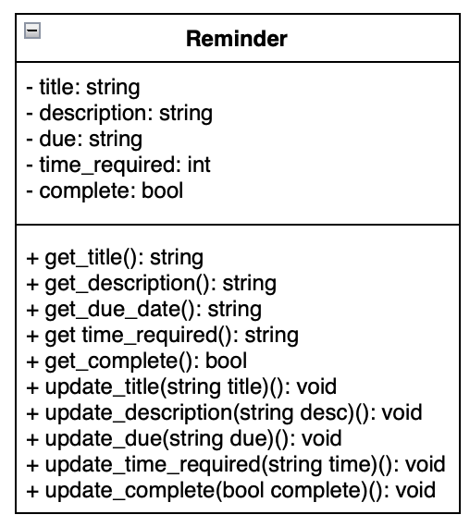
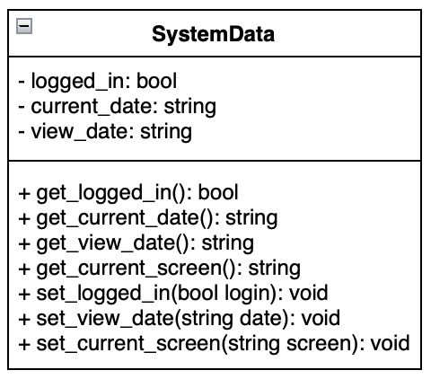
UML Diagrams
This diagram demonstrates how the system will store relevant data for the application to run.
This UML diagram demonstrates how reminders will be stored and handled client-side.

Slide 7
Issues and Challenges Faced
Learning how to setup and use a NodeJS server
Lining up the dates in the calendar when navigating through
Time management making sure other module deadlines were met while still completing sprints

Slide 8
