Slide 1
Application executing

Slide 2
Project Plan and Sprints
Sprint 1:
Introduction
Project Vision
Research Background
Create Wireframes
Sprint 2:
UML Diagrams
Program template:
Nav bar
Calendar table
Log in dialogue
Register dialogue

Slide 3
Project Plan and Sprints
Sprint 3:
JavaScript function for putting dates in calendar
Function for navigating calendar
Highlight current date
Sprint 4:
Create NodeJS server
Server-side log in function
Client-side log in function
Server-side register function

Slide 4
Project Plan and Sprints
Sprint 5:
Client-side register function
Server-side new reminder function

Slide 5
Project Plan and Sprints

Slide 6
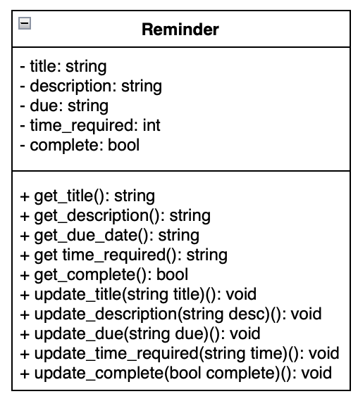
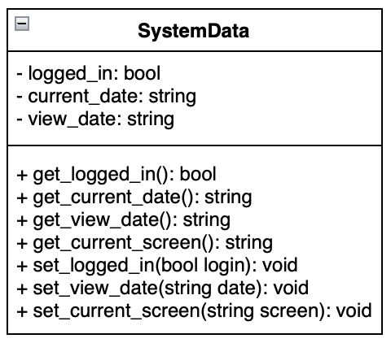
UML diagrams

Slide 7
Issues and challenges faced

Slide 8
