Slide 1
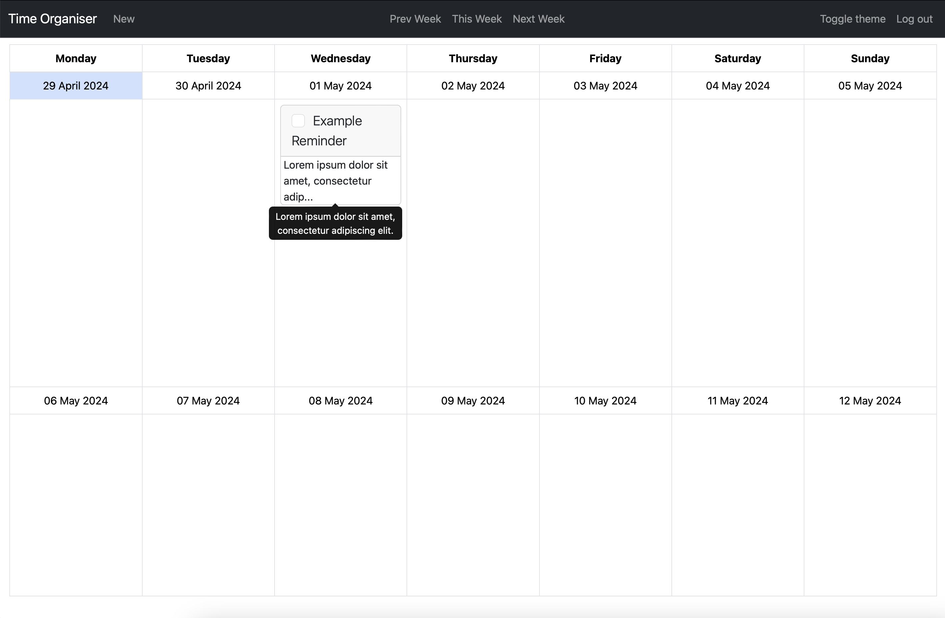
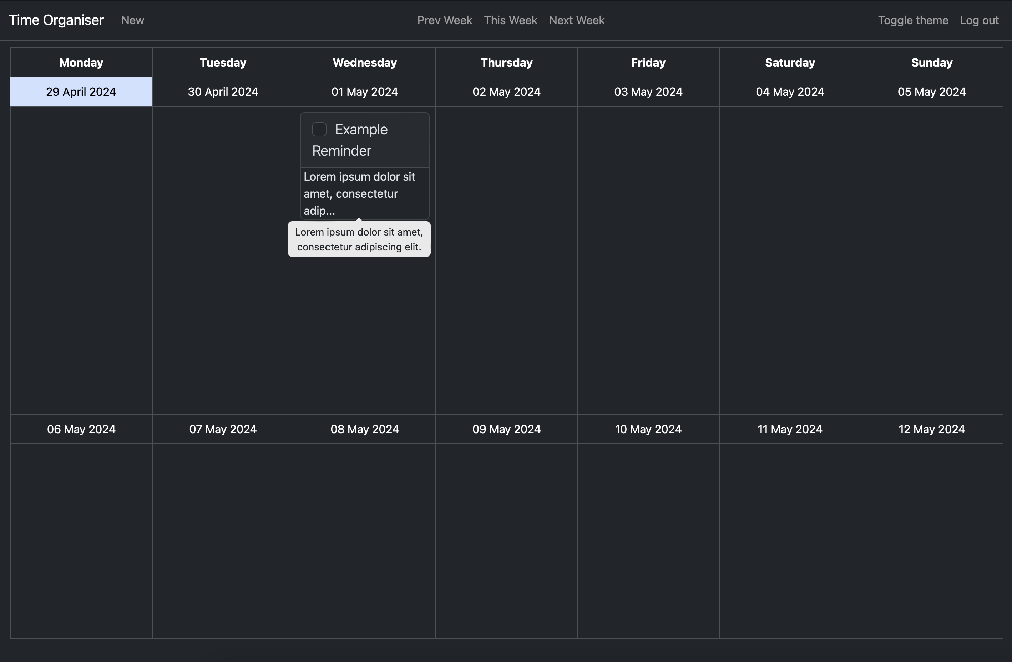





Time Organiser
Project Vision
Key Features
To allow users to manage tasks that they need to complete
The user can assign tasks to different days that they need to be completed by
Allows users to manage their time effectively and efficiently
A visual way for users to lay out their jobs
To allow users to manage tasks that they need to complete
The user can assign tasks to different days that they need to be completed by
Allows users to manage their time effectively and efficiently
A visual way for users to lay out their jobs
Challenges
Future Development
To allow users to manage tasks that they need to complete
The user can assign tasks to different days that they need to be completed by
Allows users to manage their time effectively and efficiently
A visual way for users to lay out their jobs
To allow users to manage tasks that they need to complete
The user can assign tasks to different days that they need to be completed by
Allows users to manage their time effectively and efficiently
A visual way for users to lay out their jobs
Luka Wilson-Green
luka.wilson-green@students.plymouth.ac.uk
BSc(Hons) Computer Science (Software Engineering)

