Slide 2
Cross-Border, Overarching Demonstration Update
Flexibility SSA requirements
Andraz Andolšek and Cami Dodge-Lamm
cyberGRID GmbH & Co KG, T7.8 Lead

Slide 3
Objectives, Goals, and Use Case
Objectives and Goals:
Demonstrate the advantages of cross-border/pilot, flexibility data exchanges
Demonstrate a unified Interconnect Project
Highlight the interoperability established between the devices at the pilot level, grid side
Use Case:
To demonstrate cross-border interoperability with flex services being offered to a market player, in this case a (simulated) TSO. ​

Slide 4
Use Case, in Detail
Ancillary service market*
cyberNOC collects data from the platforms/assets from pilots
Active power
Flexibility forecasts
cyberNOC aggregates the flexibility
cyberNOC offers this aggregated flexibility – BIDs to the simulated market
If BIDs are accepted – simulation the TSO sends continues activation (aFRR) or scheduled activation (mFRR)
cyberNOC de-aggregate the activation signals and send it to the platforms/assets
DSO
TSO*
cyberNOC
a)
Platform
b)
Platform (aggregation)
c)
Asset N
Asset
Asset
*Simulated
Notes:
a) Pilot platform acts as a proxy. CyberNOC receives timeseries data for each asset via single platform
b) Pilot platform acts as a aggregator. CyberNOC receives only aggregated timeseries data for entire pool
c) Single asset. CyberNOC receives timeseries data for single asset (usually big assets C&I)

Slide 5
Data exchange
Monitoring (from pilots/assets to cyberNOC)
- Active power: consumption/production from assets/pilot
Baseline: baseline from assets/pilot (optional)
Flexibility: positive and negative flexibility (optional)
Marginal prices: positive and negative marginal flexibility price (optional)
Control (from cyberNOC to pilots/assets)
- Setpoint: for asset/pilot

Slide 6
Architecture
cyberGRID
MONITORING
Asset/Platform
A
Active Power
Baseline Forecast
Flexibility forecast
Marginal price forecast
CONTROL
Activation

Slide 7
Example – PV asset
Green: Active power – production
Grey: Baseline
Orange: Upper limit
Yellow: Lower limit
Flexibility
forecast
100 kW
Envelope
Active power: 37 kW
Upper limit : 50 kW
Lower limit: 5 kW
50 kW
40 kW
5 kW
0 kW
15:00
00:00
12:00
23:00

Slide 8
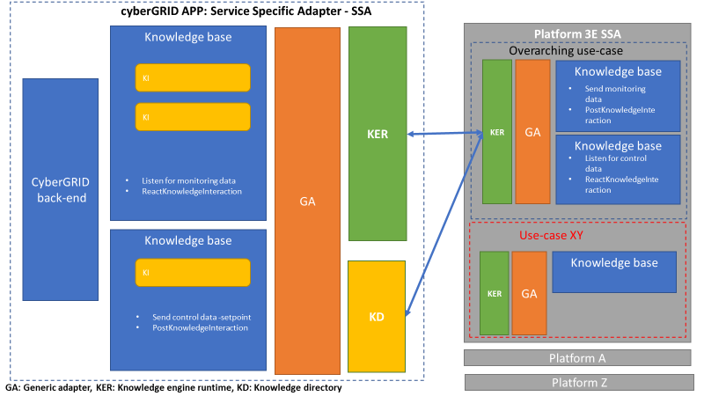
Service Specific Adapter with Overarching Use Case: Early Adopter Efforts

Slide 9
Knowledge interactions - cyberGRID
Monitoring
6 x PostReactKnowladgeInteractions
Active power
(optional) Baseline forecast
(optional) Positive flexibility forecast
(optional) Negative flexibility forecast
(optional) Positive flexibility marginal price forecast
(optional) Negative flexibility marginal price forecast
Control
1 x PostKnowladgeInteractions
Setpoints

Slide 10
Knowledge interactions - customer
Monitoring
6 x PostKnowladgeInteractions
Active power
(optional) Baseline forecast
(optional) Positive flexibility forecast
(optional) Negative flexibility forecast
(optional) Positive flexibility marginal price forecast
(optional) Positive flexibility marginal price forecast
Control
1 x PostReactKnowladgeInteractions
Setpoints

Slide 11
Customer implementation
Should implement the Flexibility SSA
Should implement at least active power data stream
Process
Active power: Customer send (broadcast) periodically (2s, 1min) the active power (production/consumption) measurement of the specified asset (device)
Baseline, Flexibility, Marginal price: customer should at least once per day send the timeseries, including at least 1 day of intervals
Intervals can be as small as 15min or as long as 4H (if possible send 15min)
If the asset doesn’t have any flexibility available for certain intervals please send 0 kW
Activations: cyberGRID will broadcast the setpoints for particular asset spontaneously when it will be needed

