Slide 1
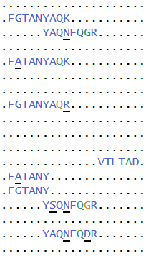
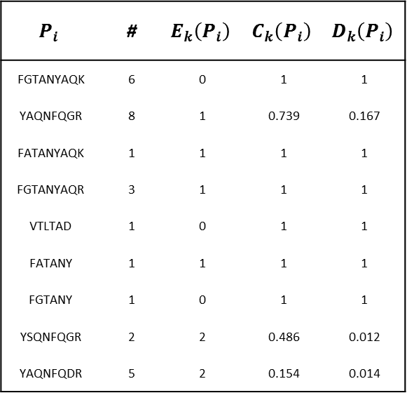
$$P_{i}$$ | # | $$E_{k}\left(P_{i}\right)$$ | $$C_{k}\left(P_{i}\right)$$ | $$D_{k}\left(P_{i}\right)$$
FGTANYAQK | 6 | 0 | 1 | 1
YAQNFQGR | 8 | 1 | 0.739 | 0.167
FATANYAQK | 1 | 1 | 1 | 1
FGTANYAQR | 3 | 1 | 1 | 1
VTLTAD | 1 | 0 | 1 | 1
FATANY | 1 | 1 | 1 | 1
FGTANY | 1 | 0 | 1 | 1
YSQNFQGR | 2 | 2 | 0.486 | 0.012
YAQNFQDR | 5 | 2 | 0.154 | 0.014

