Slide 1
Dirichlet
Multinomial
Dirichlet
Poisson
Exponential

Slide 2
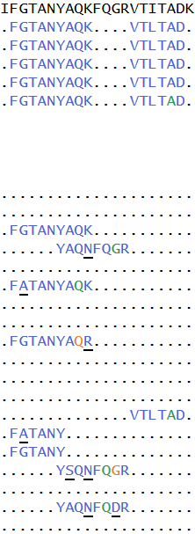
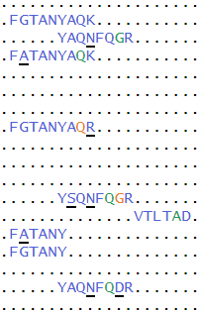
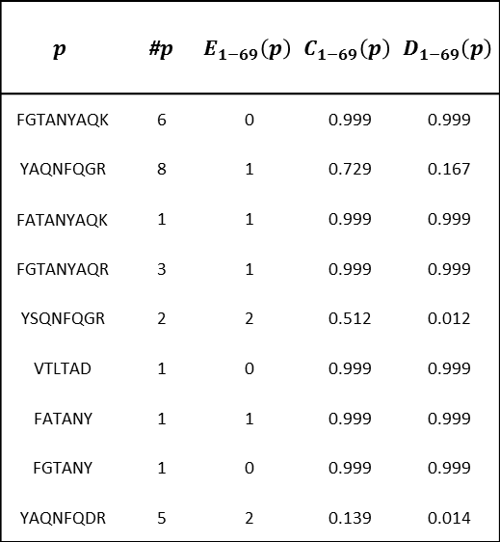
$$p$$ | #$p$ | $$E_{1−69}\left(p\right)$$ | $$C_{1−69}\left(p\right)$$ | $$D_{1−69}\left(p\right)$$
FGTANYAQK | 6 | 0 | 0.999 | 0.999
YAQNFQGR | 8 | 1 | 0.729 | 0.167
FATANYAQK | 1 | 1 | 0.999 | 0.999
FGTANYAQR | 3 | 1 | 0.999 | 0.999
YSQNFQGR | 2 | 2 | 0.512 | 0.012
VTLTAD | 1 | 0 | 0.999 | 0.999
FATANY | 1 | 1 | 0.999 | 0.999
FGTANY | 1 | 0 | 0.999 | 0.999
YAQNFQDR | 5 | 2 | 0.139 | 0.014

Slide 3
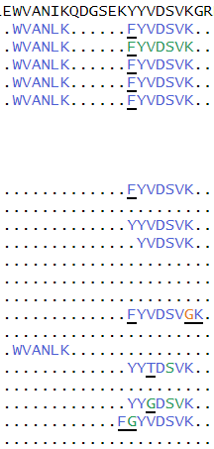
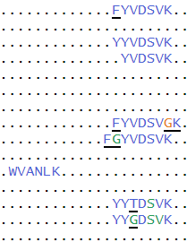

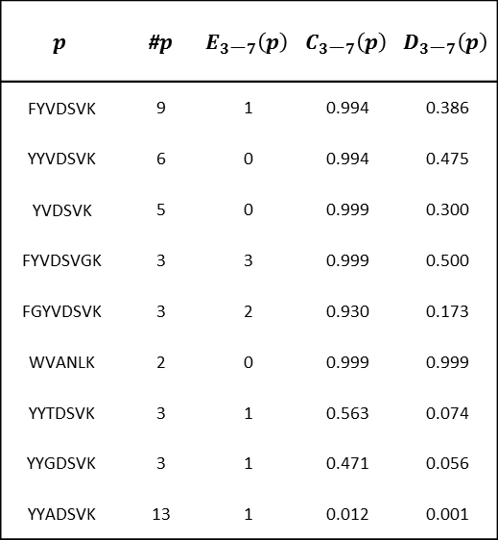
$$p$$ | #$p$ | $$E_{3\text{−}7}\left(p\right)$$ | $$C_{3\text{−}7}\left(p\right)$$ | $$D_{3\text{−}7}\left(p\right)$$
FYVDSVK | 9 | 1 | 0.994 | 0.386
YYVDSVK | 6 | 0 | 0.994 | 0.475
YVDSVK | 5 | 0 | 0.999 | 0.300
FYVDSVGK | 3 | 3 | 0.999 | 0.500
FGYVDSVK | 3 | 2 | 0.930 | 0.173
WVANLK | 2 | 0 | 0.999 | 0.999
YYTDSVK | 3 | 1 | 0.563 | 0.074
YYGDSVK | 3 | 1 | 0.471 | 0.056
YYADSVK | 13 | 1 | 0.012 | 0.001

Slide 4

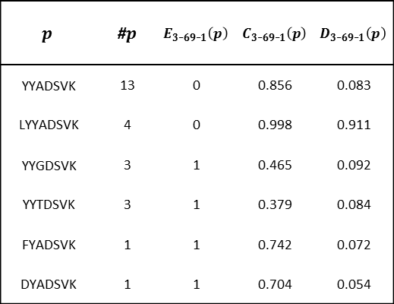
$$p$$ | #$p$ | $$E_{3\text{−}69\text{−}1}\left(p\right)$$ | $$C_{3\text{−}69\text{−}1}\left(p\right)$$ | $$D_{3\text{−}69\text{−}1}\left(p\right)$$
YYADSVK | 13 | 0 | 0.856 | 0.083
LYYADSVK | 4 | 0 | 0.998 | 0.911
YYGDSVK | 3 | 1 | 0.465 | 0.092
YYTDSVK | 3 | 1 | 0.379 | 0.084
FYADSVK | 1 | 1 | 0.742 | 0.072
DYADSVK | 1 | 1 | 0.704 | 0.054

Slide 5
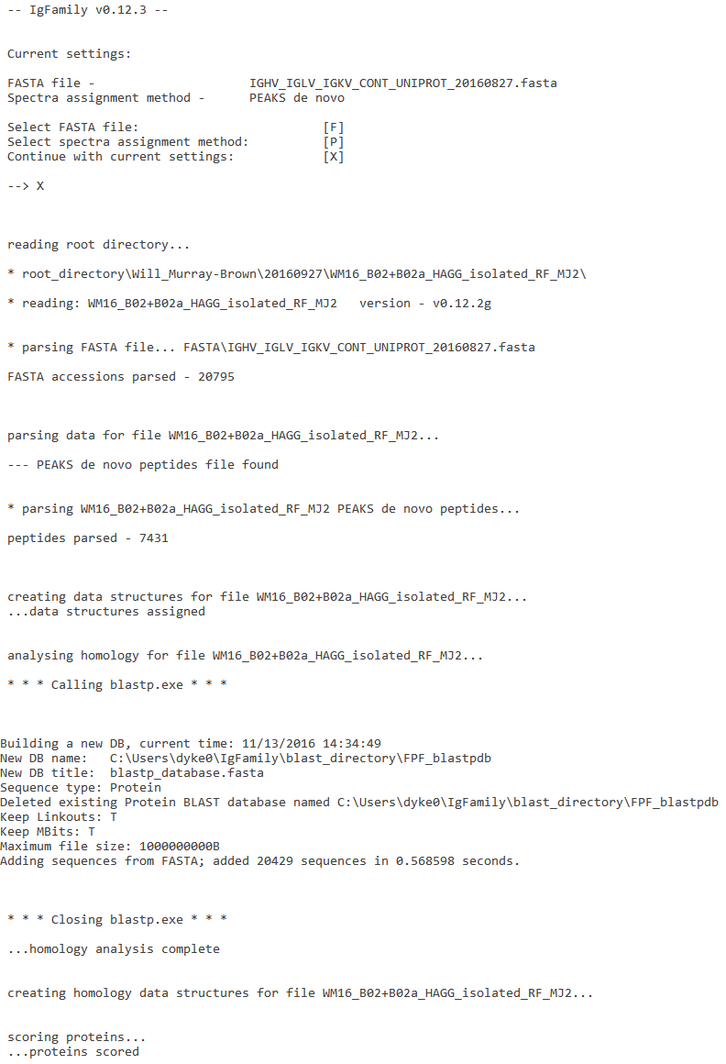

Slide 6
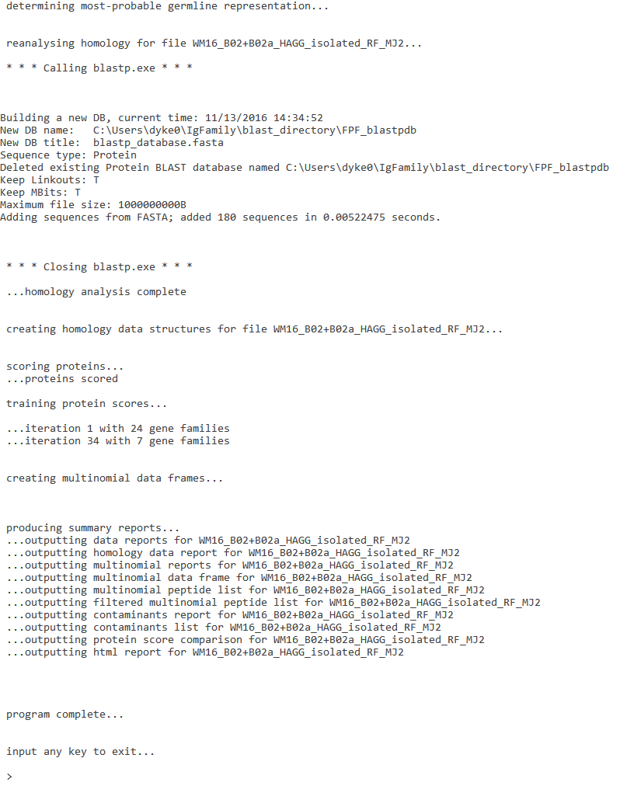

Slide 7
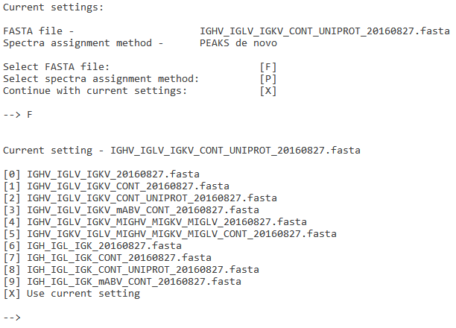

Slide 8
