Slide 1
Dirichlet
Multinomial
Dirichlet
Poisson
Exponential

Slide 2
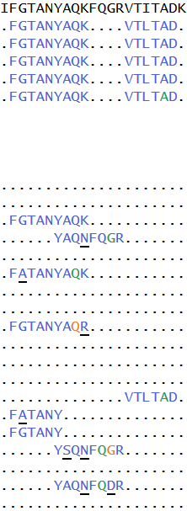
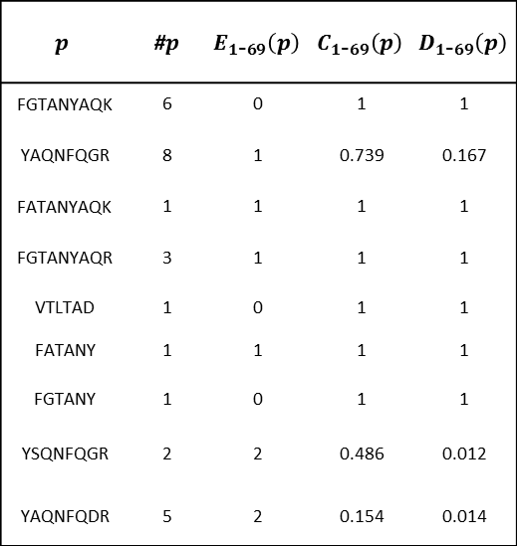
$$p$$ | #$p$ | $$E_{1\text{-}69}\left(p\right)$$ | $$C_{1\text{-}69}\left(p\right)$$ | $$D_{1\text{-}69}\left(p\right)$$
FGTANYAQK | 6 | 0 | 1 | 1
YAQNFQGR | 8 | 1 | 0.739 | 0.167
FATANYAQK | 1 | 1 | 1 | 1
FGTANYAQR | 3 | 1 | 1 | 1
VTLTAD | 1 | 0 | 1 | 1
FATANY | 1 | 1 | 1 | 1
FGTANY | 1 | 0 | 1 | 1
YSQNFQGR | 2 | 2 | 0.486 | 0.012
YAQNFQDR | 5 | 2 | 0.154 | 0.014

Slide 3
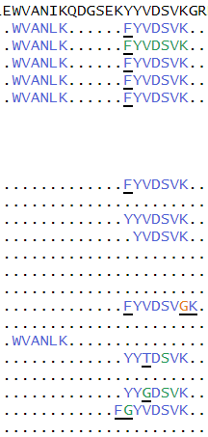

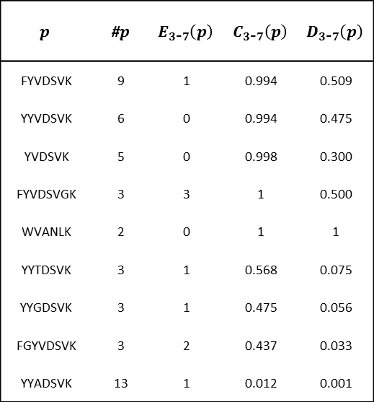
$$p$$ | #$p$ | $$E_{3\text{-}7}\left(p\right)$$ | $$C_{3\text{-}7}\left(p\right)$$ | $$D_{3\text{-}7}\left(p\right)$$
FYVDSVK | 9 | 1 | 0.994 | 0.509
YYVDSVK | 6 | 0 | 0.994 | 0.475
YVDSVK | 5 | 0 | 0.998 | 0.300
FYVDSVGK | 3 | 3 | 1 | 0.500
WVANLK | 2 | 0 | 1 | 1
YYTDSVK | 3 | 1 | 0.568 | 0.075
YYGDSVK | 3 | 1 | 0.475 | 0.056
FGYVDSVK | 3 | 2 | 0.437 | 0.033
YYADSVK | 13 | 1 | 0.012 | 0.001

Slide 4

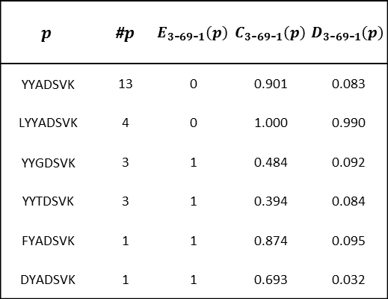
$$p$$ | #$p$ | $$E_{3\text{-}69\text{-}1}\left(p\right)$$ | $$C_{3\text{-}69\text{-}1}\left(p\right)$$ | $$D_{3\text{-}69\text{-}1}\left(p\right)$$
YYADSVK | 13 | 0 | 0.901 | 0.083
LYYADSVK | 4 | 0 | 1.000 | 0.990
YYGDSVK | 3 | 1 | 0.484 | 0.092
YYTDSVK | 3 | 1 | 0.394 | 0.084
FYADSVK | 1 | 1 | 0.874 | 0.095
DYADSVK | 1 | 1 | 0.693 | 0.032

Slide 5
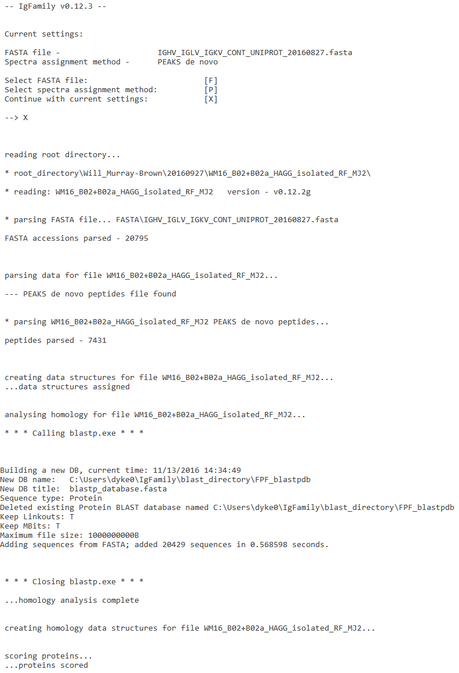

Slide 6
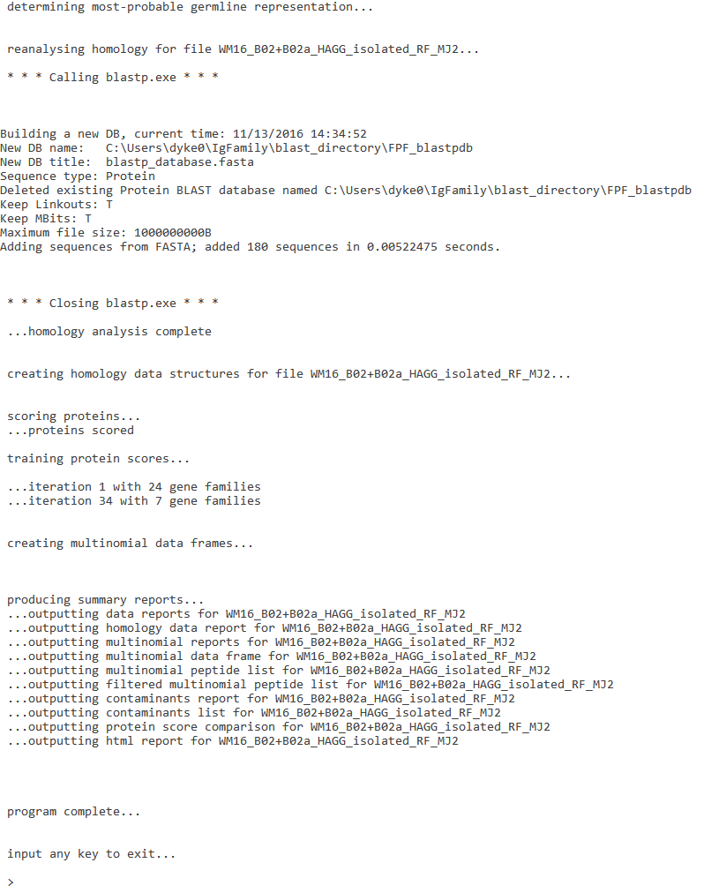

Slide 7
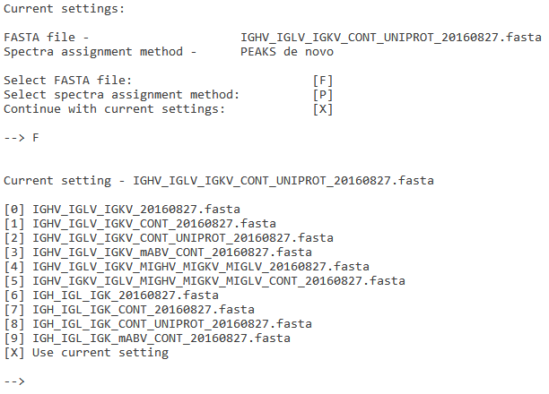

Slide 8
