Slide 1
Dirichlet
Multinomial
Dirichlet
Poisson
Exponential

Slide 2
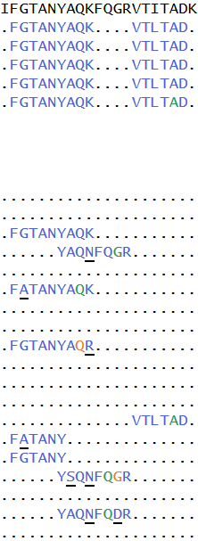
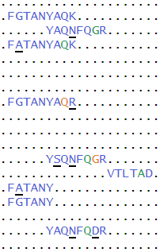
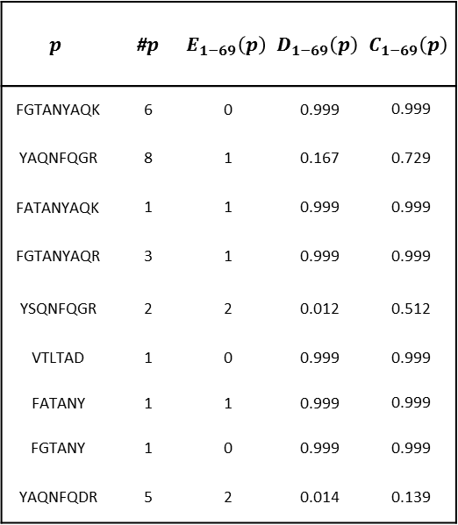
$$p$$ | #$p$ | $$E_{1−69}\left(p\right)$$ | $$D_{1−69}\left(p\right)$$ | $$C_{1−69}\left(p\right)$$
FGTANYAQK | 6 | 0 | 0.999 | 0.999
YAQNFQGR | 8 | 1 | 0.167 | 0.729
FATANYAQK | 1 | 1 | 0.999 | 0.999
FGTANYAQR | 3 | 1 | 0.999 | 0.999
YSQNFQGR | 2 | 2 | 0.012 | 0.512
VTLTAD | 1 | 0 | 0.999 | 0.999
FATANY | 1 | 1 | 0.999 | 0.999
FGTANY | 1 | 0 | 0.999 | 0.999
YAQNFQDR | 5 | 2 | 0.014 | 0.139

Slide 3
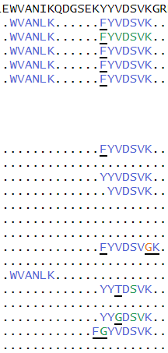
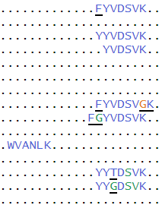

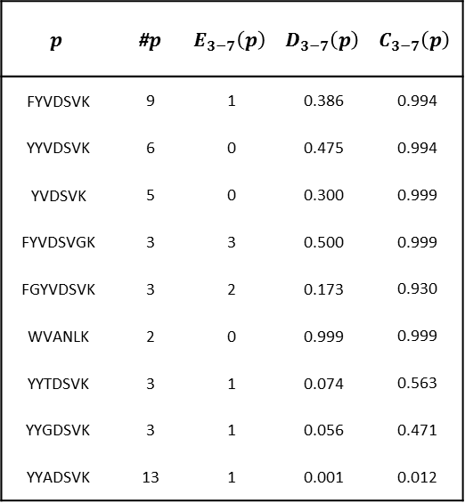
$$p$$ | #$p$ | $$E_{3−7}\left(p\right)$$ | $$D_{3−7}\left(p\right)$$ | $$C_{3−7}\left(p\right)$$
FYVDSVK | 9 | 1 | 0.386 | 0.994
YYVDSVK | 6 | 0 | 0.475 | 0.994
YVDSVK | 5 | 0 | 0.300 | 0.999
FYVDSVGK | 3 | 3 | 0.500 | 0.999
FGYVDSVK | 3 | 2 | 0.173 | 0.930
WVANLK | 2 | 0 | 0.999 | 0.999
YYTDSVK | 3 | 1 | 0.074 | 0.563
YYGDSVK | 3 | 1 | 0.056 | 0.471
YYADSVK | 13 | 1 | 0.001 | 0.012

Slide 4

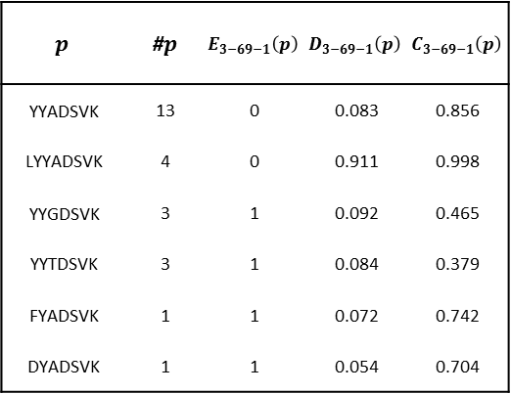
$$p$$ | #$p$ | $$E_{3−69−1}\left(p\right)$$ | $$D_{3−69−1}\left(p\right)$$ | $$C_{3−69−1}\left(p\right)$$
YYADSVK | 13 | 0 | 0.083 | 0.856
LYYADSVK | 4 | 0 | 0.911 | 0.998
YYGDSVK | 3 | 1 | 0.092 | 0.465
YYTDSVK | 3 | 1 | 0.084 | 0.379
FYADSVK | 1 | 1 | 0.072 | 0.742
DYADSVK | 1 | 1 | 0.054 | 0.704

Slide 5
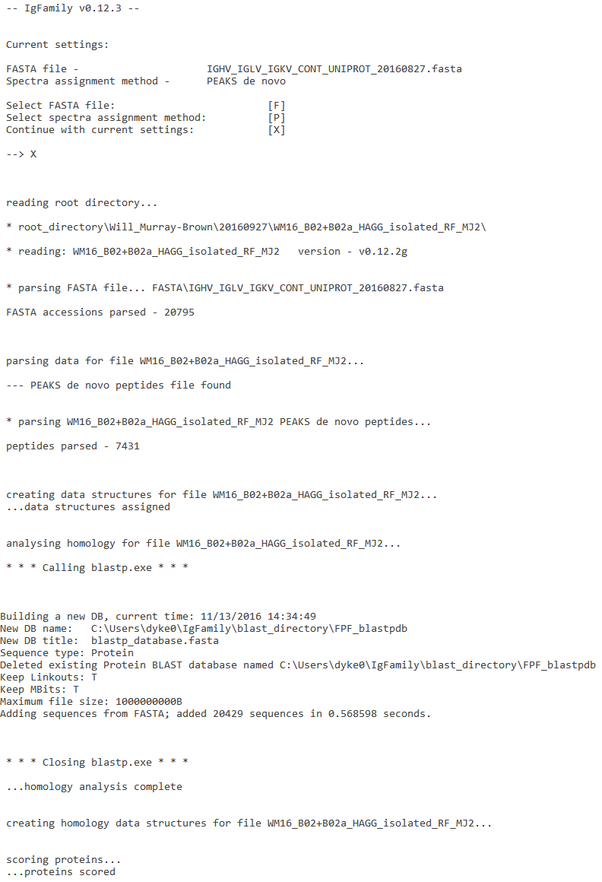

Slide 6
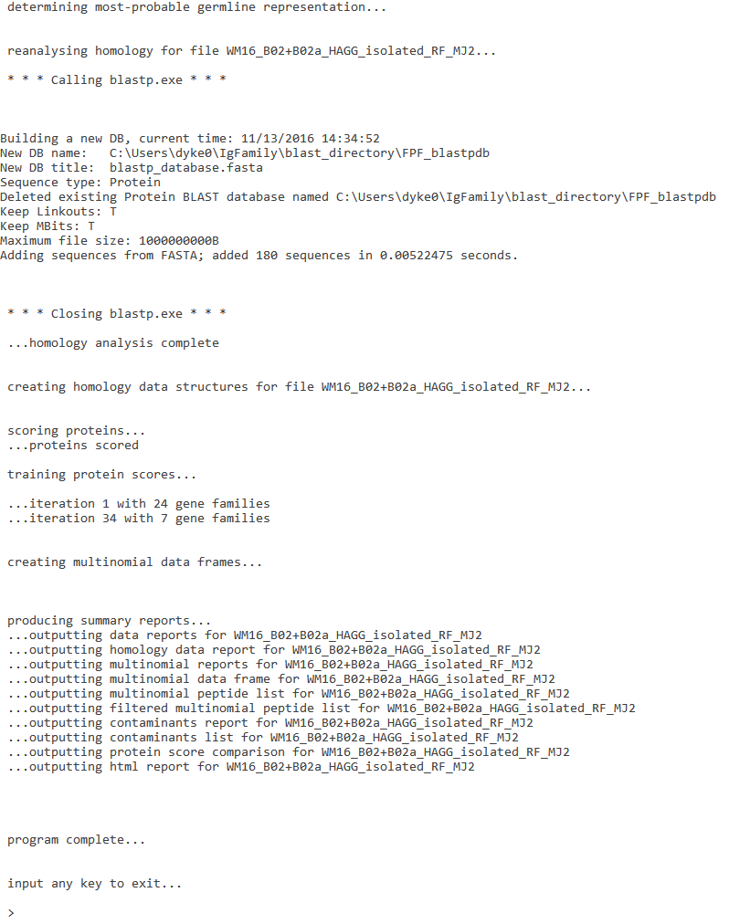

Slide 7
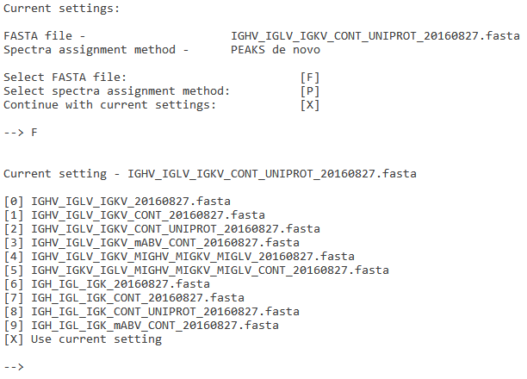

Slide 8
