Slide 1
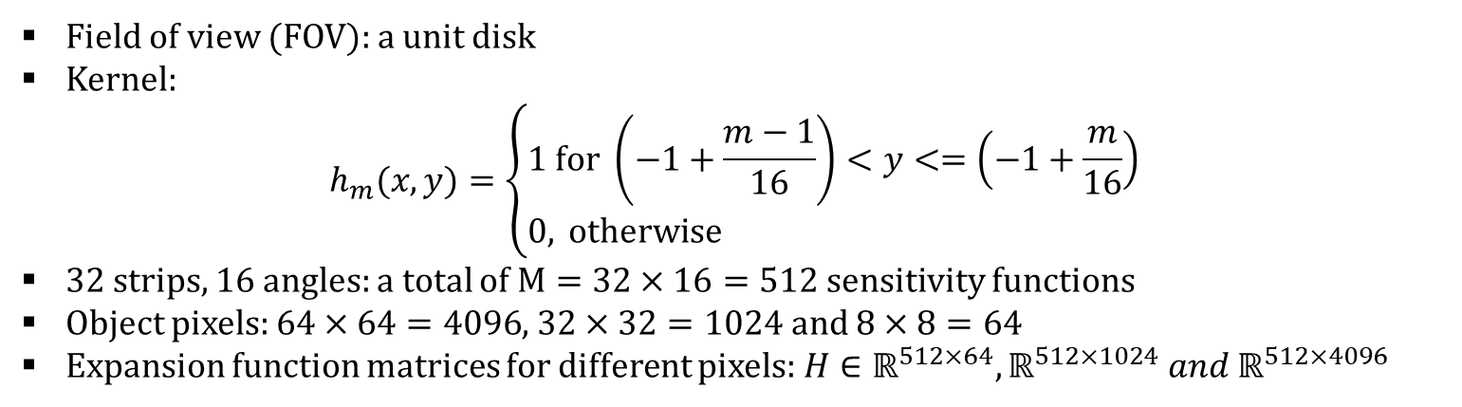
Imaging system: 2D tomographic system
Field of view (FOV): a unit disk
Kernel:
$$h_{m}(x,y)=\left\{\begin{aligned}&1 \text{for} \left(−1+\frac{m−1}{16}\right)<y<=\left(−1+\frac{m}{16}\right) \\ &0, \text{otherwise} \end{aligned}\right.$$
32 strips, 16 angles: a total of $M=32×16=512$ sensitivity functions
Object pixels: $64×64=4096$, $32×32=1024$ and $8×8=64$
Expansion function matrices for different pixels: $H∈ℝ^{512×64},ℝ^{512×1024} and ℝ^{512×4096}$
rotations

Slide 2
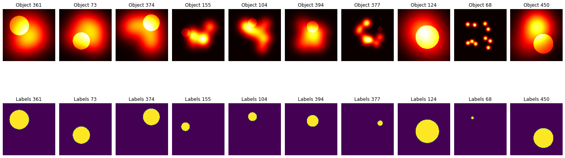
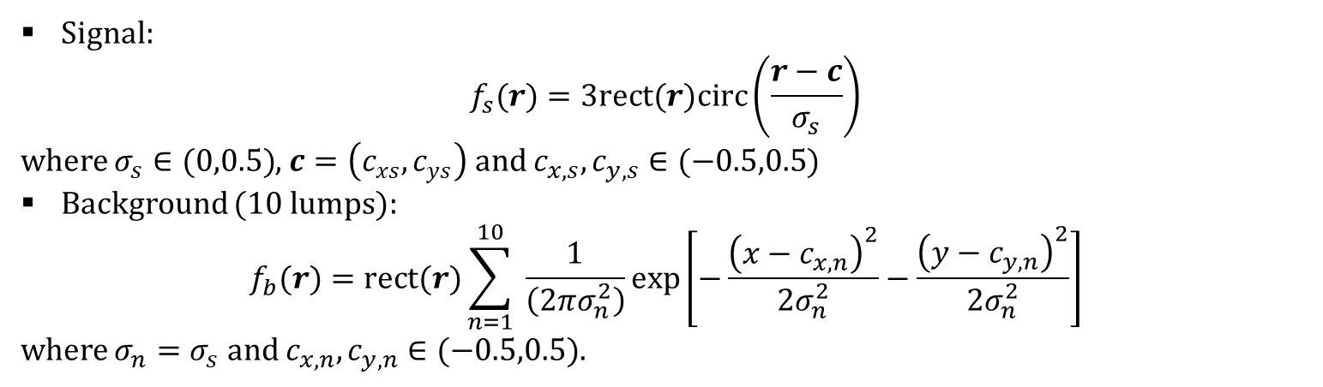
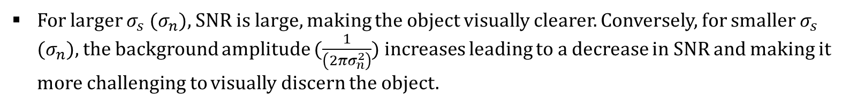
Dataset generation: 500 examples
Signal:
$$f_{s}(r)=3rect(r)circ\left(\frac{r−c}{σ_{s}}\right)$$
where $σ_{s}∈(0,0.5)$, $c=\left(c_{xs},c_{ys}\right)$ and $c_{x,s},c_{y,s}∈(−0.5,0.5)$
Background (10 lumps):
$$f_{b}(r)=rect(r)\sum_{n=1}^{10}{ }\frac{1}{\left(2πσ_{n}^{2}\right)}exp⁡\left[−\frac{{\left(x−c_{x,n}\right)}^{2}}{2σ_{n}^{2}}−\frac{{\left(y−c_{y,n}\right)}^{2}}{2σ_{n}^{2}}\right]$$
where $σ_{n}=σ_{s}$ and $c_{x,n},c_{y,n}∈(−0.5,0.5)$.
For larger $σ_{s}$ ($σ_{n}$), SNR is large, making the object visually clearer. Conversely, for smaller $σ_{s}$ ($σ_{n}$), the background amplitude ($\frac{1}{\left(2πσ_{n}^{2}\right)}$) increases leading to a decrease in SNR and making it more challenging to visually discern the object.
Notes:
code: pba.py

Slide 3
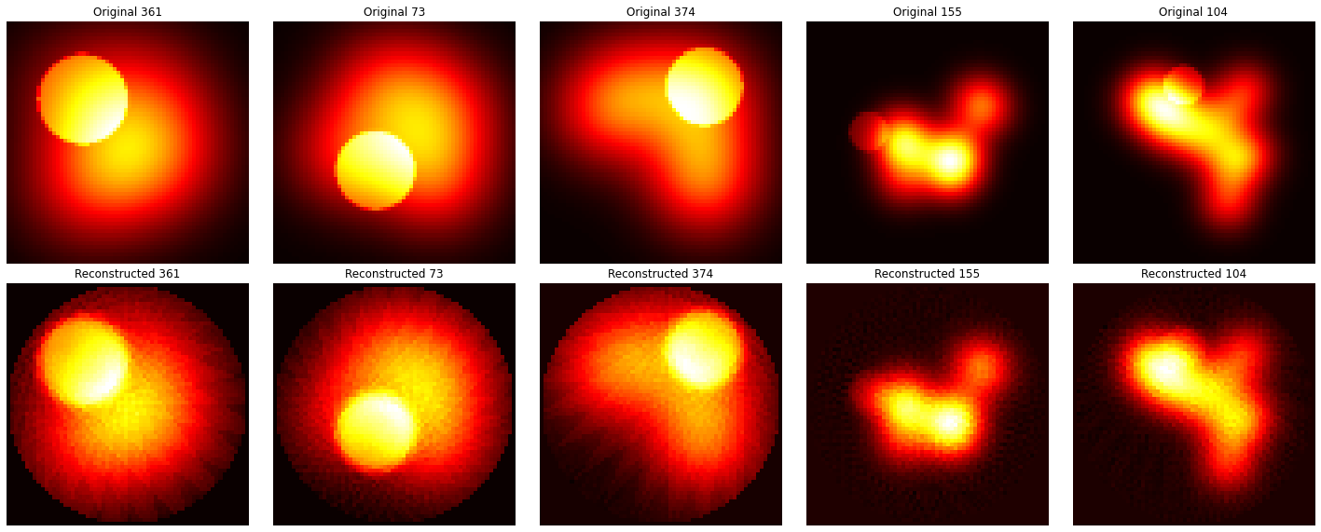
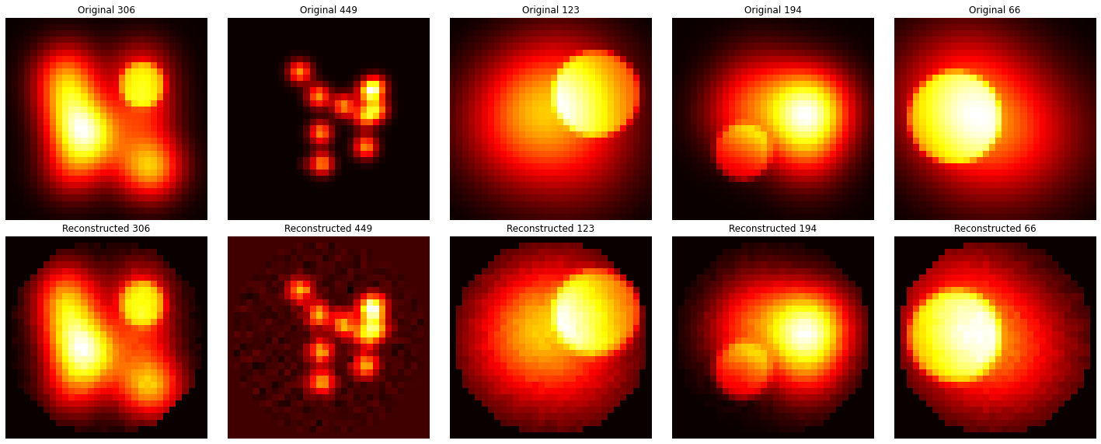
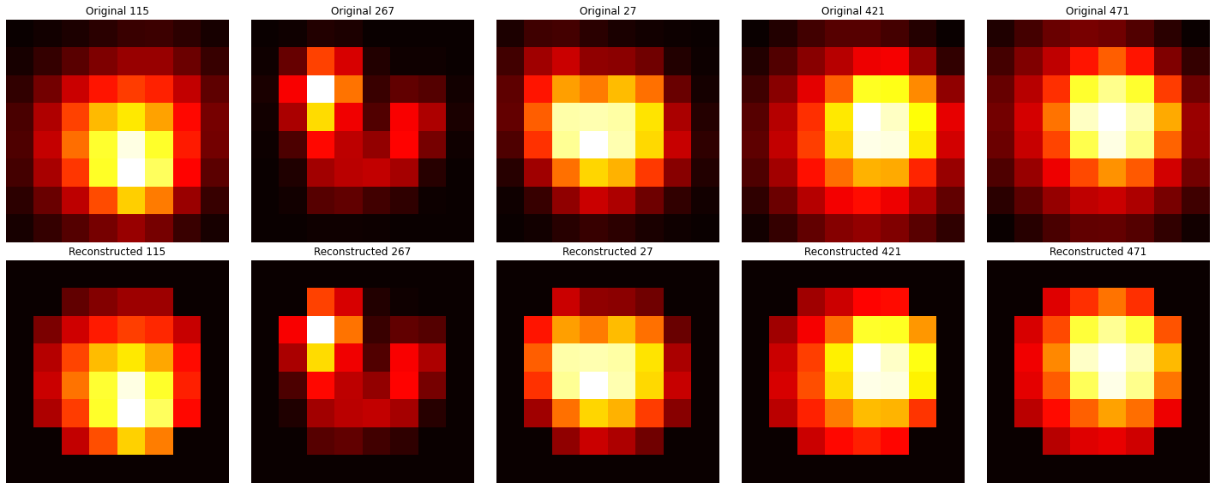

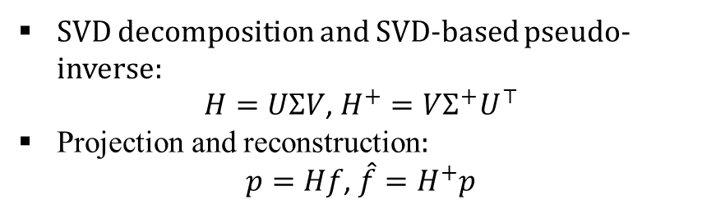


Projection and reconstruction
SVD decomposition and SVD-based pseudo-inverse:
$H=UΣV$, $H^{+}=VΣ^{+}U^{⊤}$
Projection and reconstruction:
$p=Hf$, $\hat{f}=H^{+}p$
$$64×64$$
$$32×32$$
$$8×8$$
Notes:
code: pbb.py

Slide 4
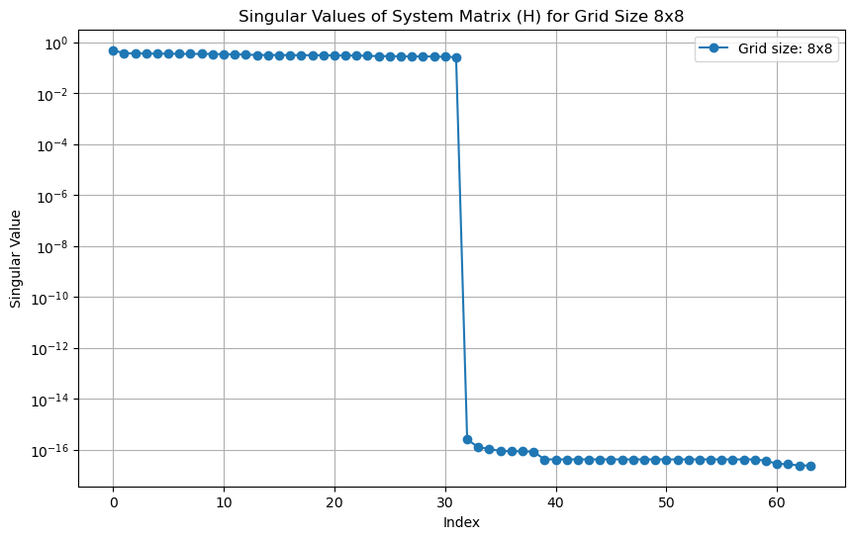
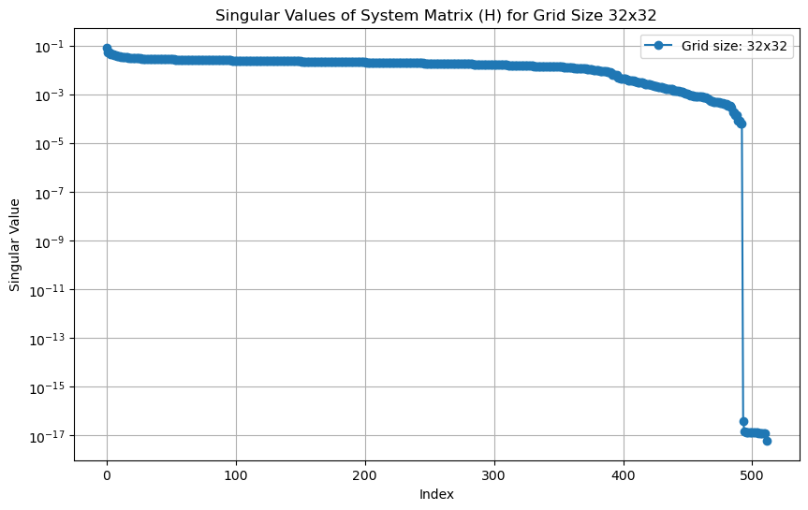
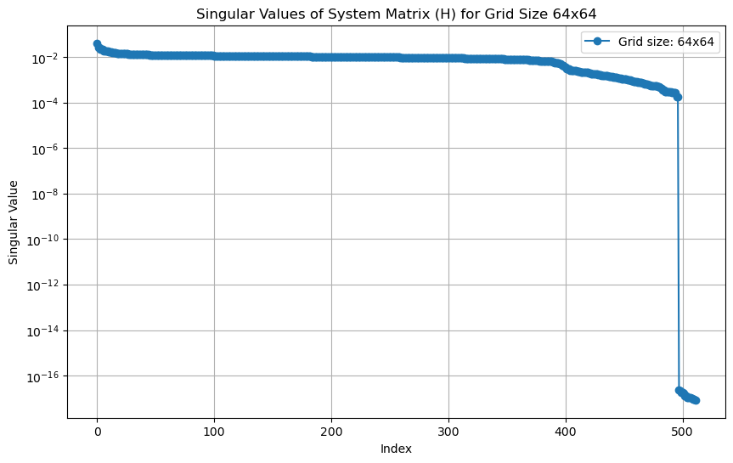
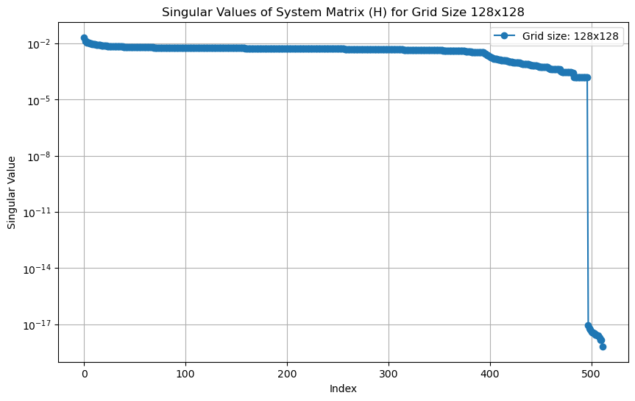
Eigenvalues
Notes:
code: pbb.py

Slide 5
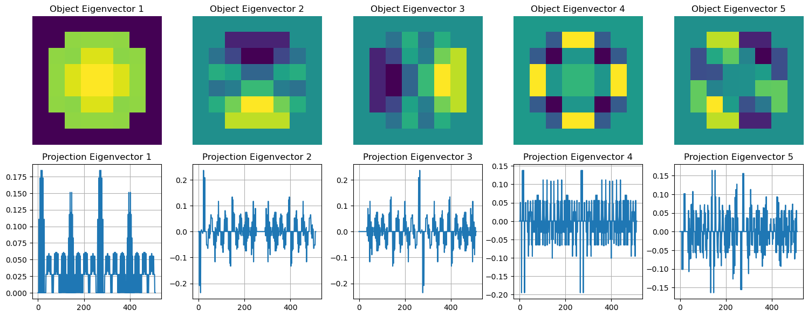
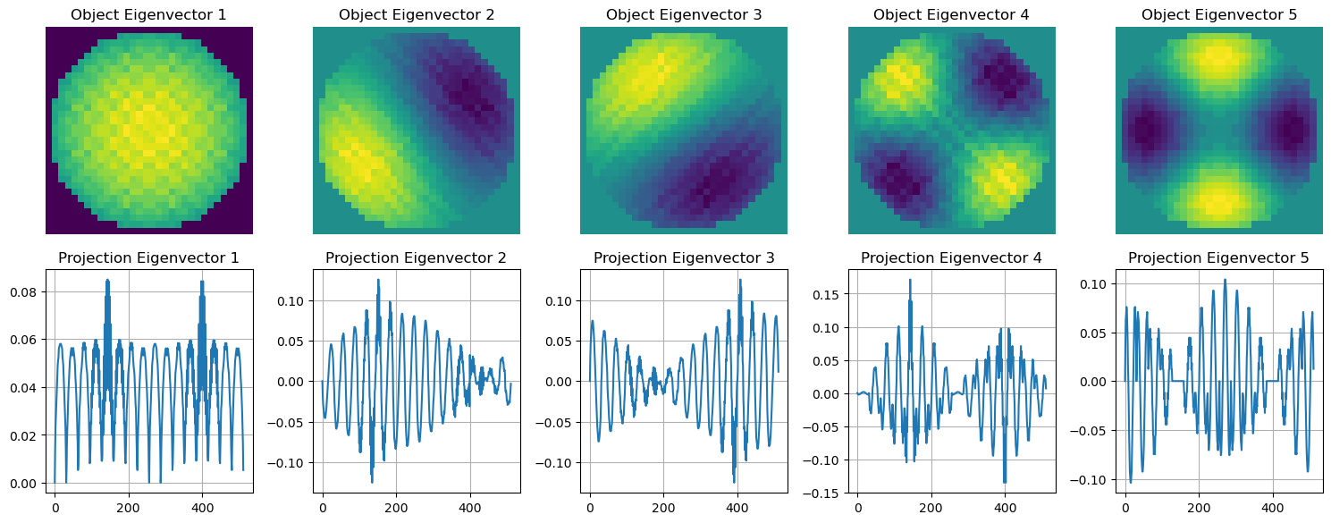
Eigenvectors: $8×8$ and $32×32$
Notes:
code: pbb.py

Slide 6
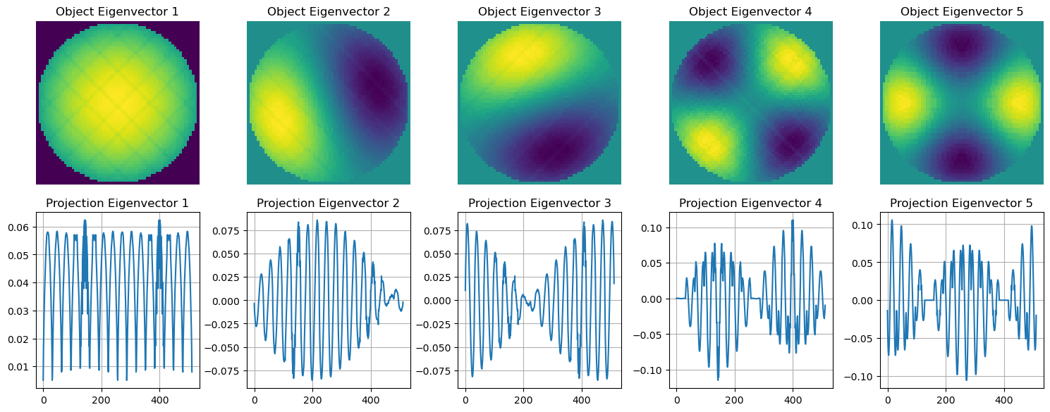
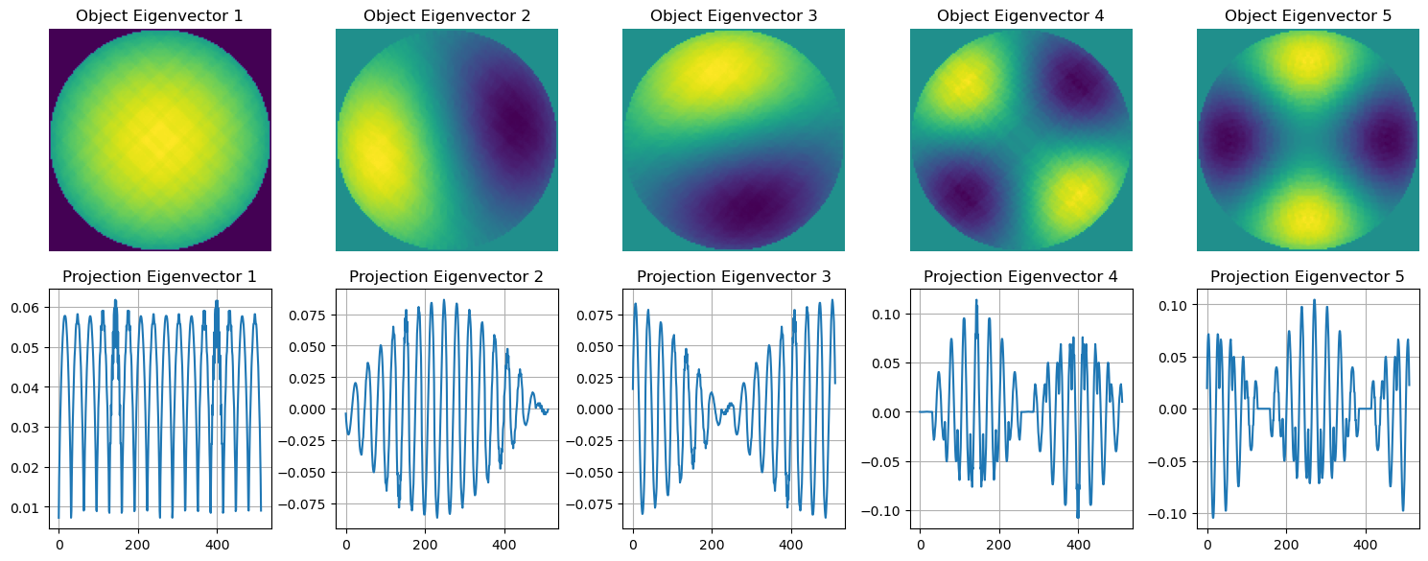
Eigenvectors: $64×64$ and $128×128$
Notes:
code: pbb.py

Slide 7
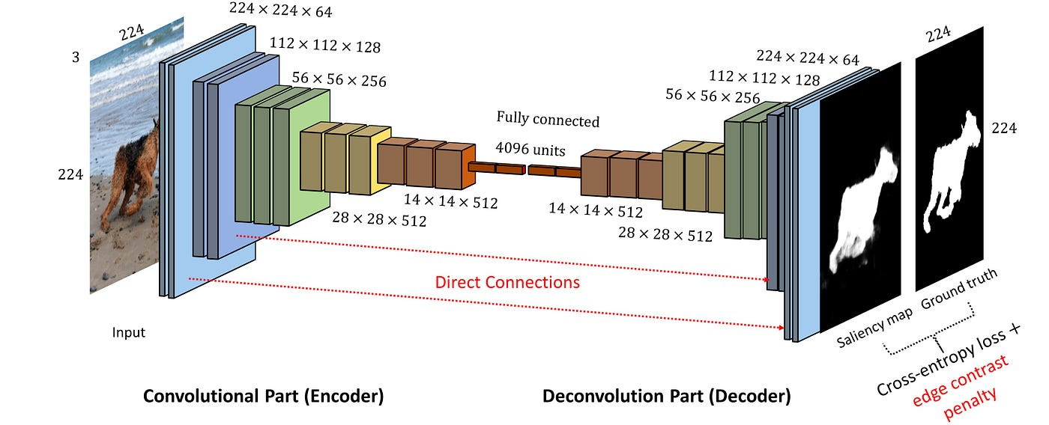
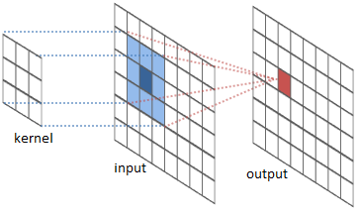
“AI”-based Segmentation using CNNs
Convolution Layer
U-Net Architecture
Convolution layers incorporate information from neighboring pixels
U-Net architecture allows for efficient ”compression” and “decompression” of high dimensional data for computational cost savings
Notes:
https://towardsdatascience.com/beginners-guide-to-understanding-convolutional-neural-networks-ae9ed58bb17d?gi=f4cbd89cadd8
https://medium.com/aimonks/unlocking-the-potential-of-convolutional-autoencoders-a-deep-dive-into-image-processing-and-3d1212bad408

Slide 8
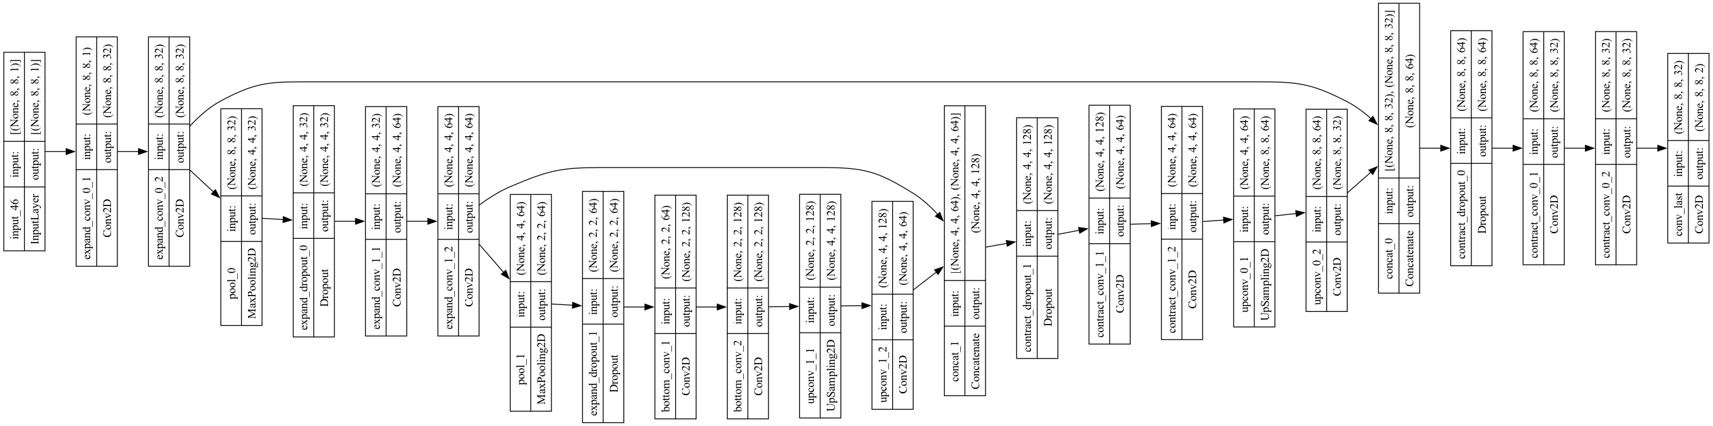
Mini U-net
Smaller model
465986 parameters

Slide 9
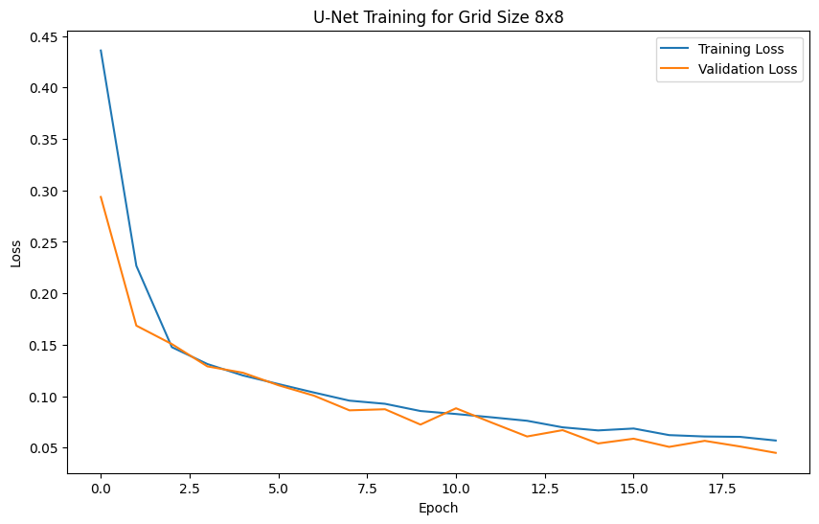
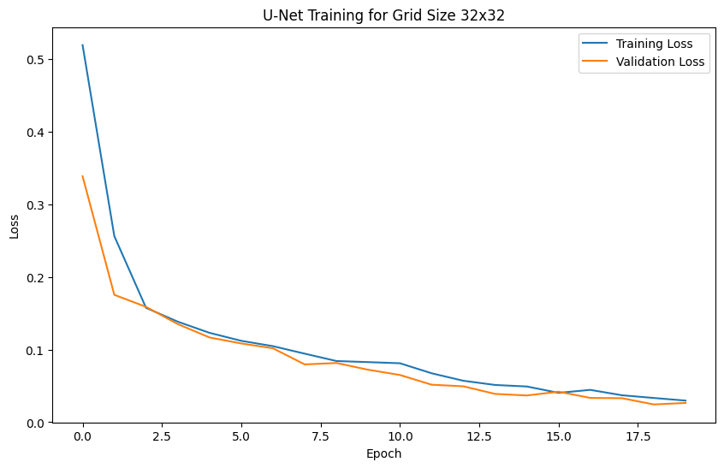
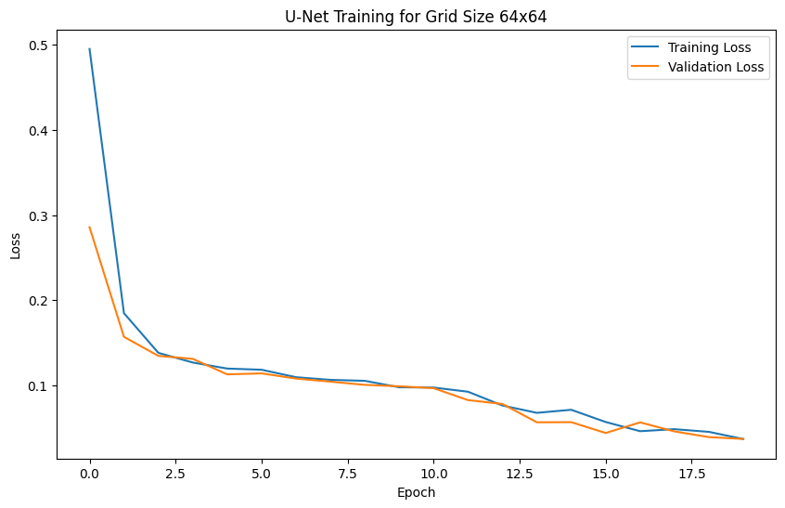
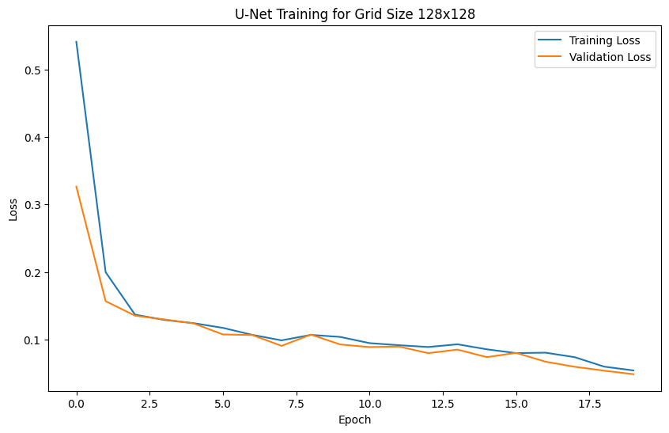
U-net Training
Data from reconstructed object images and labels
100 test, 400 training
Normalize image values between [0, 1]
Mask/labels are either 0 (background) or 1 (signal)
Minimize training loss
Validate with test images
Notes:
https://towardsdatascience.com/beginners-guide-to-understanding-convolutional-neural-networks-ae9ed58bb17d?gi=f4cbd89cadd8
https://medium.com/aimonks/unlocking-the-potential-of-convolutional-autoencoders-a-deep-dive-into-image-processing-and-3d1212bad408

Slide 10
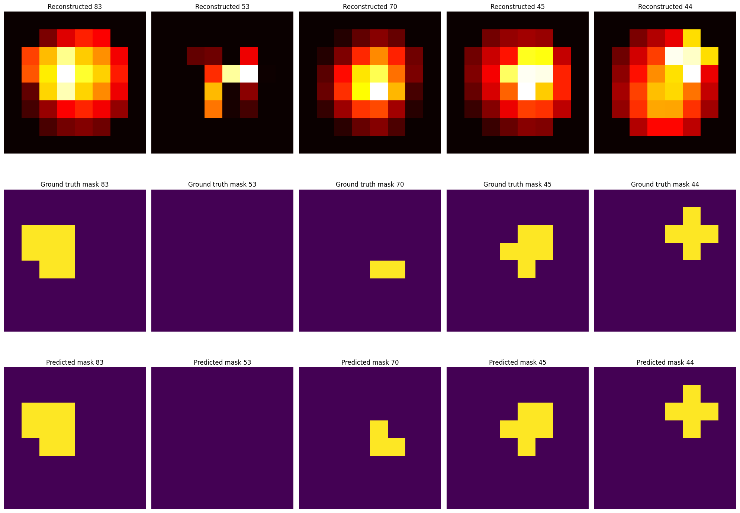
8x8 Segmentation Results

Slide 11
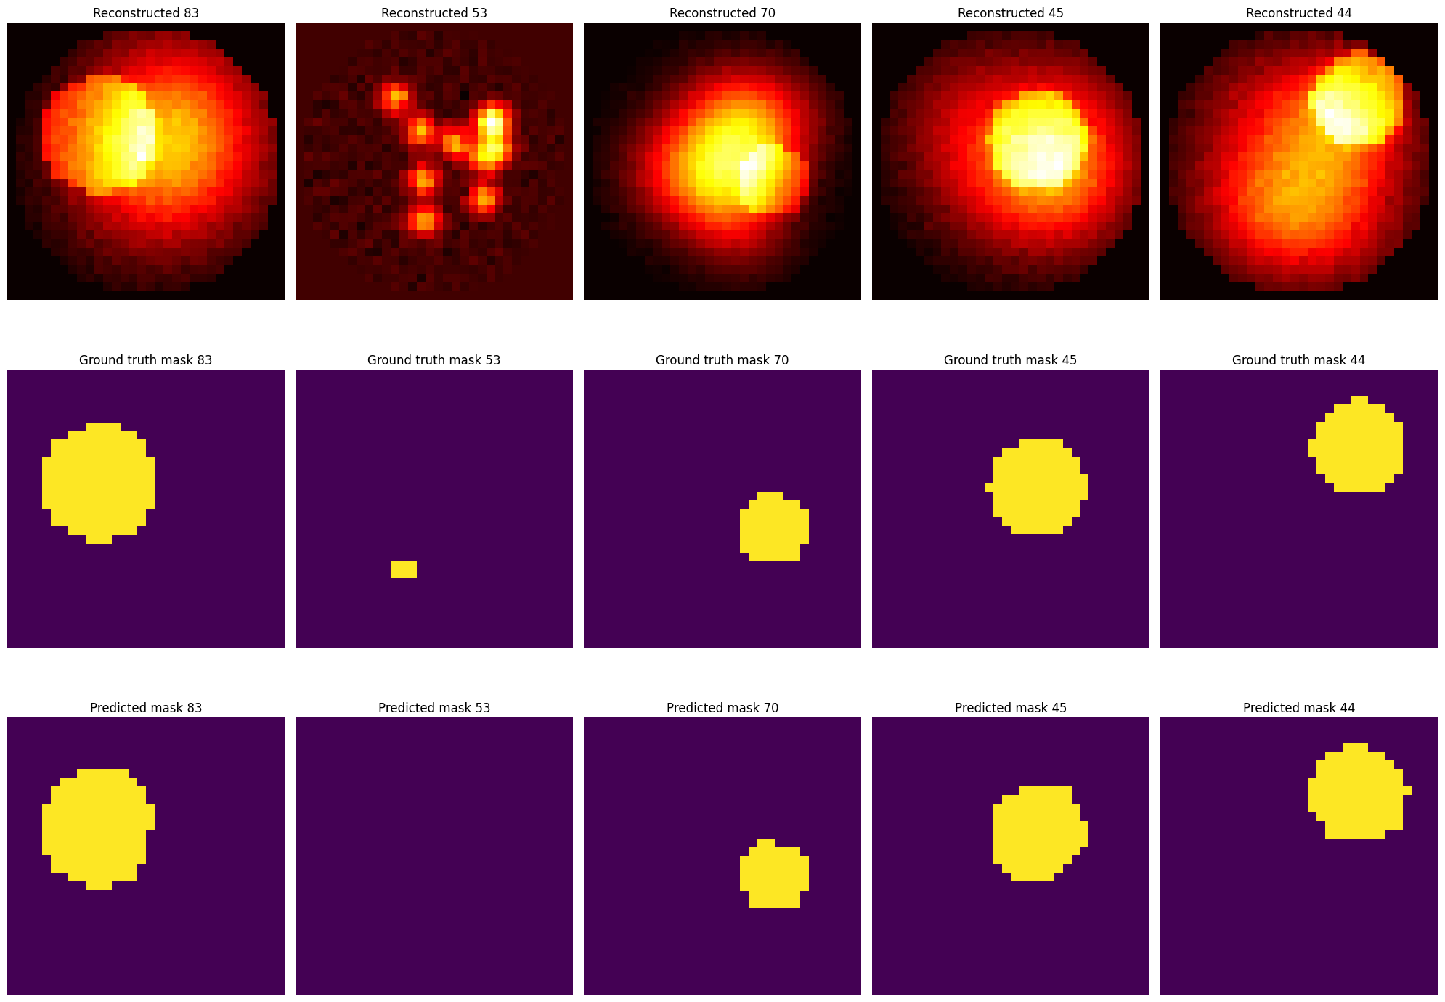
32x32 Segmentation Results

Slide 12
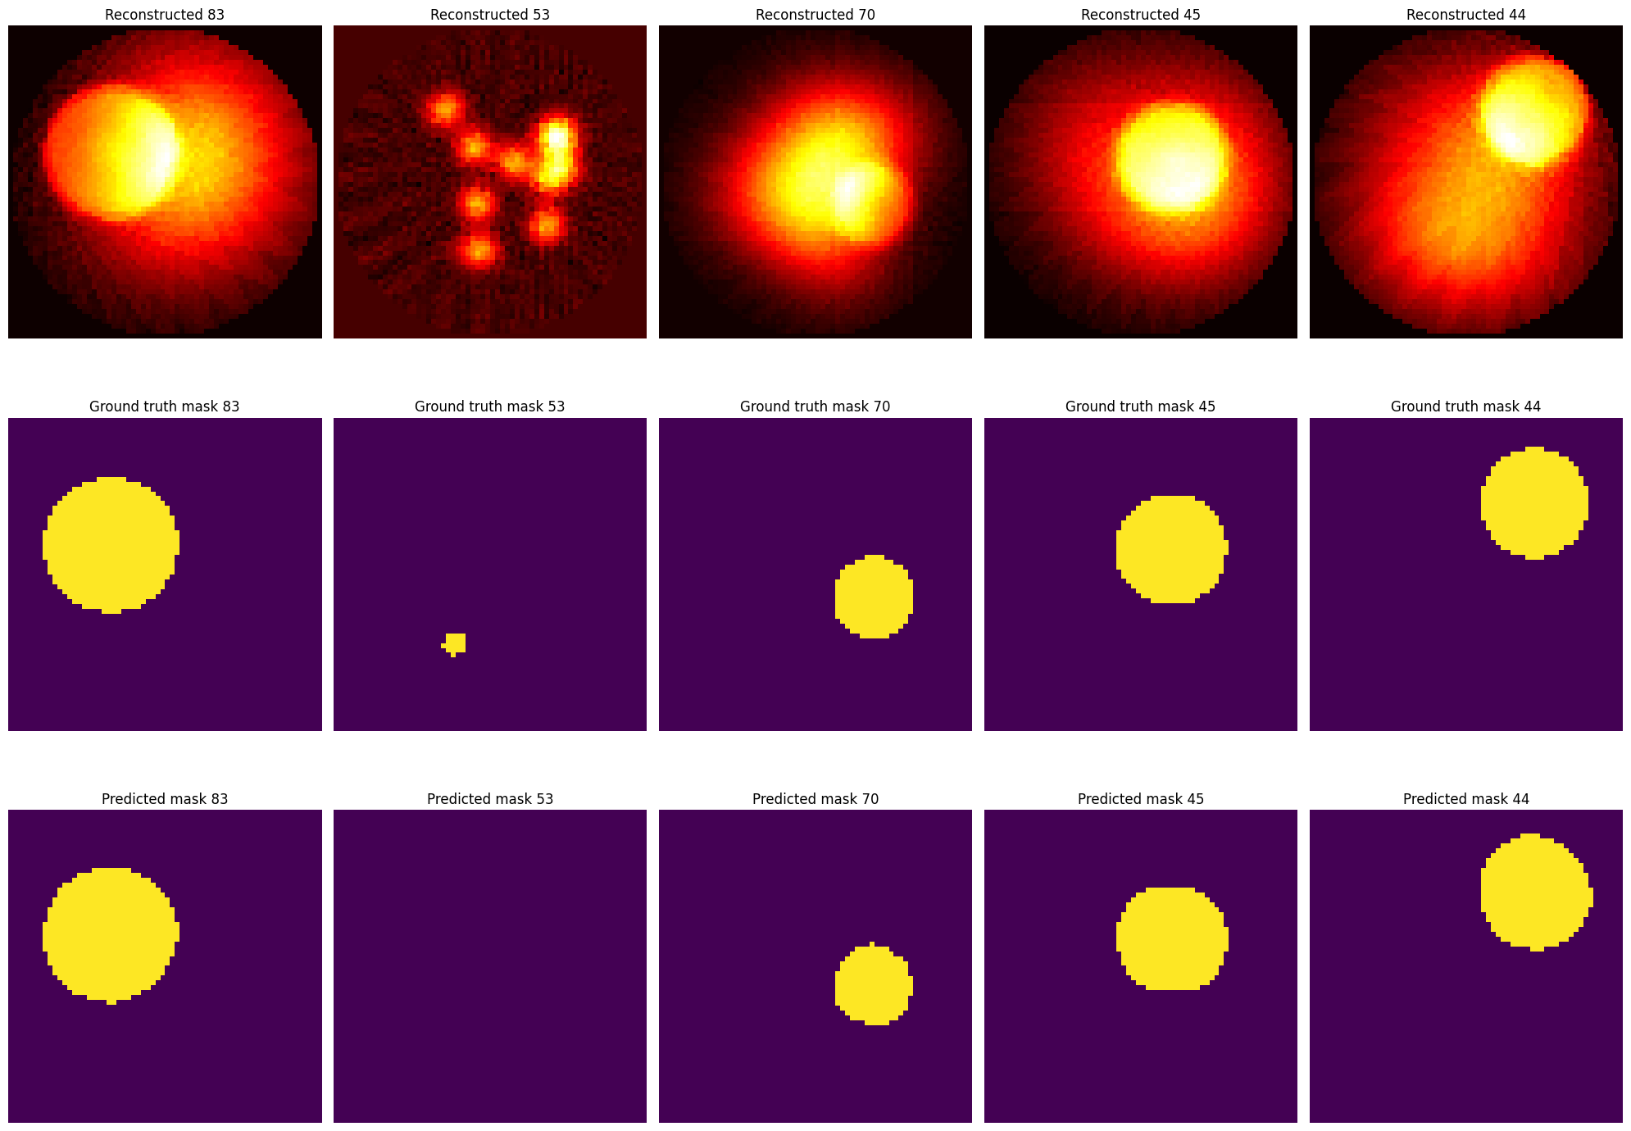
64x64 Segmentation Results

Slide 13
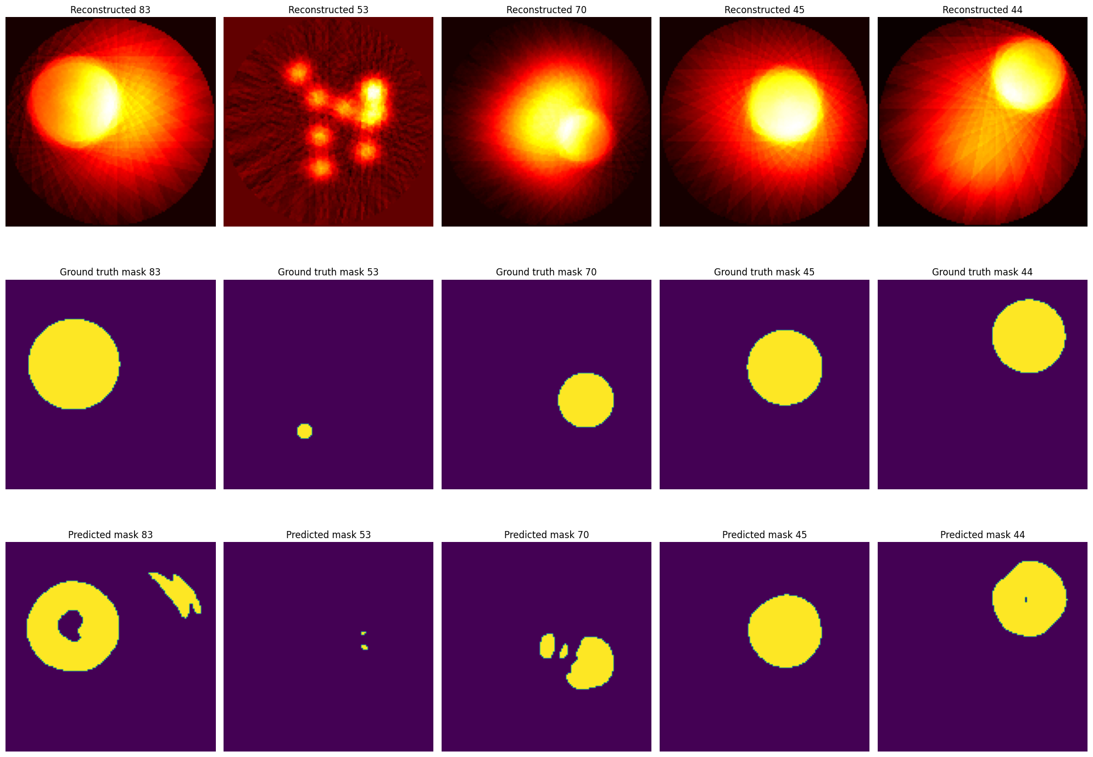
128x128 Segmentation Results

Slide 14
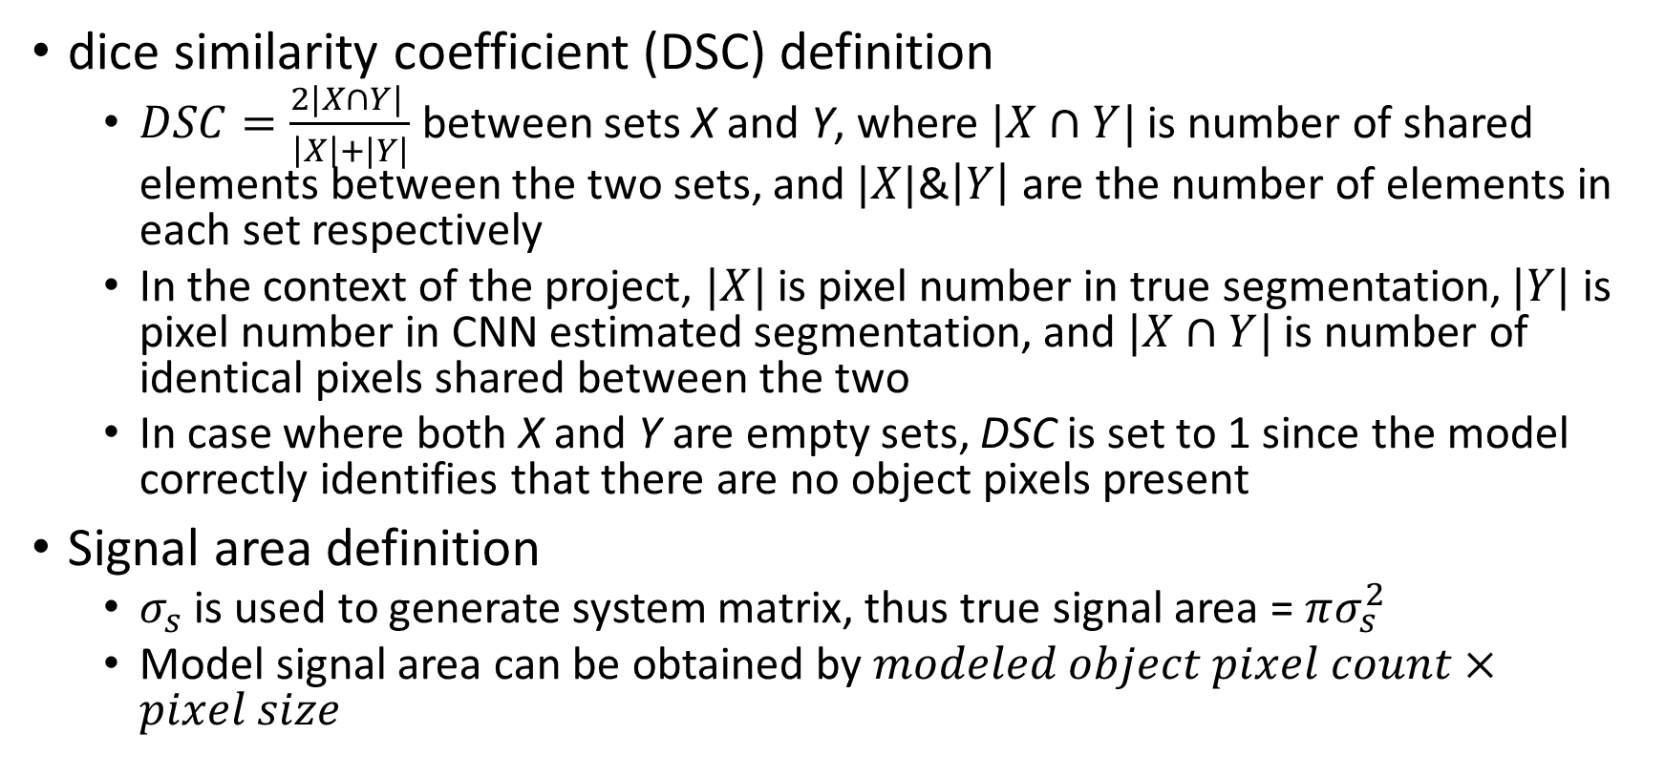
Part D calculations
dice similarity coefficient (DSC) definition
$DSC=\frac{2|X∩Y| }{\left|X\right|+|Y|}$between sets X and Y, where $|X∩Y|$is number of shared elements between the two sets, and $|X|$&$\left|Y\right|$ are the number of elements in each set respectively
In the context of the project, $|X|$ is pixel number in true segmentation, $|Y|$ is pixel number in CNN estimated segmentation, and $|X∩Y|$ is number of identical pixels shared between the two
In case where both X and Y are empty sets, DSC is set to 1 since the model correctly identifies that there are no object pixels present
Signal area definition
$σ_{s}$ is used to generate system matrix, thus true signal area = $πσ_{s}^{2}$
Model signal area can be obtained by $modeled object pixel count×pixel size$

Slide 15
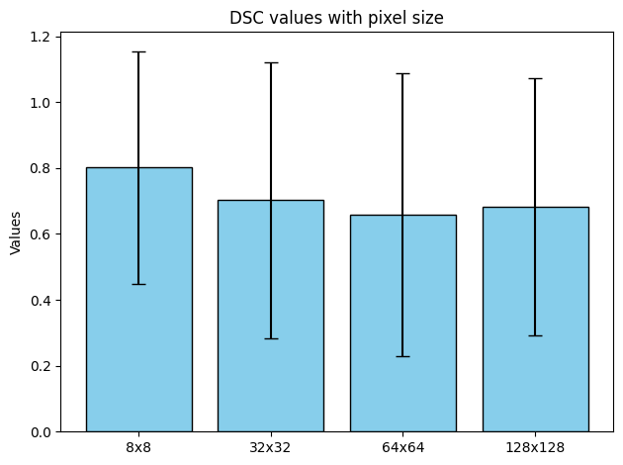
dice similarity coefficient (DSC)
DSC decreases slightly with larger amount of pixels at first
More pixels but same amount of parameters
DSC Increases again with 128x128
Higher fidelity reconstruction

Slide 16
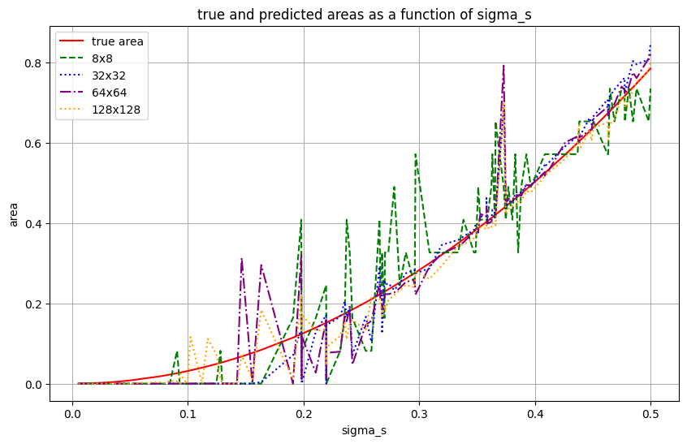
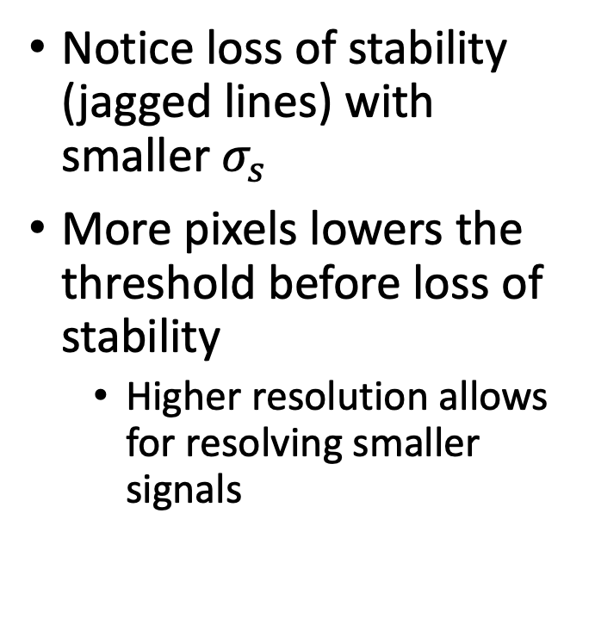

Signal area size as a function of $σ_{s}$
Notice loss of stability (jagged lines) with smaller $σ_{s}$
More pixels lowers the threshold before loss of stability
Higher resolution allows for resolving smaller signals

Slide 17
Conclusion
#Pixels↑ Pixel Size↓ Reconstruction quality↑
Index↑ Eigenvalue↓ Eigenvector oscillations↑
#Pixels↑ #Non-null eigenvalues↑
#Pixels↓↓ Convolution breadth↓ Segment accuracy↑
#Pixels↑↑ Reconstruction quality↑ Segment accuracy↑
#Pixels↓ Reconstruction quality↓ Min size of resolvable signal↑

