Slide 1
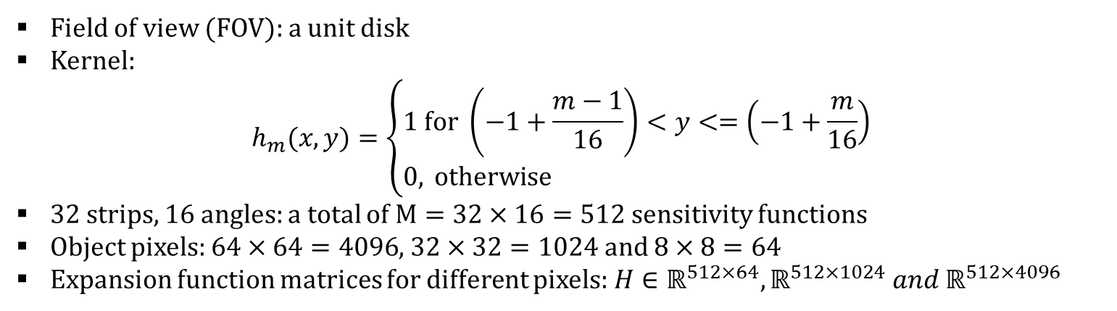
Imaging system: 2D tomographic system
Field of view (FOV): a unit disk
Kernel:
$$h_{m}(x,y)=\left\{\begin{aligned}&1 \text{for} \left(−1+\frac{m−1}{16}\right)<y<=\left(−1+\frac{m}{16}\right) \\ &0, \text{otherwise} \end{aligned}\right.$$
32 strips, 16 angles: a total of $M=32×16=512$ sensitivity functions
Object pixels: $64×64=4096$, $32×32=1024$ and $8×8=64$
Expansion function matrices for different pixels: $H∈ℝ^{512×64},ℝ^{512×1024} and ℝ^{512×4096}$
rotations

Slide 2
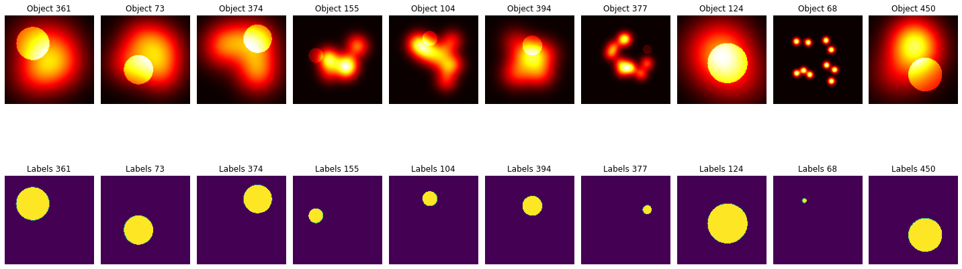
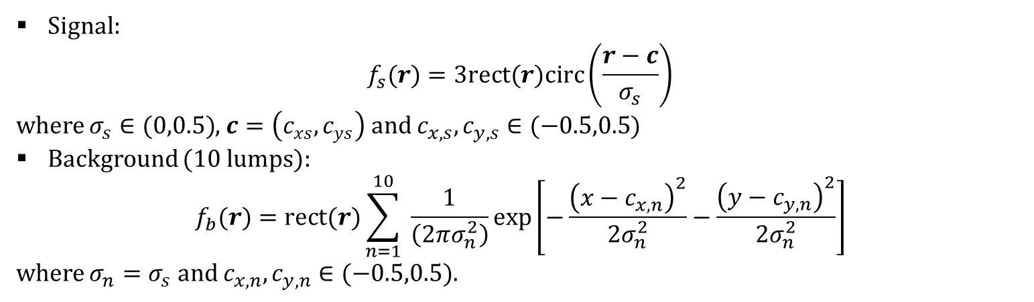
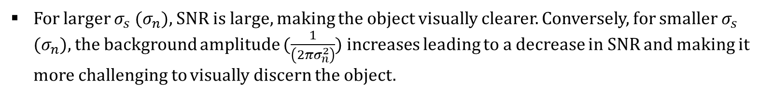
Dataset generation: 500 examples
Signal:
$$f_{s}(r)=3rect(r)circ\left(\frac{r−c}{σ_{s}}\right)$$
where $σ_{s}∈(0,0.5)$, $c=\left(c_{xs},c_{ys}\right)$ and $c_{x,s},c_{y,s}∈(−0.5,0.5)$
Background (10 lumps):
$$f_{b}(r)=rect(r)\sum_{n=1}^{10}{ }\frac{1}{\left(2πσ_{n}^{2}\right)}exp⁡\left[−\frac{{\left(x−c_{x,n}\right)}^{2}}{2σ_{n}^{2}}−\frac{{\left(y−c_{y,n}\right)}^{2}}{2σ_{n}^{2}}\right]$$
where $σ_{n}=σ_{s}$ and $c_{x,n},c_{y,n}∈(−0.5,0.5)$.
For larger $σ_{s}$ ($σ_{n}$), SNR is large, making the object visually clearer. Conversely, for smaller $σ_{s}$ ($σ_{n}$), the background amplitude ($\frac{1}{\left(2πσ_{n}^{2}\right)}$) increases leading to a decrease in SNR and making it more challenging to visually discern the object.
Notes:
code: pba.py

Slide 3
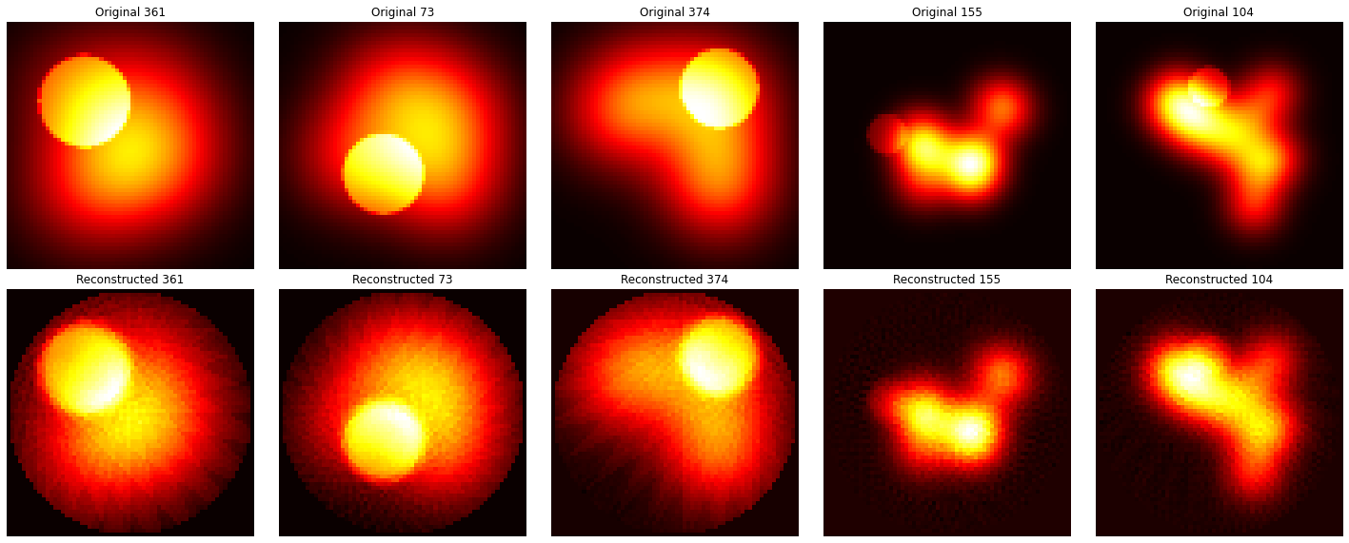
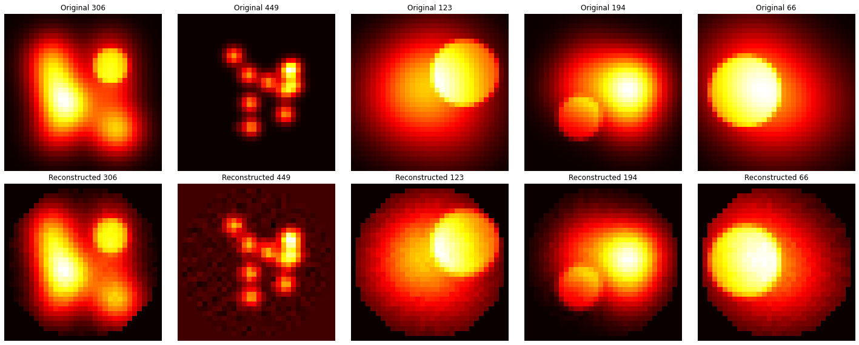
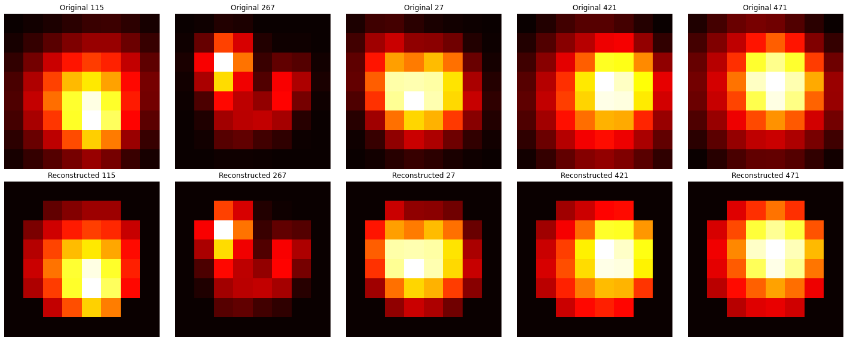

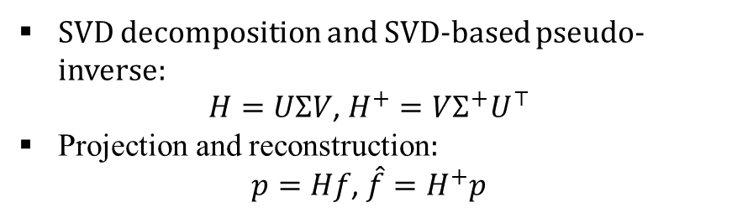


Projection and reconstruction
SVD decomposition and SVD-based pseudo-inverse:
$H=UΣV$, $H^{+}=VΣ^{+}U^{⊤}$
Projection and reconstruction:
$p=Hf$, $\hat{f}=H^{+}p$
$$64×64$$
$$32×32$$
$$8×8$$
Notes:
code: pbb.py

Slide 4
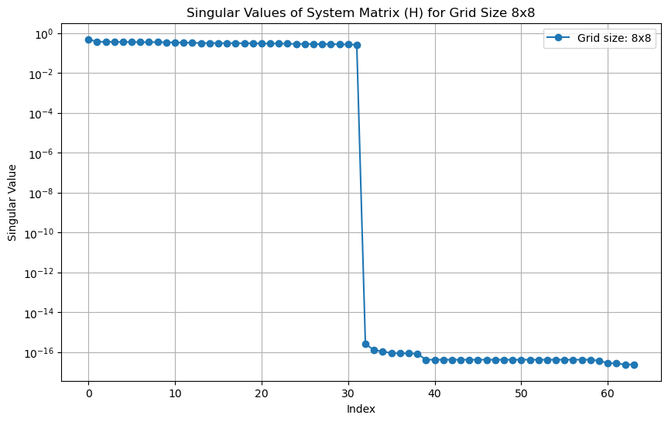
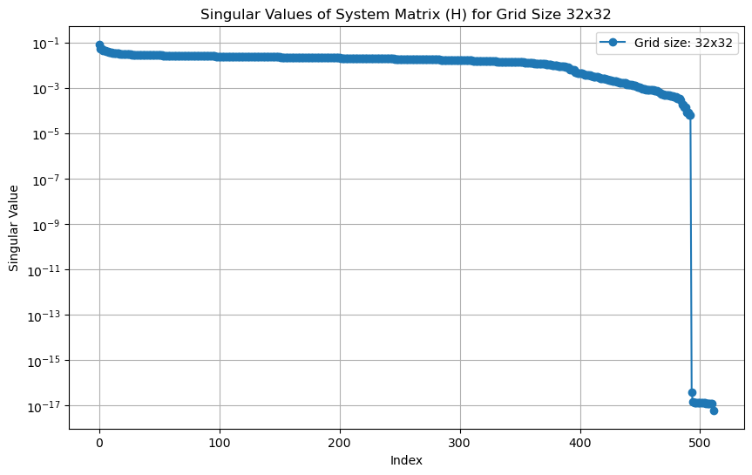
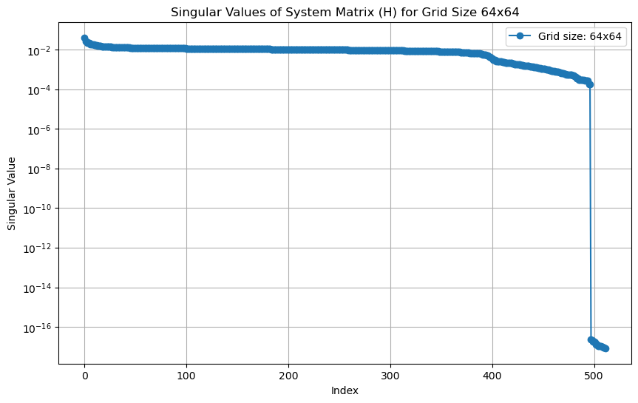
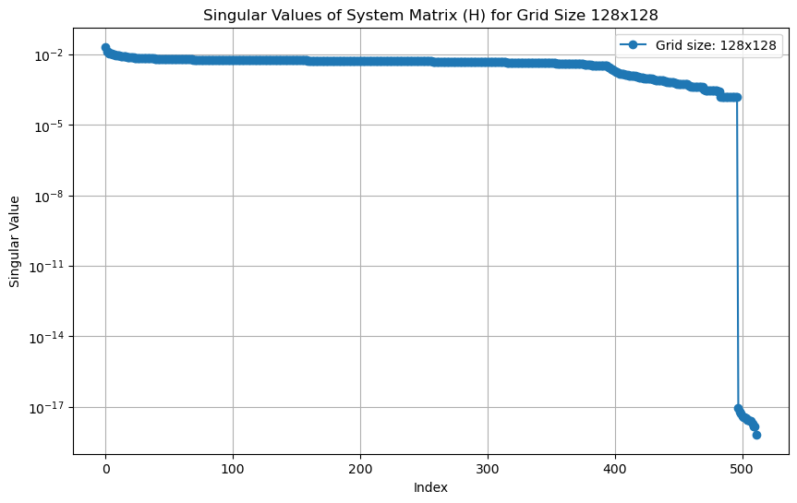
Eigenvalues
Notes:
code: pbb.py

Slide 5
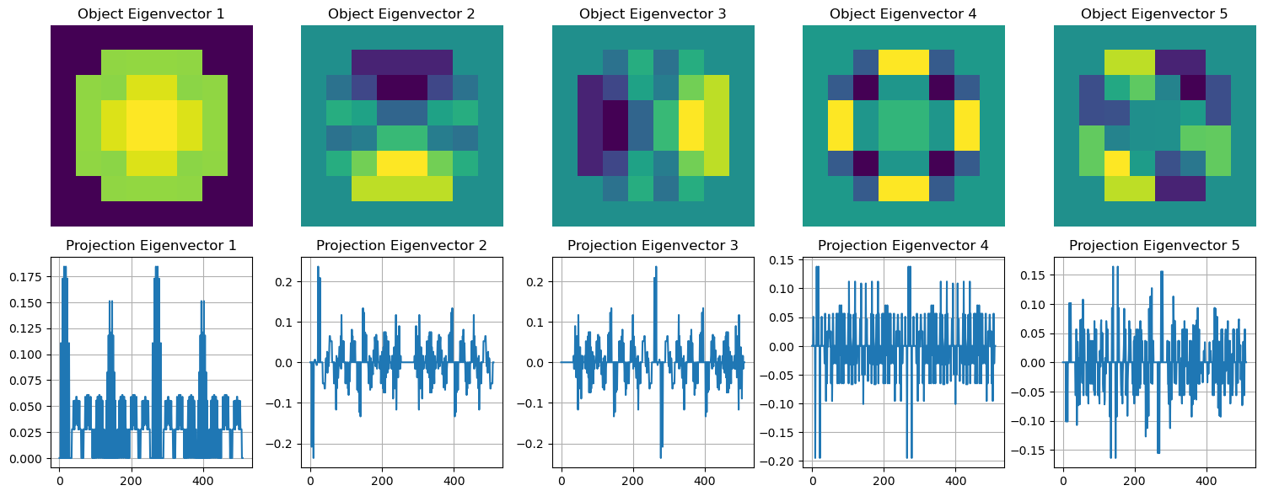
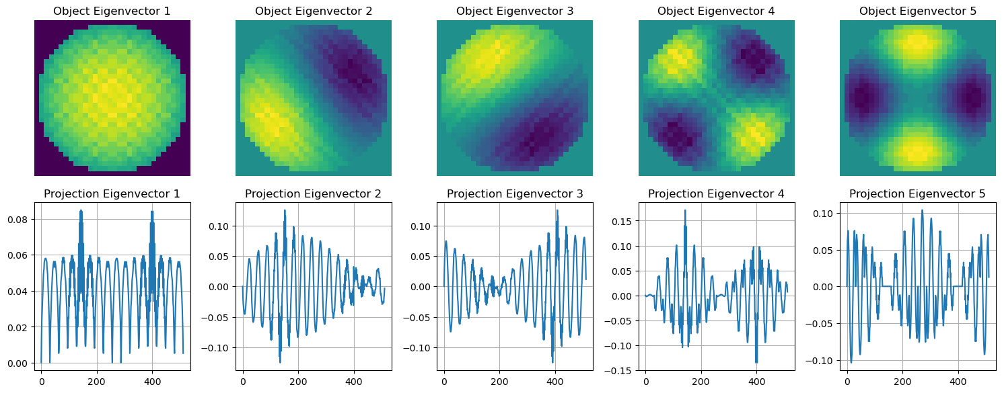
Eigenvectors: $8×8$ and $32×32$
Notes:
code: pbb.py

Slide 6
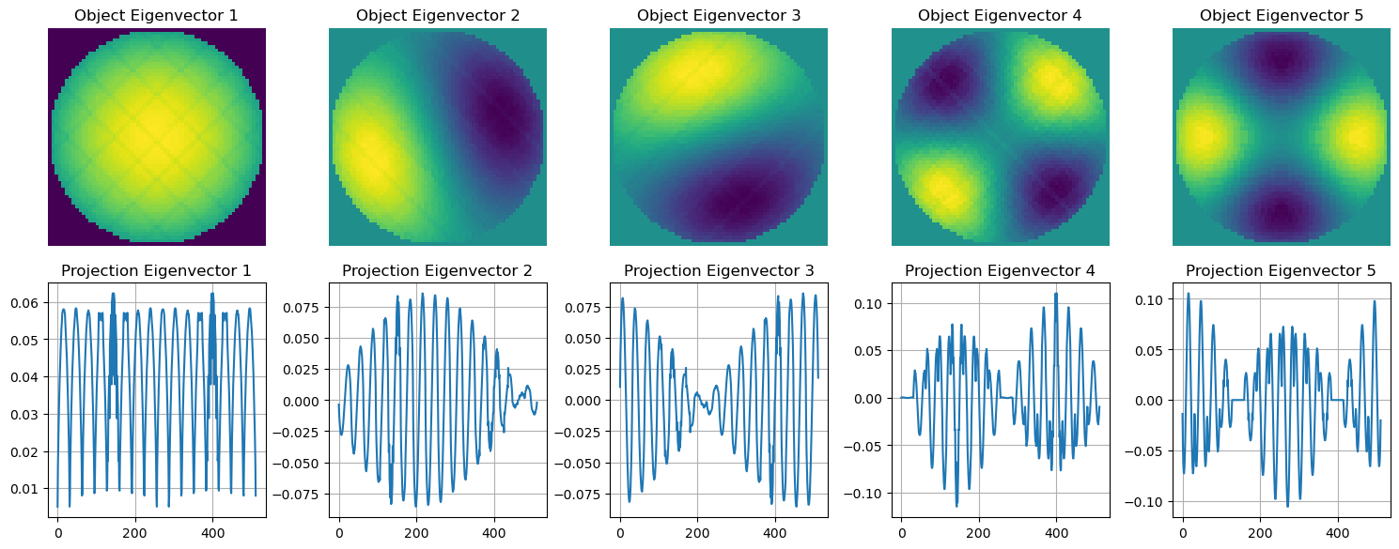
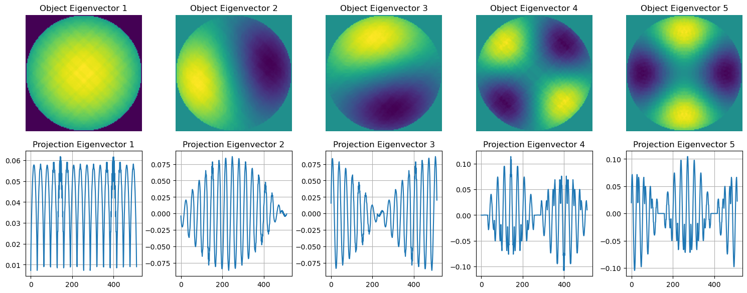
Eigenvectors: $64×64$ and $128×128$
Notes:
code: pbb.py

Slide 7
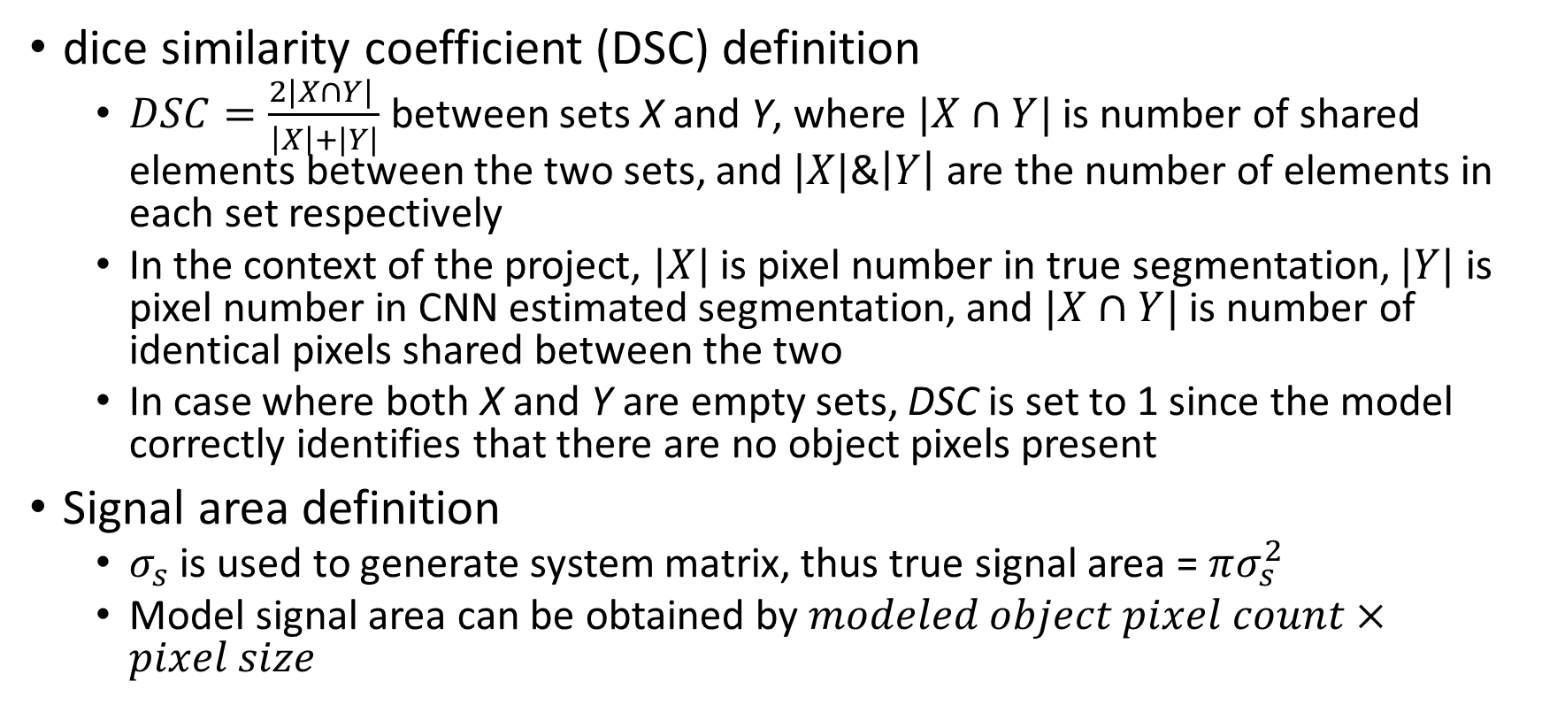
Part D calculations
dice similarity coefficient (DSC) definition
$DSC=\frac{2|X∩Y| }{\left|X\right|+|Y|}$between sets X and Y, where $|X∩Y|$is number of shared elements between the two sets, and $|X|$&$\left|Y\right|$ are the number of elements in each set respectively
In the context of the project, $|X|$ is pixel number in true segmentation, $|Y|$ is pixel number in CNN estimated segmentation, and $|X∩Y|$ is number of identical pixels shared between the two
In case where both X and Y are empty sets, DSC is set to 1 since the model correctly identifies that there are no object pixels present
Signal area definition
$σ_{s}$ is used to generate system matrix, thus true signal area = $πσ_{s}^{2}$
Model signal area can be obtained by $modeled object pixel count×pixel size$

Slide 8
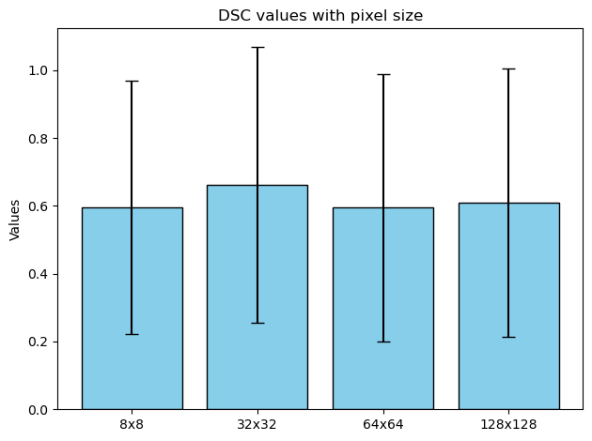
dice similarity coefficient (DSC)

Slide 9
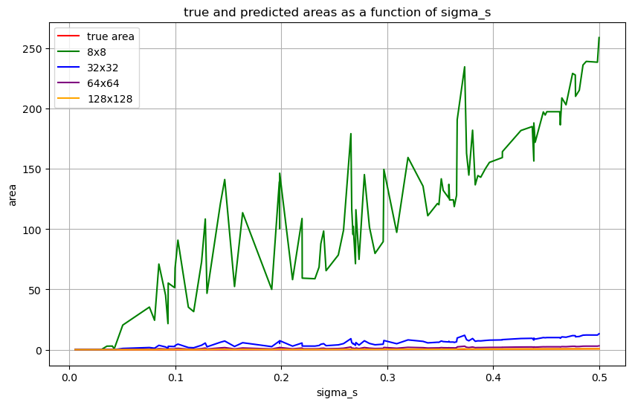

Signal area size as a function of $σ_{s}$

