Slide 1

Introductory Applied Machine Learning
Adaptive Linear Neuron (Adaline)

Slide 2
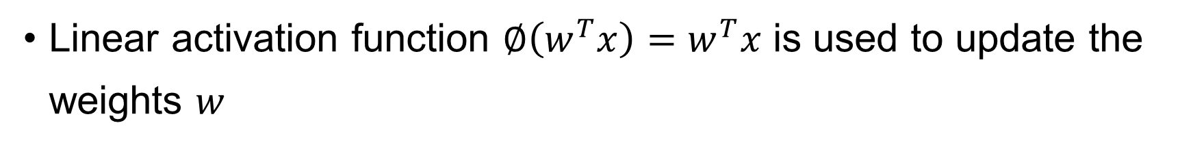
Adaptive Linear Neuron
Linear activation function $∅\left(w^{T}x\right)=w^{T}x$ is used to update the weights $w$

Slide 3
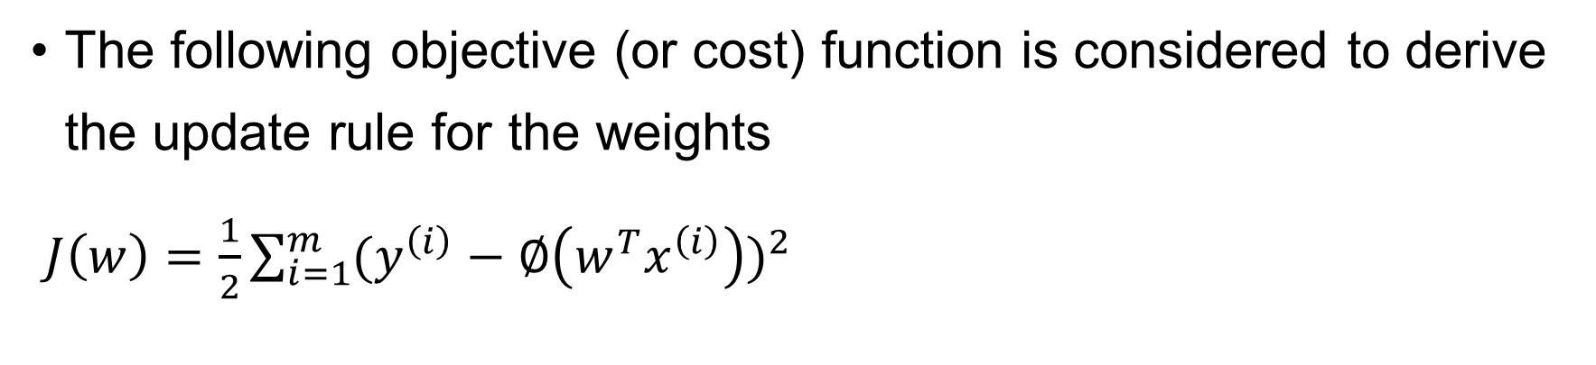
Objective function
The following objective (or cost) function is considered to derive the update rule for the weights
$J\left(w\right)=\frac{1}{2}\sum_{i=1}^{m}{{(y^{\left(i\right)}−∅\left(w^{T}x^{\left(i\right)}\right))}^{2}}$

Slide 4

Gradient descent method
Gradient of a function with vector input
ex) $f\left(x\right)=2x_{1}^{2}+x_{2}^{2}$
ex) $f\left(x\right)=3x_{1}^{2}−4x_{1}x_{2}^{2}$

Slide 5
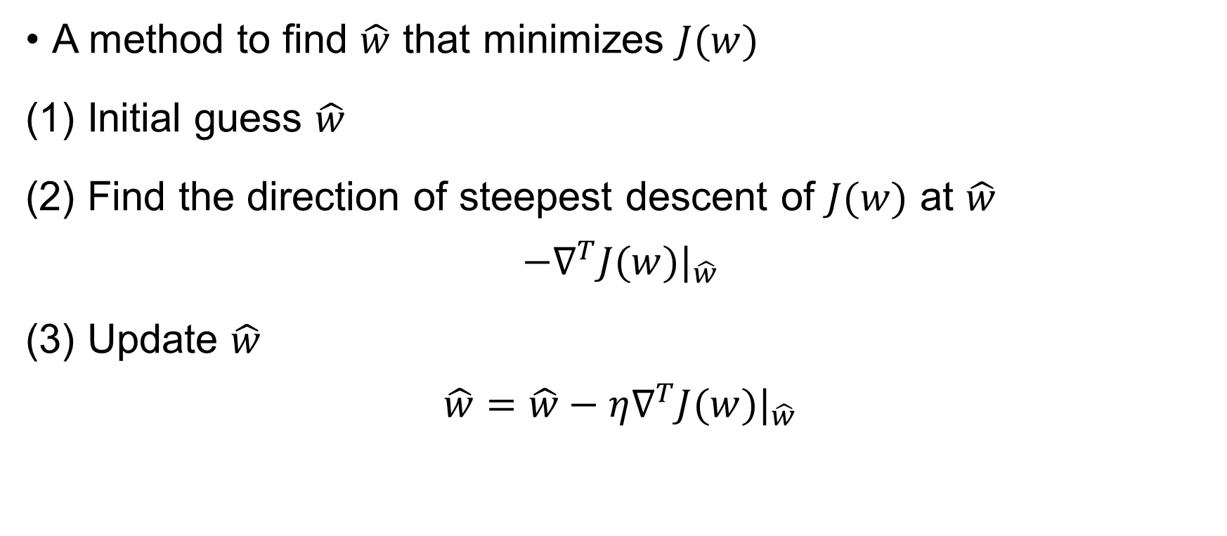
Gradient descent method
A method to find $\hat{w}$ that minimizes $J(w)$
(1) Initial guess $\hat{w}$
(2) Find the direction of steepest descent of $J(w)$ at $\hat{w}$
$$−∇^{T}J(w)|_{\hat{w}}$$
(3) Update $\hat{w}$
$$\hat{w}=\hat{w}−η∇^{T}J(w)|_{\hat{w}}$$

Slide 6

Gradient descent method
Let’s find the gradient of $J\left(w\right)=\frac{1}{2}\sum_{i=1}^{m}{{(y^{\left(i\right)}−∅\left(w^{T}x^{\left(i\right)}\right))}^{2}}$
$$∇J\left(w\right)=\left[\begin{matrix}\frac{∂J}{∂w_{1}} & \frac{∂J}{∂w_{2}}\end{matrix} \begin{matrix}⋯ & \frac{∂J}{∂w_{n}}\end{matrix}\right]$$

Slide 7
Gradient descent method

Slide 8

Batch gradient descent
The update rule for the weights is
$$w_{j}=w_{j}+η\sum_{i}{(y^{\left(i\right)}−∅\left(w^{T}x^{\left(i\right)}\right))x_{j}^{(i)} }$$

Slide 9
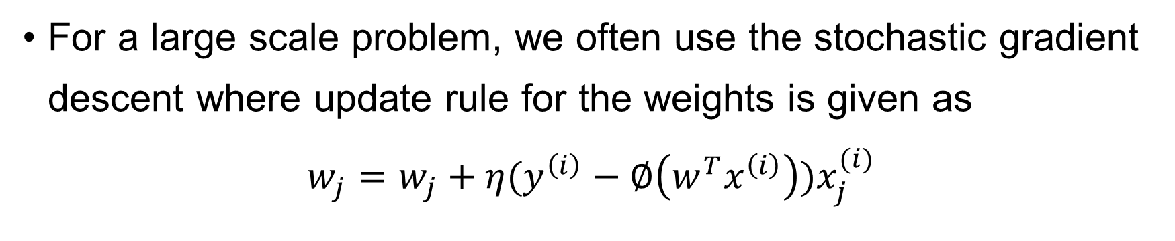
Stochastic gradient descent
For a large scale problem, we often use the stochastic gradient descent where update rule for the weights is given as
$$w_{j}=w_{j}+η(y^{\left(i\right)}−∅\left(w^{T}x^{\left(i\right)}\right))x_{j}^{(i)}$$

