Slide 1
Logo
Username
password
→

Slide 2
Logo
Patient name
Patient ID
search

Slide 3
Logo
Patient name
ID1
ID2
Date of insemination
Schqsbchcb jskjsax asjsab 1920/09/22
view

Slide 4
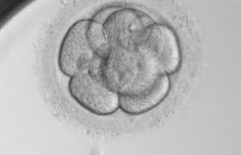
Logo
One or multiple videos playing
of the embryos tagged as
transferred
Patient name
ID1
ID2
Date of insemination

