Slide 1
Tutorial Machine Learning in Solid Mechanics – Task 2
Alexander Pahl & Lukas Fromme

Slide 2
Agenda
1
Dataset 1
3
Dataset 3
Dataset 1 - Models
Dataset 3 - Models
1.1
3.1
1.2
Dataset 1 - Evaluation
3.2
Dataset 3 - Evaluation
1.3
Dataset 1 - Training Set Variation
3.3
Dataset 3 - Data Augmentation
2
Dataset 2
4
Conclusion & Limitations

Slide 3
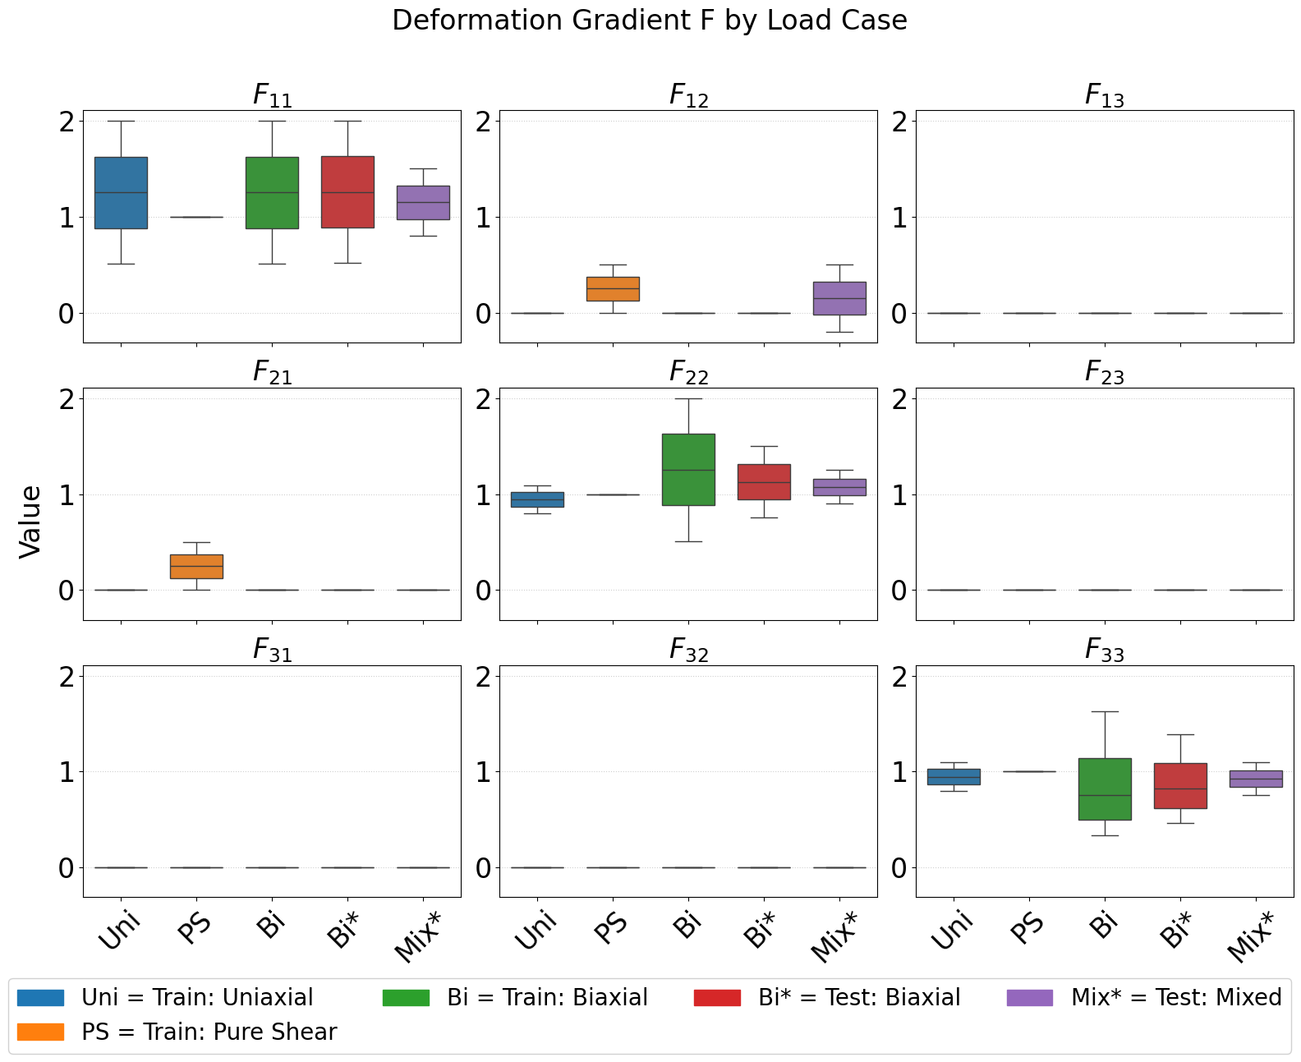
Dataset 1 – Introduction
Transverse Isotropic Material:
Training: Uniaxial, Pure Shear, Biaxial.
Test: Mixed Case combines stretch + shear simultaniously.
New combination → Extrapolation in feature space.
Notes:
Source: Synthetic data generated from a known transversely isotropic potential (Ground Truth available).
Training Data: Standard load cases only: Uniaxial, Biaxial, Pure Shear.
Test Data ("The Challenge"): A "Mixed" load path.
Combines tension and shear simultaneously.
Crucial Point: The model has never seen this combination ->This tests Extrapolation, not just Interpolation.
The data shown here was generated using a known analytical transversely isotropic potential. We implemented this potential and its gradient in JAX to serve as our Ground Truth for training and validation.

Slide 4


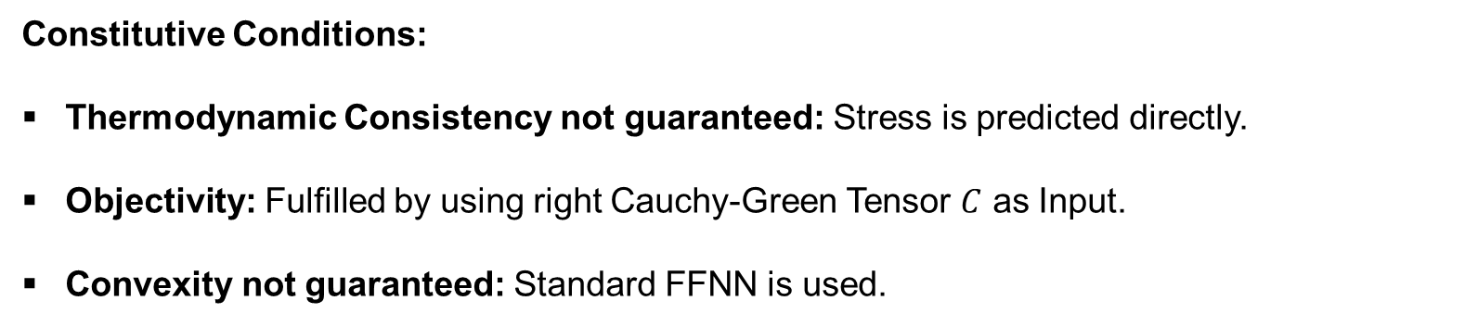








Naive FFNN
$$Fεℝ^{9}$$
$$Cεℝ^{9}$$
$$C_{vec}εℝ^{6}$$
$$Pεℝ^{9}$$
$$M^{S}$$
$$F$$
$$C$$
$$C_{vec}$$
$$FFNN$$
$$P$$
Constitutive Conditions:
Thermodynamic Consistency not guaranteed: Stress is predicted directly.
Objectivity: Fulfilled by using right Cauchy-Green Tensor $C$ as Input.
Convexity not guaranteed: Standard FFNN is used.
Notes:
Approach: Direct mapping from strain to stress. A "Black Box".
Input: Right Cauchy-Green Tensor C.
Why? It automatically fulfills Objectivity (Frame Indifference).
Output: Stress P is predicted directly.
Major Drawback:
No Energy Potential: We bypass W.
Violation: Thermodynamic consistency is not guaranteed. It's pure curve fitting.

Slide 5


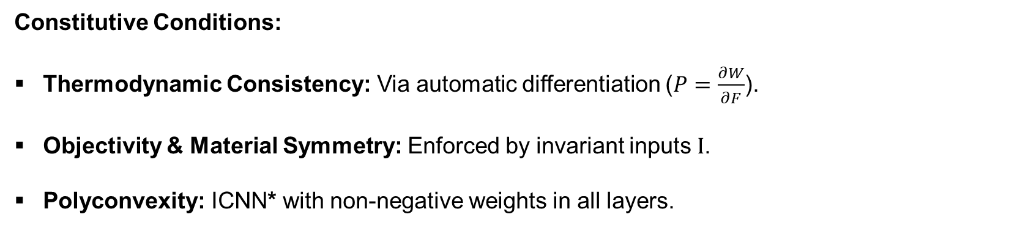







Invariant Based PANN
$$Fεℝ^{9}$$
$$Cεℝ^{9}$$
$$Iεℝ^{5}$$
$$Wεℝ^{1}$$
$$\frac{∂W}{∂F}$$
$$Pεℝ^{9}$$
$$W^{I}$$
$$F$$
$$C$$
$$I$$
$$ICNN∗$$
$$W$$
$$P$$
Constitutive Conditions:
Thermodynamic Consistency: Via automatic differentiation ($P=\frac{∂W}{∂F}$).
Objectivity & Material Symmetry: Enforced by invariant inputs $I$.
Polyconvexity: ICNN* with non-negative weights in all layers.
Notes:
All PANNs use the Loss Weighted Strategy

Slide 6
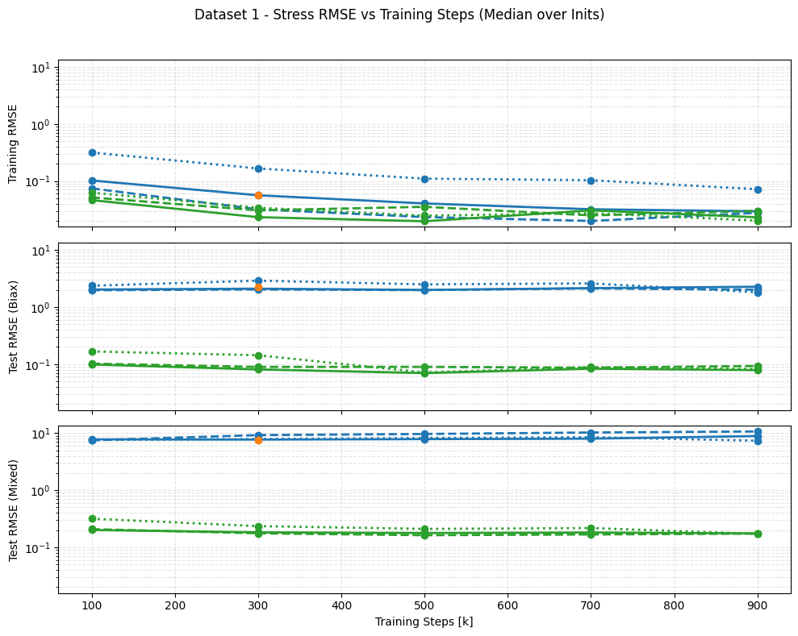
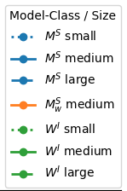

Dataset 1 – FFNN vs. PANN
Key Observations:
Interpolation (Training):
Both models learn to interpolate the training data (RMSE decrease).
Extrapolation (Test):
PANN learns to extrapolate (Test RMSE same magnitude as Train).
FFNN shows terrible extrapolation, especially for mixed test set.
Inits = different random Initialization
$$W^{I}=PANN\left(I\right),{ M}^{S}=FFNN\left(C_{vec}\right)$$

Slide 7
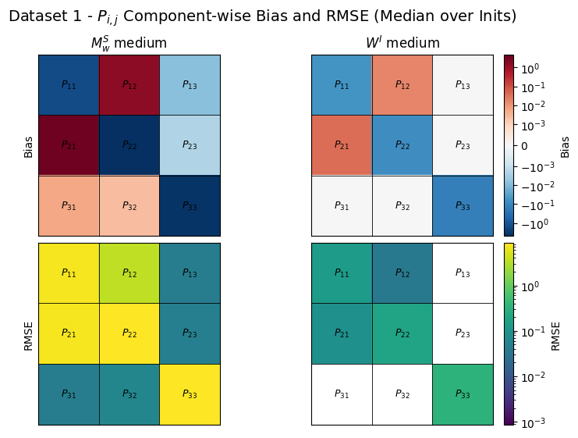

Dataset 1 – Component Eval
Scope: unseen Test Data (Biaxial + Mixed Load Cases).
Naive FFNN
High systematic Bias and RMSE indicates incorrect physical mapping.
PANN
Orders of magnitude lower RMSE.
Inits = different random Initialization
$W^{I}=PANN\left(I\right), M_{W}^{S}=FFNN\left(C\right)$ uses Loss Weighted Strategy
Notes:
Look at the shear components like $P_{13}$ or $P_{23}$.
In our experiment, these should be zero.
The Naive FFNN (left) predicts random noise here — we call these 'ghost stresses'. It doesn't know they have to be zero.
The PANN (right) predicts exactly zero (white/green).
Because it uses Invariants, it structurally understands that no stress should exist in these directions. This is the power of Inductive Bias.

Slide 8
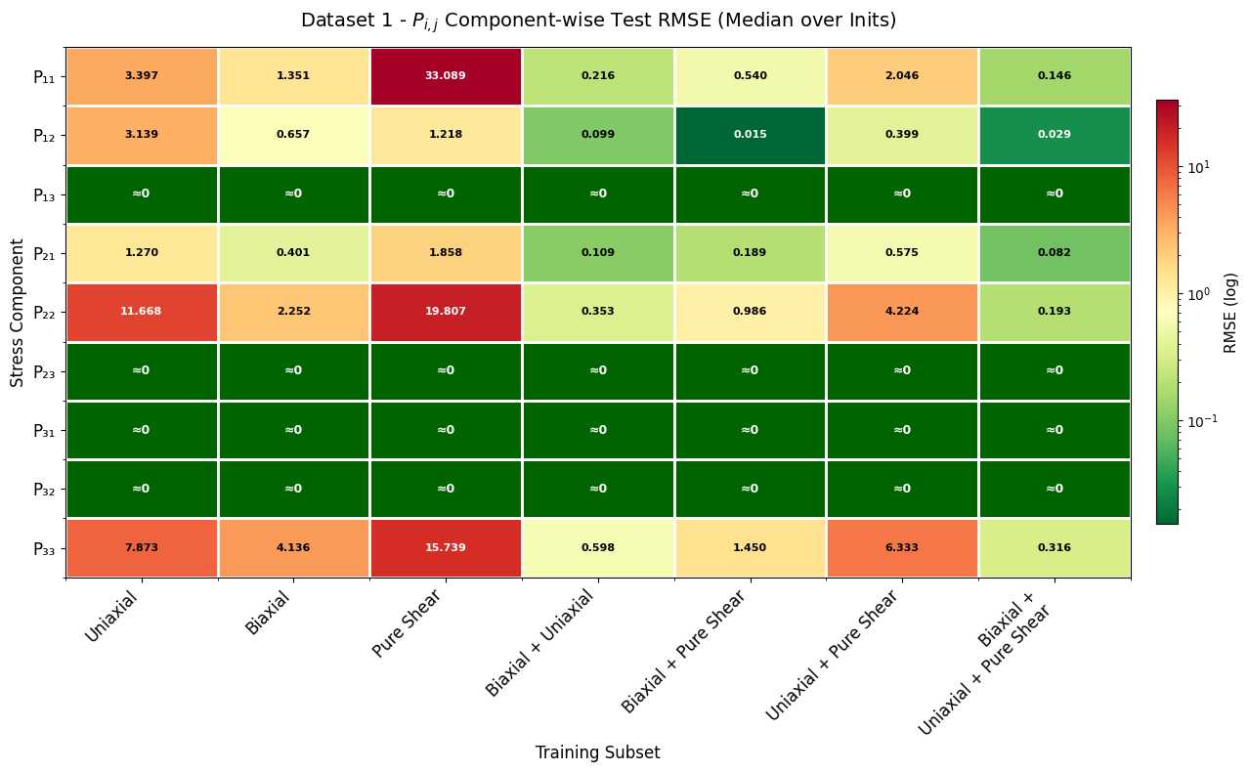

Training Set Variation
Scope: PANN
Key Observations:
Single Load Cases: Training on single cases does not generalize well.
Combined Load Cases: Combining load paths drastically improves generalization.
Best Performance when trained on all datasets.
Inits = different random Initialization
$$W^{I}=PANN\left(I\right)$$

Slide 9
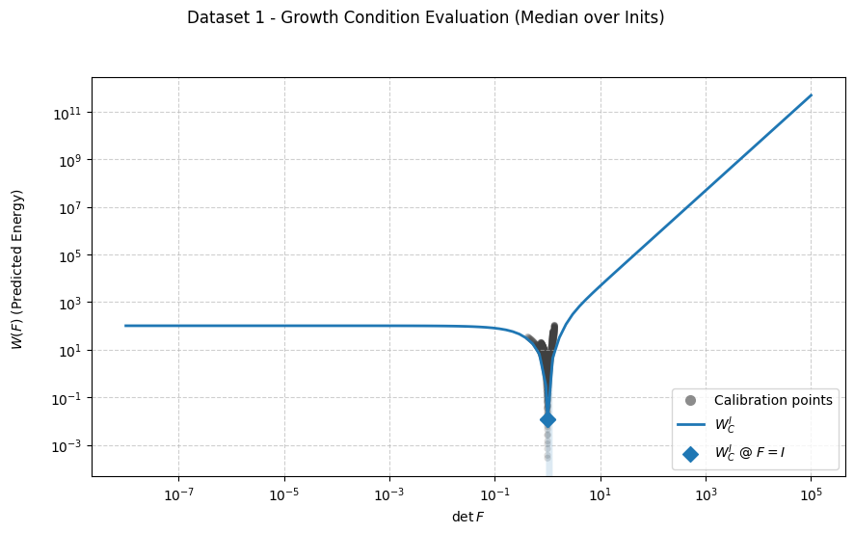
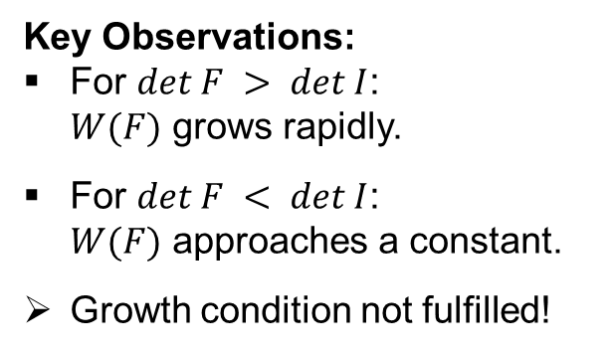

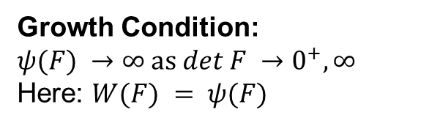
Dataset 1 –
Constitutive Conditions (1)
Growth Condition: $$ψ(F) →∞ as det F →0^{+}, ∞$$ Here: $W(F) = ψ(F)$
Key Observations:
For $det F > det I$: $W(F)$ grows rapidly.
For $det F < det I$: $W(F)$ approaches a constant.
Growth condition not fulfilled!
Inits = different random Initialization
${W^{I}}_{C}=PANN(I)$ that uses Sobolev Training

Slide 10
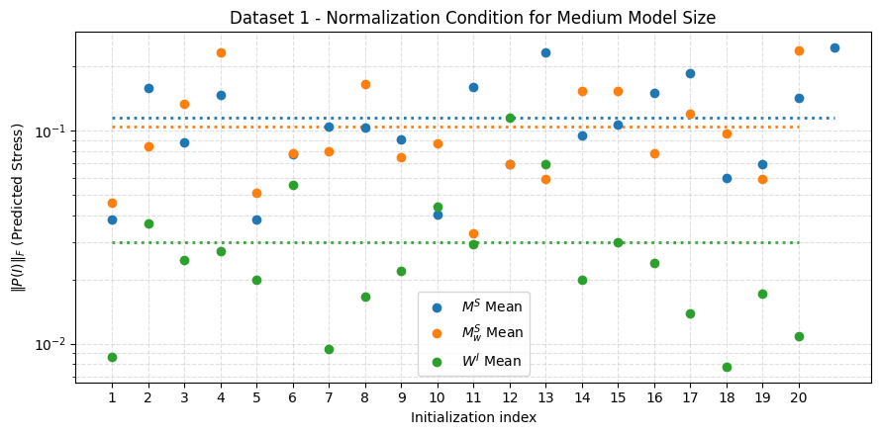
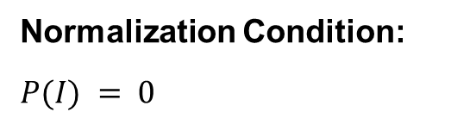
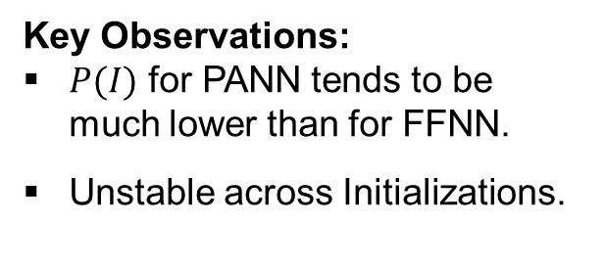
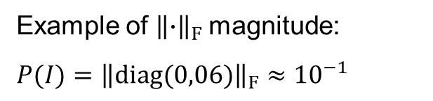
Dataset 1 –
Constitutive Conditions (2)
Normalization Condition:
$$P(I) = 0$$
Example of ${\left\|∙\right\|}_{F}$ magnitude:
$$P(I)={\left\|diag(0,06)\right\|}_{F}≈{10}^{−1}$$
Key Observations:
$P(I)$ for PANN tends to be much lower than for FFNN.
Unstable across Initializations.
Inits = different random Initialization
$W^{I}=PANN\left(I\right),{ M}^{S}=FFNN\left(C\right)$, $M_{W}^{S}=FFNN\left(C\right)$ uses Loss Weighted Strategy

Slide 11
Dataset 1 –
Key Takeaways
In all tests the PANN exhibited significantly lower RMSE than the naïve FFNN.
PANN benefits from diverse training set.
Growth condition not fulfilled by PANN.
PANN satisfies normalization condition more closely than FFNN.

Slide 12
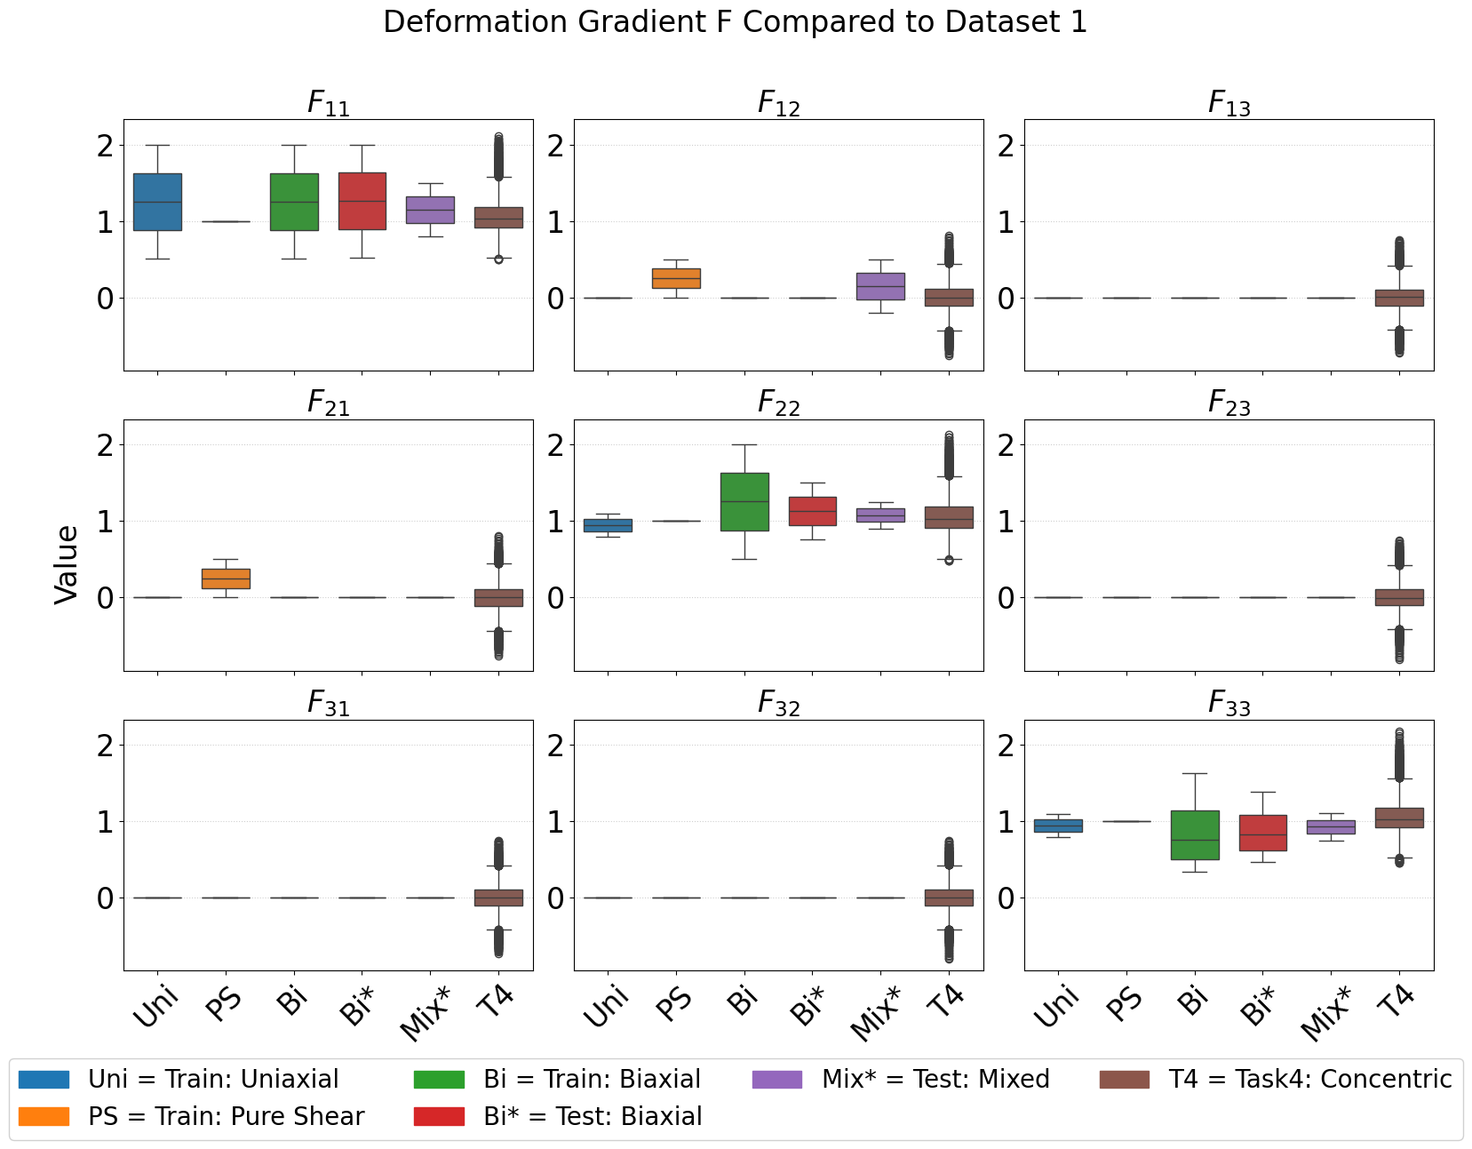


Dataset 2
Concentric sampling:
5.000 deformation gradients (vs. 600 in Dataset 1).
Covers all 9 components of $P$ including off-diagonal shear.
Enables comparison of FFNN vs. PANN with more training data.
Inits = different random Initialization
$$W^{I}=PANN\left(I\right),{ M}^{S}=FFNN\left(C\right)$$

Slide 13
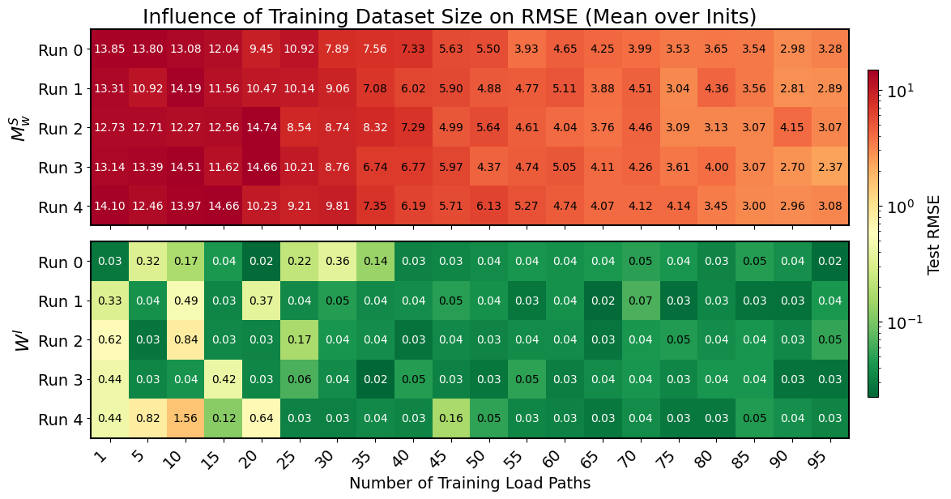

Evaluation on Dataset 2
Inits = different random Initialization
$$W^{I}=PANN\left(I\right), { M}_{W}^{S}=FFNN\left(C\right) \text{uses} \text{Loss} \text{Weighted} \text{Strategy}$$

Slide 14
Dataset 2 –
Key Takeaway
PANN consistently provides much better predictions then naïve FFNN, especially for small datasets.

Slide 15
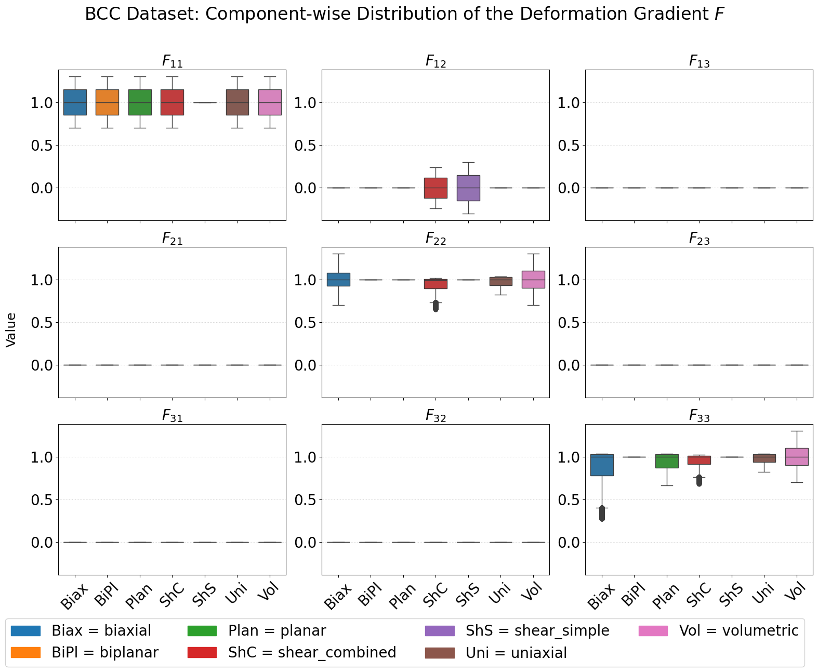
Dataset 3
Cubic Anisotropic Material:
7 Load Cases
2,060 Load Paths available.
414k Total Datapoints.
Training: Only basic load cases (Uniaxial & Simple Shear).
Test: Mixed Shear-Tension (Shear Combined).
Notes:
The complete database provided by Fernández et al. is huge,
containing over 2,000 load paths and 400,000 data points.
However, to prove the efficiency of our PANN model, we don't need all of it.
We intentionally select only a small subset (Uniaxial and Simple Shear) for calibration.
If the model works, it proves that physics-informed learning creates massive data efficiency.

Slide 16





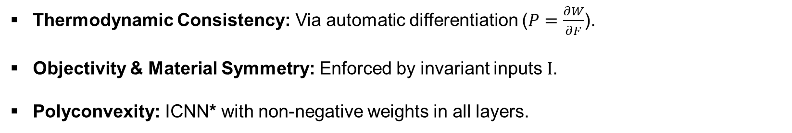








Cubic Invariant Based PANN
$$Fεℝ^{9}$$
$$Cεℝ^{9}$$
$$Iεℝ^{6}$$
$$Wεℝ^{1}$$
$$\frac{∂W}{∂F}$$
$$Pεℝ^{9}$$
$$W_{cub}^{I}$$
$$F$$
$$C$$
$$I$$
$$ICNN∗$$
$$W$$
$$P$$
Thermodynamic Consistency: Via automatic differentiation ($P=\frac{∂W}{∂F}$).
Objectivity & Material Symmetry: Enforced by invariant inputs $I$.
Polyconvexity: ICNN* with non-negative weights in all layers.

Slide 17



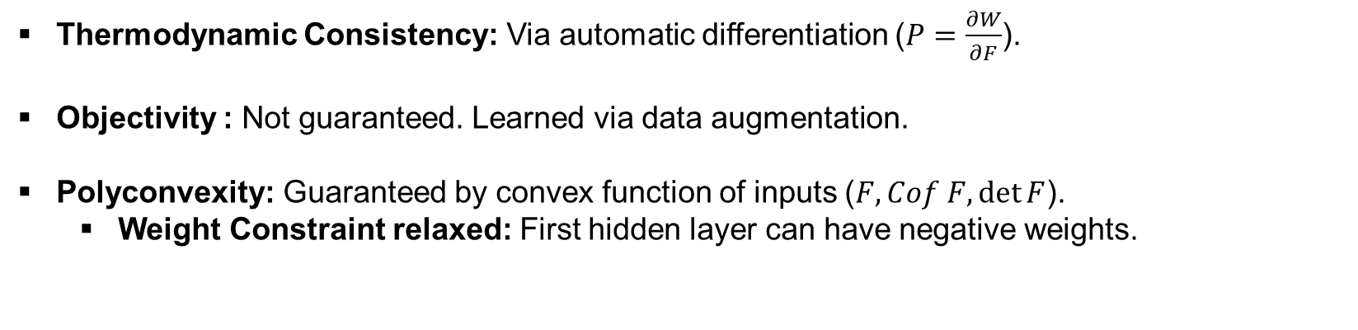



Deformation Gradient PANN
$$Fεℝ^{9}$$
$$\{F, Cof F, det F\}εℝ^{19}$$
$$Wεℝ^{1}$$
$$\frac{∂W}{∂F}$$
$$Pεℝ^{9}$$
$$W^{F}$$
$$F$$
$$F, Cof F, det F$$
$$ICNN$$
$$W$$
$$P$$
Thermodynamic Consistency: Via automatic differentiation ($P=\frac{∂W}{∂F}$).
Objectivity : Not guaranteed. Learned via data augmentation.
Polyconvexity: Guaranteed by convex function of inputs ($F, Cof F, det⁡F$).
Weight Constraint relaxed: First hidden layer can have negative weights.

Slide 18
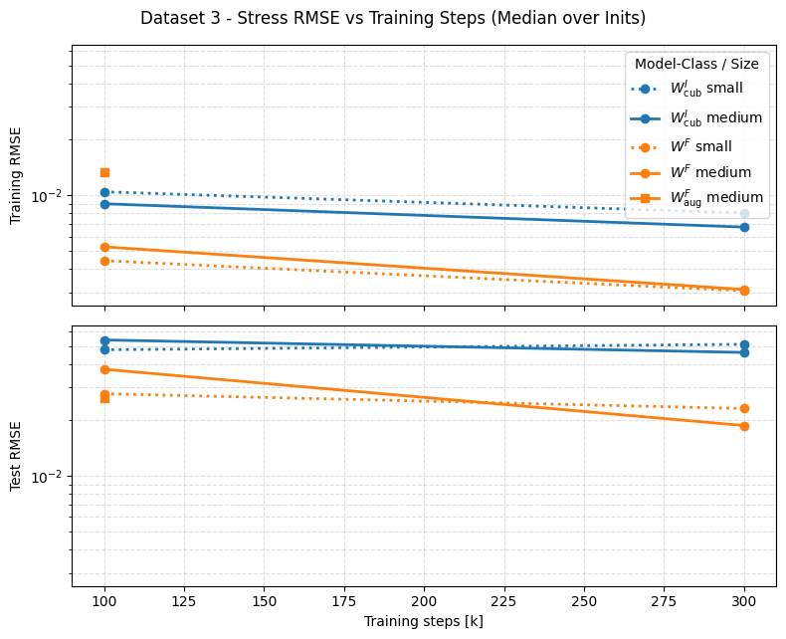
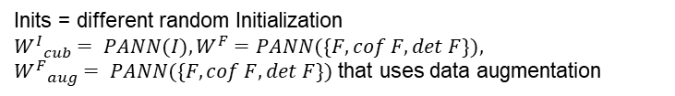
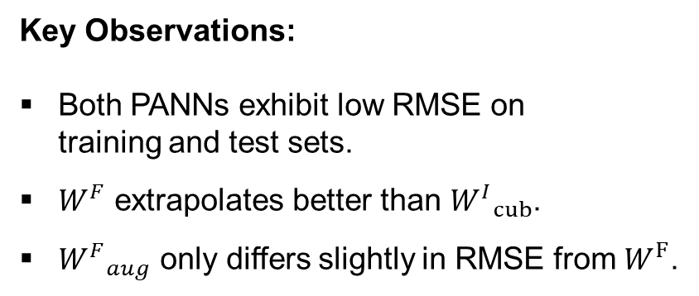
Dataset 3 –
Model evaluation
Key Observations:
Both PANNs exhibit low RMSE on training and test sets.
$W^{F}$ extrapolates better than ${W^{I}}_{cub}$.
${W^{F}}_{aug}$ only differs slightly in RMSE from $W^{F}$.
Inits = different random Initialization
${W^{I}}_{cub}= PANN(I),W^{F}=PANN(\{F, cof F, det F\}),$ ${W^{F}}_{aug}= PANN(\{F, cof F, det F\})$ that uses data augmentation

Slide 19
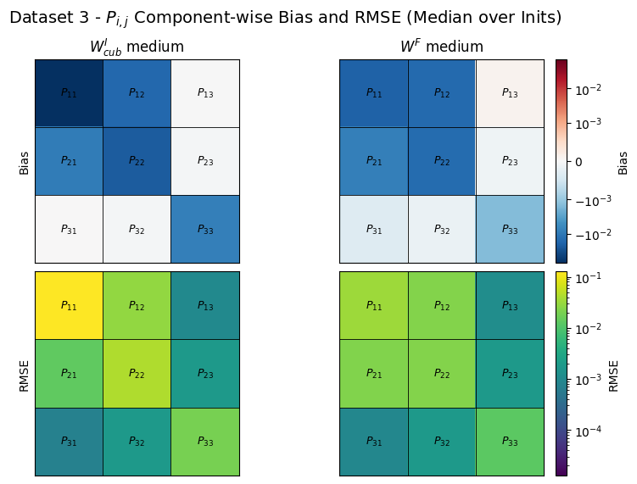
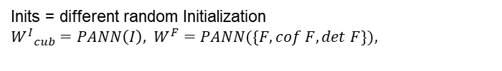
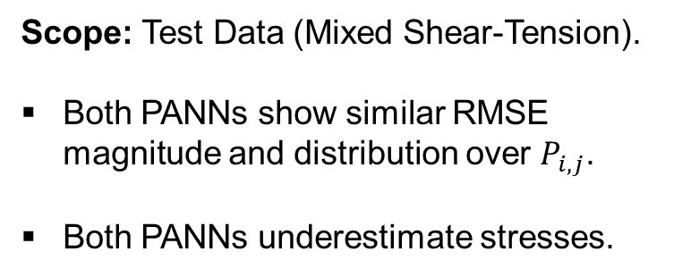
Dataset 3 – Component Eval
Scope: Test Data (Mixed Shear-Tension).
Both PANNs show similar RMSE magnitude and distribution over $P_{i,j}$.
Both PANNs underestimate stresses.
Inits = different random Initialization
${W^{I}}_{cub}=PANN\left(I\right), W^{F}=PANN(\{F, cof F, det F\}),$

Slide 20
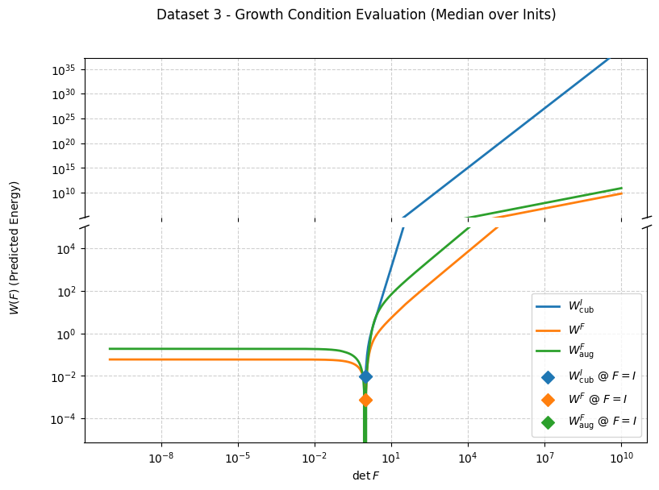
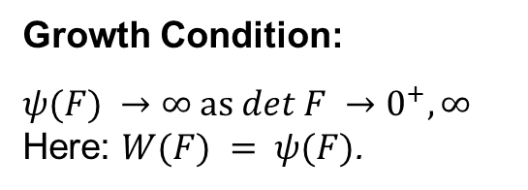
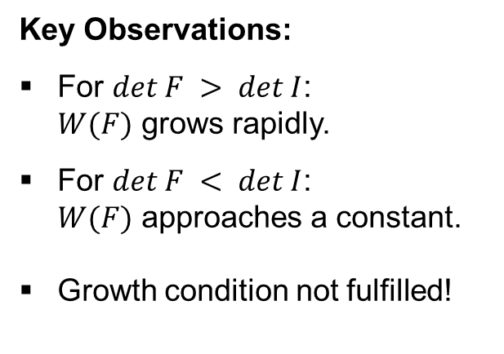
Dataset 3 –
Constitutive conditions (1)
Growth Condition:
$$ψ(F) →∞ as det F →0^{+}, ∞$$
Here: $W(F) = ψ(F)$.
Key Observations:
For $det F > det I$: $W(F)$ grows rapidly.
For $det F < det I$: $W(F)$ approaches a constant.
Growth condition not fulfilled!
Inits = different random Initialization
${W^{I}}_{cub}= PANN(I),W^{F}=PANN(\{F, cof F, det F\}),$ ${W^{F}}_{aug}= PANN(\{F, cof F, det F\})$ that uses data augmentation

Slide 21
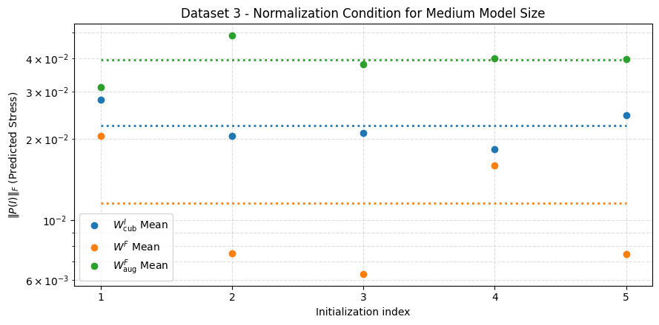
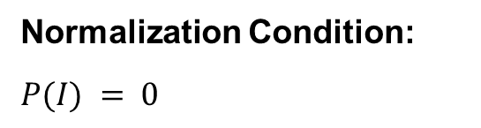
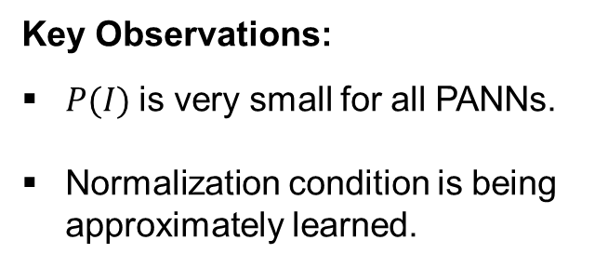
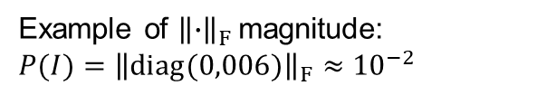
Dataset 3 –
Constitutive conditions (2)
Normalization Condition:
$$P(I) = 0$$
Example of ${\left\|∙\right\|}_{F}$ magnitude:
$$P(I)={\left\|diag(0,006)\right\|}_{F}≈{10}^{−2}$$
Key Observations:
$P(I)$ is very small for all PANNs.
Normalization condition is being approximately learned.
Inits = different random Initialization
${W^{I}}_{cub}= PANN(I),W^{F}=PANN(\{F, cof F, det F\}),$ ${W^{F}}_{aug}= PANN(\{F, cof F, det F\})$ that uses data augmentation

Slide 22
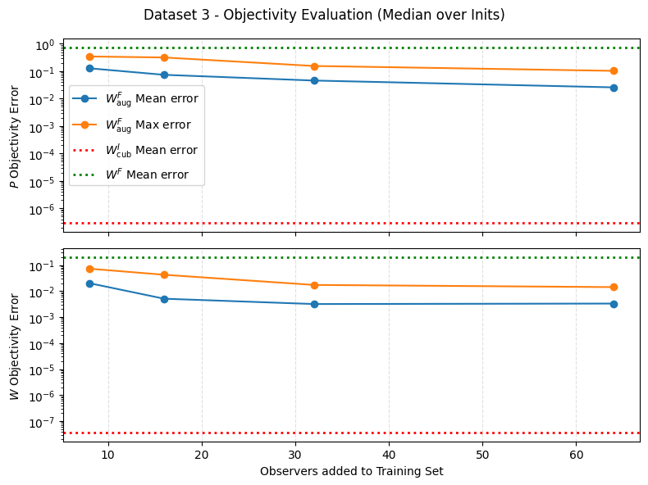
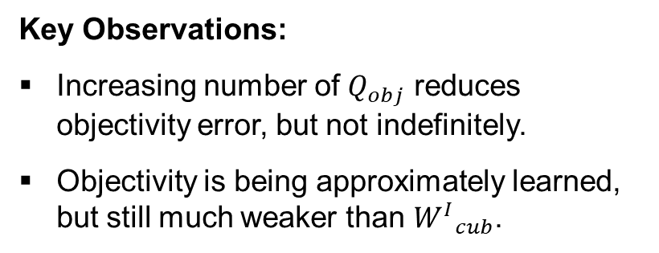


Dataset 3 –
Data Augmentation
Objectivity Errors Computed as:
$P_{err}=\left\|P\left(QF\right)−QP\left(F\right)\right\|,$
$W_{err}=\left|W\left(QF\right)−W\left(F\right)\right|$
Key Observations:
Increasing number of $Q_{obj}$ reduces objectivity error, but not indefinitely.
Objectivity is being approximately learned, but still much weaker than ${W^{I}}_{cub}$.
Inits = different random Initialization
${W^{I}}_{cub}= PANN(I),W^{F}=PANN(\{F, cof F, det F\}),$ ${W^{F}}_{aug}= PANN(\{F, cof F, det F\})$ that uses data augmentation

Slide 23
Dataset 3 –
Key Takeaways
Neither Invariant based- nor deformation gradient based PANNs learn growth condition!
Objectivity can be learned to a degree through data augmentation.
Learning normalization condition is improved with a larger training dataset!

Slide 24
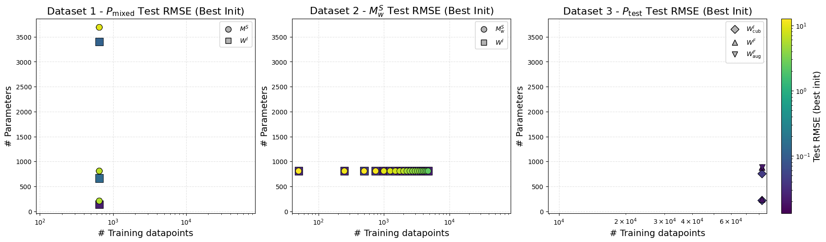
Conclusion
PANN outperforms FFNN consistently across all datasets, especially with limited training data.
Normalization and objectivity can be approximately learned, growth condition not fulfilled.

Slide 25
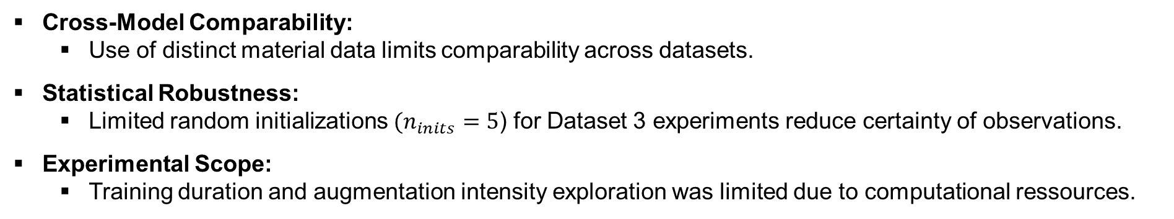
Limitations
Cross-Model Comparability:
Use of distinct material data limits comparability across datasets.
Statistical Robustness:
Limited random initializations $(n_{inits}=5$) for Dataset 3 experiments reduce certainty of observations.
Experimental Scope:
Training duration and augmentation intensity exploration was limited due to computational ressources.

Slide 26
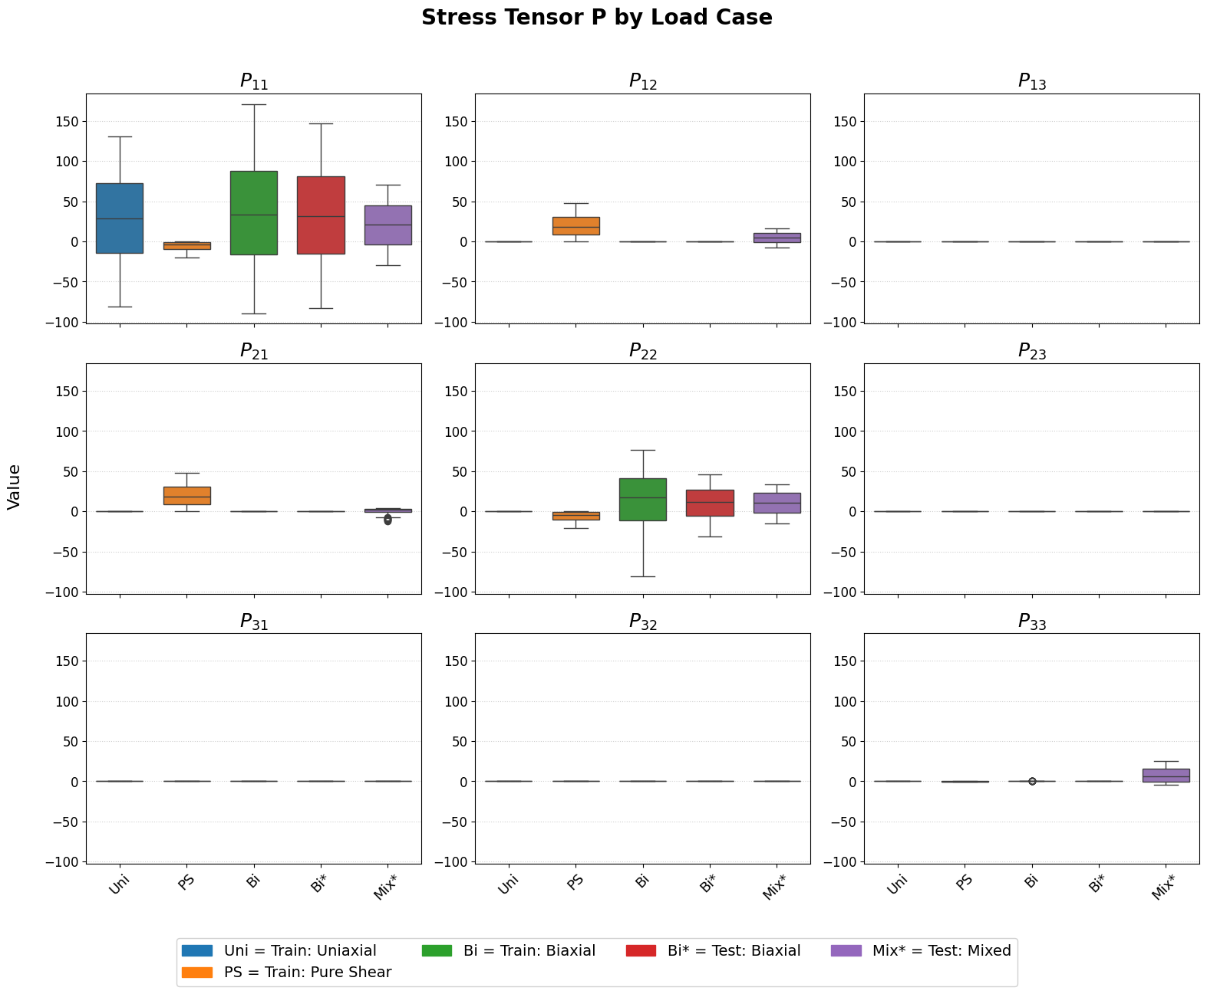
Backup – Dataset 1 Stress Tensor
Inits = different random Initialization
$$W^{I}=PANN\left(I\right),{ M}^{S}=FFNN\left(C\right)$$

