Slide 1
Tutorial Machine Learning in Solid Mechanics – Task 2
Alexander Pahl & Lukas Fromme

Slide 2
Agenda
1
Dataset 1
3
Dataset 3
Dataset 1 - Models
Dataset 3 - Models
1.1
3.1
1.2
Dataset 1 - Evaluation
3.2
Dataset 3 - Evaluation
1.3
Dataset 1 - Training Set Variation
3.3
Dataset 3 - Data Augmentation
2
Dataset 2
4
Conclusion & Limitations

Slide 3
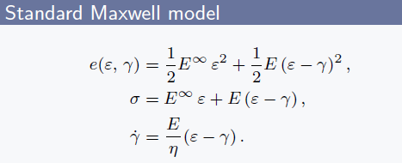
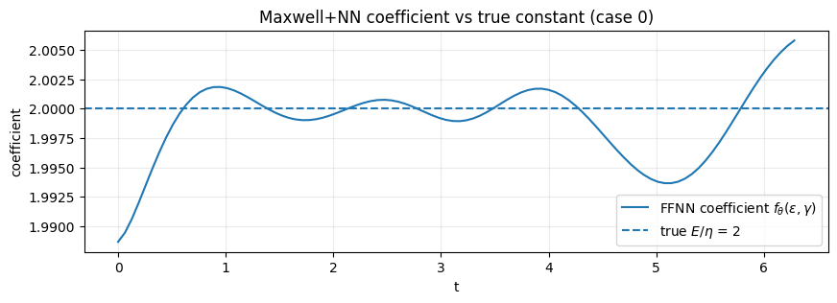
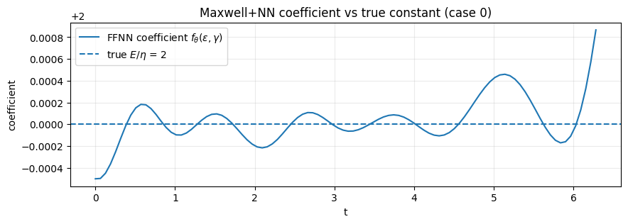






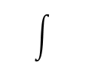



Maxwell+ FFNN model
$$M^{M}$$
Learned
Analytically computed
$$\frac{∂e(ε, γ)}{∂ε}$$
$$×(ε− γ)$$
$$(γ,ε)$$
$$FFNN: f_{θ}(ε, γ)$$
$$\dot{γ}$$
$$γ$$
$$e(ε, γ)$$
$$σ$$
Notice, that for a linear Maxwell material, the optimal FFNN representation reduces to a constant $f_{θ}≈\frac{E}{η}.$
Trained for ~ 1k steps:
Trained for ~ 250k steps:
Notes:
Approach: Direct mapping from strain to stress. A "Black Box".
Input: Right Cauchy-Green Tensor C.
Why? It automatically fulfills Objectivity (Frame Indifference).
Output: Stress P is predicted directly.
Major Drawback:
No Energy Potential: We bypass W.
Violation: Thermodynamic consistency is not guaranteed. It's pure curve fitting.

Slide 4
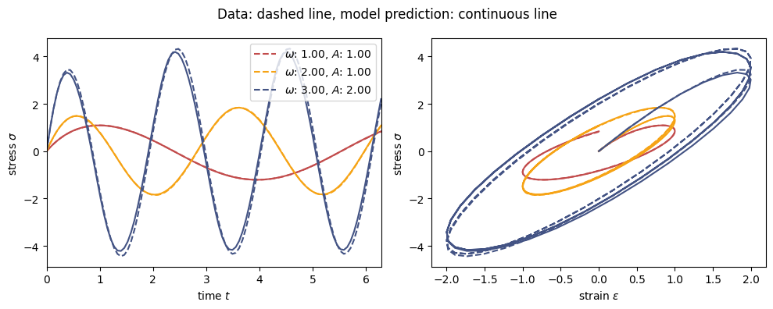
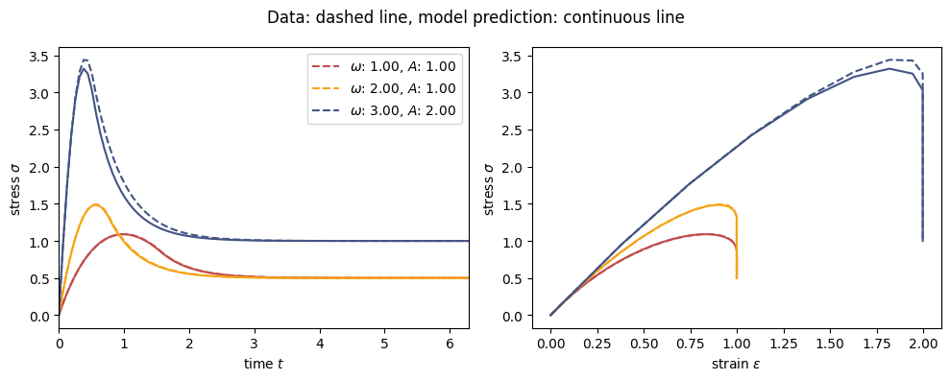
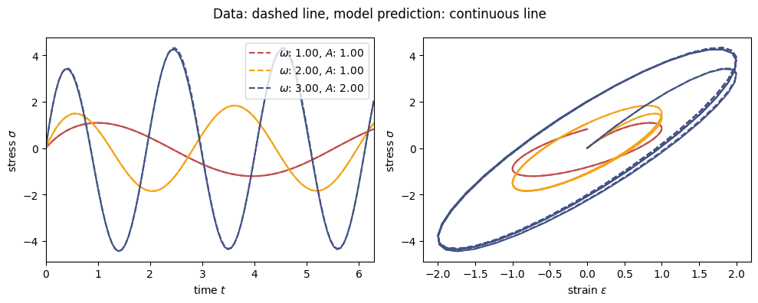
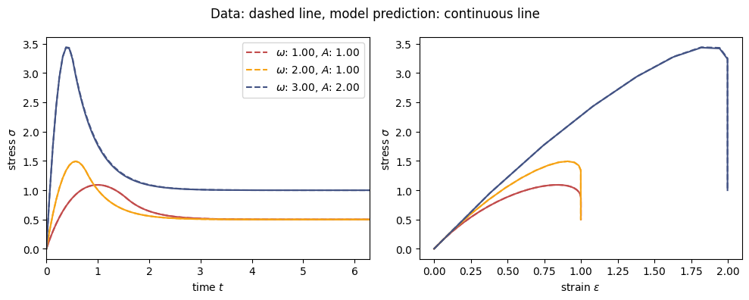
Maxwell+ FFNN model
Evaluating Stress
Trained for
~ 1k steps:
Trained for
~ 250k steps:
Notes:
Approach: Direct mapping from strain to stress. A "Black Box".
Input: Right Cauchy-Green Tensor C.
Why? It automatically fulfills Objectivity (Frame Indifference).
Output: Stress P is predicted directly.
Major Drawback:
No Energy Potential: We bypass W.
Violation: Thermodynamic consistency is not guaranteed. It's pure curve fitting.

Slide 5
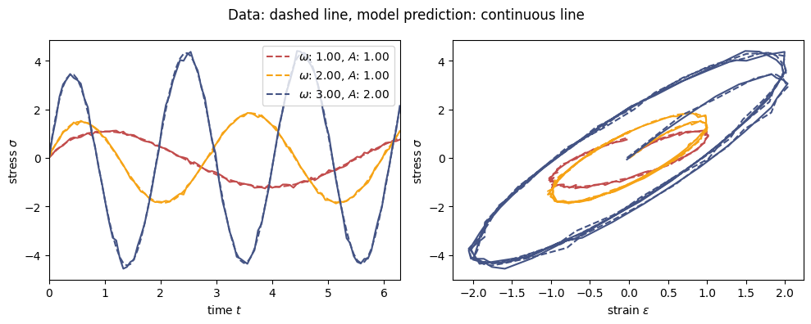
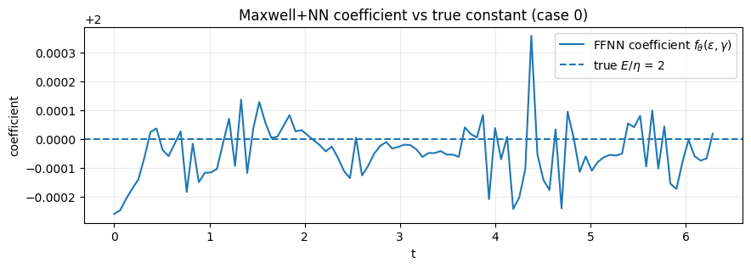
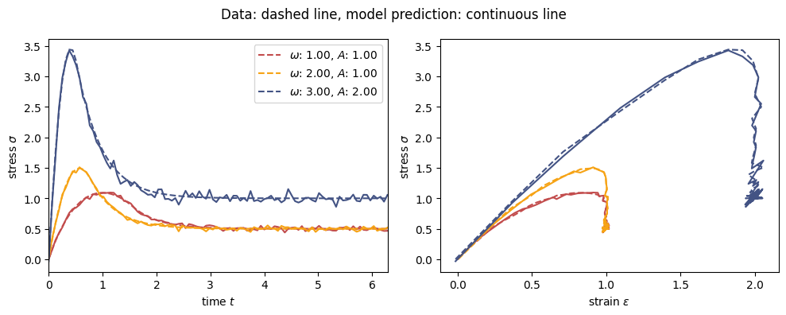
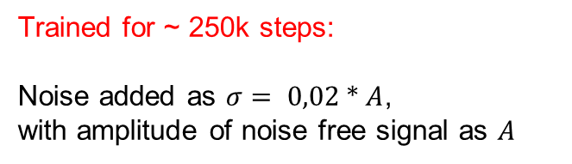
Maxwell+ FFNN model
Evaluating Stress (Noisy)
Trained for ~ 250k steps:
Noise added as $σ= 0,02 ∗ A$, with amplitude of noise free signal as $A$
Notes:
Approach: Direct mapping from strain to stress. A "Black Box".
Input: Right Cauchy-Green Tensor C.
Why? It automatically fulfills Objectivity (Frame Indifference).
Output: Stress P is predicted directly.
Major Drawback:
No Energy Potential: We bypass W.
Violation: Thermodynamic consistency is not guaranteed. It's pure curve fitting.

Slide 6
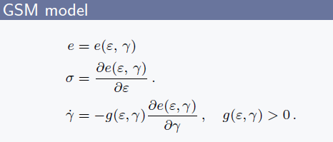
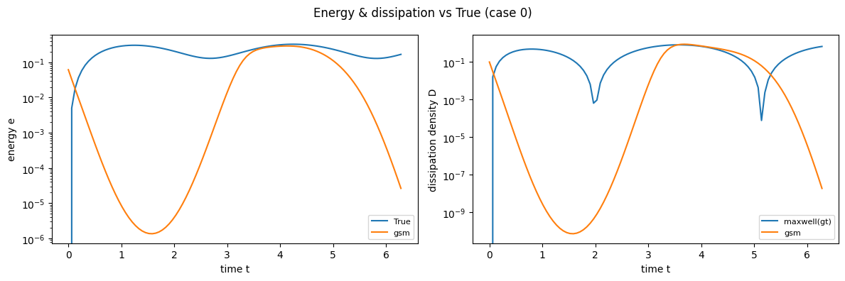
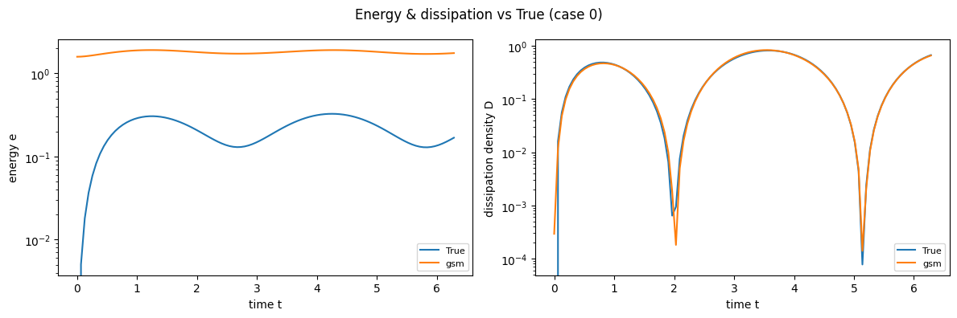
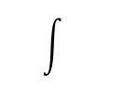





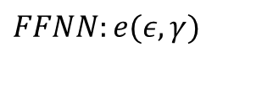


GSM Model
$$M^{GSM}$$
Learned
Analytically computed
$$\frac{∂e\left(ε,γ\right)}{∂γ}×(g≔η^{−1})$$
$$\dot{γ}$$
$$γ$$
$$FFNN:e(ε, γ)$$
$$σ$$
$$\frac{∂e(ε, γ)}{∂ε}$$
All Models Trained with $ω= 1, A=1$
Trained for ~ 1k steps:
Trained for ~ 250k steps:

Slide 7
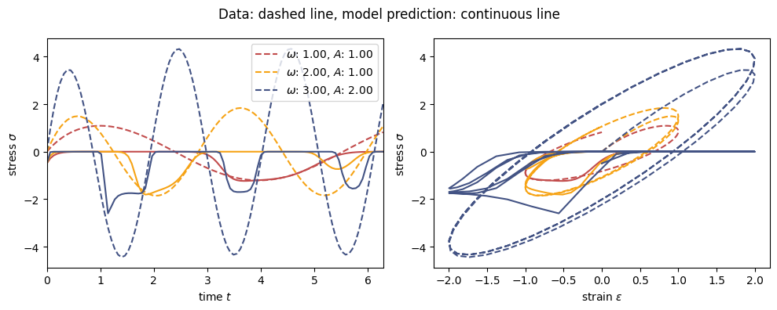
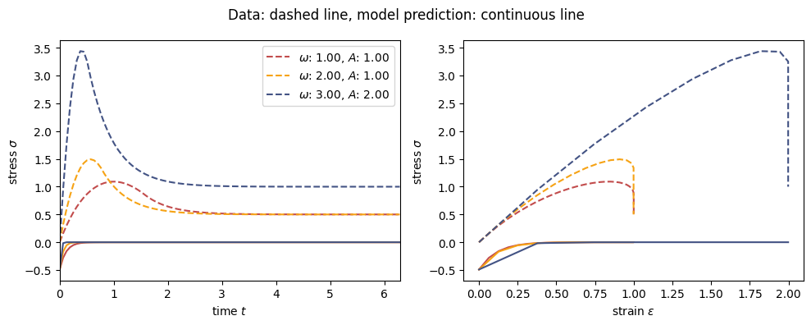
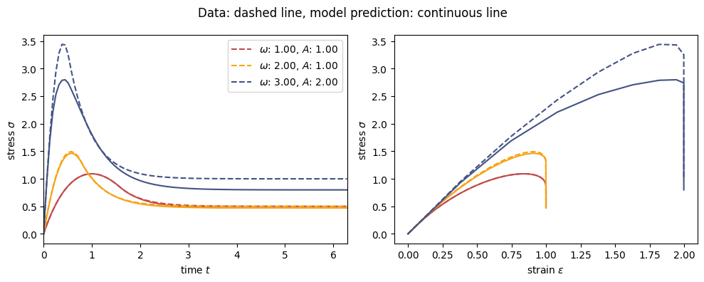
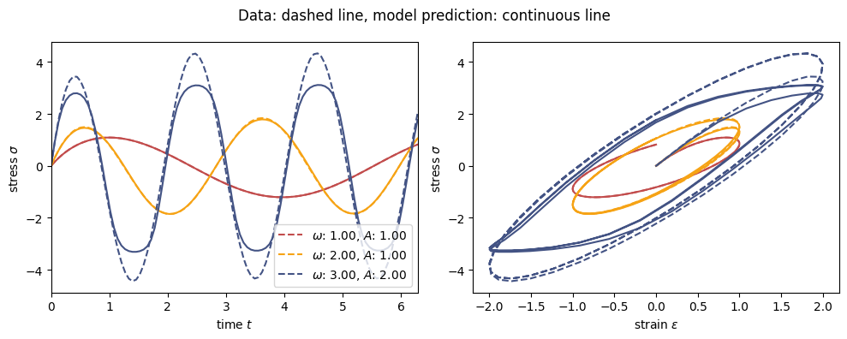

GSM model
Evaluating Stress (1LP)
Trained for
~ 1k steps:
All Models Trained with $ω= 1, A=1$
Trained for
~ 250k steps:
Notes:
Approach: Direct mapping from strain to stress. A "Black Box".
Input: Right Cauchy-Green Tensor C.
Why? It automatically fulfills Objectivity (Frame Indifference).
Output: Stress P is predicted directly.
Major Drawback:
No Energy Potential: We bypass W.
Violation: Thermodynamic consistency is not guaranteed. It's pure curve fitting.

Slide 8
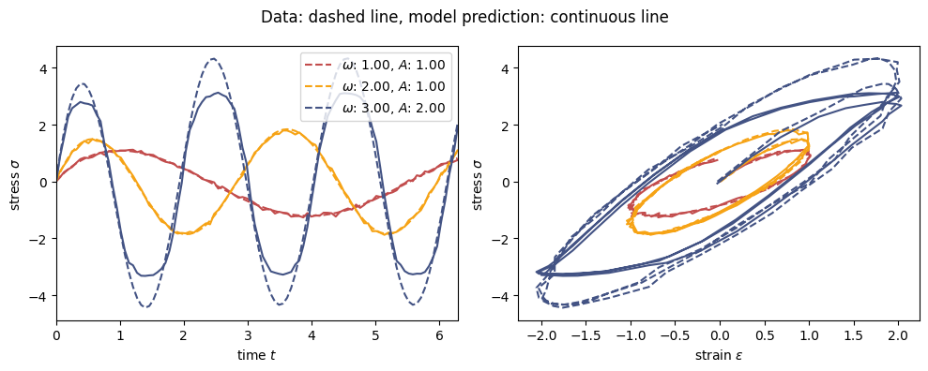
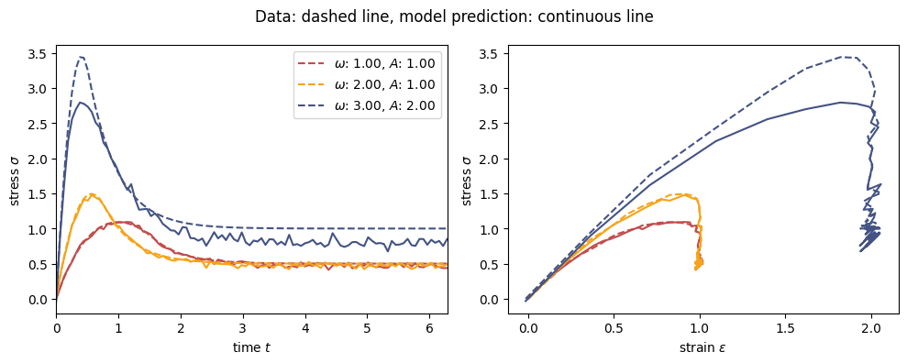


GSM model
Evaluating Stress (Noisy)
All Models Trained with $ω= 1, A=1$
Trained for ~ 250k steps:
Noise added as $σ= 0,02 ∗ A$, with amplitude of noise free signal as $A$
Notes:
Approach: Direct mapping from strain to stress. A "Black Box".
Input: Right Cauchy-Green Tensor C.
Why? It automatically fulfills Objectivity (Frame Indifference).
Output: Stress P is predicted directly.
Major Drawback:
No Energy Potential: We bypass W.
Violation: Thermodynamic consistency is not guaranteed. It's pure curve fitting.

Slide 9
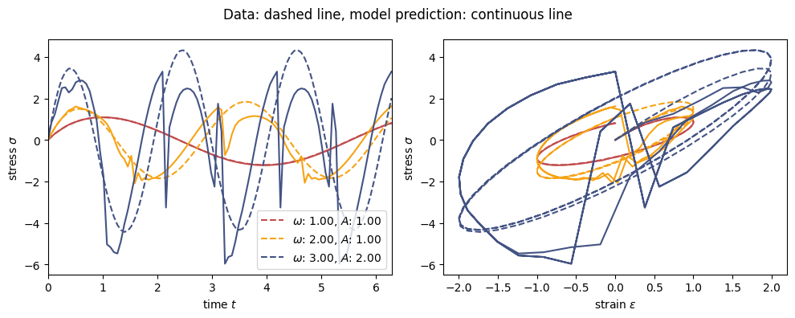
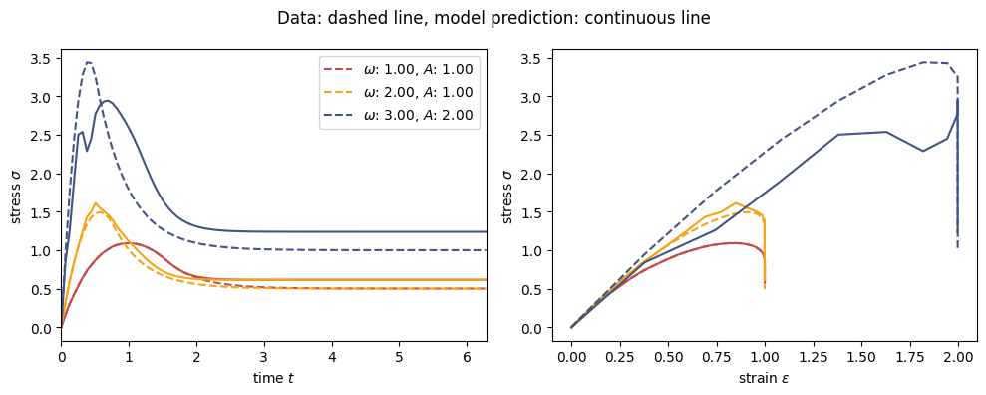
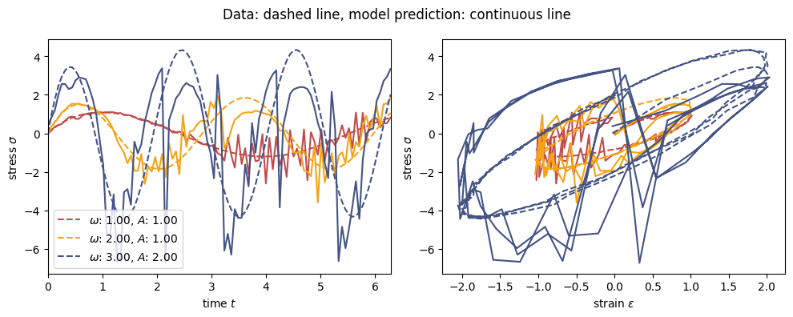
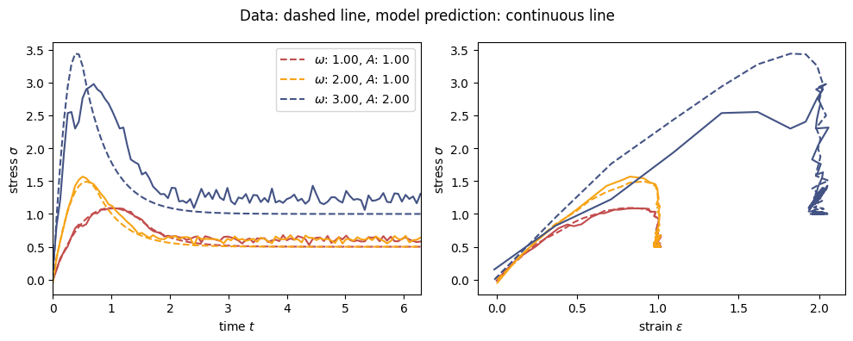
GSM model
Evaluating Stress (2LP)
Trained for ~ 250k steps with $ω= \{1, 1\}, A=\{1, 2\}$
NOISY Trained for ~ 250k steps with $ω= \{1, 1\}, A=\{1, 2\}$
Notes:
Approach: Direct mapping from strain to stress. A "Black Box".
Input: Right Cauchy-Green Tensor C.
Why? It automatically fulfills Objectivity (Frame Indifference).
Output: Stress P is predicted directly.
Major Drawback:
No Energy Potential: We bypass W.
Violation: Thermodynamic consistency is not guaranteed. It's pure curve fitting.

Slide 10
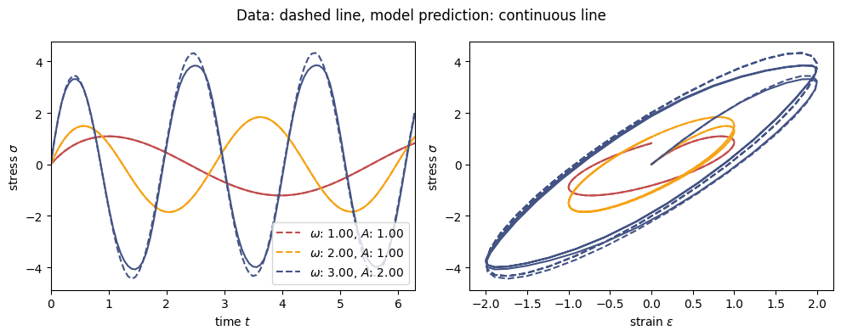
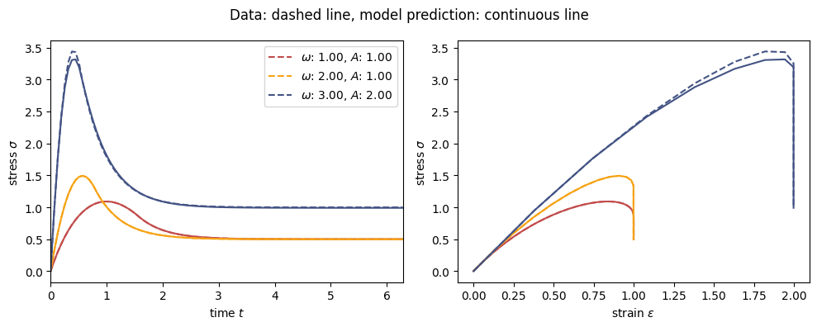
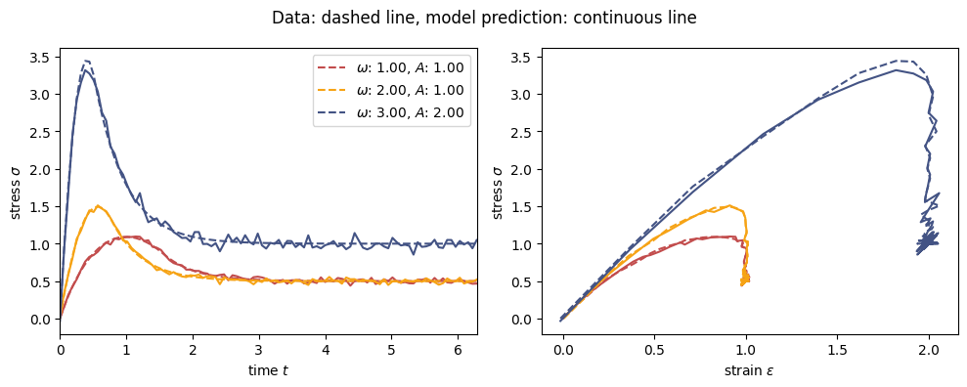
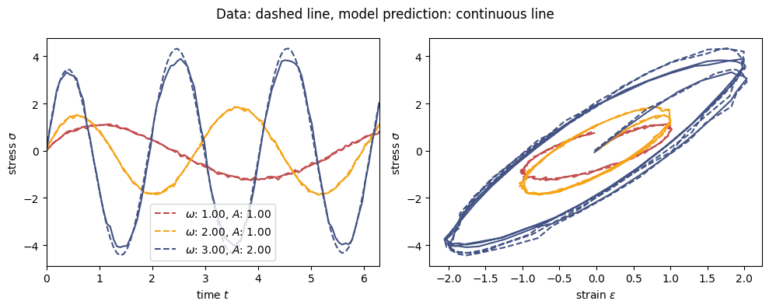
GSM model
Evaluating Stress (3LP)
Trained for ~ 250k steps with $ω= \{1, 1, 2\}, A=\{1, 2, 1\}$
NOISY Trained for ~ 250k steps with $ω= \{1, 1, 2\}, A=\{1, 2, 1\}$
Notes:
Approach: Direct mapping from strain to stress. A "Black Box".
Input: Right Cauchy-Green Tensor C.
Why? It automatically fulfills Objectivity (Frame Indifference).
Output: Stress P is predicted directly.
Major Drawback:
No Energy Potential: We bypass W.
Violation: Thermodynamic consistency is not guaranteed. It's pure curve fitting.

Slide 11
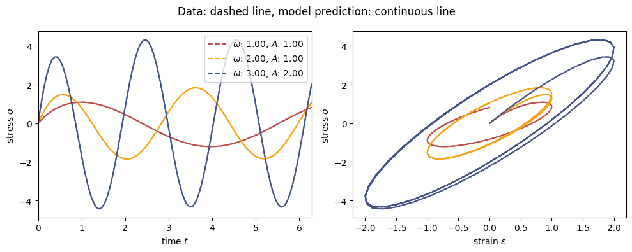
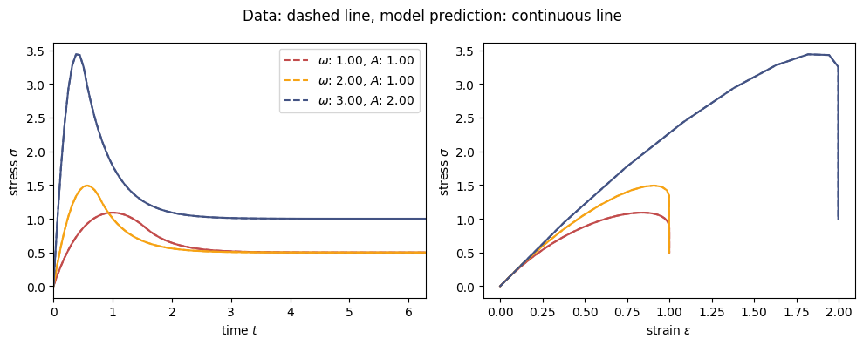

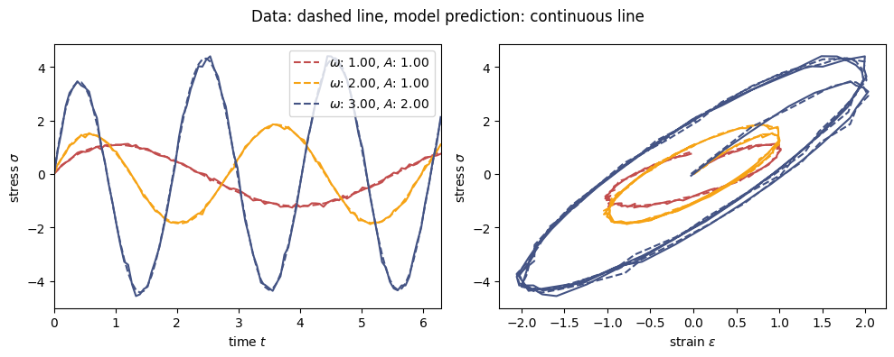
GSM model
Evaluating Stress (4 LP)
Trained for ~ 250k steps with $ω= \{1, 1, 2, 3\}, A=\{1, 2, 1, 3\}$
NOISY Trained for ~ 250k steps with $ω= \{1, 1, 2, 3\}, A=\{1, 2, 1, 3\}$
Notes:
Approach: Direct mapping from strain to stress. A "Black Box".
Input: Right Cauchy-Green Tensor C.
Why? It automatically fulfills Objectivity (Frame Indifference).
Output: Stress P is predicted directly.
Major Drawback:
No Energy Potential: We bypass W.
Violation: Thermodynamic consistency is not guaranteed. It's pure curve fitting.

Slide 12
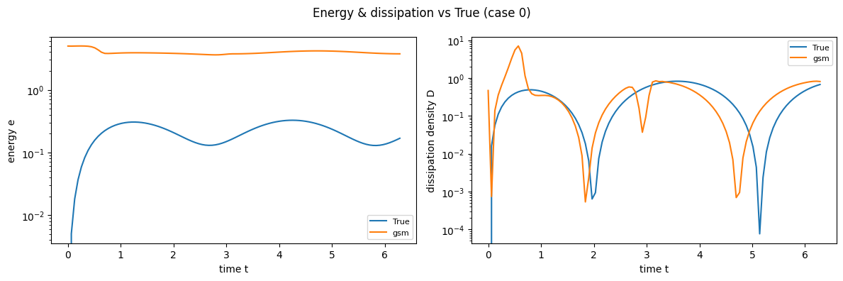
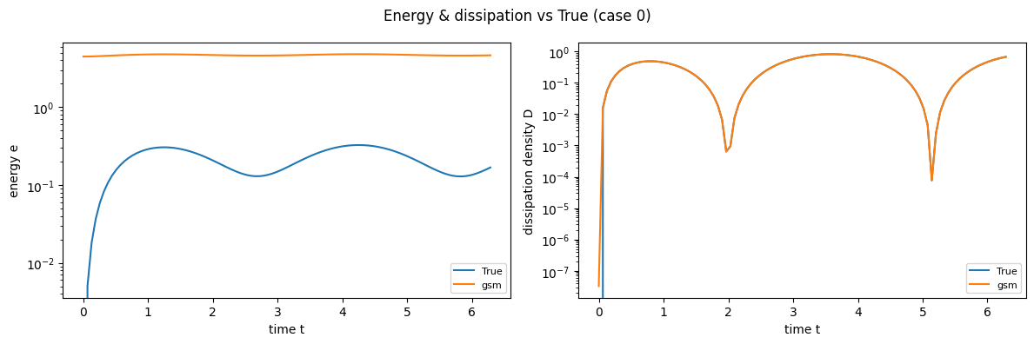
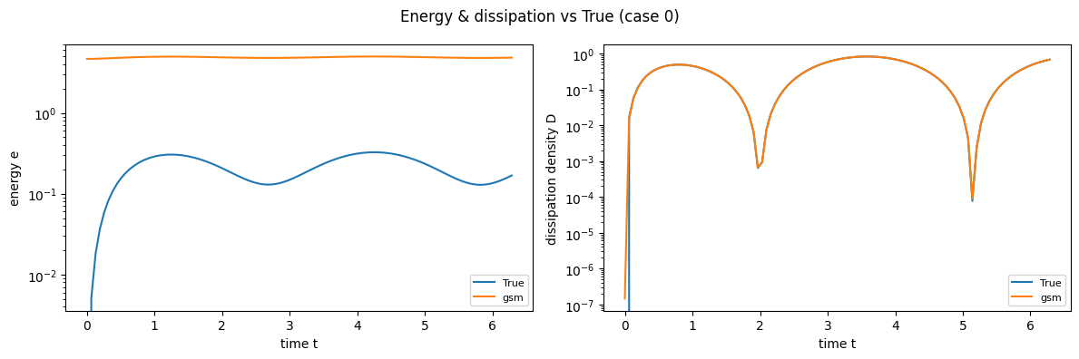
GSM model
Evaluating Energy
Trained for ~ 250k steps with $ω= \{1, 1\}, A=\{1, 2\}$
Trained for ~ 250k steps with $ω= \{1, 1, 2, 3\}, A=\{1, 2, 1, 3\}$
Trained for ~ 250k steps with $ω= \{1, 1, 2\}, A=\{1, 2, 1\}$
Notes:
Approach: Direct mapping from strain to stress. A "Black Box".
Input: Right Cauchy-Green Tensor C.
Why? It automatically fulfills Objectivity (Frame Indifference).
Output: Stress P is predicted directly.
Major Drawback:
No Energy Potential: We bypass W.
Violation: Thermodynamic consistency is not guaranteed. It's pure curve fitting.

Slide 13


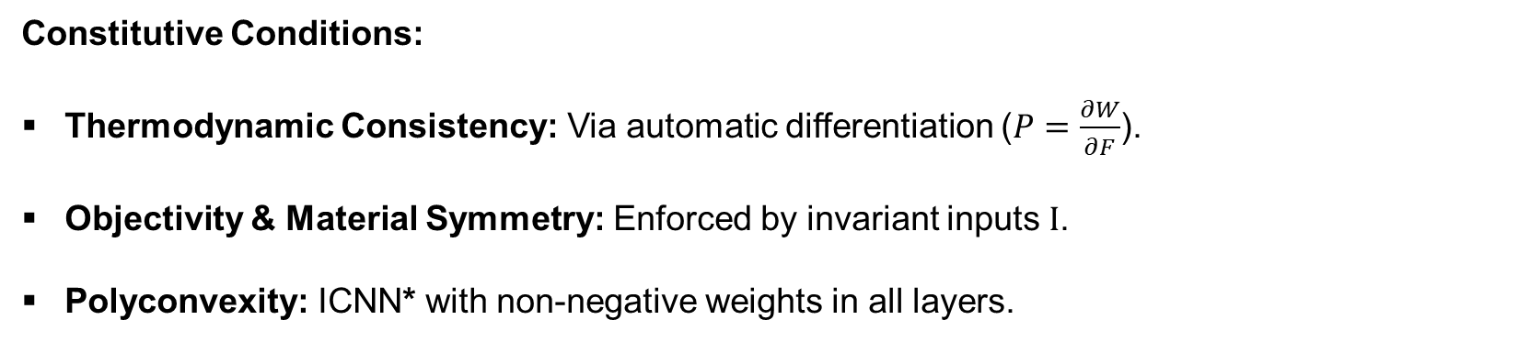











Invariant Based PANN
$$Fεℝ^{9}$$
$$Cεℝ^{9}$$
$$Iεℝ^{5}$$
$$Wεℝ^{1}$$
$$\frac{∂W}{∂F}$$
$$Pεℝ^{9}$$
$$W^{I}$$
$$F$$
$$C$$
$$I$$
$$ICNN∗$$
$$W$$
$$P$$
Constitutive Conditions:
Thermodynamic Consistency: Via automatic differentiation ($P=\frac{∂W}{∂F}$).
Objectivity & Material Symmetry: Enforced by invariant inputs $I$.
Polyconvexity: ICNN* with non-negative weights in all layers.
Notes:
All PANNs use the Loss Weighted Strategy

Slide 14
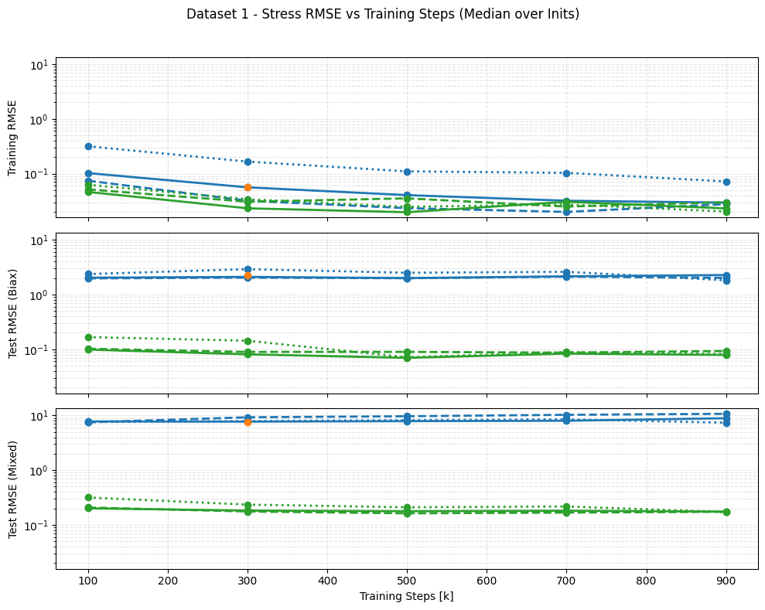
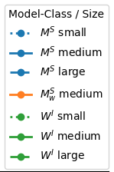

Dataset 1 – FFNN vs. PANN
Key Observations:
Interpolation (Training):
Both models learn to interpolate the training data (RMSE decrease).
Extrapolation (Test):
PANN learns to extrapolate (Test RMSE same magnitude as Train).
FFNN shows terrible extrapolation, especially for mixed test set.
Inits = different random Initialization
$$W^{I}=PANN\left(I\right),{ M}^{S}=FFNN\left(C_{vec}\right)$$

Slide 15
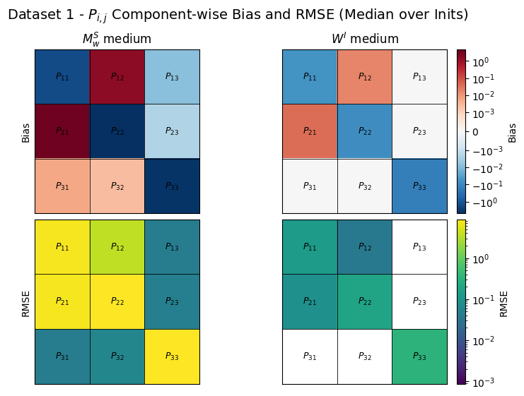

Dataset 1 – Component Eval
Scope: unseen Test Data (Biaxial + Mixed Load Cases).
Naive FFNN
High systematic Bias and RMSE indicates incorrect physical mapping.
PANN
Orders of magnitude lower RMSE.
Inits = different random Initialization
$W^{I}=PANN\left(I\right), M_{W}^{S}=FFNN\left(C\right)$ uses Loss Weighted Strategy
Notes:
Look at the shear components like $P_{13}$ or $P_{23}$.
In our experiment, these should be zero.
The Naive FFNN (left) predicts random noise here — we call these 'ghost stresses'. It doesn't know they have to be zero.
The PANN (right) predicts exactly zero (white/green).
Because it uses Invariants, it structurally understands that no stress should exist in these directions. This is the power of Inductive Bias.

Slide 16
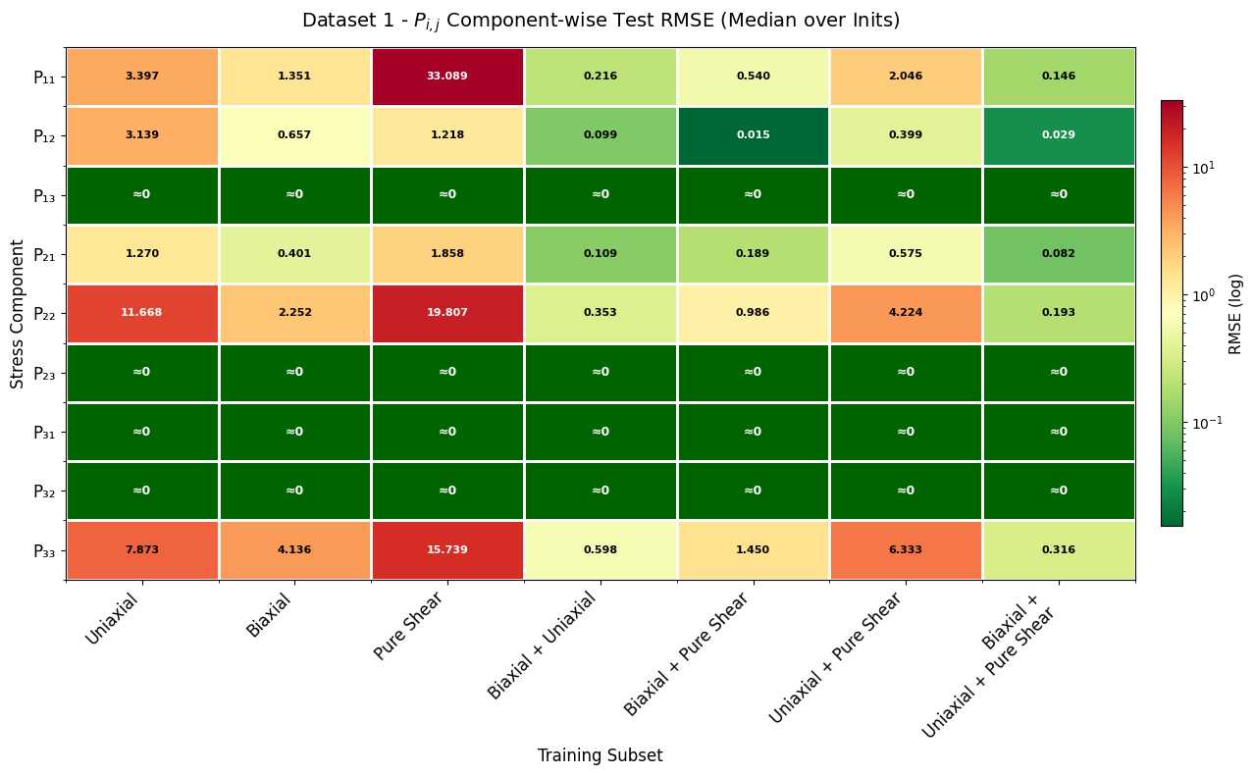

Training Set Variation
Scope: PANN
Key Observations:
Single Load Cases: Training on single cases does not generalize well.
Combined Load Cases: Combining load paths drastically improves generalization.
Best Performance when trained on all datasets.
Inits = different random Initialization
$$W^{I}=PANN\left(I\right)$$

Slide 17
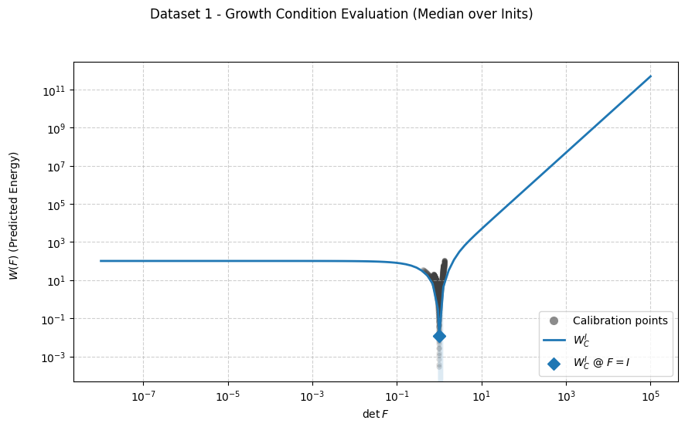
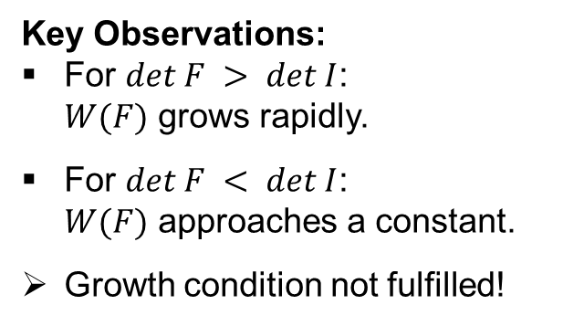

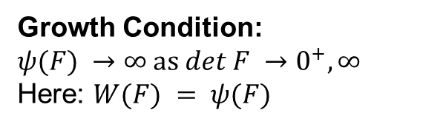
Dataset 1 –
Constitutive Conditions (1)
Growth Condition: $$ψ(F) →∞ as det F →0^{+}, ∞$$ Here: $W(F) = ψ(F)$
Key Observations:
For $det F > det I$: $W(F)$ grows rapidly.
For $det F < det I$: $W(F)$ approaches a constant.
Growth condition not fulfilled!
Inits = different random Initialization
${W^{I}}_{C}=PANN(I)$ that uses Sobolev Training

Slide 18
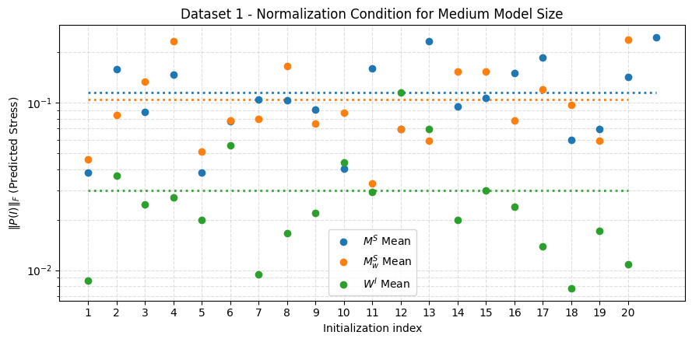
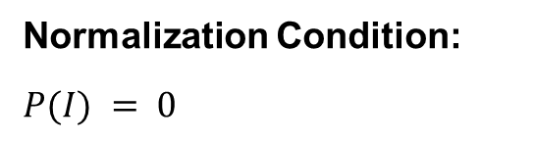
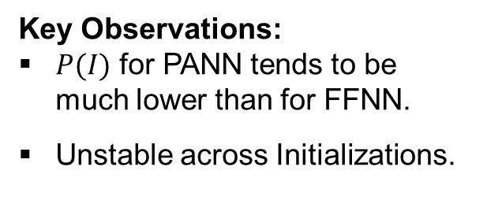
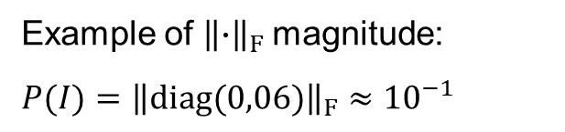
Dataset 1 –
Constitutive Conditions (2)
Normalization Condition:
$$P(I) = 0$$
Example of ${\left\|∙\right\|}_{F}$ magnitude:
$$P(I)={\left\|diag(0,06)\right\|}_{F}≈{10}^{−1}$$
Key Observations:
$P(I)$ for PANN tends to be much lower than for FFNN.
Unstable across Initializations.
Inits = different random Initialization
$W^{I}=PANN\left(I\right),{ M}^{S}=FFNN\left(C\right)$, $M_{W}^{S}=FFNN\left(C\right)$ uses Loss Weighted Strategy

Slide 19
Dataset 1 –
Key Takeaways
In all tests the PANN exhibited significantly lower RMSE than the naïve FFNN.
PANN benefits from diverse training set.
Growth condition not fulfilled by PANN.
PANN satisfies normalization condition more closely than FFNN.

Slide 20
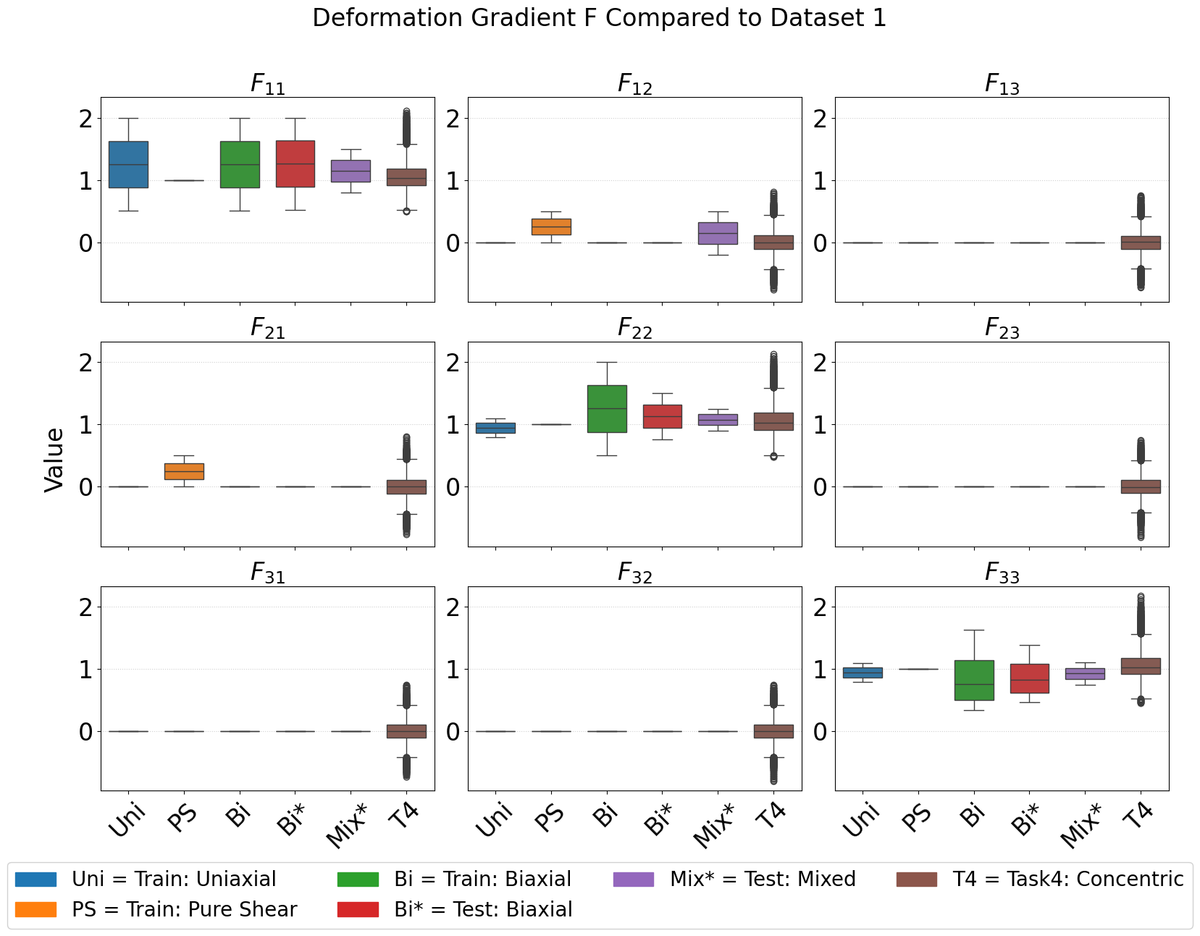


Dataset 2
Concentric sampling:
5.000 deformation gradients (vs. 600 in Dataset 1).
Covers all 9 components of $P$ including off-diagonal shear.
Enables comparison of FFNN vs. PANN with more training data.
Inits = different random Initialization
$$W^{I}=PANN\left(I\right),{ M}^{S}=FFNN\left(C\right)$$

Slide 21


Evaluation on Dataset 2
Inits = different random Initialization
$$W^{I}=PANN\left(I\right), { M}_{W}^{S}=FFNN\left(C\right) \text{uses} \text{Loss} \text{Weighted} \text{Strategy}$$

Slide 22
Dataset 2 –
Key Takeaway
PANN consistently provides much better predictions then naïve FFNN, especially for small datasets.

Slide 23

Dataset 3
Cubic Anisotropic Material:
7 Load Cases
2,060 Load Paths available.
414k Total Datapoints.
Training: Only basic load cases (Uniaxial & Simple Shear).
Test: Mixed Shear-Tension (Shear Combined).
Notes:
The complete database provided by Fernández et al. is huge,
containing over 2,000 load paths and 400,000 data points.
However, to prove the efficiency of our PANN model, we don't need all of it.
We intentionally select only a small subset (Uniaxial and Simple Shear) for calibration.
If the model works, it proves that physics-informed learning creates massive data efficiency.

Slide 24














Cubic Invariant Based PANN
$$Fεℝ^{9}$$
$$Cεℝ^{9}$$
$$Iεℝ^{6}$$
$$Wεℝ^{1}$$
$$\frac{∂W}{∂F}$$
$$Pεℝ^{9}$$
$$W_{cub}^{I}$$
$$F$$
$$C$$
$$I$$
$$ICNN∗$$
$$W$$
$$P$$
Thermodynamic Consistency: Via automatic differentiation ($P=\frac{∂W}{∂F}$).
Objectivity & Material Symmetry: Enforced by invariant inputs $I$.
Polyconvexity: ICNN* with non-negative weights in all layers.

Slide 25







Deformation Gradient PANN
$$Fεℝ^{9}$$
$$\{F, Cof F, det F\}εℝ^{19}$$
$$Wεℝ^{1}$$
$$\frac{∂W}{∂F}$$
$$Pεℝ^{9}$$
$$W^{F}$$
$$F$$
$$F, Cof F, det F$$
$$ICNN$$
$$W$$
$$P$$
Thermodynamic Consistency: Via automatic differentiation ($P=\frac{∂W}{∂F}$).
Objectivity : Not guaranteed. Learned via data augmentation.
Polyconvexity: Guaranteed by convex function of inputs ($F, Cof F, det⁡F$).
Weight Constraint relaxed: First hidden layer can have negative weights.

Slide 26



Dataset 3 –
Model evaluation
Key Observations:
Both PANNs exhibit low RMSE on training and test sets.
$W^{F}$ extrapolates better than ${W^{I}}_{cub}$.
${W^{F}}_{aug}$ only differs slightly in RMSE from $W^{F}$.
Inits = different random Initialization
${W^{I}}_{cub}= PANN(I),W^{F}=PANN(\{F, cof F, det F\}),$ ${W^{F}}_{aug}= PANN(\{F, cof F, det F\})$ that uses data augmentation

Slide 27



Dataset 3 – Component Eval
Scope: Test Data (Mixed Shear-Tension).
Both PANNs show similar RMSE magnitude and distribution over $P_{i,j}$.
Both PANNs underestimate stresses.
Inits = different random Initialization
${W^{I}}_{cub}=PANN\left(I\right), W^{F}=PANN(\{F, cof F, det F\}),$

Slide 28



Dataset 3 –
Constitutive conditions (1)
Growth Condition:
$$ψ(F) →∞ as det F →0^{+}, ∞$$
Here: $W(F) = ψ(F)$.
Key Observations:
For $det F > det I$: $W(F)$ grows rapidly.
For $det F < det I$: $W(F)$ approaches a constant.
Growth condition not fulfilled!
Inits = different random Initialization
${W^{I}}_{cub}= PANN(I),W^{F}=PANN(\{F, cof F, det F\}),$ ${W^{F}}_{aug}= PANN(\{F, cof F, det F\})$ that uses data augmentation

Slide 29




Dataset 3 –
Constitutive conditions (2)
Normalization Condition:
$$P(I) = 0$$
Example of ${\left\|∙\right\|}_{F}$ magnitude:
$$P(I)={\left\|diag(0,006)\right\|}_{F}≈{10}^{−2}$$
Key Observations:
$P(I)$ is very small for all PANNs.
Normalization condition is being approximately learned.
Inits = different random Initialization
${W^{I}}_{cub}= PANN(I),W^{F}=PANN(\{F, cof F, det F\}),$ ${W^{F}}_{aug}= PANN(\{F, cof F, det F\})$ that uses data augmentation

Slide 30




Dataset 3 –
Data Augmentation
Objectivity Errors Computed as:
$P_{err}=\left\|P\left(QF\right)−QP\left(F\right)\right\|,$
$W_{err}=\left|W\left(QF\right)−W\left(F\right)\right|$
Key Observations:
Increasing number of $Q_{obj}$ reduces objectivity error, but not indefinitely.
Objectivity is being approximately learned, but still much weaker than ${W^{I}}_{cub}$.
Inits = different random Initialization
${W^{I}}_{cub}= PANN(I),W^{F}=PANN(\{F, cof F, det F\}),$ ${W^{F}}_{aug}= PANN(\{F, cof F, det F\})$ that uses data augmentation

Slide 31
Dataset 3 –
Key Takeaways
Neither Invariant based- nor deformation gradient based PANNs learn growth condition!
Objectivity can be learned to a degree through data augmentation.
Learning normalization condition is improved with a larger training dataset!

Slide 32

Conclusion
PANN outperforms FFNN consistently across all datasets, especially with limited training data.
Normalization and objectivity can be approximately learned, growth condition not fulfilled.

Slide 33

Limitations
Cross-Model Comparability:
Use of distinct material data limits comparability across datasets.
Statistical Robustness:
Limited random initializations $(n_{inits}=5$) for Dataset 3 experiments reduce certainty of observations.
Experimental Scope:
Training duration and augmentation intensity exploration was limited due to computational ressources.

Slide 34

Backup – Dataset 1 Stress Tensor
Inits = different random Initialization
$$W^{I}=PANN\left(I\right),{ M}^{S}=FFNN\left(C\right)$$

