Slide 1
Tutorial Machine Learning in Solid Mechanics – Task 1
Alexander Pahl & Lukas Fromme

Slide 2
Objective
Model stress-strain behaviour of hyperelastic materials accurately, in interpolation and extrapolation
We use different NN based models and test different techniques to improve these models
Use some type of F based input and obtain P
We test on 3 differnet datasets
Learning Objective:
How to utilize physical knowledge to improve these models.

Slide 3
Agenda
1 Methodology
2 Two-dimensional functions
1.2 Dataset 1
2.1 Data Generation
1.3 Modeling Strategy xyz..
2.2 Trainable custom layer
2.3 Sobolev Training
2.4 Hyperelasticity

Slide 4
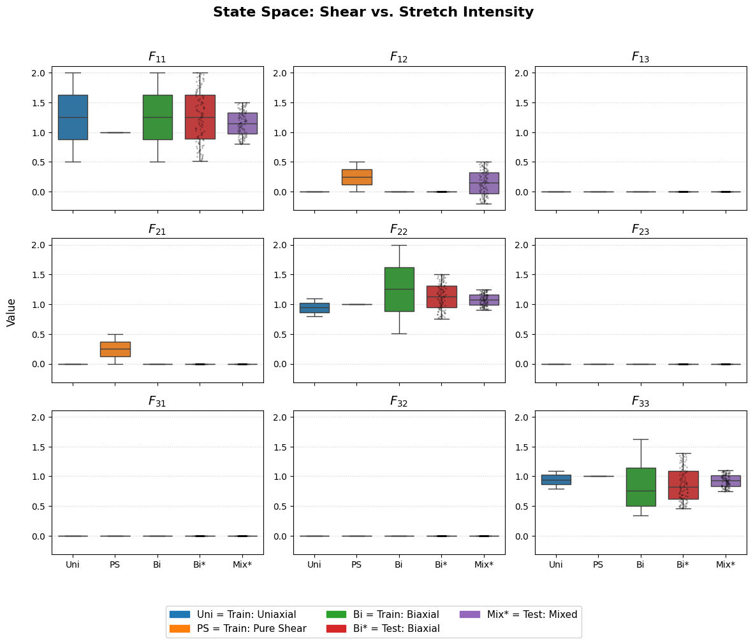
1 Introduction Dataset 1
Dataset 1 consists of n, F – P pairs….
Aa
Aa
Aa
Aa

Slide 5







FFNN – Architecture
From Task XXX
$$FFNN(C_{6}) →P,{ C}_{6}∈C$$
$$F$$
$$C$$
$$C_{idpdt.}$$
$$NN$$
$$P$$
…
$$C_{i,j}$$
Justification for restraining 1st layer weights of ICNN to be non-negative aswell:

Slide 6


Invariant Based PANN Architecture
$$F$$
$$C$$
$$I$$
$$ICNN$$
$$P$$

Slide 7
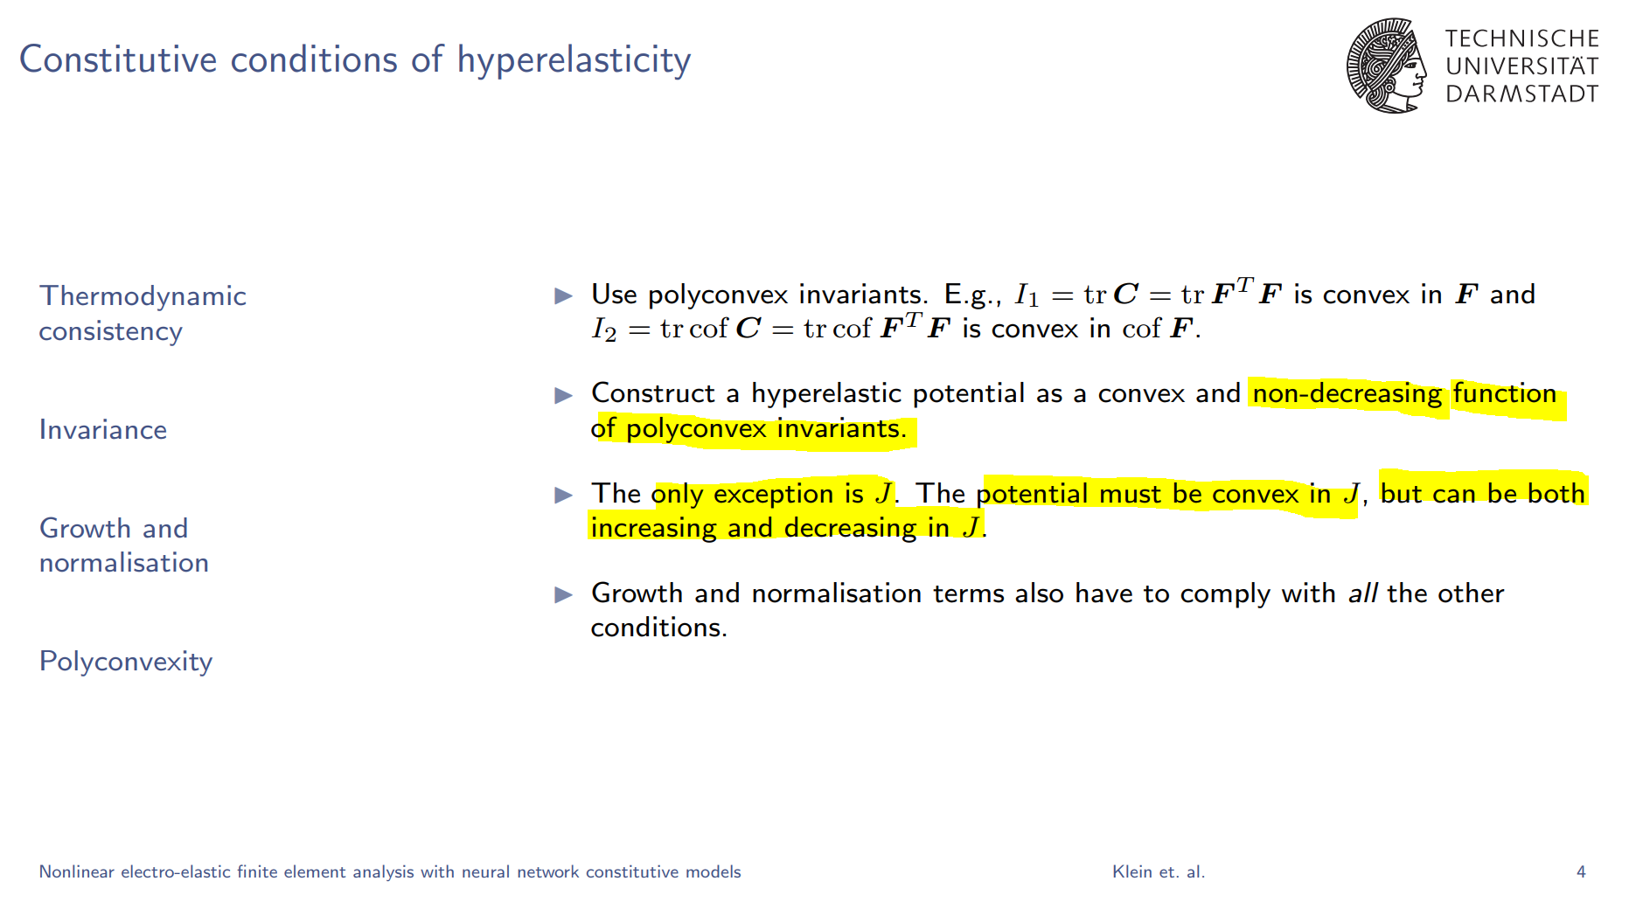
Invariant Based PANN Architecture
Justification for restraining 1st layer weights of ICNN to be non-negative aswell:

Slide 8
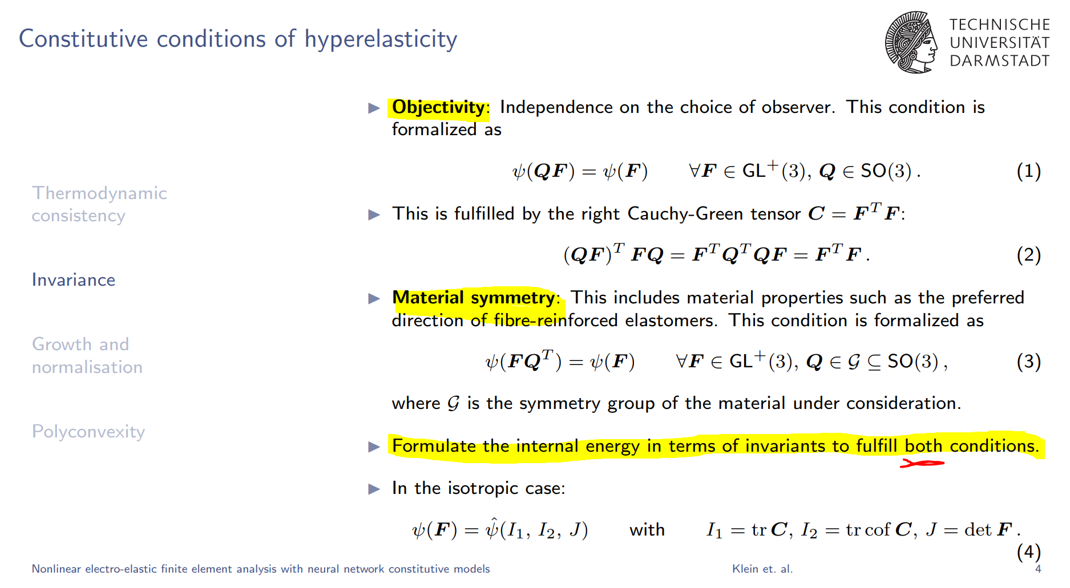
1 Model Task 3
Constitutive conditions for invariant based models:

Slide 9
FFNN Constitutive Conditions

Slide 10
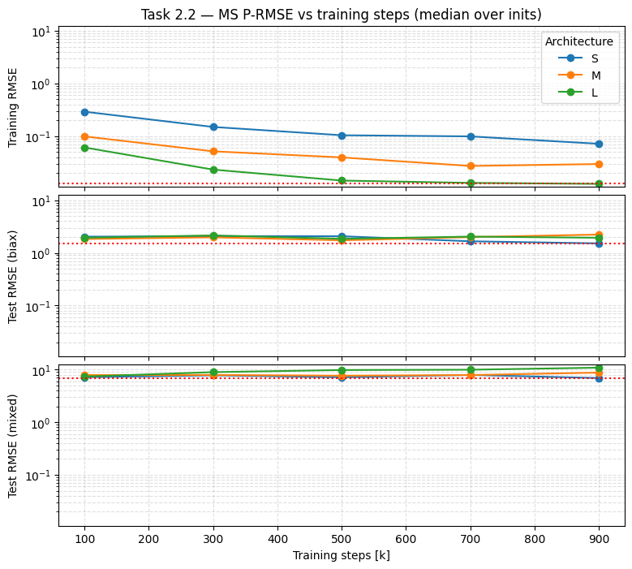
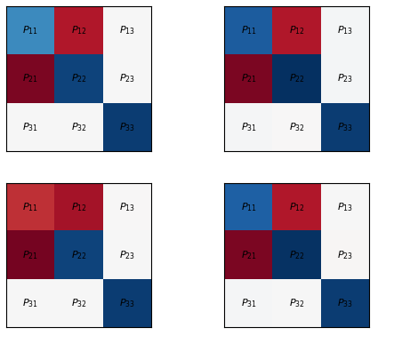
FFNN Stress
PANN _medium
FFNN _medium
RMSE
Bias

Slide 11
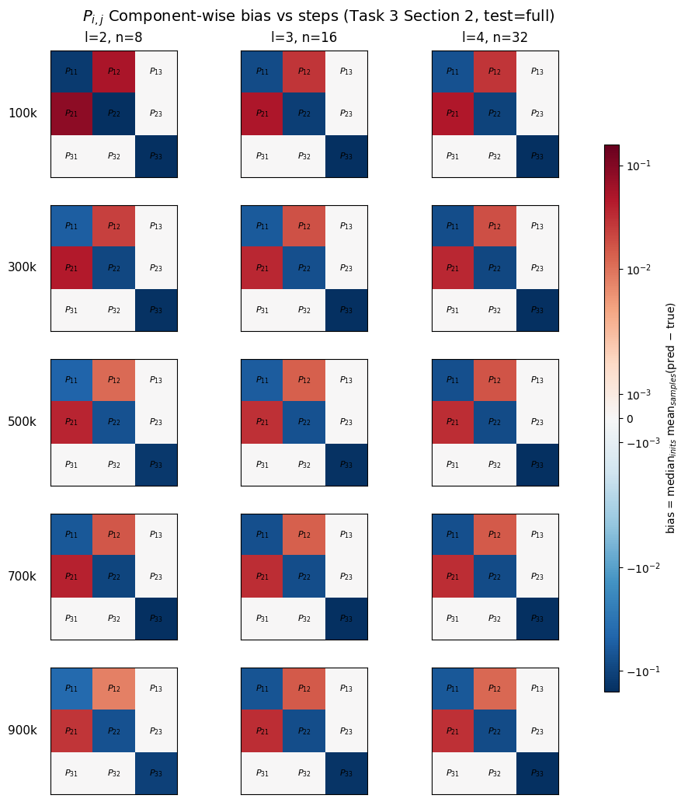
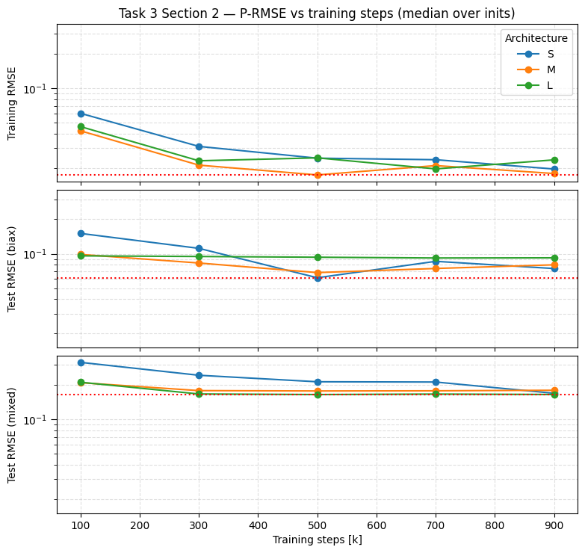
Invariant Based PANN Evaluation - Stress

Slide 12
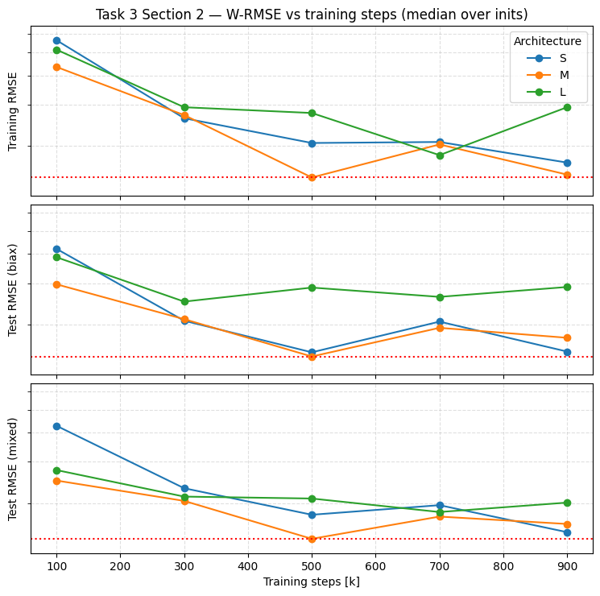
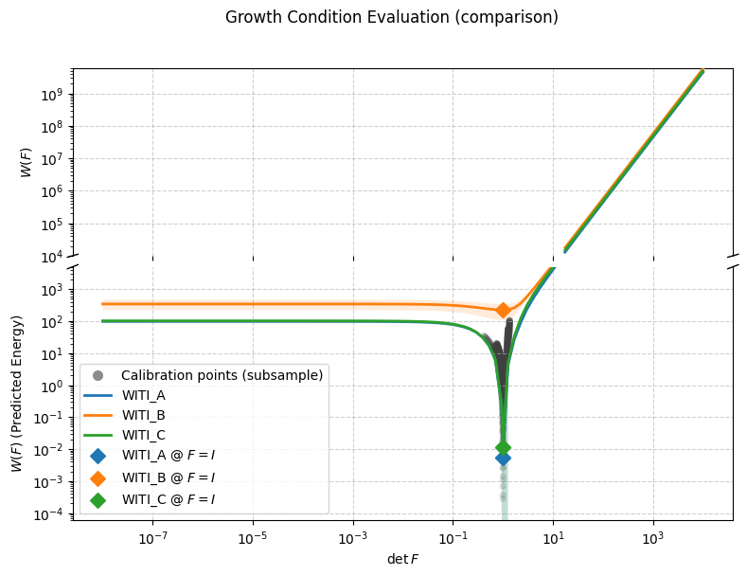
Invariant Based PANN Evaluation - Energy

Slide 13
Invariant Based PANN Constitutive Conditions

Slide 14
Introduction Dataset 2
Dataset 1 consists of n, F – P pairs….
Aa
Aa
Aa
Aa

Slide 15
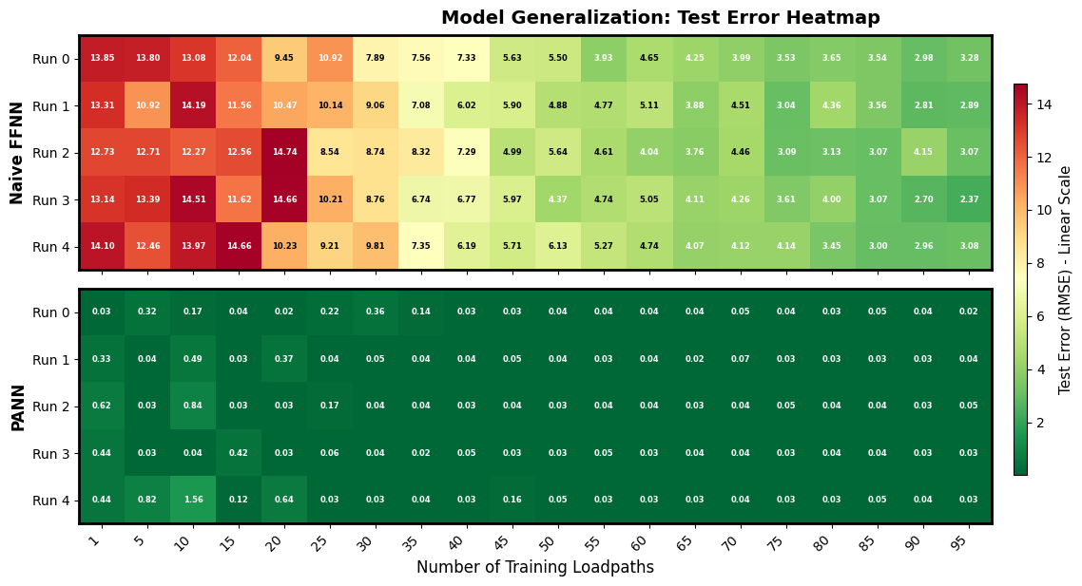
Evaluation on Dataset 2

Slide 16
Introduction Dataset 3
Dataset 1 consists of n, F – P pairs….
Aa
Aa
Aa
Aa

Slide 17
Deformation Gradient Based PANN Architecture

Slide 18
Invariant Based PANN (cubic) Architecture

Slide 19
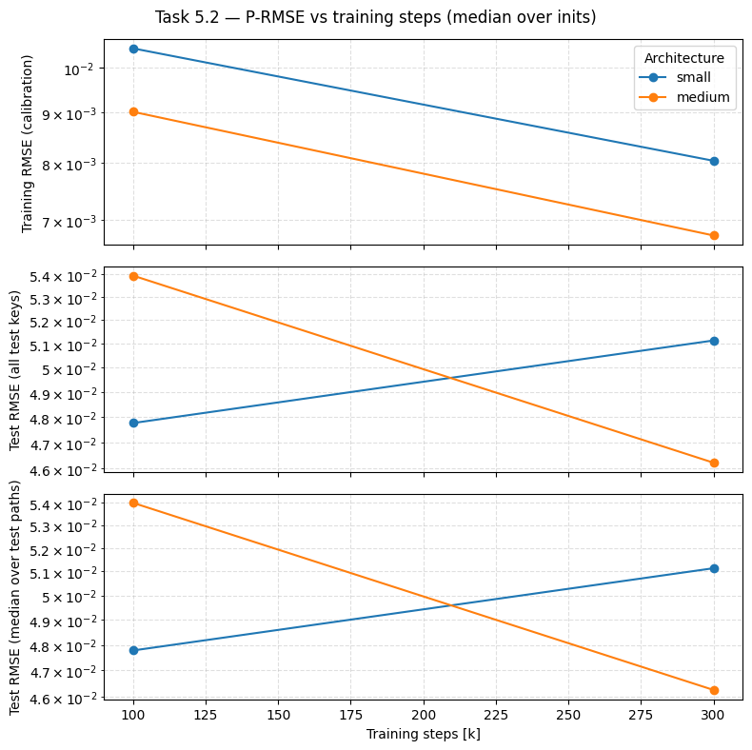
Invariant Based PANN Evaluation - Stress

Slide 20
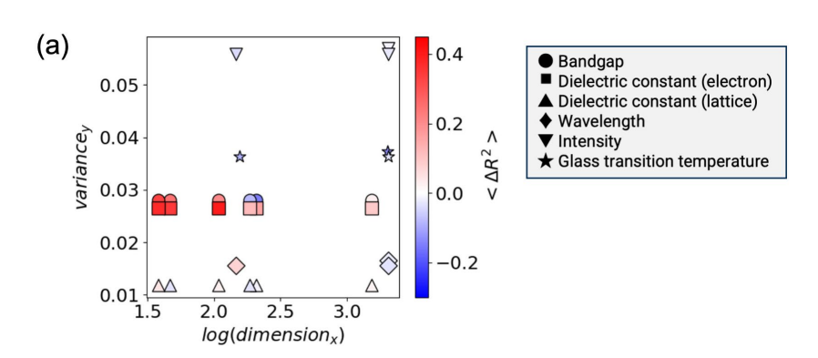
Conclusion
Grafik die alle modelle abschließend vergleich, maybe noch verschiedene datasets einbauen oder so
Idee: X-Achse = „Number Datapoints used for training“ → man sollte sehen, dass bei komplexerem datenset mehr datapoints benötigt werden und man sollte sehen, dass PANNs overall weniger datapoints brauchen und mit mehr datapoints sich weniger verbessern als FFNN
Note: Zwei von diesen plots, einer für TI und einer für cub datasets
Error RMSE
# Model Parameters
# Datapoints in Training set

