Slide 1

Scoot-e cell tests
Status update CW7/23

Slide 2
Key take-aways:
Test temperature shows 2x higher influence on capacity retention compared to mean SOC and DOD at warranty life througput.
C-rates show only marginal influence on capacity retention.
DOD and temperature show strongest influence on capacity decay rate at early life throughput.
2 subsequent projects identified to de-risk cell degradation due to temperature and DOD.

Slide 3
Correlation of capacity retention at 1500whwh and ist stress factors
Focus on: Temperature
*SOH_capacity @1500 fce was extrapolated for cell 1,10 12,14

Slide 4
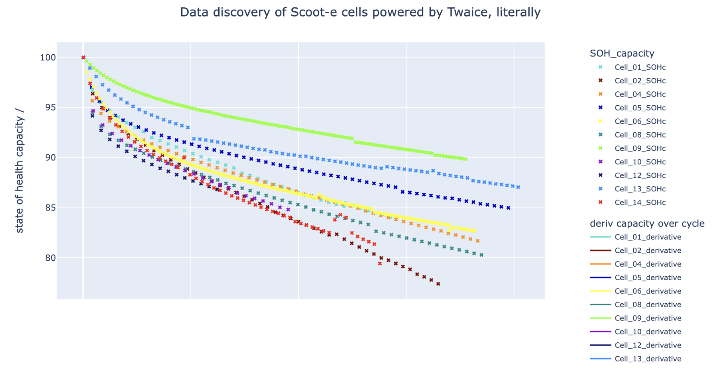
40°C results show lowest capacity retention
T25
T10
T10
T40
T40

Slide 5
Correlation of capacity decay rate at 25 whwh and its stress factors
Focus on: DOD and T.

Slide 6
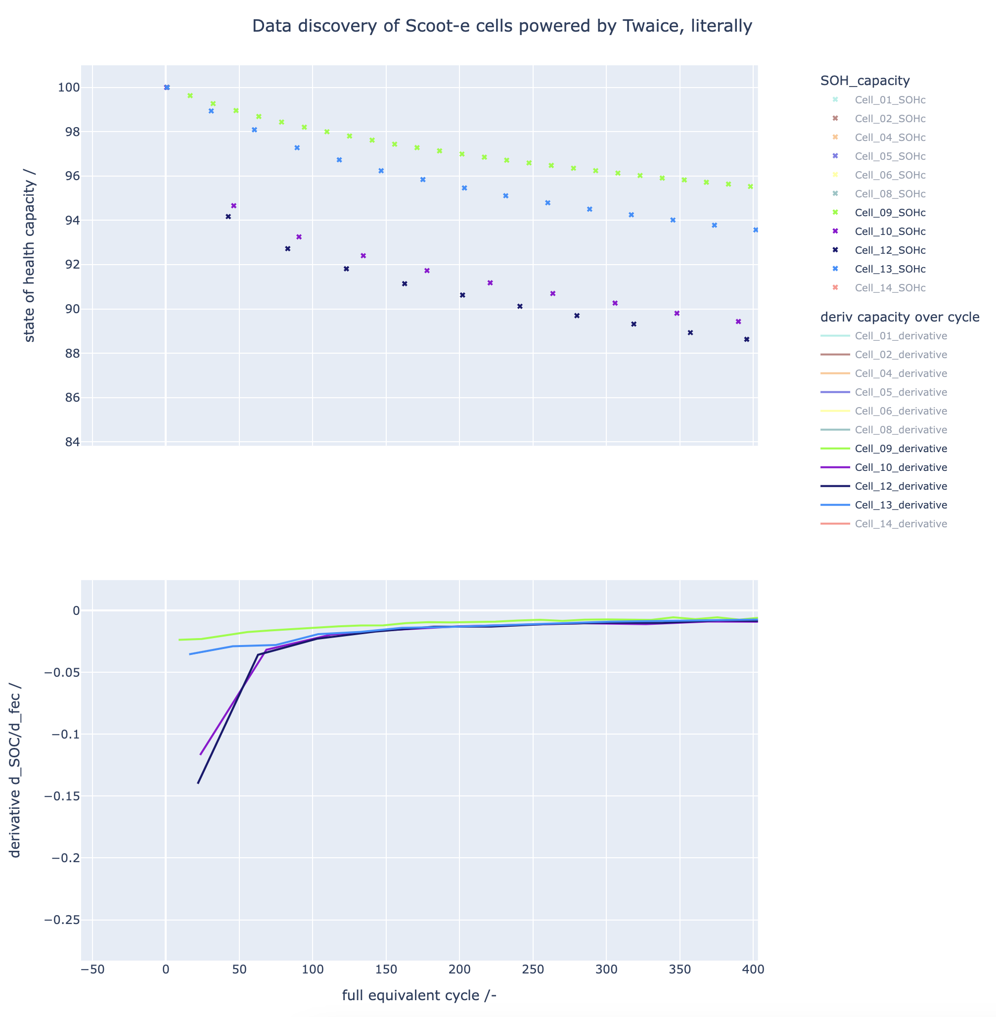
DOD100 cells show highest rate of decay
DOD30-60
DOD100

Slide 7
Next steps
Project 1: De-risk identified temperature influence on degradation further. Check operating temperaratues of fleet to identify %-ile of scooters at >25C.
Project 2: Limit DOD usage for first 50 whwh. Twaice to offer “pre-cycling” at DODs <60, then release cells to customer (or into scooters)

Slide 8
Ressources
Interactive plot as html: LINK
Jupyter notebook: LINK
Correlation analysis: LINK

Slide 9
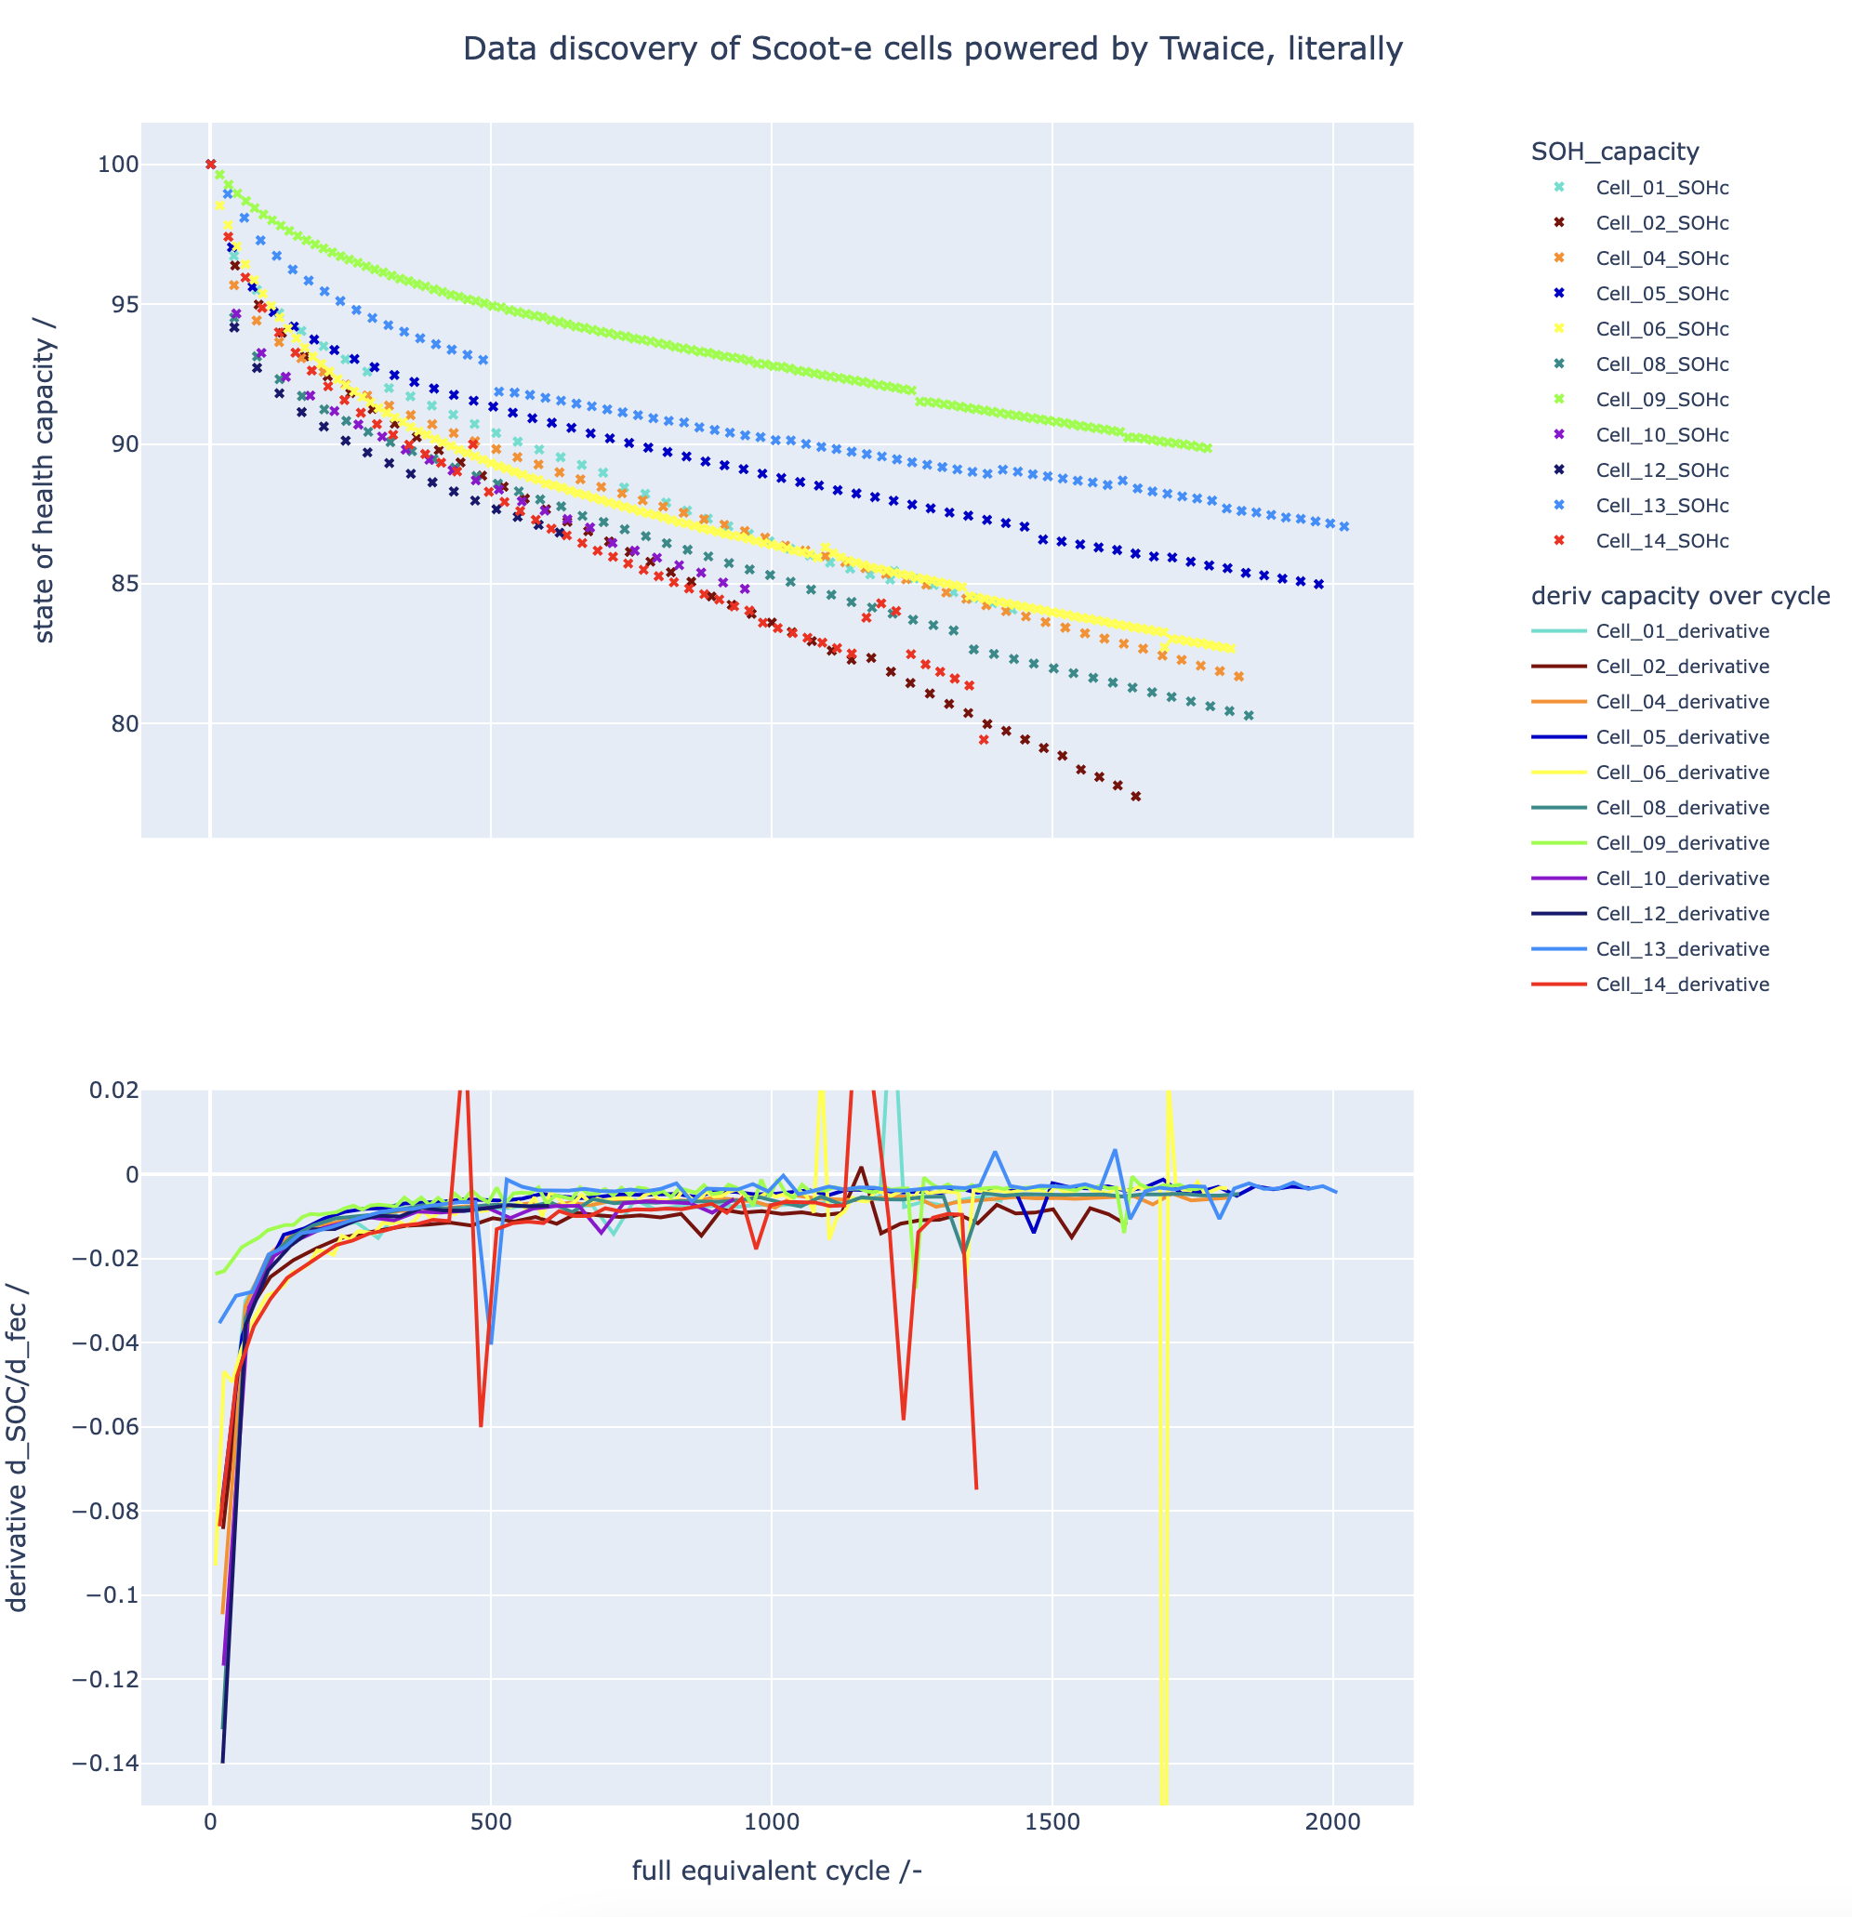
Cycle date
Cell | T | mSOC | DOD | C_ch | C_dis | SOH_* @1500 fce
9 | 25 | 20 | 30 | 1 | 1 | 91
13 | 10 | 40 | 60 | 1 | 2 | 89
5 | 10 | 50 | 100 | 1 | 1 | 87
1 | 25 | 50 | 100 | 1 | 2 | 84
4 | 25 | 50 | 100 | 1 | 1 | 84
6 | 25 | 80 | 30 | 1 | 1 | 84
8 | 25 | 50 | 60 | 1 | 1 | 82
10 | 25 | 50 | 100 | 0.5 | 0.5 | 82
12 | 25 | 50 | 100 | 1.4 | 2.3 | 82
2 | 40 | 50 | 100 | 1 | 1 | 79
14 | 40 | 40 | 60 | 1 | 2 | 78
*SOH_capacity @1500 fce was extrapolated for cell 1,10 12,14

Slide 10
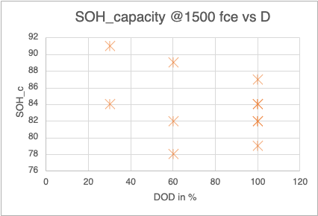
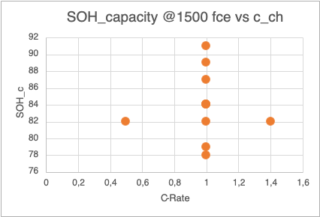
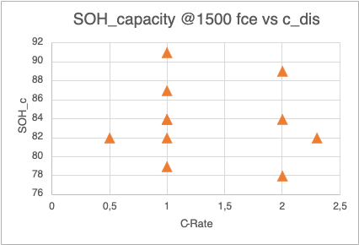
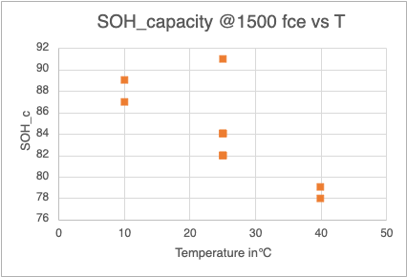
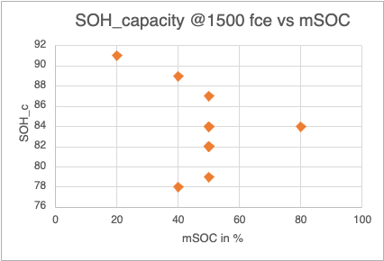
Stress factors on SOH_capacity
Data here: LINK

