Slide 1
Distributing Workloads on computing nodes
Lukas Kaufmann

Slide 2
Problem
Distributing some set of Workloads among many computational nodes
Meant to simulate the distribution of tasks to different machines in a cloud environment
Not meant to optimize for shortest time but for minimum resources required
Two classes of jobs available

Slide 3
Jobs
Some characteristics have to be known about the required resources
Can come from previously running the jobs (and now redistributing the jobs)
Static code analysis
cpu-/storage-/io-heavy
Regular and irregular triggers
Average utilization of resources and maximum utilization have to be known
modeled without units because couldn‘t find appropriate dataset

Slide 4
Genome Encoding
Repeats for the number of workloads
0
1
0
1
1
0
0
0
0
1
0
1
1
0
0
0
….
encodes task id
encodes node id

Slide 5
Implementations
Regular two point crossover
random bitflips
switching part of genomes with encóded node id‘s => lead to good improvements

Slide 6
Fitness
Simulate processing the schedule
Punish overutilization
Reward near-zero utilization of a node => node isn‘t needed (cost reduction)
Fast response time => unsure how to implement for now

Slide 7
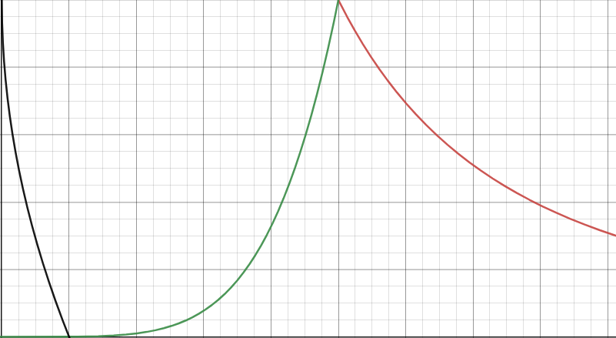
Mapping utilization to fitness
1
Fitness
0
0
Utilization
1

Slide 8

Implementation

Slide 9
References
Jang, Sung Ho, et al. "The study of genetic algorithm-based task scheduling for cloud computing." International Journal of Control and Automation 5.4 (2012): 157-162.
Pezzella, Ferdinando, Gianluca Morganti, and Giampiero Ciaschetti. "A genetic algorithm for the flexible job-shop scheduling problem." Computers & operations research 35.10 (2008): 3202-3212.
Agarwal, Mohit, and Gur Mauj Saran Srivastava. "A genetic algorithm inspired task scheduling in cloud computing." 2016 International Conference on Computing, Communication and Automation (ICCCA). IEEE, 2016.
https://github.com/KonstantinLukaschenko/genetic-algorithm-kotlin

