Slide 1
Distributing Workloads on computing nodes
Lukas Kaufmann

Slide 2
Problem
Distributing some set of Workloads among many computational nodes
Meant to simulate the distribution of tasks to different machines in a cloud environment
Not meant to optimize for shortest time but for minimum resources required
Two classes of jobs available

Slide 3
Jobs
Some characteristics have to be known about the required resources
Can come from previously running the jobs (and now redistributing the jobs)
Static code analysis
cpu-/storage-/io-heavy
Regular and irregular triggers
Average utilization of resources and maximum utilization have to be known
modeled without units because couldn‘t find appropriate dataset

Slide 4
Genome Encoding
Repeats for the number of workloads
0
1
0
1
1
0
0
0
0
1
0
1
1
0
0
0
….
encodes task id
encodes node id

Slide 5
Implementation of fitness
Evaluate genome by turning it into map of nodes and collection of loads
calculate expected utilization per node (considering both levels of loads, secondaries can exceed the available resources for maximum required resources)
From given information about the workloads
stop algorithm if there has been minimal change in the best fitness in 2000 generations

Slide 6
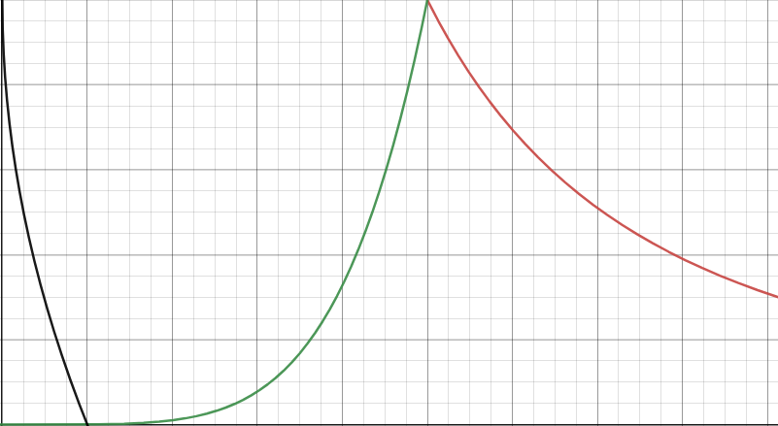
Mapping utilization to fitness
1
Fitness
0
0
Utilization
1

Slide 7
Problems encountered
Fitness value depends largely on ratio of nodes and work
only small changes in fitness => modified mutation helped
performance
no fitting dataset

Slide 8
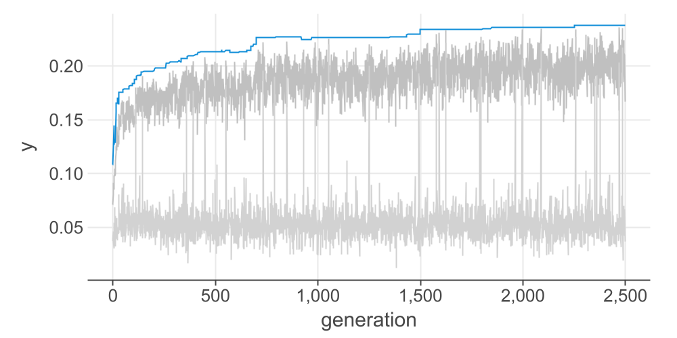
Fitness of 100 nodes 1000 jobs

Slide 9
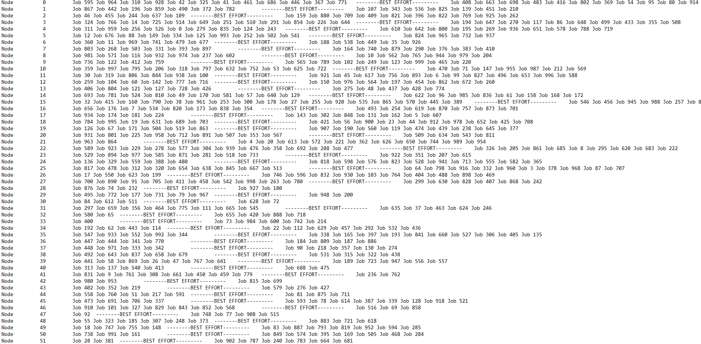
Produced Schedule as Txt

Slide 10
References
Jang, Sung Ho, et al. "The study of genetic algorithm-based task scheduling for cloud computing." International Journal of Control and Automation 5.4 (2012): 157-162.
Pezzella, Ferdinando, Gianluca Morganti, and Giampiero Ciaschetti. "A genetic algorithm for the flexible job-shop scheduling problem." Computers & operations research 35.10 (2008): 3202-3212.
Agarwal, Mohit, and Gur Mauj Saran Srivastava. "A genetic algorithm inspired task scheduling in cloud computing." 2016 International Conference on Computing, Communication and Automation (ICCCA). IEEE, 2016.
https://github.com/KonstantinLukaschenko/genetic-algorithm-kotlin

