Slide 1
Encryption modes
“Hands-on theoretical workshop”
Martin Ukrop mukrop@mail.muni.cz
Faculty of Informatics, Masaryk University
1
Notes:
1

Slide 2

Need for encryption...
2

Slide 3
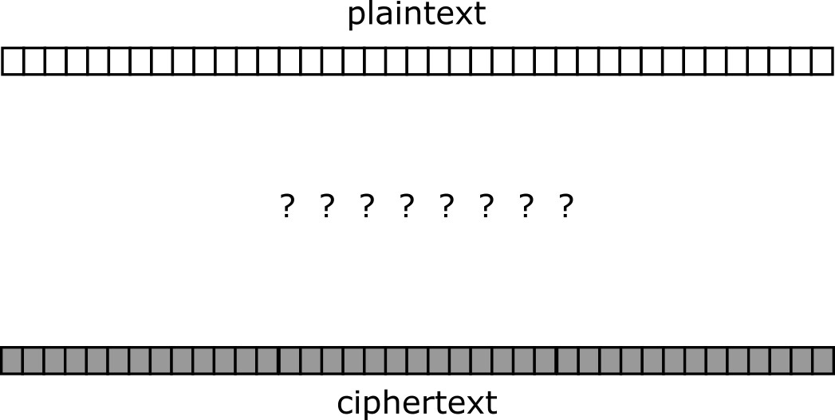
Need for encryption...
3

Slide 4
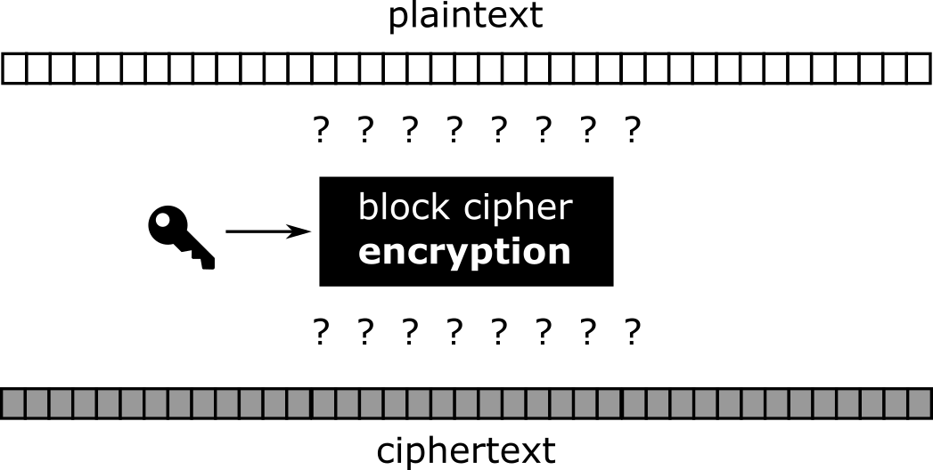
Block cipher to help!
4

Slide 5
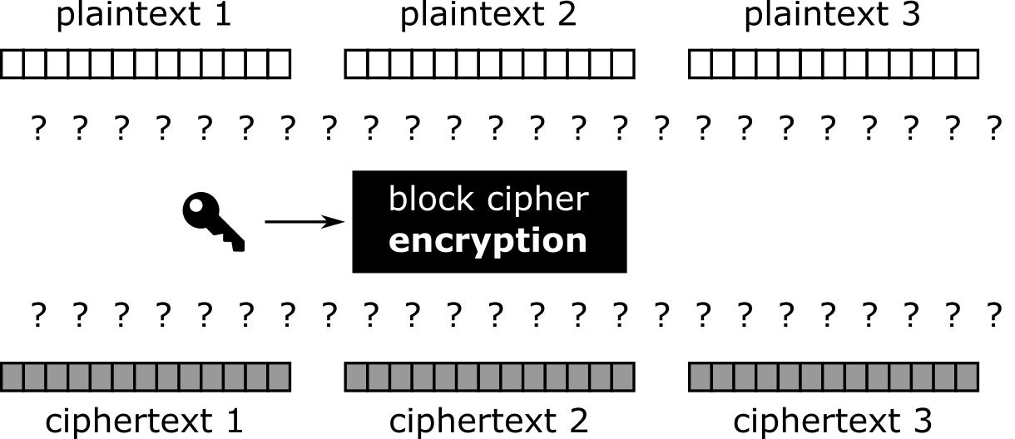
Cutting plaintext in small, workable pieces
5

Slide 6
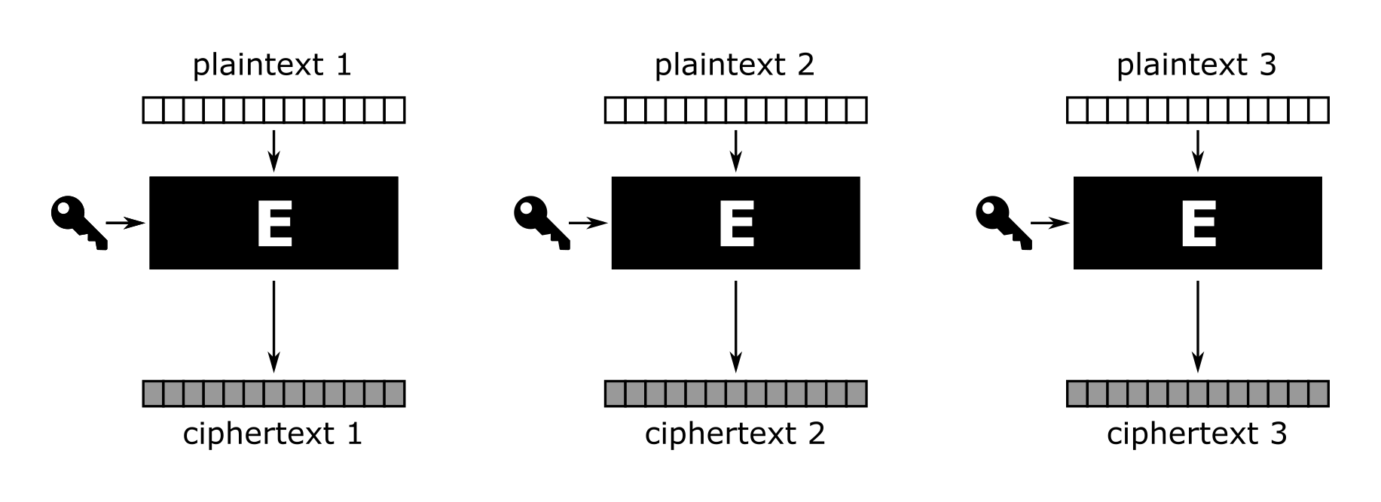
Electronic code book (ECB)
6

Slide 7
Encrypting TUX (ECB)
7

Slide 8

Encrypting TUX (ECB)
8

Slide 9
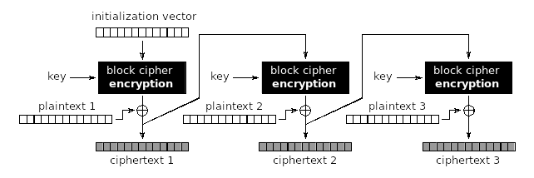

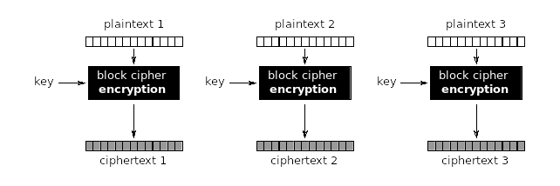
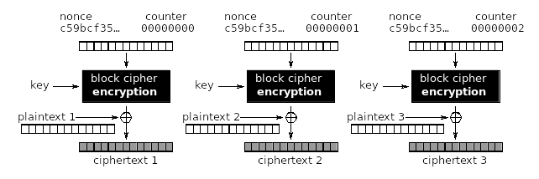
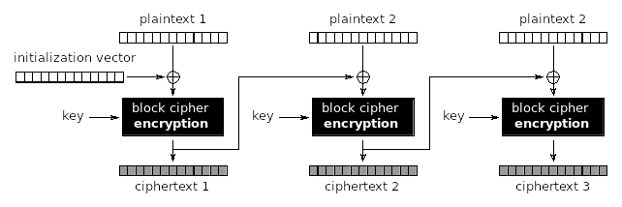
We can do better...
9

Slide 10
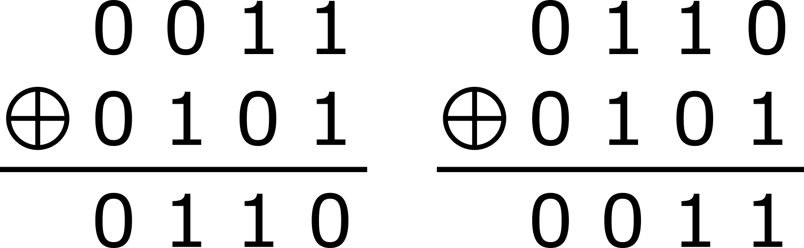
Features of XOR (eXclusive OR)
10

Slide 11
Features of XOR (eXclusive OR)
11

Slide 12
Thank you for your attention.
Questions are welcome!
Martin Ukrop mukrop@mail.muni.cz
Faculty of Informatics, Masaryk University
12

