Slide 1


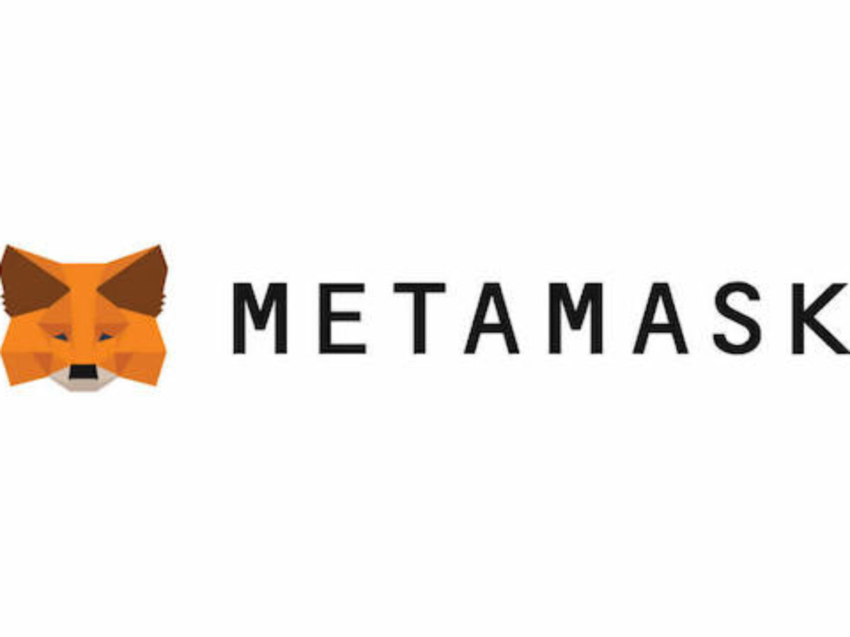

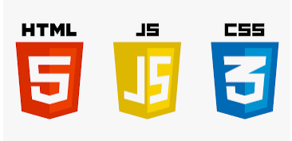




Browser
Signer
Internet
Front-end
JSON RPC
Provider
NFTCollection
NFTMarketplace
Smart Contracts
Ethereum Virtual Machine
Meta Data Storage
Block
Block
Block
Etherum Blockchain

Slide 2
User opens the website
Marketplace requires a wallet
User creates (mints) a NFT
User creates (mints) a NFT
NFT is visible in users collection
The marketplace will handle the transfer of funds, ownership and removes the NFT from sale
Other user can buy the NFT
User sets NFT for sale

Slide 3

Backend
(Metadata and Image)
Metadata
Frontend
NFT Smart Contract
URI of NFT
Image

