Slide 1
React

Slide 2
Agenda
About React
Key Concepts
Elements and Components
Additional Functionalities
Showcase

Slide 3
”A JavaScript library for building user interfaces”

Slide 4
History
Created at Facebook (now Meta)
First used on Facebook’s Newsfeed
Open-source since 2013
Currently on version 18.2.0

Slide 5
Used by e.g.
Yahoo
Bing
Pinterest
Paypla

Slide 6
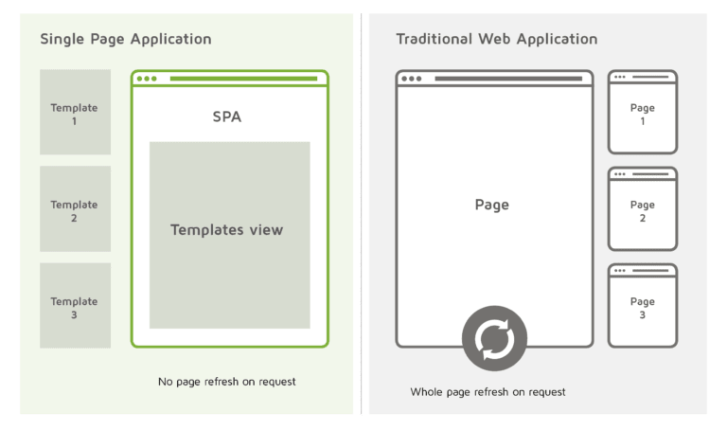
Single Page Application

Slide 7
Virtual DOM
DOM – Document Object Model
Ideal representation of UI
Real DOM matches changes made in Virtual DOM

Slide 8
JSX
Syntax extension for JavaScript
Describe what UI should look like
Mix of JavaScript and Markup (HTML)
Produces JS Objects -> React Elements

Slide 9
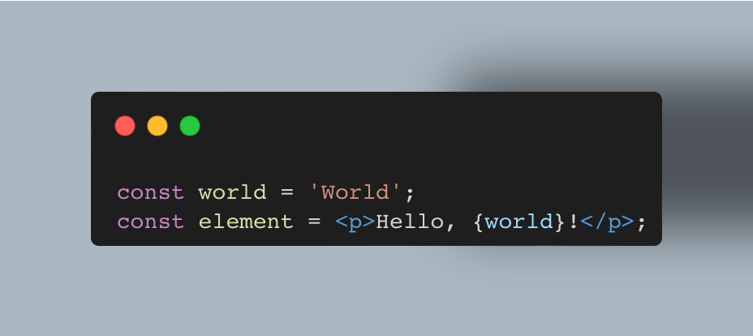
JSX and React Elements

Slide 10
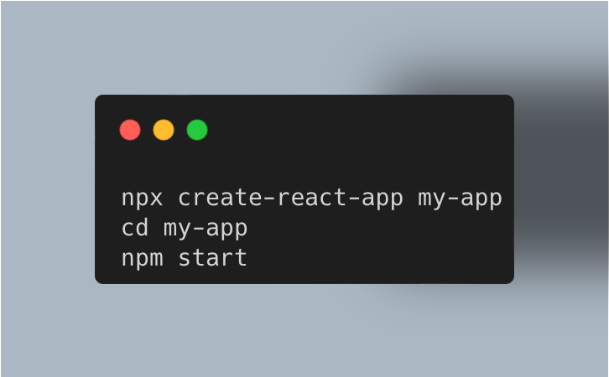
Setup and Structure

Slide 11
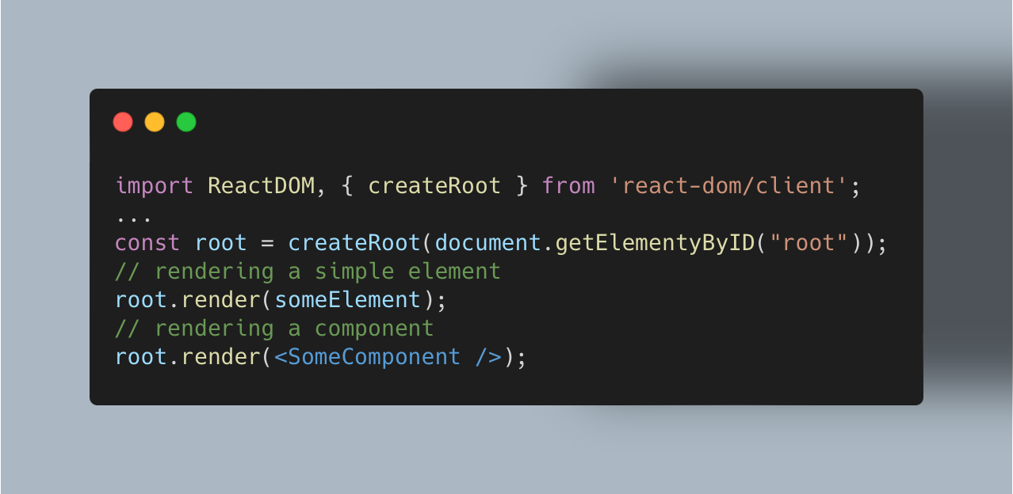
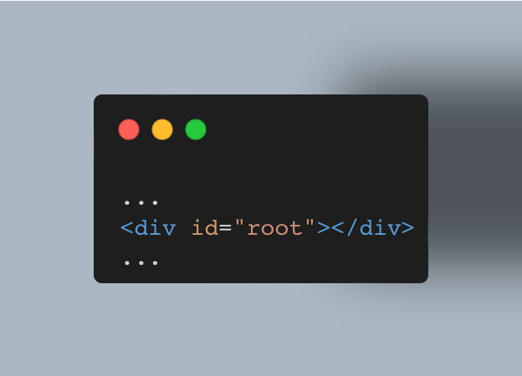
Rendering Elements and Components

Slide 12
Components
Divide and Conquer
Reusable and independent
Conceptually like JavaScript functions
interfaces

Slide 13
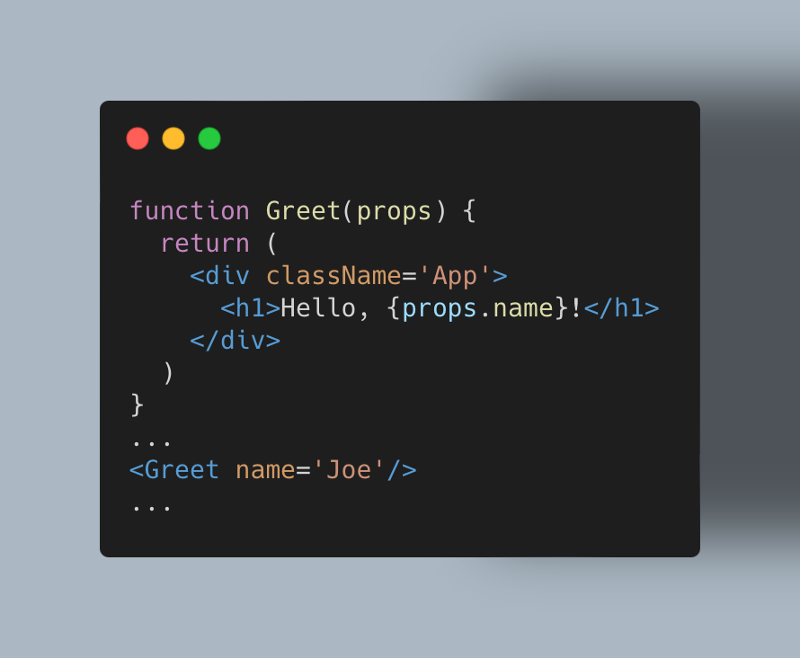
Simple function components

Slide 14
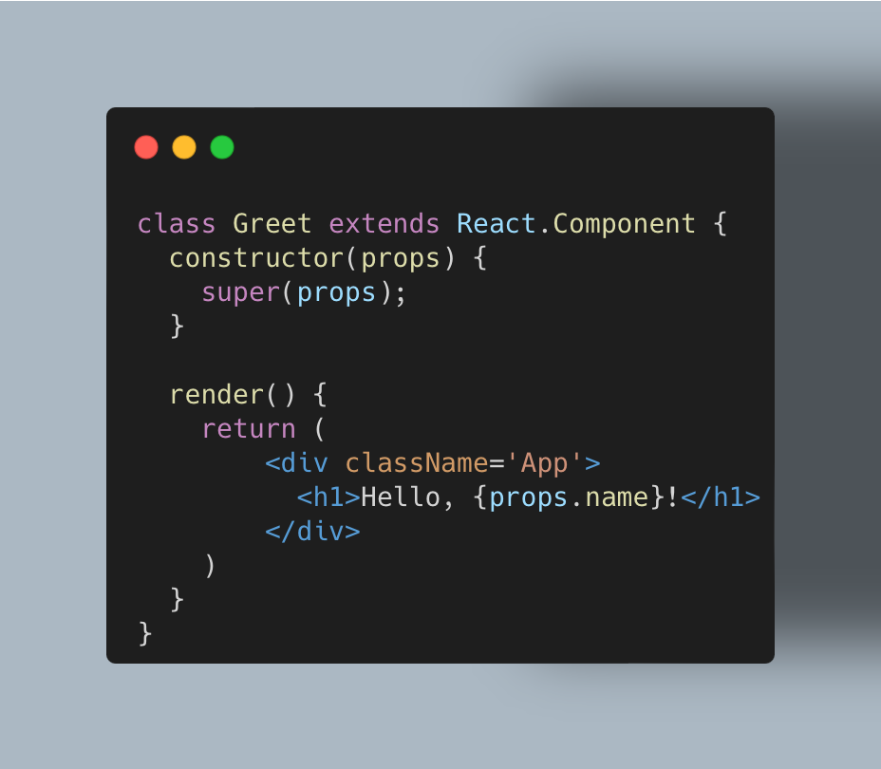
Simple Class Components

Slide 15
State and Lifecycle

Slide 16
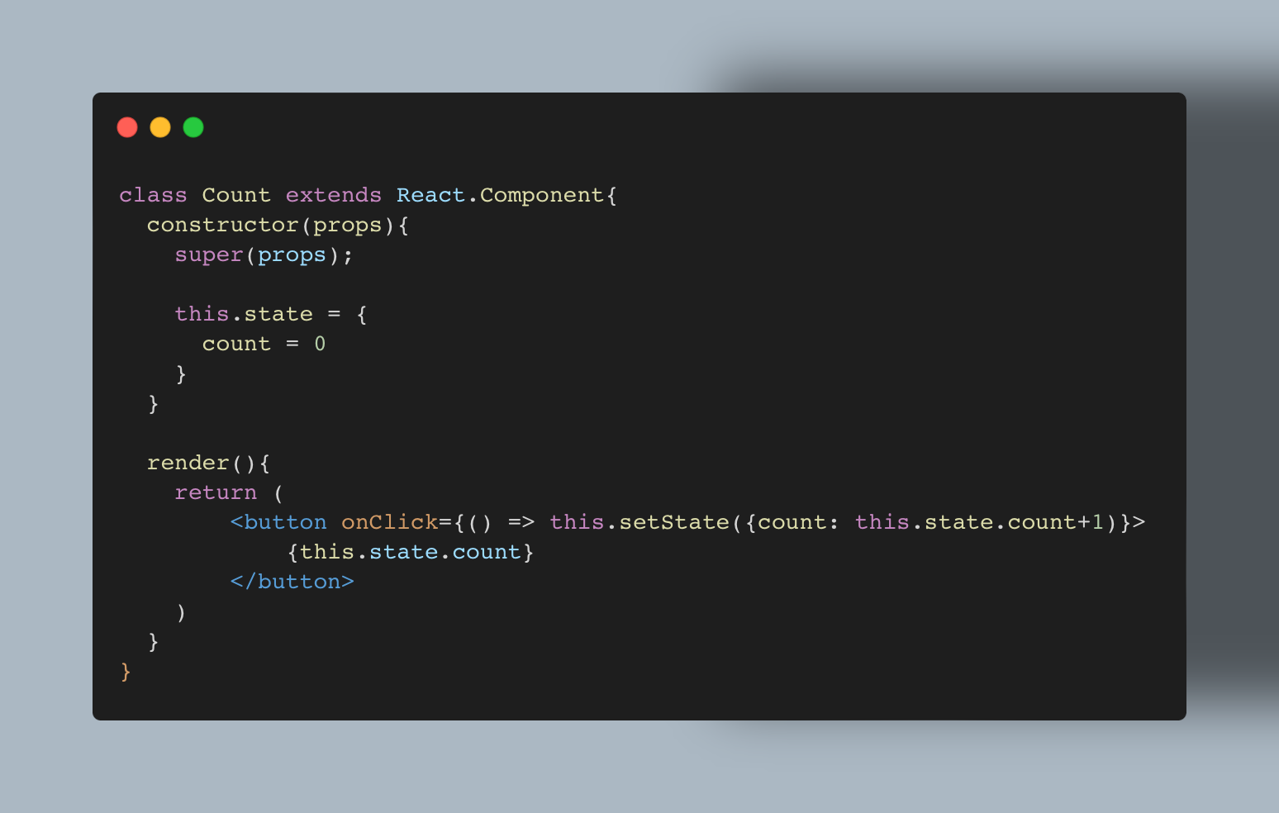
Stateful Class Components

Slide 17
Hooks – stateful function components
Hook into React features like Elements
Adding State and Lifecycle
No classes needed
useState() -> add State to React functions
useEffect() -> perform Side Effects in React functions

Slide 18
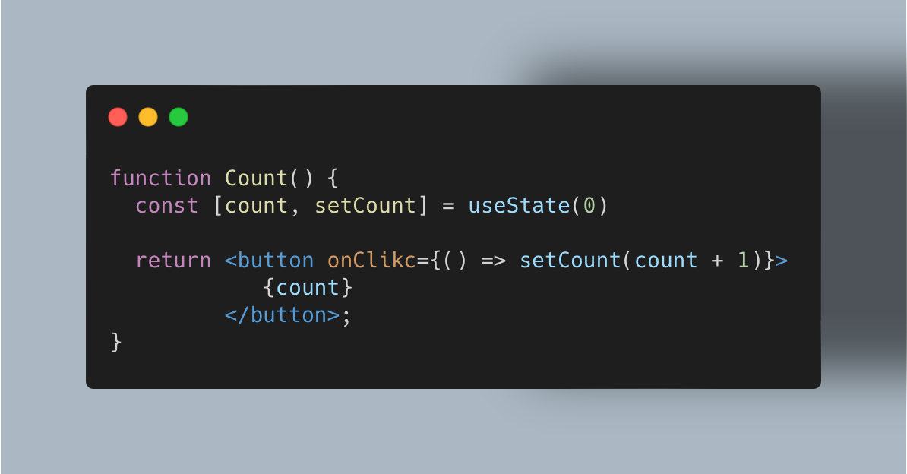
useState()

Slide 19
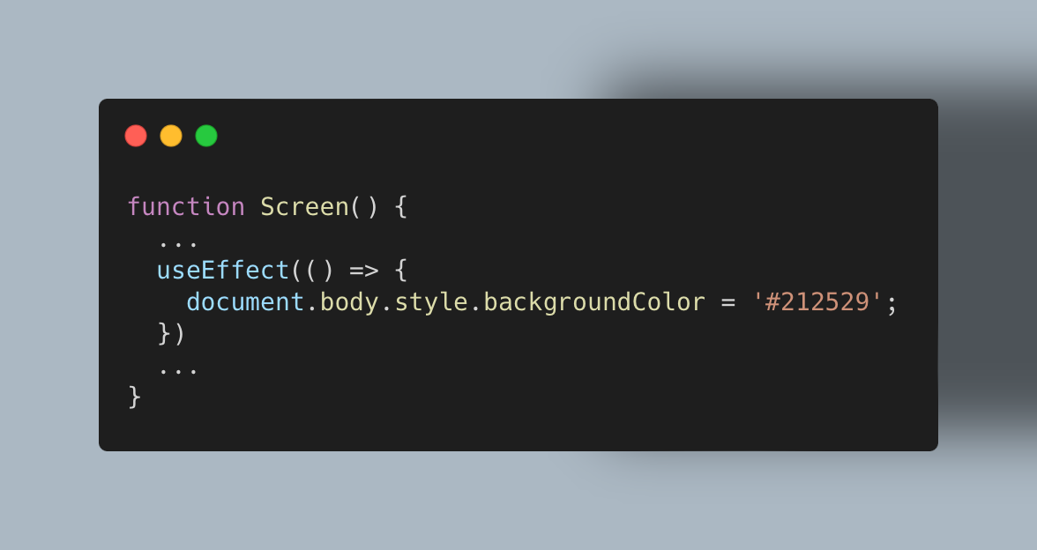
useEffect()

Slide 20
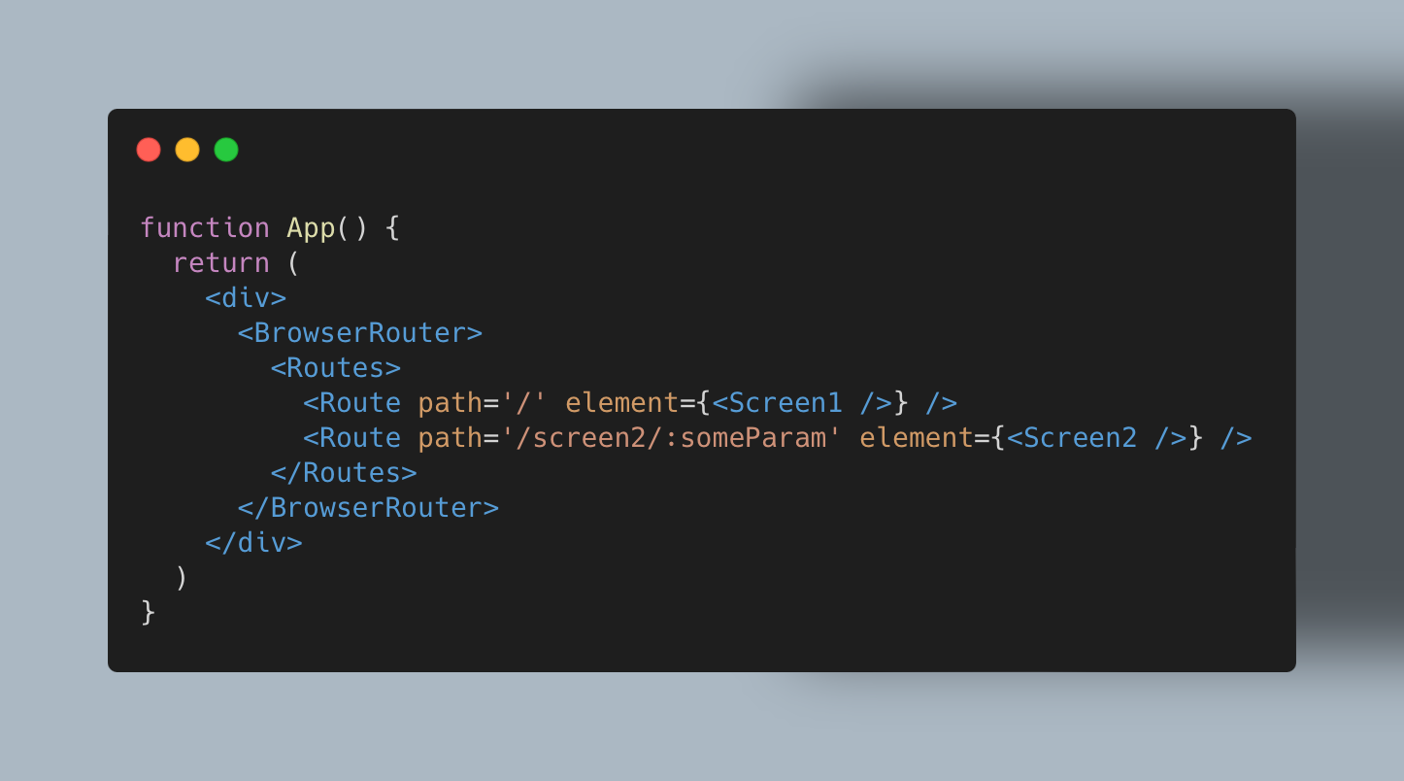
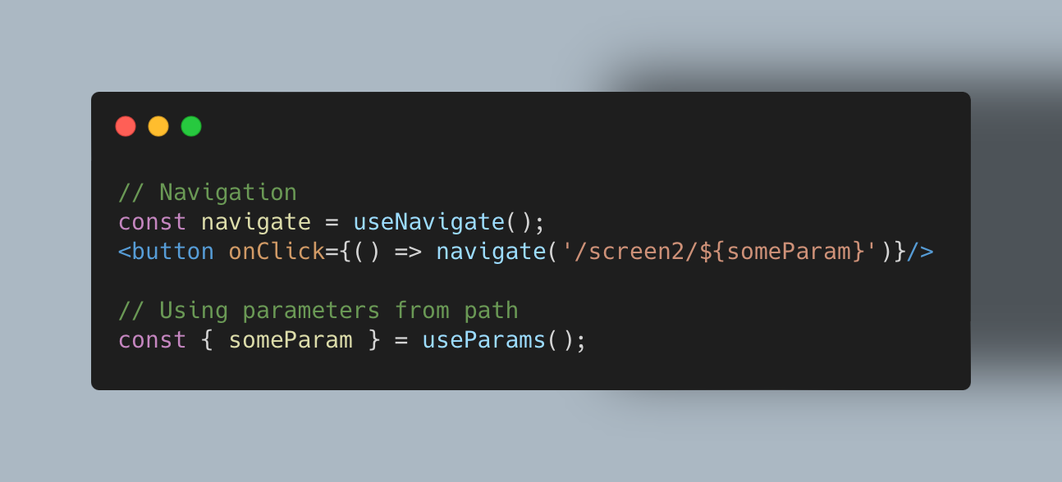
Routing

Slide 21
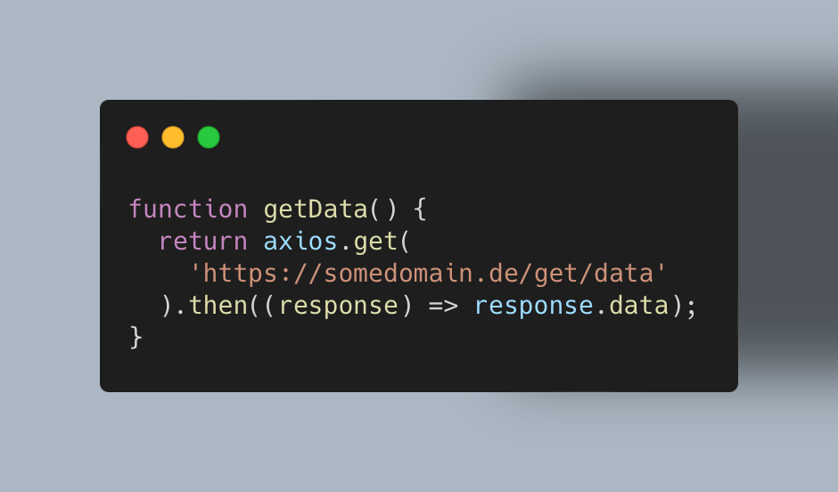
Axios

Slide 22
Showcase

Slide 23
Thank you for your attention!

Slide 24
Sources
http://reactjs.org
https://www.slideshare.net/BojanGolubovi/react-workshop-presentation

