Slide 1
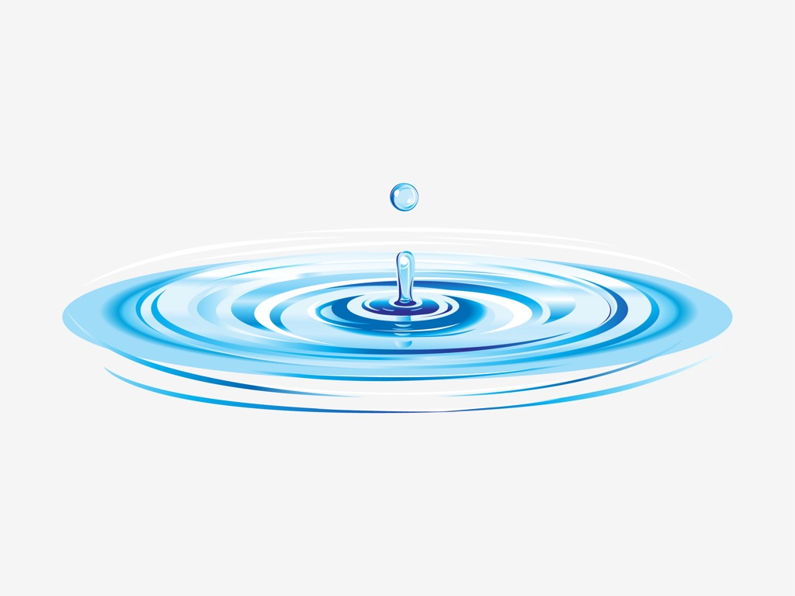
Shallow Water Equations
AG: HPC
https://www.freevector.com/water-ripples-vector

Slide 2
Shallow Water Equations (SWE)
Navier-Stokes
SWE
Domain/BC
Solver
HPC
Approximations
Source Terms
Structured Grid
Finite Volume
High Order
Scalability
Parallelization
Notes:
Continuity: Incompressible -> local fluid volum is preserved!

Slide 3

Navier Stokes
Mass conservation:
$∂_{t}ρ + ∇(ρu)=0$
Momentum conservation:
$∂_{t}\left(ρu\right)+∇(ρu⊗u) =−∇p+∇τ+ρg$
Terminology:
- $ρ$: fluid density
- $u$: velocity field
- $p$: pressure
-$τ$: stress tensor
Notes:
Continuity: Incompressible -> local fluid volum is preserved!

Slide 4

Navier Stokes
Approximations:
(1) Constant density: $ρ=$const.
(2) Newtonian fluid: $τ∝∇u$ , $μ=$const.
Navier Stokes (v2):
$ρ(∂_{t}u+(u⋅∇)u) =−∇p+μ∇u+ρg$
Notes:
Continuity: Incompressible -> local fluid volum is preserved!

Slide 5



Navier Stokes
Approximations:
(3) Shallow Domain: $\frac{H}{L} ≪ 1$
(4) Velocity scaling: $u_{z}≪u_{x},u_{y}$
(5) Hydrostatic balance: $∂_{z}p=−ρg$
(6) Depth Average: $u\left(x,y,z,t\right) → \hat{u}(x,y,t)$
$$H$$
$$L$$
Notes:
Continuity: Incompressible -> local fluid volum is preserved!

Slide 6





Shallow Water Equations
$$u=\left({u \atop v}\right)$$
Mass conservation:
$∂_{t}h+∂_{x}\left(hu\right)+∂_{y}\left(hv\right)=0$
Momentum conservation:
$∂_{t}(hu)+∂_{x}\left(hu^{2}+ \frac{1}{2}gh^{2}\right)+∂_{y}\left(huv\right)=0$
$∂_{t}(hv)+∂_{y}\left(hv^{2}+ \frac{1}{2}gh^{2}\right)+∂_{x}\left(huv\right)=0$
$$z$$
$$h$$
$$x$$
Notes:
Continuity: Incompressible -> local fluid volum is preserved!

Slide 7


Shallow Water Equations
$$u=\left({u \atop v}\right)$$
Mass conservation:
$∂_{t}h+∂_{x}\left(hu\right)+∂_{y}\left(hv\right)=0$
Momentum conservation: non-flat bottom
$∂_{t}(hu)+∂_{x}\left(hu^{2}+ \frac{1}{2}gh^{2}\right)+∂_{y}\left(huv\right)=−ghb_{x}$
$∂_{t}(hv)+∂_{y}\left(hv^{2}+ \frac{1}{2}gh^{2}\right)+∂_{x}\left(huv\right)=−ghb_{y}$
$$z$$
$$h$$
$$b$$
$$x$$
Notes:
Continuity: Incompressible -> local fluid volum is preserved!

Slide 8

Shallow Water Equations
$$u=\left({u \atop v}\right)$$
Mass conservation:
$∂_{t}h+∂_{x}\left(hu\right)+∂_{y}\left(hv\right)=0$
Momentum conservation: non-flat bottom, bottom friction
$∂_{t}(hu)+∂_{x}\left(hu^{2}+ \frac{1}{2}gh^{2}\right)+∂_{y}\left(huv\right)=−ghb_{x}−γhu$
$∂_{t}(hv)+∂_{y}\left(hv^{2}+ \frac{1}{2}gh^{2}\right)+∂_{x}\left(huv\right)=−ghb_{y}−γhv$
$$z$$
$$h$$
$$b$$
$$x$$
Notes:
Continuity: Incompressible -> local fluid volum is preserved!

Slide 9

Shallow Water Equations
$$u=\left({u \atop v}\right)$$
Mass conservation:
$∂_{t}h+∂_{x}\left(hu\right)+∂_{y}\left(hv\right)=0$
Momentum conservation: non-flat bottom, bottom friction, viscosity
$∂_{t}(hu)+∂_{x}\left(hu^{2}+ \frac{1}{2}gh^{2}\right)+∂_{y}\left(huv\right)=−ghb_{x}−γhu + ∇(hμ∇u)$
$∂_{t}(hv)+∂_{y}\left(hv^{2}+ \frac{1}{2}gh^{2}\right)+∂_{x}\left(huv\right)=−ghb_{y}−γhv$ $+ ∇(hμ∇v)$
$$z$$
$$h$$
$$b$$
$$x$$
Notes:
Continuity: Incompressible -> local fluid volum is preserved!

Slide 10
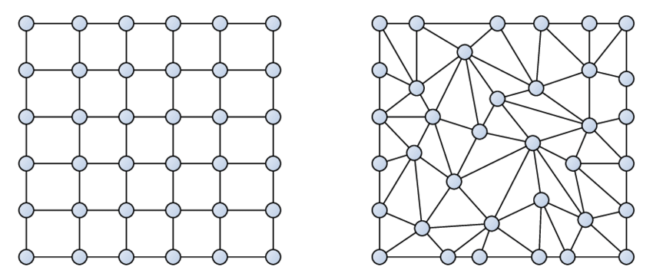
Domain/BC
Domain:
structured, rectangular grid
Boundary condition:
reflecting walls
Notes:
Continuity: Incompressible -> local fluid volum is preserved!

Slide 11
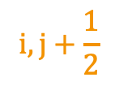
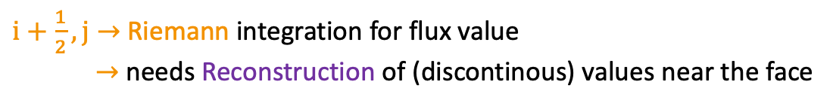

Domain/BC
Fluxes and Cell Average Values
$$i,j+\frac{1}{2}$$
With Riemann flux field and FV
$$i,j$$
$i+\frac{1}{2}, j→$ Riemann integration for flux value
$→$ needs Reconstruction of (discontinous) values near the face
Notes:
Continuity: Incompressible -> local fluid volum is preserved!

Slide 12
Solver
SerialSolver.run()
// SSP-RK3
for () {
computeRHS(State& U, State& rhs) {
<>.applyBC(State& U) {
for (i in x_dim) {
for (j in y_dim) {
<implementation> → optimize Array Acces (like saxpy)
Acces THREE different arrays in ONE loop :/
}
}
}
<>.compute_x_fluxes(State& U, ReconstructionInstance, RiemannInstance, XFluxField& Fx, Grid& grid) {
for (i in x_dim) {
for (j in y_dim) {
create Objects Cellstate UL, UR
<>.x_flux(CellState& UL, CellState& UR) {
access
computeU1(State& U, <>) {
saxpy_array( loop over ij but in Array2D form – loop over k-> Array2D size – good acces ) {
Access ONE array in THREE different loops -> much cache friendlier?
}
computeRHS() * 2
computeU*() * 2
U_ = U_next_; -> copy by value?
<>.applyBC(State& U_)
// ETA, Writer, SanityChecks
Notes:
Continuity: Incompressible -> local fluid volum is preserved!

Slide 13
Solver
Finite Volume:
numerical flux: Rusanov
Finite Volume + MUSCL:
numerical flux: HLL, Roe
slope limiter
positivity preservation
Notes:
Continuity: Incompressible -> local fluid volum is preserved!

Slide 14
HPC
Goals:
code analysis
memory (access) optimization
Parallelization with OpenMP
GPU acceleration with CUDA
strong scaling analysis
weak scaling analysis
CPU vs. GPU
Notes:
Continuity: Incompressible -> local fluid volum is preserved!

Slide 15
Thank you fo your attention

