Slide 1
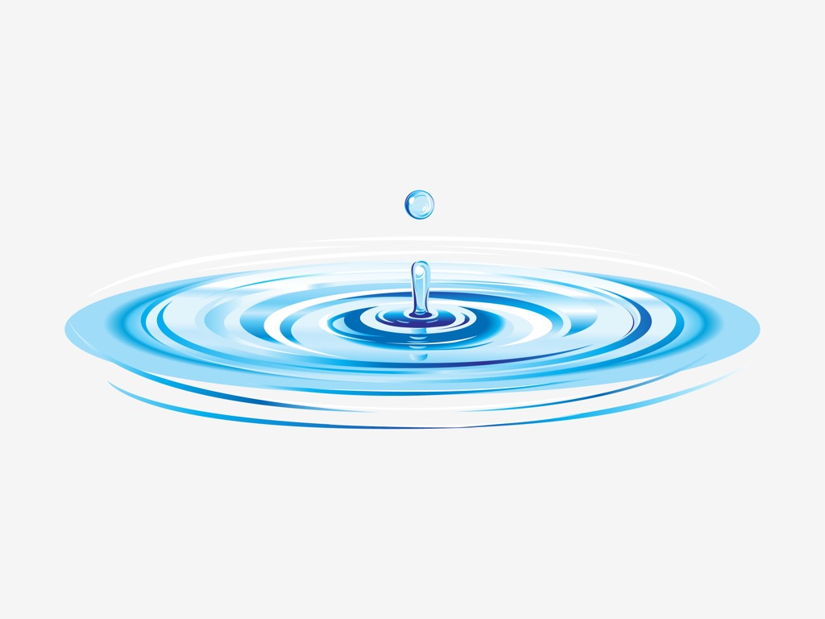
Shallow Water Equations: Progress report
AG: HPC Lukas Blanck
https://www.freevector.com/water-ripples-vector

Slide 2





Shallow Water Equations
Mass conservation:
$∂_{t}h+∂_{x}\left(hu\right)+∂_{y}\left(hv\right)=0$
Momentum conservation:
$∂_{t}(hu)+∂_{x}\left(hu^{2}+ \frac{1}{2}gh^{2}\right)+∂_{y}\left(huv\right)=0$
$∂_{t}(hv)+∂_{y}\left(hv^{2}+ \frac{1}{2}gh^{2}\right)+∂_{x}\left(huv\right)=0$
$$z$$
$$h$$
$$b$$
$$x$$

Slide 3

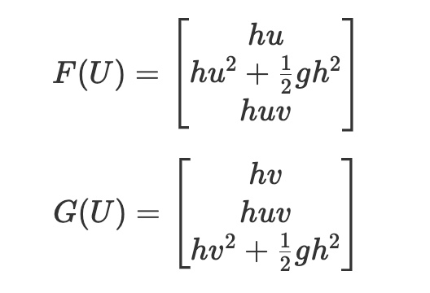
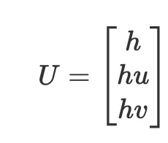
Numerical Model
Conservative Variables:

Slide 4
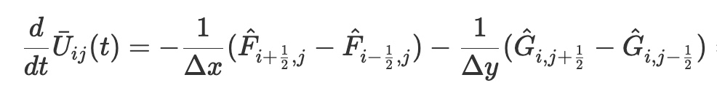
Numerical Model - Space
Finite Volume Method:
Cell average
Numerical Flux in x
Numerical Flux in y

Slide 5
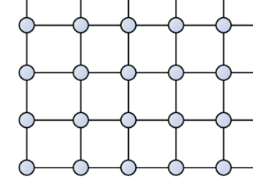



Numerical Model - Space
Fluxes and Cell Averages
Fluxes $→ i,j+\frac{1}{2}$
Cell Average
$$i,j$$
$i+\frac{1}{2}, j →$ Fluxes
Notes:
Continuity: Incompressible -> local fluid volum is preserved!

Slide 6

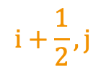

Numerical Model - Space
Fluxes
Riemann Solvers !
$$i+\frac{1}{2}, j$$
$$i, j$$
$$i + 1,j$$
Local Discontinuities
Approximate Fluxes
Notes:
Continuity: Incompressible -> local fluid volum is preserved!

Slide 7
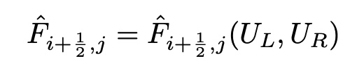
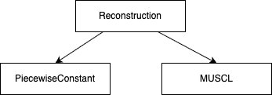

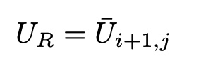
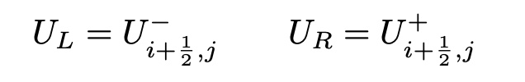

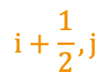

Numerical Model - Space
Reconstruction:
$$i, j$$
$$i+\frac{1}{2}, j$$
$$i + 1,j$$
First order accurate
Very diffusive
Very robust
Second order accurate
Non-physical osciallations in near shocks
Needs a slope limiter

Slide 8
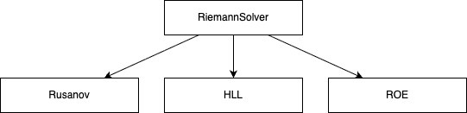
Numerical Model - Space
Riemann Solvers:
Approximates with ONE maximum wavespeed
Very diffusive
Very stable
Differentiates between TWO wavespeeds
Less diffusive
Still Very stable
Creates characteristic waves with Eigenvalues und -vectors
Most accurate
Less Stable
Negative water heights
Entropy fix

Slide 9
Numerical Model - Space
Homogenous PDE :
Reconstruction -> Fluxes -> Finite Volume Operator

Slide 10

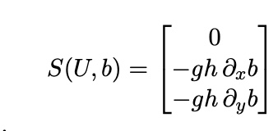





Numerical Model - Space
Final PDE WITH bathymetry:
Additionally:
- Reconstruction of $η = h + b$
- Reconstruction of $b$
- Well balanced source treatment
correct reconstruction for $η$ and $b$
hydrostatic pressure correction
$$z$$
$$h$$
$$η$$
$$b$$
$$x$$
Source: Well-balanced finite volume schemes of arbitrary order of accuracy for shallow water flows, Sebastian Noelle a,, Normann Pankratz a, Gabriella Puppo b, Jostein R. Natvig
Journal of Computational Physics 2006

Slide 11

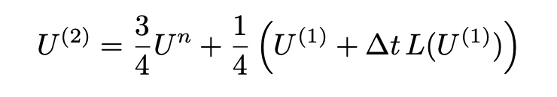
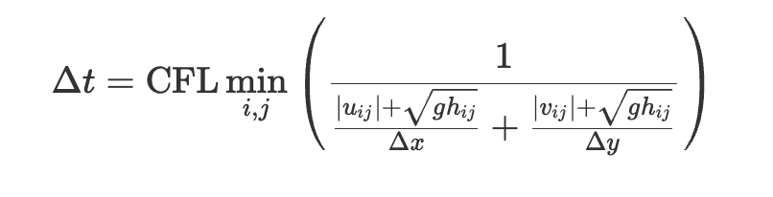
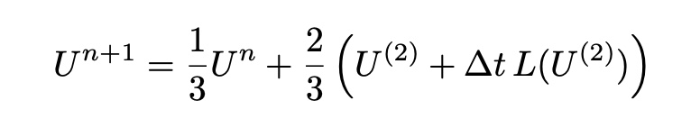
Numerical Model - Time
SSP-RK3: Strong Stability Preserving Runge Kutta 3
Preserves nonlinear stability properties
CFL condition:

Slide 12
Numerical Model - Problems
 | Diffuse |  | Unstable
Riemann Solver | Rusanov | HLL | ROE
Reconstruction | Piecewise Constant | MUSCL
=> Optimized Solvers will only implement HLL + MUSCL

Slide 13






Numerical Model - Problems
MUSCL Bottom Reconstruction:
Reconstructs $η$ and b
Extracts
Although
This might be
Riemann then
Therfore ->
=> Current Solution: Piecewise Constant Reconstruction of bottom
-> avoids negative RECONSTRUCTED h

Slide 14
Project Scope
Core Solver
Modular solver
Acceleration
Optimized serial solver
Parallelization with OpenMP
GPU use with CUDA
Analysis
strong scaling analysis
weak scaling analysis
CPU vs. GPU

Slide 15
Modular Solver
Pros:
Modular
Easy to extend
Useful for testing and comparison
Cons:
Repeated object construction
Repeated bound-check
Poor cache efficiency
Function-call overhead by Reconstruction and Riemann
Large temporary flux fields

Slide 16
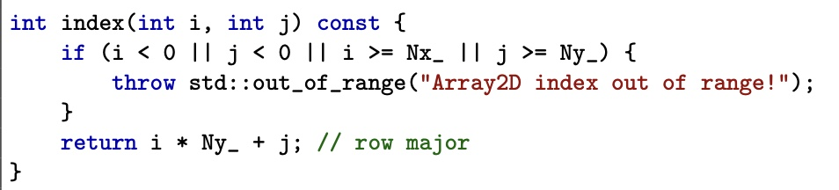
Modular Solver - Optimizations
Repeated bound-check :

Slide 17
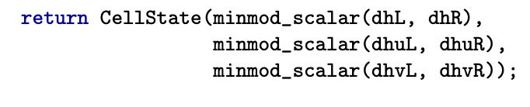
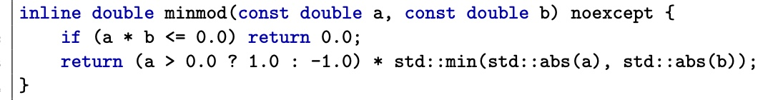
Modular Solver - Optimizations
Repeated object construction:
// extract data from U at indices i and j

Slide 18
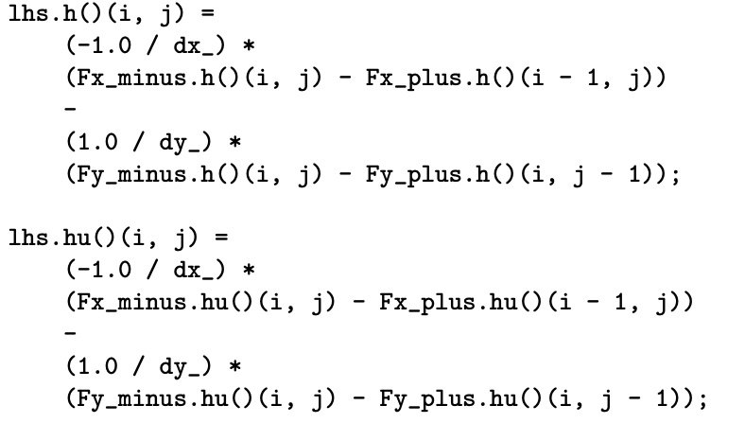
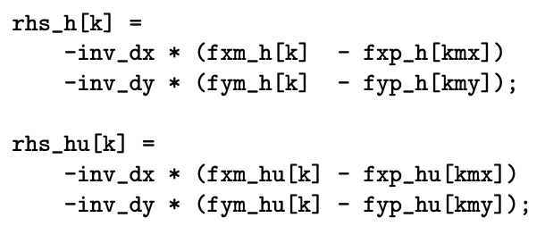
Modular Solver - Optimizations
Function overhead:
Structure of arrays vs Array of structures:

Slide 19
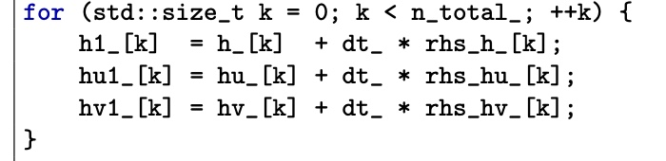
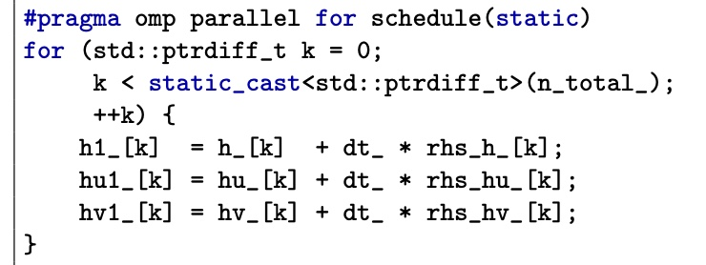
OpenMP Solver - Optimizations
Parallelization of loops:

Slide 20
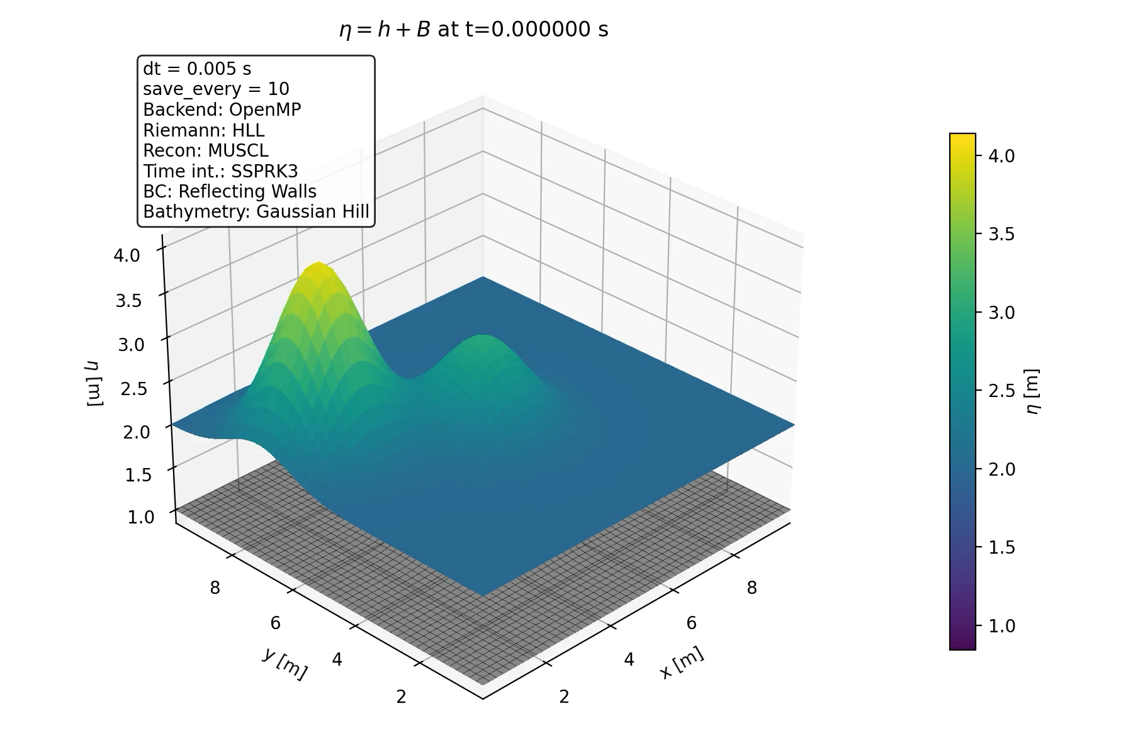
Results

Slide 21
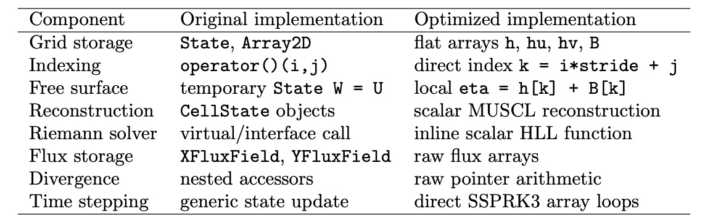
Summary

Slide 22
Ressources
[1] Vincent Guinot, Carole Delenne. MUSCL schemes for the shallow water sensitivity equations with passive scalar transport. Computers and Fluids, 2012, 59, pp.11-30. ⟨10.1016/j.compfluid.2012.02.001⟩. ⟨hal-01196932⟩
[2] P. L. ROE , Approximate Riemann Solvers, Parameter Vectors and Difference Schemes, Jpurnal of Computational Physics, 43, 357-372 (1981)
[3] Sigal Gottlieb, Chi-Wang Shu, Eitan Tadmor, Strong Stability-Preserving High-Order Time Discretization Methods, SIAM REVIEW, 2001 Society for Industrial and Applied Mathematics, Vol. 43, No. 1, pp. 89–112
[4] Jose ́ M. Gallardo, Carlos Pare ́s, Manuel Castro, On a well-balanced high-order finite volume scheme for shallow water equations with topography and dry areas, Journal of Computational Physics 27 (2007) 574–601

Slide 23
Thank you for your attention !
AG: HPC Shallow Water Equations Lukas Blanck

