Slide 1
0. Check initial stream offset
5. Make a packet of the last popped frames
1. Wait for all buffers to have >= 1 frame
17
15
13
11
9
13
11
9
7
5
23
21
19
17
15
13
11
10
19
17
15
13
11
10
10
8
6
back
front
Packet
back
front
6. Use frame packet and repeat
2. Find most recent timestamp T_{q} at buffer fronts
13
11
9
7
5
19
17
15
13
11
10
6
back
front
3. Wait until all buffers have a frame with timestamp T >= T_{q}
17
15
13
11
9
7
5
23
21
19
17
15
13
11
10
10
8
6
back
front
4. Pop all frames with timestamps T < T_{q}, remember last popped frame
17
15
13
11
9
7
5
23
21
19
17
15
13
11
10
10
8
6
back
front

Slide 2
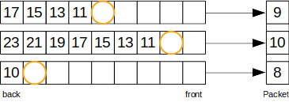
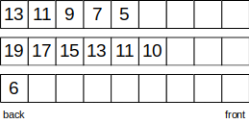
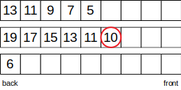
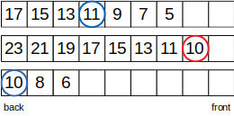
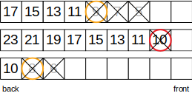
0. Check initial stream offset
5. Make a packet of the last popped frames
1. Wait for all buffers to have >= 1 frame
6. Use frame packet and repeat
2. Find most recent timestamp T_{q} at buffer fronts
3. Wait until all buffers have a frame with timestamp T >= T_{q}
4. Pop all frames with timestamps T < T_{q}, remember last popped frame

