Slide 1
Photo-mozaic-ator
By Lukáš Caha for Programming in C# NPRG035

Slide 2
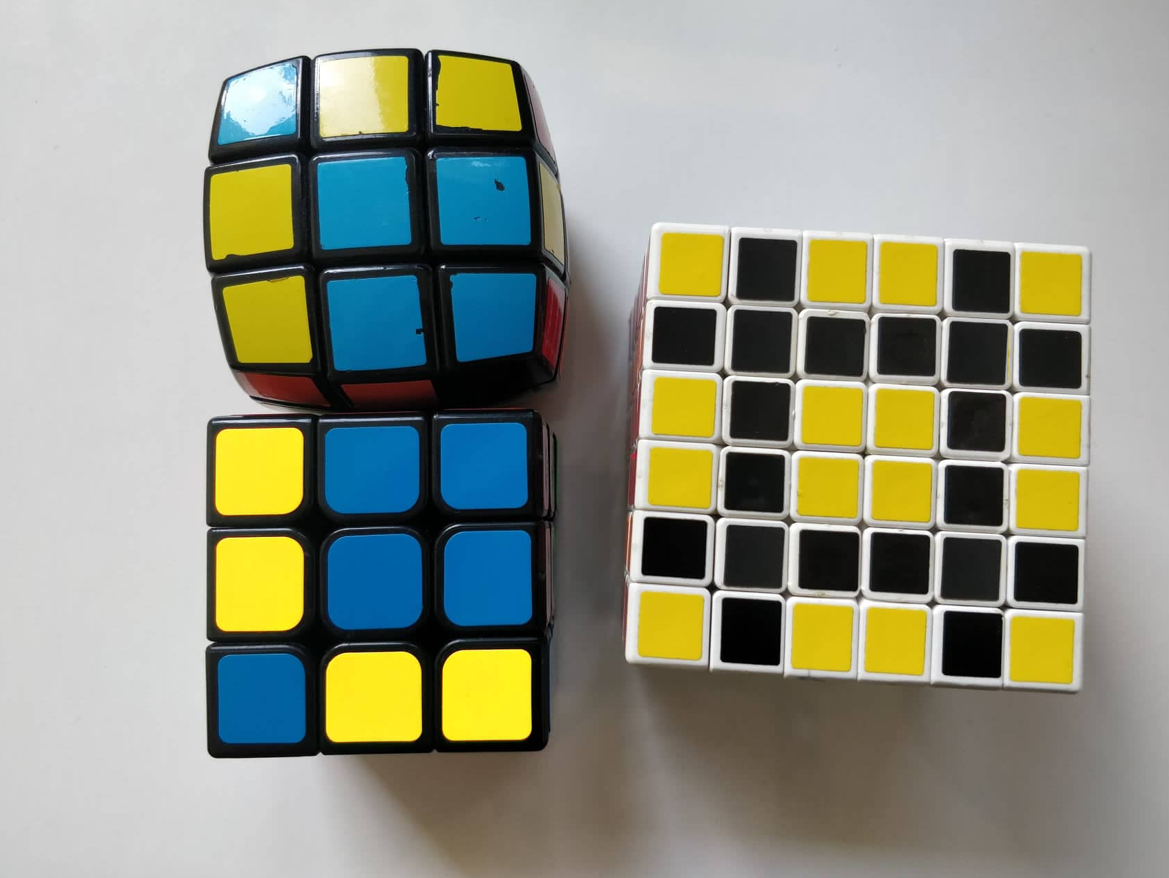
About
Written in C# .NET 3.1 as WinForm
Developed in VS studio 2019
Versions on GitHub
Event based

Slide 3
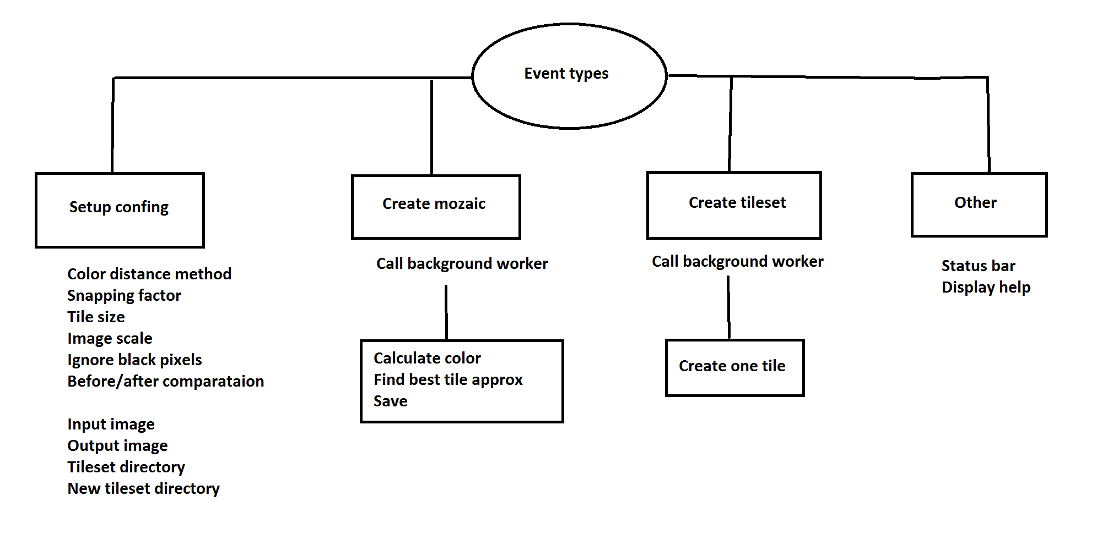

Slide 4
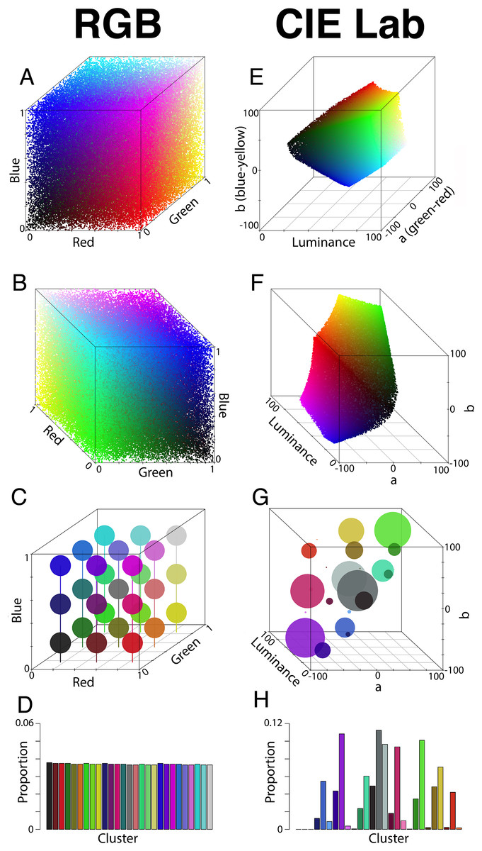
Color distance
Strategies
Square RGB
Bitwise
CIE76
Better distance aproximation → better mozaic

Slide 5
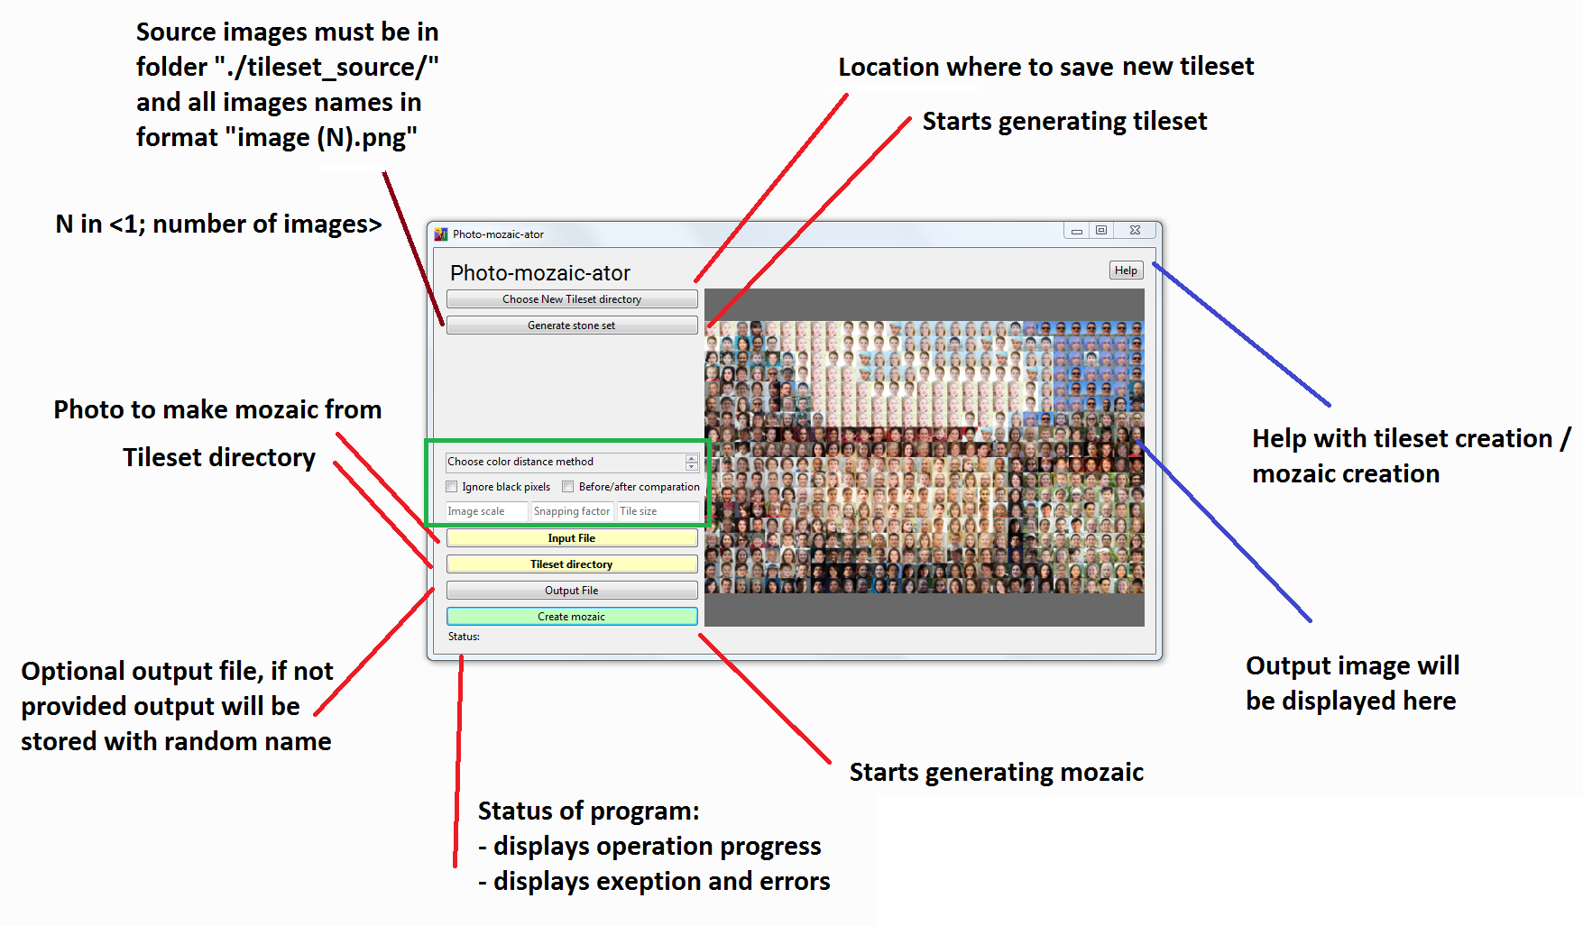

Slide 6
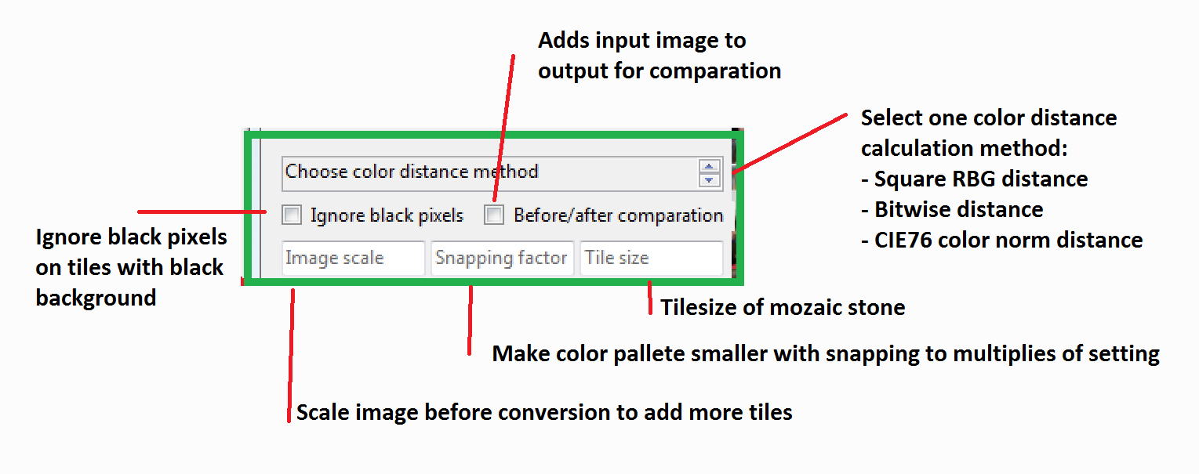

Slide 7
Source code / other resources
Source code https://github.com/LukasCaha/Photo-mozaic-ator
Pokemon dataset https://lukascaha.com/pokemon/pokemon_images.zip
Needs to be tiled
Tiled http://lukascaha.com/mozaicator/pokemon.zip
People dataset https://thispersondoesnotexist.com/
Needs to be scraped and then tiled
Tiled http://lukascaha.com/mozaicator/people.zip
Minecraft blocks tileset http://lukascaha.com/mozaicator/minecraft.zip
Ready to go
Rubiks cube tiles http://lukascaha.com/mozaicator/rubiks.zip

