Slide 1
Dike: Deep Reinforcement Learning For Function Scheduling in SLO-targeted Serverless Edge Computing
Chen Chen*, Emanuele Carlini†, Richard Mortier*
* University of Cambridge, UK
† CNR, Italy

Slide 2
What is serverless ?
A computing paradigm:
Function developers only focus on the function code
Resource management and configuration are managed by the platform
Pay-as-you-use billing model
Users are charged based on resource usage, number of requests and duration
Serverless functions are only invoked by events/requests
Functions are terminated after some time when they finish execution
Lightweight and elastic
Notes:
Serverless computing, also known as FaaS, emerged as a new computing paradigm to provide short-lived, lightweight services. Function developers only need to focus on the function code and upload it to the platform. The resource management and configuration are managed by the platform. Serverless computing adopts a pay-as-you-go billing model where users are only charged for what they have used. This is because serverless functions are only invoked by events and requests, reducing the resource usage massively.
Functions are terminated after they finish execution to save resources. These features enable lightweight and elastic computing.

Slide 3
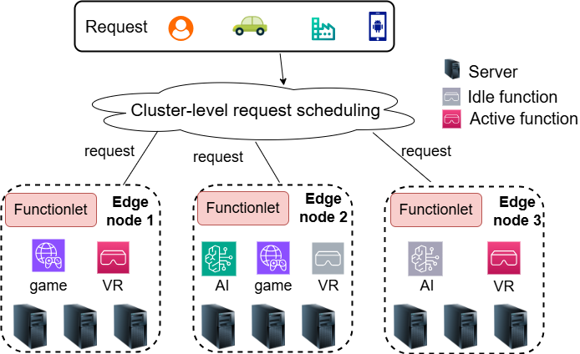
Motivation
Services need to meet the Service Level Objectives (SLOs)
Which edge node to host a request?
Which function to process the request?
Create a new function or use an existing function?
Notes:
However, a significant disadvantage of pay-as-you-go model is users cannot predict their monetary costs.
For example, organisations usually need to estimate their costs to meet their budget. In other word, organisations need to understand how much cost will be incurred by serverless services over a period of time, before approving their budget.
The diagram shows a network with three edge nodes, the requests are scheduled by a centralized controller.
The controller needs to decide which edge node to host the request, and whether to create a new function or reuse an existing function.
Example services include online gaming, virtual reality and AI.

Slide 4
Motivation
Existing works mostly focus on:
End-to-end latency optimization
Deployment cost optimization
Energy consumption or carbon emission
Startup process of serverless functions
Therefore, we decided to optimize deployment cost while guaranteeing the SLO for users
Notes:
Existing works mostly concentrate on optimizing the end-to-end latency perceived by users or guarantee the service level agreement to ensure user experiences.
Some works focus on reducing the deployment cost, energy consumption or carbon emission of the system.
Also, a large number of works have focused on reducing the startup time of serverless functions.
We reckon providing a budget option for users is missing.
Thus, we decided to optimize the deployment cost of serverless functions while providing a budget option for users.

Slide 5







Motivation
Request #1
AI Function
Node 1
Node 2
Node 3
Node 4
Notes:
To better exemplify our decision process, we show that there is a request #1 arriving in the system.
Request#1 requires a AI function. By iterating over different edge nodes, we observe that node 3 has an idle AI Function instance and hence it is best to assign the request to node 3.
The problem is complex because we consider a scenario where hundreds of requests arrive in the system concurrently and each node has limited capacity.
We need to dynamically create, reuse and terminate functions to accommodate incoming requests.

Slide 6
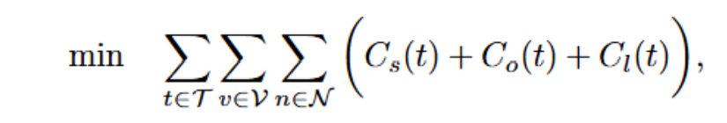
Problem formulation
Objective: Monetary deployment cost for serverless functions
min: Function creating cost + running cost + traffic routing cost
Constraints:
Edge node capacity (e.g., CPU and memory)
SLO for each request
Integer constraint for decision variables
Notes:
We formulate the problem as an Integer Linear Programming (ILP) problem, minimizing the deployment cost of serverless functions.
The deployment cost includes function creating cost, function running cost and traffic routing cost.
Function creating cost is the cost to launch a new function instance, pulling images from a remote repository and initialize the environment.
Function running cost is incurred by executing a specific request, processing the data.
Traffic routing cost is incurred by routing network traffic between users and functions.
We also formulate several constraints such as the edge node capacity, the budget for each request and constraints for decision variables.
Mathematical formulation can be found in the paper section III.

Slide 7
Problem formulation
The problem is reduced from Generalized Assignment Problem, which is NP-hard.
To handle the computational complexity, we chose Deep Reinforcement Learning.
We have selected Deep Q-Network (Dike-DQN) and Proximal Policy Optimization (Dike-PPO).
Notes:
We prove the proposed problem is NP-hard by reducing it from the well-known Generalized Assignment Problem (GAP) which is NP-hard.
To deal with the computational complexity, we chose Deep Reinforcement Learning because DRL can make quick decisions and reduce computational cost for the controller. DRL can also generalize to different traces, offering a good performance without re-solving from the scratch. We have used two different algorithms of DRL which is Deep Q Network and Proximal Policy Optimization. DQN uses a Q function to estimate the reward of actions in different states, while PPO uses policy gradient method that directly optimizes the policy itself.

Slide 8
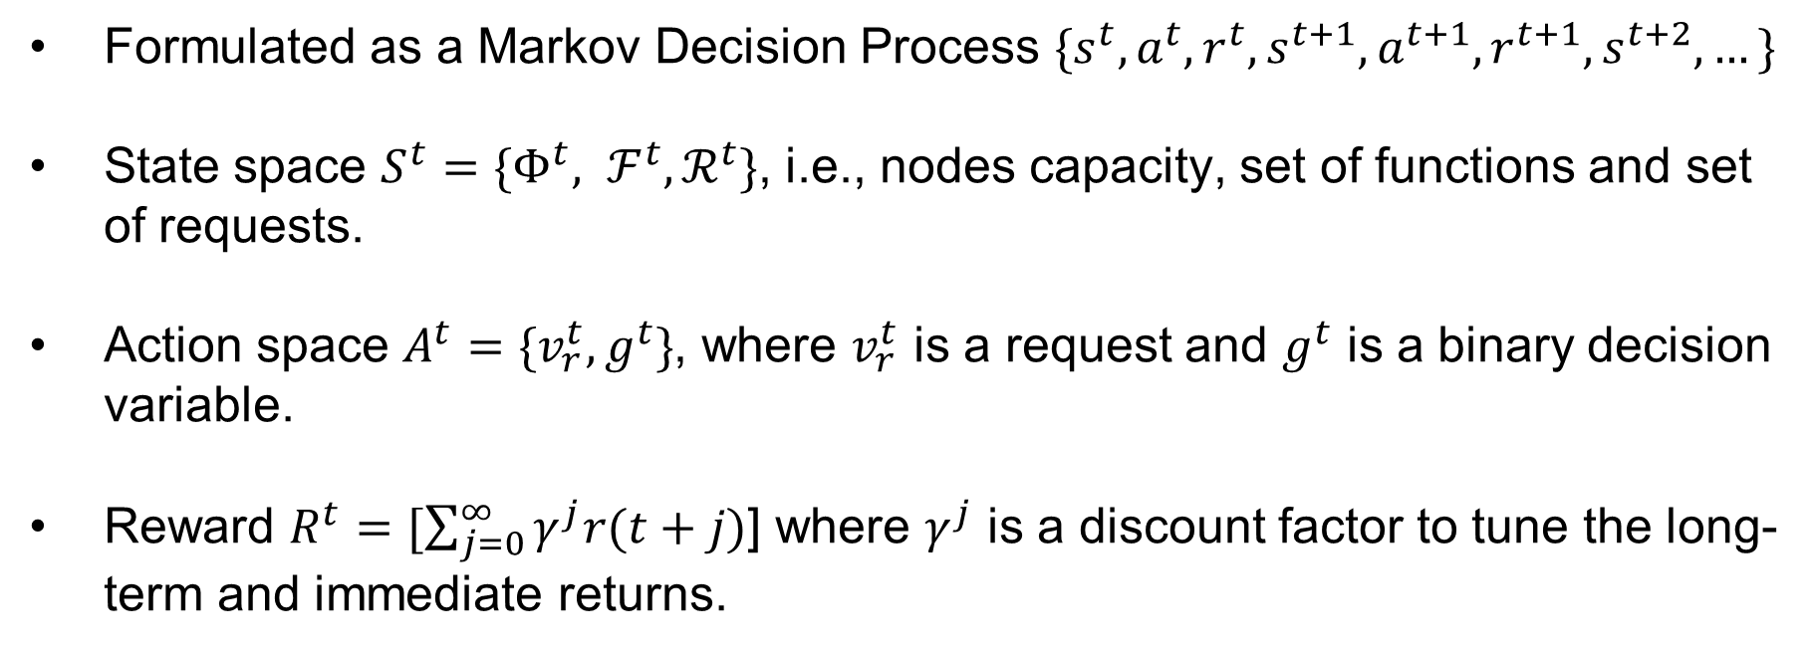
Deep Reinforcement Learning – Dike!
Formulated as a Markov Decision Process ${\{s}^{t}, a^{t}, r^{t}, s^{t+1}, a^{t+1}, r^{t+1}, s^{t+2}, …\}$
State space $S^{t}=\{Φ^{t}, ℱ^{t}, ℛ^{t}\}$, i.e., nodes capacity, set of functions and set of requests.
Action space $A^{t}=\{v_{r}^{t}, g^{t}\}$, where $v_{r}^{t}$ is a request and $g^{t}$ is a binary decision variable.
Reward $R^{t}=[\sum_{j=0}^{∞}{γ^{j}r(t+j)}$] where $γ^{j}$ is a discount factor to tune the long-term and immediate returns.
Notes:
To solve the problem, we first structure it as a Markov Decision Process. where the edge network is deemed as the environment.
The decisions of function placement is deemed as actions a^t, and the node and function status are deemed as the state s^t.
The reward is negative of the deployment cost with a discount factor.
The discount factor is to tune the long-term and immediate returns.

Slide 9
DRL workflow
State Observation
Action Selection
Reward Evaluation
Policy Update
Repeat
Notes:
The algorithm workflow consists of several steps: 1. at each time step, the agent observes the current state, i.e., status of the network and functions.
2. Based on the observation and its policy, the agent selects an action from the action space. The action decides the node assignment and whether to create a new container.
3. After executing the action, the agent receives a reward, assessing the efficiency of the action in terms of resource utilization and task completion.
4. Policy update: DQN updates a Q-value table with experience replay to enhance learning stability.
For PPO, policy gradients are computed and the policy is updated by adjusting gradients. The policy update is also constrained bt a clipping range to prevent excessive divergence.
5. This process is repeated several times so the agent can refine its policy to maximize the rewards.

Slide 10
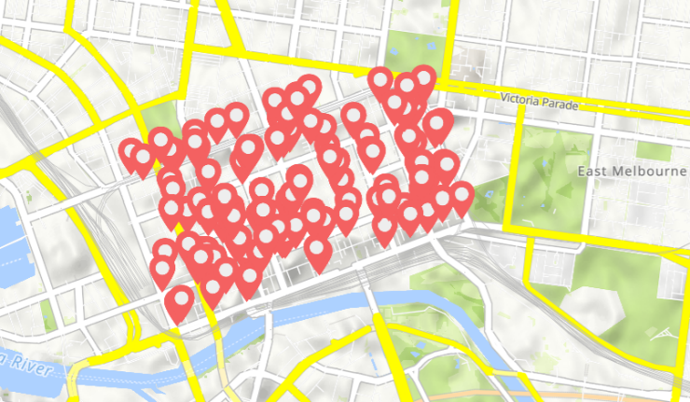
Simulation setup
Topology – EUA dataset^{[1]}, 125 edge nodes
Requests – Huawei serverless dataset^{[2]}
DQN and PPO – Stable baseline 3^{[3]}
Baseline – Midaco solver^{[4]}
[1] https://github.com/PhuLai/eua-dataset
[2] https://github.com/sir-lab/data-release
[3] https://stable-baselines3.readthedocs.io/en/master/
[4] https://www.midaco-solver.com/
Notes:
We use a network from the EUA dataset which is derived from the Melbourne CBD area.
The network consists of 125 edge nodes as shown in the Figure.
The serverless requests are derived from the Huawei serverless dataset and we use the zip-f distribution to generate requests for different edge nodes.
We assumed 5 types of different edge nodes with different hardware capacities.
We implemented the DRL by using the stable baseline 3 framework.
We use the Midaco solver as performance benchmark which can efficiently approximate the optimum.

Slide 11
Results
Fig. 1 CDF of cost
Fig. 2 CDF of latency
Fig. 3 SLO violations
Fig. 4 Scheduling time
Midaco only improves 1.79% from 200k rounds to 300k rounds, - approximating the optimum
Dike-DQN – within a factor of 1.19 to Midaco at 95th percentile for cost
Dike-PPO – within a factor of 1.08 to Midaco at 95th percentile for cost
Comparable latency
Dike-PPO and Dike-DQN receive better performance at SLO violations
The decision-making time is 99% less than Midaco
Notes:
We name the DQN and PPO approaches as DFaaS and PFaaS, respectively.
We run Midaco for 200k and 300k rounds of iterations.
Figure 1 shows the boxplots of deployment costs achieved by different approaches.
We see that DFaaS and EFaaS efficiently approach the results of Midaco at 75th and 95th percentile.
DFaaS guarantees the cost within a factor of 1.05 to Midaco at 95th percentile while that of EFaaS is 1.06.
For average deployment cost, both DFaaS and EFaaS remain within a factor of 1.03 compared to Midaco.
Also, Figure 2 shows the acceptance rate of different approaches, DRL outperforms Midaco because they can efficiently explore the solution space.
Figure 3 shows the scheduling time. DRL-based approaches use 5 orders of magnitude less time than Midaco.
The rationale is that after training process, DRL can make online decisions in time-efficient manner.

Slide 12
Takeaway
Demand for reducing monetary costs with SLO guarantee
The problem can be formulated as an ILP problem with a SLO constraint
DRL can efficiently achieve near-optimal solutions while maintain SLOs
The scheduling time is significantly reduced
Notes:
The takeaway is that we reckon organizations have a demand for efficient budget management in serverless computing.
The problem can be formulated as an ILP problem with a budget constraint for each request.
It can also be adapted to a total budget for all requests.
Once trained, DRL can make online near-optimal solutions.
Meanwhile, the scheduling time is massively reduced compared with ILP solvers.

Slide 13
Thank you
Q&A
Chen Chen cc2181@cam.ac.uk

