Slide 1
Efficient Request Scheduler for LLM Inference
Chen Chen (Nottingham Trent University),
Lei jiao (University of Oregon),
Richard Mortier (University of Cambridge)
22nd April, 2026

Slide 2
Background

Slide 3
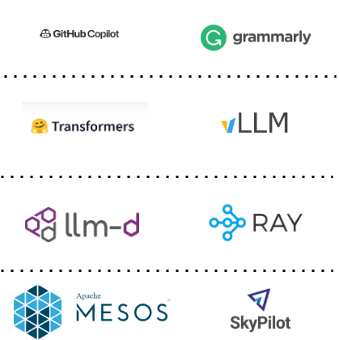
AI Stack
LLM-Based applications
LLM Engines
(LLM inference)
Distributed Frameworks
(run distributed apps)
Infra Layer
(allocate resources)

Slide 4
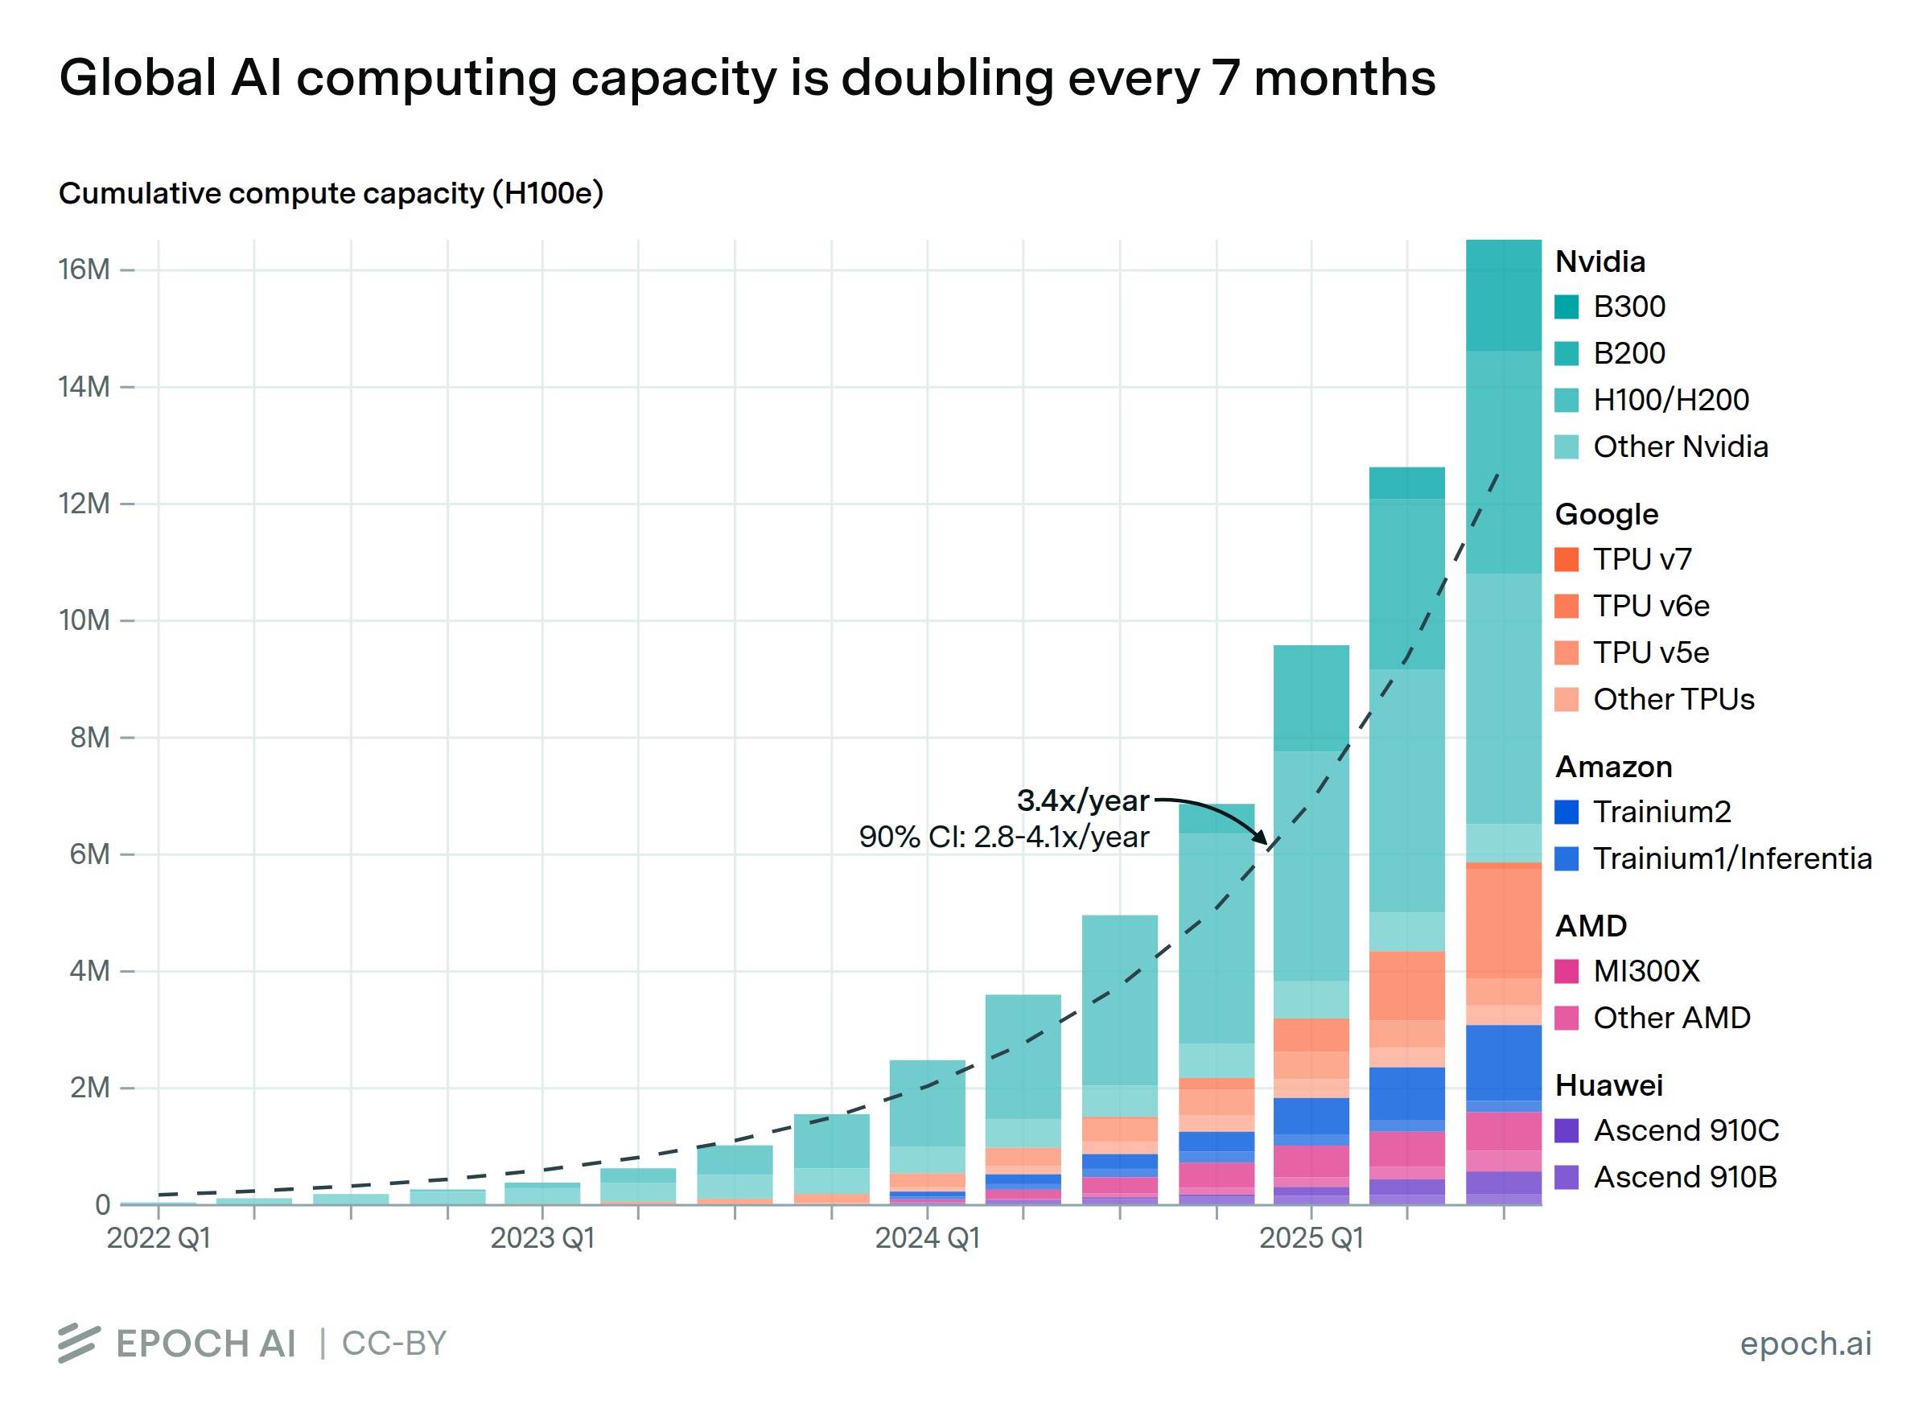
AI demands growing fast
https://epoch.ai/data-insights/ai-chip-production

Slide 5
LLM models are large – 30B-70B parameters for high performance, over 100B for frontier models.
Inference is also resource-intensive, especially memory.
LLM applications inject system prompts to define the role and tune.
Prefill is GPU-heavy while decode is memory-heavy.

Slide 6
Where does memory go?
Where
is
the
capital
of
UK
Model parameters (24GB, 60%)
KV Cache (12GB, 30%)
The
capital
is
London
KV cache stores the previous token embeddings:
40~50KB per token
A request can take a few hundreds MB to 1 GB
Others
A 12B LLM on A100-40GB, presume the KV cache is 4K context x 64 batches

Slide 7
Prefix caching
Extending this caching concept across multiple requests, we call it prefix caching.
Different requests with identical prefixes can reuse the same cache of the prefix tokens.

Slide 8
Challenges

Slide 9
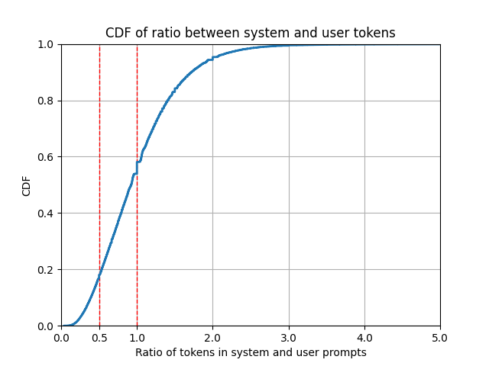
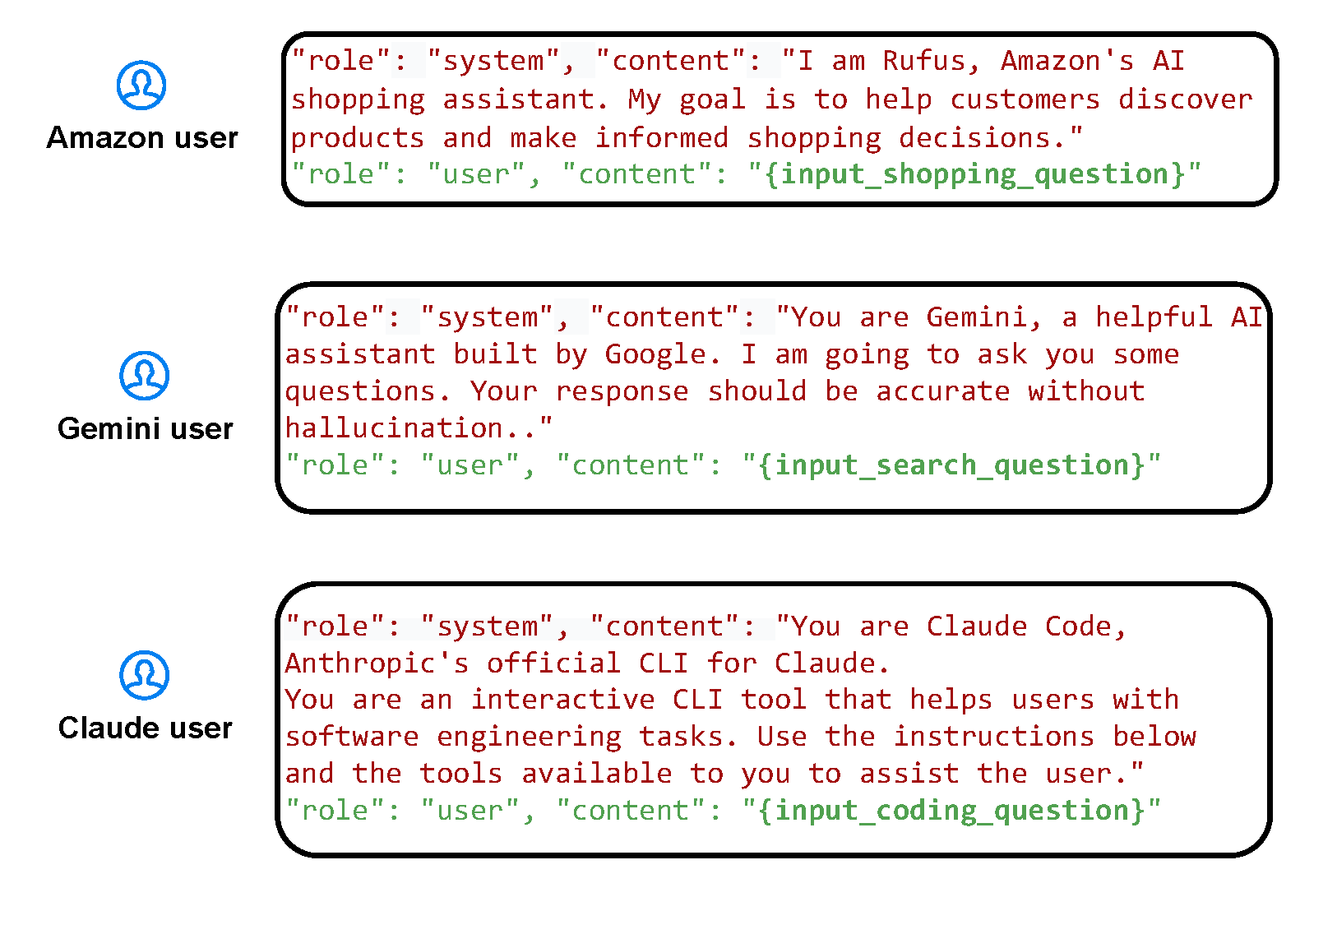
System prompts are everywhere
Examples of System prompts
https://github.com/LouisShark/chatgpt_system_prompt/tree/main
https://github.com/FoundationAgents/MetaGPT

Slide 10
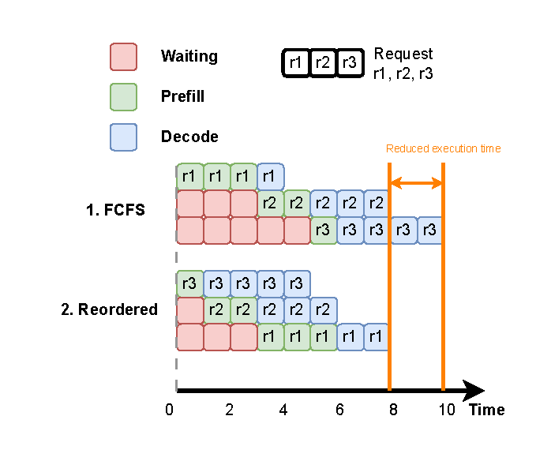
Continuous batching
New requests get inserted (prefill)
Ongoing requests (decode) continue
The scheduler mixes them into the same batch

Slide 11
The idea

Slide 12
Aggregate requests in request groups

Slide 13
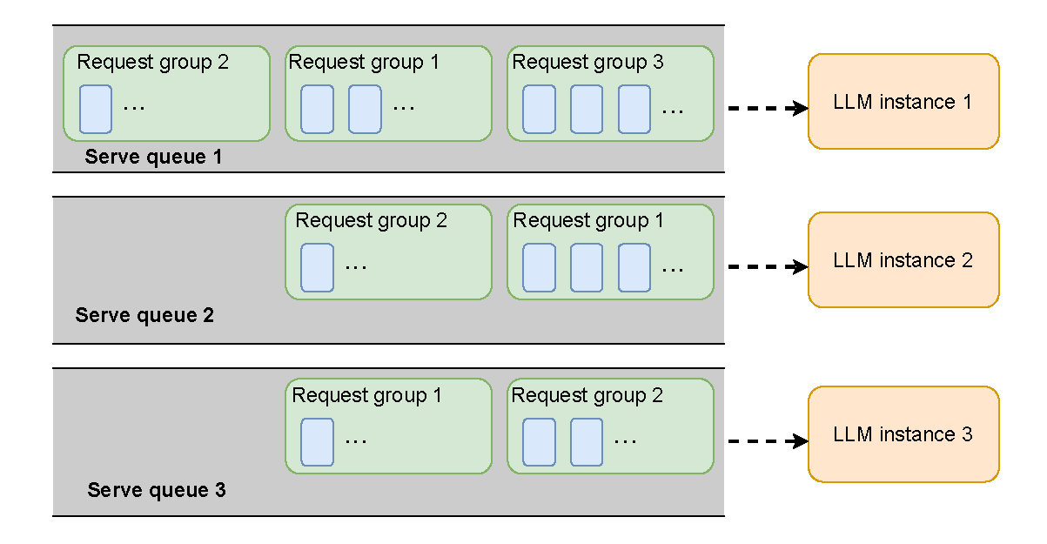
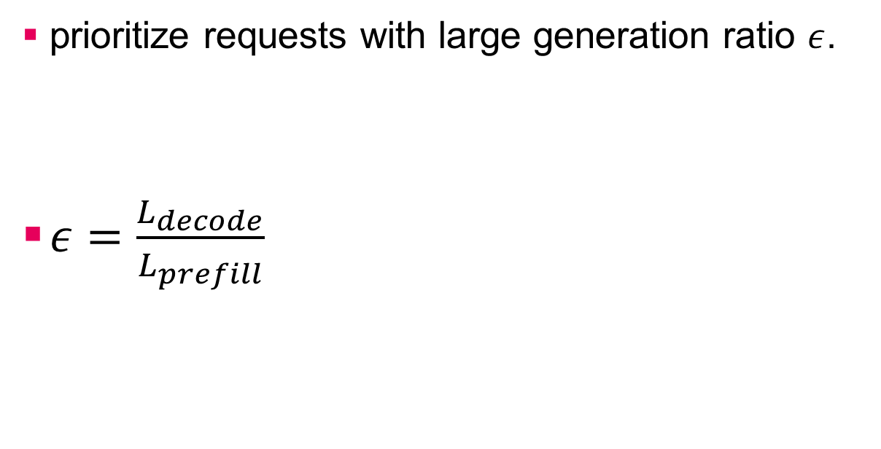
Maximize prefill and decode overlap
prioritize requests with large generation ratio $ε$.
$ε=\frac{L_{decode}}{L_{prefill}}$

Slide 14
Performance

Slide 15
Set up
Type | Dataset | Request size
Conversation | AlpacaEval | 805
Question Q&A | MS MARCO | 102k
Code generation | Nl2bash | 609
Math problem | Orca-math | 200k
Finance | Finance-alpaca | 68.9k
Nvidia Jetson AGX Orin, Gemma-3-1B, Llama-3-1B, SmoiLM2-360M over vLLM.

Slide 16
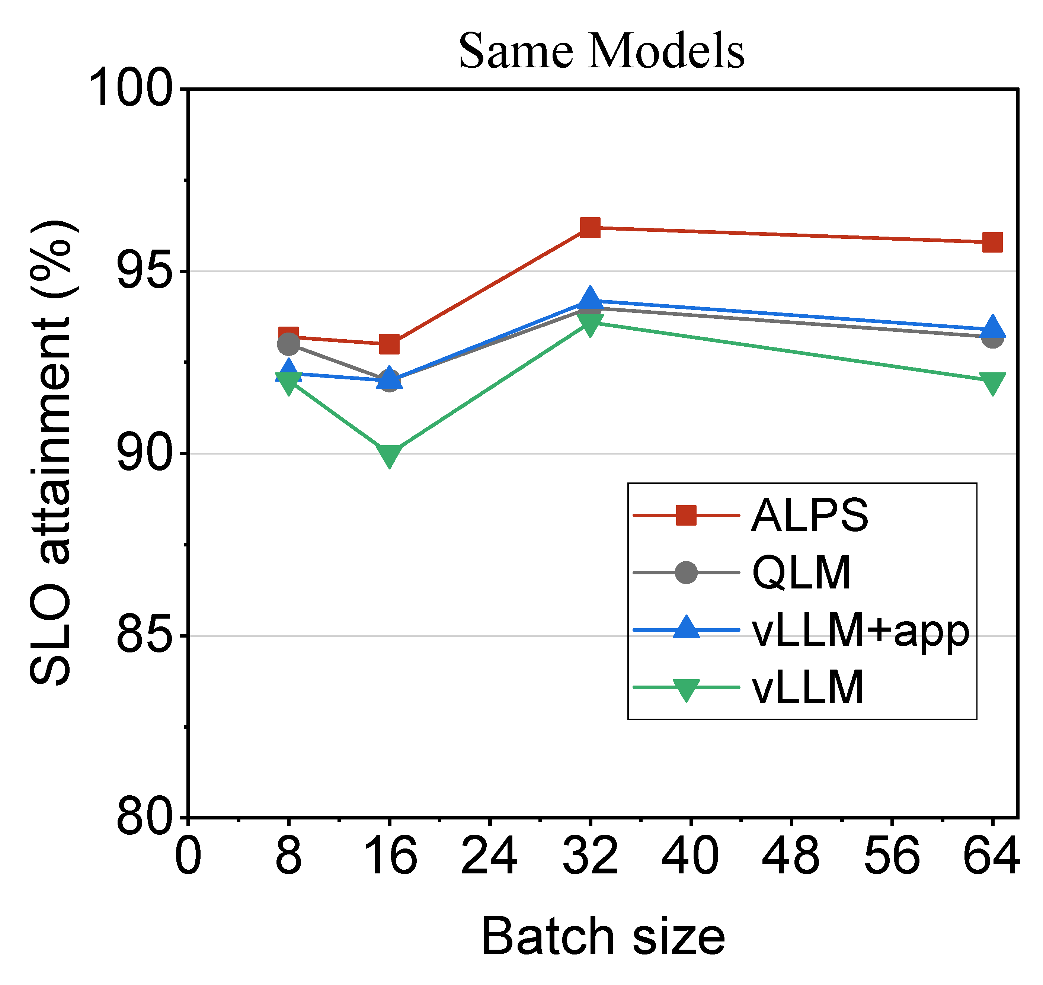
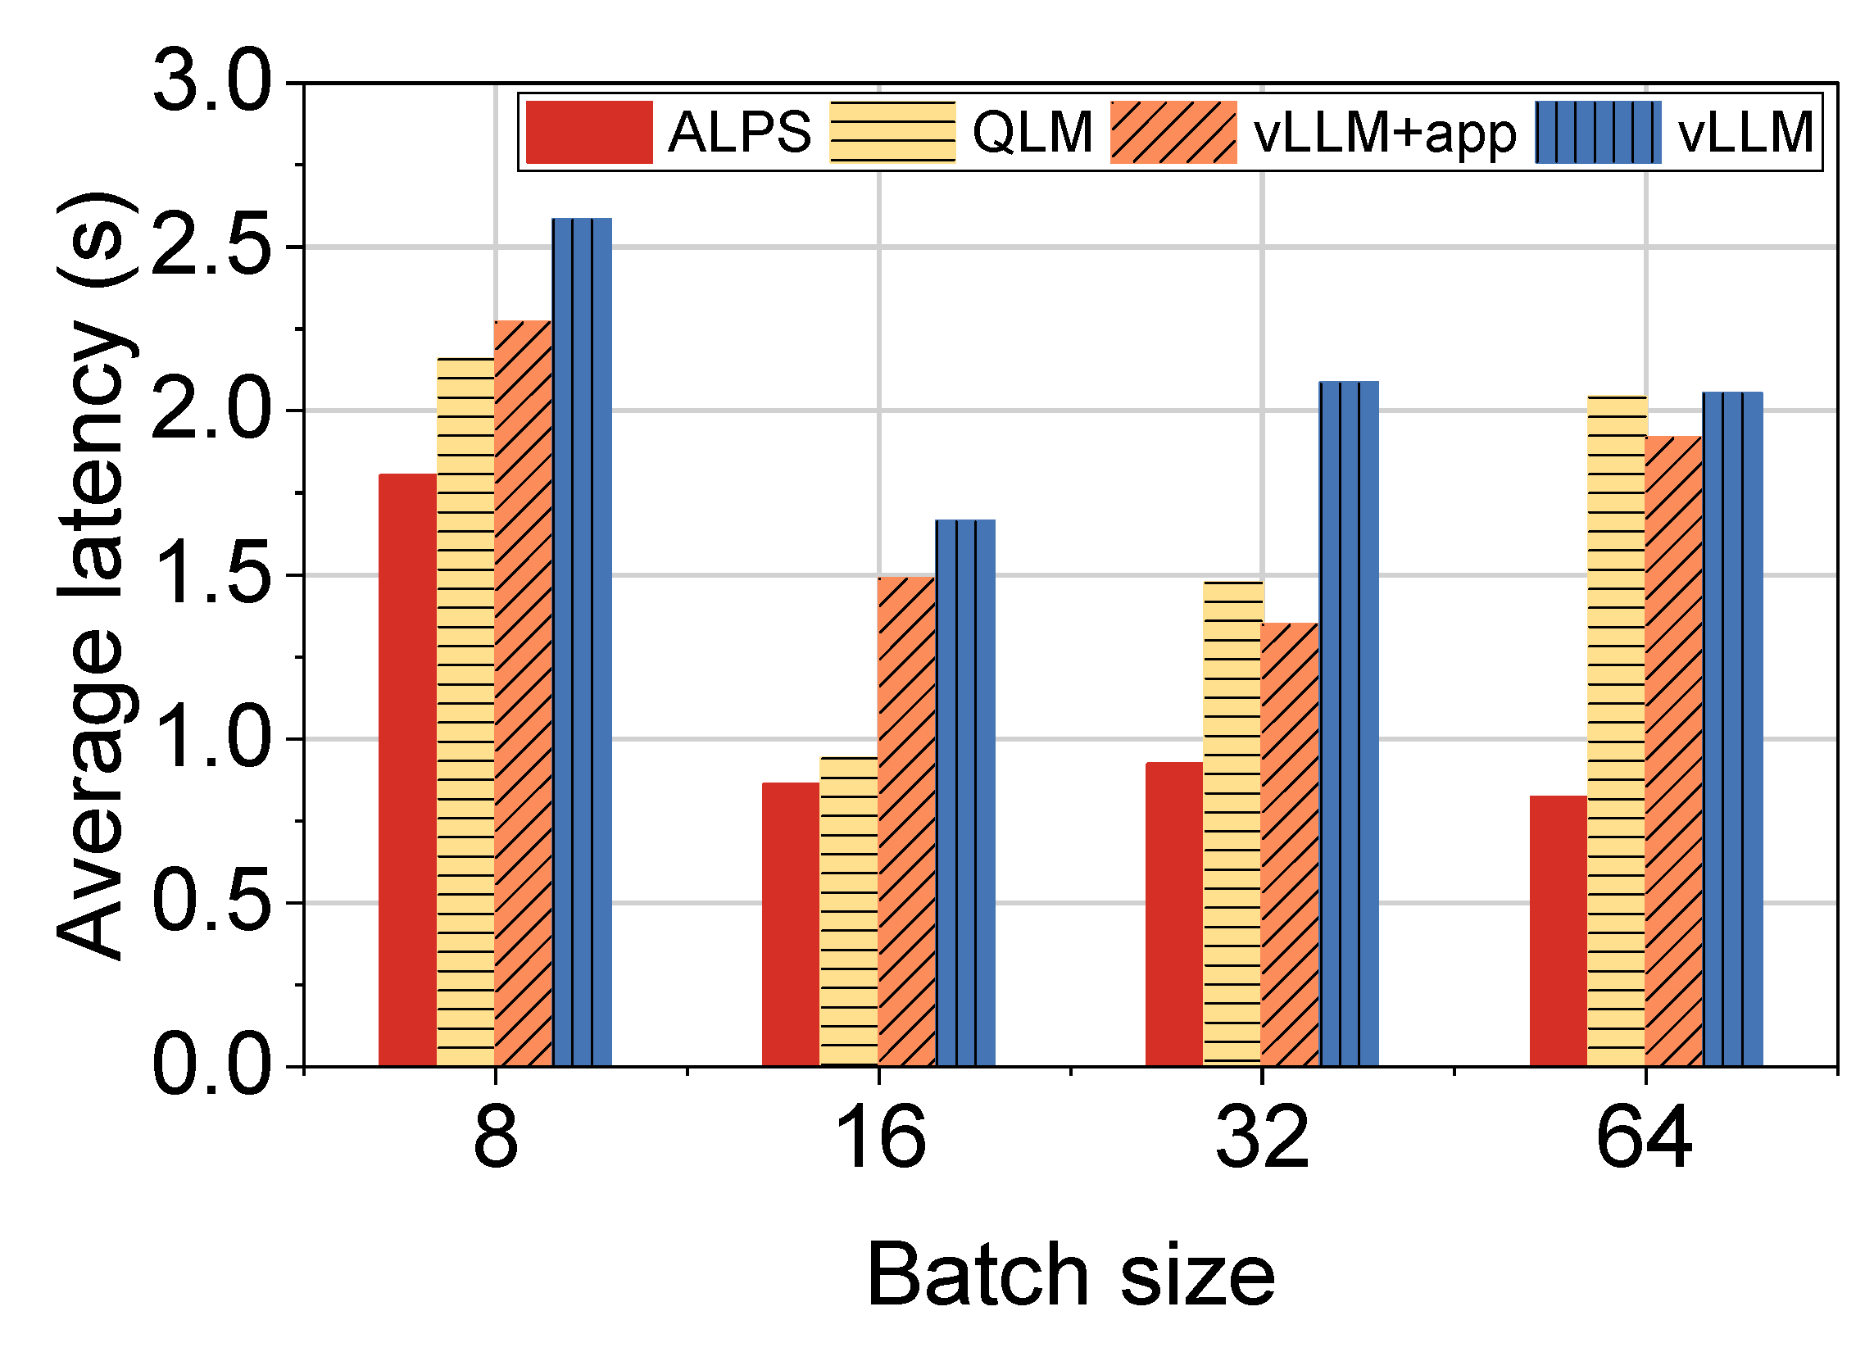
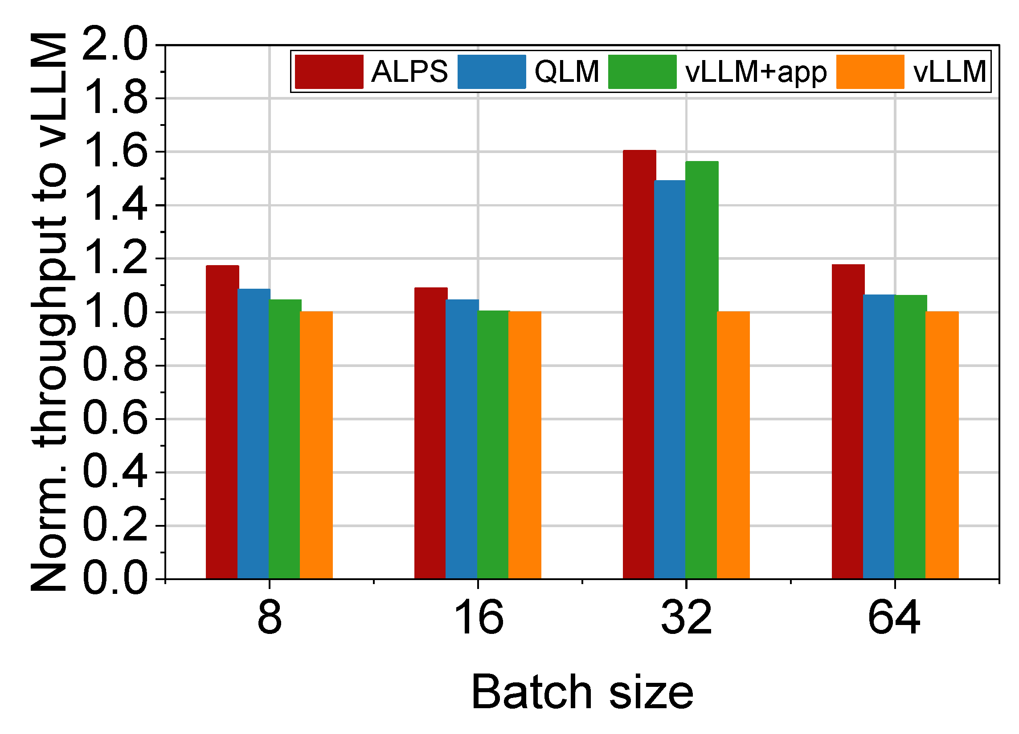
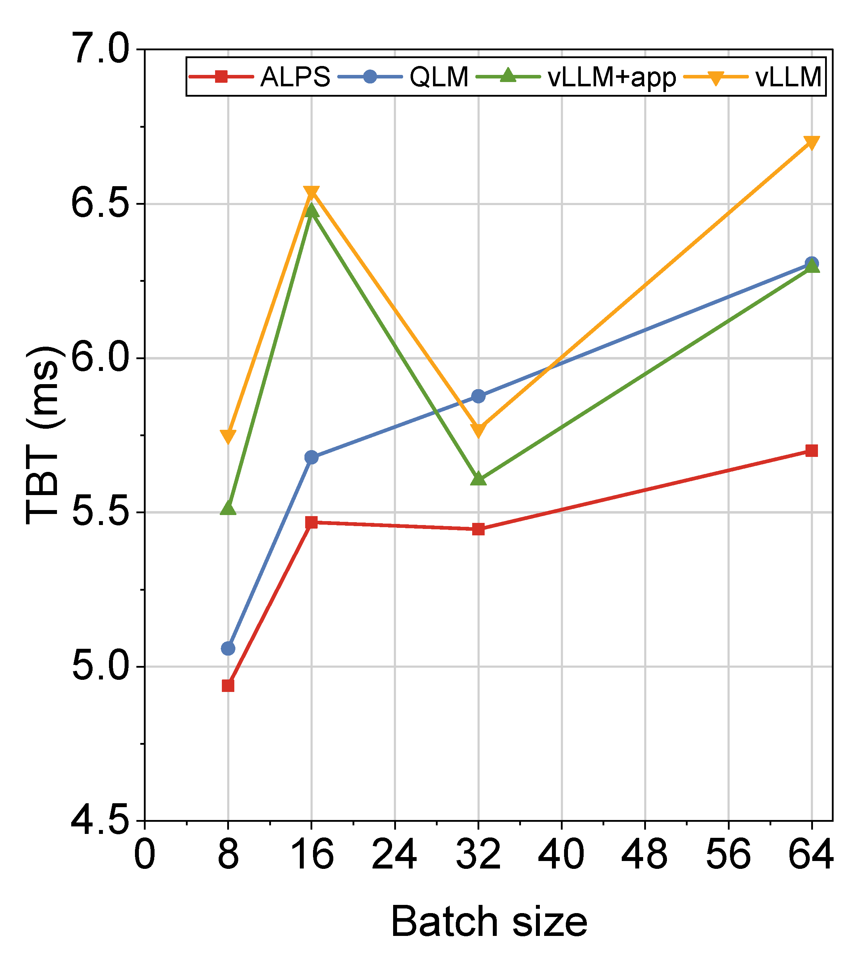
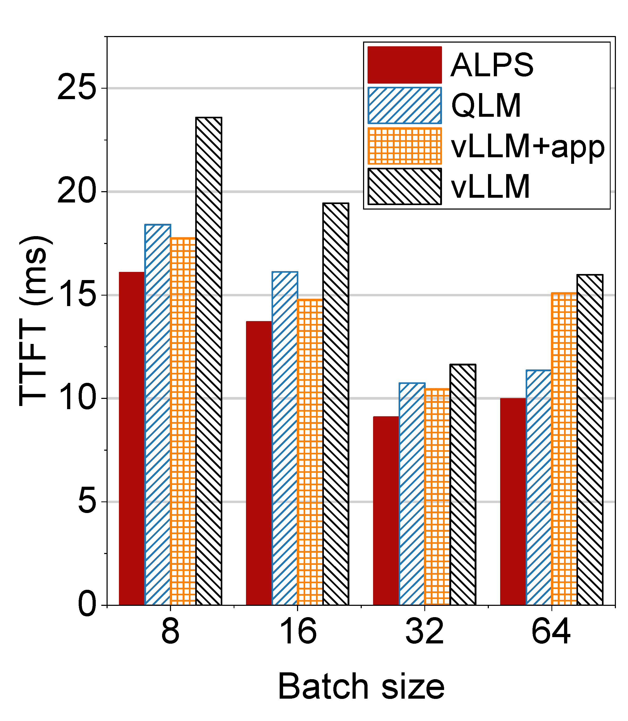
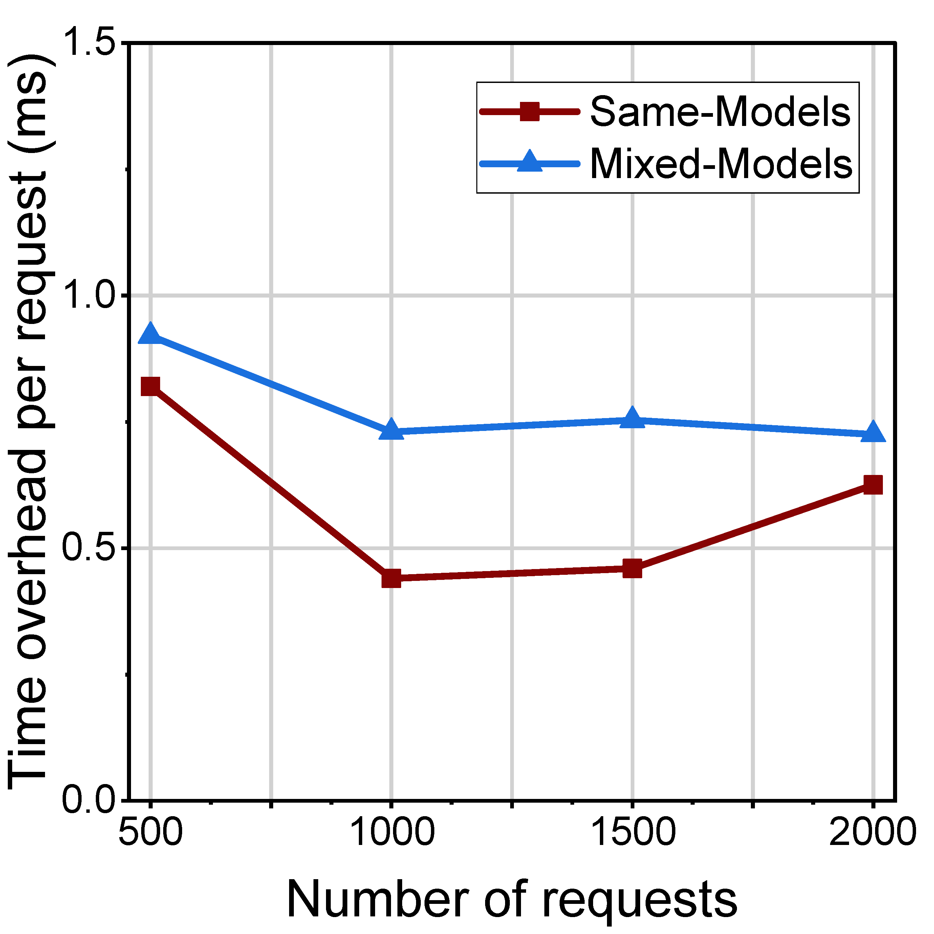

Slide 17
Future work

Slide 18
Can we partition a model into smaller components?
Can we make those components distributed?
Can we only scale the components that need to be scaled up/out?

