Slide 1
Classification of Japanese Characters (Hiragana)
Lukas fiala
UCT Prague

Slide 2

Data [1]
Targets / labels : 10 Hiragana characters
Features : 28 * 28 pixels -> one image
60 000 train images + 10 000 test images
Uniformly distributed
GOAL – classify a image of character using convolutional neural network
き
す
つ
な
は
ま
や
れ
を
[1] Risdal, M.; kasasagi, T. Kuzushiji-MNIST, 2018. kaggle. https://www.kaggle.com/ (accessed Dec 04, 2024).

Slide 3
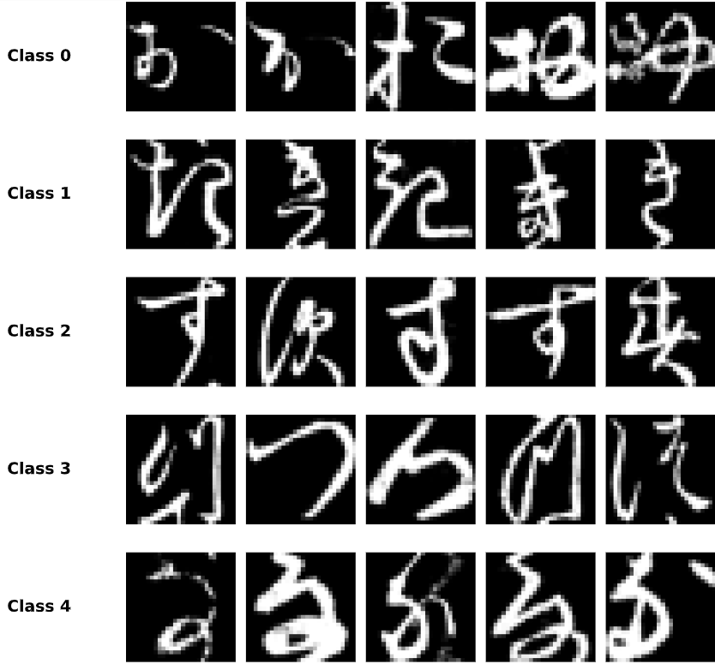
お
き
す
つ
な

Slide 4
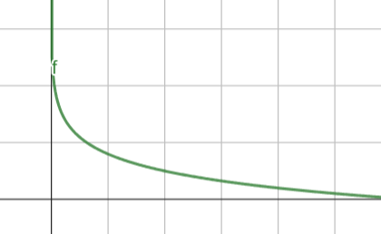
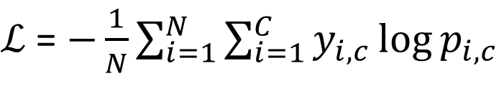
Loss funcion – Cross entropy
Standard loss function for multi-class classification
Measures the “difference” between the predicted probability distribution and the true label distribution (ground truth)
Penalizes incorrect predictions in wrong classes
Rewards high probability for the correct class
→Provides meaningful gradients for weight updates (backpropagation)
$ℒ$ = $−\frac{1}{N}\sum_{i=1}^{N}{\sum_{i=1}^{C}{y_{i,c}\log{p_{i,c}}}}$

Slide 5
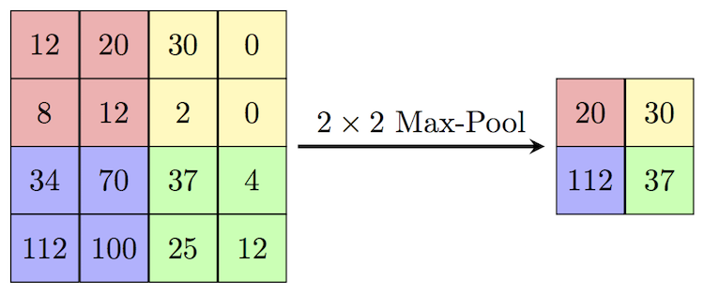
Max pooling – feature extraction
Extracts the most prominent feature from a region of the input feature map
Reduces the spatial dimensions (height and width) while retaining critical information
Selects a maximum value in window defined by Kernel size
→ Extracting object from background in a image

Slide 6
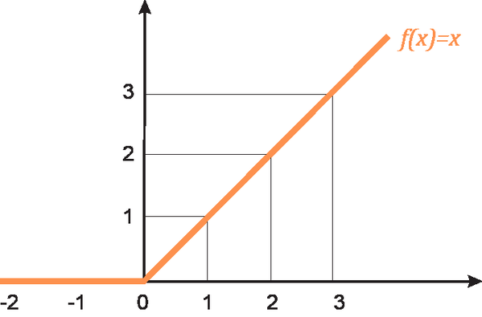

Activation functions - Relu
Introducing non-linearity → ability to see complex patterns
Rectified Linear Unit - most commonly used activation functions in deep learning
$$f\left(x\right)= \text{max}(0, x)$$
Inexpensive computation, extracts features, no Vanishing Gradient Problem
Defined derivative at 0
Problem - Dying Neurons – zero gradient, cannot update new weights

Slide 7
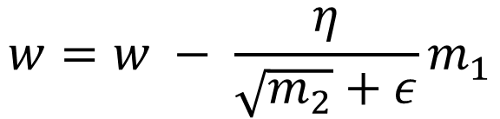

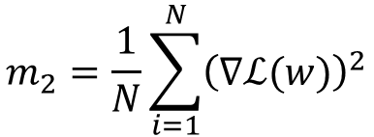
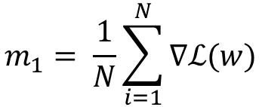
Optimizers – updating weights
Stochastic Gradient Descent (SGD)
Updating weights using gradient descent
Uses randomly selected minibatches
Low cost of computation
Effectively avoiding local minimums
Problems with oscilating gradients
Adaptive Moment Estimation (Adam)
Updating weights using moment estimation and adaptive learning rate
Moves in directions of given moments
Quick convergence, but not avoiding local minimums
Great for very complex data
$$m_{1}= \frac{1}{N}\sum_{i=1}^{N}{\text{∇}ℒ(w)}$$
$$w=w − λ ∇ℒ(w)$$
$$w=w − \frac{η}{\sqrt{m_{2}}+ε}m_{1}$$
$$m_{2}=\frac{1}{N}\sum_{i=1}^{N}{{\left(\text{∇}ℒ(w)\right)}^{2}}$$

Slide 8
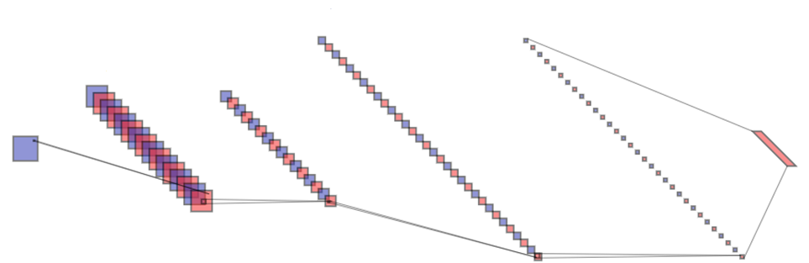
Standard CNN model
INPUT 1 * 28 * 28
OUTPUT 1 * 10 * 1
1. Convolution layer 16 * 24 * 24 * (5 * 5)
Relu activated
1. Max-pool 16 * 12 * 12 * (2 * 2)
2. Max-pool 32 * 4 * 4 * (2 * 2)
2. Convolution layer 32 * 8 * 8 * (5 * 5)
Relu activated

Slide 9
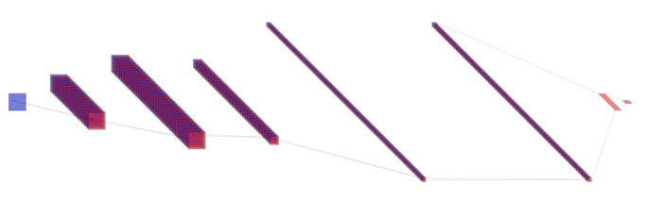
Enhanced CNN model
INPUT 1 * 28 * 28
OUTPUT 1 * 256 * 1
1*10
1. Convolution layer 32 * 28 * 28 * (3 * 3) padding 1
Relu activated
1. Max-pool 64 * 14 * 14 * (2 * 2) dropout – 0.25
2. Convolution layer 64 * 28 * 28 * (3 * 3) padding 1
Relu activated
2. Max-pool 128 * 7 * 7 * (2 * 2) dropout – 0.25
3. Convolution layer 128 * 7 * 7 * (3 * 3) padding 1
Relu activated

Slide 10
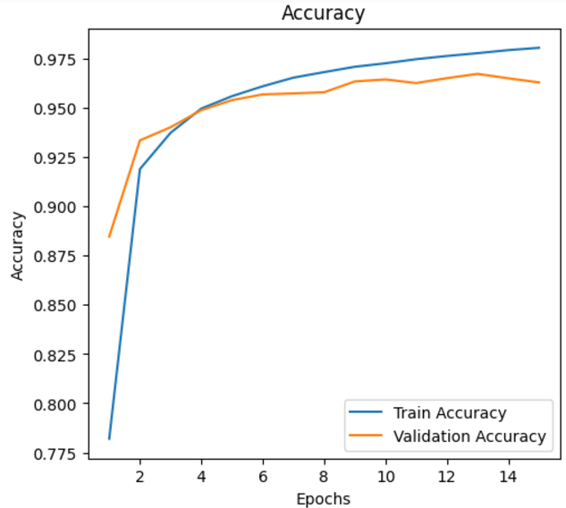
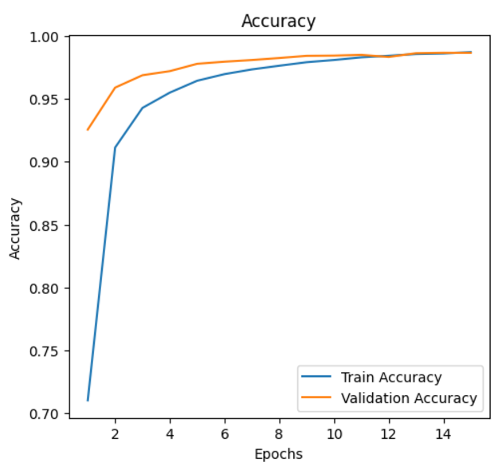
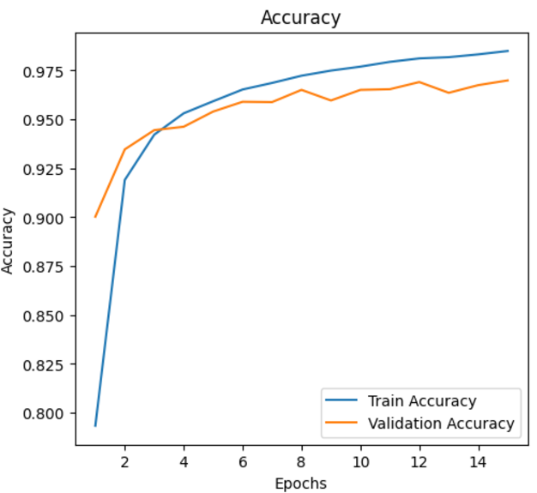
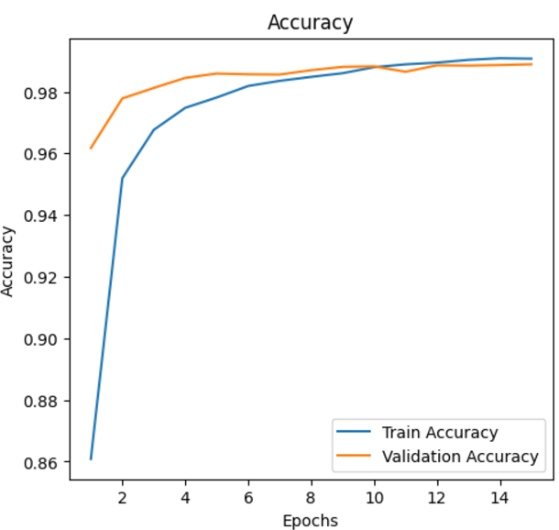
Standard CNN
Enhanced CNN
SGD Optimizer
Learning rate = 0.1
Adam Optimizer
HIGHEST ACCURACY

Slide 11




Testing the models
Results | Accuracy |  | F1 score
 | Dataset 1 | Dataset 2 | Dataset 1 | Dataset 2
Basic model - SGD | 0.9015 | 0.9023 | 0.9024 | 0.9031
Basic model – Adam | 0.9164 | 0.9153 | 0.9133 | 0.9141
Enhanced model – SGD | 0.9562 | 0.9570 | 0.9562 | 0.9570
Enhanced model – Adam | 0.9611 | 0.9617 | 0.9610 | 0.9616
*Uniformly distributed dataset
** Also tested on different dataset [2]
$$\text{accuracy}\text{ = }\frac{TP+TN}{TP+TN+FP+FN}$$
$$\text{recall}\text{ = }\frac{TP}{TP+FN}$$
?? GENERALIZED MODEL ??
$$\text{f}\text{1−}\text{score}\text{ = }2\frac{\text{precision}\text{ ∗ }\text{recall}}{\text{precision}\text{ + }\text{recall}}$$
$$\text{precision}\text{ = }\frac{TP}{TP+FP}$$
[2] Mahajan, S. Japanese Characters, 2022. kaggle. https://www.kaggle.com/ (accessed Dec 04, 2024).

Slide 12
Place for questions!
Lukas fiala, UCT Prague

