Slide 1
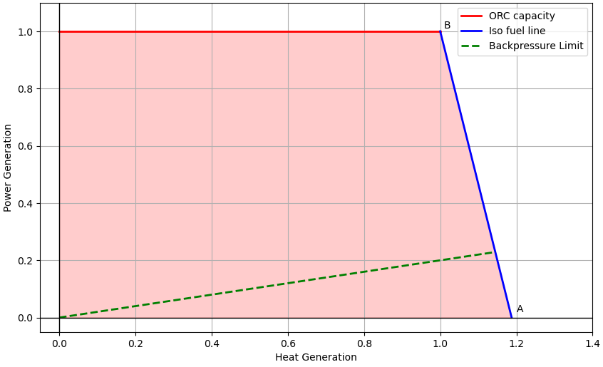
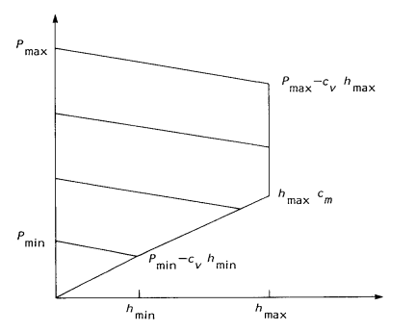
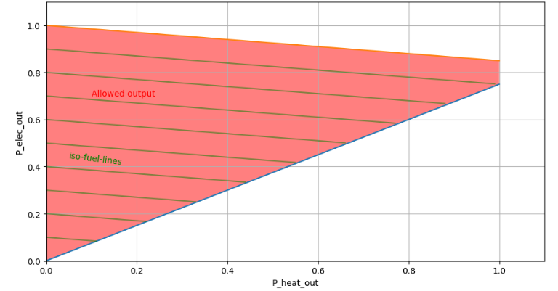
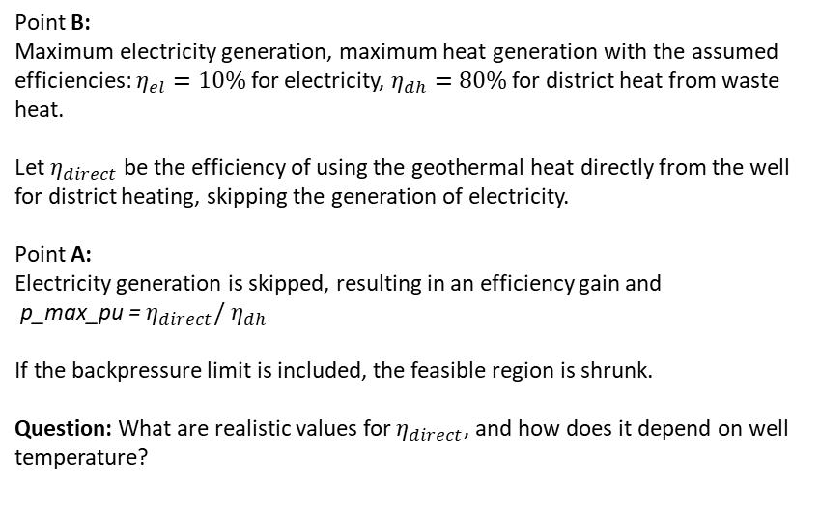
PyPSA-Eur version
Proposal
Modelling CHP within a national power system, Grohnheit 1993
Problem: In the EGS case, peak electricity generation produces waste heat that still has utility for DH. Hence, the line starting at (0., 1.) being sloped is not appropriate: 100% electricity generation should still allow some DH generation.
https://pypsa.readthedocs.io/en/latest/examples/power-to-gas-boiler-chp.html
Point B:
Maximum electricity generation, maximum heat generation with the assumed efficiencies: $η_{el}=10\%$ for electricity, $η_{dh}=80\%$ for district heat from waste heat.
Let $η_{direct}$ be the efficiency of using the geothermal heat directly from the well for district heating, skipping the generation of electricity.
Point A:
Electricity generation is skipped, resulting in an efficiency gain and p_max_pu = $η_{direct}/$ $η_{dh}$
If the backpressure limit is included, the feasible region is shrunk.
Question: What are realistic values for $η_{direct}$, and how does it depend on well temperature?

Slide 2
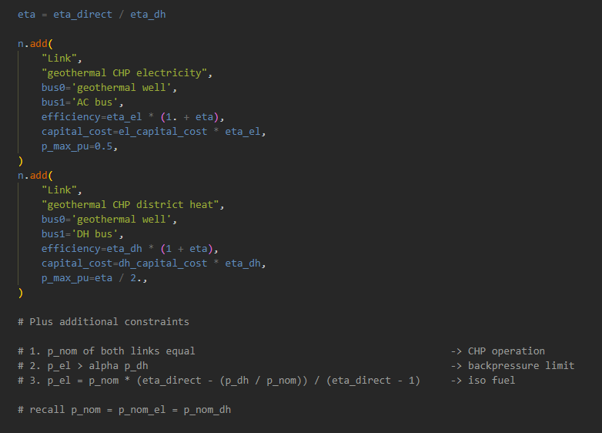
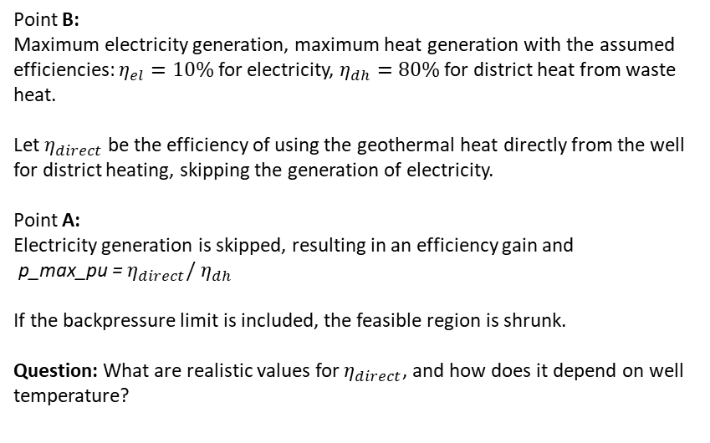
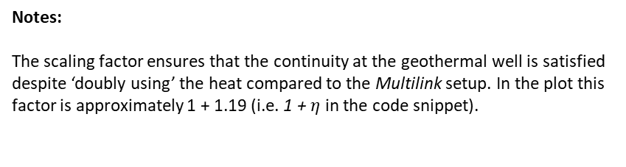
Proposal
Implementation
Point B:
Maximum electricity generation, maximum heat generation with the assumed efficiencies: $η_{el}=10\%$ for electricity, $η_{dh}=80\%$ for district heat from waste heat.
Let $η_{direct}$ be the efficiency of using the geothermal heat directly from the well for district heating, skipping the generation of electricity.
Point A:
Electricity generation is skipped, resulting in an efficiency gain and p_max_pu = $η_{direct}/$ $η_{dh}$
If the backpressure limit is included, the feasible region is shrunk.
Question: What are realistic values for $η_{direct}$, and how does it depend on well temperature?
Notes:
The scaling factor ensures that the continuity at the geothermal well is satisfied despite ‘doubly using’ the heat compared to the Multilink setup. In the plot this factor is approximately 1 + 1.19 (i.e. 1 + $η$ in the code snippet).

