Slide 1
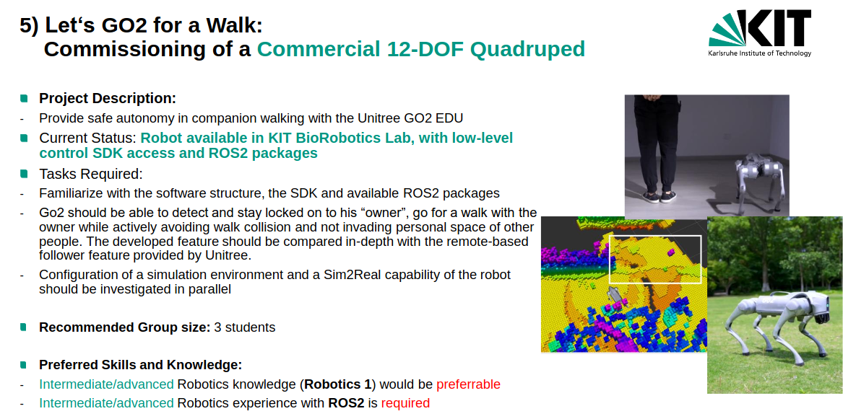

Slide 2
Task
interim project presentation
Each group has a time window of 20 minutes
15 min presentation
5 min discussion/questions
All group members are expected to present and respond to questions
Contents of the presentation
Introduction (theoretical & technical foundation, related work)
Detailed workplan for your project
Current state of your work & problems
Not graded but mandatory

Slide 3

Let‘s GO2 for a Walk:
Commissioning of a Commercial 12-DOF Quadruped
Lukas, Simon, Linus Fischer

Slide 4
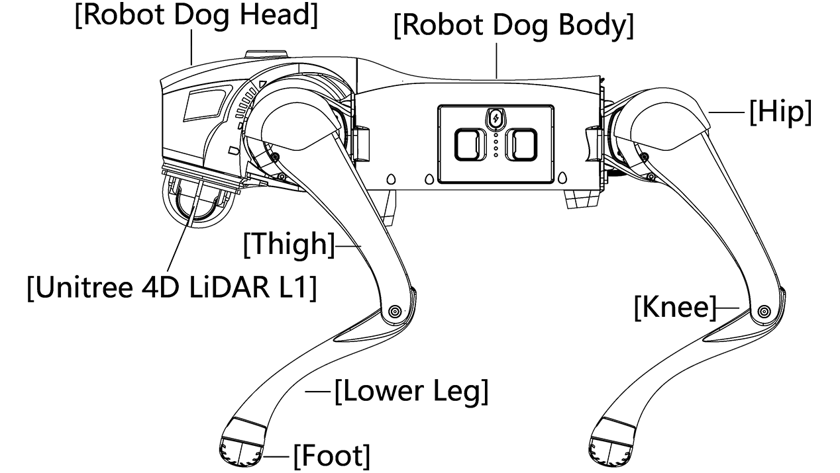
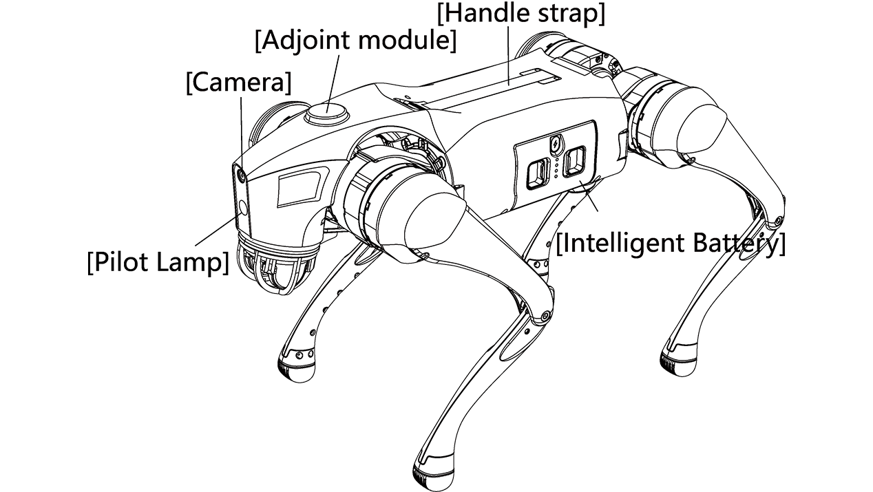
The Task
Go2 should be able to detect and stay locked on to his “owner”, go for a walk with the owner while actively avoiding walk collision and not invading personal space of other people.

Slide 5
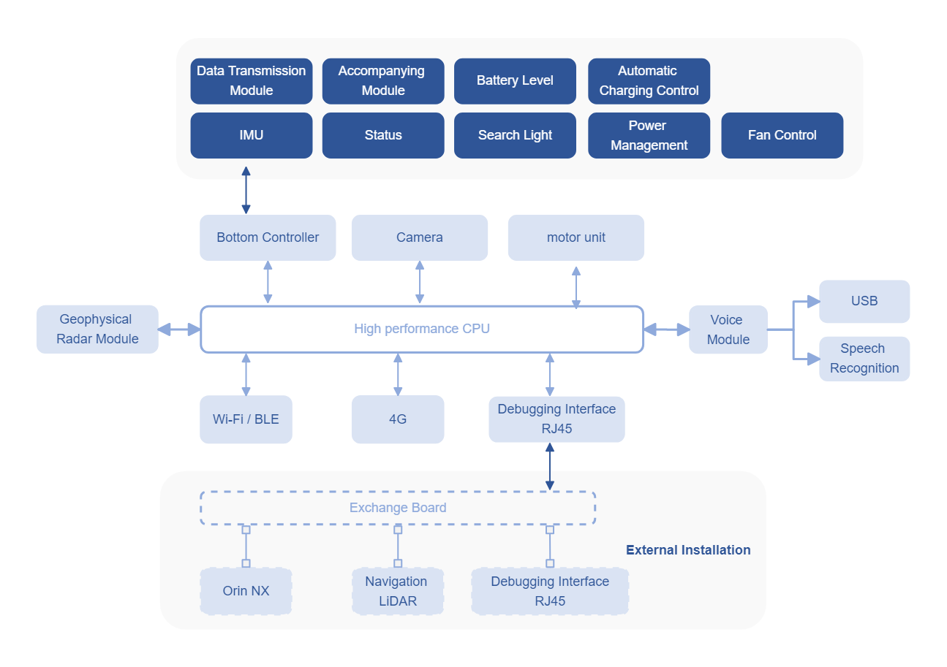
GO2 Architecture

Slide 6
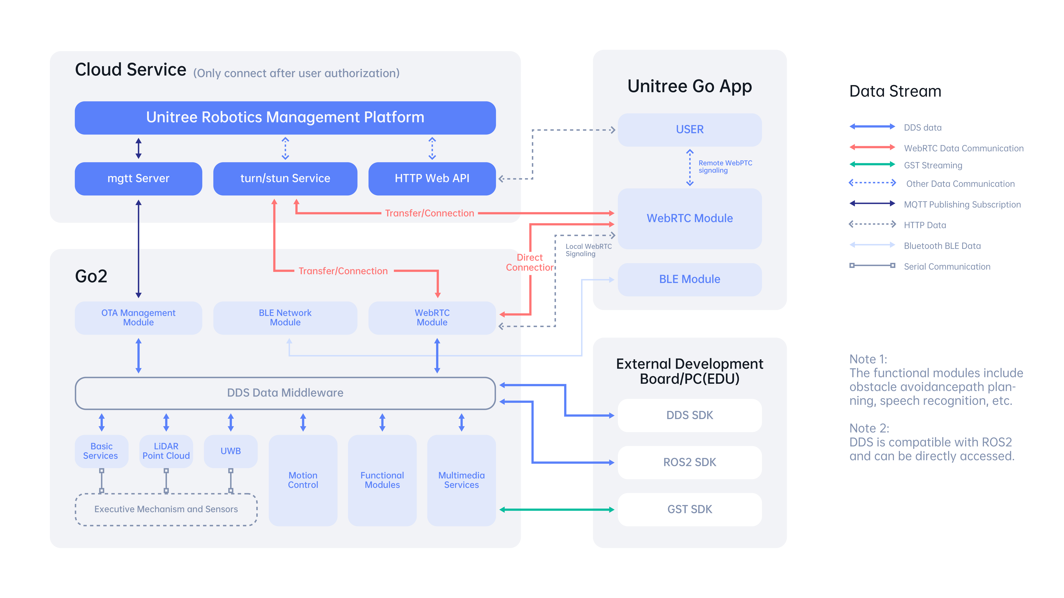
GO2 Architecture

Slide 7
Project Plan
Use Camera
Make a ROS2 Node to publish camera image
Implement Person detection and Tracking node
Map Bounding Box and Depth Information to calculate relative pose
Send Movement commands to a movement node
Implement a Node that get to goal position while avoiding collisions

Slide 8
Current State

Slide 9
Problems
Unofficial SDK needed different Ubuntu Version (22 Humble)
We tried to make a dev container
We tried to use VMs
We fixed the dependencies on the normal system
What does the unofficial SDK do
How to install something on the robot
How to place the camera cable

