Slide 1

Let‘s GO2 for a Walk:
Commissioning of a Commercial 12-DOF Quadruped
Lukas, Simon, Linus Fischer

Slide 2
The Task

Slide 3
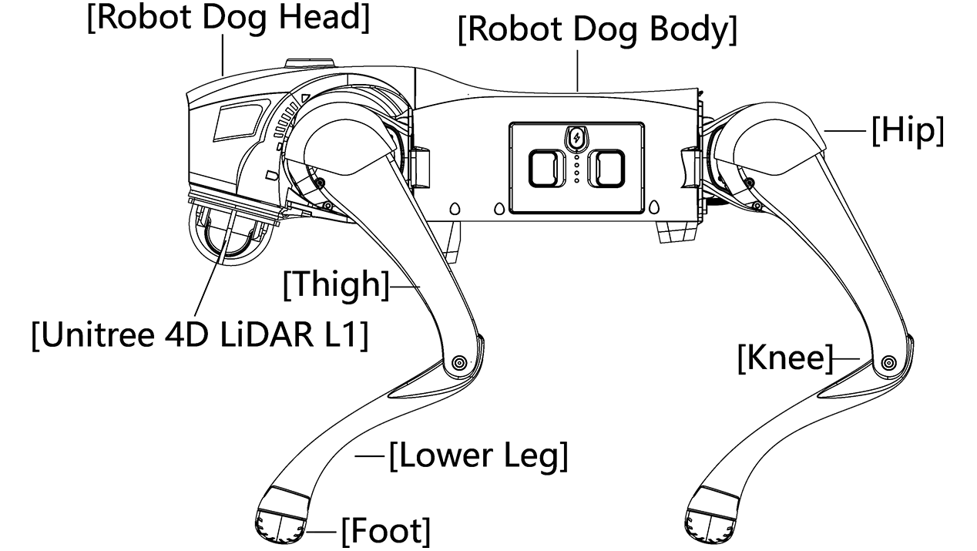
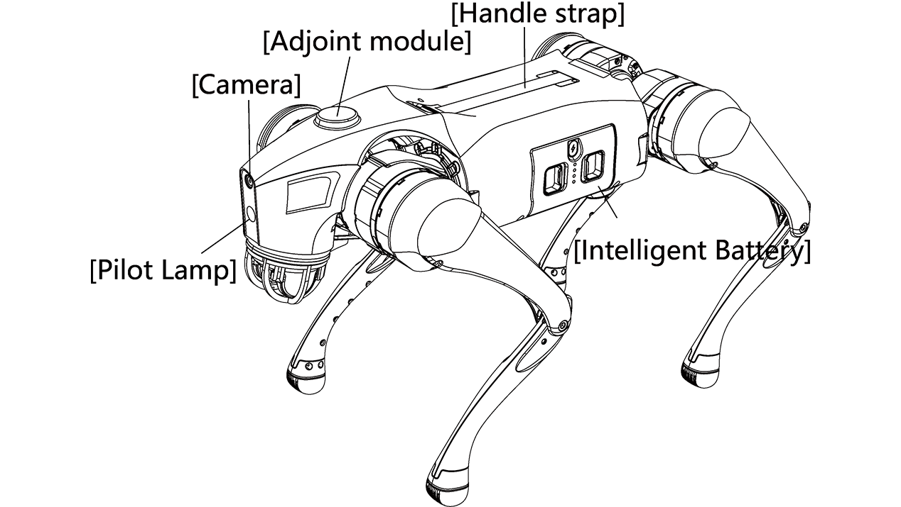
The Task
Go2 should be able to detect and stay locked on to his “owner”, go for a walk with the owner while actively avoiding walk collision and not invading personal space of other people.

Slide 4
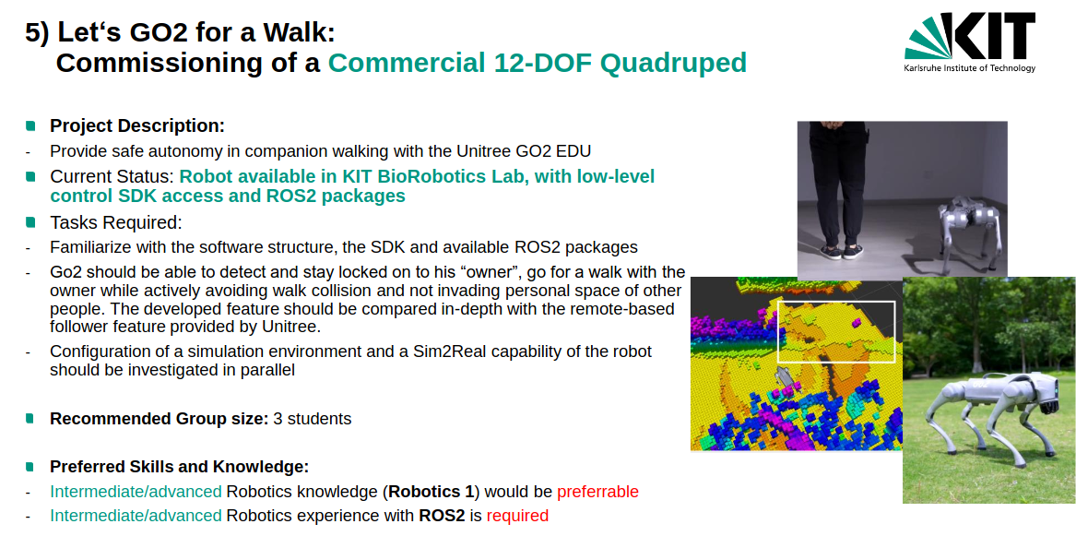

Slide 5
Task
interim project presentation
Each group has a time window of 20 minutes
15 min presentation
5 min discussion/questions
All group members are expected to present and respond to questions
Contents of the presentation
Introduction (theoretical & technical foundation, related work)
Detailed workplan for your project
Current state of your work & problems
Not graded but mandatory

Slide 6
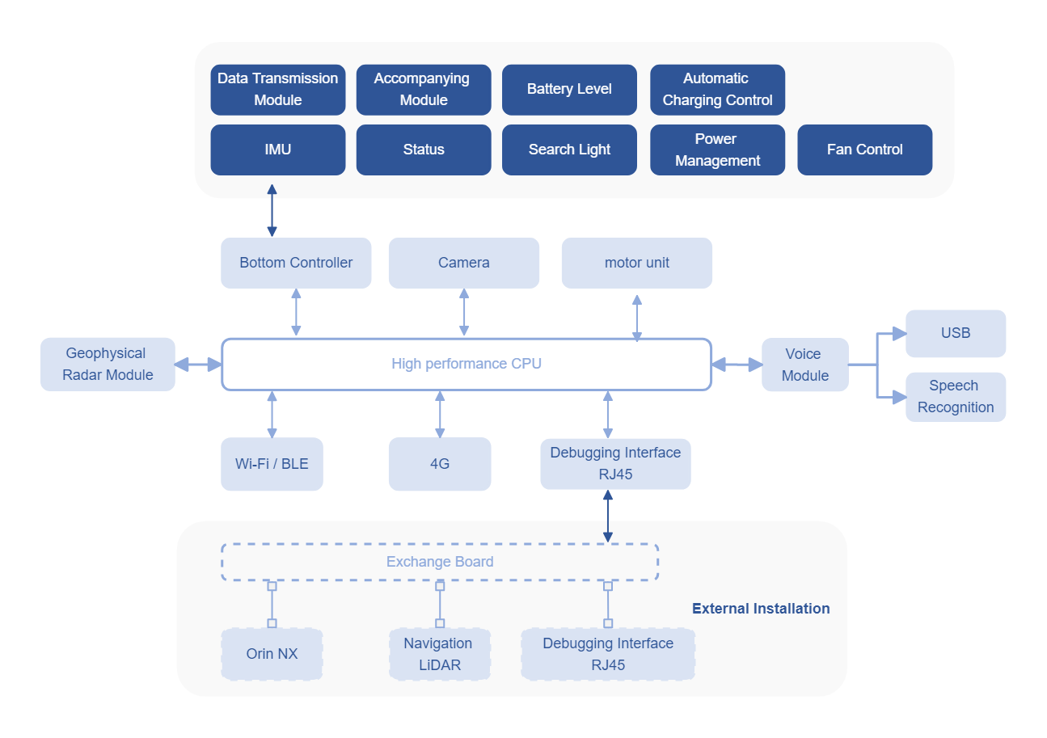
GO2 Architecture

Slide 7
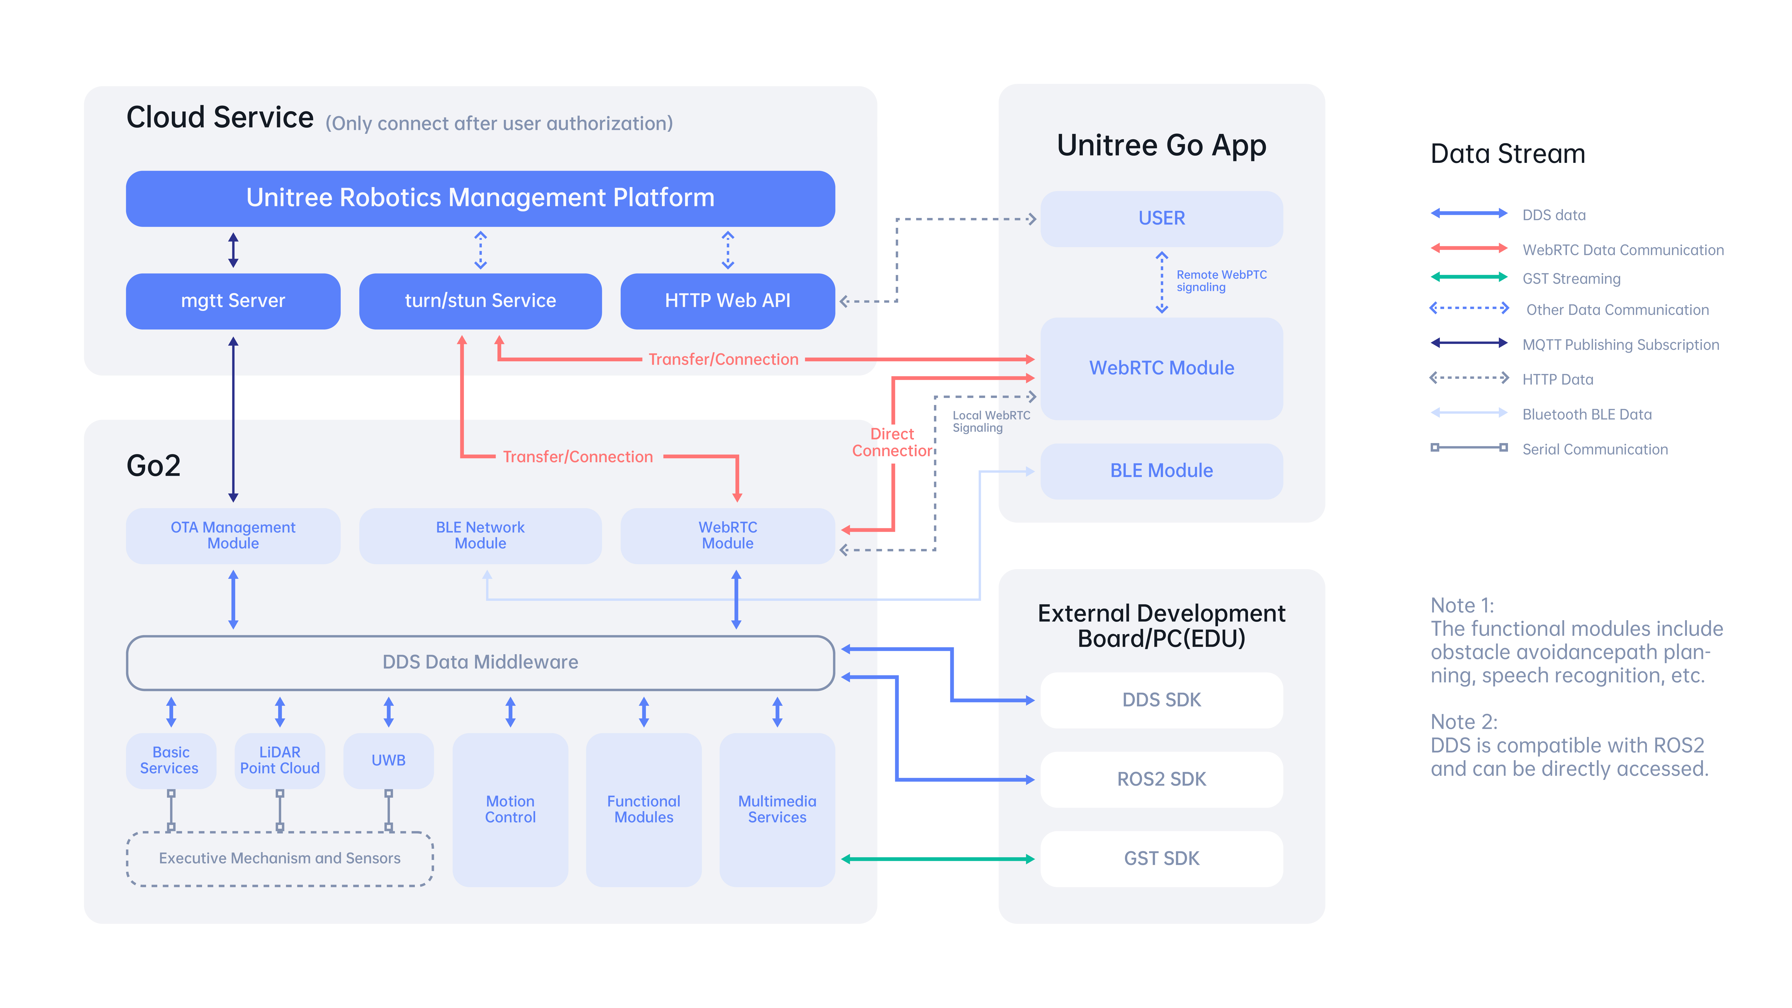
GO2 Architecture

