Slide 1
Who Says?
Karl Duckert Karlsson, Abbas Alubeid, Mårten Saltin, Johan von Axelson, Oscar Hjelm, Gor Durgaryan, Lukas Ingemarsson
template
Notes:
Gor

Slide 2
Table of contents
01
02
03
About
Pipeline
Result
Notes:
Gor

Slide 3
About the project
Multi-speaker speech is hard (overlap, noise, similar voices)
Transcription alone is not enough
Need speaker-aware pipelines
Who spoke what and when
Notes:
Gor

Slide 4
02
Pipeline
Notes:
Kalle

Slide 5
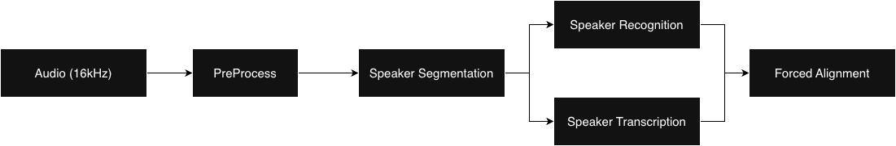
Pipeline
Notes:
Kalle

Slide 6
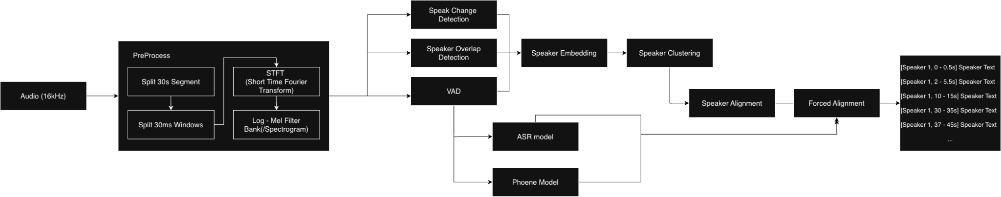
Pipeline
Notes:
Kalle

Slide 7
Speaker Segmentation
01
02
03
Voice Activity Detection
Speaker Overlap Detection
Speaker Change Detection
Notes:
Mårten
After preprocess we run Speaker Segmentation that consists of 3 main components, Voice Activity Detection, Speaker Change Detection and Speaker Overlap Detection

Slide 8
Voice Activity Detection (VAD)
Neural network based speech segment detection
Detects and separates human voice activity from noise
Used for
Efficiency
Prevent Hallucinations
Notes:
Abbas

Slide 9

Speaker Overlap Detection (SOD)
Finds regions where 2+ speakers talk simultaneously.
Separates overlapping speech into individual speaker segments.
Notes:
Mårten
An important component of meeting diarization is handling moments when two or more people talk simultaneously. This is where Speaker Overlap Detection (SOD) comes in, it identifies regions in the audio where overlap occurs. Once detected, Speaker Overlap Seperation (SOS) splits those regions into separate sources, allowing us to run ASR and Speaker Recognition on each speaker individually.

Slide 10
Speaker Change Detection (SCD)
Identifies when one speaker stops and another begins
Segments audio into single speaker regions
Improves the ASR and Speaker Recognition
Notes:
Mårten
Speaker Change Point Detection (SCD) identifies when one speaker stops and another begins. These transition points segment audio into single speaker regions. Its in-order to improve ASR and Speaker Recognition.

Slide 11
Speaker Recognition
01
02
03
Speaker Embedding
Speaker Clustering
Speaker Recognition
Notes:
Lukas

Slide 12
Speaker Embedding
Embed audio to a low-dimensional, feature-rich representation
Compare embeddings → distinguish different voices
Notes:
Lukas

Slide 13
Speaker Clustering
For each speaker: record “reference” phrase → embed it
Assign each speaker to a cluster (initial centroid = reference)
In real-time: embed input segments → add to the cluster space
Notes:
Lukas
(tänkte att denna skulle kunna vara kvar även om vi ej använder clustering, främst för att förklara idén och varför vi i slutändan ej behövde använda det)

Slide 14
Speaker Recognition
Clustering:
In real-time: embed input segments → add to cluster space (assigned cluster = predicted speaker)
Alternative (our chosen approach):
In real-time: directly compute similarity (input ↔ reference)
Confidence increases as current segment length increases
Benefits: straight-forward + efficient + competitive accuracy
Notes:
Lukas
Kan korta ner om det önskas (är ganska mkt text nu, ik)

Slide 15
Speaker Transcription
01
02
Automatic Speech Recognition
Phoneme model
Notes:
Johan

Slide 16
Automatic speech recognition (ASR)
ASR models use ML and NLP for speech-to-text conversion
Generating transcripts using Whisper models
Multiple variants and sizes for GPU or CPU usage with different precision
Ability to produce word level timestamps → align transcription with speakers in real-time
Notes:
Johan

Slide 17
Phoneme model
SpeechBrain Sound-Choice grapheme-to-phoneme model (ARPAbet-style)
Converting text to phonetic representation
Phonemes provide fine-grained temporal units
Supports more precise alignment between VAD, ASR, and speakers
Example: "I live in Pasadena" → "AY L IH V IH N P AE S AH D IY N AH"
Notes:
Gor

Slide 18
03
Results
Notes:
Mårten

Slide 19
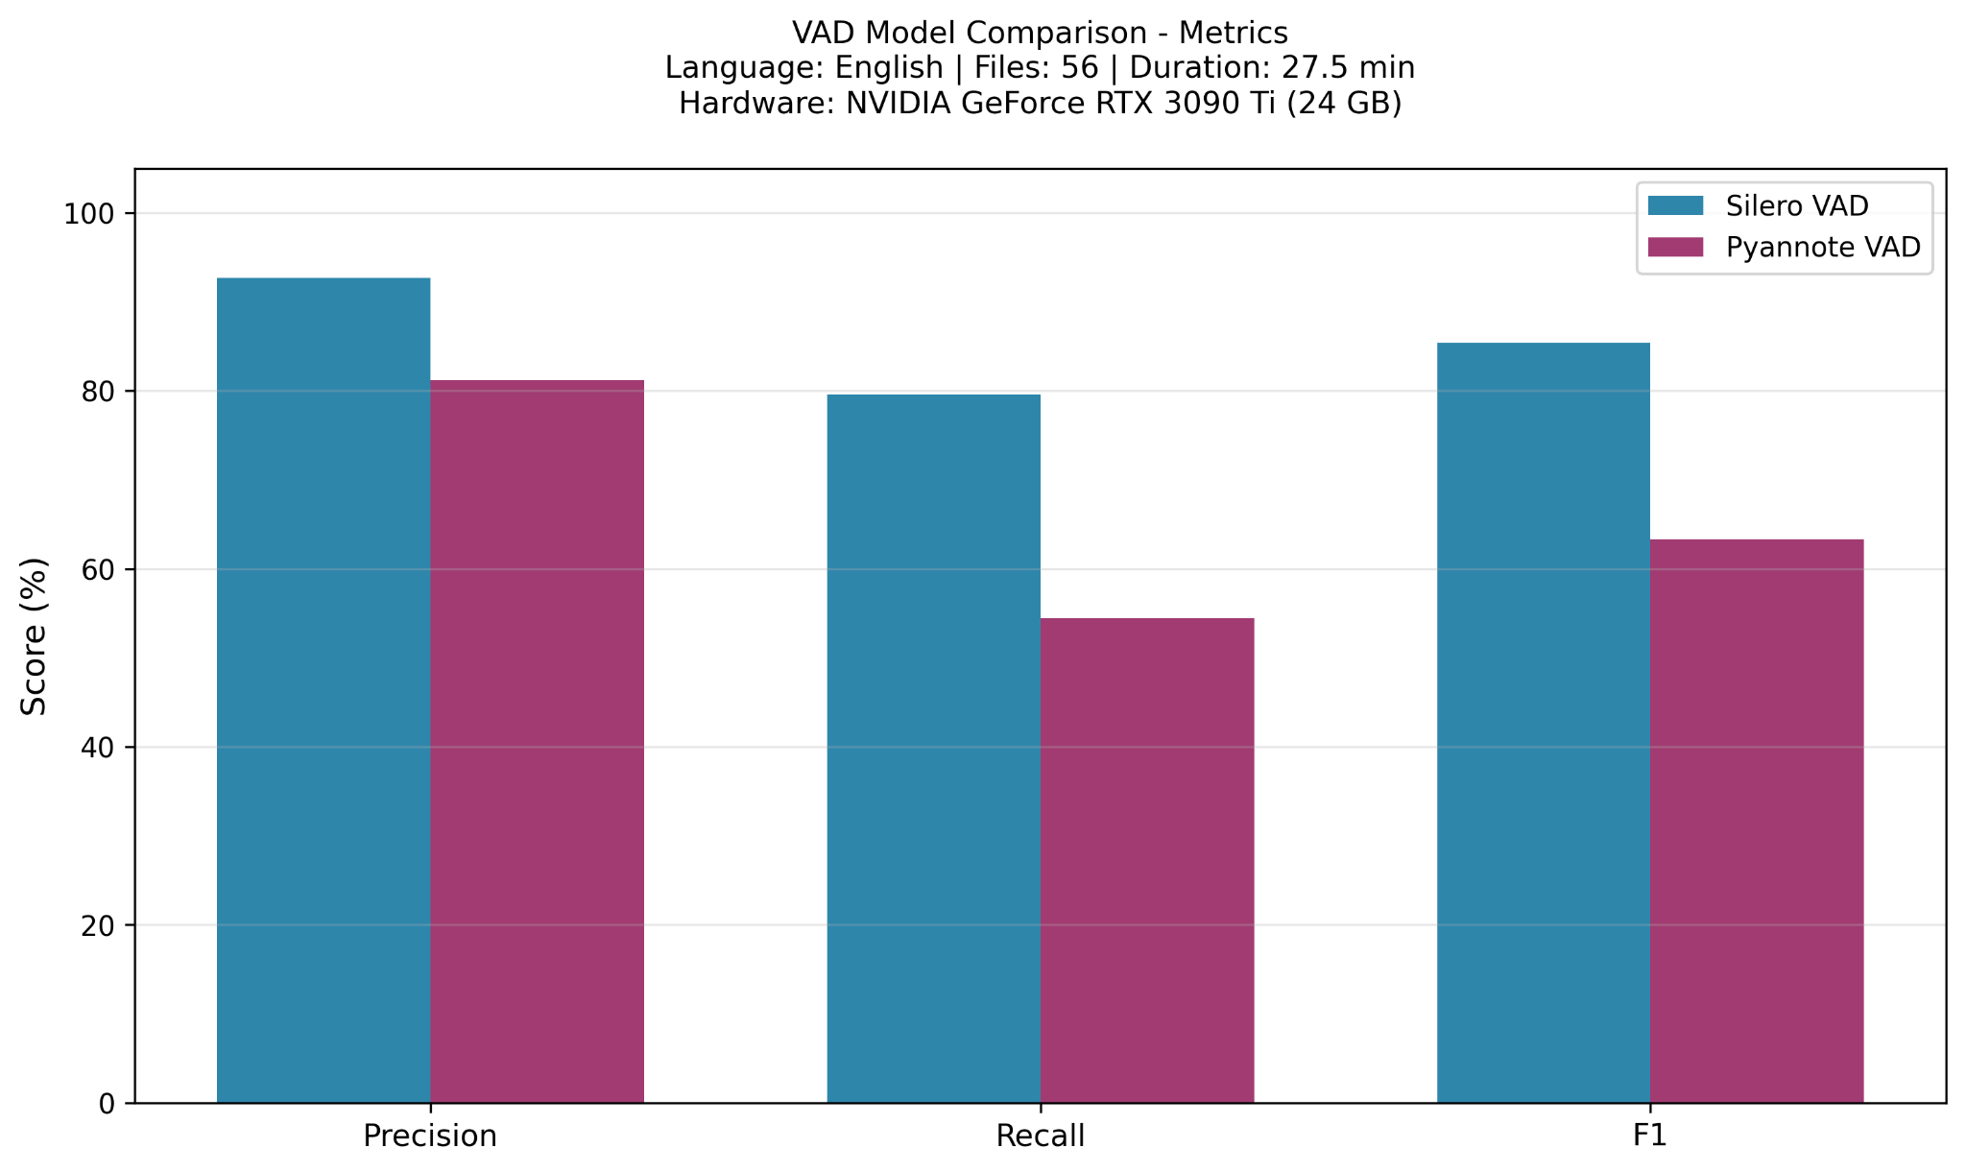
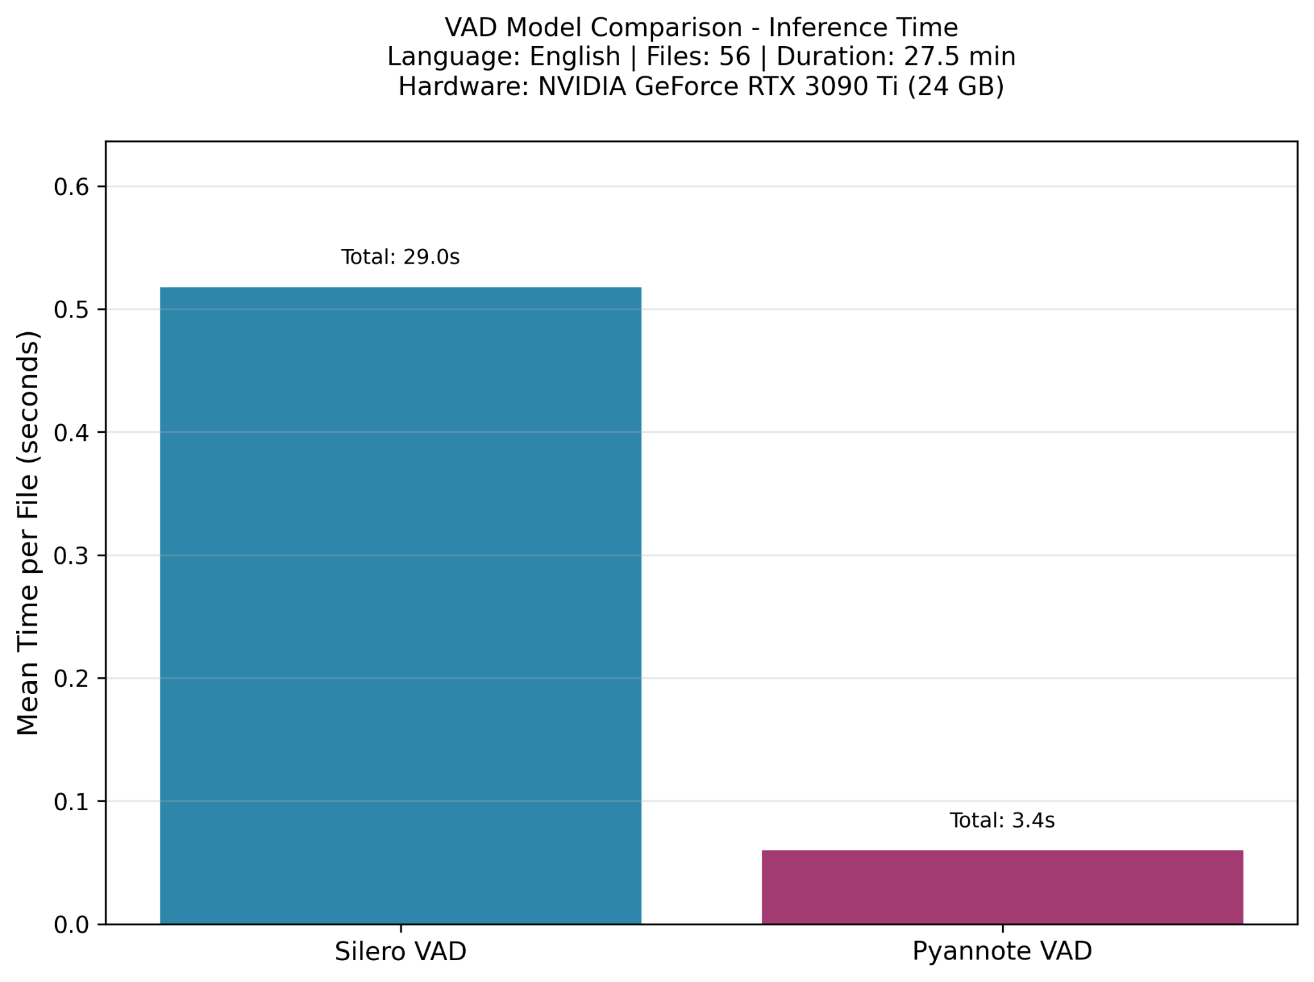
Voice Activity Detection (VAD)
Notes:
Abbas

Slide 20
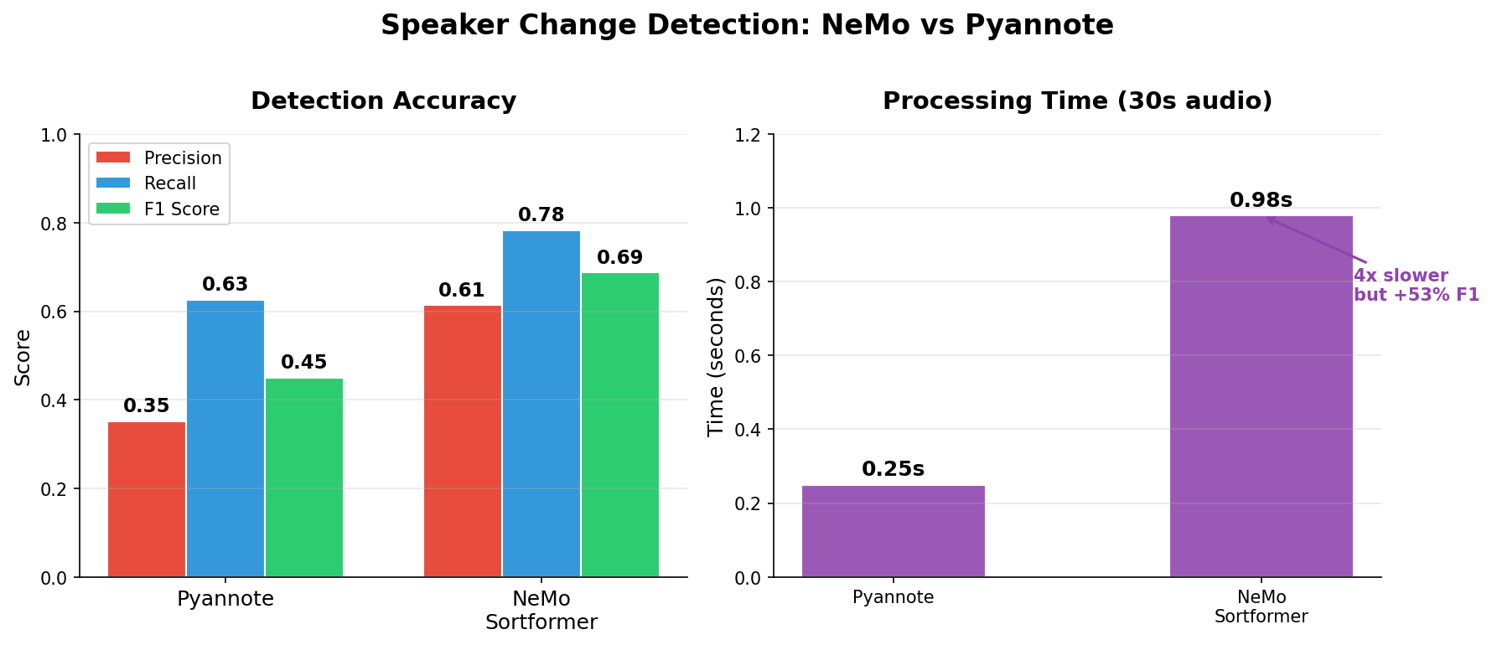
Speaker Change Detection (SCD)
Notes:
Mårten
Here is comparison between two different models that were selected for speaker change detection. As we can see the NeMo Sortformer outperforms Pyannote, although being 4x times slower. The metric is calculated frame by frame and using binary classification if there is a new speaker or not.

Slide 21
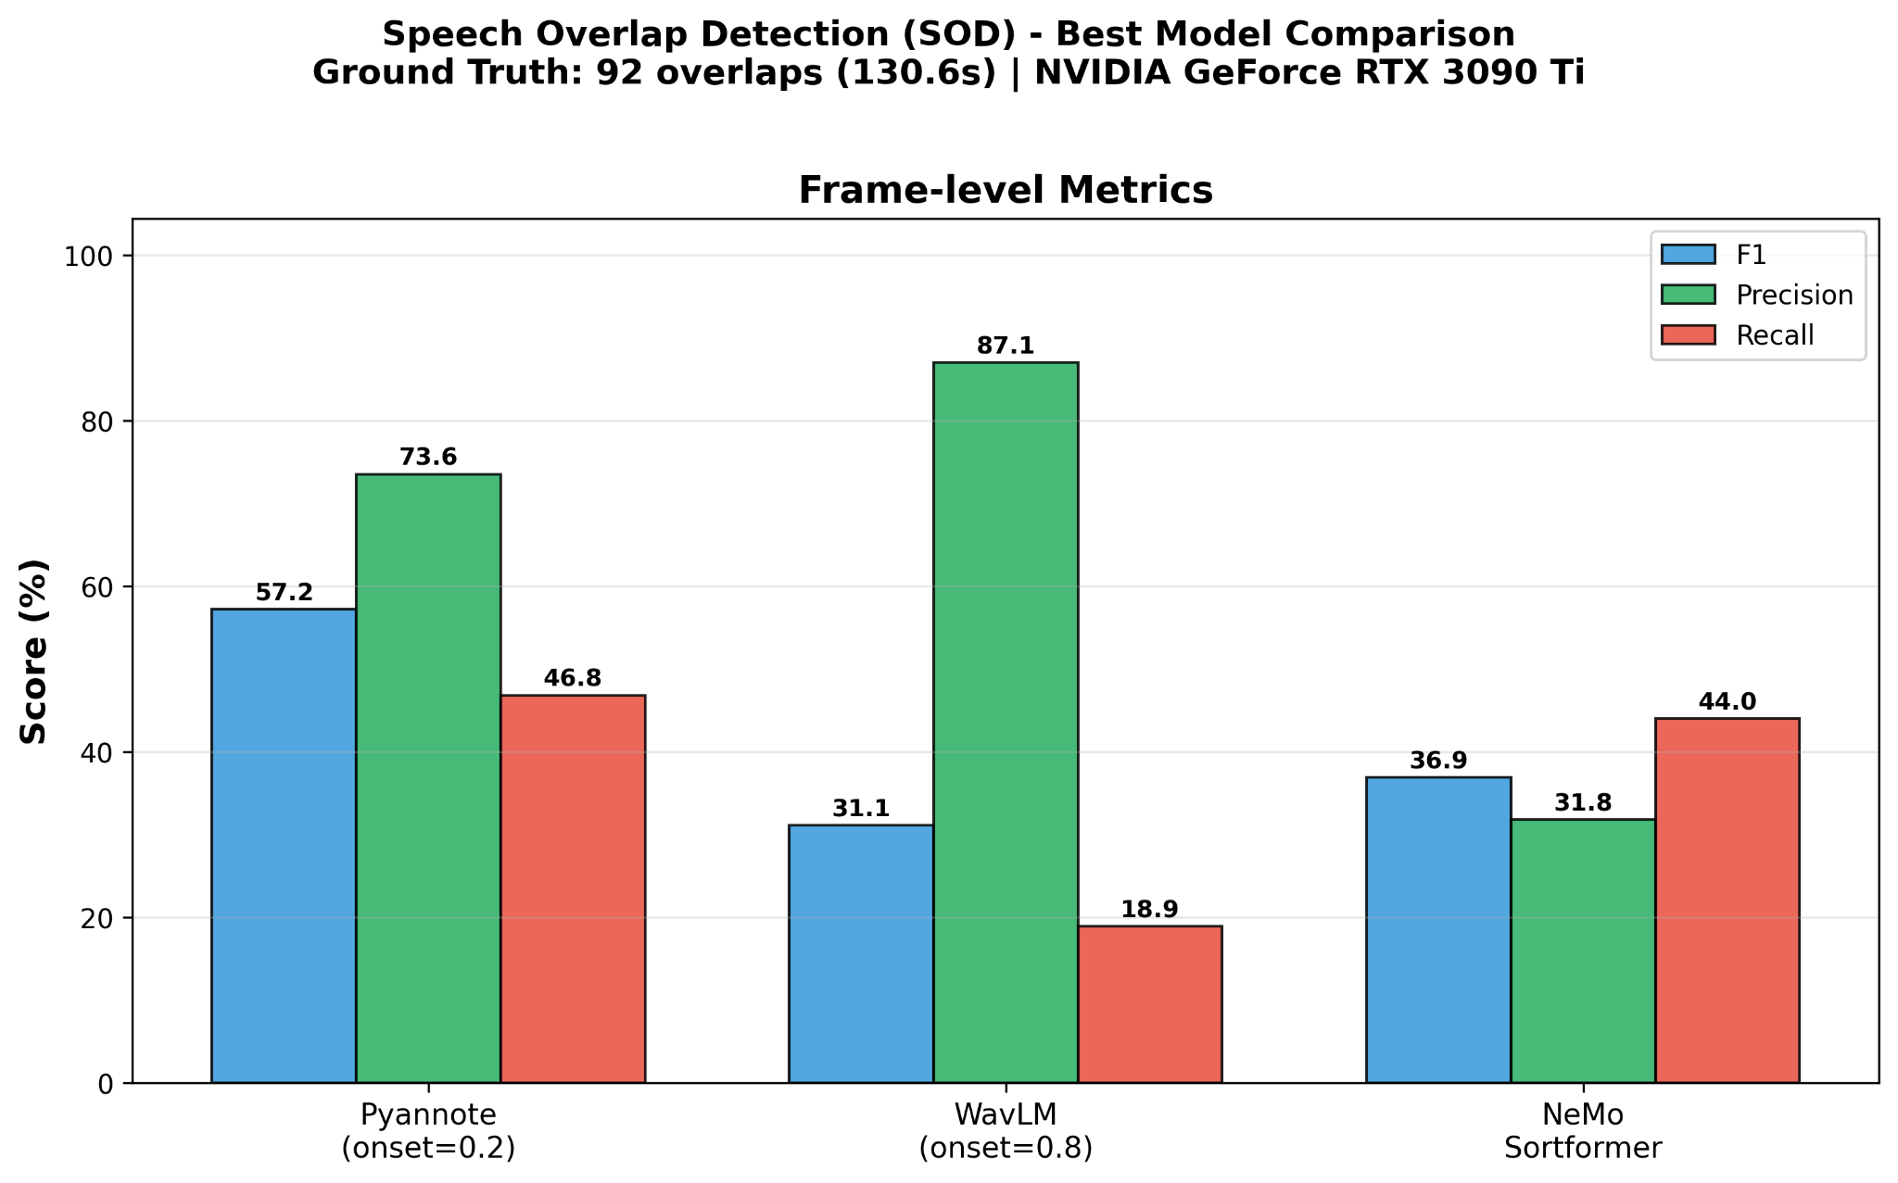
Speaker Overlap Detection (SOD)
Notes:
Mårten
Here is comparison between two different models that were selected for speaker overlap detection. As we can see the Pyannote outperforms Nemo, but the microsoft/wavlm-base-plus-sd model outperforms pyannote. The metric is calculated frame by frame and using binary classification if there is a new speaker or not. Looking at the metrics is that is worse on finding overlap (recall), but when it finds it, it is often correct.

Slide 22
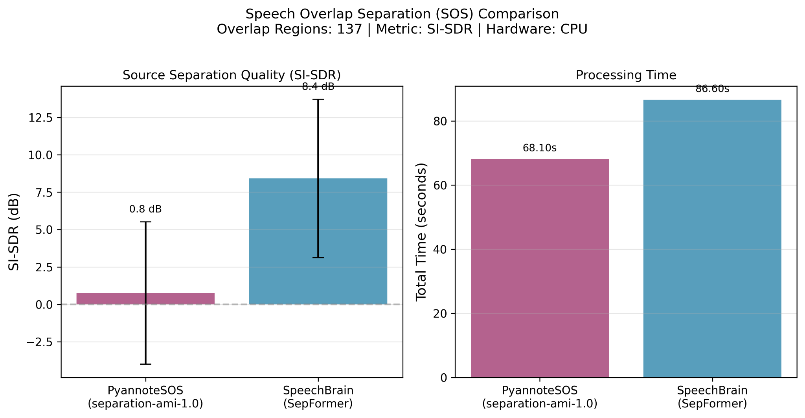
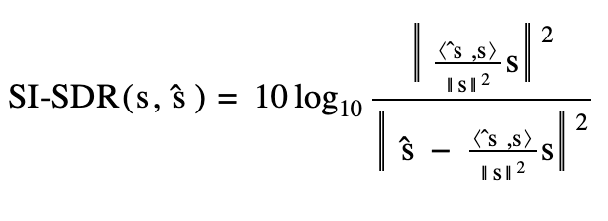
Speaker Overlap Detection (SOD)
Notes:
Mårten
Here we can see a comparison between Pyannote and SpeechBrain models. As I said earlier the goal is to separate overlapped segments into 2 different segments. SI-SDR shows how well the true audio for speaker is separated out from overlapped. It measure how much of the estimation is close to the actua output, meaning that higher dB is better.

Slide 23
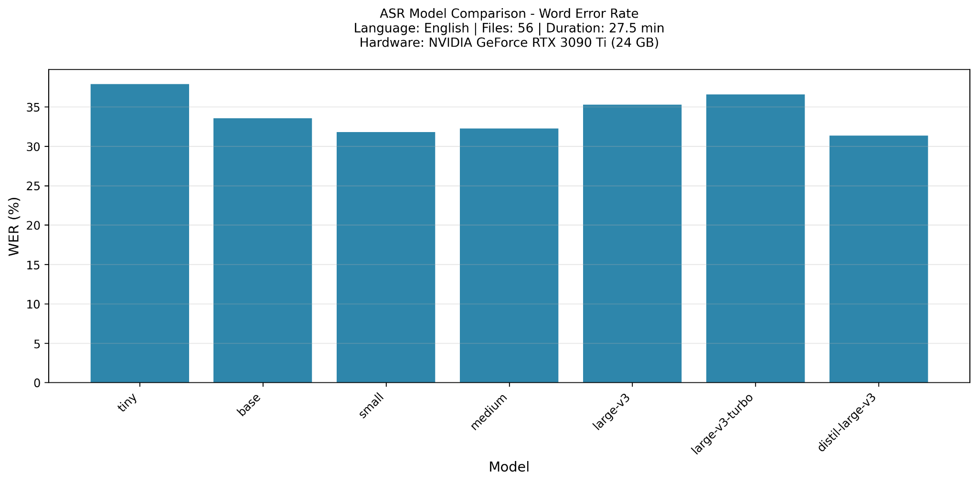
Automatic Speech Recognition (ASR)
Notes:
Johan Highlight that while WER is quite similar for all models, small and medium outperform two of the large models.

Slide 24
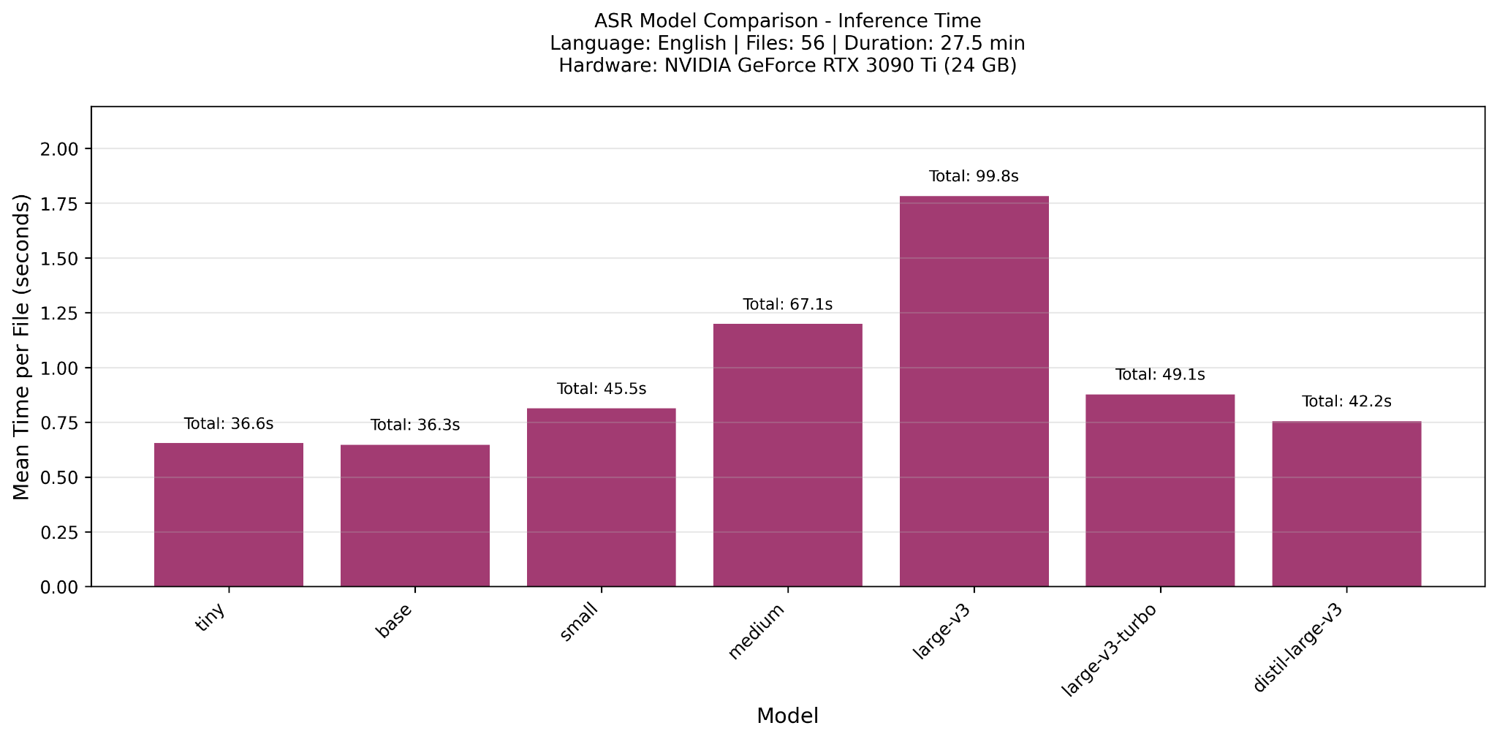
Automatic Speech Recognition (ASR)
Notes:
Johan

Slide 25
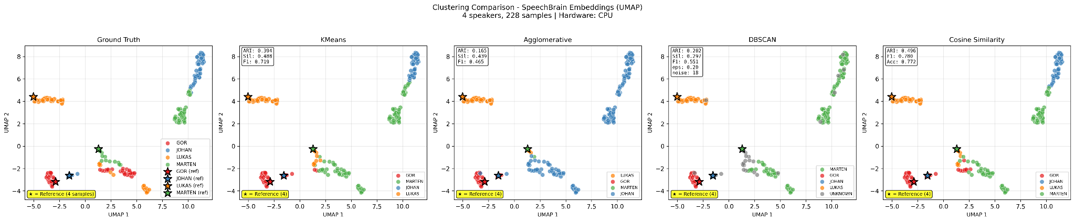
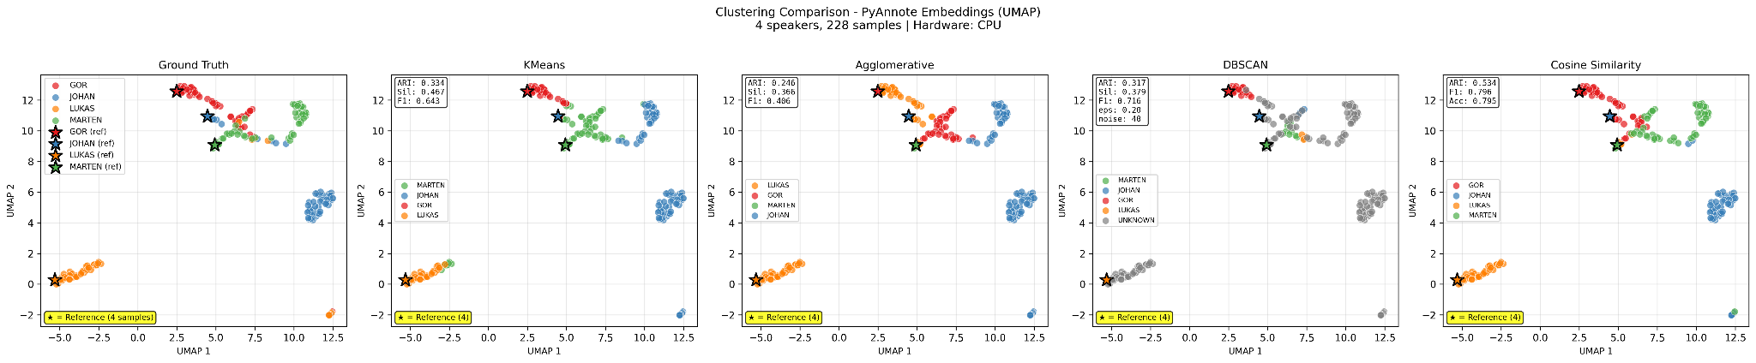
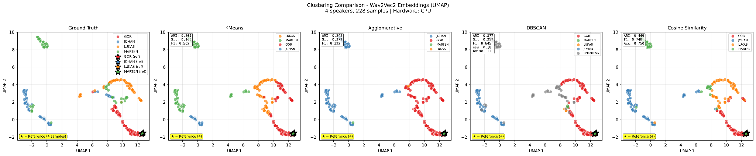
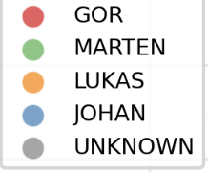
Speaker Embedding
Speech Brain
224 samples
Pyannote
Wav2vec2
Notes:
(Lukas)

Slide 26
Speaker Embedding
Speech Brain
224 samples
Pyannote
Wav2vec2
Notes:
(Lukas)

Slide 27
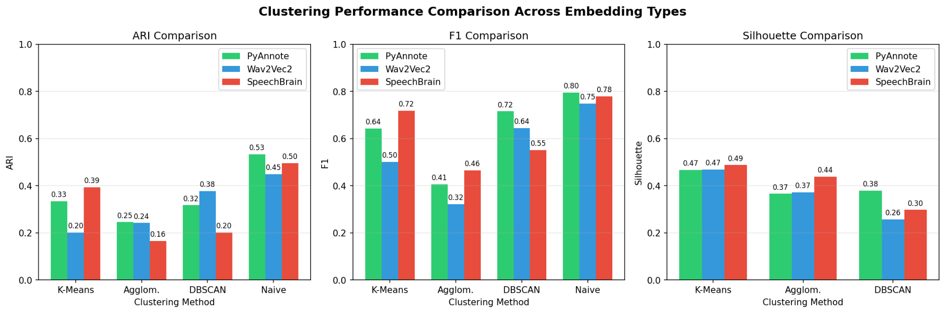
Speaker Recognition
Notes:
Lukas

Slide 28
Speaker Recognition
Notes:
Lukas

Slide 29
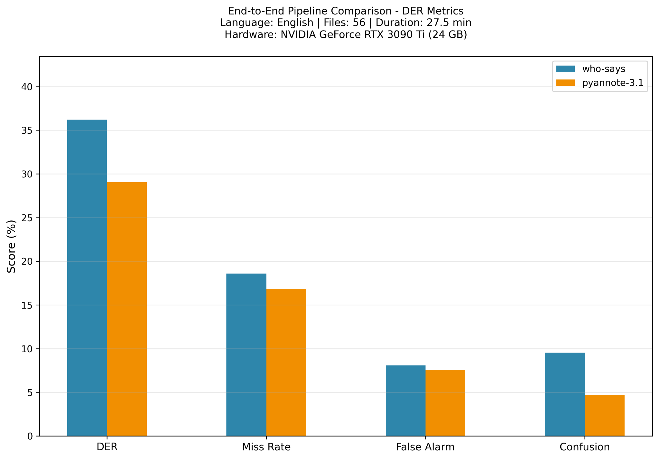
Pipeline
Notes:
Kalle

Slide 30
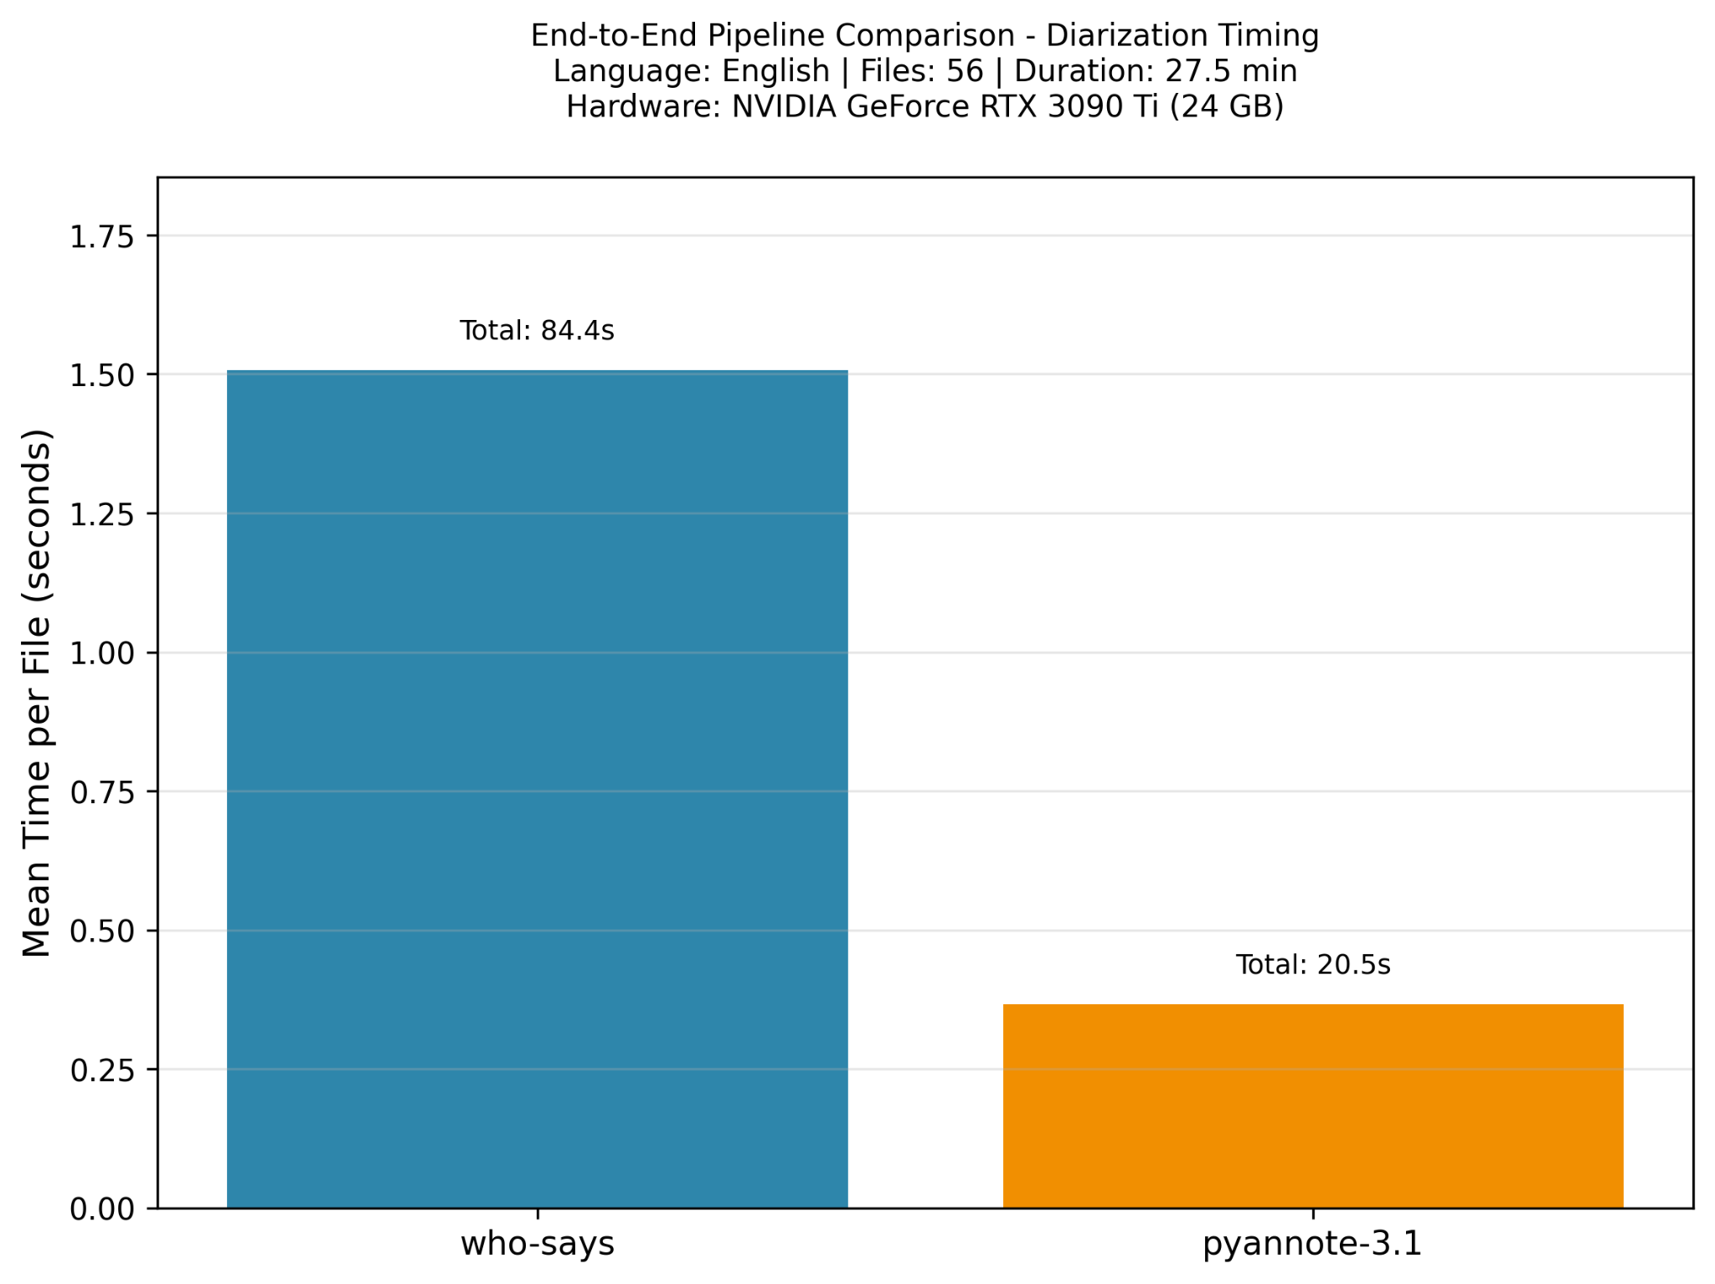
Pipeline
Notes:
Kalle

Slide 31
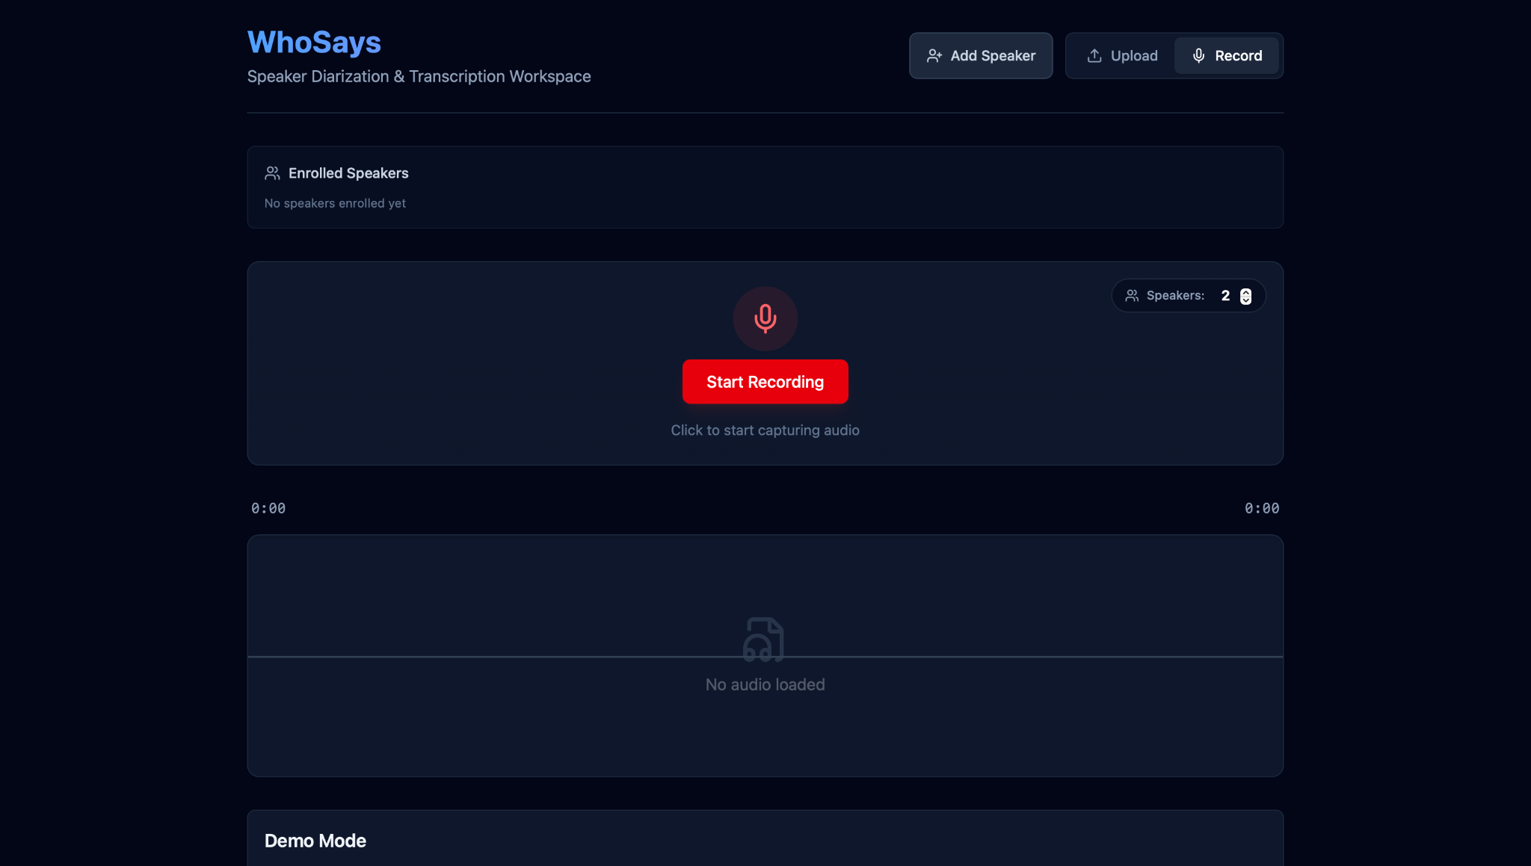

Slide 32
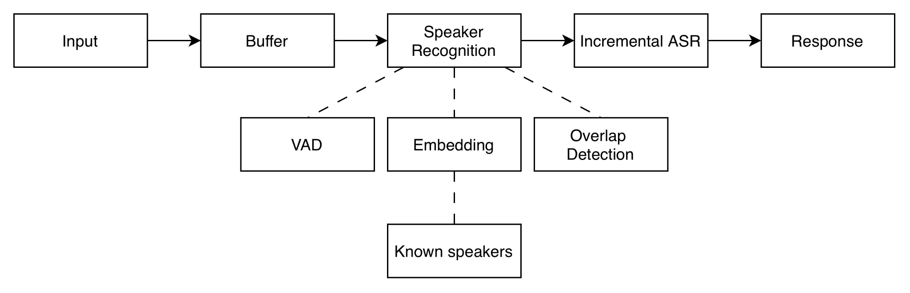
Live Streaming
Notes:
Oscar
a per‑session ASR buffer (so we can do incremental transcription with a cursor),
a rolling buffer for VAD context, and a speech buffer that accumulates enough speech to compute a stable speaker embedding,
plus a per‑session overlap buffer used specifically for overlap detection.
Incremental ASR: run asr on new speech only

Slide 33
Demo
Introduction
Speaker Embeddings:
Lukas, Marten, Johan
Oscar has no reference → Unknown
Overlap showing

Slide 34


Slide 35
Thanks!
Questions?
Karl Duckert Karlsson, Abbas Alubeid, Mårten Saltin, Johan von Axelson, Oscar Hjelm, Gor Durgaryan, Lukas Ingemarsson

