Slide 1
Interview - Data Case
Predictive Maintenance - Always one step ahead of failure with AI
Hamburg, 2021

Slide 2
Agenda

Slide 3
Introduction into Maintenance Approaches
Predictive Maintenance - Always one step ahead of failure with AI
Reactive Maintenance Waiting for something to fail in order to repair it.
Preventive Maintenance Relying on average or expected life statistics.
Predictive Maintenance Relying on the actual condition of equipment (e.g., measured through sensors) by using ML approaches to diagnose the health of the system and forecast its future states.

Slide 4
Why Predictive Maintenance will benefit you
Predictive Maintenance - Always one step ahead of failure with AI
Saved Money
Minimization of maintenance cost by combining the cost of maintenance and machine failures with the predictions of our machine learning models
Enhanced Trust in the reliability of your machines
You will predict failures before they happen by using machine learning models for pattern identification in your sensory data
Confidence in knowing you are not missing out on the advantages of state-of-the-art AI technologies

Slide 5
The Predictive Power in your Data Our Approach – Defining and Predicting Danger Windows
Predictive Maintenance - Always one step ahead of failure with AI
The data is labeled:
Normal, the machine is working properly
Recovering, the machine‘s status after a failure
Broken, the machine failed
We introduce a new label:
Danger, the X minutes before a machine fails
The amount of minutes has to satisfy certain criteria:
Machine Learning models can properly distinguish between Danger and No Danger observations
An employee has enough time to react upon a warning
Our window for this example: 4 days (5760 minutes)

Slide 6
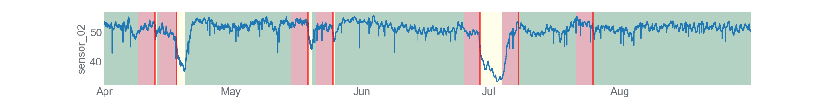
The Predictive Power in your Data
Predictive Maintenance - Always one step ahead of failure with AI
Label Modification
Normal – Green Recovering – Yellow Danger – Red Failure – Vertical Line

Slide 7
The Predictive Power in your Data
Predictive Maintenance - Always one step ahead of failure with AI
 | Precision | Recall | F1-Score | Support
No Danger | 0.83 | 1 | 0.91 | 127892
Danger | 0.74 | 0.03 | 0.05 | 26190
Accuracy |  |  | 0.83 | 154082
Macro Avg. | 0.79 | 0.51 | 0.48 | 154082
Weighted Avg. | 0.82 | 0.83 | 0.76 | 154082
ExtraTreesClassifier
bootstrap=False
criterion="gini"
max_features=0.1
min_samples_leaf=19
min_samples_split=2
n_estimators=100
 | Precision | Recall | F1-Score | Support
No Danger | 0.85 | 0.86 | 0.86 | 127892
Danger | 0.29 | 0.27 | 0.28 | 26190
Accuracy |  |  | 0.76 | 154082
Macro Avg. | 0.57 | 0.57 | 0.57 | 154082
Weighted Avg. | 0.76 | 0.76 | 0.76 | 154082
KNeighborsClassifier
n_neighbors=100
p=1
weights=uniform

Slide 8
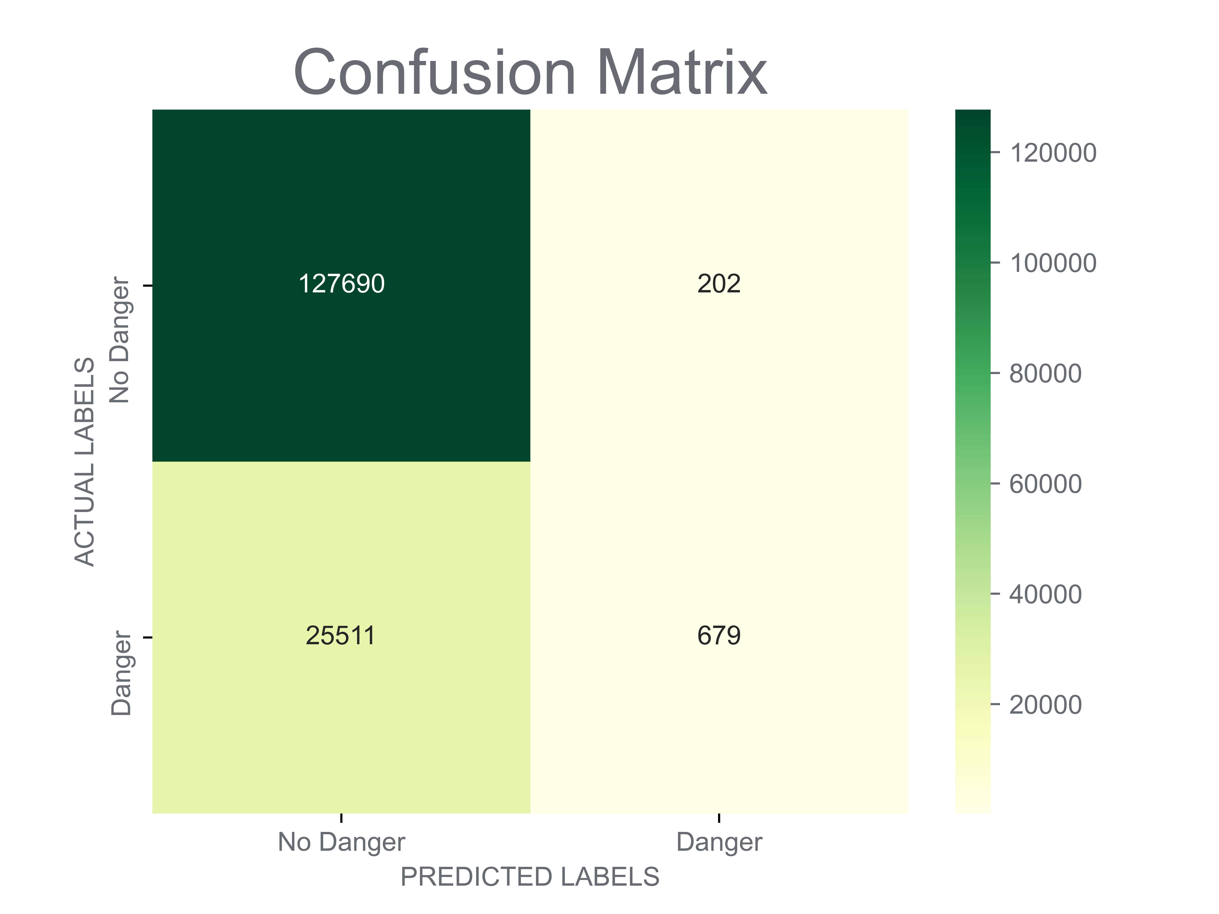
The Predictive Power in your Data Evaluating the ExtraTreesClassifier
Predictive Maintenance - Always one step ahead of failure with AI
Average daily warnings when there is no danger:
2.27
1440 * 202 / (127690+202) = 2.27
Average daily warnings when there is danger:
37.3
1440 * 679 / (25511+679) = 37.3

Slide 9
The Predictive Power in your Data Failure prevention through real-time warning
Predictive Maintenance - Always one step ahead of failure with AI
How can we help the employees figure out if the warning is just a fluke?
We aggregate the predictions of the past 24 hours
Based off these aggregations' multiple approaches:
Assigning a fixed threshold where a surpassing triggers an acute warning response
Installation of a Hypothesis Testing
Minimizing total maintenance cost by incorporating the cost for a “false alarm” and a “failure without alarm” into a statistical quality control model
Deployment of chosen approach in a visual real-time Dash-Board

Slide 10
Next steps with Ginkgo Analytics by your side
Predictive Maintenance - Always one step ahead of failure with AI
Determining and finding the optimal warning window
How much time do employees need in order to react?
More flexibility in the face of uncertainty
Priorities and opportunity costs change and the costs of failure or maintenance today might not be the costs you face tomorrow
We want to give you a tool that allows you to adapt to such changes by setting up a multi-classifier machine learning model that is capable of minimizing maintenance cost – on the fly

Slide 11
Thank you for your time – any open questions?
Predictive Maintenance - Always one step ahead of failure with AI
Hamburg, 2021

