Slide 1
Interview - Data Case
Sensor Data
Hamburg, 2021

Slide 2
Predictive Maintenance – What does it offer to you?
Predictive Maintenance - Always one step ahead of failure with AI
Predicting Failures before they happen by using machine learning models for pattern identification in your sensory data
Enhanced Trust in the reliability of your machines
Minimization of maintenance cost by combining the cost of maintenance and failing machines with the predictions of our machine learning models
Confidence in knowing you are not missing out on the advantages of state-of-the-art AI technologies

Slide 3
Our Approach – Defining and Predicting Danger Windows
Predictive Maintenance - Always one step ahead of failure with AI
The Data is labeled:
Normal, the machine is working properly
Recovering, the machine‘s status after a failure
Broken, the machine failed
We introduce a new label:
Danger, the X minutes before a machine failes
The amount of minutes has to satisfy certain criteria:
Machine Learning models can properly distinguish between Danger and No Danger observations
An employee has enough time to react upon a warning
Our window: 4 days (5760 minutes)

Slide 4
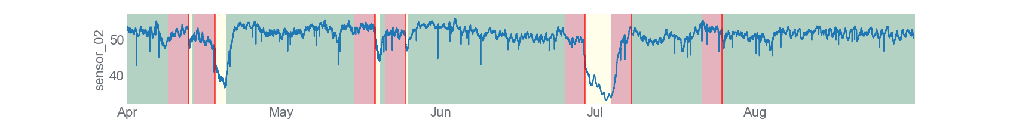
Our Approach – Predicting
Integrating danger windows into the data
Label Modification
Normal – Green Recovering – Yellow Danger – Red Failure – Vertical Line

Slide 5
Splitting the Data
Predictive Maintenance - Always one step ahead of failure with AI
Train-Set
Test-Set
Unusual Train-Test-Split to ensure the model performs decently on different failures.

Slide 6
Best Performing Machine Learning Models
Predictive Maintenance - Always one step ahead of failure with AI
 | Precision | Recall | F1-Score | Support
No Danger | 0.83 | 1 | 0.91 | 127892
Danger | 0.74 | 0.03 | 0.05 | 26190
Accuracy |  |  | 0.83 | 154082
Macro Avg. | 0.79 | 0.51 | 0.48 | 154082
Weighted Avg. | 0.82 | 0.83 | 0.76 | 154082
ExtraTreesClassifier
bootstrap=False
criterion="gini"
max_features=0.1
min_samples_leaf=19
min_samples_split=2
n_estimators=100
 | Precision | Recall | F1-Score | Support
No Danger | 0.85 | 0.86 | 0.86 | 127892
Danger | 0.29 | 0.27 | 0.28 | 26190
Accuracy |  |  | 0.76 | 154082
Macro Avg. | 0.57 | 0.57 | 0.57 | 154082
Weighted Avg. | 0.76 | 0.76 | 0.76 | 154082
KNeighborsClassifier
n_neighbors=100
p=1
weights=uniform

Slide 7
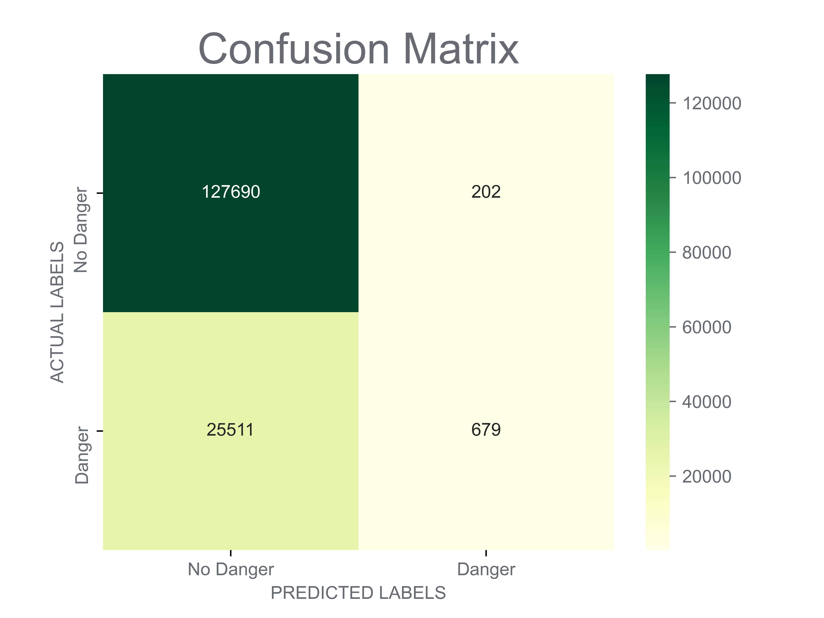
Evaluating the ExtraTreesClassifier
Predictive Maintenance - Always one step ahead of failure with AI
Average Daily Warnings when there is no Danger:
2.27
1440 * 202 / (127690+202) = 2.27
Average Daily Warnings when there is Danger:
37.3
1440 * 679 / (25511+679) = 37.3

Slide 8
Next steps - Deployment
Predictive Maintenance - Always one step ahead of failure with AI
Preventing Failure through real-time Warnings
How can we help the employees figuring out if the warning is just a fluke?
Aggregating the predictions of the past 24 hours
Based off of these aggregations' multiple approaches:
Assigning a fixed threshold where a surpassing triggers an acute warning response
Installation of a Hypothesis Testing
Minimizing total maintenance cost by incorporating the cost for a “false alarm” and a “failure without alarm” into a statistical quality control model
Deployment of chosen approach in a visual real-time Dash-Board

Slide 9
Going beyond … and are there any questions?
Predictive Maintenance - Always one step ahead of failure with AI
Determining and Finding the optimal warning window
How much time do employees need in order to react?
Even more advanced usage of Deep Learning (RNN, LSTM)
Sensor Dashboard with integrated Anomaly Detection

