Slide 1
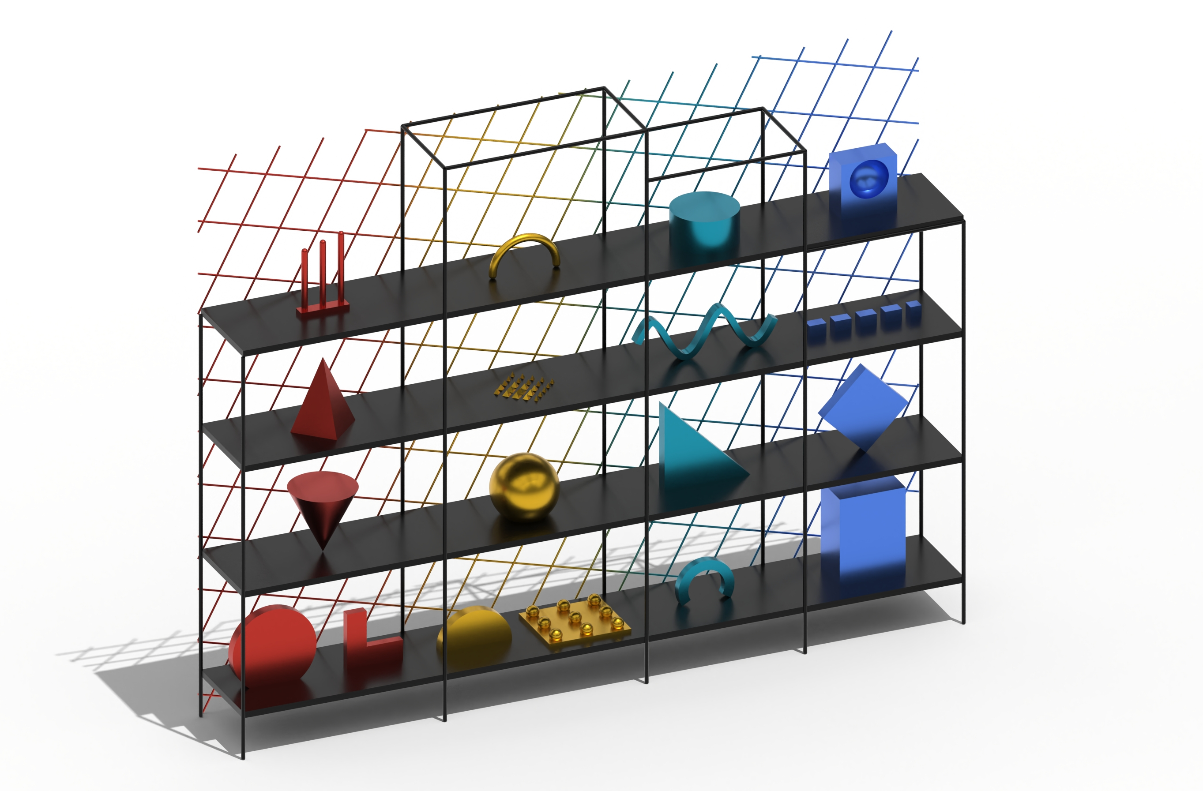
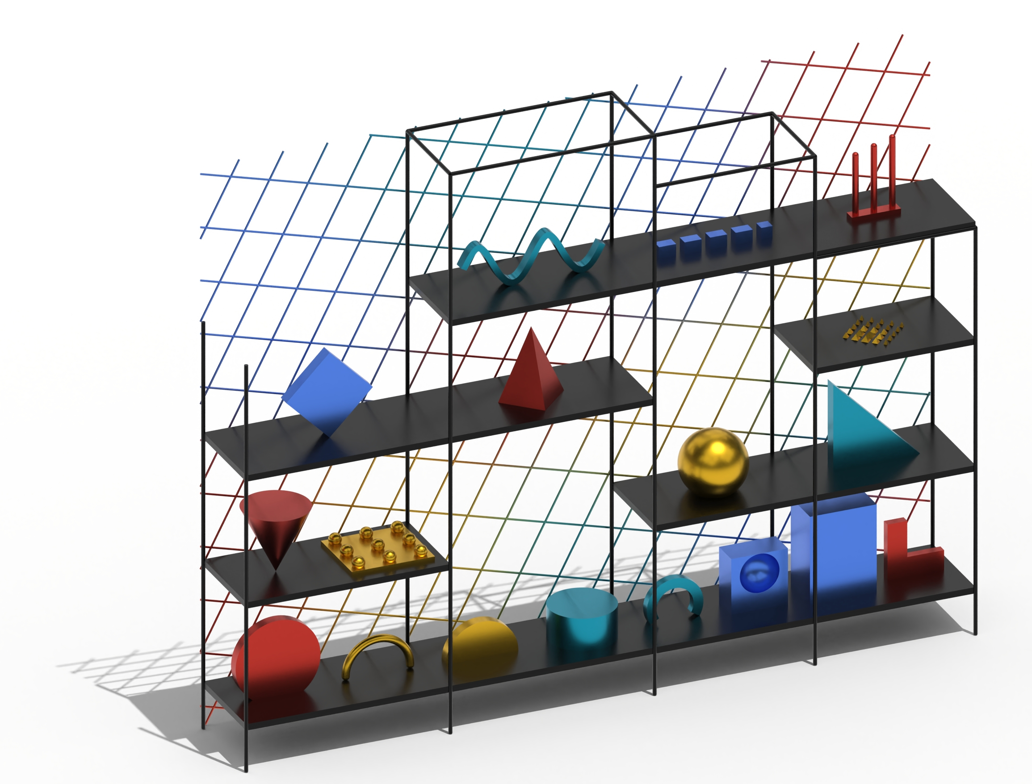
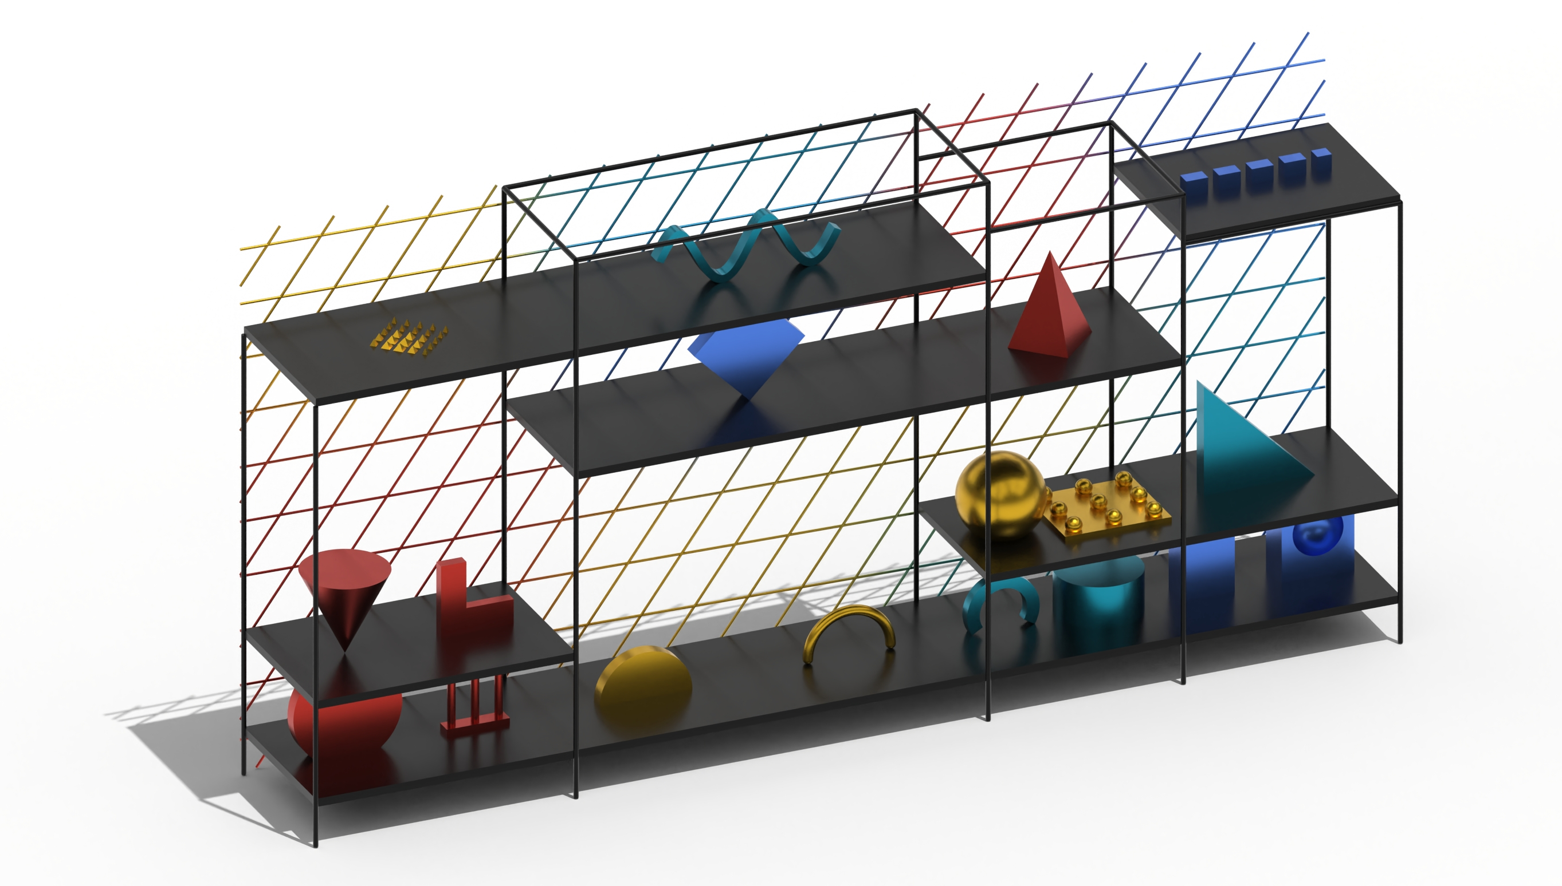
Parametric shelving system
Lukas Litterst - 03802916
PARAMETERS
• Shelf width, height, depth and layout
• Open shelf sections and tower height
• Individual object dimensions and scale
• Diamond density, rotation, shear and offset
• Attractor position, influence and color blending
RELATIONSHIPS
• Boards and posts share one structural grid.
• Objects follow the positions of occupied shelves.
• The back grid adapts to the shelf dimensions.
• Attractor distance controls diamond sizes.
• Nearby objects influence the grid’s coloo gradient.
Notes:
If we let each parameter run over its allowed range, f produces a whole family of shapes. That family is the design space.

Slide 2
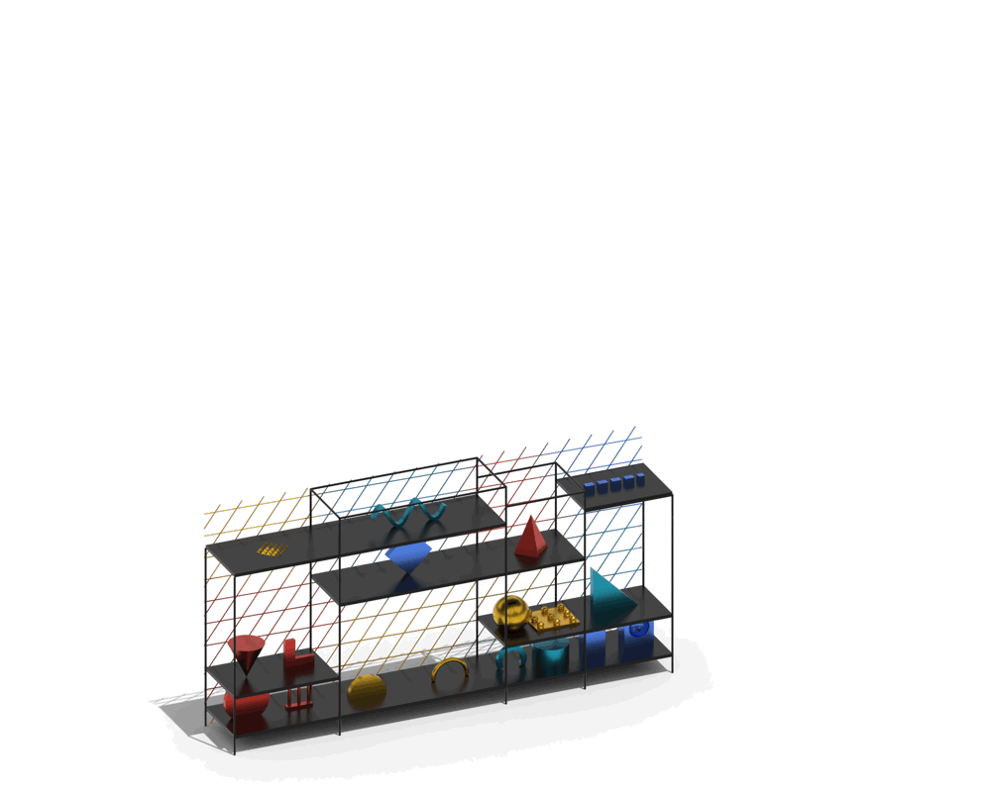
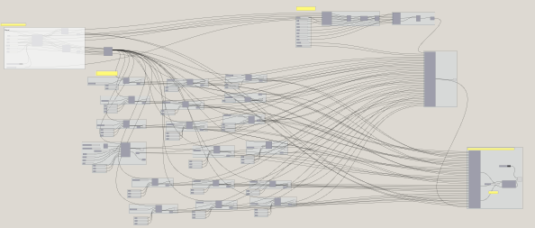
Parametric shelving system
Lukas Litterst - 03802916
(bake)
Shelf
Individual library
Colored net
Variation of size, thickness, paneling.
Positioning on the shelf without being too big.
Own size control.
Diamond paneling net, variable in size, angle.
Colored based on the closest color next to it.
Positioning on the shelves, structural grid, limiting the size of the elements.
Input influences the size and color grading.
(no randomizer used)
Notes:
If we let each parameter run over its allowed range, f produces a whole family of shapes. That family is the design space.

