Slide 1
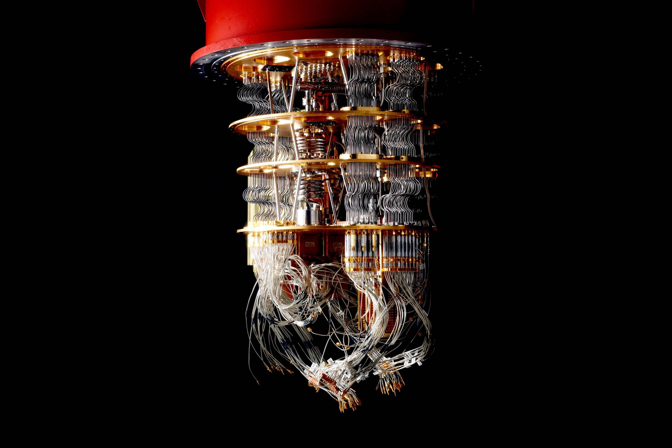
How will quantum computing affect the mainframe and its applications
Francis Harkins
Martijn Saelens
Lukas Marivoet

Slide 2
Quantum computing?
A field still in its infancy that could revolutionise computer science itself.
How does it work?
Why is the interest so high?
How would the mainframe tie into this?

Slide 3
The Mainframe
The Transaction backbone

Slide 4
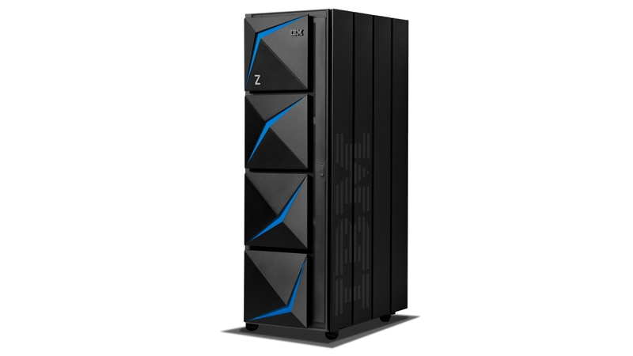
Mainframe
I/O devices
Enterprise grade data manipulation
Enterprise security and atomicity
Data bottle necks in specific fields

Slide 5
Qubit
The core unit of any quantum device

Slide 6
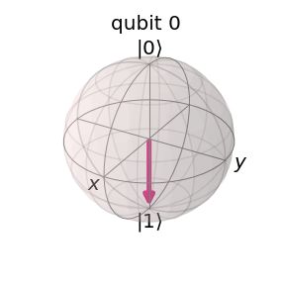

Representations
Representing a qubit and understanding that representation can give greater insights in quantum computing as a whole.
Multi-dimension
Mathematical

Slide 7

Interacting with a qubit
Quantum gates ←→ Classical Gates
Single Qubit Gates
Multiple Qubit Gates
Reversibility
Measurement
Classical processes lose information through its irreversibility

Slide 8
Superposition, entanglement and interference
The Quantum phenomena

Slide 9
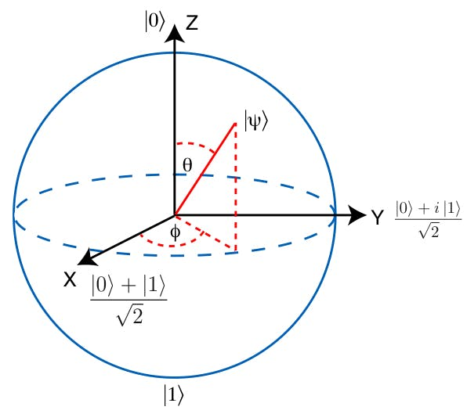
Superposition

Slide 10
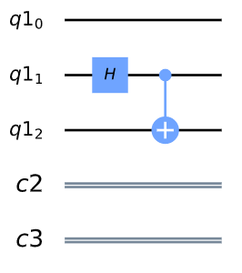
Entanglement

Slide 11
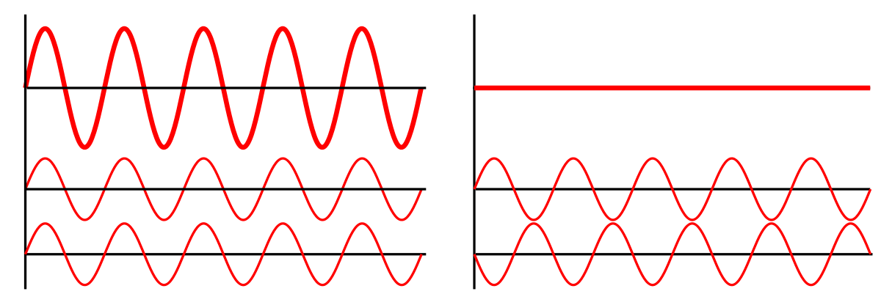
Interference

Slide 12
Quantum Decoherence
The Party Crasher of Quantum computing

Slide 13
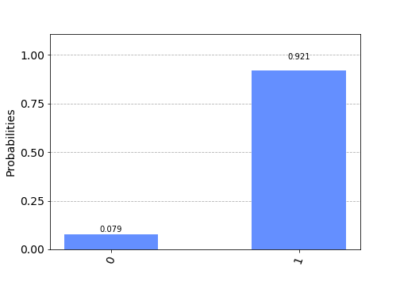
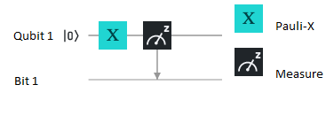
Decoherence
Internal decoherence
External decoherence
Length of calculations
Size of the quantum devices

Slide 14
The experiment
Grover applied to the 3-SAT problem

Slide 15
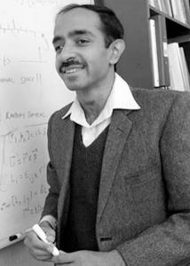
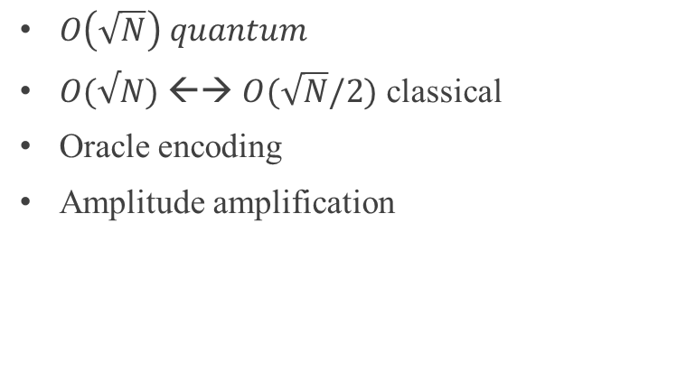
Grover’s algorithm
Unstructured search quantum algorithm
$O\left(\sqrt{N}\right) quantum$
$O(√N)$ ←→ $O(\sqrt{N}/2)$ classical
Oracle encoding
Amplitude amplification

Slide 16
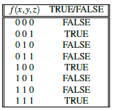
The experiment
3-SAT Boolean problem

Slide 17
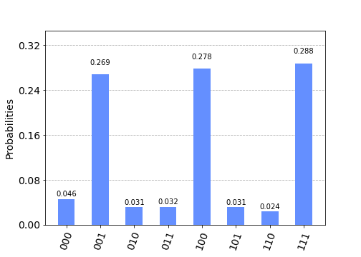
The experiment on a simulator
3-SAT Boolean problem

Slide 18
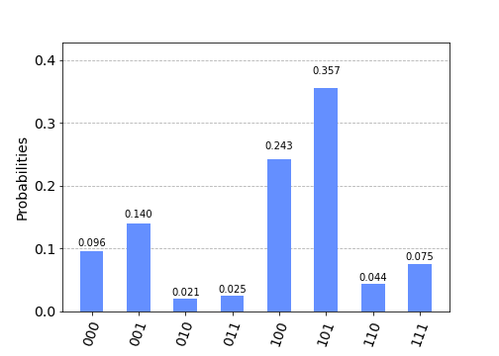
The experiment on a real quantum device
Ibmq_16_melbourne

Slide 19
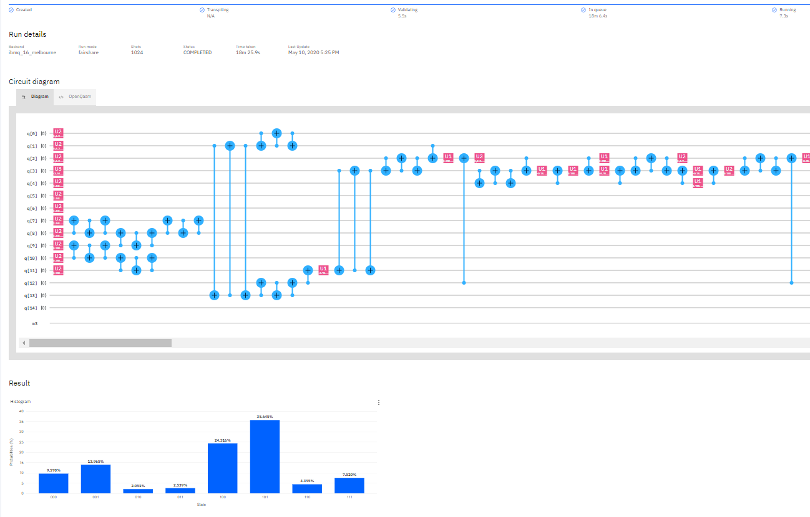
The experiment on a real quantum device
Ibmq_16_melbourne

Slide 20
DEMO

Slide 21
Discussion

Slide 22
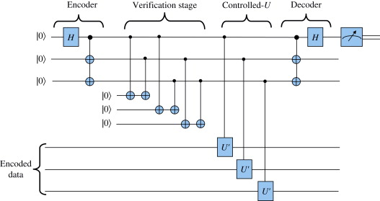
Data encoding and decoding
Time necessary
Classical to quantum and back
Mainframe devices do not yet fit in this picture
Fitting our classical problems in the quantum realm

Slide 23
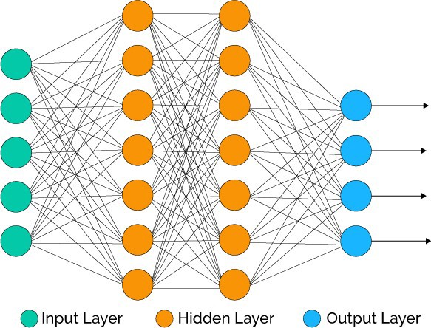
Quantum problems
Chemistry
Physics
Machine learning
Simulation
…

Slide 24
Future development
What is in store for us?

Slide 25
Interesting developments
“Hot” silica-made qubits, UNSW Sydney
Qiskit quantum documentation, Qiskit
Cirq, Q#...
Open sourcing research

Slide 26

Thank you
FIRST UP CONSULTANTS
Lukas Marivoet
Lukas.marivoet@student.hogent.be

