Slide 1
Neighbouring group participation in O-glycosylation
SE Seminar biological organic chemistry
lukas.meinschad@uibk.student.ac.at
University of Innsbruck, Austria
Das, R.; Mukhopadhyay, B. Beilstein J. Org. Chem. 2025, 21, 369–406. doi:10.3762/bjoc.21.27

Slide 2
Carbohydrates are essential building blocks
Lactose (animal milk)
Adenosine Triphosphate (ATP)
Cellulose
Daunomycin (Leukemia Treatment)
Erythromycin (Antibiotic)
Heparin (blood anticoagulant)
Weymouth-Wilson, A. C. (1997). The role of carbohydrates in biologically active natural products. Natural product reports, 14(2), 99-110.

Slide 3
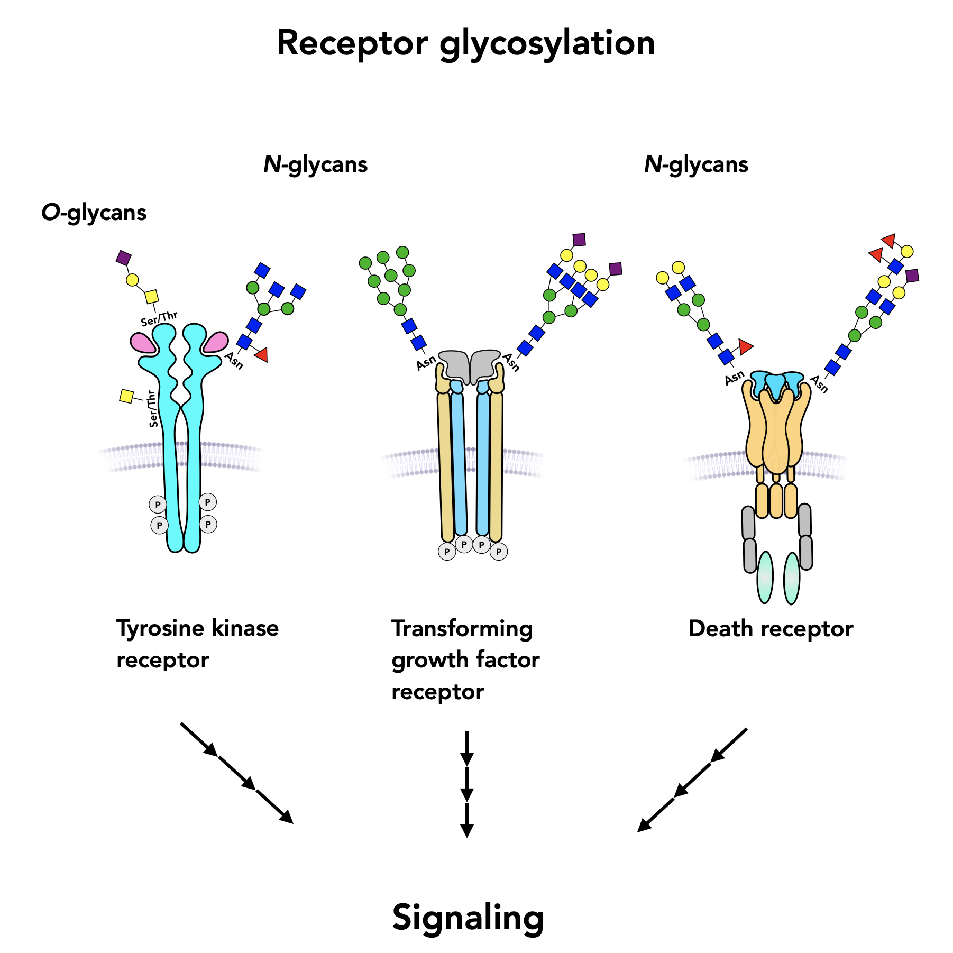
Biological Background
Cell-Surface Glycans
Cell-to-Cell Communications
Immune and Humoral Response
Post-Translational Modification of Proteins
Cell Growth / Fertilisation
Gao, Y.; Luan, X.; Melamed, J.; Brockhausen, I. Role of Glycans on Key Cell Surface Receptors That Regulate Cell Proliferation and Cell Death. Cells 2021, 10, 1252. https://doi.org/10.3390/cells10051252

Slide 4


Overview Carbohydrates
Carbohydrate $≅$ ”watered carbon” with general formula: $C_{x}{\left(H_{2}O\right)}_{y}$
$α$-D-glucopyranose
$β$-D-glucopyranose

Slide 5
Overview Carbohydrates
Carbohydrate $≅$ ”watered carbon” with general formula: $C_{x}{\left(H_{2}O\right)}_{y}$
Anomeric position
$α$-D-glucopyranose
$β$-D-glucopyranose

Slide 6
Overview Carbohydrates
Carbohydrate $≅$ ”watered carbon” with general formula: $C_{x}{\left(H_{2}O\right)}_{y}$
Anomeric position
Glycosidic bond
$α$-D-glucopyranose
$β$-D-glucopyranose
Lactose = Galactose + Glucose
Notes:
Galactose nachschauen epimere →

Slide 7
Overview Carbohydrates
Carbohydrate $≅$ ”watered carbon” with general formula: $C_{x}{\left(H_{2}O\right)}_{y}$
Anomeric position
Glycosidic bond
Carbohydrates
$α$-D-glucopyranose
$β$-D-glucopyranose
Simple
Complex
Monosaccharides
Disaccharides
Polysaccharides
Lactose = Galactose + Glucose

Slide 8
Principle of Glycosylation
Glycosylation
Formation of a glycosidic bond between:
Two carbohydrate units
Or carbohydrate with aglycon
Nucleophilic Substitution at anomeric centre
Notes:
N

Slide 9



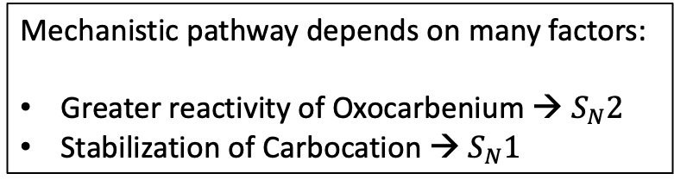
Principle of Glycosylation
Mechanistic pathway depends on many factors:
Greater reactivity of Oxocarbenium → $S_{N}2$
Stabilization of Carbocation → $S_{N}1$
solvent separated ion pair
contact / tight ion pair
$$S_{N}2$$
$$S_{N}1$$
$$S_{N}1$$

Slide 10

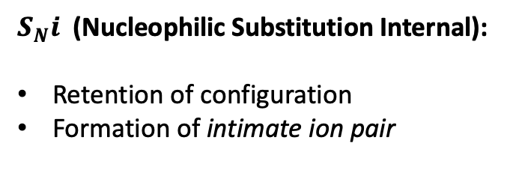

Principle of Glycosylation
Mechanistic pathway depends on many factors:
Greater reactivity of Oxocarbenium → $S_{N}2$
Stabilization of Carbocation → $S_{N}1$
solvent separated ion pair
contact / tight ion pair
$S_{N}i$ (Nucleophilic Substitution Internal):
Retention of configuration
Formation of intimate ion pair
$$S_{N}i$$
$$S_{N}i$$
$$S_{N}2$$
$$S_{N}1$$
$$S_{N}1$$
Notes:
SnI reaction nochmals genauer anschauen

Slide 11
Neighbouring Group Participation
Protecting groups at C-2 position can be participating / non-participating
Ester protecting groups
Non-ester protecting groups

Slide 12
Formation of 1,2-trans glycosides

Slide 13
Formation of 1,2-trans glycosides
$α$-face blocked off, attack induced from opposite face

Slide 14
Formation of 1,2-trans glycosides
Possible Side-Product
$α$-face blocked off, attack induced from opposite face

Slide 15
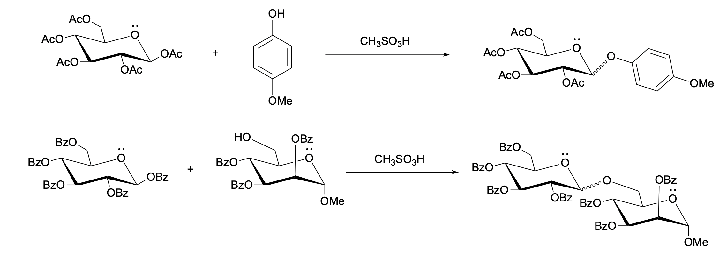


Glycosylation under solvent free conditions
No solvent
75 % ($α/β$ 1:7.5)
No solvent
30 % ($α/β$ 1:9)
Methanesulphonic acid as mild promoter
Significant 1,2-trans selectivity
S. Traboni, E. Bedini, A. Silipo, G. Vessella, A. Iadonisi, Eur. J. Org. Chem. 2021, 2021, 5669.
Notes:
Ein kohlenstoff zu viel im letzten schema

Slide 16

Levulinoyl Protection
45 %
Levulinic Acid $≅$ Lev
T.K. Mong, H. Lee, S.G. Durón, & C. Wong, Reactivity-based one-pot total synthesis of fucose GM₁ oligosaccharide: A sialylated antigenic epitope of small-cell lung cancer, Proc. Natl. Acad. Sci. U.S.A. 100 (3) 797-802,

Slide 17
Levulinoyl Protection
45 %
Levulinic Acid $≅$ Lev
Used for activation (glycosyl cation intermediate)
Deprotection through AcOH
T.K. Mong, H. Lee, S.G. Durón, & C. Wong, Reactivity-based one-pot total synthesis of fucose GM₁ oligosaccharide: A sialylated antigenic epitope of small-cell lung cancer, Proc. Natl. Acad. Sci. U.S.A. 100 (3) 797-802,
Notes:
Aktivierung durch Iodierung mit NIS, TfOH, Glucosamine kann man kaum abspalten

Slide 18
Pivalate Protection
Derivatives of pivaloyl group
OPivCN
Reduces probability for nucleophilic attack at oxocarbenium centre
Removal of pivalate group requires harsher conditions
Cyanopivaloyl Ester in the Automated Solid-Phase Synthesis of Oligorhamnans Anne Geert Volbeda, Jeanine van Mechelen, Nico Meeuwenoord, Herman S. Overkleeft, Gijsbert A. van der Marel, and Jeroen D. C. Codée The Journal of Organic Chemistry 2017 82 (24), 12992-13002 DOI: 10.1021/acs.joc.7b02511

Slide 19
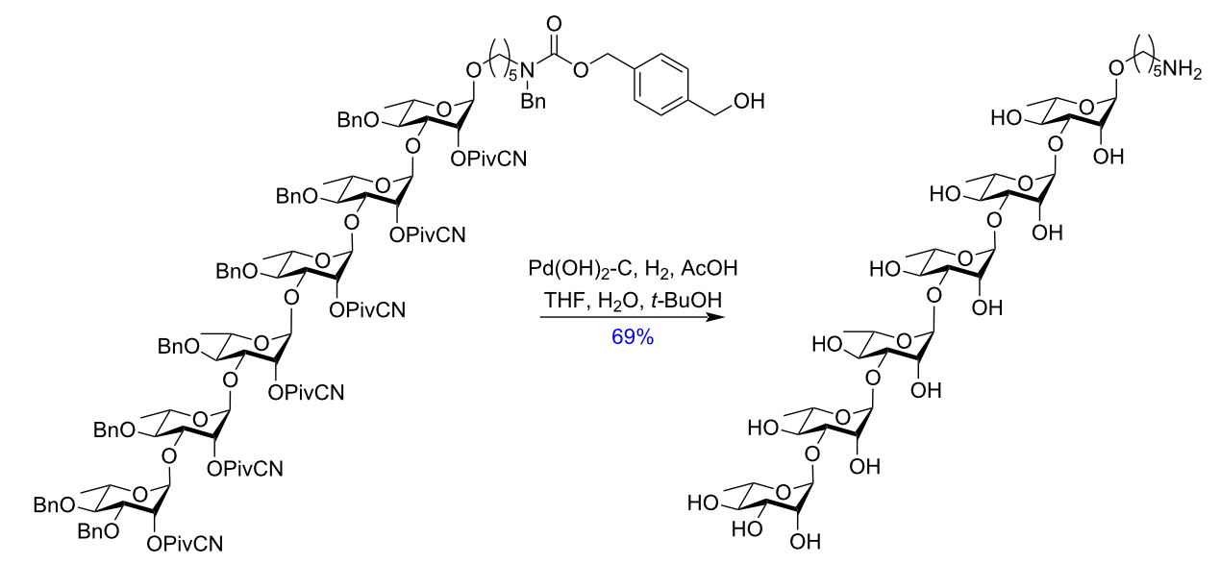
Pivalate Protection
Derivatives of pivaloyl group
OPivCN
Reduces probability for nucleophilic attack at oxocarbenium centre
Removal of pivalate group requires harsher conditions
Cyanopivaloyl Ester in the Automated Solid-Phase Synthesis of Oligorhamnans Anne Geert Volbeda, Jeanine van Mechelen, Nico Meeuwenoord, Herman S. Overkleeft, Gijsbert A. van der Marel, and Jeroen D. C. Codée The Journal of Organic Chemistry 2017 82 (24), 12992-13002 DOI: 10.1021/acs.joc.7b02511

Slide 20
Non-Ester Participating Protecting Groups
Recap:
Ester groups influence stereoselectivity of glycosylation
Formation of 1,2-trans glycosides
Electron-withdrawing → reduces activity of glycosyl donors

Slide 21
Non-Ester Participating Protecting Groups
Recap:
Ester groups influence stereoselectivity of glycosylation
Formation of 1,2-trans glycosides
Electron-withdrawing → reduces activity of glycosyl donors
Are there protecting groups which perform NGP and impart higher reactivity of to glycosyl donors?

Slide 22
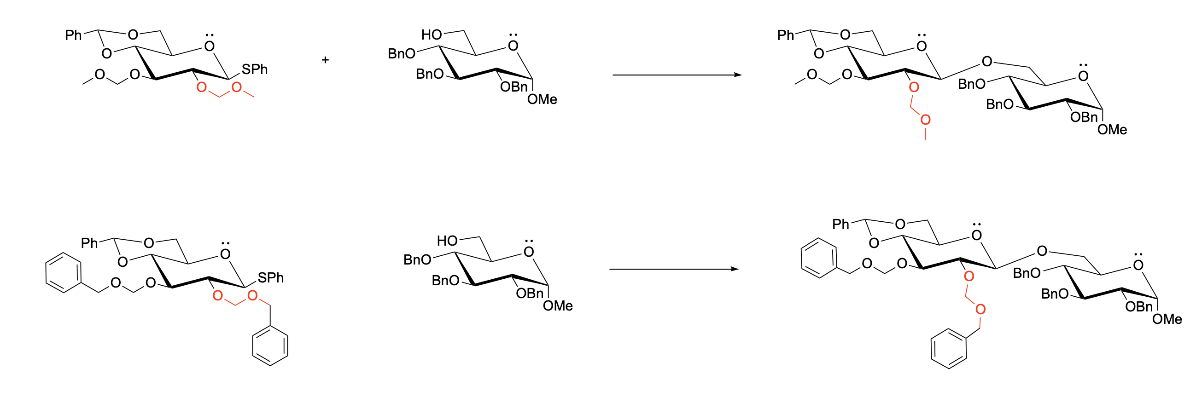
Alkoxymethyl-type Protecting Groups
A
85 %
A
75 %
Activation of thiophenyl glycoside donor
Nucleophilic attack of the glycoside acceptor
A = $In{\left(OTf\right)}_{3} \left(1.1 eqv\right), NIS \left(1.2 eqv\right), MS, CH_{2}Cl_{2},$ -78 °C
Neighboring Group Participation of 9-Anthracenylmethyl Group in Glycosylation: Preparation of Unusual C-Glycosides Suvarn S. Kulkarni, Yi-Hung Liu, and Shang-Cheng Hung The Journal of Organic Chemistry 2005 70 (7), 2808-2811 DOI: 10.1021/jo047794a
Notes:
Beim Benzenring drehen, → nicht ganz 90 ° beide machen

Slide 23
Alkoxymethyl-type Protecting Groups
Target
Side Product
Neighboring Group Participation of 9-Anthracenylmethyl Group in Glycosylation: Preparation of Unusual C-Glycosides Suvarn S. Kulkarni, Yi-Hung Liu, and Shang-Cheng Hung The Journal of Organic Chemistry 2005 70 (7), 2808-2811 DOI: 10.1021/jo047794a
Notes:
NAP Gruppe als Backup slide vorbereiten.

Slide 24
Conclusion
Protecting group manipulation highly essential in carbohydrate chemistry
Neighbouring group participation of protecting groups provides stereoselective control
Electron-withdrawing groups reduce the reactivity of glycosylation reaction
Exploration of different electron-donating groups to enhance reactivity of glycoside donor

Slide 25


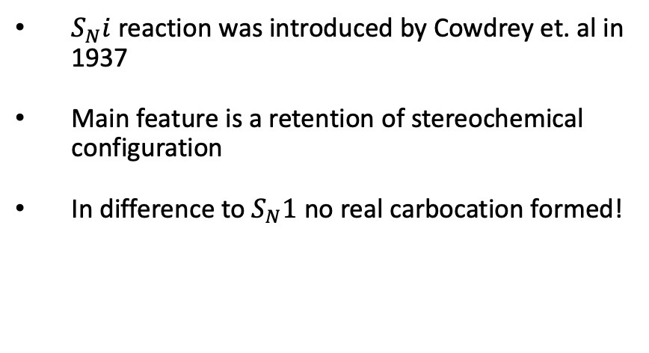



Backup I: $S_{N}i$ reaction
$S_{N}i$ reaction was introduced by Cowdrey et. al in 1937
Main feature is a retention of stereochemical configuration
In difference to $S_{N}1$ no real carbocation formed!
$S_{N}2$≈
inversion
$$S_{N}2$$
$$S_{N}2$$
$$S_{N}2$$
$$S_{N}i$$
inversion
inversion
retention

Slide 26
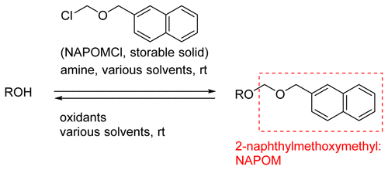
Backup II: 2-Napthylmethoxymetyl Protective Group
2-Napthylmethoxymethyl (NAPOM) used for protection of hydroxy groups
Can be introduced in extremely mild condition
Selective removal with various oxidants
2-Naphthylmethoxymethyl as a Mildly Introducible and Oxidatively Removable Benzyloxymethyl-Type Protecting Group Takuya Sato, Tohru Oishi, and Kohei Torikai
Organic Letters 2015 17 (12), 3110-3113 DOI: 10.1021/acs.orglett.5b01408

Slide 27
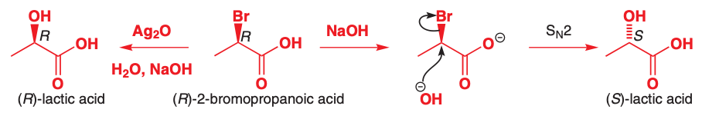
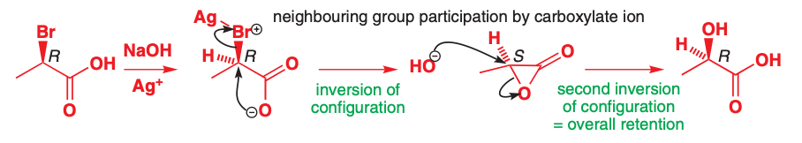
Backup III: Revision Neighbouring Group Participation
Rule of Thumb:
Substitution Reaction with Retention → Neighbouring Group Participation

Slide 28
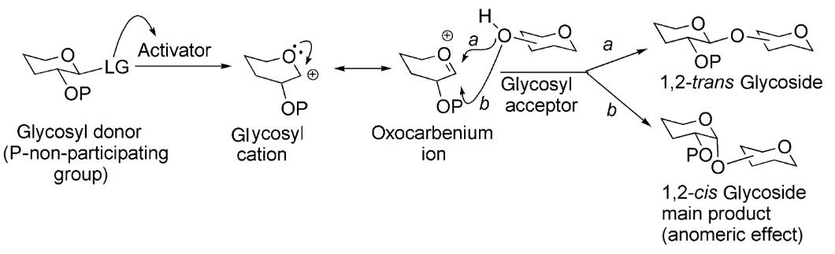
Backup IV: Trans/Cis Glycoside
Demchenko, A. V. (2008). General aspects of the glycosidic bond formation. Handbook of chemical glycosylation: advances in stereoselectivity and therapeutic relevance, 1-27.

