Slide 1
Neighbouring group parcipitation and long range remote group participation in O-glycosylation
SE Seminar biological organic chemistry
lukas.meinschad@uibk.ac.at
University of Innsbruck, Austria

Slide 2
Carbohydrates are essential building blocks
Lactose (animal milk)
Adenosine Triphosphate (ATP)
Cellulose
Daunomycin (Leukemia Treatment)
Erythromycin (Antibiotic)
Heparin (blood anticoagulant)
Weymouth-Wilson, A. C. (1997). The role of carbohydrates in biologically active natural products. Natural product reports, 14(2), 99-110.

Slide 3
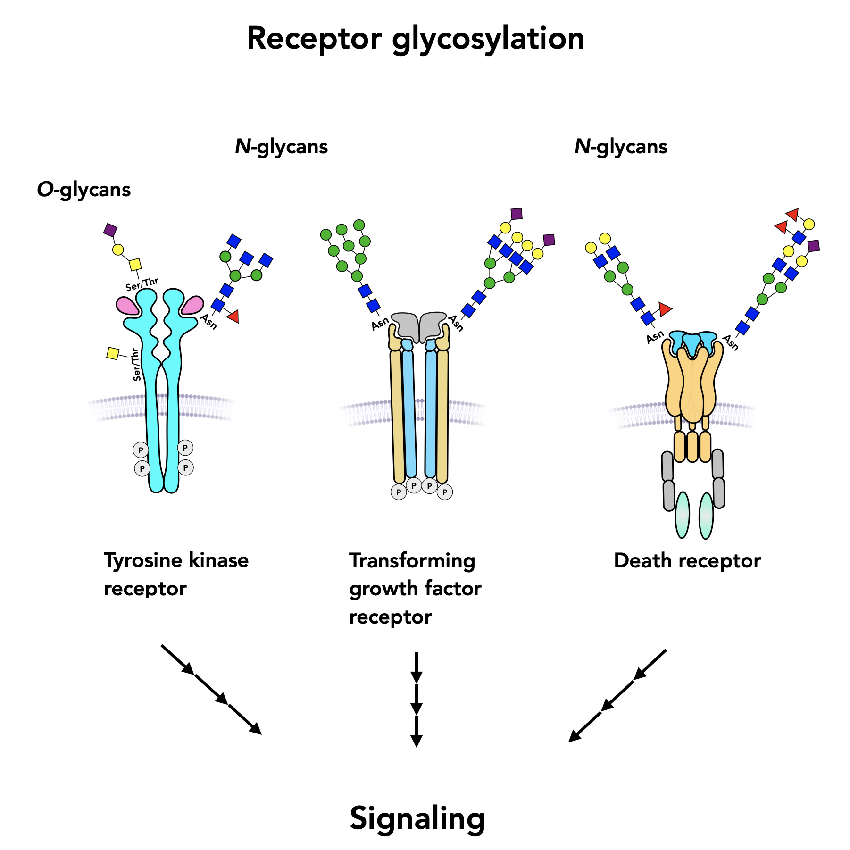
Biological Background
Cell-Surface Glycans
Cell-to-Cell Communications
Immune and Humoral Response
Post-Translational Modification of Proteins
Cell Growth / Fertilisation
Gao, Y.; Luan, X.; Melamed, J.; Brockhausen, I. Role of Glycans on Key Cell Surface Receptors That Regulate Cell Proliferation and Cell Death. Cells 2021, 10, 1252. https://doi.org/10.3390/cells10051252

Slide 4
Overview Carbohydrates
Carbohydrate $≅$ ”watered carbon” with general formula: $C_{x}{\left(H_{2}O\right)}_{y}$

Slide 5


Important Definitions: Carbohydrates
Anomeric carbon
chiral center which results from ring closure
$α$-D-glucopyranose
$β$-D-glucopyranose

Slide 6
Principle of Glycosylation
Glycosylation
Formation of a glycosidic bond between:
Two carbohydrate units
Or carbohydrate with aglycon
Nucleophilic Substitution at anomeric centre

Slide 7
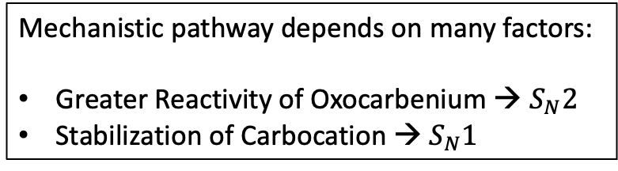



Principle of Glycosylation
Mechanistic pathway depends on many factors:
Greater Reactivity of Oxocarbenium → $S_{N}2$
Stabilization of Carbocation → $S_{N}1$
solvent separated ion pair
contact / tight ion pair
$$S_{N}2$$
$$S_{N}1$$
$$S_{N}1$$

Slide 8


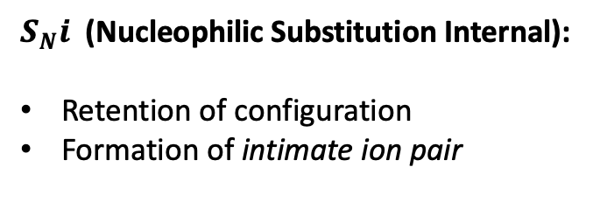
Principle of Glycosylation
Mechanistic pathway depends on many factors:
Greater Reactivity of Oxocarbenium → $S_{N}2$
Stabilization of Carbocation → $S_{N}1$
solvent separated ion pair
contact / tight ion pair
$S_{N}i$ (Nucleophilic Substitution Internal):
Retention of configuration
Formation of intimate ion pair
$$S_{N}i$$
$$S_{N}i$$
$$S_{N}2$$
$$S_{N}1$$
$$S_{N}1$$

Slide 9
Neighbouring Group Partcipitation
Protecting Groups at C-2 position can be participating / non-participating
Ester protecting groups
Non-ester protecting groups

Slide 10
Formation of 1,2-trans glycosides

Slide 11
Formation of 1,2-trans glycosides
$α$-face blocked of, attack induced from opposite face

Slide 12
Formation of 1,2-trans glycosides
Possible Side-Product
$α$-face blocked of, attack induced from opposite face

Slide 13


Glycosylation under solvent free conditions
Methanesulphonic acid as mild promoter
Significant 1,2-trans selectivity
No solvent
75 % ($α/β$ 1:7.5)
No solvent
30 % ($α/β$ 1:9)
S. Traboni, E. Bedini, A. Silipo, G. Vessella, A. Iadonisi, Eur. J. Org. Chem. 2021, 2021, 5669.

