Slide 1
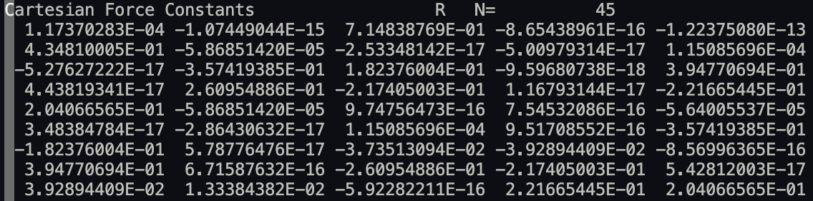
Gaussian Importer
Using newzmat on fchk file gives cartesian coordinates (done)
Converting chk to fchk gives result version of cartesian force constant matrix
Matrix is symmetric → lower triangular is stored
Problem: Orientation, which entry corresponds to which coordinate?

Slide 2
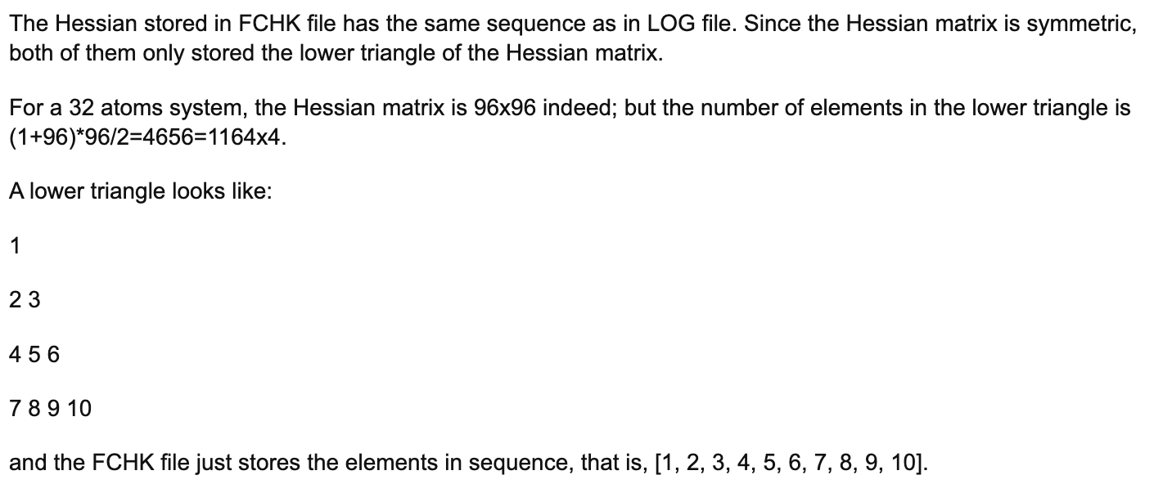
Gaussian Importer

