Slide 1
Roadmap Spectroscopy Tool
spectrum.py
Current Programm Structure:
import classes
Plotting
Integration
spec_tools.py
baseline.py
Polynomial
Spline
Whittaker
General New Features:
Orca Integration (Importing Spectra, Frequencies)
NIST-Integration (Direct access to Reference Spectra)
Plot Configuration Dictionary (Globally manipulate plot appearance)
molecule.py
Visualizing molecules (py3dmol)
Symmetry Analysis
Character Table
annotation.py
Annotate peaks

Slide 2
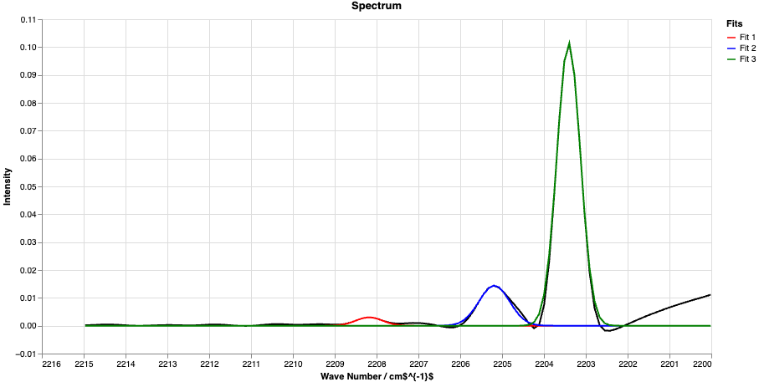
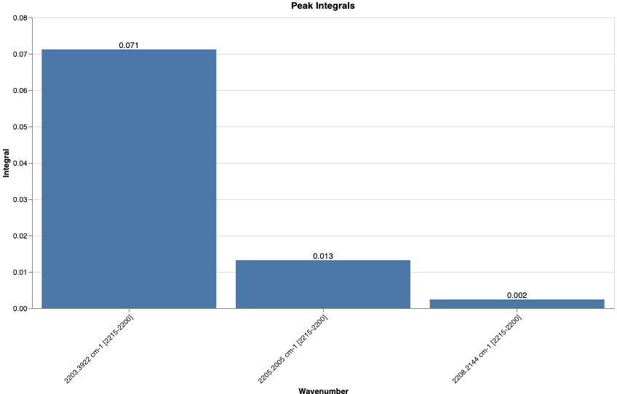
Roadmap Spectroscopy Tool
Final Steps and Project Completion:
Build command line interface (Application in Practical Course)
Update and provide more Peak Deconvolution and Smoothing Methods
Write Documentation and build python package
Final testing with examples from previous publications (Carbonic Acid, Methanol…)

