Slide 1
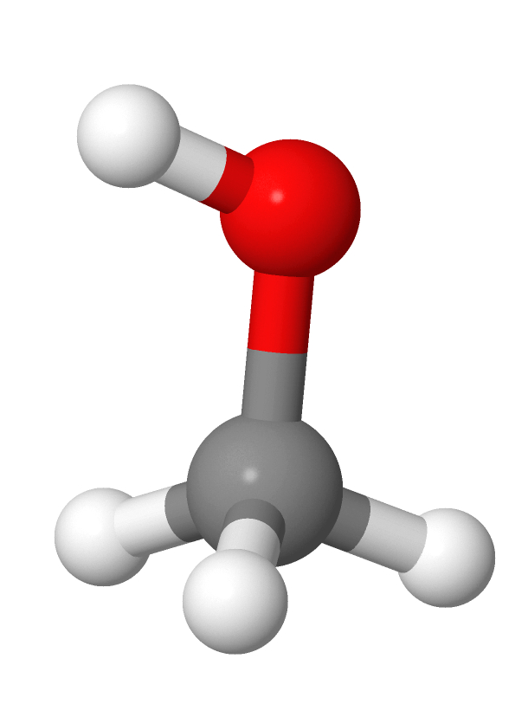
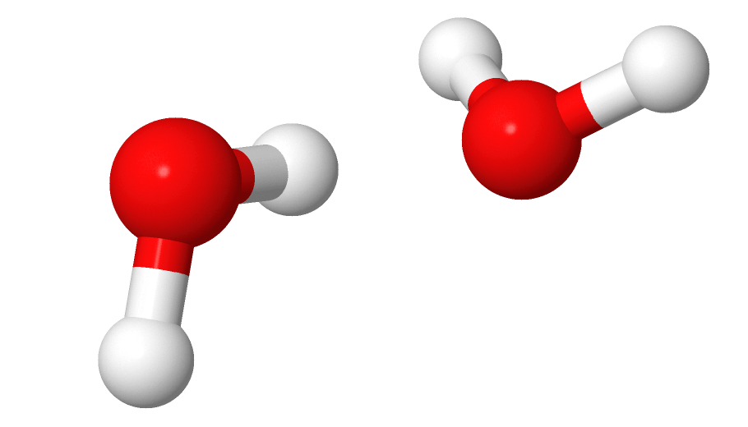
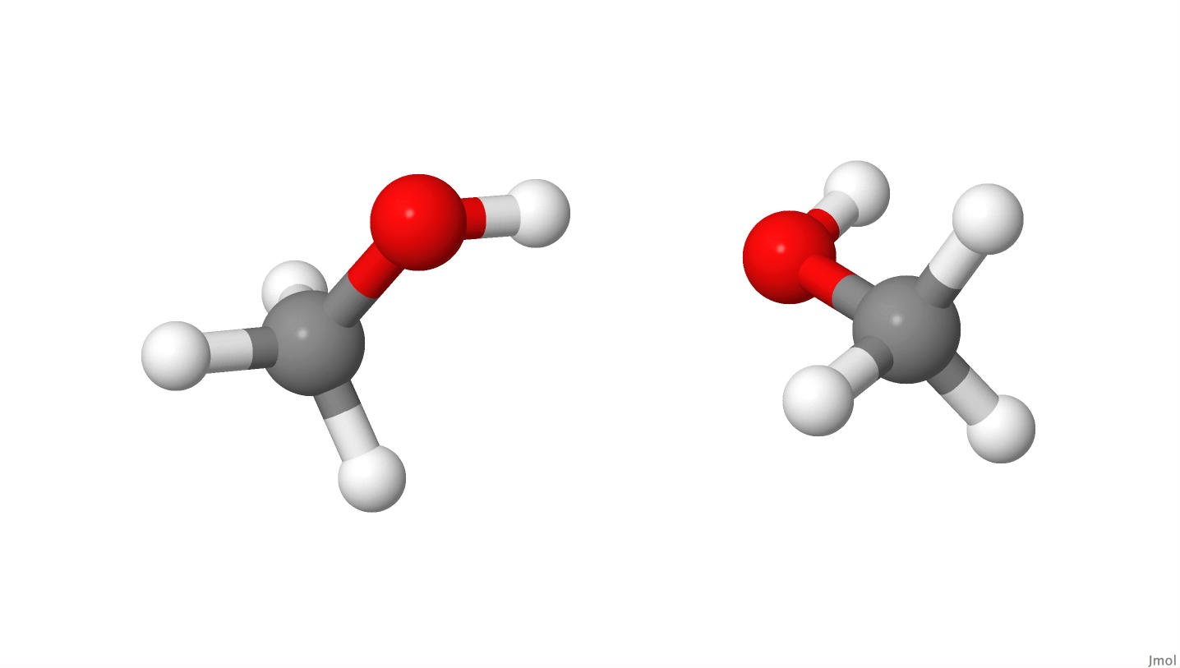
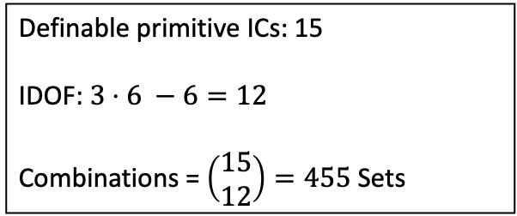
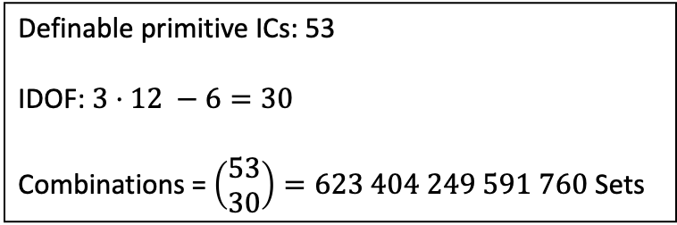
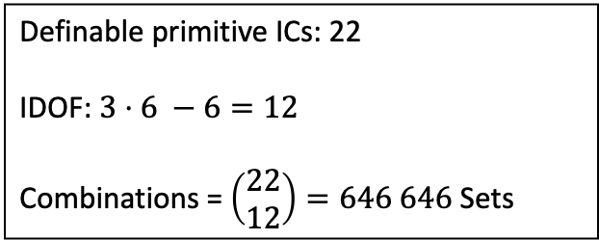
Problem: Combinatorics
Definable primitive ICs: 15
IDOF: $3⋅6 −6=12$
Combinations = $\left(\begin{matrix}15 \\ 12\end{matrix}\right)=455$ Sets
Definable primitive ICs: 22
IDOF: $3⋅6 −6=12$
Combinations = $\left(\begin{matrix}22 \\ 12\end{matrix}\right)=646 646$ Sets
Definable primitive ICs: 53
IDOF: $3⋅12 −6=30$
Combinations = $\left(\begin{matrix}53 \\ 30\end{matrix}\right)=623 404 249 591 760$ Sets

Slide 2
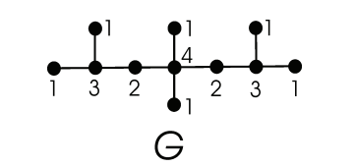
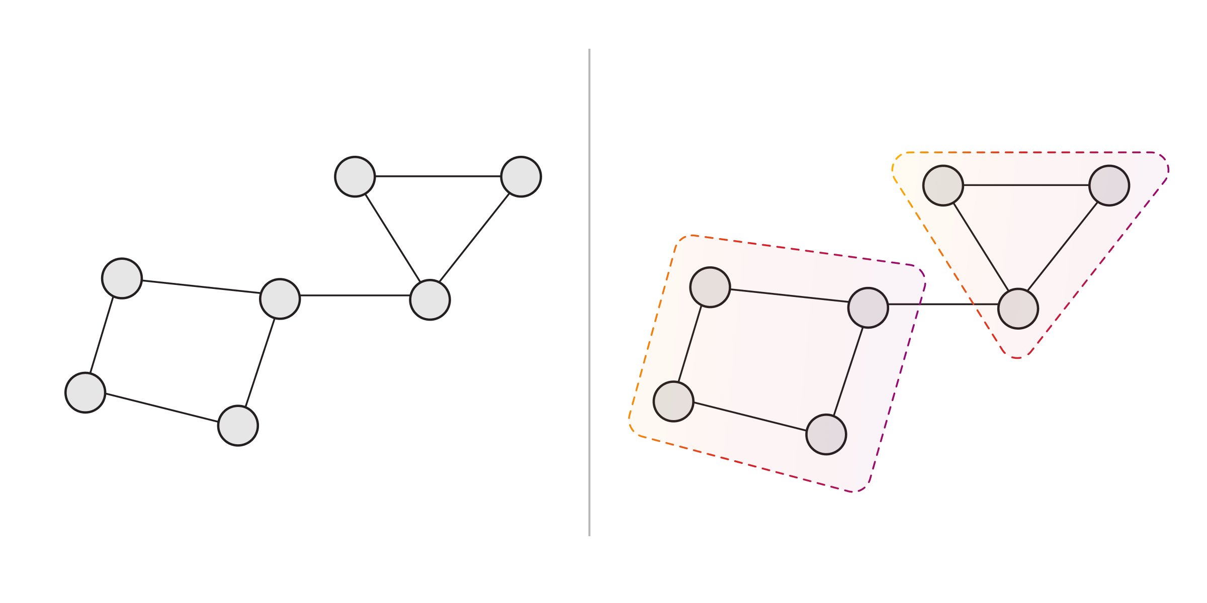
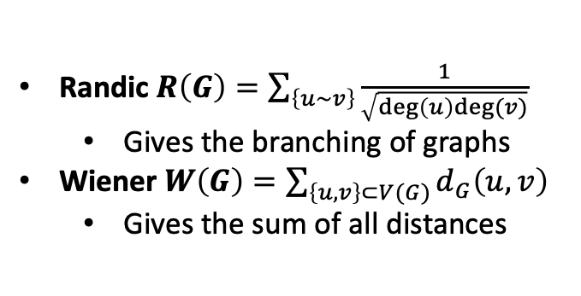
Outlook: Using Topological Indices + Decius Rules
Graph Representation of Molecules
Randic $R\left(G\right)=\sum_{\left\{u\sim v\right\}}{\frac{1}{\sqrt{\deg\left(u\right)deg⁡(v)}}}$
Gives the branching of graphs
Wiener $W\left(G\right)=\sum_{\left\{u,v\right\}⊂V(G)}{d_{G}\left(u,v\right)}$
Gives the sum of all distances
Determine Topological Indices
Cluster Graph in respect to it‘s Topology
vertices
edges
Fix ICs for Subgraphs in order to avoid high combinatorics

