Slide 1

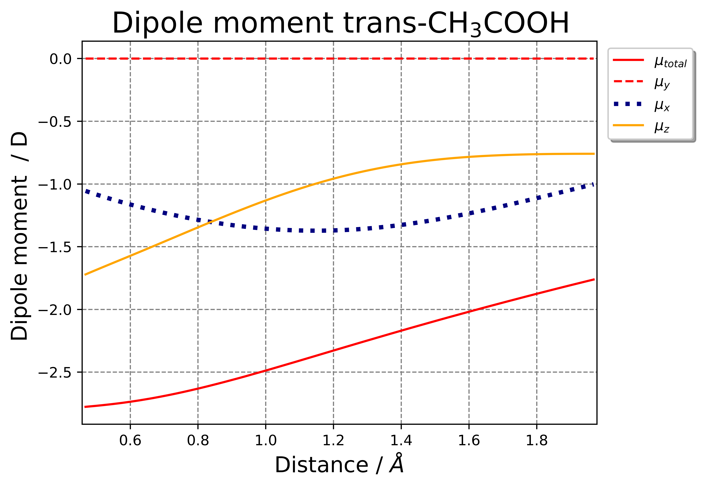
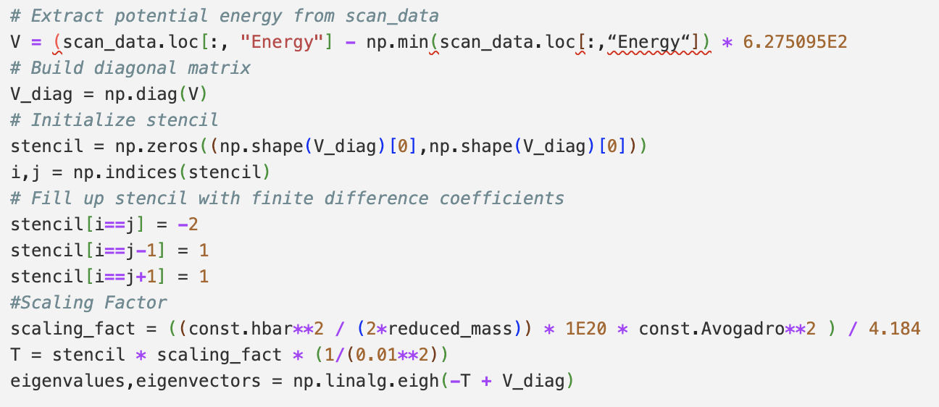
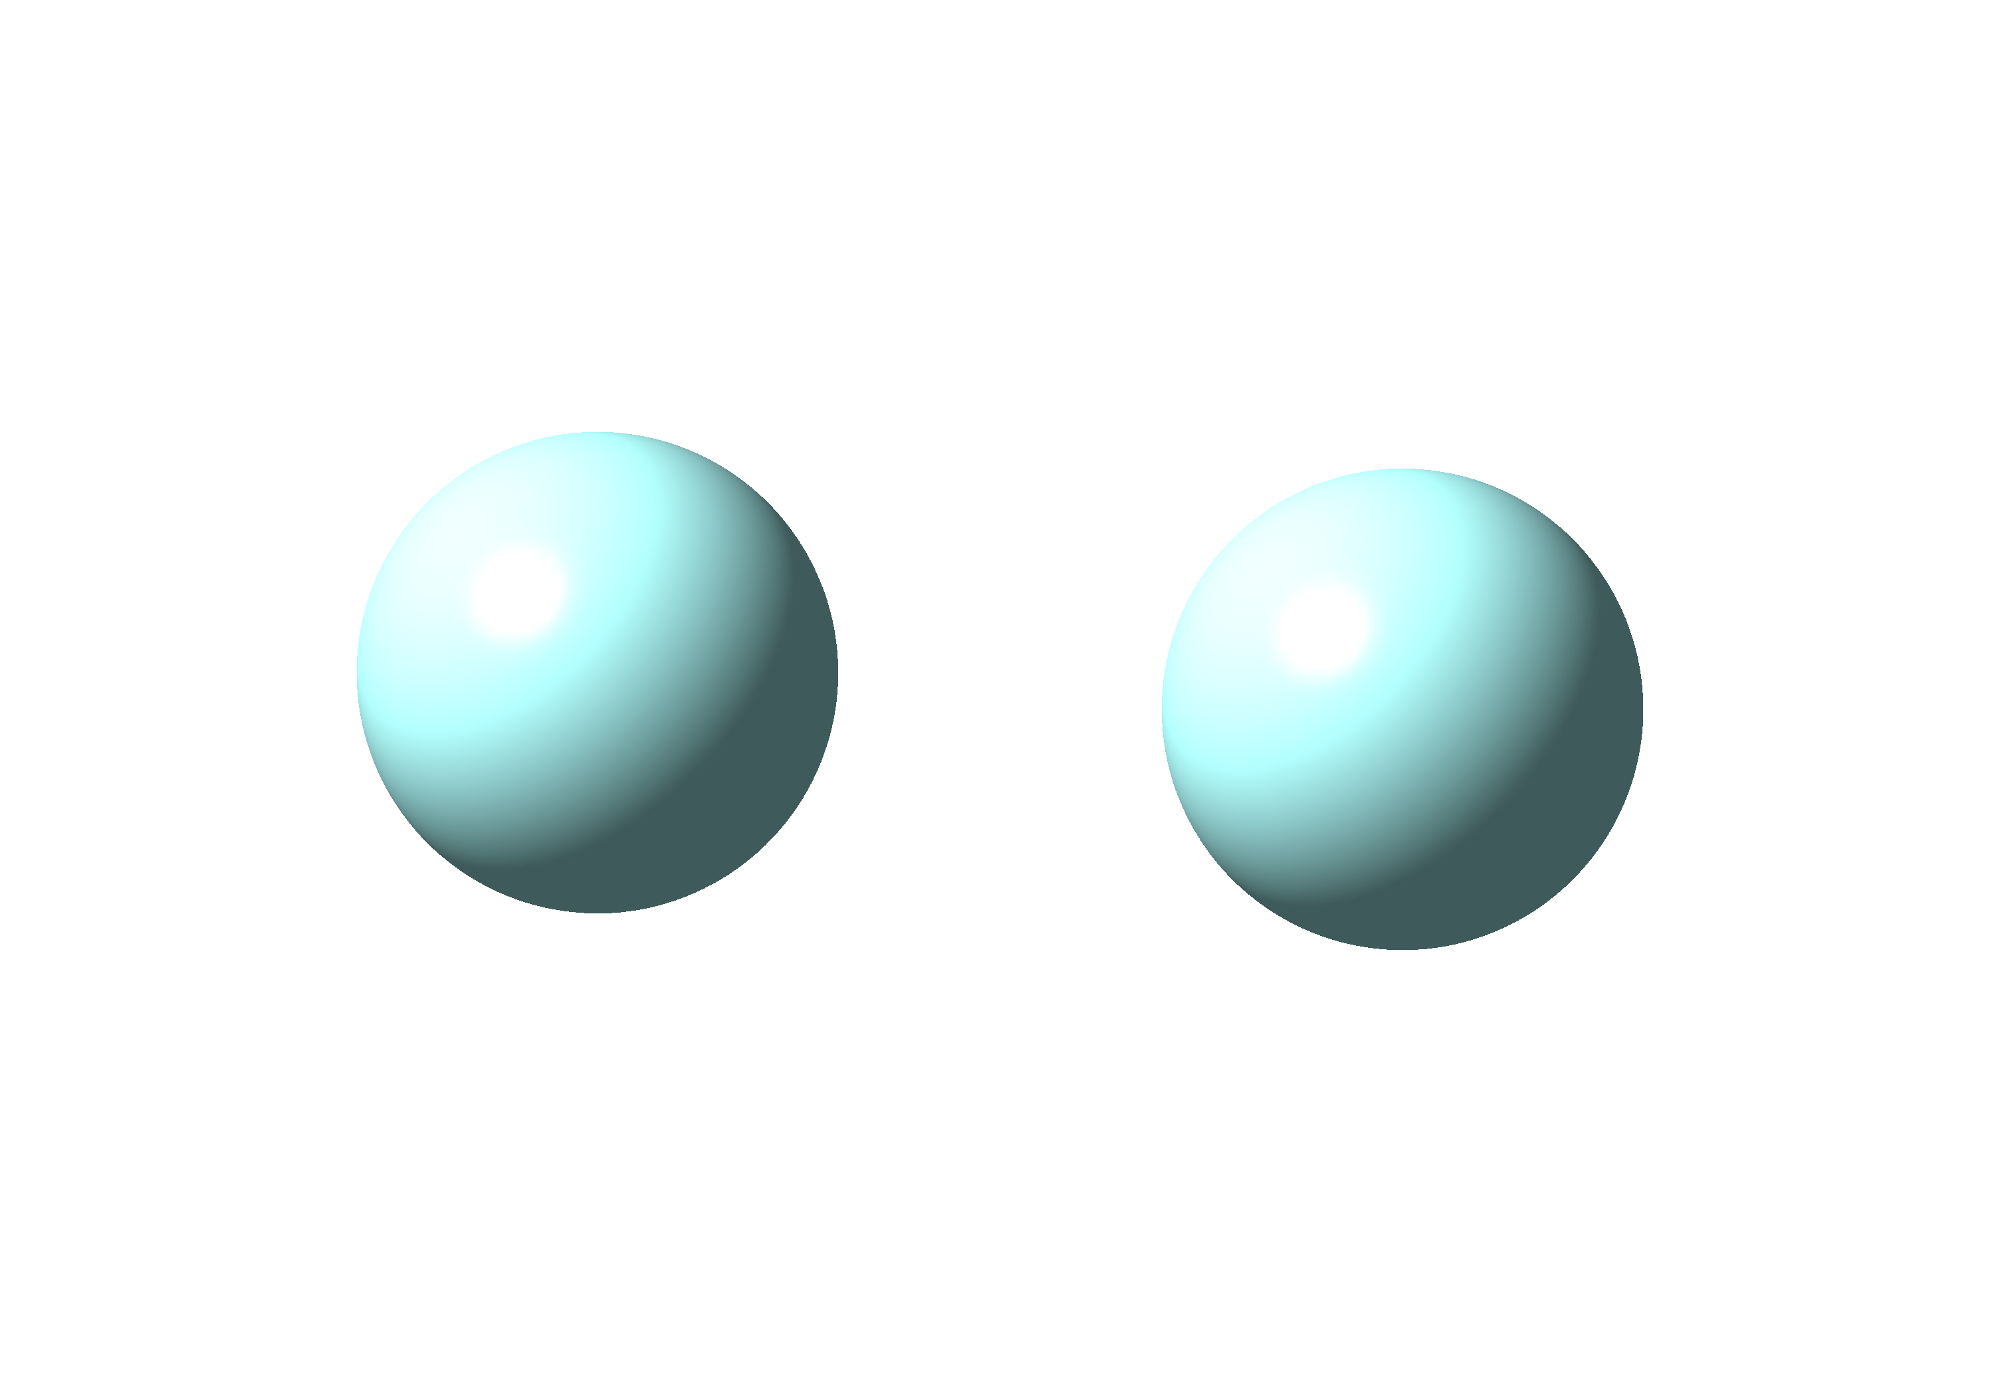
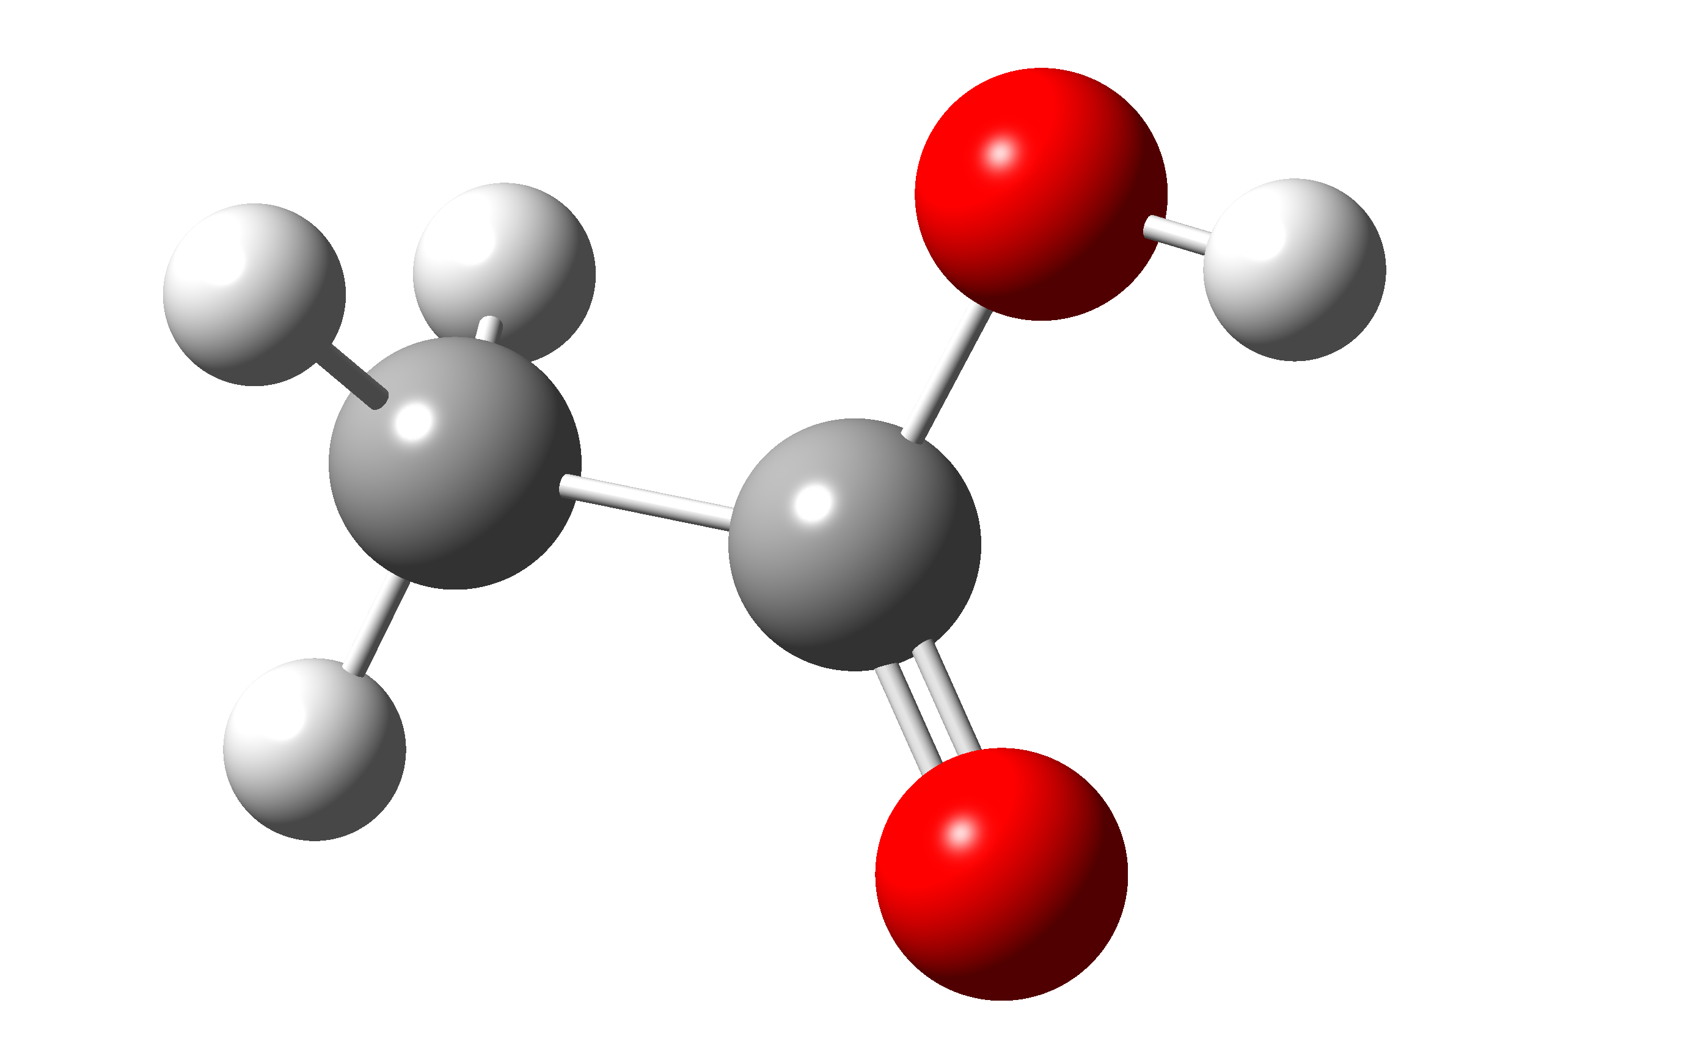
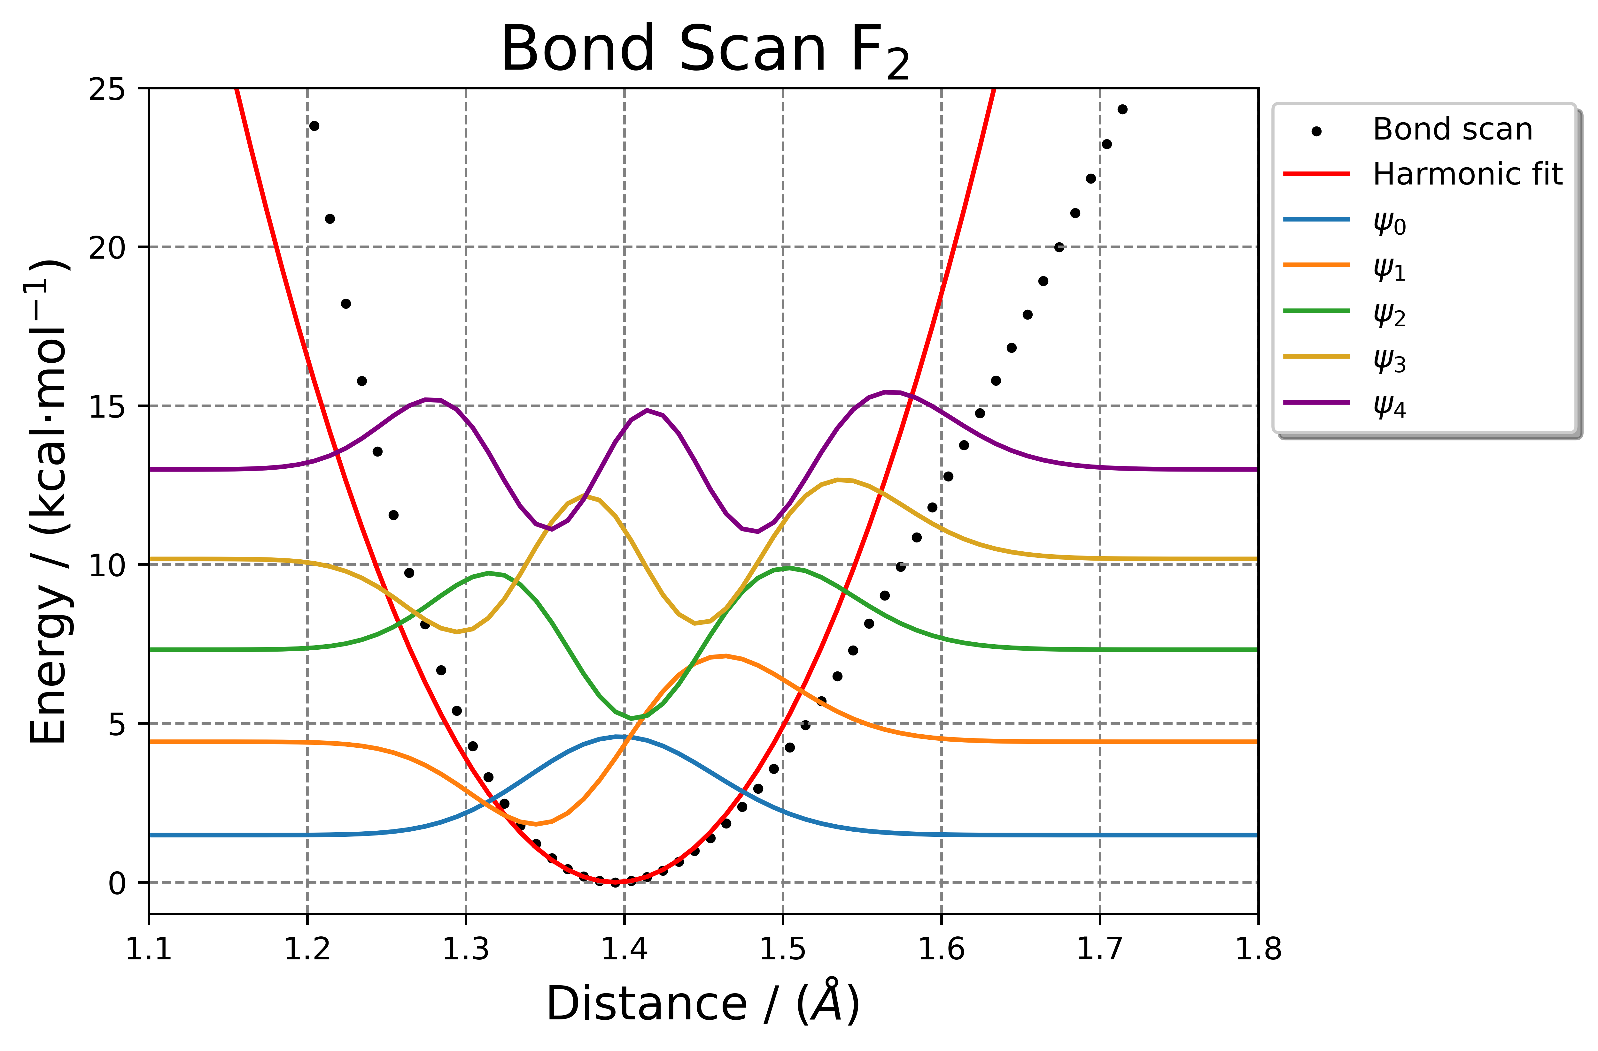
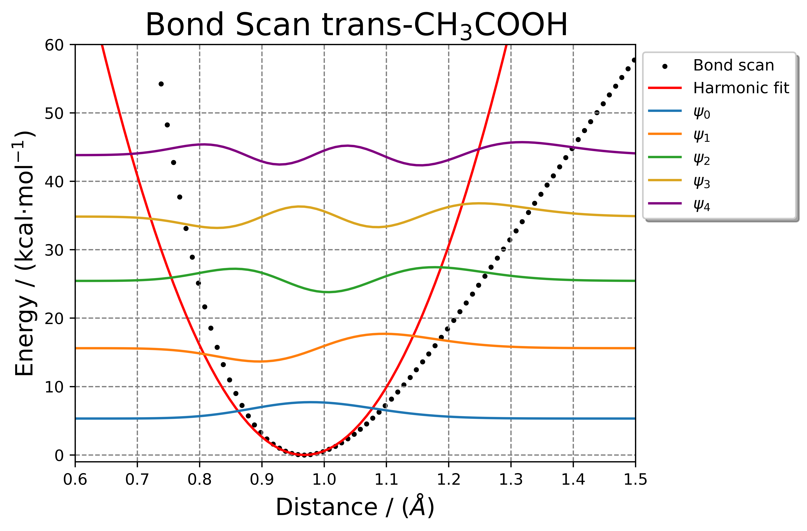
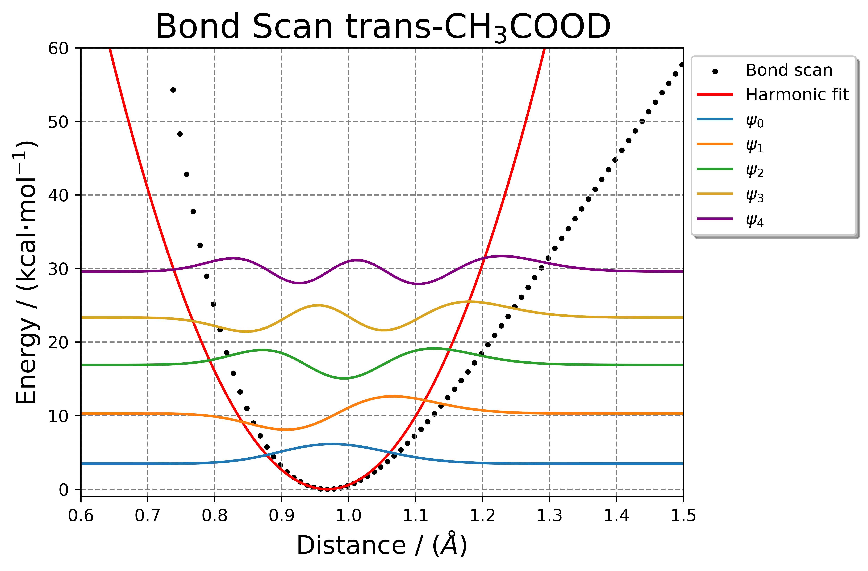

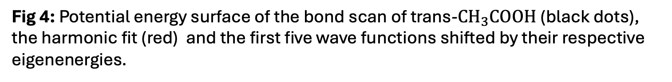
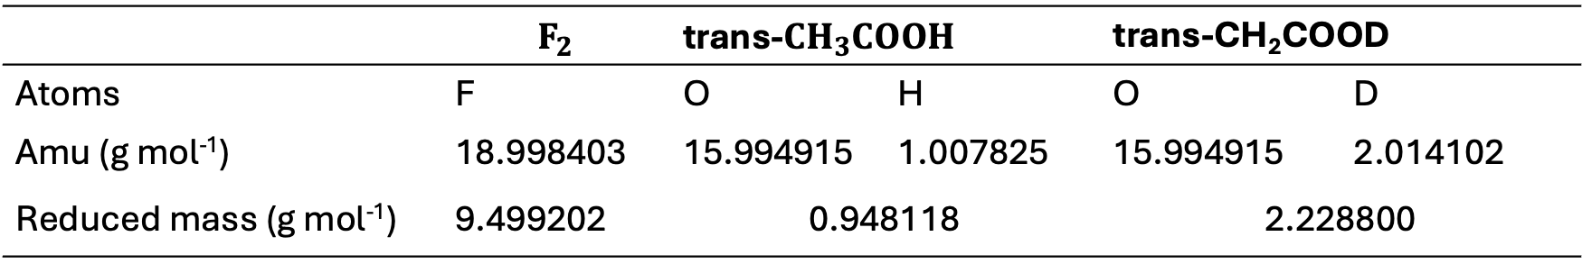
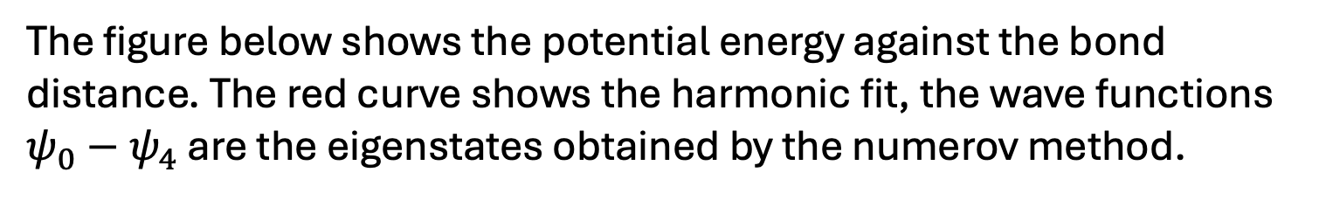

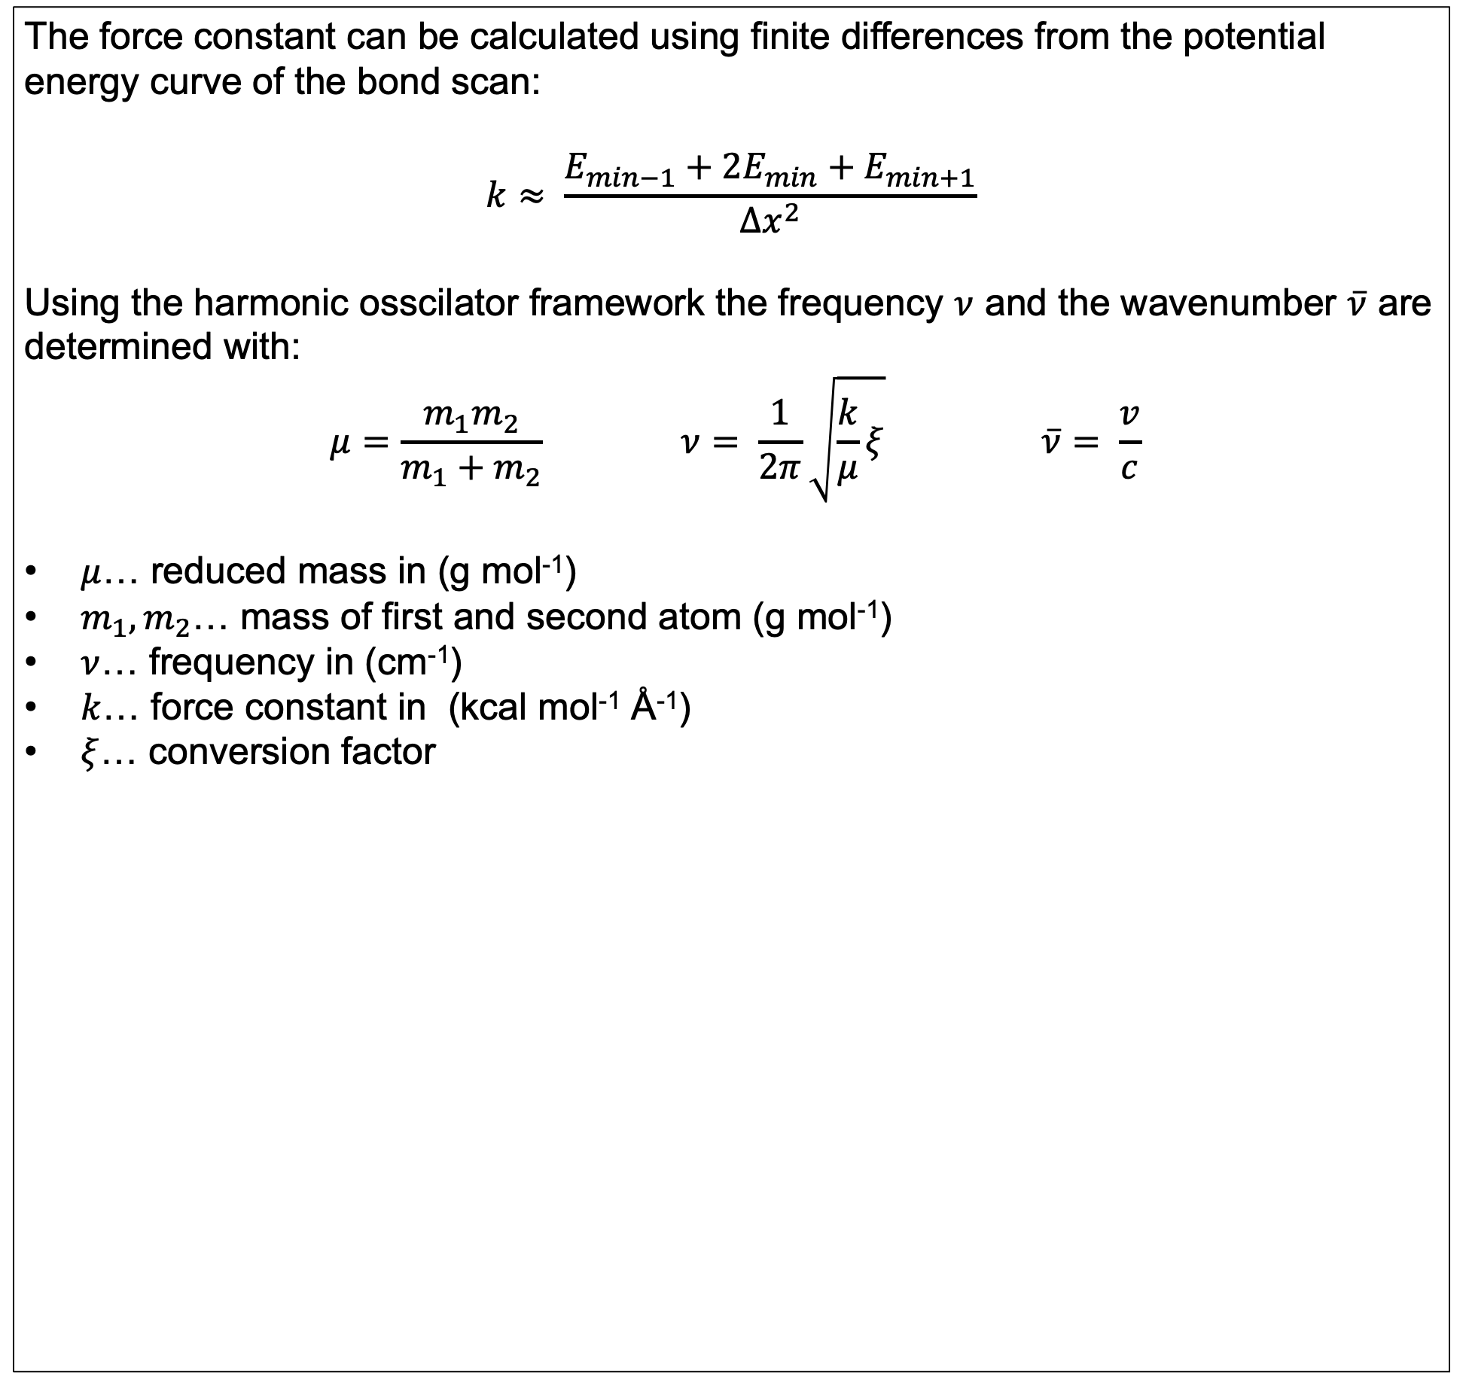
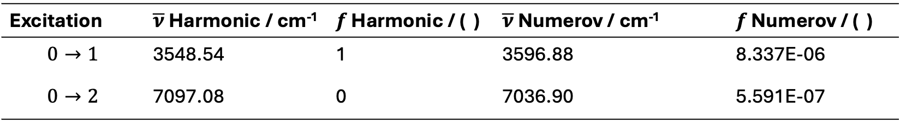
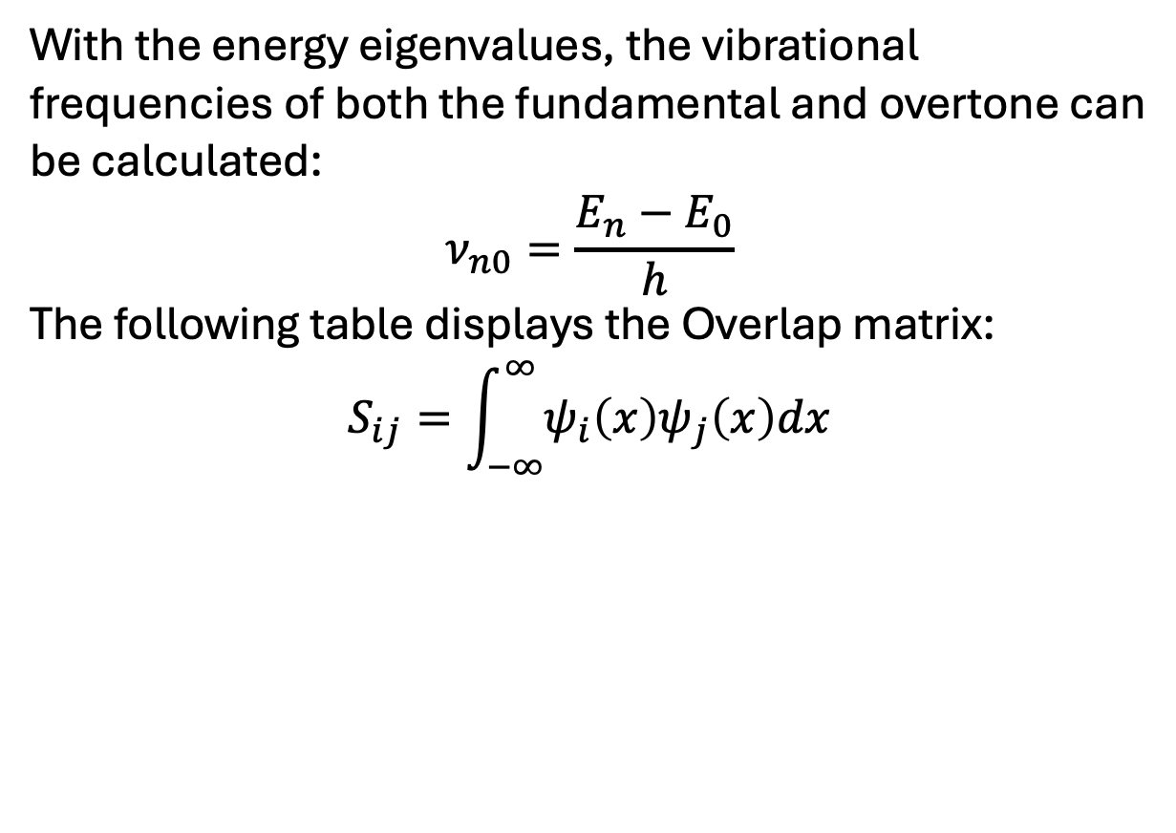
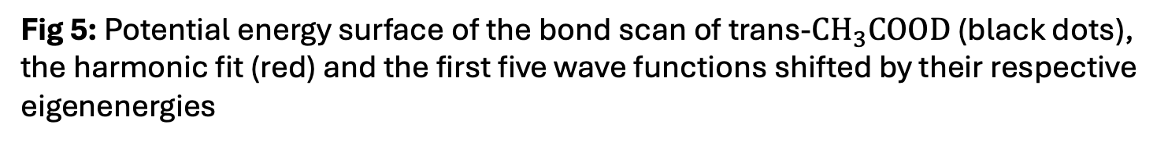
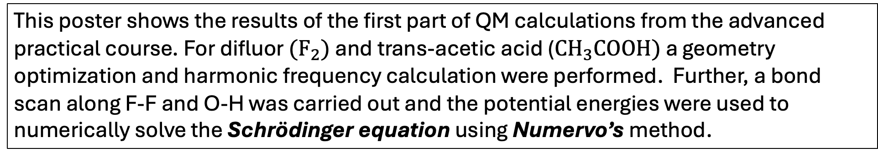
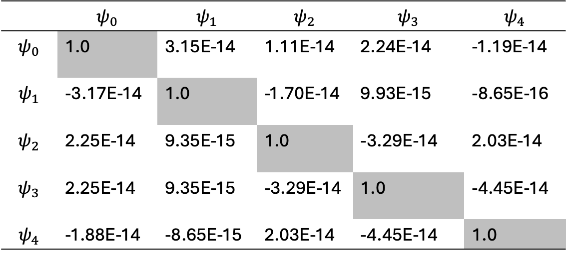

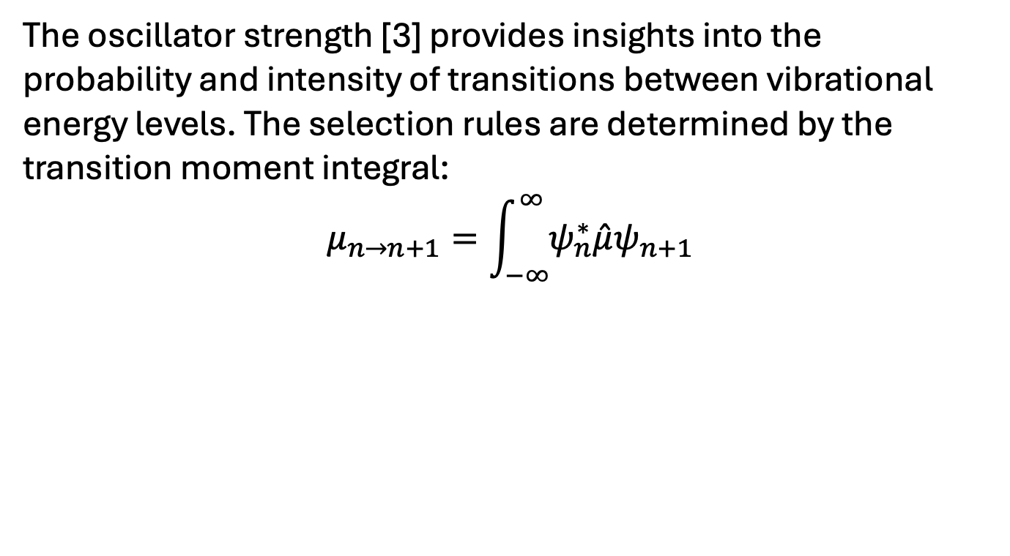
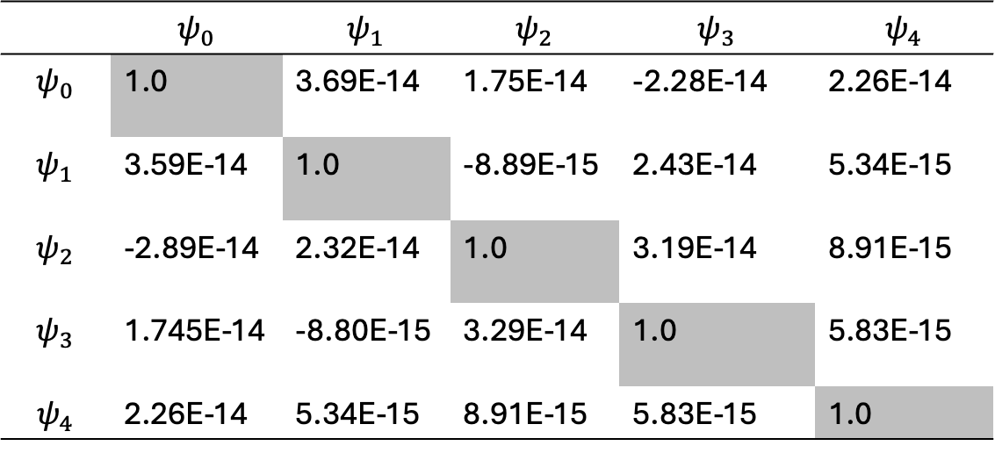
QM PART A: Vibrational spectroscopy using nuclear wave functions
Advanced Practical in Theoretical Chemistry
Lukas Meinschad (lukas.meinschad@student.uibk.ac.at), 12104730
Introduction
Numerov Procedure
Dipole Moment / Oscillator strenght
This poster shows the results of the first part of QM calculations from the advanced practical course. For difluor $(F_{2})$ and trans-acetic acid ($CH_{3}COOH)$ a geometry optimization and harmonic frequency calculation were performed. Further, a bond scan along F-F and O-H was carried out and the potential energies were used to numerically solve the Schrödinger equation using Numervo’s method.
Numerov method is a numerical method to solve differential equations. This method can be to obtain the energy eigenvalues $E_{n}$ and the wave functions $Ψ$:
$$\frac{∂^{2}Ψ }{∂x^{2}}= \frac{2m}{ℏ}\left(V−E\right)Ψ⇒\frac{∂^{2}Ψ }{∂x^{2}}≈\frac{Δg}{Δx}$$
In order for a vibration to be IR active the dipole moment must change. The plot on the left side displays the change in the dipole moment components $μ_{x},μ_{y},μ_{z}$. The component $μ_{y}$ is zero this is a result of the orientation of the molecule in the coordinate system.
$μ_{total}$ shows a overall change in the dipole moment which is expected as the change in the bond length alters the distribution of electron density.
With the energy eigenvalues, the vibrational frequencies of both the fundamental and overtone can be calculated:
$$ν_{n0}=\frac{E_{n}−E_{0}}{h}$$
The following table displays the Overlap matrix:
$$S_{ij}=\int_{−∞}^{∞}{ψ_{i}\left(x\right)ψ_{j}\left(x\right)dx}$$
Starting Structures / Calculation Parameters
The oscillator strength [3] provides insights into the probability and intensity of transitions between vibrational energy levels. The selection rules are determined by the transition moment integral:
$$μ_{n→n+1}=\int_{−∞}^{∞}{ψ_{n}^{∗}\hat{μ}ψ_{n+1}}$$
The geometries of both structures were optimized with the B3LYP functional using the 6-311++G(3df,3pd) basis set. Further, a frequency calculation and a bond scan was performed.
Fig 2: Python implementation for Numerov‘s algorithm
Fig 6: The total dipole moment as well the components along x,y,z plotted against the distance
Tab 2/3: Overlap Matrix for $ψ_{0}−ψ_{4}$, obtained by Numerov‘s method for trans-CH₃COOH (right) and trans-CH₃COOD (left)
 | $$ψ_{0}$$ | $$ψ_{1}$$ | $$ψ_{2}$$ | $$ψ_{3}$$ | $$ψ_{4}$$
$$ψ_{0}$$ | 1.0 | 3.15E-14 | 1.11E-14 | 2.24E-14 | -1.19E-14
$$ψ_{1}$$ | -3.17E-14 | 1.0 | -1.70E-14 | 9.93E-15 | -8.65E-16
$$ψ_{2}$$ | 2.25E-14 | 9.35E-15 | 1.0 | -3.29E-14 | 2.03E-14
$$ψ_{3}$$ | 2.25E-14 | 9.35E-15 | -3.29E-14 | 1.0 | -4.45E-14
$$ψ_{4}$$ | -1.88E-14 | -8.65E-15 | 2.03E-14 | -4.45E-14 | 1.0
 | $$ψ_{0}$$ | $$ψ_{1}$$ | $$ψ_{2}$$ | $$ψ_{3}$$ | $$ψ_{4}$$
$$ψ_{0}$$ | 1.0 | 3.69E-14 | 1.75E-14 | -2.28E-14 | 2.26E-14
$$ψ_{1}$$ | 3.59E-14 | 1.0 | -8.89E-15 | 2.43E-14 | 5.34E-15
$$ψ_{2}$$ | -2.89E-14 | 2.32E-14 | 1.0 | 3.19E-14 | 8.91E-15
$$ψ_{3}$$ | 1.745E-14 | -8.80E-15 | 3.29E-14 | 1.0 | 5.83E-15
$$ψ_{4}$$ | 2.26E-14 | 5.34E-15 | 8.91E-15 | 5.83E-15 | 1.0
Tab 5: Comparison of the osscilator strength $f$ in the harmonic oscillator framework and the Numerov’ Method.
The harmonic osscilator allows only transitions with $Δn±1$, in reality, anharmonicity introduces non-zero oscillator strength also for higher transitions
Fig 1: $F_{2}$ and $CH_{3}COOH$ optimized with B3LYP/6-311++G(3df,3pd)
Excitation | $\overline{ν}$ Harmonic / cm⁻¹ | $f$ Harmonic / ( ) | $\overline{ν}$ Numerov / cm⁻¹ |  | $f$ Numerov / ( )
$$0→1$$ | 3548.54 | 1 | 3596.88 |  | 8.337E-06
$$0→2$$ | 7097.08 | 0 | 7036.90 |  | 5.591E-07
Potential Energy Curves
Calculation of force Constant and reduced mass
Bond Scan along F-F
Determination of the effect of deuteration of trans-acetic-acid
The force constant can be calculated using finite differences from the potential energy curve of the bond scan:
$$k≈ \frac{E_{min−1}+2E_{min}+E_{min+1}}{Δx^{2}}$$
Using the harmonic osscilator framework the frequency $ν$ and the wavenumber $\overline{ν}$ are determined with:
$$μ=\frac{m_{1}m_{2}}{m_{1}+m_{2}} ν= \frac{1}{2π}\sqrt{\frac{k}{μ}ξ} \overline{ν}= \frac{v}{c}$$
$μ$… reduced mass in (g mol⁻¹)
$m_{1},m_{2}$… mass of first and second atom (g mol⁻¹)
$ν$… frequency in (cm⁻¹)
$k$… force constant in (kcal mol⁻¹ Å⁻¹)
$ξ$… conversion factor
The figure below shows the potential energy against the bond distance. The red curve shows the harmonic fit, the wave functions $ψ_{0}−ψ_{4}$ are the eigenstates obtained by the numerov method.
The figures below show the effect of deuteration to the bond scan between O-H and O-D. For trans-CH₃COOD the substitution was carried out in Gaussian using the iso keyword in the Z-matrix coordinates. One thing to note here is the anharmonicity of the PES. For more complicated chemical systems, effect like mode coupling become more dominant, making the harmonic approximation less precise.
Fig 3: Potential energy surface of the bond scan of $F_{2}$(black dots), the harmonic fit (red) and the first five wave functions shifted by their respective eigenenergies.
Fig 4: Potential energy surface of the bond scan of trans-$CH_{3}COOH$ (black dots), the harmonic fit (red) and the first five wave functions shifted by their respective eigenenergies.
Fig 5: Potential energy surface of the bond scan of trans-$CH_{3}COOD$ (black dots), the harmonic fit (red) and the first five wave functions shifted by their respective eigenenergies
Tab 1: Atomic and reduced masses for the atoms used in the analysis
Tab 2: Comparison of the frequencies obtained by Gaussian, the harmonic fit, and the Numervo’s method with literature calculations (CCSD/cc-pVXZ)
Tab 3: Comparison of the frequencies obtained by Gaussian, the harmonic fit, and the Numervo’s method with experimental data (FTIR) for trans-CH₃COOH
Tab 4: Comparison of the frequencies obtained by Gaussian, the harmonic fit, and the Numervo’s method with experimental data (*FTIR, trans-CD₃COOD) for trans-CH₃COOD
 | $$F_{2}$$ | trans-$CH_{3}COOH$ |  | trans-CH₂COOD
Atoms | F | O | H | O | D
Amu (g mol⁻¹) | 18.998403 | 15.994915 | 1.007825 | 15.994915 | 2.014102
Reduced mass (g mol⁻¹) | 9.499202 | 0.948118 |  | 2.228800
 | base (cm⁻¹) | 1st overtone (cm⁻¹) | 2nd overtone (cm⁻¹) | 3rd overtone (cm⁻¹)
Gaussian | 1042.04 | 2084.35 | 3126.53 | 4168.71
Harmonic | 1042.18 | 2084.35 | 3126.53 | 4168.71
Numerov | 1027.70 | 2041.15 | 3040.47 | 4025.77
Literature [1] | 1012.5 | -- | -- | --
 | base (cm⁻¹) | 1st overtone (cm⁻¹) | 2nd overtone (cm⁻¹) | 3rd overtone (cm⁻¹)
Gaussian | 3753.12 | 7506.24 | 11259.36 | 15012.48
Harmonic | 3548.54 | 7097.08 | 10645.61 | 14194.15
Numerov | 3596.88 | 7036.90 | 10325.04 | 13466.99
Literature [2] | 3581(8) | 6991(30) | 10246(32) | --
 | base (cm⁻¹) | 1st overtone (cm⁻¹) | 2nd overtone (cm⁻¹) | 3rd overtone (cm⁻¹)
Gaussian | 2729.98 | 5459.96 | 8189.95 | 10919.93
Harmonic | 2452.89 | 4905.78 | 7358.66 | 9811.55
Numerov | 2382.38 | 4696.81 | 6944.72 | 9127.60
Literature* [3] | 2630.4 | - | - | --
With 14.5 cm⁻¹ (1,43 %) Numerov‘s method has the smallest deviation compared to the literature. Because Numervo‘s method numerically calculates points on the PES it takes anharmonicity into account, leading to overall more precise performance.
Regarding the fundamential frequency again the Numerov method with 15.88 cm⁻¹ (0,44 %) shows the smallest derivation to the literature data. Fig 4 shows that the PES is anharmonic, which is reflected in higher deviations of the harmonic wavenumbers with the experimental data.
Here with a deviation of 99.58 cm⁻¹ (3.79 %) the frequencies obtained from Gaussian perform the best in respect to the experimental data. The experimental data comes from a FTIR measurement in a Ar matrix at 8K. The smaller deviation of the harmonic Gaussian result could be a error cancellation of error compensation.
References:
[1] Accuracy of spectroscopic constants of diatomic molecules from ab initio calculations (2003); Pawloski et al. https://doi.org/10.1063/1.1533032
[2] Integrated Intensities of O−H Stretching Bands: Fundamentals and Overtones in Vapor-Phase Alcohols and Acids (2001), Lange et.al; DOI: https://doi.org/10.1021/jp003277u
[3] Photochemistry and Vibrational Spectroscopy of the Trans and Cis Conformers of Acetic Acid in Solid Ar (2004), Macoas et al, doi: https://doi.org/10.1021/jp037840v

