Slide 1

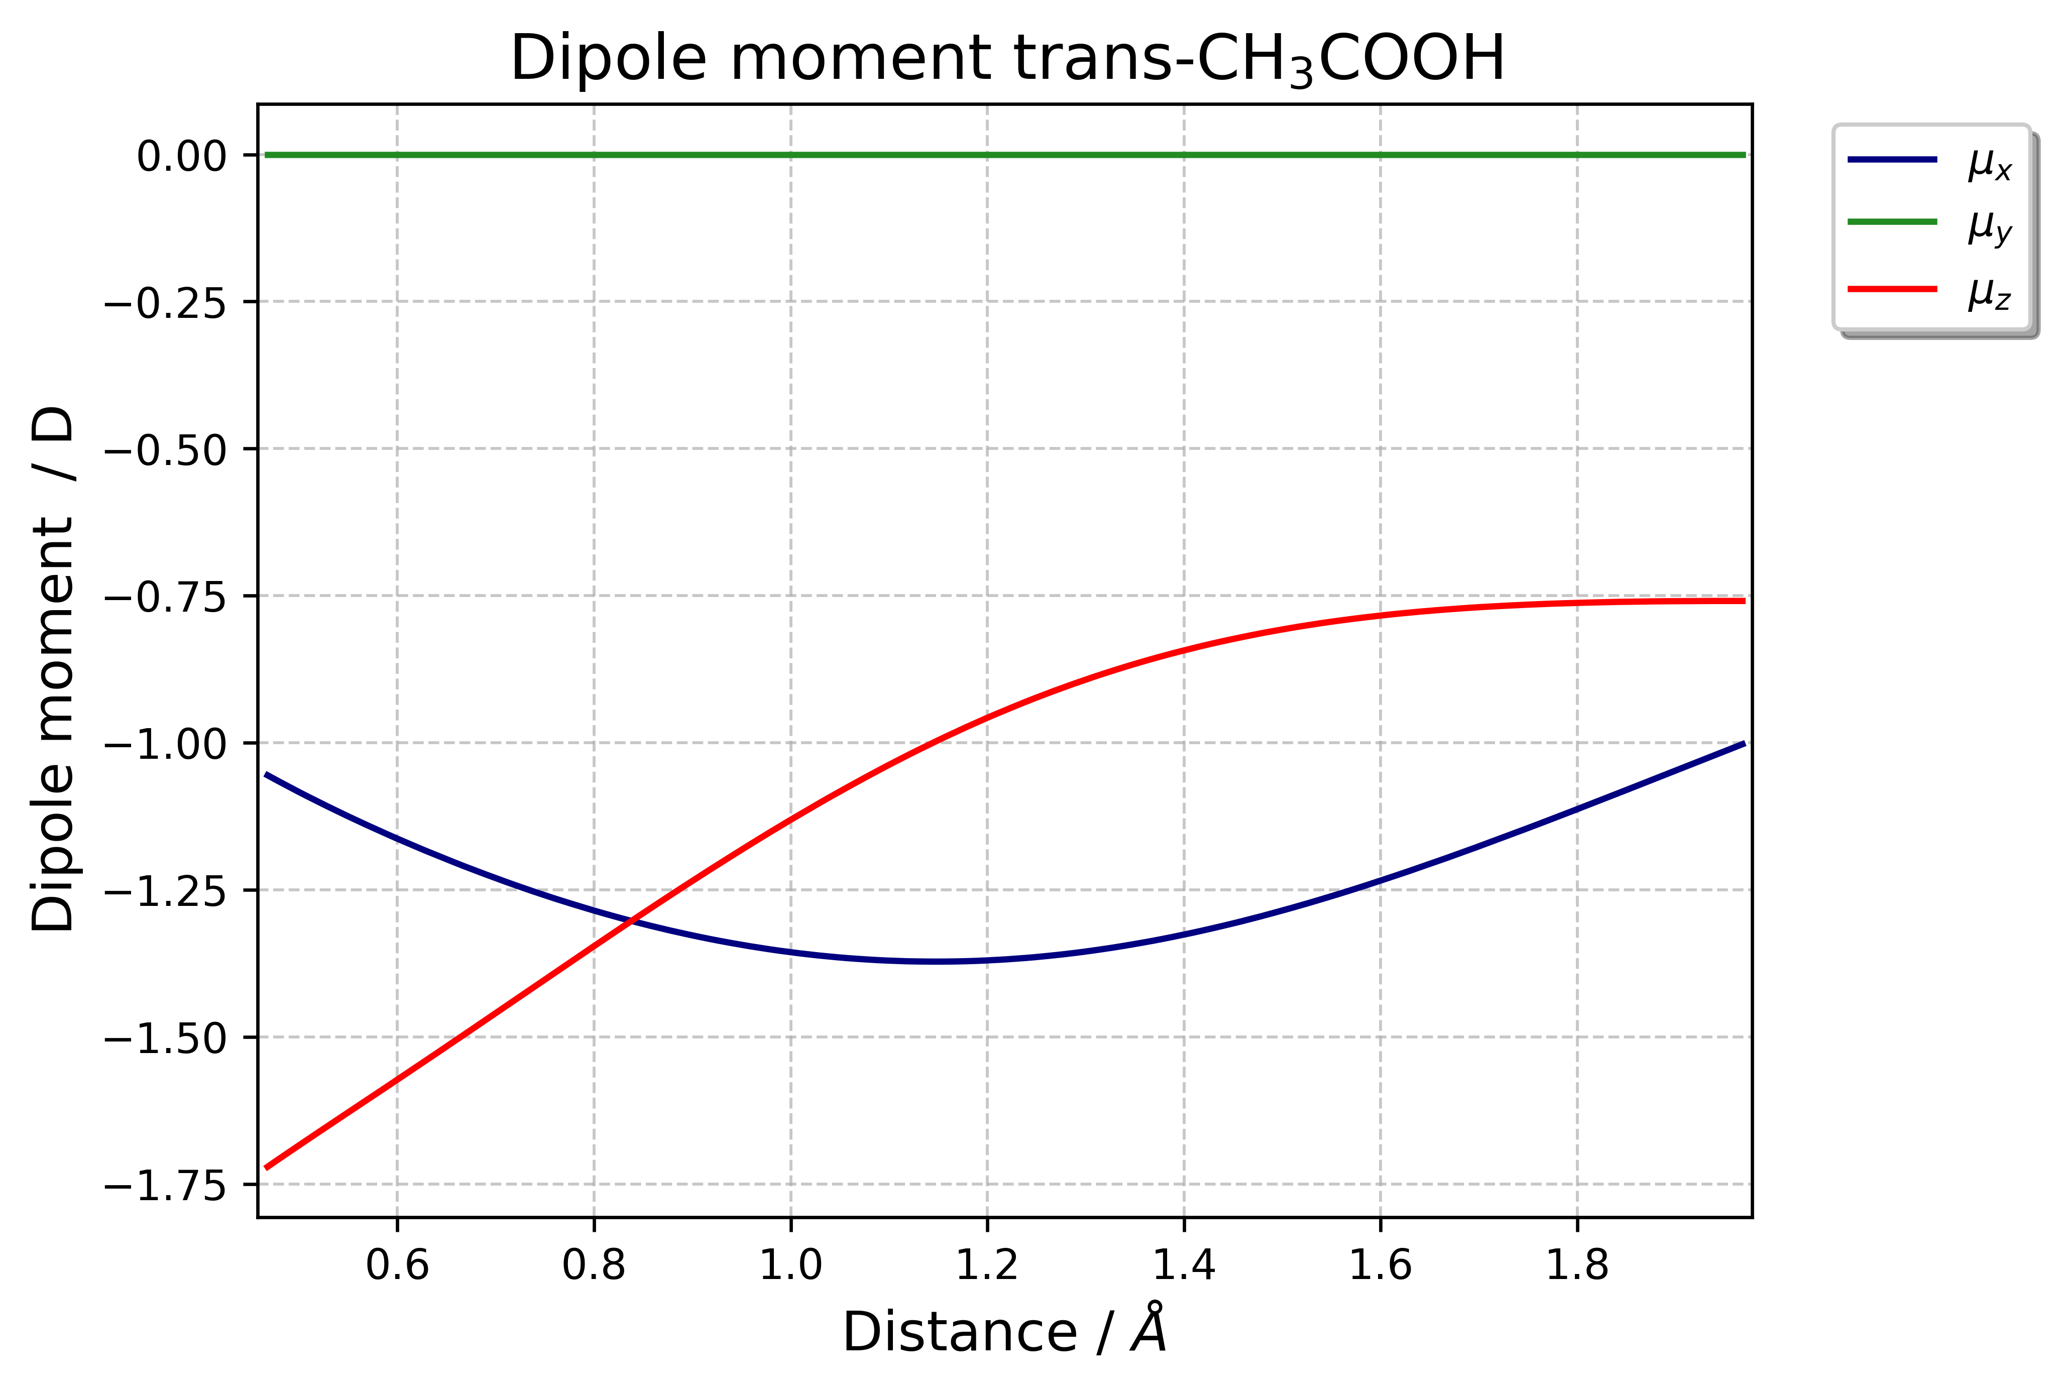
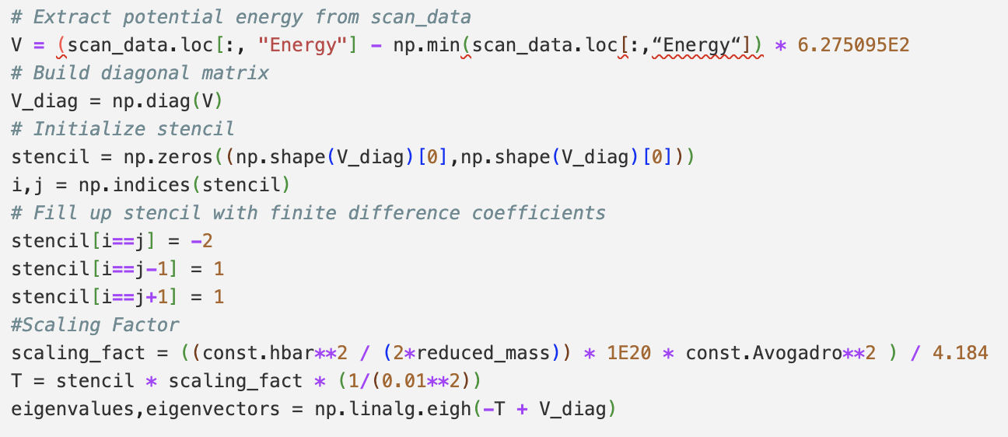
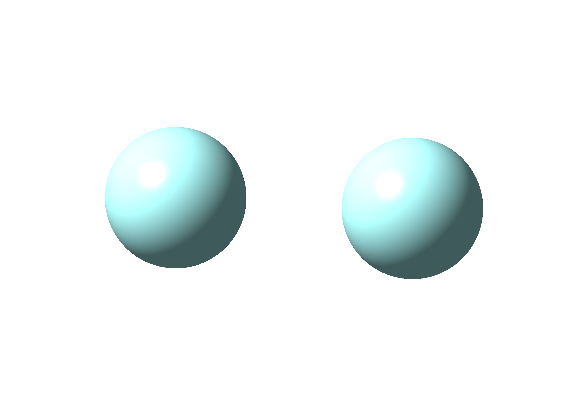
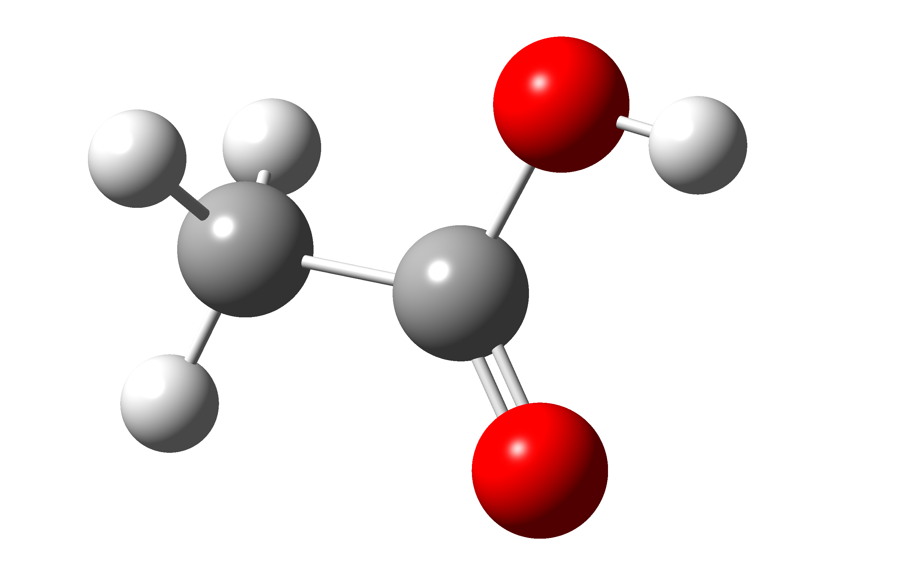
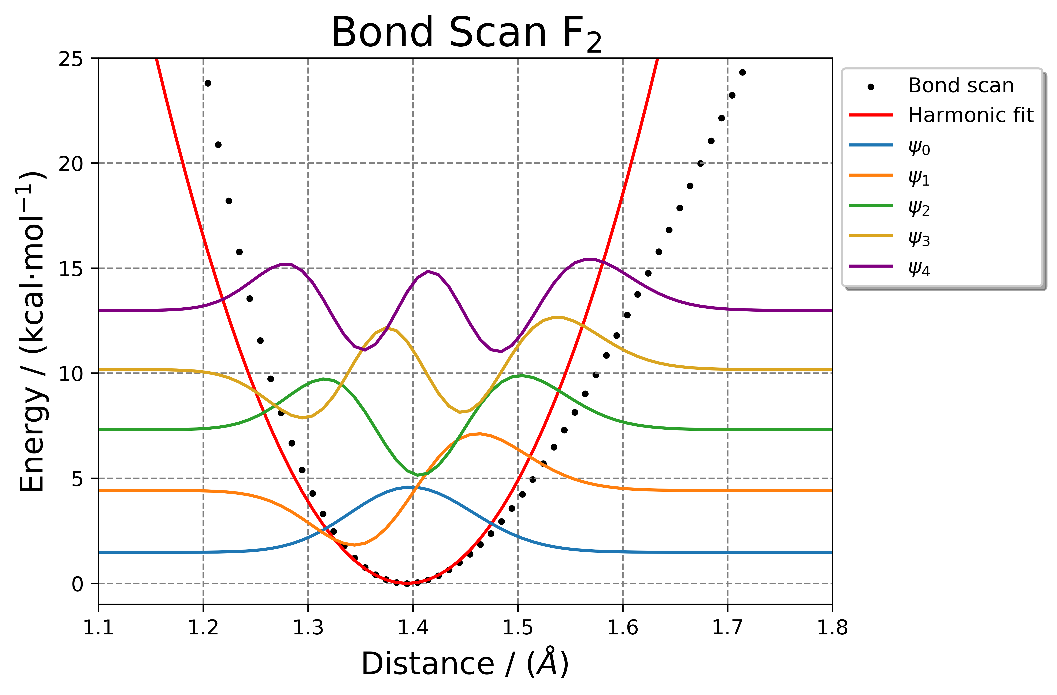
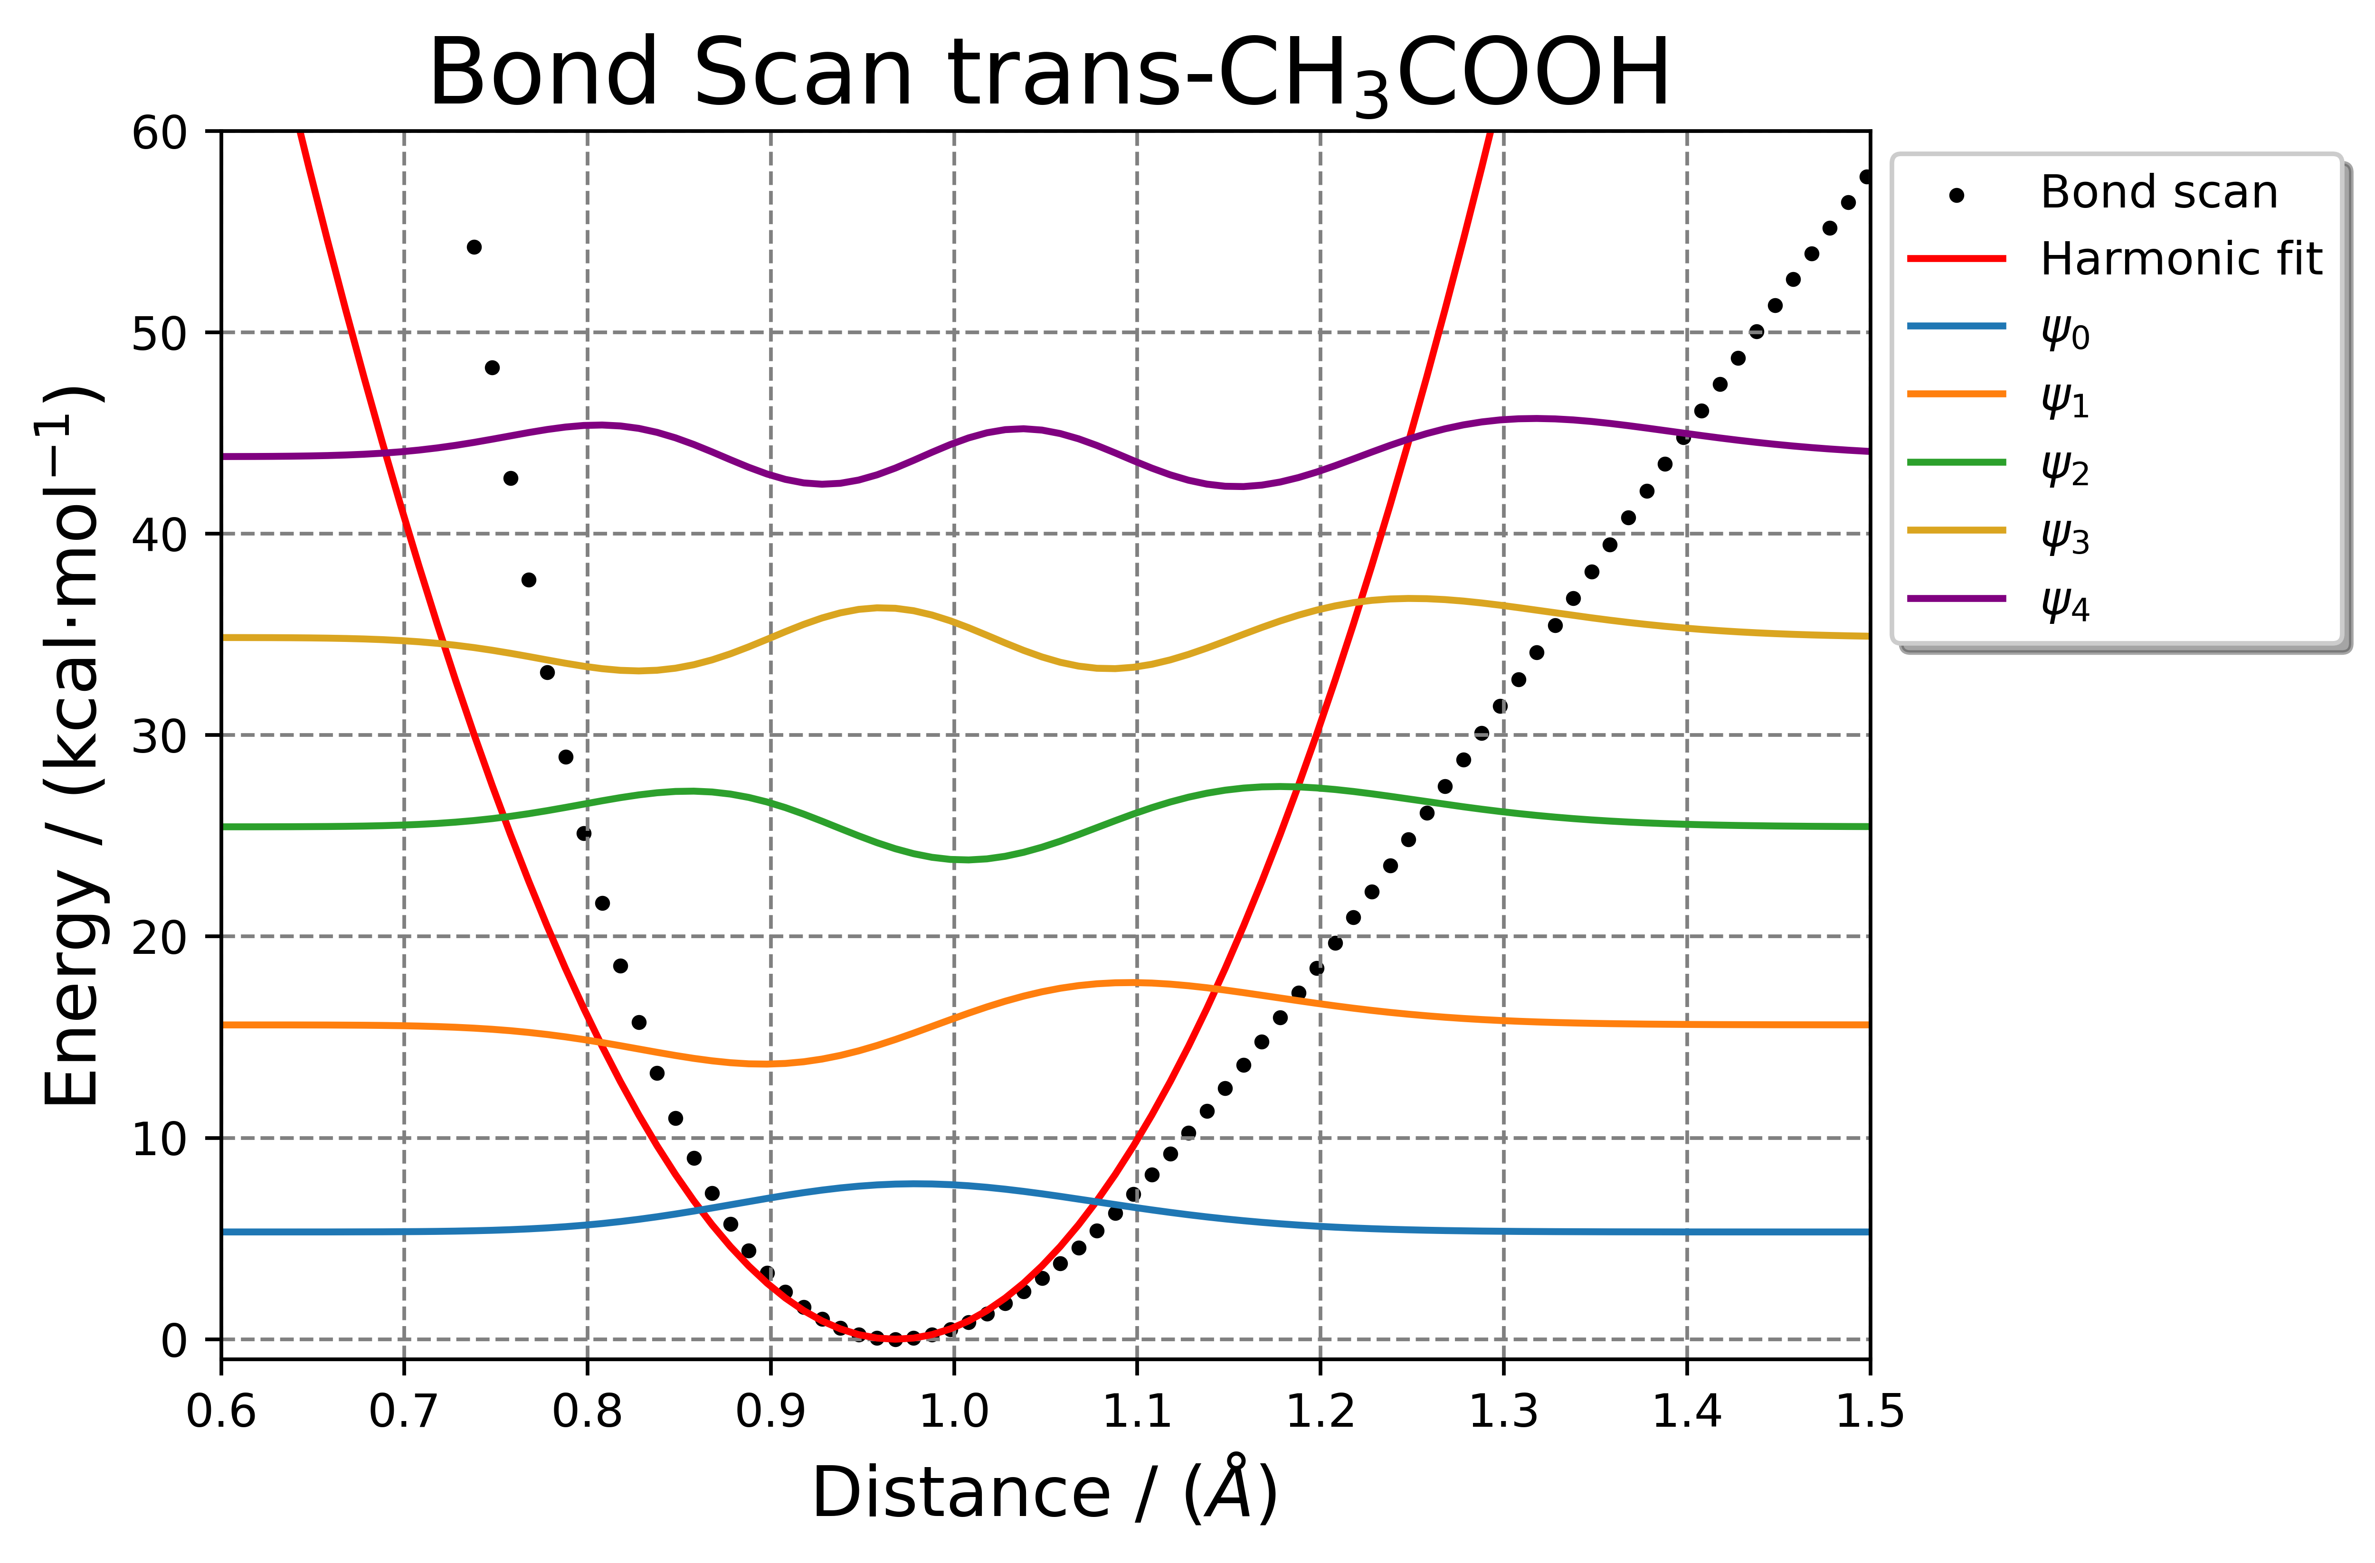
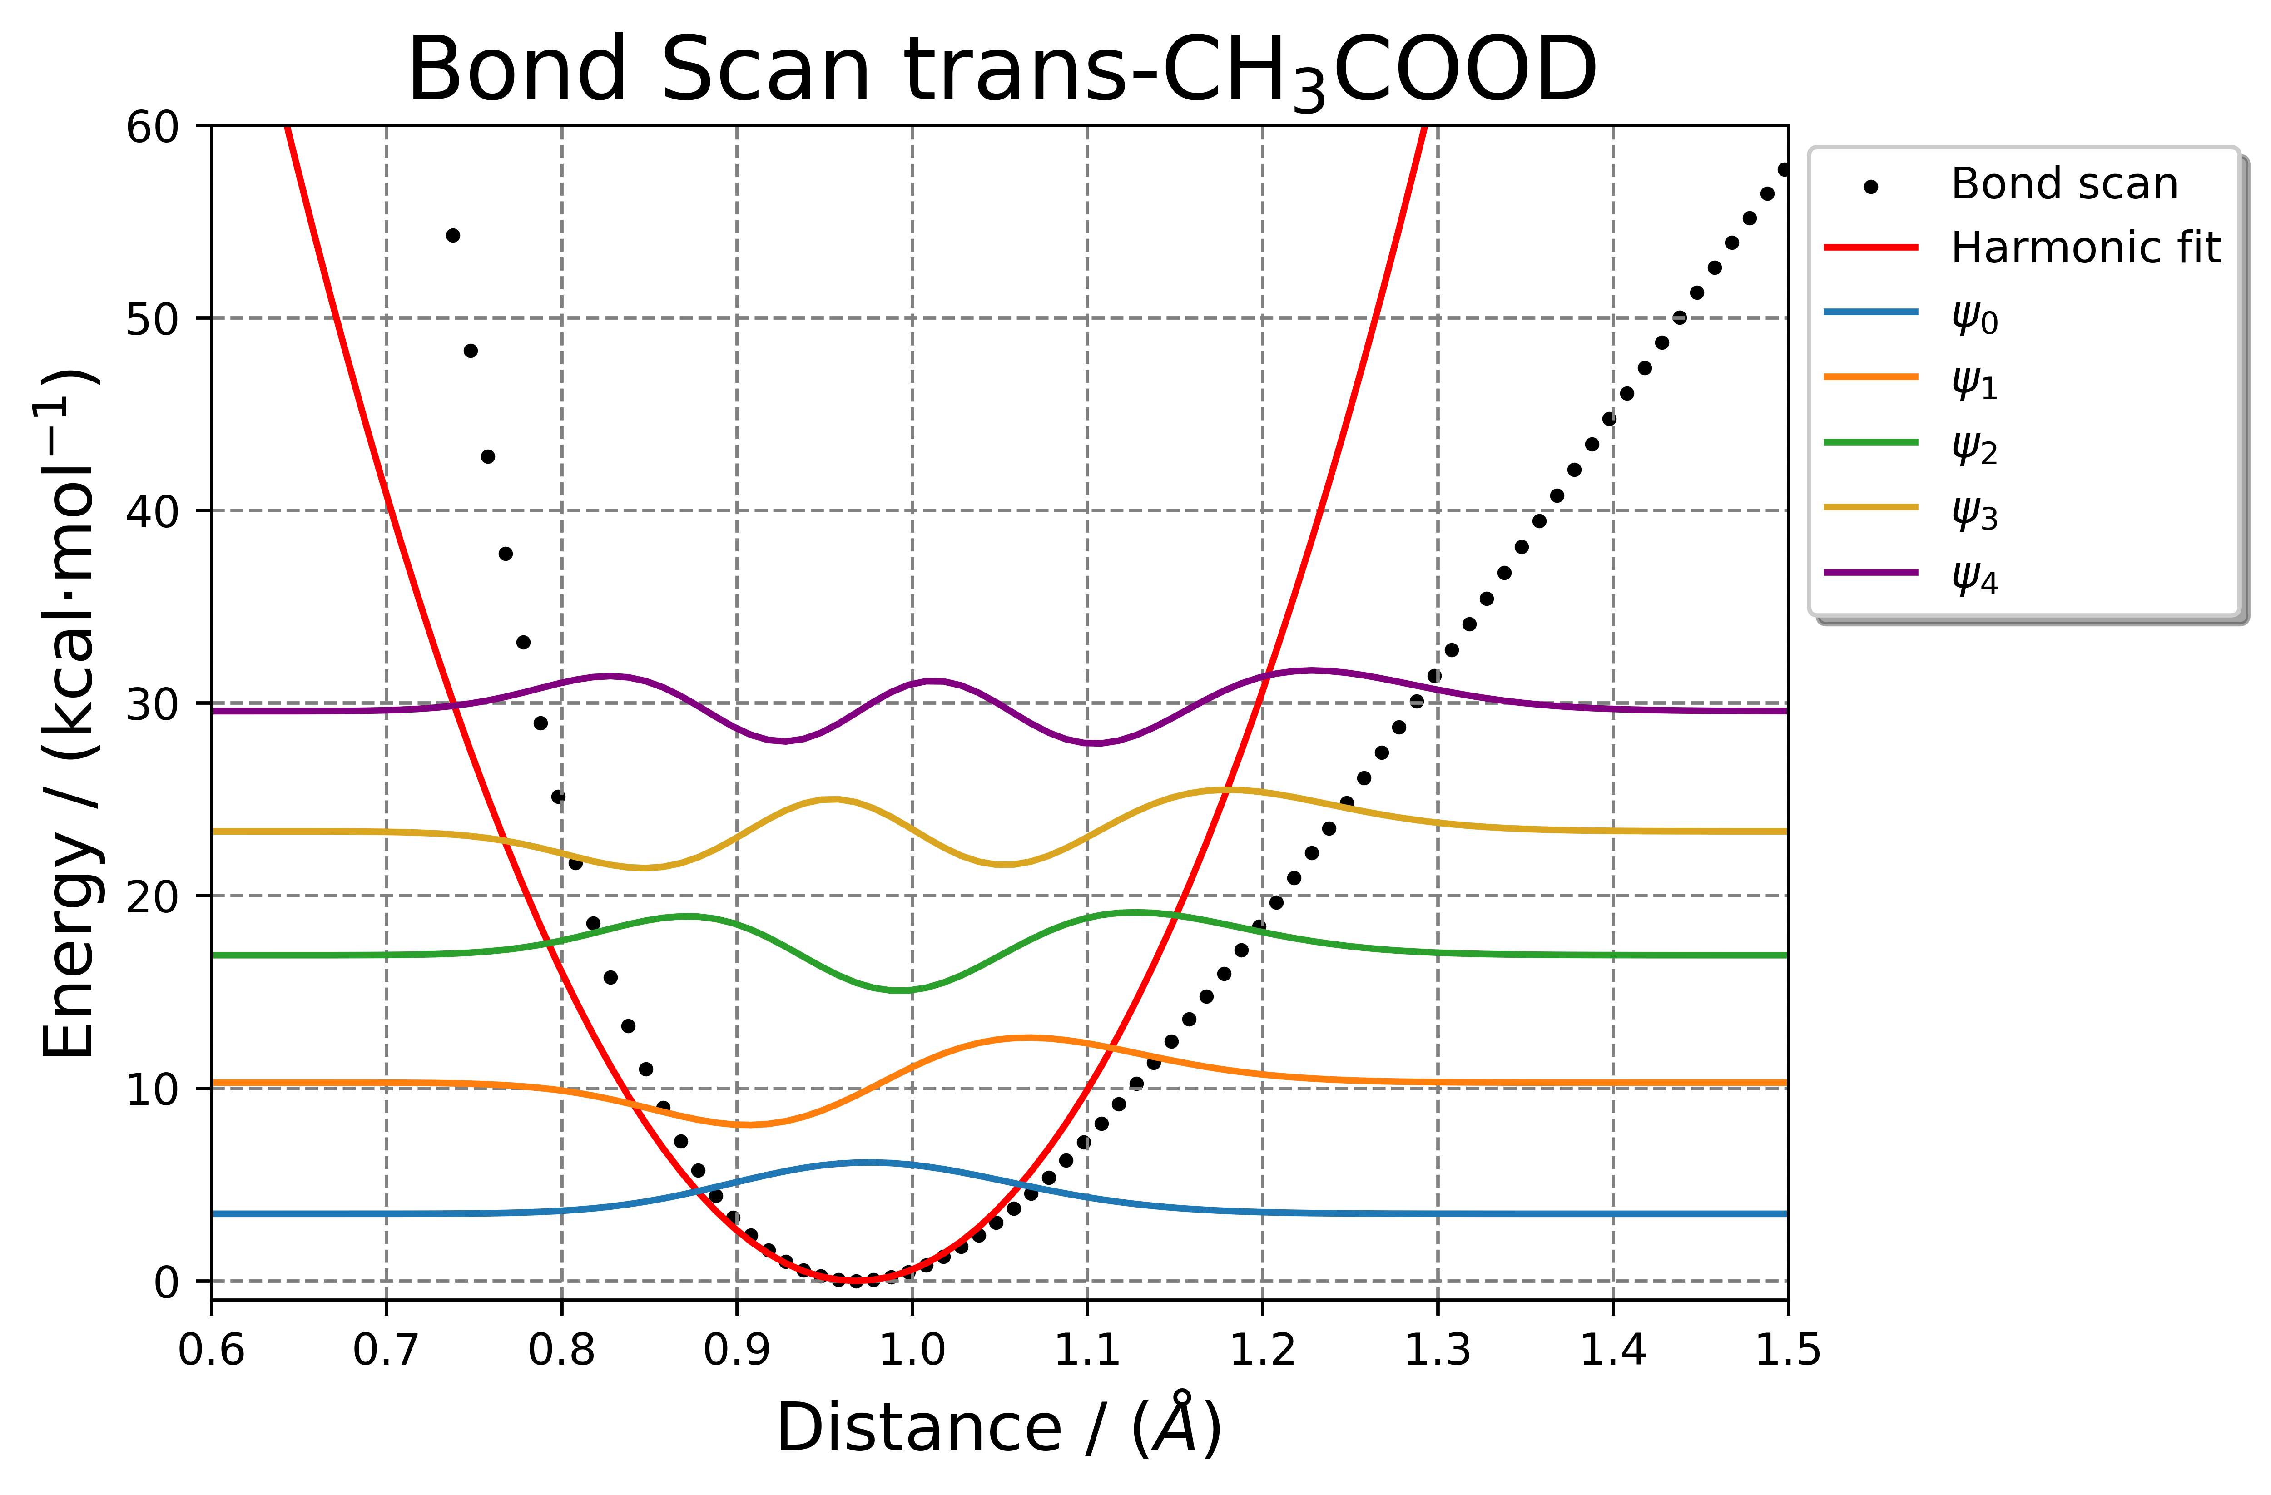

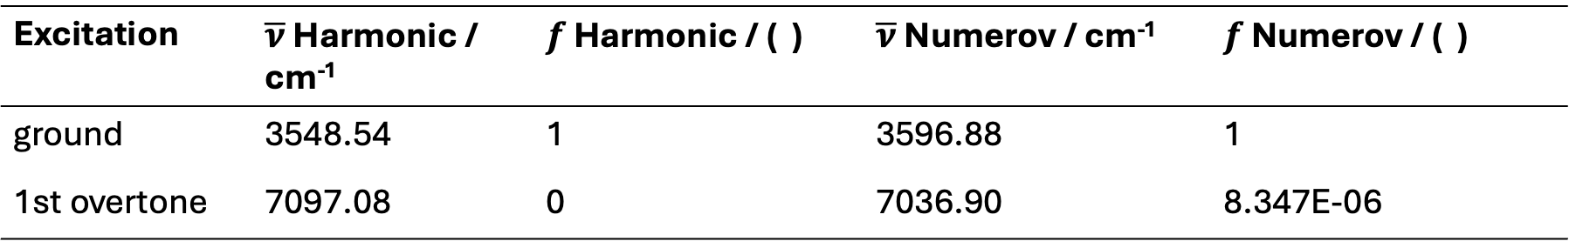
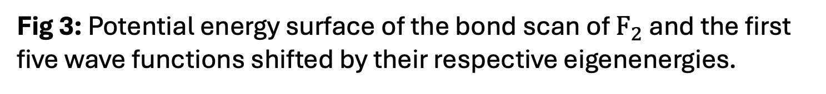
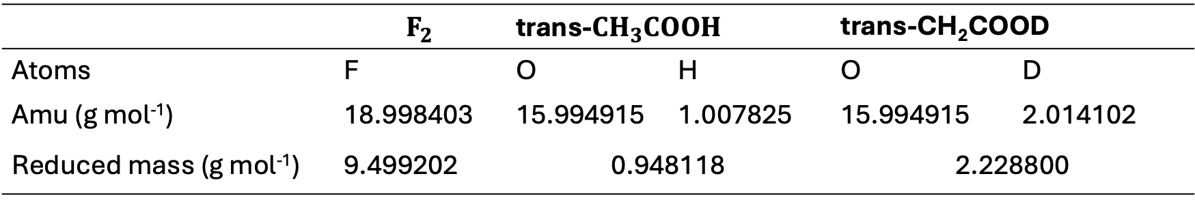
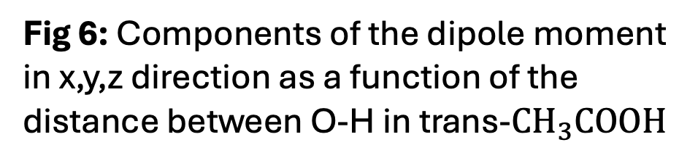
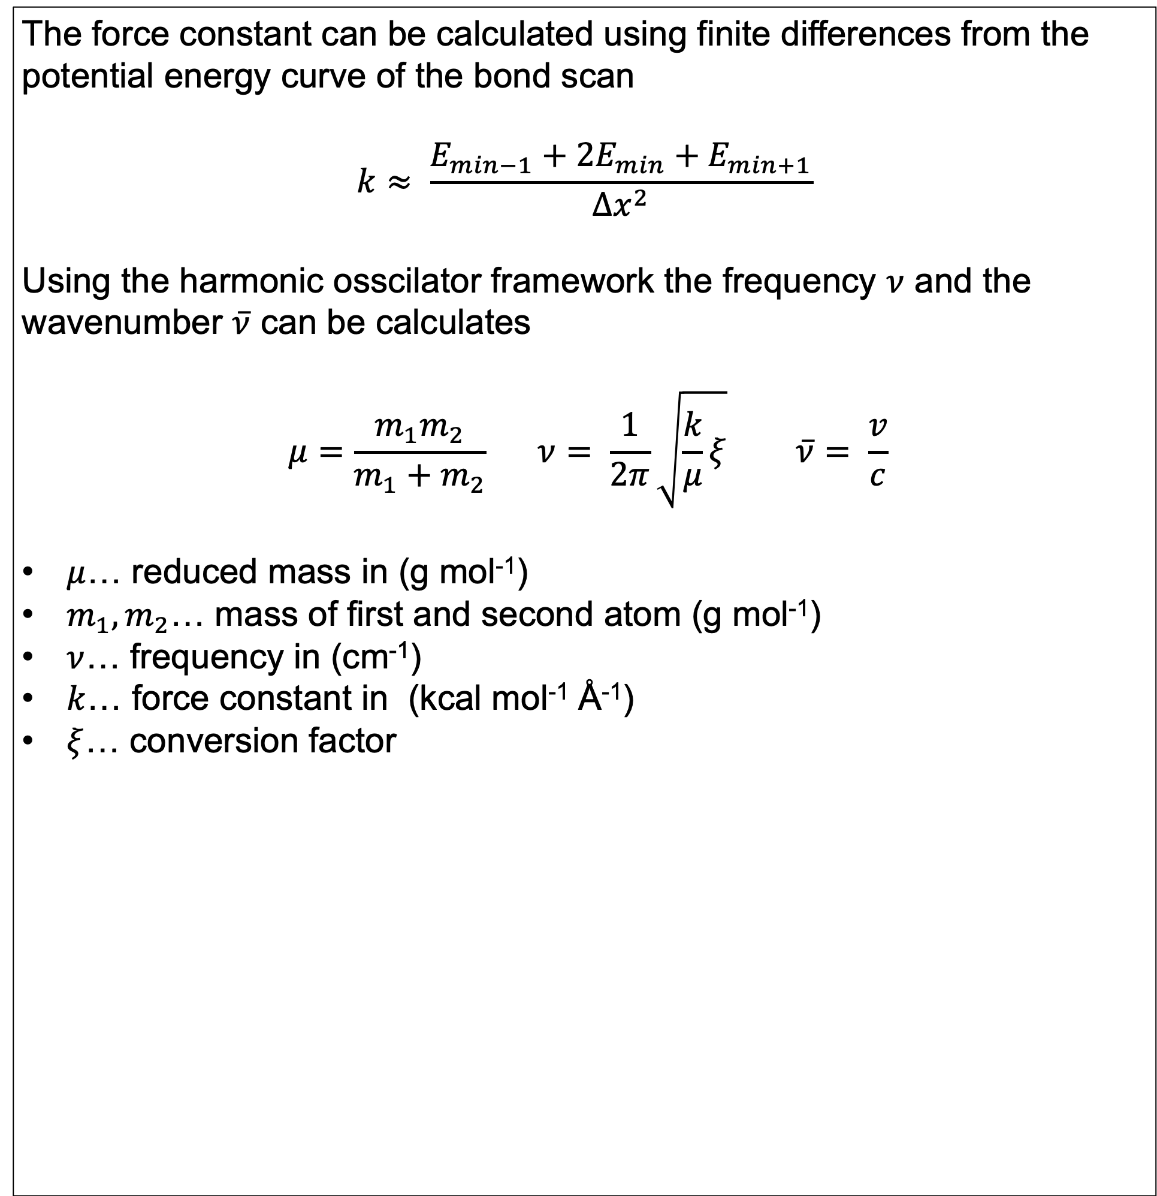
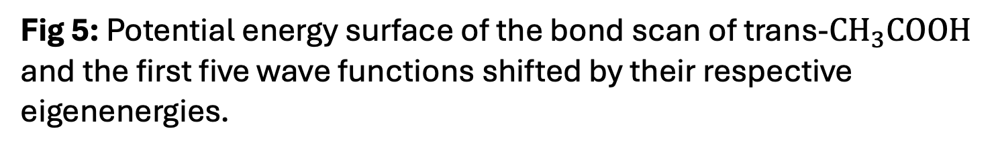

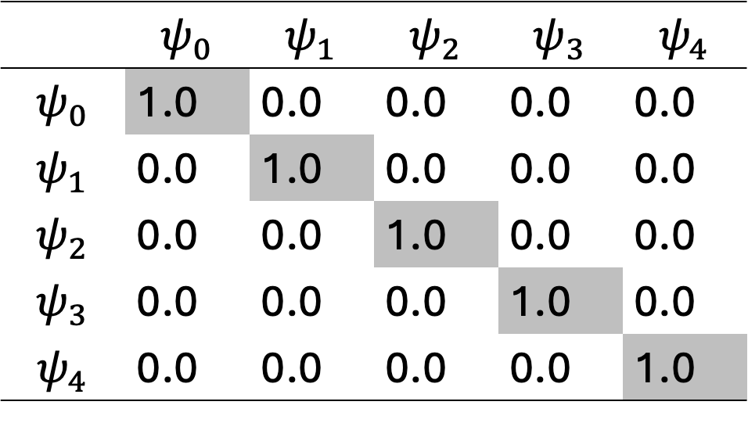
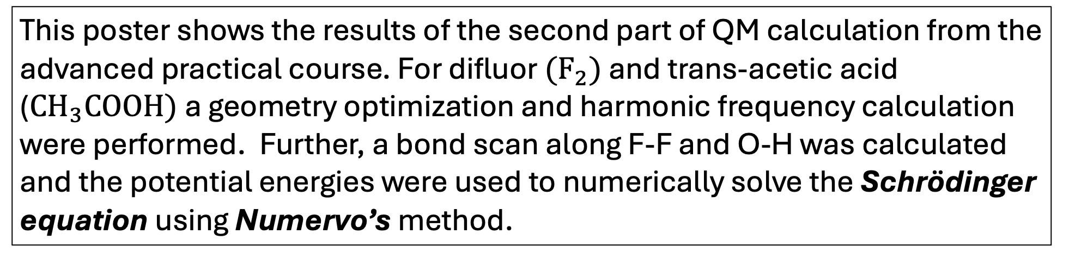
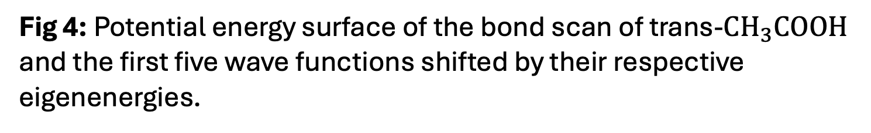
QM PART A: Vibrational spectroscopy using nuclear wave functions
Advanced Practical in Theoretical Chemistry
Lukas Meinschad (lukas.meinschad@student.uibk.ac.at), 12104730
Introduction
Numerov Procedure
Dipole Moment / Oscillator strenght
This poster shows the results of the second part of QM calculation from the advanced practical course. For difluor $(F_{2})$ and trans-acetic acid ($CH_{3}COOH)$ a geometry optimization and harmonic frequency calculation were performed. Further, a bond scan along F-F and O-H was calculated and the potential energies were used to numerically solve the Schrödinger equation using Numervo’s method.
Numerov method is a numerical method to solve differential equa-
tions. This method can be to obtain the energy eigenvalues $E_{n}$ and the wave functions $Ψ$
$$\frac{∂^{2}Ψ }{∂x^{2}}= \frac{2m}{ℏ}\left(V−E\right)Ψ⇒\frac{∂^{2}Ψ }{∂x^{2}}≈\frac{Δg}{Δx}$$
With the oscillator strength [3] the probability of a transition between two states can be predicted
In order for a vibration to be IR active the dipole moment must change. The plot on the left side displays the change in the dipole moment components $μ_{x},μ_{y},μ_{z}$. The component $μ_{y}$ is zero this is a result of the orientation of the molecule in the coordinate system.
As a overall trend the dipole moment decreases with increasing bond distance
Starting Structures / Calculation Parameters
The geometries of both structures were optimized with B3LYP exchange-correlation function using the 6-311++G(3df,3pd) basis set. Further a frequency calculation and a bond scan was performed. For the bond scan the coordinate was
Fig 6: Components of the dipole moment in x,y,z direction as a function of the distance between O-H in trans-$CH_{3}COOH$
Fig 2: Python implementation for Numerov‘s algorithm
Excitation | $\overline{ν}$ Harmonic / cm⁻¹ | $f$ Harmonic / ( ) | $\overline{ν}$ Numerov / cm⁻¹ |  | $f$ Numerov / ( )
ground | 3548.54 | 1 | 3596.88 |  | 1
1st overtone | 7097.08 | 0 | 7036.90 |  | 8.347E-06
Fig 1: $F_{2}$ and $CH_{3}COOH$ optimized with B3LYP/6-311++G(3df,3pd)
Potential Energy
Calculation of force Constant and reduced mass
The force constant can be calculated using finite differences from the potential energy curve of the bond scan
$$k≈ \frac{E_{min−1}+2E_{min}+E_{min+1}}{Δx^{2}}$$
Using the harmonic osscilator framework the frequency $ν$ and the wavenumber $\overline{ν}$ can be calculates
$$μ=\frac{m_{1}m_{2}}{m_{1}+m_{2}} ν= \frac{1}{2π}\sqrt{\frac{k}{μ}ξ} \overline{ν}= \frac{v}{c}$$
$μ$… reduced mass in (g mol⁻¹)
$m_{1},m_{2}$… mass of first and second atom (g mol⁻¹)
$ν$… frequency in (cm⁻¹)
$k$… force constant in (kcal mol⁻¹ Å⁻¹)
$ξ$… conversion factor
Fig 3: Potential energy surface of the bond scan of $F_{2}$ and the first five wave functions shifted by their respective eigenenergies.
Fig 4: Potential energy surface of the bond scan of trans-$CH_{3}COOH$ and the first five wave functions shifted by their respective eigenenergies.
Fig 5: Potential energy surface of the bond scan of trans-$CH_{3}COOH$ and the first five wave functions shifted by their respective eigenenergies.
 | base | 1st overtone | 2nd overtone | 3rd overtone
Gaussian | 1042.04 | 2084.35 | 3126.53 | 4168.71
Harmonic | 1042.18 | 2084.35 | 3126.53 | 4168.71
Numerov | 1027.70 | 2041.15 | 3040.47 | 4025.77
Literature [1] | 916.929 | -- | -- | --
 | base | 1st overtone | 2nd overtone | 3rd overtone
Gaussian | 3753.12 | 7506.24 | 11259.36 | 15012.48
Harmonic | 3548.54 | 7097.08 | 10645.61 | 14194.15
Numerov | 3596.88 | 7036.90 | 10325.04 | 13466.99
Literature [2] | 3581(8) | 6991(30) | 10246(32) | --
 | base | 1st overtone | 2nd overtone | 3rd overtone
Gaussian | 2729.98 | 5459.96 | 8189.95 | 10919.93
Harmonic | 2452.89 | 4905.78 | 7358.66 | 9811.55
Numerov | 2382.38 | 4696.81 | 6944.72 | 9127.60
Literature [2] | 3581(8) | 6991(30) | 10246(32) | --
Tab 1: Atomic and reduced masses for the atoms used in the analysis
 | $$ψ_{0}$$ | $$ψ_{1}$$ | $$ψ_{2}$$ | $$ψ_{3}$$ | $$ψ_{4}$$
$$ψ_{0}$$ | 1.0 | 0.0 | 0.0 | 0.0 | 0.0
$$ψ_{1}$$ | 0.0 | 1.0 | 0.0 | 0.0 | 0.0
$$ψ_{2}$$ | 0.0 | 0.0 | 1.0 | 0.0 | 0.0
$$ψ_{3}$$ | 0.0 | 0.0 | 0.0 | 1.0 | 0.0
$$ψ_{4}$$ | 0.0 | 0.0 | 0.0 | 0.0 | 1.0
 | $$F_{2}$$ | trans-$CH_{3}COOH$ |  | trans-CH₂COOD
Atoms | F | O | H | O | D
Amu (g mol⁻¹) | 18.998403 | 15.994915 | 1.007825 | 15.994915 | 2.014102
Reduced mass (g mol⁻¹) | 9.499202 | 0.948118 |  | 2.228800
References:
[1] Experimental Vibrational Zero-Point Energies: Diatomic Molecules (2007), Karl K. Irikura; DOI: https://doi.org/10.1063/1.2436891
[2] Integrated Intensities of O−H Stretching Bands: Fundamentals and Overtones in Vapor-Phase Alcohols and Acids (2001), Lange et.al; DOI: https://doi.org/10.1021/jp003277u
[3] Atomic and Molecular Photoabsorption (2002), Joseph Berkowitz; DOI: https://doi.org/10.1016/B978-0-12-091841-6.X5000-2

