Slide 1
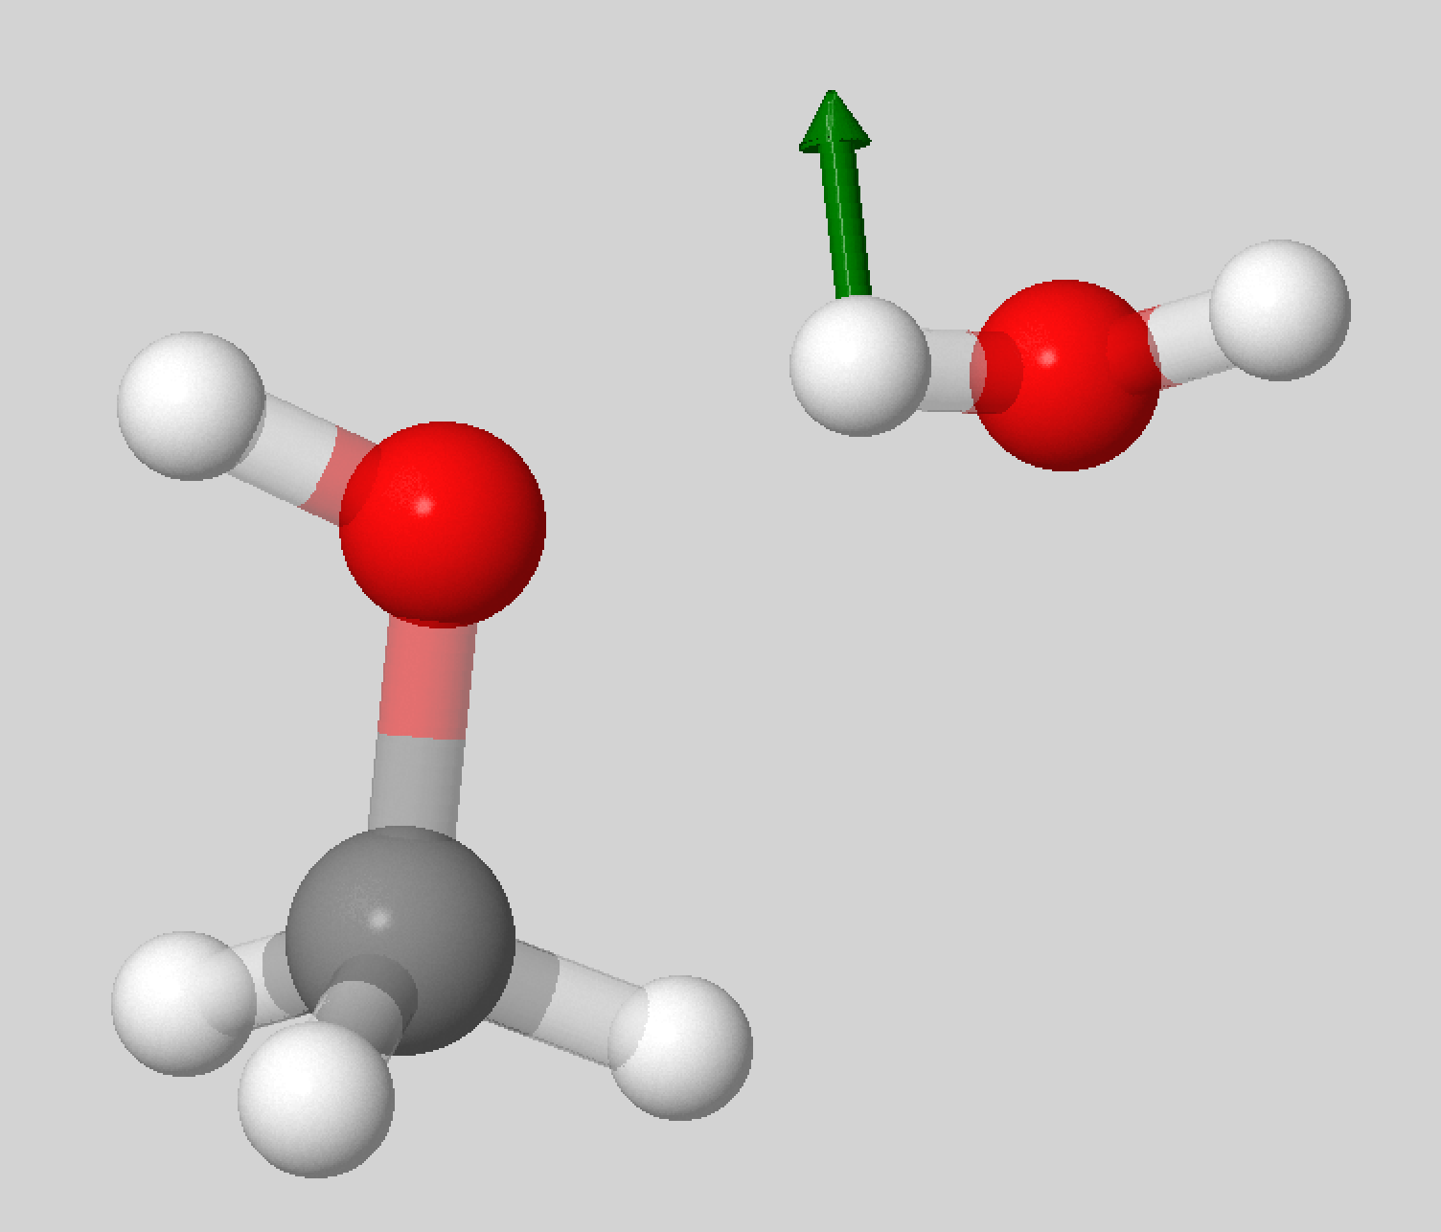
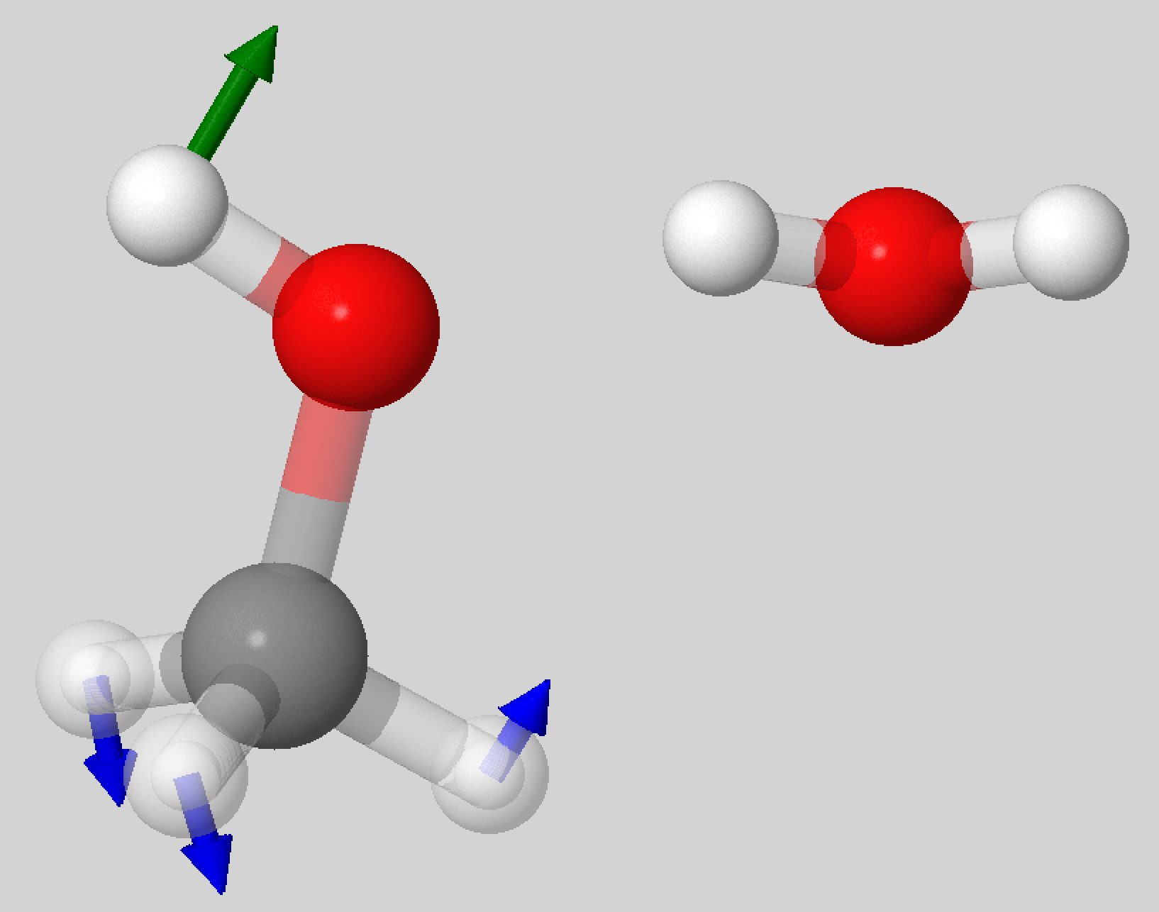
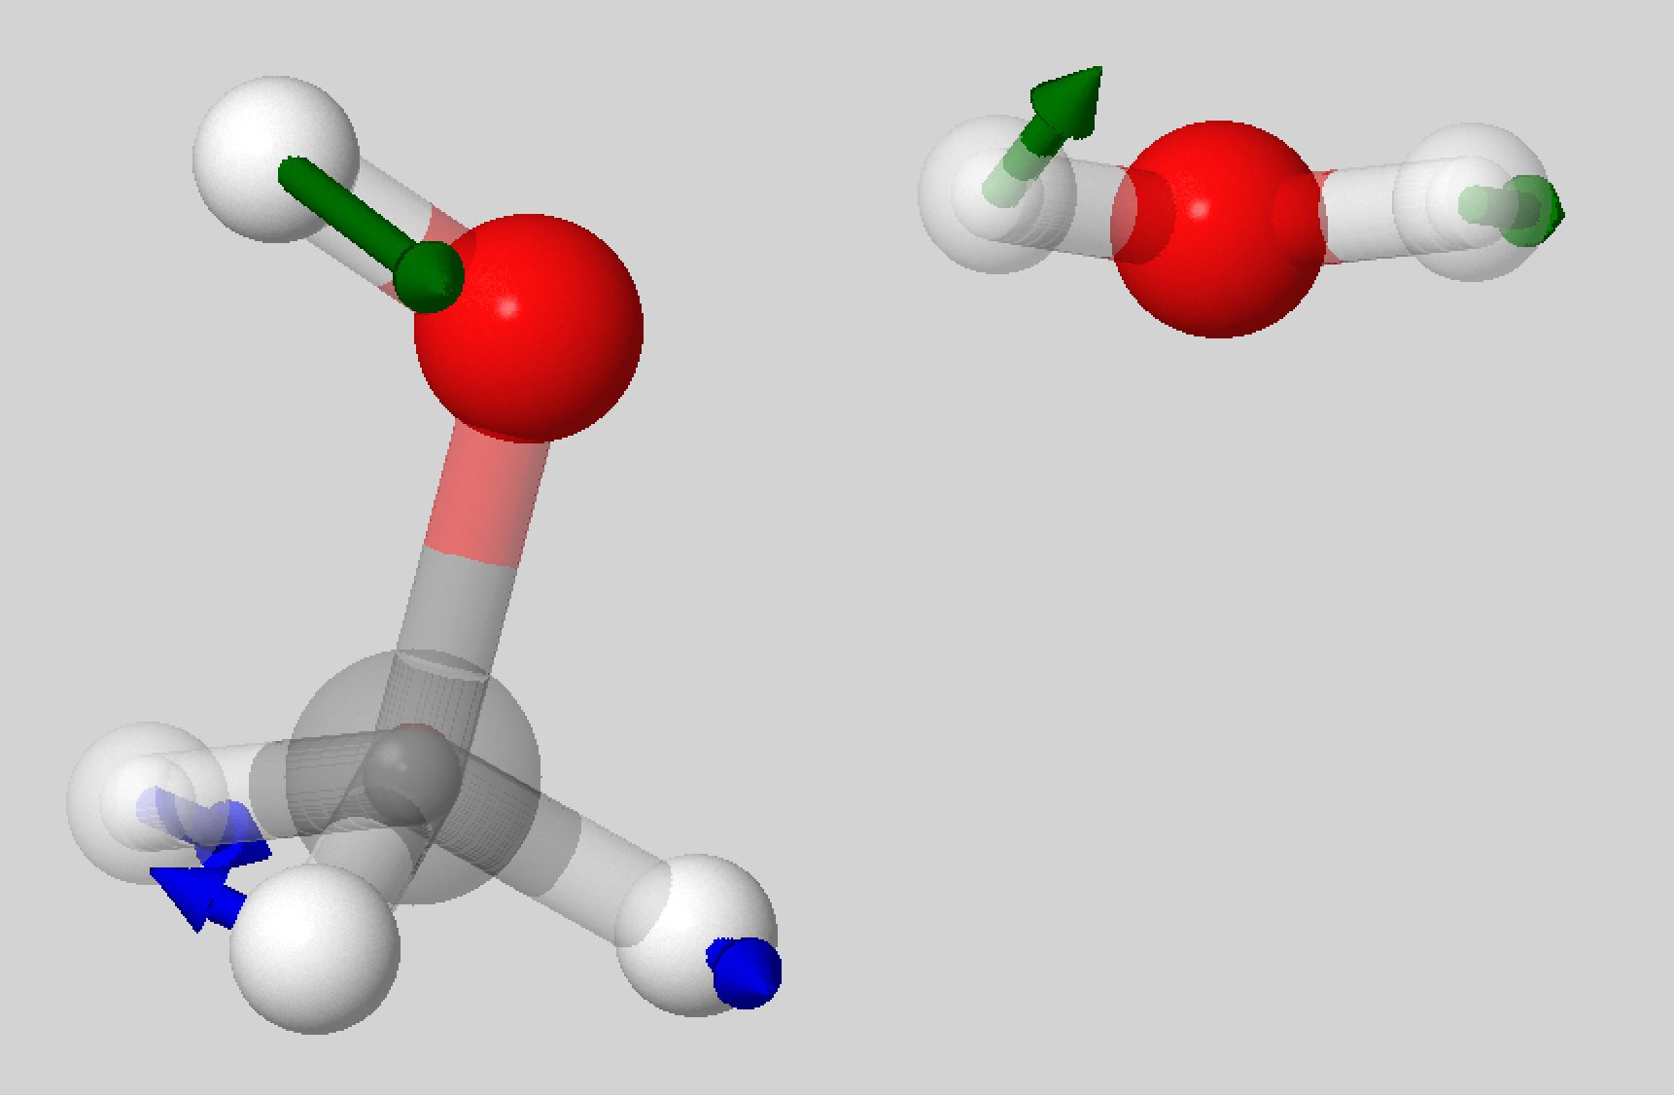
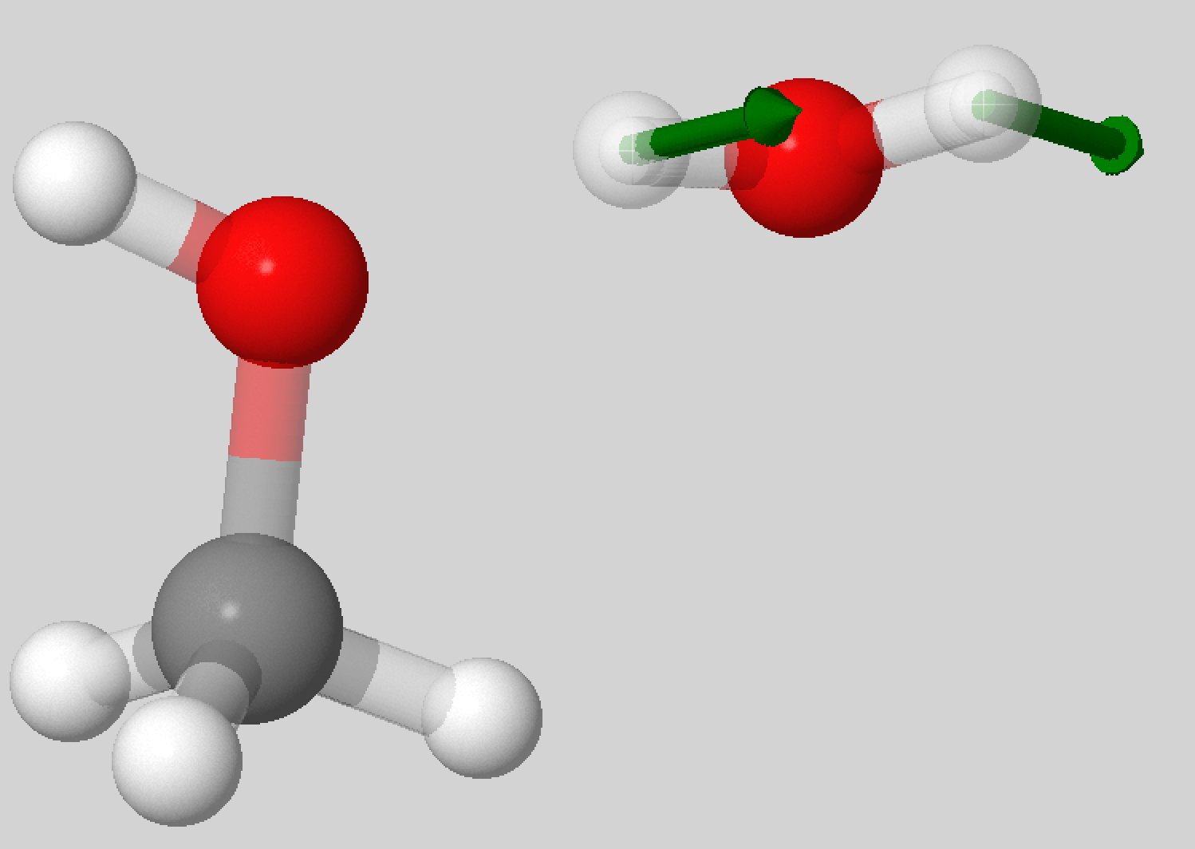
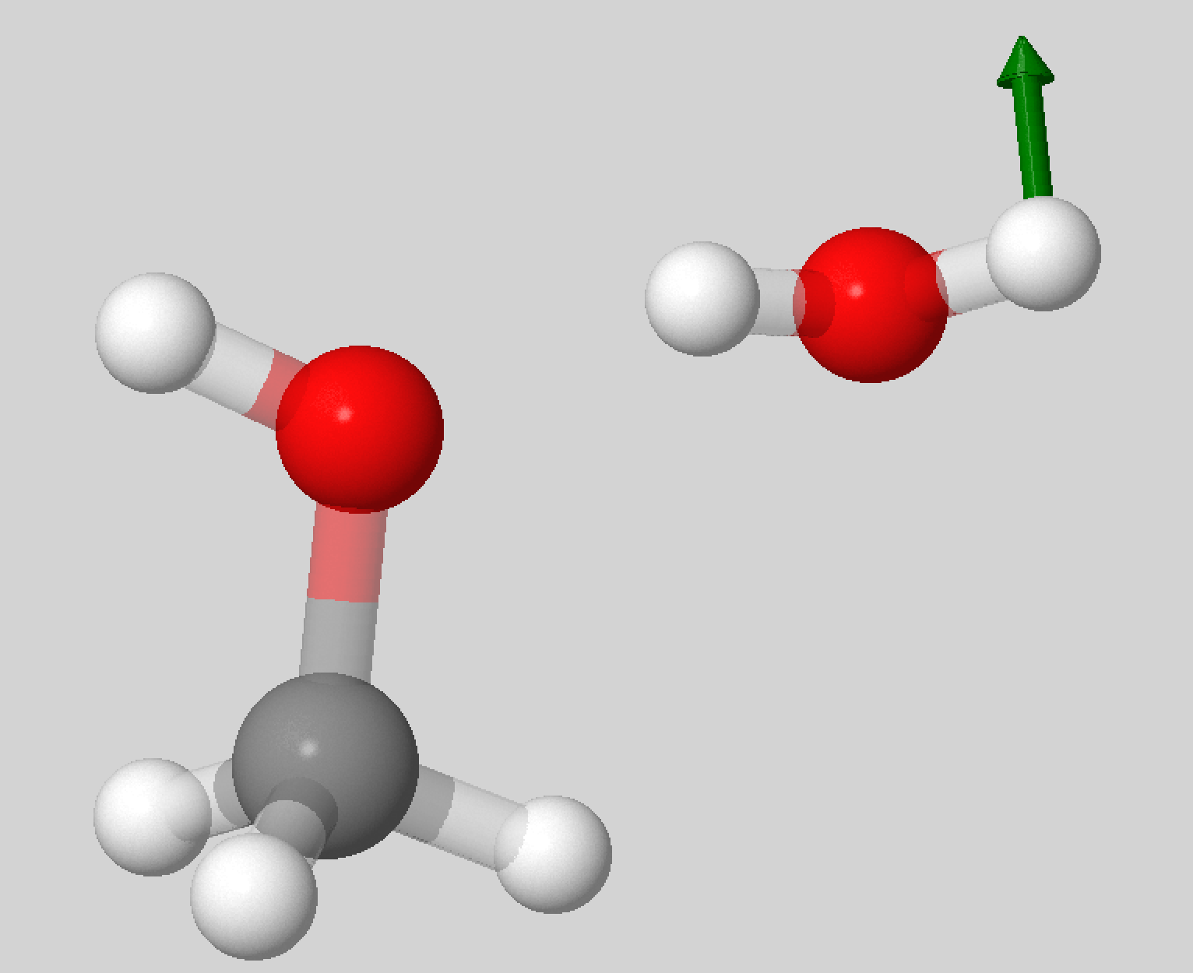
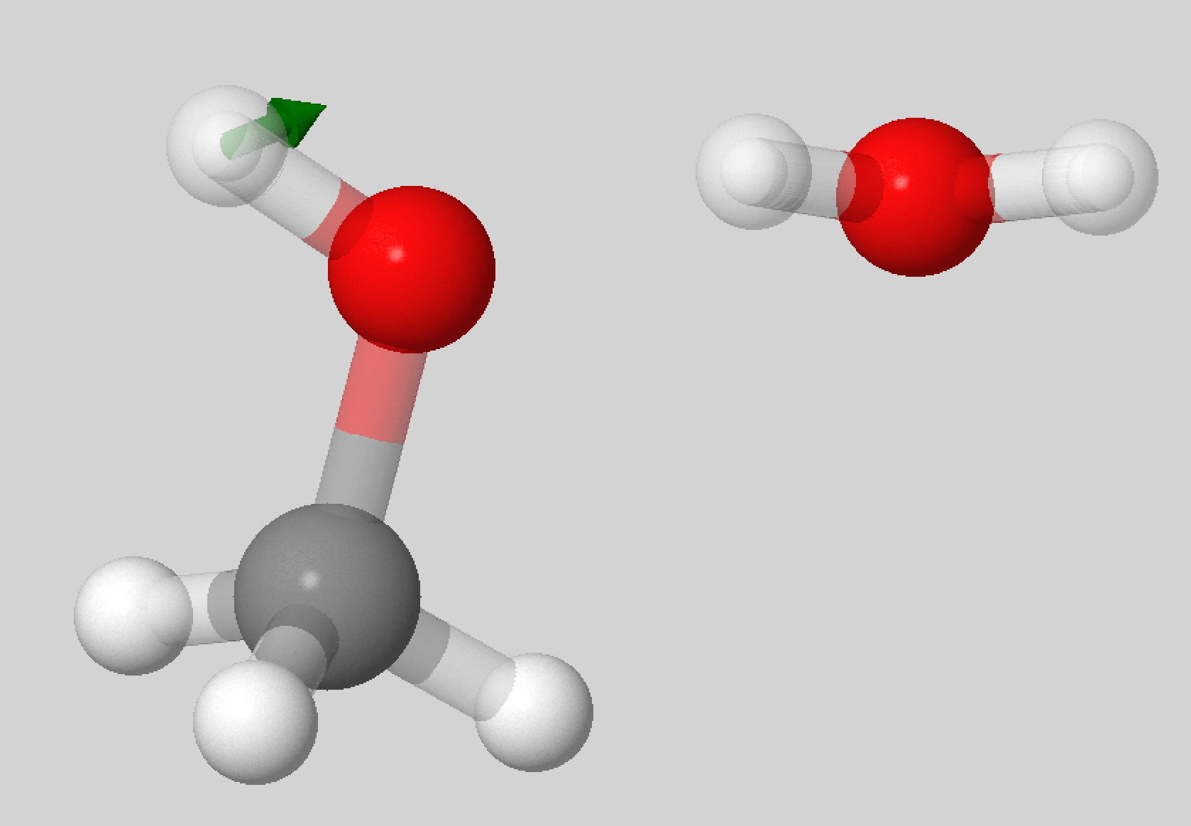
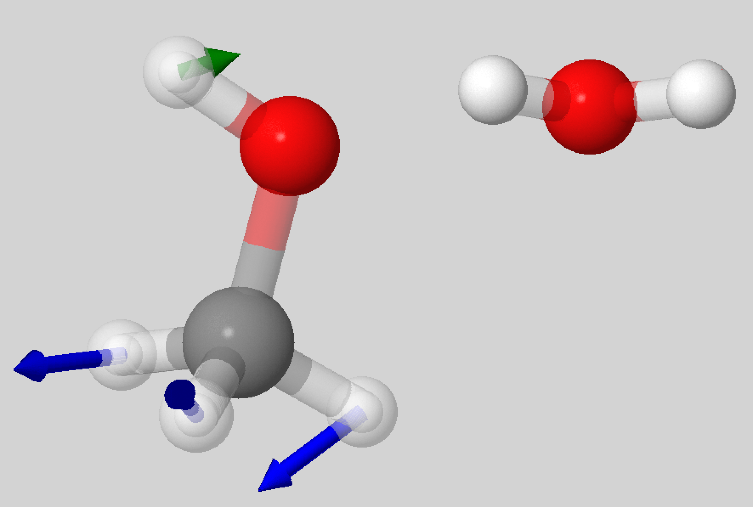
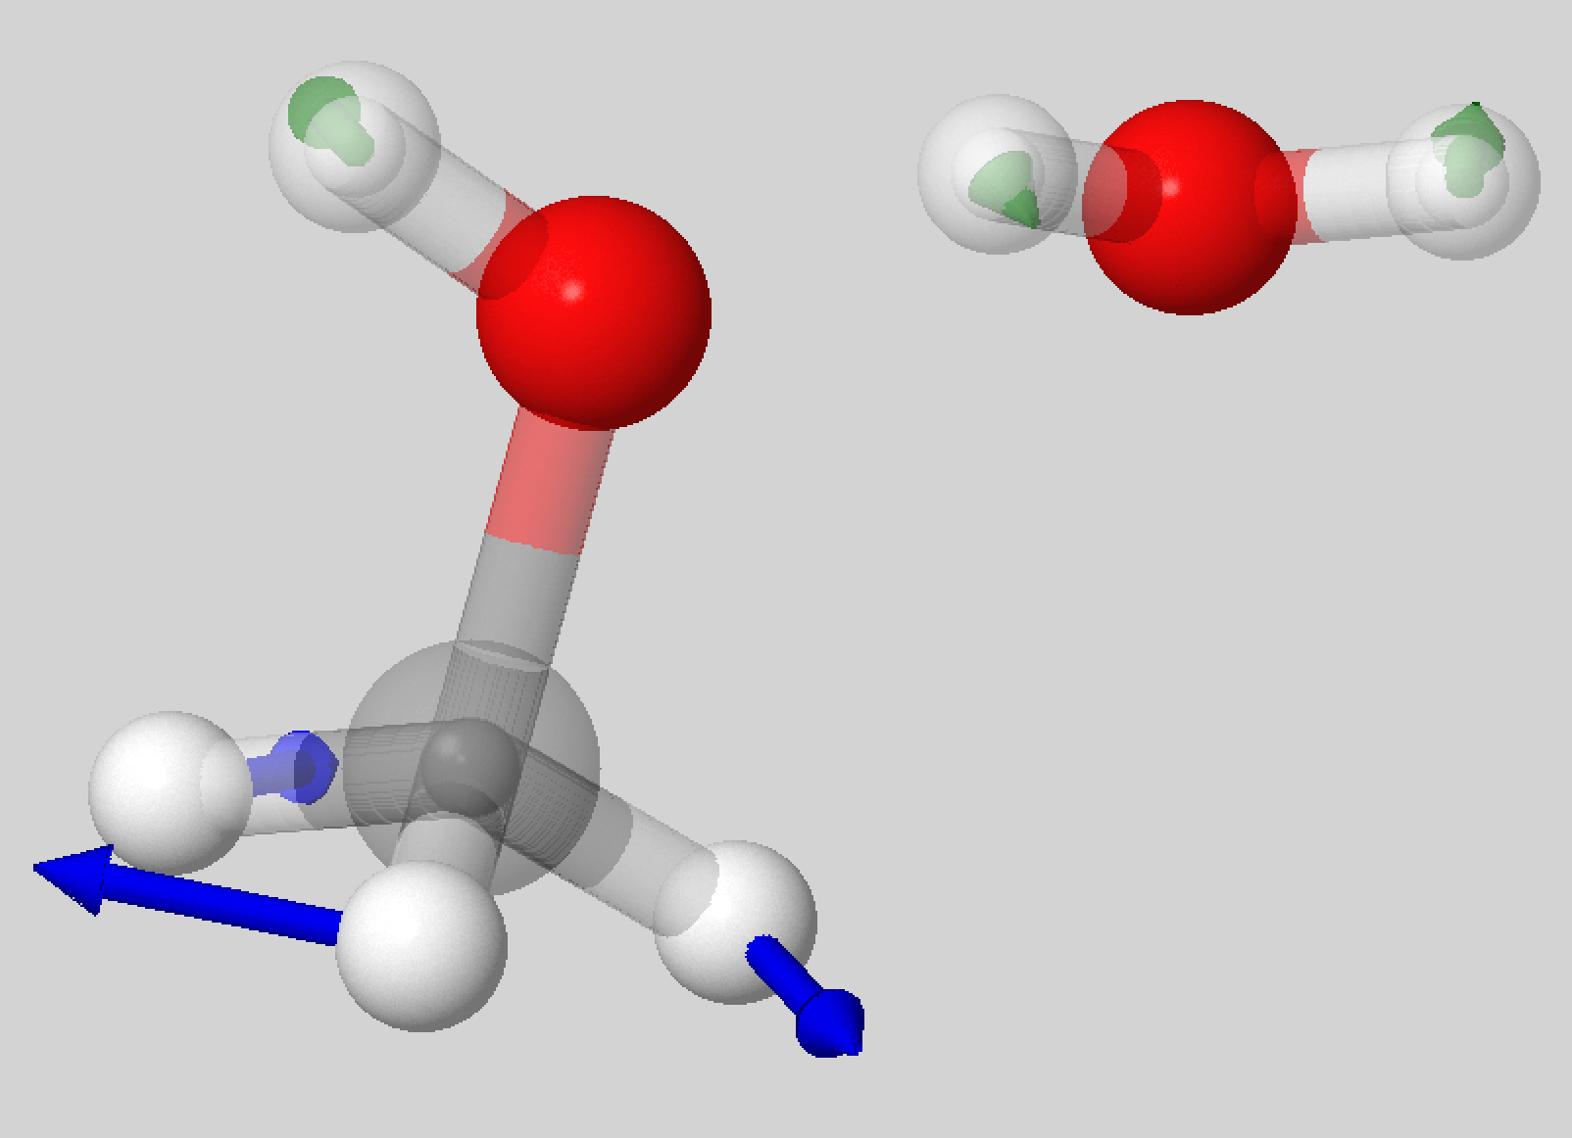





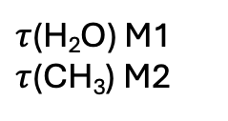

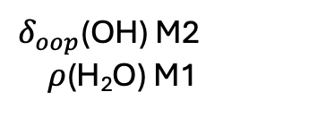








$$q_{14}$$
1157 cm⁻¹
$$q_{15}$$
595 cm⁻¹
$$q_{16}$$
354 cm⁻¹
$$q_{17}$$
266 cm⁻¹
$δ_{oop}$(OH) M2 $ρ$(H₂O) M1
$ν$(CO) M2
$δ_{oop}$(OH) M1
$ρ$ (H₂O) M1
$$q_{18}$$
175 cm⁻¹
$$q_{19}$$
152 cm⁻¹
$$q_{20}$$
66 cm⁻¹
$$q_{21}$$
53 cm⁻¹
$τ$(H₂O) M1
$τ$(CH₃) M2
$ν$(M1M2)
$δ_{oop}$(OH) M1
$ω$(CH₃) M2

