Slide 1

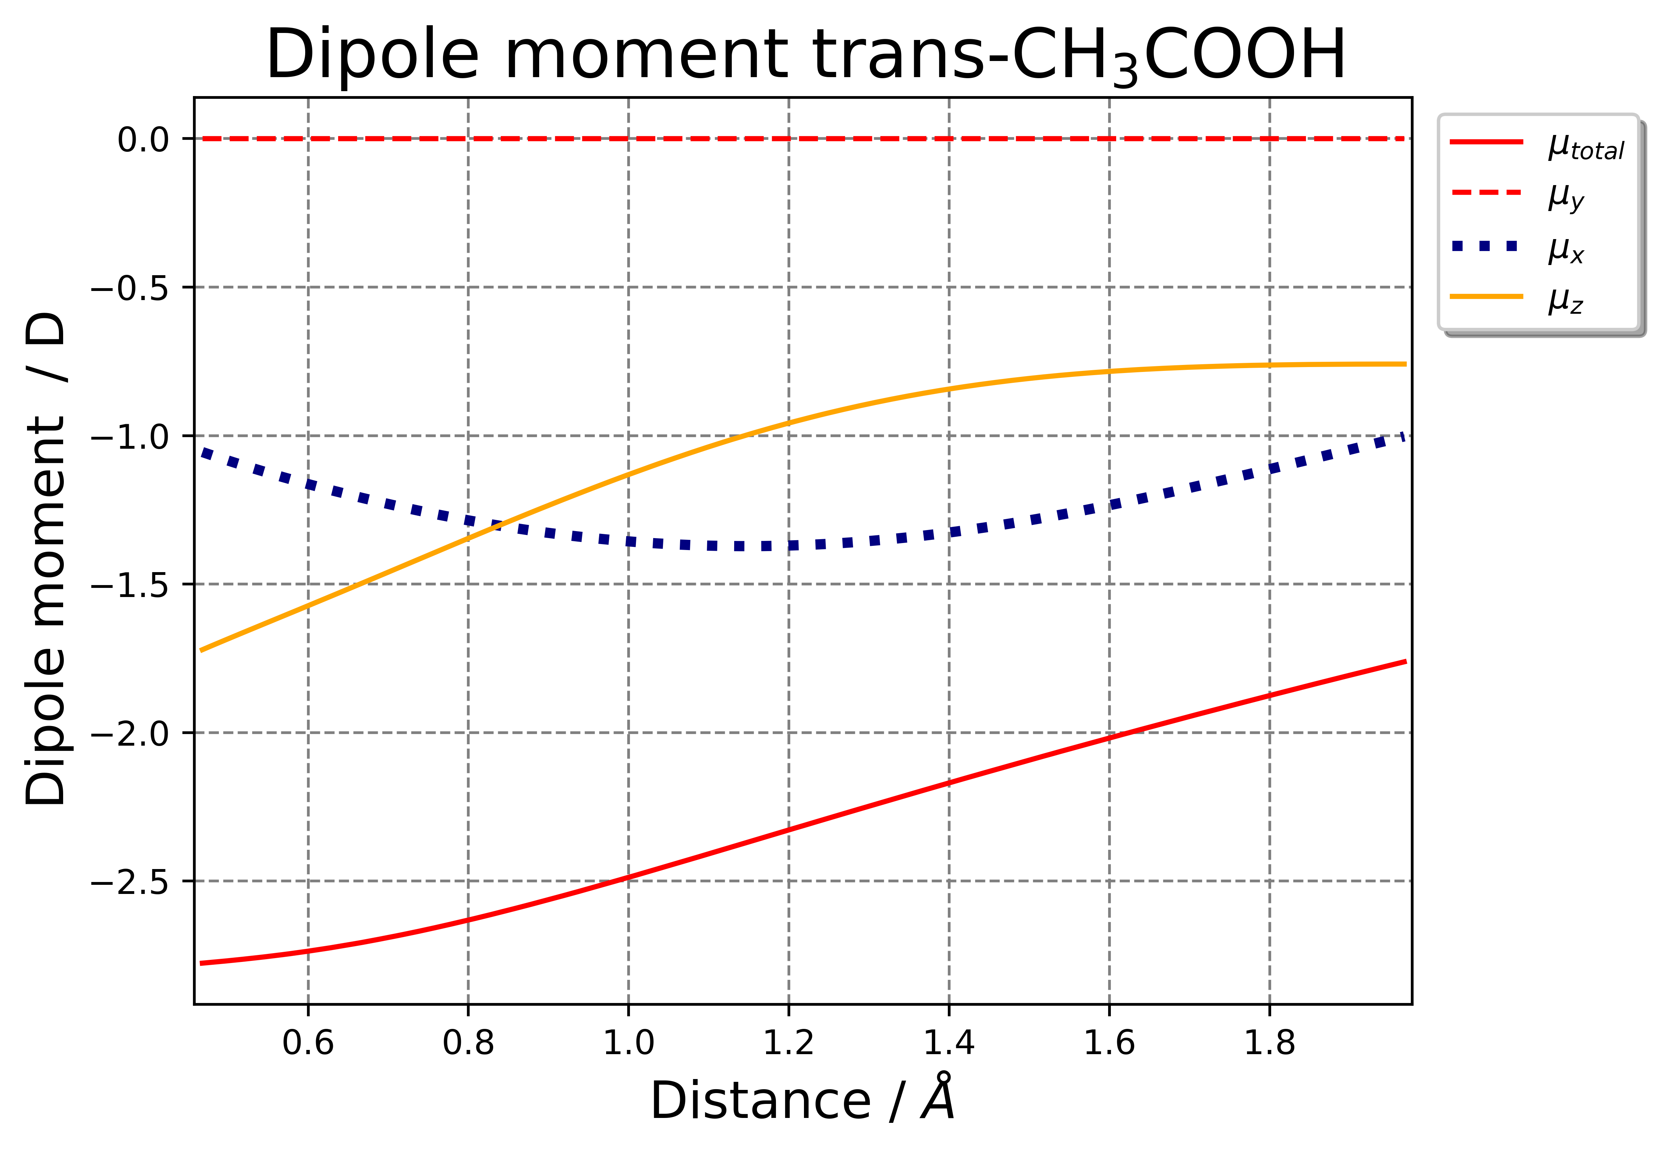
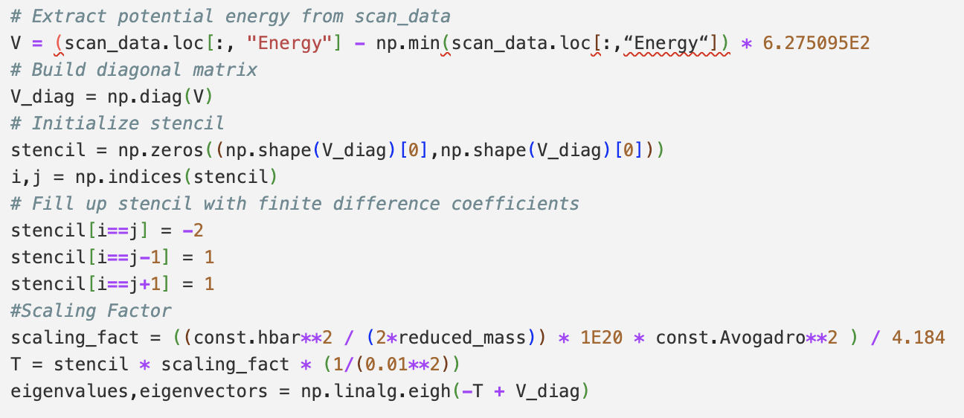
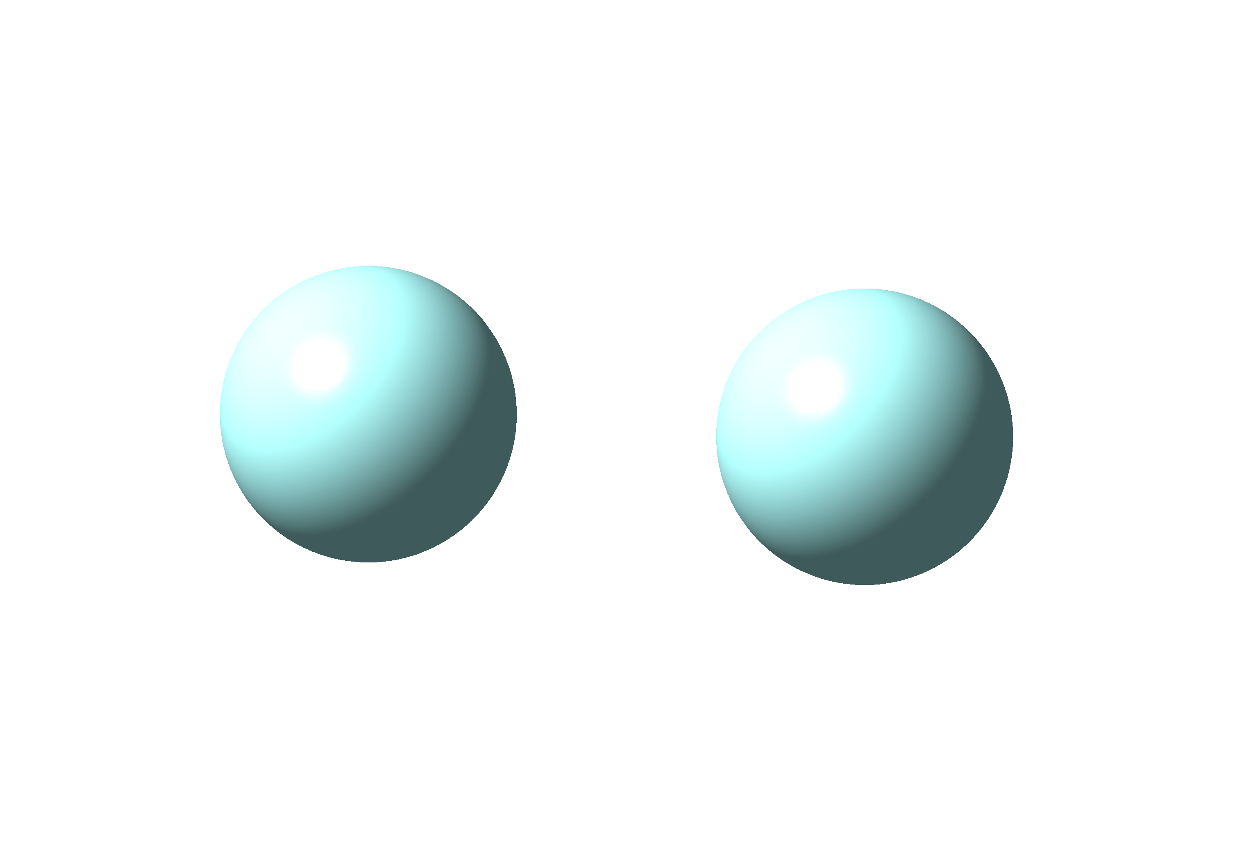
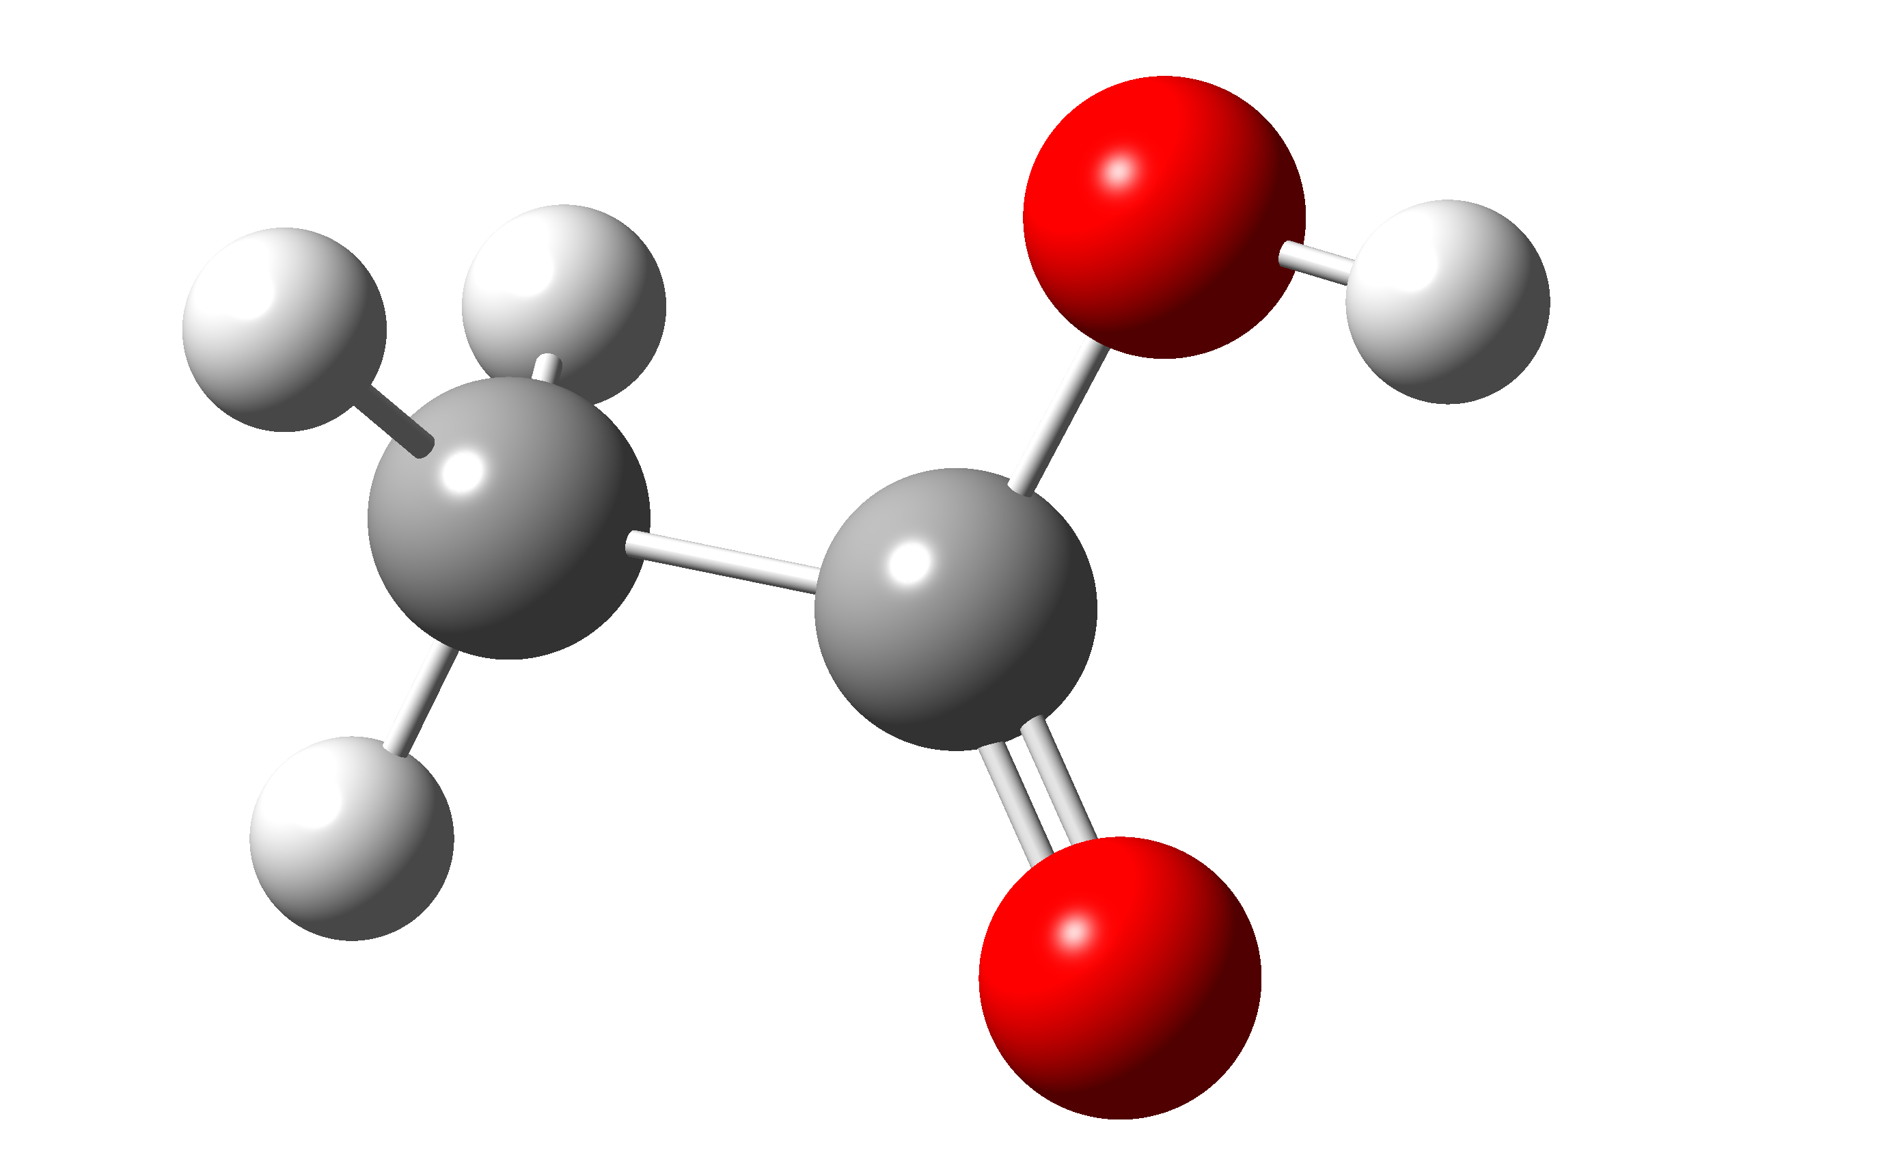
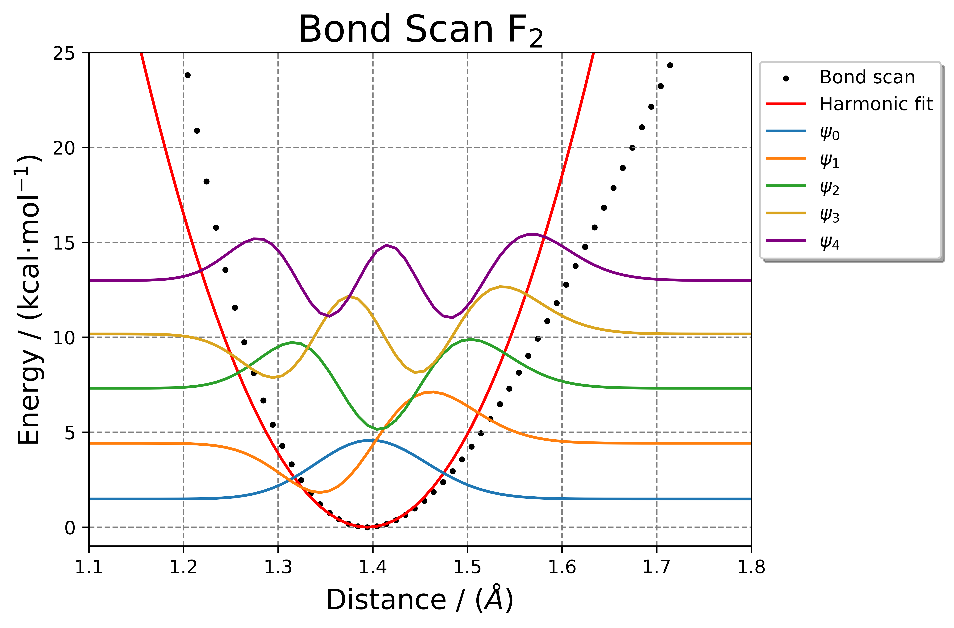
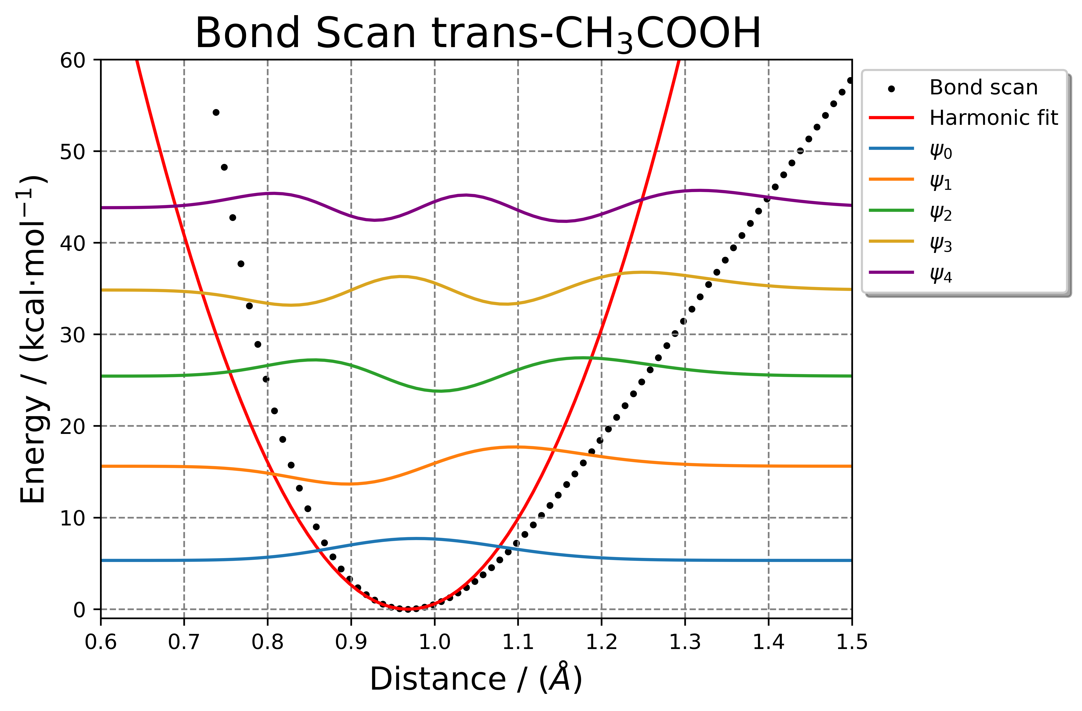
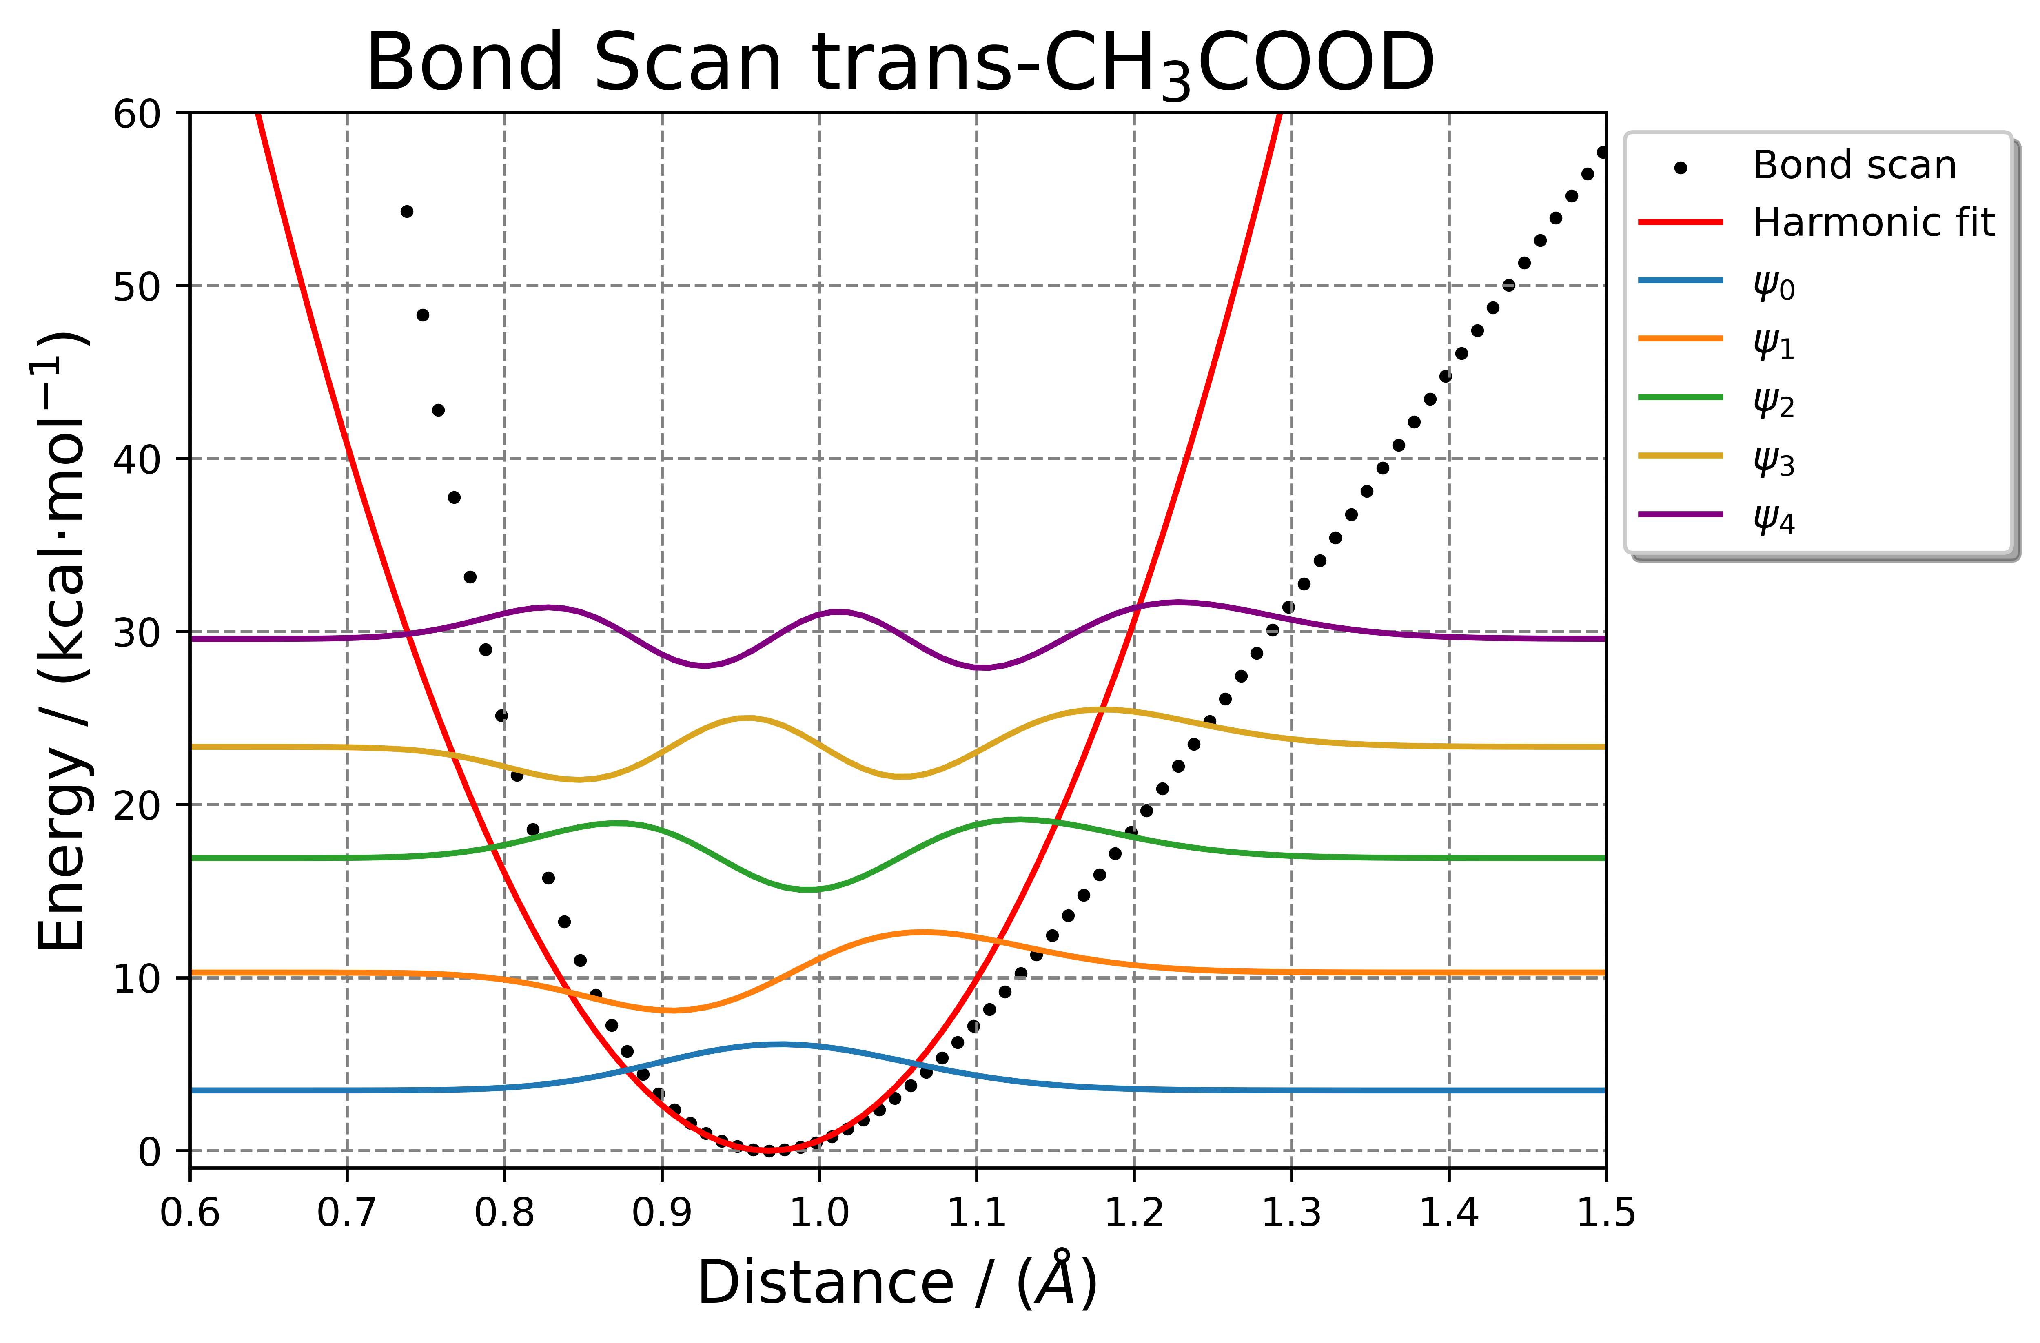

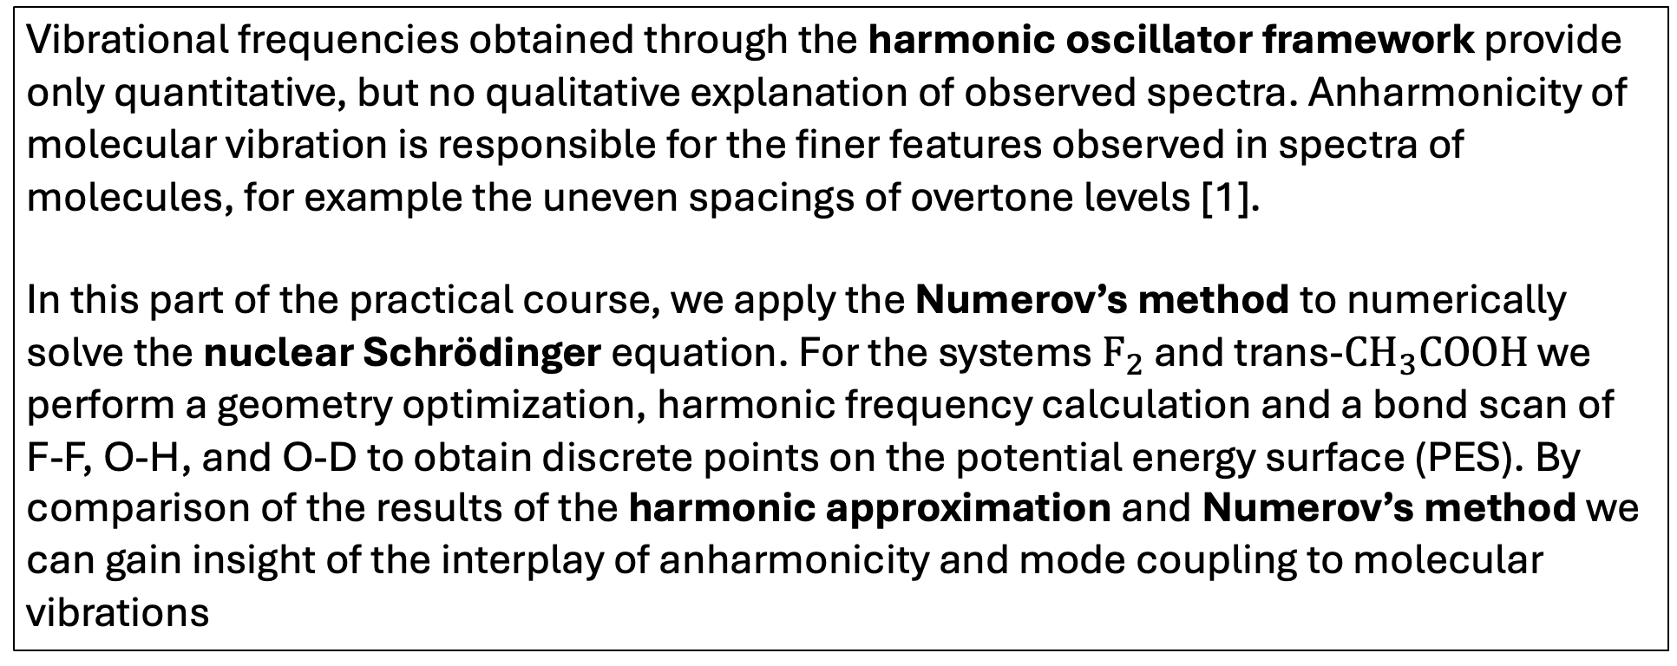
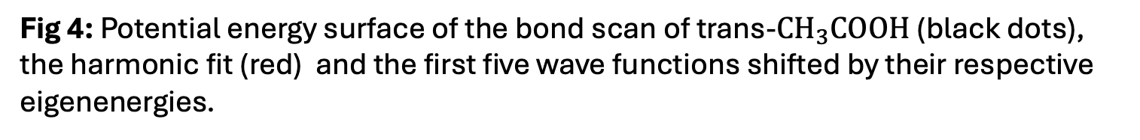

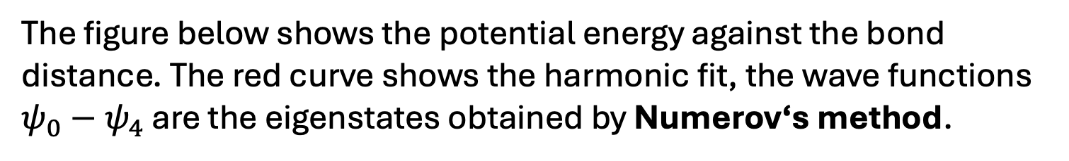

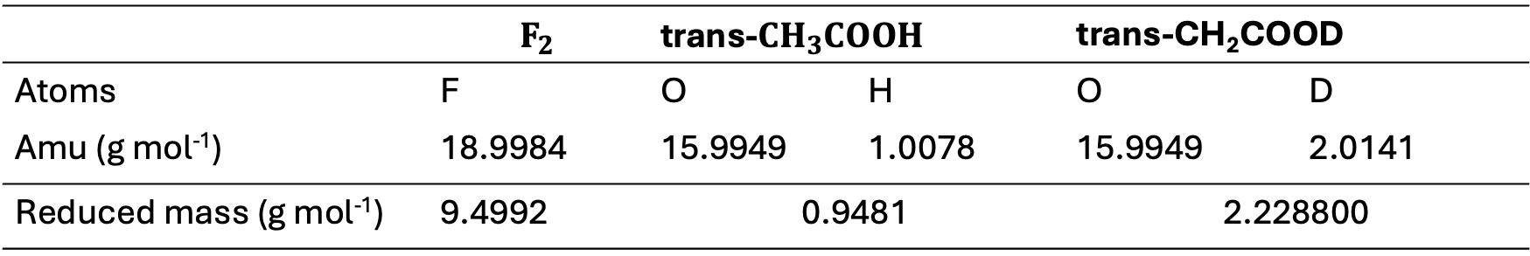
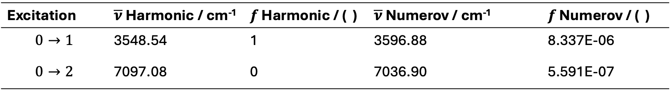
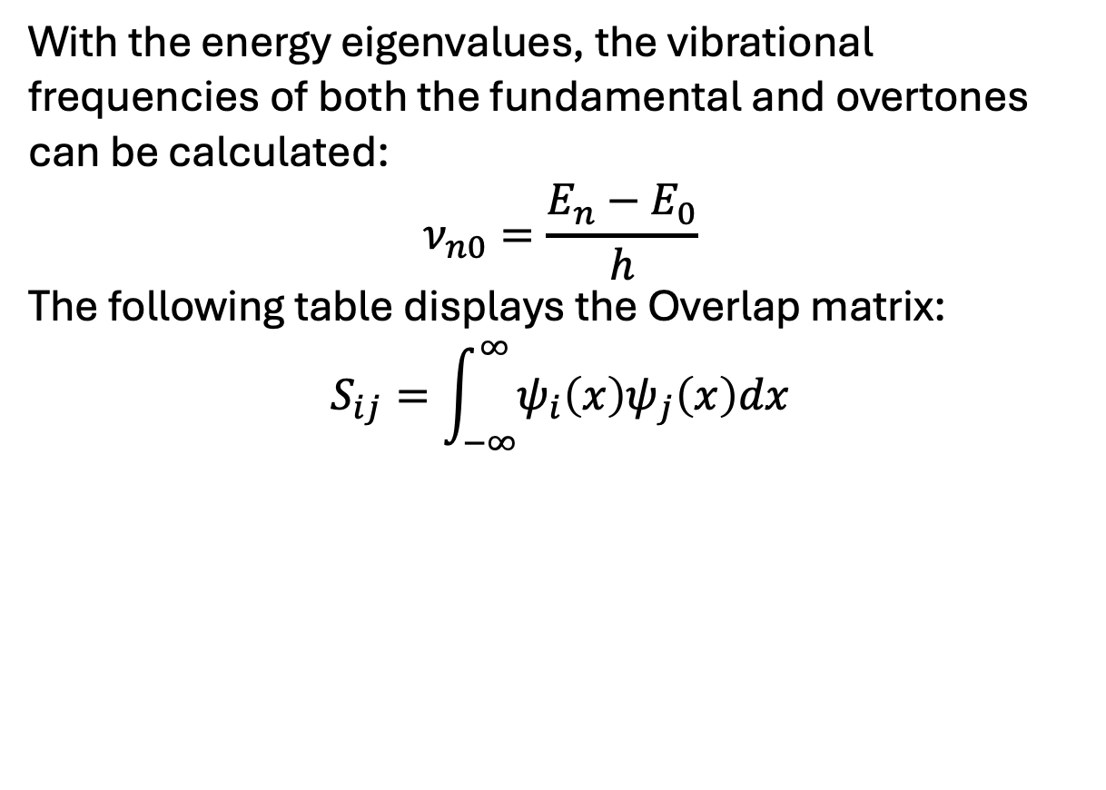
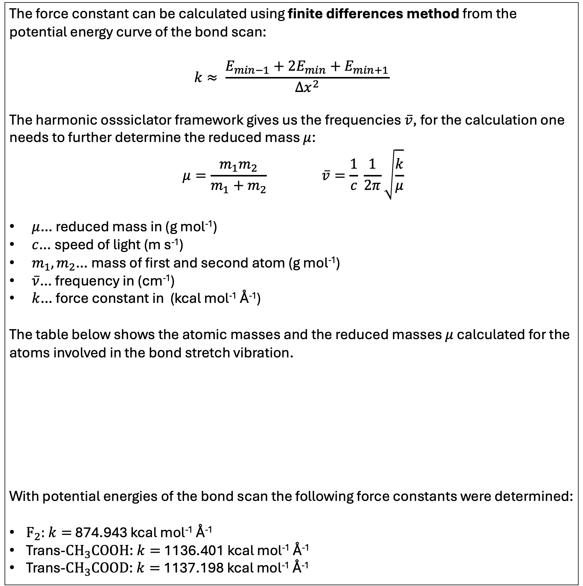
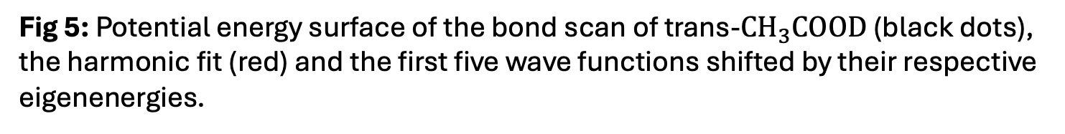

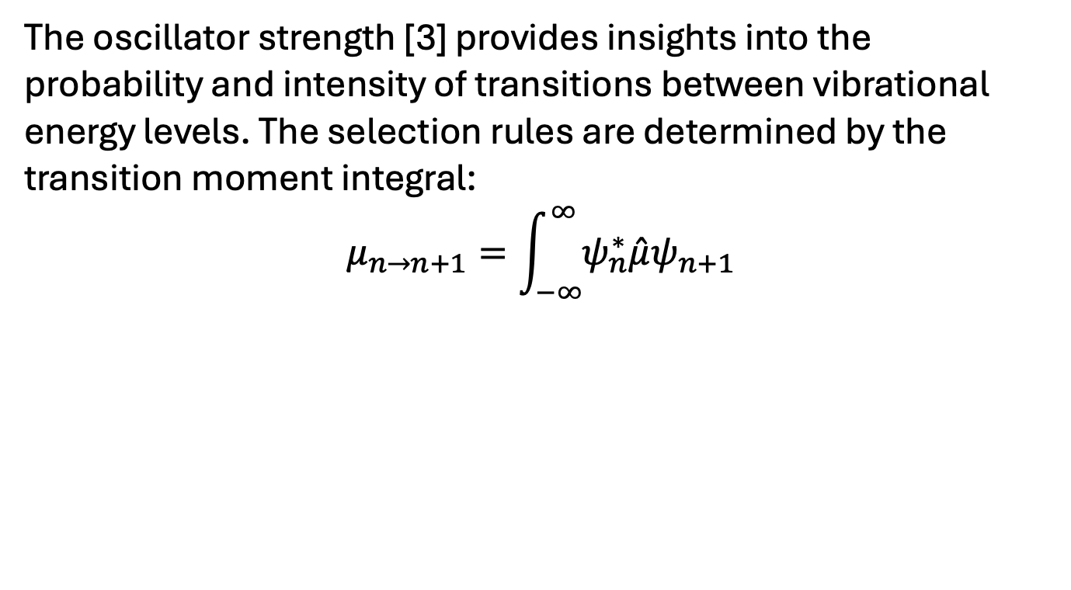

QM PART A: Vibrational spectroscopy using nuclear wave functions
Advanced Practical Course in Theoretical Chemistry
Lukas Meinschad (lukas.meinschad@student.uibk.ac.at), 12104730
Introduction
Numerov Procedure
Dipole Moment / Oscillator strenght
Vibrational frequencies obtained through the harmonic oscillator framework provide only quantitative, but no qualitative explanation of observed spectra. Anharmonicity of molecular vibration is responsible for the finer features observed in spectra of molecules, for example the uneven spacings of overtone levels [1].
In this part of the practical course, we apply the Numerov’s method to numerically solve the nuclear Schrödinger equation. For the systems $F_{2}$ and trans-$CH_{3}COOH$ we perform a geometry optimization, harmonic frequency calculation and a bond scan of F-F, O-H, and O-D to obtain discrete points on the potential energy surface (PES). By comparison of the results of the harmonic approximation and Numerov’s method we can gain insight of the interplay of anharmonicity and mode coupling to molecular vibrations
Numerov’s method is a numerical algorithm to solve differential equations. This method can be used to obtain the energy eigenvalues $E_{n}$ and the wave functions $ψ$:
$$\frac{∂^{2}Ψ }{∂x^{2}}= \frac{2m}{ℏ}\left(V−E\right)Ψ⇒\frac{∂^{2}Ψ }{∂x^{2}}≈\frac{Δg}{Δx}$$
In order for a vibration to be IR active the dipole moment must change. The plot on the left side displays the change in the dipole moment components $μ_{x},μ_{y},μ_{z}$. The component $μ_{y}$ is zero, this is a result of the orientation of the molecule in the coordinate system.
$μ_{total}$ shows an overall change in the dipole moment which is expected as the change in the bond length alters the distribution of electron density.
With the energy eigenvalues, the vibrational frequencies of both the fundamental and overtones can be calculated:
$$ν_{n0}=\frac{E_{n}−E_{0}}{h}$$
The following table displays the Overlap matrix:
$$S_{ij}=\int_{−∞}^{∞}{ψ_{i}\left(x\right)ψ_{j}\left(x\right)dx}$$
Fig 2: Python implementation for Numerov‘s method.
Fig 6: The total dipole moment as well the components along x,y,z plotted against the distance between O-H.
The oscillator strength [3] provides insights into the probability and intensity of transitions between vibrational energy levels. The selection rules are determined by the transition moment integral:
$$μ_{n→n+1}=\int_{−∞}^{∞}{ψ_{n}^{∗}\hat{μ}ψ_{n+1}}$$
Starting Structures / Calculation Parameters
Tab 2/3: Overlap Matrix for $ψ_{0}−ψ_{4}$, obtained by Numerov‘s method for trans-CH₃COOH (right) and trans-CH₃COOD (left).
 | $$ψ_{0}$$ | $$ψ_{1}$$ | $$ψ_{2}$$ | $$ψ_{3}$$ | $$ψ_{4}$$
$$ψ_{0}$$ | 1.0 | 3.15E-14 | 1.11E-14 | 2.24E-14 | -1.19E-14
$$ψ_{1}$$ | -3.17E-14 | 1.0 | -1.70E-14 | 9.93E-15 | -8.65E-16
$$ψ_{2}$$ | 2.25E-14 | 9.35E-15 | 1.0 | -3.29E-14 | 2.03E-14
$$ψ_{3}$$ | 2.25E-14 | 9.35E-15 | -3.29E-14 | 1.0 | -4.45E-14
$$ψ_{4}$$ | -1.88E-14 | -8.65E-15 | 2.03E-14 | -4.45E-14 | 1.0
 | $$ψ_{0}$$ | $$ψ_{1}$$ | $$ψ_{2}$$ | $$ψ_{3}$$ | $$ψ_{4}$$
$$ψ_{0}$$ | 1.0 | 3.69E-14 | 1.75E-14 | -2.28E-14 | 2.26E-14
$$ψ_{1}$$ | 3.59E-14 | 1.0 | -8.89E-15 | 2.43E-14 | 5.34E-15
$$ψ_{2}$$ | -2.89E-14 | 2.32E-14 | 1.0 | 3.19E-14 | 8.91E-15
$$ψ_{3}$$ | 1.745E-14 | -8.80E-15 | 3.29E-14 | 1.0 | 5.83E-15
$$ψ_{4}$$ | 2.26E-14 | 5.34E-15 | 8.91E-15 | 5.83E-15 | 1.0
The geometry optimization and frequency calculation of both structures were carried out with the B3LYP functional using the 6-311++G(3df,3pd) basis set and additional convergence criteria.
Tab 7: Comparison of the osscilator strength $f$ in the harmonic oscillator framework and the Numerov’ Method.
The harmonic osscilator allows only transitions with $Δn±1$, in reality, anharmonicity introduces non-zero oscillator strength also for higher transitions.
Excitation | $\overline{ν}$ Harmonic / cm⁻¹ | $f$ Harmonic / ( ) | $\overline{ν}$ Numerov / cm⁻¹ |  | $f$ Numerov / ( )
$$0→1$$ | 3548.54 | 1 | 3596.88 |  | 8.337E-06
$$0→2$$ | 7097.08 | 0 | 7036.90 |  | 5.591E-07
Fig 1: $F_{2}$ and $CH_{3}COOH$ optimized with B3LYP/6-311++G(3df,3pd).
Potential Energy Curves
Bond Scan along F-F
Determination of the effect of deuteration of trans-acetic-acid
Calculation of force constants and reduced masses
The figure below shows the potential energy against the bond distance. The red curve shows the harmonic fit, the wave functions $ψ_{0}−ψ_{4}$ are the eigenstates obtained by Numerov‘s method.
The figures below show the effect of deuteration to the bond scan between O-H and O-D. For trans-CH₃COOD the substitution was carried out in Gaussian using the iso keyword in the Z-matrix coordinates. One thing to note here is the anharmonicity of the PES. For more complicated chemical systems, effect like mode coupling become more dominant, making the harmonic approximation less precise.
The force constant can be calculated using finite differences method from the potential energy curve of the bond scan:
$$k≈ \frac{E_{min−1}+2E_{min}+E_{min+1}}{Δx^{2}}$$
The harmonic osssiclator framework gives us the frequencies $\overline{v}$, for the calculation one needs to further determine the reduced mass $μ$:
$$μ=\frac{m_{1}m_{2}}{m_{1}+m_{2}} \overline{v}=\frac{1}{c} \frac{1}{2π}\sqrt{\frac{k}{μ}}$$
$μ$… reduced mass in (g mol⁻¹)
$c$… speed of light (m s⁻¹)
$m_{1},m_{2}$… mass of first and second atom (g mol⁻¹)
$\overline{ν}$… frequency in (cm⁻¹)
$k$… force constant in (kcal mol⁻¹ Å⁻¹)
The table below shows the atomic masses and the reduced masses $μ$ calculated for the atoms involved in the bond stretch vibration.
With potential energies of the bond scan the following force constants were determined:
$F_{2}:$ $k=$ 874.943 kcal mol⁻¹ Å⁻¹
Trans-$CH_{3}COOH$: $k=$1136.401 kcal mol⁻¹ Å⁻¹
Trans-$CH_{3}COOD$: $k=$1137.198 kcal mol⁻¹ Å⁻¹
Fig 3: Potential energy surface of the bond scan of $F_{2}$(black dots), the harmonic fit (red) and the first five wave functions shifted by their respective eigenenergies.
Fig 4: Potential energy surface of the bond scan of trans-$CH_{3}COOH$ (black dots), the harmonic fit (red) and the first five wave functions shifted by their respective eigenenergies.
Fig 5: Potential energy surface of the bond scan of trans-$CH_{3}COOD$ (black dots), the harmonic fit (red) and the first five wave functions shifted by their respective eigenenergies.
Tab 4: Comparison of the frequencies obtained by Gaussian, the harmonic fit, and the Numervo’s method with literature calculations (CCSD/cc-pVXZ).
Tab 5: Comparison of the frequencies obtained by Gaussian, the harmonic fit, and the Numervo’s method with experimental data (FTIR) for trans-CH₃COOH.
Tab 6: Comparison of the frequencies obtained by Gaussian, the harmonic fit, and the Numervo’s method with experimental data (*FTIR, trans-CD₃COOD) for trans-CH₃COOD.
 | base (cm⁻¹) | 1st overtone (cm⁻¹) | 2nd overtone (cm⁻¹) | 3rd overtone (cm⁻¹)
Gaussian | 1042.04 | 2084.35 | 3126.53 | 4168.71
Harmonic | 1042.18 | 2084.35 | 3126.53 | 4168.71
Numerov | 1027.70 | 2041.15 | 3040.47 | 4025.77
Literature [2] | 1012.5 | -- | -- | --
 | base (cm⁻¹) | 1st overtone (cm⁻¹) | 2nd overtone (cm⁻¹) | 3rd overtone (cm⁻¹)
Gaussian | 3753.12 | 7506.24 | 11259.36 | 15012.48
Harmonic | 3548.54 | 7097.08 | 10645.61 | 14194.15
Numerov | 3596.88 | 7036.90 | 10325.04 | 13466.99
Literature [3] | 3581(8) | 6991(30) | 10246(32) | --
 | base (cm⁻¹) | 1st overtone (cm⁻¹) | 2nd overtone (cm⁻¹) | 3rd overtone (cm⁻¹)
Gaussian | 2729.98 | 5459.96 | 8189.95 | 10919.93
Harmonic | 2452.89 | 4905.78 | 7358.66 | 9811.55
Numerov | 2382.38 | 4696.81 | 6944.72 | 9127.60
Literature* [4] | 2630.4 | - | - | --
Tab 1: Atomic and reduced masses for the atoms used in the analysis
 | $$F_{2}$$ | trans-$CH_{3}COOH$ |  | trans-CH₂COOD
Atoms | F | O | H | O | D
Amu (g mol⁻¹) | 18.9984 | 15.9949 | 1.0078 | 15.9949 | 2.0141
Reduced mass (g mol⁻¹) | 9.4992 | 0.9481 |  | 2.228800
With 14.5 cm⁻¹ (1,43 %) Numerov‘s method has the smallest deviation compared to the literature. The PES along a bond stretch is best described by a Morse-Potential, Fig 3. clearly displays the deviation of the harmonic approximation. Here, anharmonic methods like VSFC, VCI or Numerov lead to more precise results.
Regarding the fundamental frequency, again the Numerov method with 15.88 cm⁻¹ (0,44 %) shows the smallest derivation to the literature data. In reality the overtones are not equally spaced due to anharmonicity of molecular vibration. Tab 5. shows clearly that Numerov‘s method shows the best fit to the literature data
Here with a deviation of 99.58 cm⁻¹ (3.79 %) the frequencies obtained from Gaussian perform the best in respect to the experimental data. The experimental data comes from a FTIR measurement in an Ar matrix at 8K. The smaller deviation of the harmonic Gaussian result could be an error cancellation of error compensation.
References:
[1] ANHARMONICITY OF VlBRATION IN MOLECULES, K. S. VISWANATHAN (1957), https://doi.org/10.1007/BF03052565
[2] Accuracy of spectroscopic constants of diatomic molecules from ab initio calculations (2003); Pawloski et al. https://doi.org/10.1063/1.1533032
[3] Integrated Intensities of O−H Stretching Bands: Fundamentals and Overtones in Vapor-Phase Alcohols and Acids (2001), Lange et.al; DOI: https://doi.org/10.1021/jp003277u
[4] Photochemistry and Vibrational Spectroscopy of the Trans and Cis Conformers of Acetic Acid in Solid Ar (2004), Macoas et al, doi: https://doi.org/10.1021/jp037840v

