Slide 1
Update
Finished writing thesis
Programming and Implementations finished
Open Tasks:
Writing How To Use on Github
Documentation for Python Script
Modification of the Output File
Further Testing …
New Argument Keyword → latex_tab
Updated Requirements.txt

Slide 2
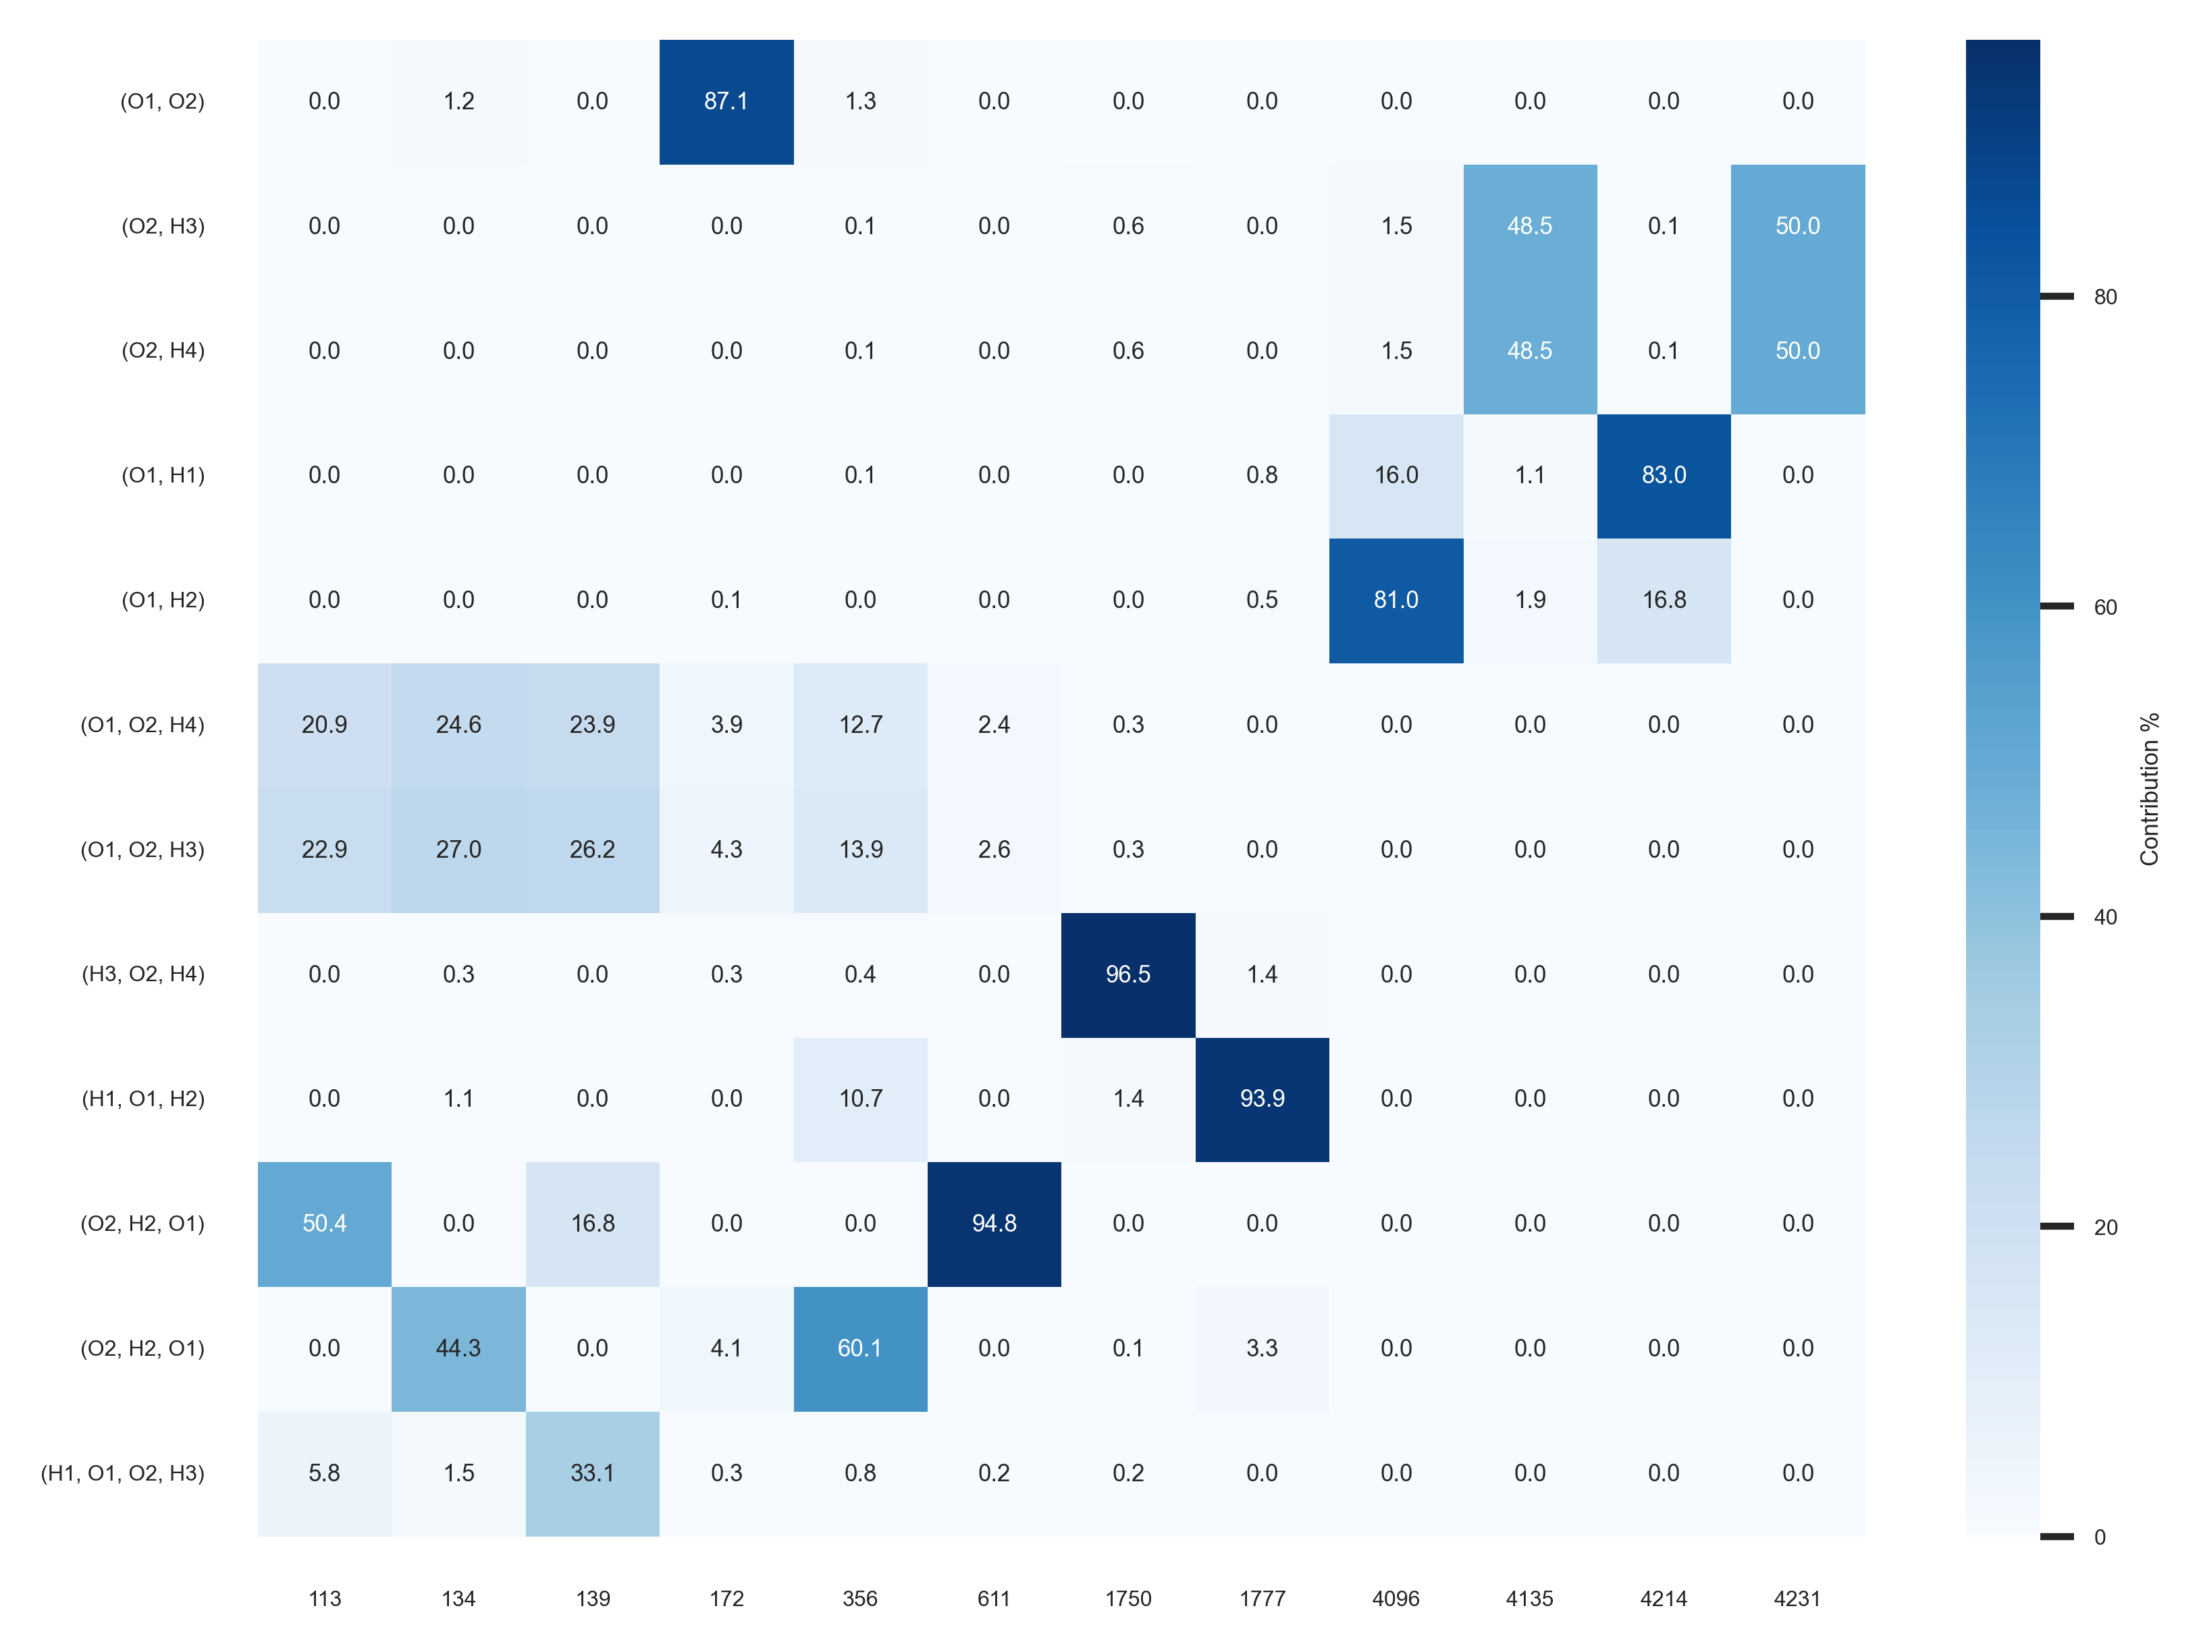
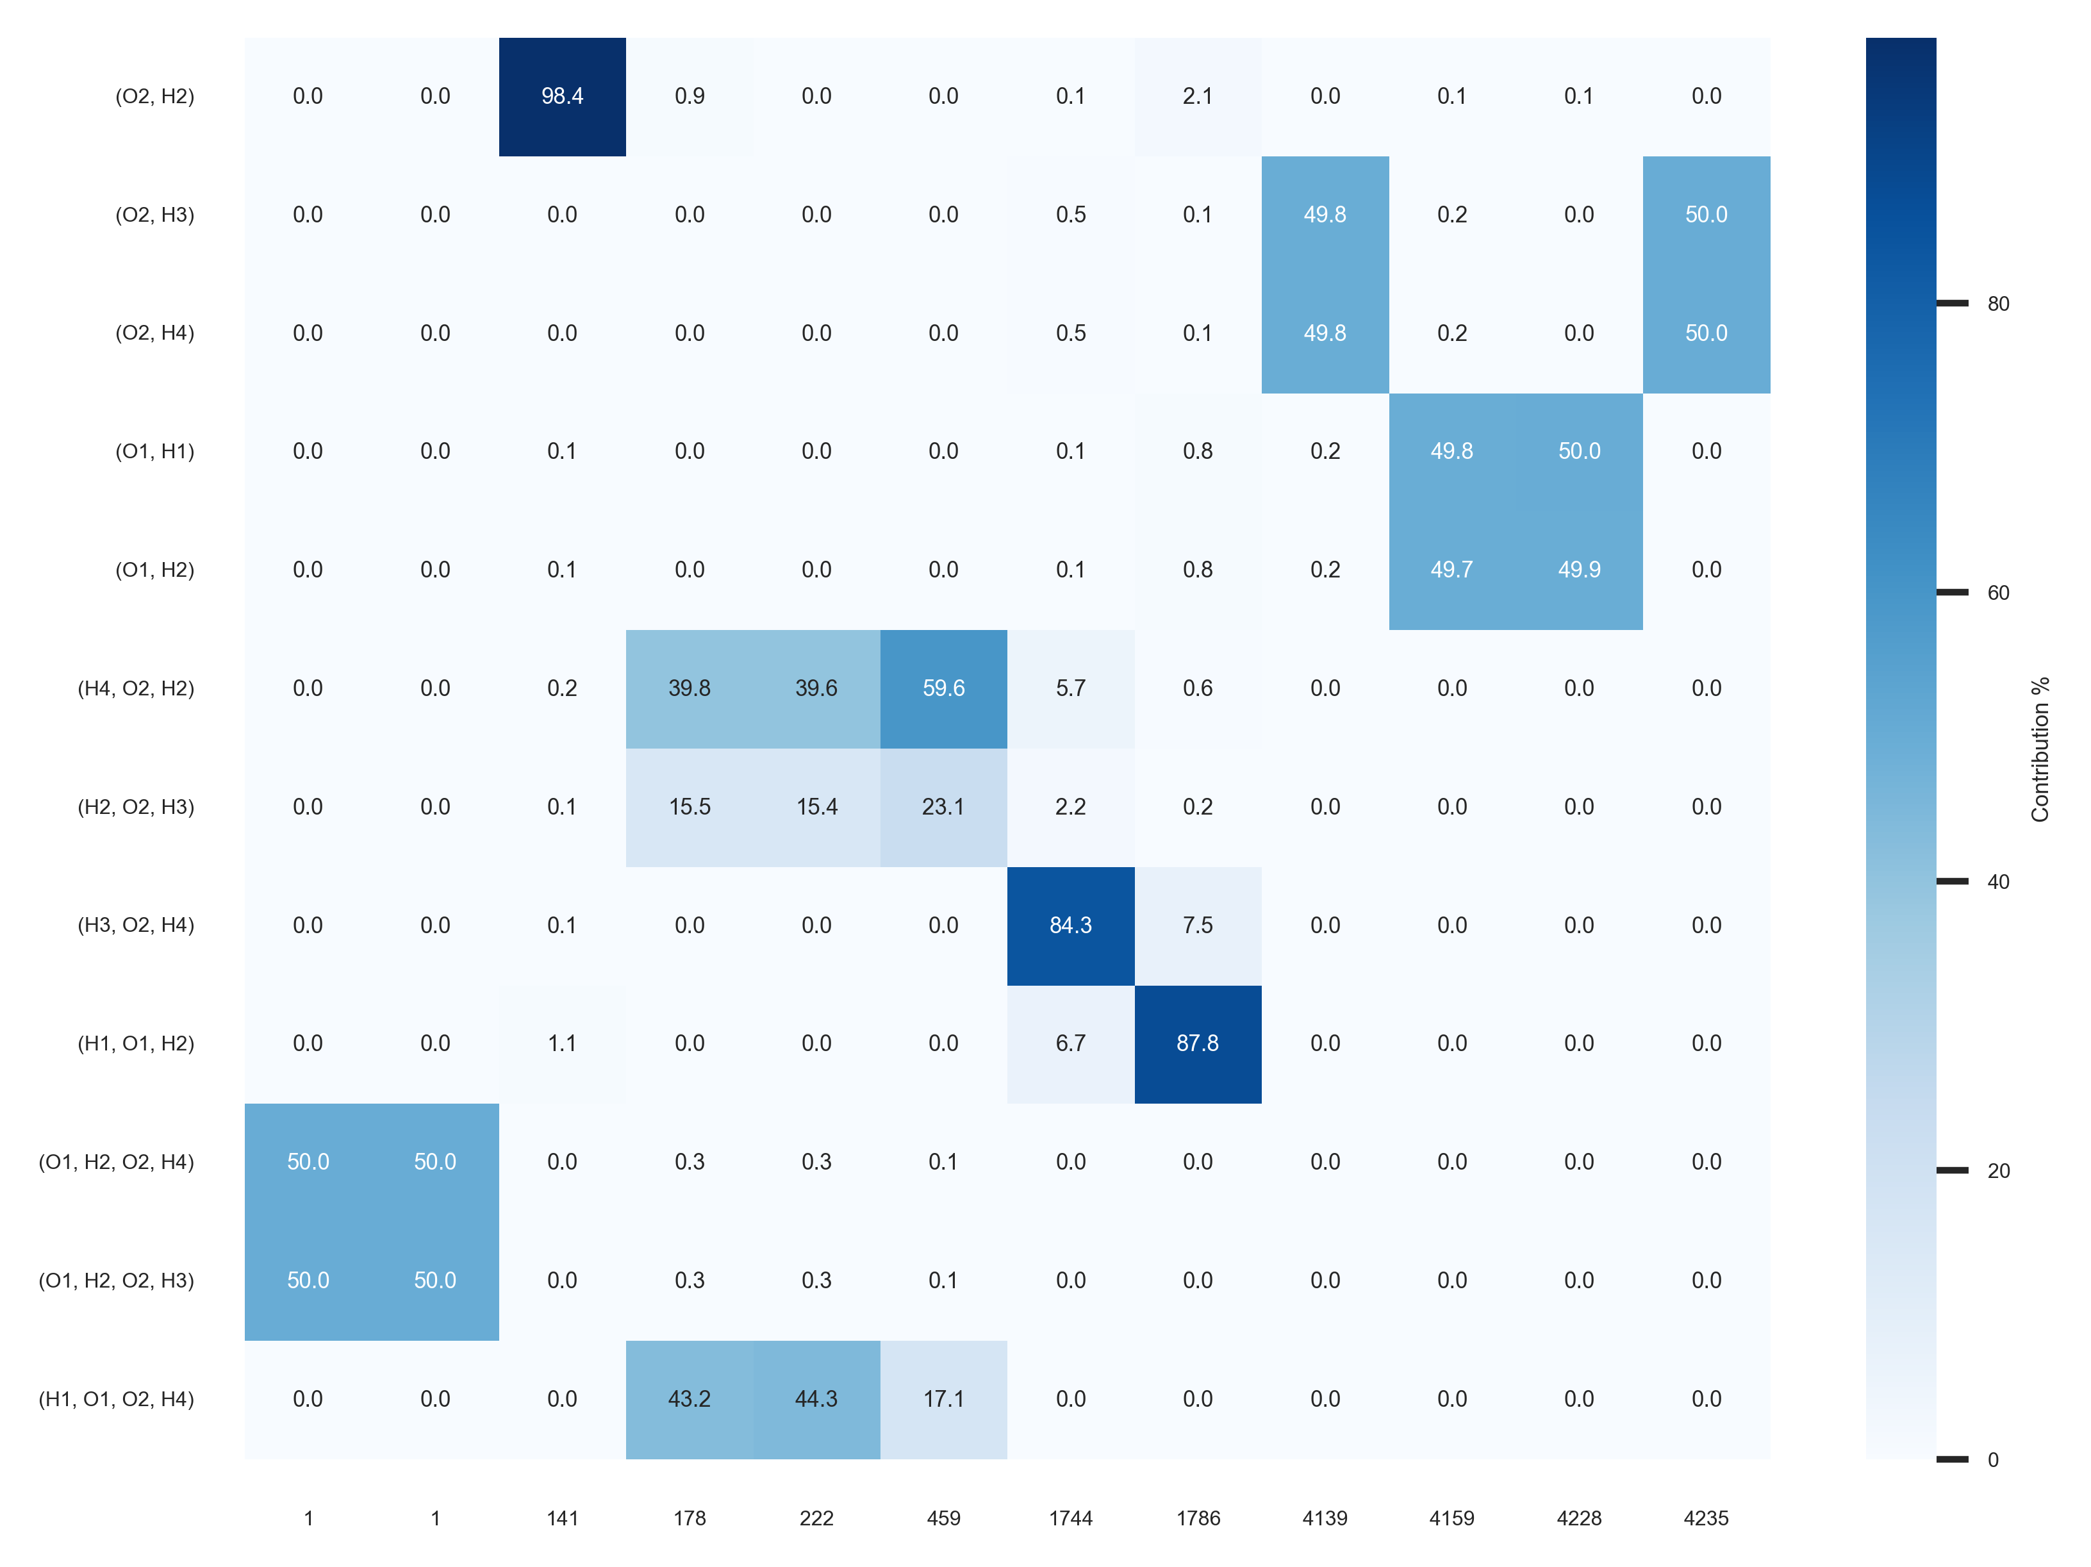
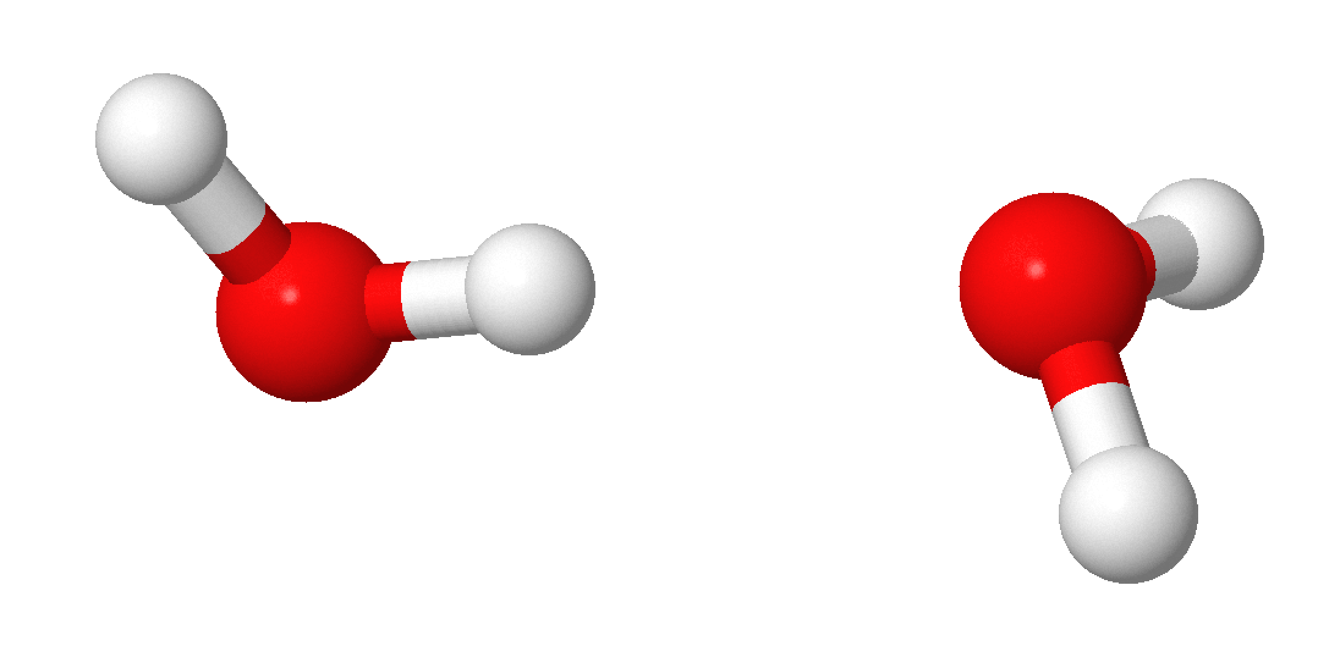
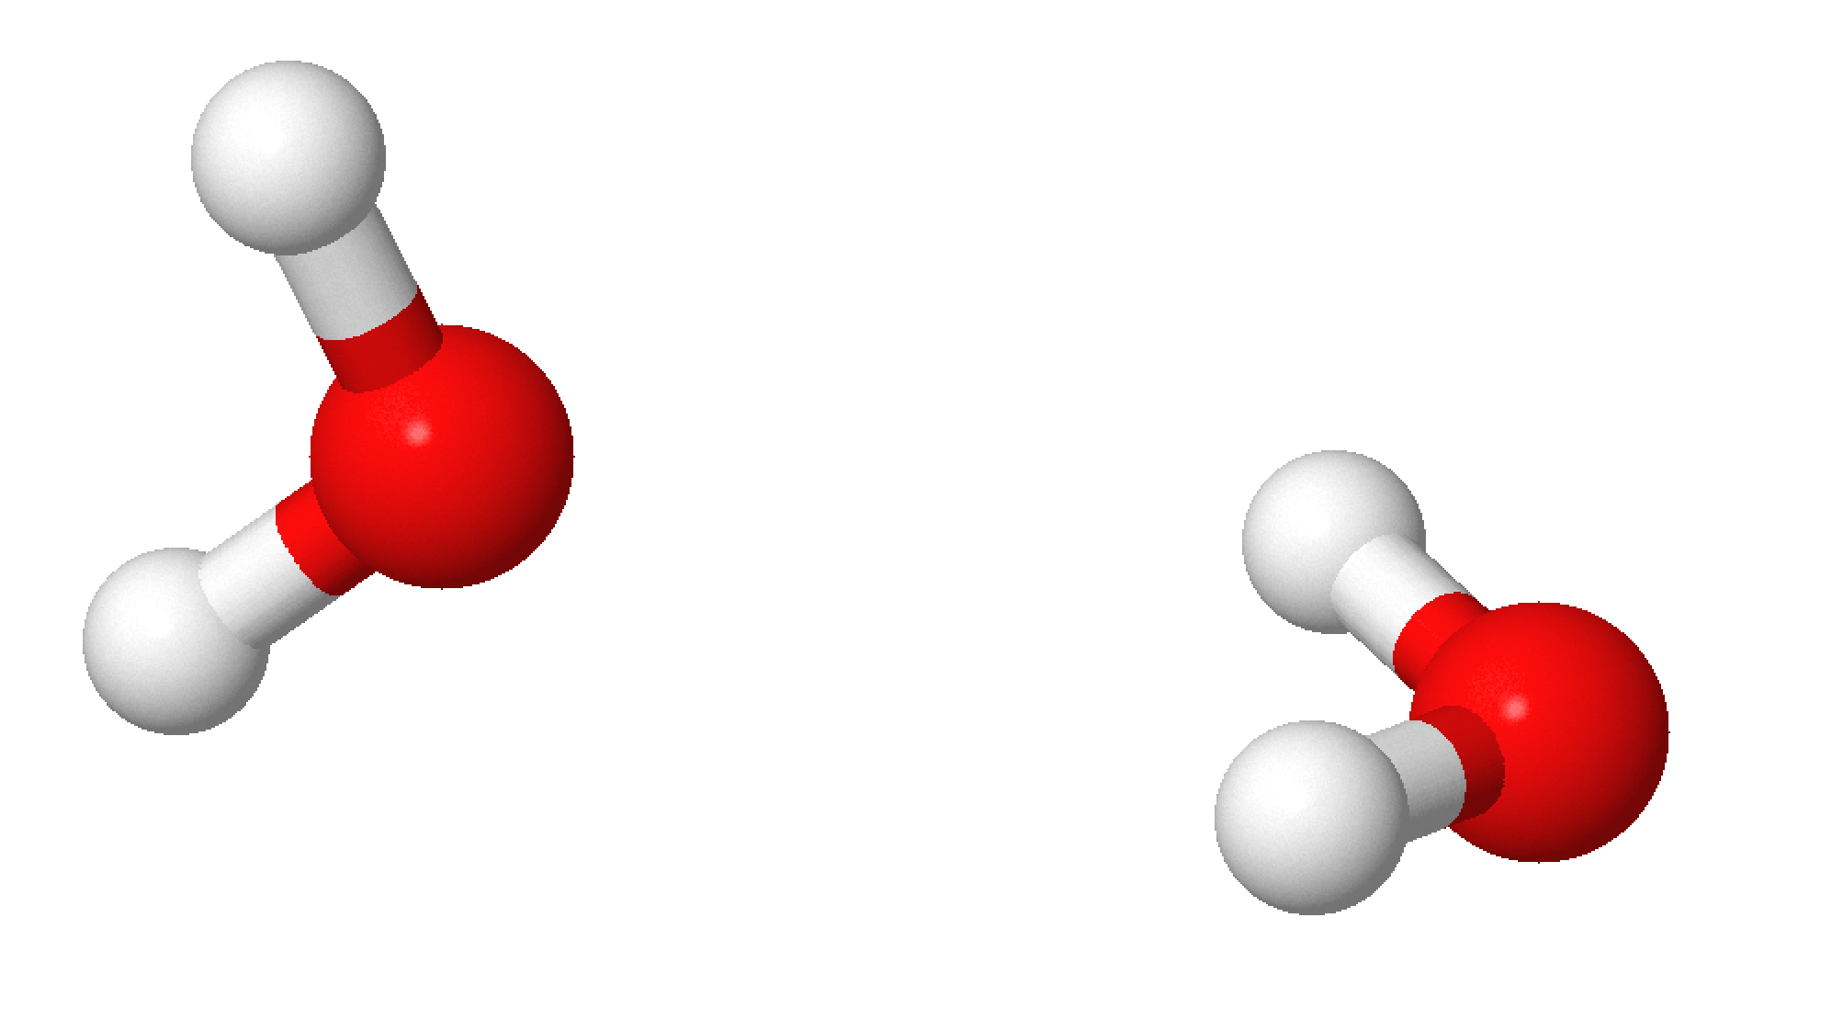
Configurations Water Dimer
non-planar C_{s}
non-planar C_{2V}
H1
H4
H2
O2
H4
O1
O2
H1
H3
H3
O1
H2

Slide 3
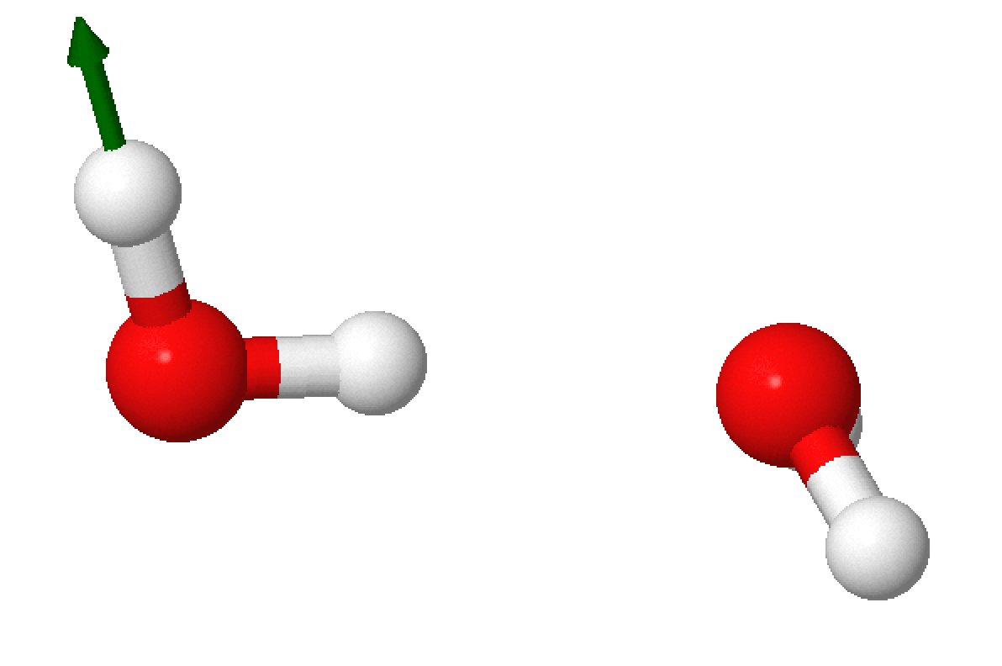
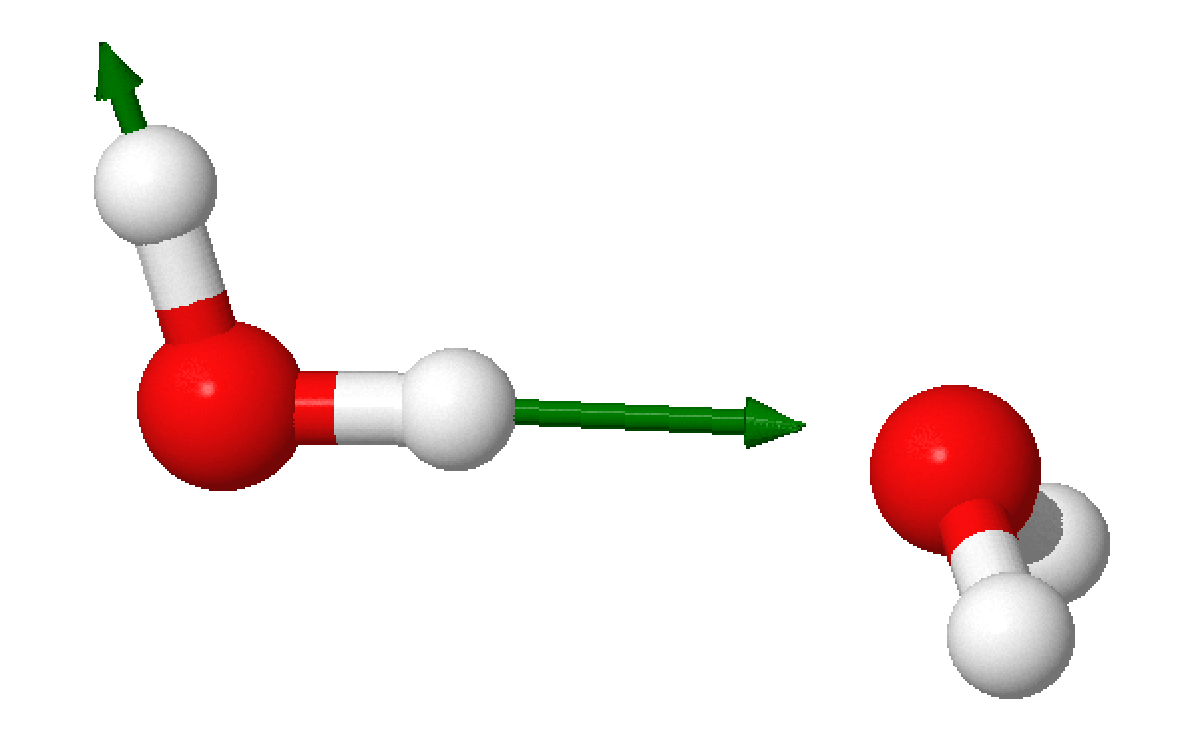


Configurations Water Dimer
H1
H2
O2
H4
O1
$ν_{as}$ 4212 cm⁻¹
H3
$v_{s}$ 4212 cm⁻¹
Contribution not 50/50 because of hydrogen bonding?

Slide 4
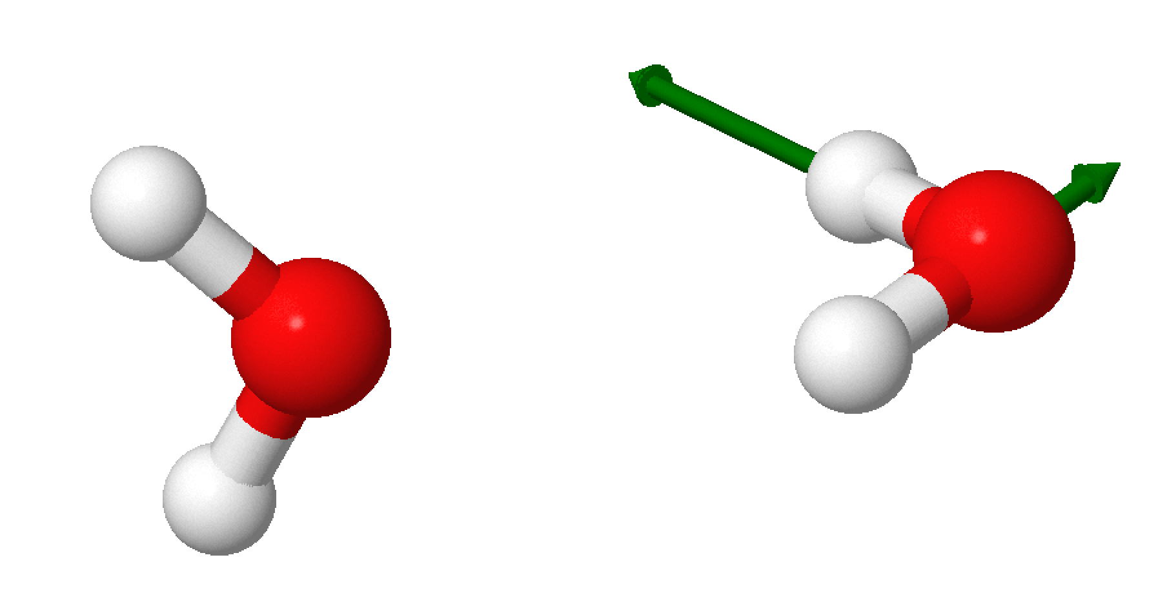
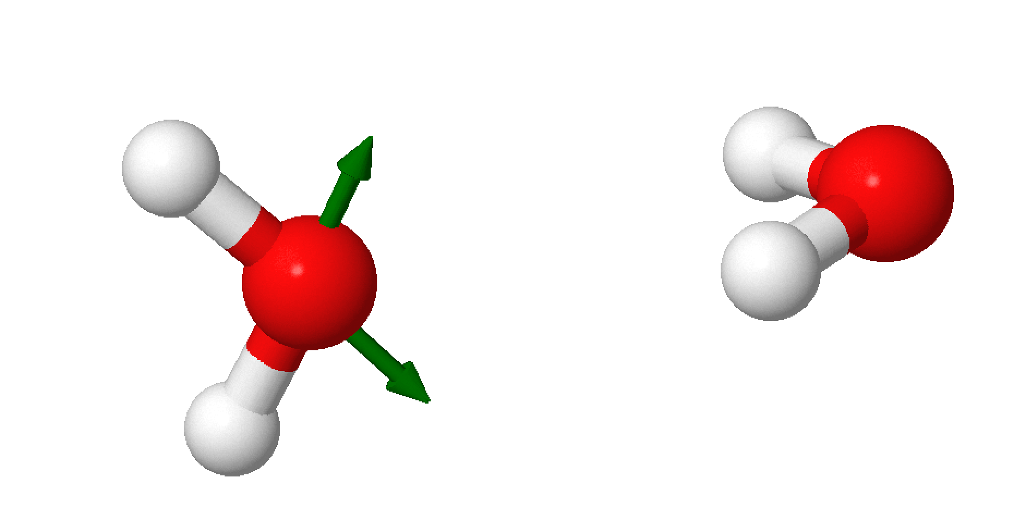


Configuration Water Dimer
H4
O2
H1
H3
O1
$ν_{as}$ 4228 cm⁻¹
H2
$ν_{s}$ 4139 cm⁻¹

Slide 5
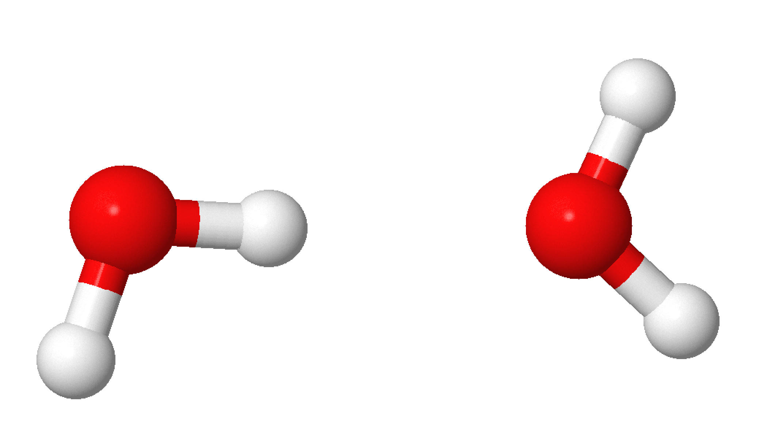
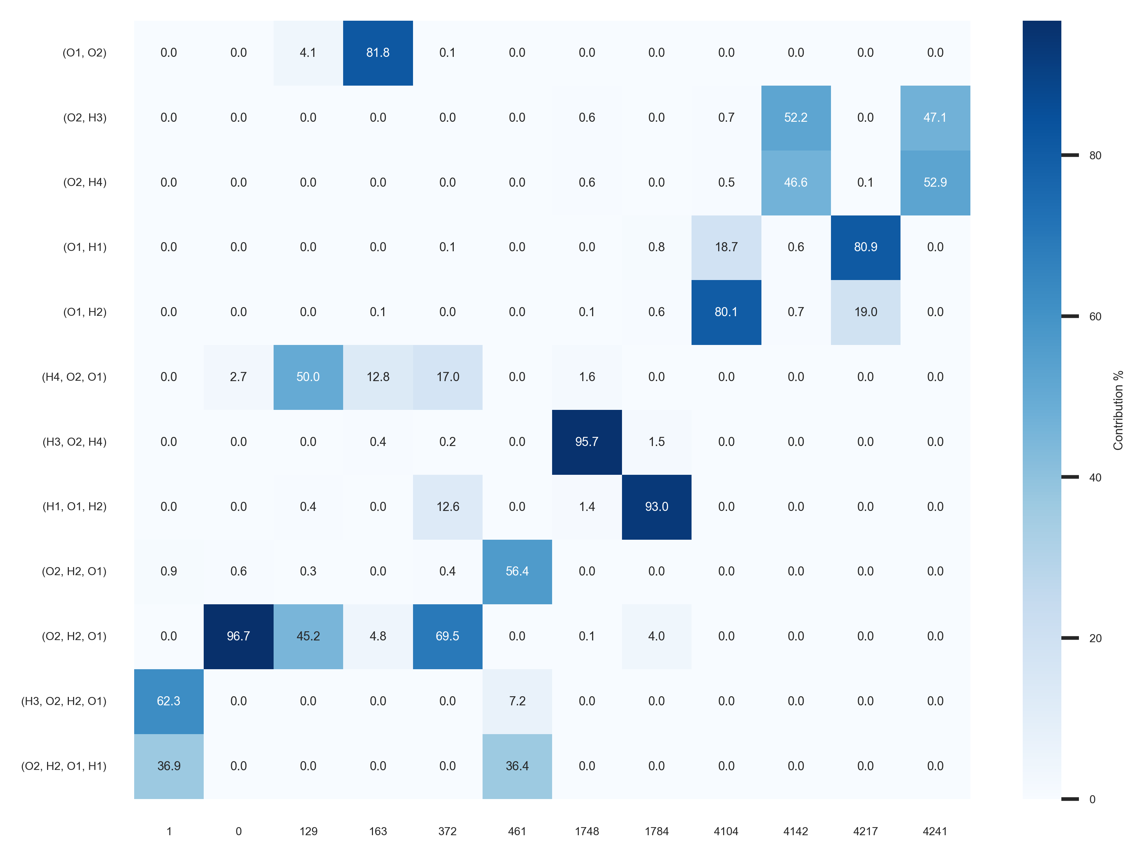
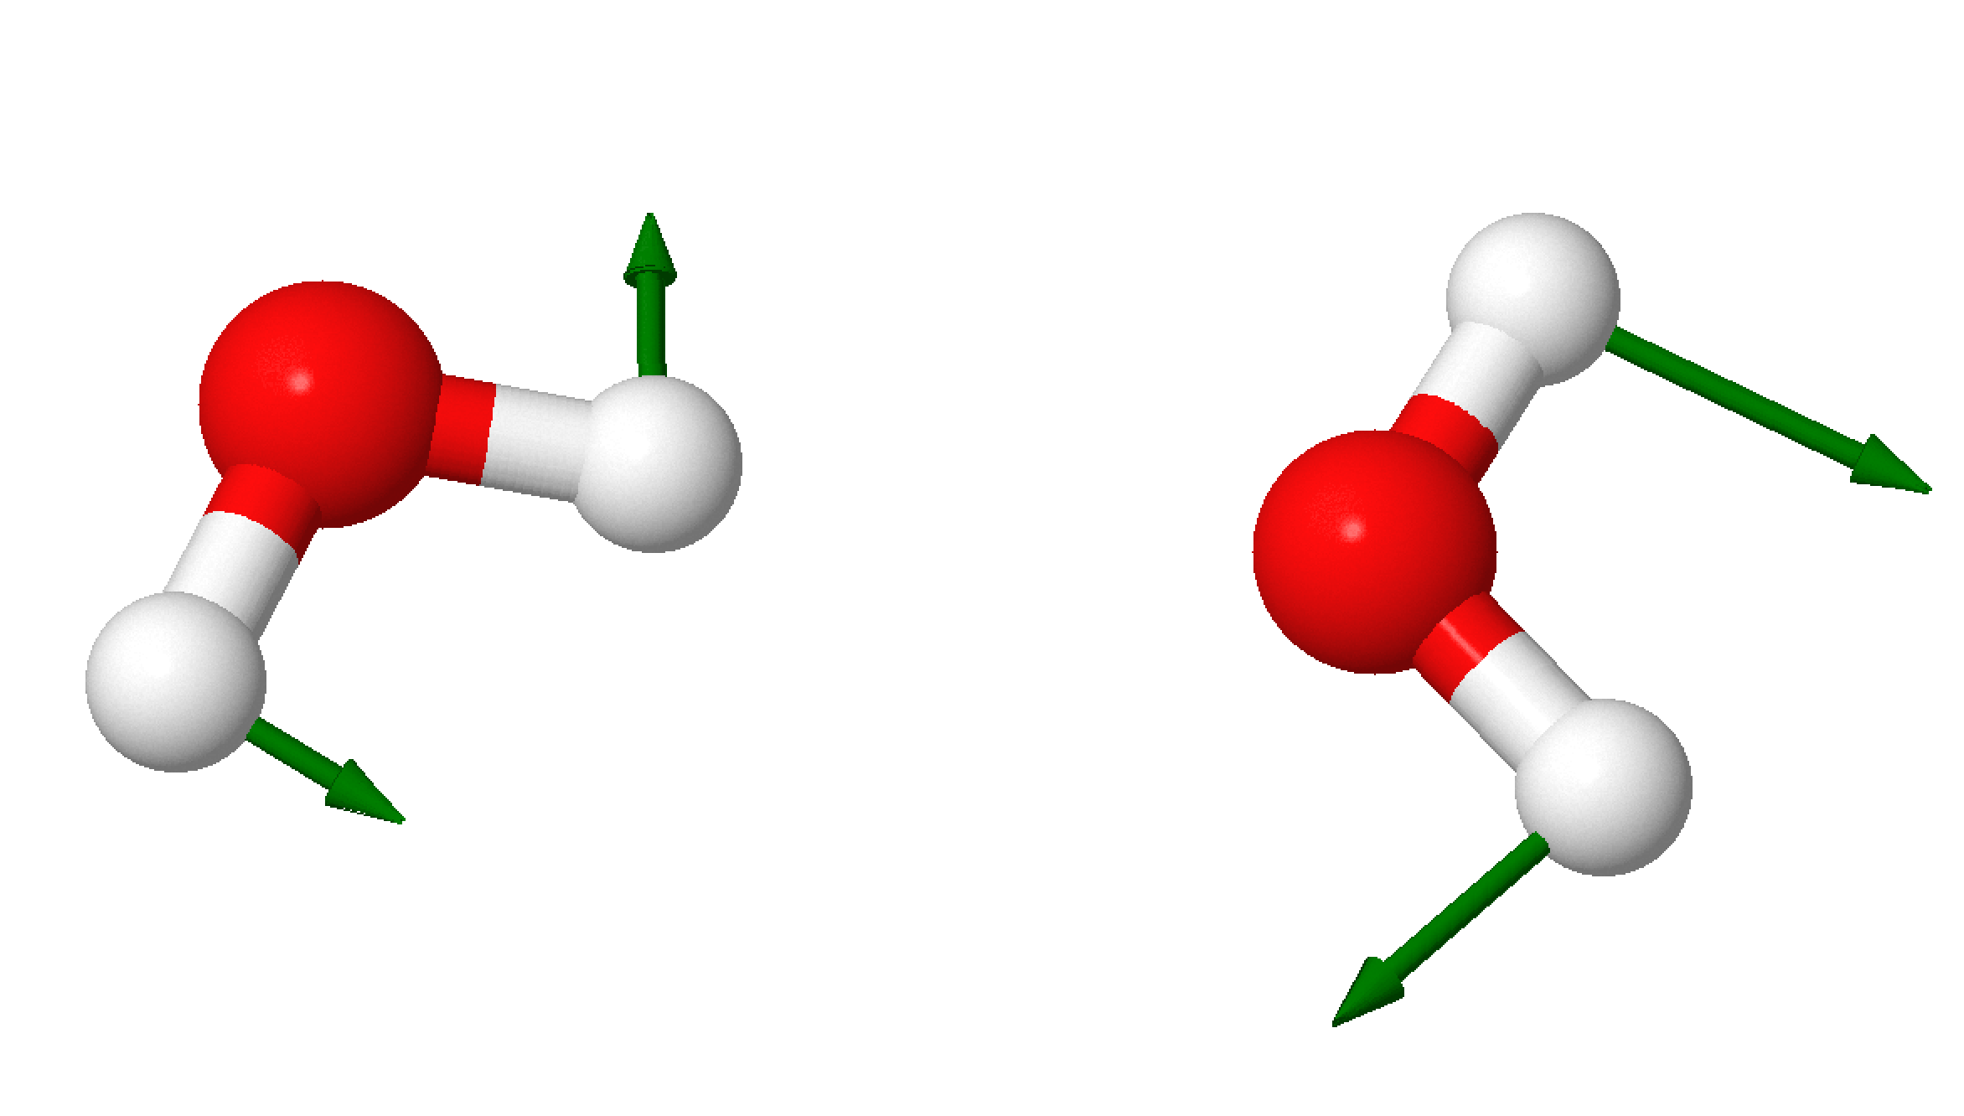
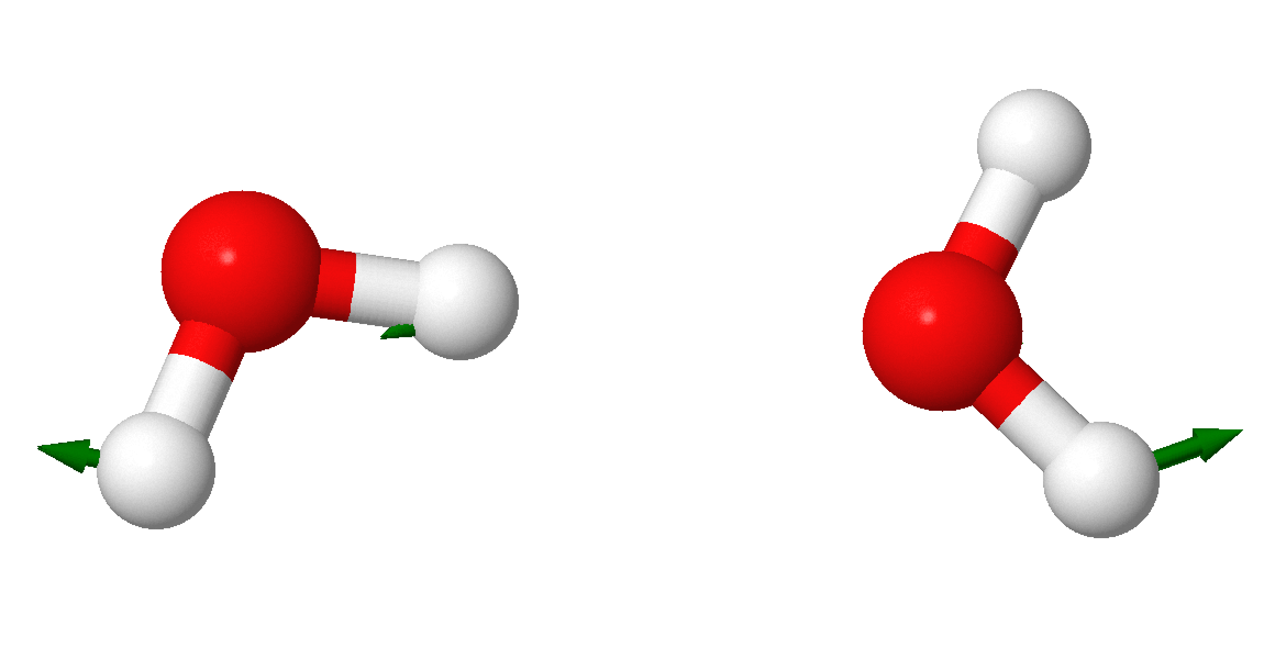


Other Configurations
H3
Planar C_{S}
O1
H2
O2
H4
H1
$ρ,ρ$ 129 cm⁻¹
$ν(M1,M2)$ 163 cm⁻¹

